Slide 1
CS162 Operating Systems and Systems Programming Lecture 6 Synchronization 1: Concurrency and Mutual Exclusion
February 4th, 2021
Profs. Natacha Crooks and Anthony D. Joseph
http://cs162.eecs.Berkeley.edu

Slide 2
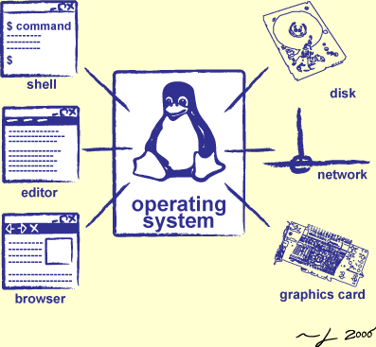
Goals for Today: Synchronization
How does an OS provide concurrency through threads?
Brief discussion of process/thread states and scheduling
High-level discussion of how stacks contribute to concurrency
Introduce needs for synchronization
Discussion of Locks and Semaphores

Slide 3
Recall: Inter-Process Communication (IPC)
Mechanism to create communication channel between distinct processes
Same or different machines, same or different programming language…
Requires serialization format understood by both
Failure in one process isolated from the other
Sharing is done in a controlled way through IPC
Still have to be careful handling what is received via IPC
Later in the term: Many uses and interaction patterns
Logging process, window management, …
Potentially allows us to move some system functions outside of kernel to userspace

Slide 4
Recall: POSIX/Unix PIPE
write(wfd, wbuf, wlen);
Memory Buffer is finite:
If producer (A) tries to write when buffer full, it blocks (Put sleep until space)
If consumer (B) tries to read when buffer empty, it blocks (Put to sleep until data)
int pipe(int fileds[2]);
Allocates two new file descriptors in the process
Writes to fileds[1] read from fileds[0]
Implemented as a fixed-size queue
Process A
UNIX Pipe
Process B
n = read(rfd, rbuf, rmax);

Slide 5
Recall: Socket Endpoint for Communication
Key Idea: Communication across the world looks like File I/O
Sockets: Bidirectional Endpoint for Communication
Queues to temporarily hold results
Queues are NOT Pipes!
Connection: Two Sockets Connected Over the network ⇒ IPC over network!
How to open()?
What is the namespace?
How are they connected in time?
write(wfd, wbuf, wlen);
Process
Socket
Socket
Process
n = read(rfd, rbuf, rmax);

Slide 6
Recall: Connection Setup over TCP/IP
5-Tuple identifies each connection:
Source IP Address
Destination IP Address
Source Port Number
Destination Port Number
Protocol (always TCP here)
Server
Socket
Request Connection
new
socket
socket
Connection
socket
connection
Client
Server
Often, Client Port “randomly” assigned
Done by OS during client socket setup
Server Port often “well known”
80 (web), 443 (secure web), 25 (sendmail), etc
Well-known ports from 0—1023

Slide 7
Recall: Server Protocol (v1)
// Create socket to listen for client connections
char *port_name;
struct addrinfo *server = setup_address(port_name);
int server_socket = socket(server->ai_family, server->ai_socktype, server->ai_protocol);
// Bind socket to specific port
bind(server_socket, server->ai_addr, server->ai_addrlen);
// Start listening for new client connections
listen(server_socket, MAX_QUEUE);
while (1) {
// Accept a new client connection, obtaining a new socket
int conn_socket = accept(server_socket, NULL, NULL);
serve_client(conn_socket);
close(conn_socket);
}
close(server_socket);

Slide 9
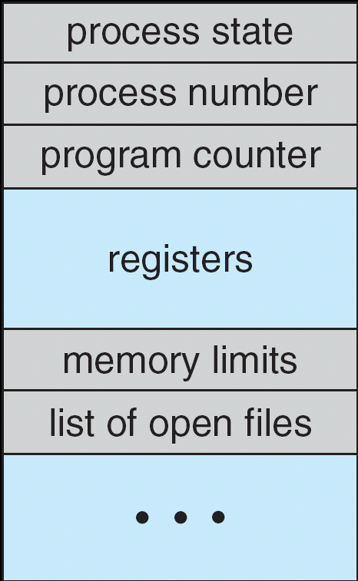
Multiplexing Processes: The Process Control Block
Kernel represents each process as a process control block (PCB)
Status (running, ready, blocked, …)
Register state (when not ready)
Process ID (PID), User, Executable, Priority, …
Execution time, …
Memory space, translation, …
Kernel Scheduler maintains a data structure containing the PCBs
Give out CPU to different processes
This is a Policy Decision
Give out non-CPU resources
Memory/IO
Another policy decision
Process Control Block

Slide 10
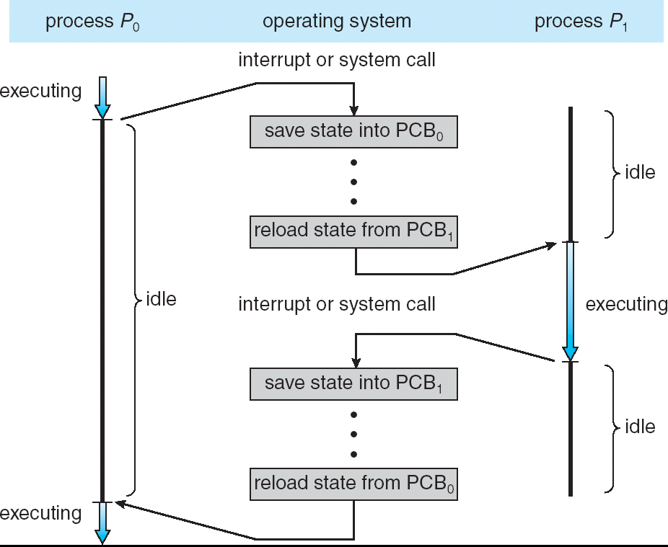
Context Switch
Privilege Level: 3 - user
Privilege Level: 0 - sys
Privilege Level: 3 - user

Slide 11
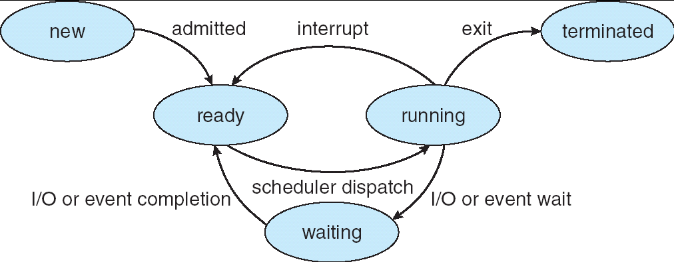
Lifecycle of a Process or Thread
As a process executes, it changes state:
new: The process/thread is being created
ready: The process is waiting to run
running: Instructions are being executed
waiting: Process waiting for some event to occur
terminated: The process has finished execution

Slide 12
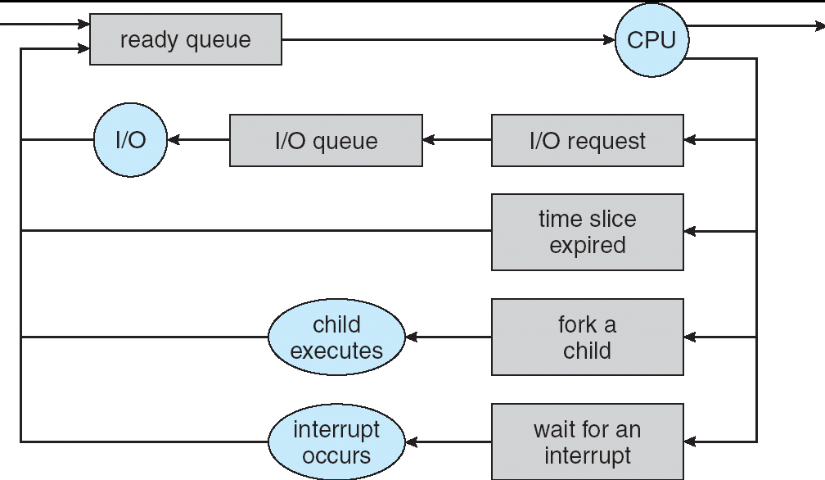
Scheduling: All About Queues
PCBs move from queue to queue
Scheduling: which order to remove from queue
Much more on this soon

Slide 13
Ready Queue And Various I/O Device Queues
Process not running ⇒ PCB is in some scheduler queue
Separate queue for each device/signal/condition
Each queue can have a different scheduler policy
Ready
Queue
Head
Other
State
PCB₉
Link
Other
State
PCB₆
Link
Other
State
PCB₁₆
Link
Tail
Registers
Registers
Registers
USB
Unit 0
Head
Tail
Disk
Unit 0
Head
Other
State
PCB₂
Link
Other
State
PCB₃
Link
Tail
Registers
Registers
Disk
Unit 2
Head
Tail
Other
State
PCB₈
Ether
Netwk 0
Link
Head
Tail
Registers

Slide 14
Scheduler
if ( readyProcesses(PCBs) ) {
nextPCB = selectProcess(PCBs);
run( nextPCB );
} else {
run_idle_process();
}
Scheduling: Mechanism for deciding which processes/threads receive the CPU
Lots of different scheduling policies provide …
Fairness or
Real-time guarantees or
Latency optimization or ..

Slide 15
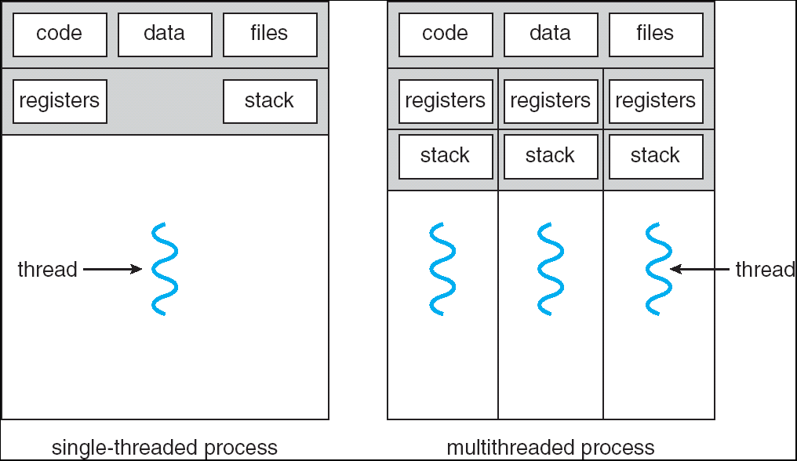
Recall: Single and Multithreaded Processes
Threads encapsulate concurrency: “Active” component
Address spaces encapsulate protection: “Passive” part
Keeps buggy program from trashing the system
Why have multiple threads per address space?
Notes:
Sometimes need parallelism for a single job, and processes are very expensive – to start, switch between, and to communicate between

Slide 16
Recall: Shared vs. Per-Thread State

Slide 17
The Core of Concurrency: the Dispatch Loop
Conceptually, the scheduling loop of the operating system looks as follows:
Loop {
RunThread();
ChooseNextThread();
SaveStateOfCPU(curTCB);
LoadStateOfCPU(newTCB);
}
This is an infinite loop
One could argue that this is all that the OS does
Should we ever exit this loop???
When would that be?
Notes:
Emergency crash of operating system called “panic()”

Slide 19
Administrivia
Homework 1 due Wed 2/10
Project 1 in full swing! (Design doc due Tue 2/9)
We expect that your design document will give intuitions behind your designs, not just a dump of pseudo-code
Think of this you are in a company and your TA is you manager
Paradox: need code for design document?
Not full code, just enough prove you have thought through complexities of design
Should be attending your permanent discussion section!
Remember to turn on your camera in Zoom
Discussion section attendance is mandatory
Midterm 1: Thu February 18th, 5-6:30PM (Two weeks from today!)
Video Proctored, Use of computer to answer questions
More details as we get closer to exam

Slide 21
The Core of Concurrency: the Dispatch Loop
Conceptually, the scheduling loop of the operating system looks as follows:
Loop {
RunThread();
ChooseNextThread();
SaveStateOfCPU(curTCB);
LoadStateOfCPU(newTCB);
}
This is an infinite loop
One could argue that this is all that the OS does
Should we ever exit this loop???
When would that be?
Notes:
Emergency crash of operating system called “panic()”

Slide 22
Running a Thread
Consider first portion: RunThread()
How do I run a thread?
Load its state (registers, PC, stack pointer) into CPU
Load environment (virtual memory space, etc)
Jump to the PC
How does the dispatcher get control back?
Internal events: thread returns control voluntarily
External events: thread gets preempted
Notes:
OS’s have almost human characteristics – unpredictable, hard to understand, …
Different things share the same CPU – one thread, then another
Similar to schizophrenia, like the movie Sybil, one body shared by several people, say we start with Dave Patterson
Threads are like the personalities of the CPU. First one thread/personality uses the CPU, then another,…

Slide 23
Internal Events
Blocking on I/O
The act of requesting I/O implicitly yields the CPU
Waiting on a “signal” from other thread
Thread asks to wait and thus yields the CPU
Thread executes a yield()
Thread volunteers to give up CPU
computePI() {
while(TRUE) {
ComputeNextDigit();
yield();
}
}
Notes:
Yield is for really nice people – Ever see two people at the supermarket checkout line? You first, no you first, …

Slide 24
Recall: POSIX API for Threads: pthreads
int pthread_create(pthread_t *thread, const pthread_attr_t *attr, void *(*start_routine)(void*), void *arg);
thread is created executing start_routine with arg as its sole argument.
return is implicit call to pthread_exit
void pthread_exit(void *value_ptr);
terminates the thread and makes value_ptr available to any successful join
int pthread_join(pthread_t thread, void **value_ptr);
suspends execution of the calling thread until the target thread terminates.
On return with a non-NULL value_ptr the value passed to pthread_exit() by the terminating thread is made available in the location referenced by value_ptr.
void pthread_yield(void); void sched_yield(void);
Current thread yields (gives up) CPU so that another thread can run

Slide 25
Stack for Yielding Thread
ComputePI
yield
Trap to OS
kernel_yield
Stack growth
run_new_thread
switch
How do we run a new thread?
run_new_thread() {
newThread = PickNewThread();
switch(curThread, newThread);
ThreadHouseKeeping(); /* Do any cleanup */
}
How does dispatcher switch to a new thread?
Save anything next thread may trash: PC, regs, stack pointer
Maintain isolation for each thread

Slide 26
What Do the Stacks Look Like?
Consider the following code blocks:
proc A() {
B();
}
proc B() {
while(TRUE) {
yield();
}
}
Suppose we have 2 threads:
Threads S and T
Thread S
Thread T
A
A
B(while)
B(while)
Stack growth
yield
yield
run_new_thread
run_new_thread
switch
switch
Thread S's switch returns to Thread T's (and vice versa)

Slide 27
Saving/Restoring State (Often Called “Context Switch)
Switch(tCur,tNew) {
/* Unload old thread */
TCB[tCur].regs.r7 = CPU.r7;
…
TCB[tCur].regs.r0 = CPU.r0;
TCB[tCur].regs.sp = CPU.sp;
TCB[tCur].regs.retpc = CPU.retpc; /*return addr*/
/* Load and execute new thread */
CPU.r7 = TCB[tNew].regs.r7;
…
CPU.r0 = TCB[tNew].regs.r0;
CPU.sp = TCB[tNew].regs.sp;
CPU.retpc = TCB[tNew].regs.retpc;
return; /* Return to CPU.retpc */
}

Slide 28
Switch Details (continued)
What if you make a mistake in implementing switch?
Suppose you forget to save/restore register 32
Get intermittent failures depending on when context switch occurred and whether new thread uses register 32
System will give wrong result without warning
Can you devise an exhaustive test to test switch code?
No! Too many combinations and inter-leavings
Cautionary tale:
For speed, Topaz kernel saved one instruction in switch()
Carefully documented! Only works as long as kernel size < 1MB
What happened?
Time passed, People forgot
Later, they added features to kernel (no one removes features!)
Very weird behavior started happening
Moral of story: Design for simplicity

Slide 29
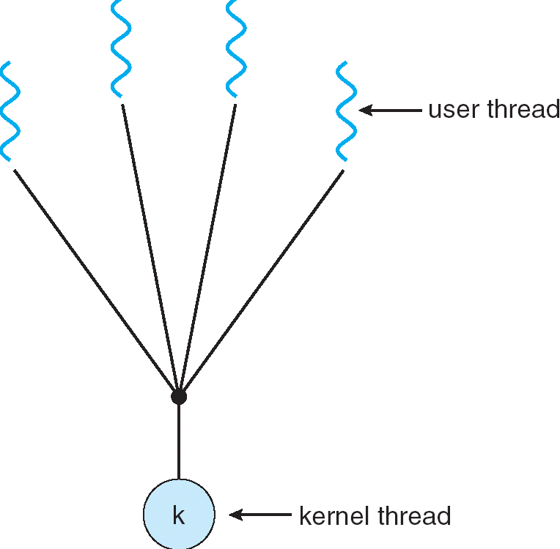
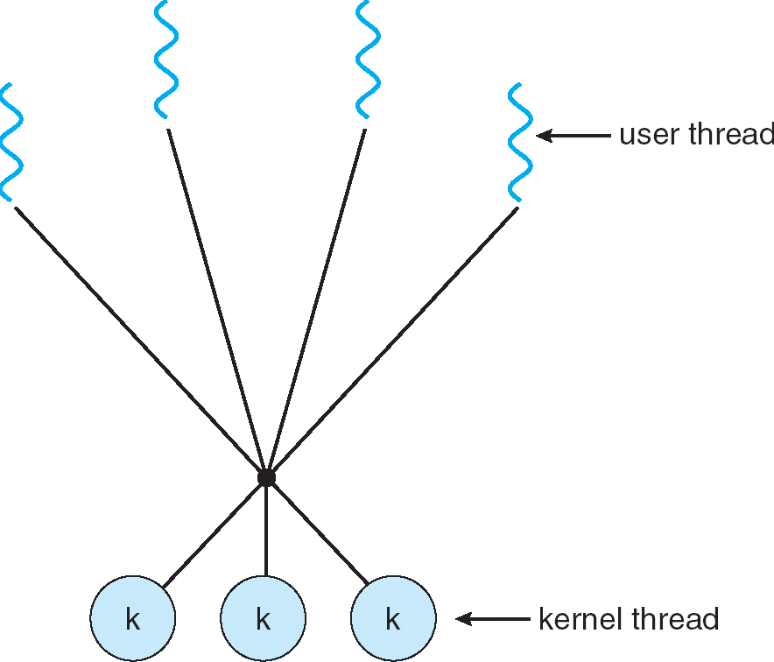
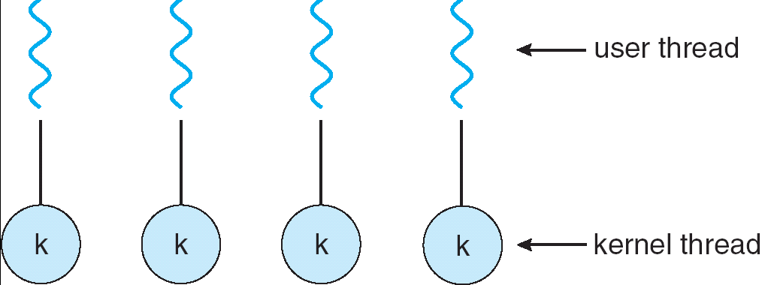
Aren't we still switching contexts?
What we are talking about in Today’s lecture
Simple One-to-One
Threading Model
Many-to-One
Many-to-Many
Yes, but much cheaper than switching processes
No need to change address space
Some numbers from Linux:
Frequency of context switch: 10-100ms
Switching between processes: 3-4 μsec.
Switching between threads: 100 ns
Even cheaper: switch threads (using “yield”) in user-space!

Slide 30
Processes vs. Threads
Process 1
Process N
Switch overhead:
Same process: low
Different proc.: high
Protection
Same proc: low
Different proc: high
Sharing overhead
Same proc: low
Different proc: high
Parallelism: no
threads
threads
Mem.
Mem.
…
IO
state
…
…
IO
state
CPU
state
CPU
state
CPU
state
CPU
state
CPU sched.
OS
1 thread at a time
CPU
(1 core)

Slide 31
Processes vs. Threads
Process 1
Process N
Switch overhead:
Same process: low
Different proc.: high
Protection
Same proc: low
Different proc: high
Sharing overhead
Same proc: low
Different proc, simultaneous core: medium
Different proc, offloaded core: high
Parallelism: yes
threads
threads
Mem.
Mem.
…
IO
state
…
…
IO
state
CPU
state
CPU
state
CPU
state
CPU
state
CPU sched.
OS
4 threads at a time
Core 1
Core 2
Core 3
Core 4

Slide 32
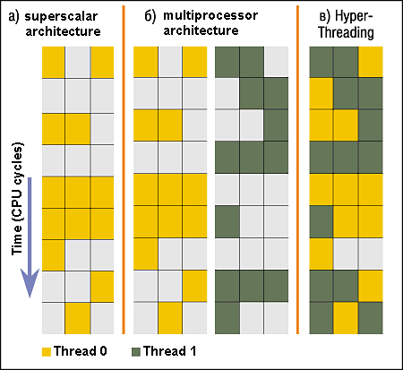
Simultaneous MultiThreading/Hyperthreading
Hardware scheduling technique
Superscalar processors can execute multiple instructions that are independent.
Hyperthreading duplicates register state to make a second “thread,” allowing more instructions to run.
Can schedule each thread as if were separate CPU
But, sub-linear speedup!
Original technique called “Simultaneous Multithreading”
http://www.cs.washington.edu/research/smt/index.html
SPARC, Pentium 4/Xeon (“Hyperthreading”), Power 5
Colored blocks show
instructions executed
Notes:
Intel seems to be discarding SMT in Silvermont because of power problems

Slide 33
What happens when thread blocks on I/O?
CopyFile
read
Trap to OS
Stack growth
kernel_read
run_new_thread
switch
What happens when a thread requests a block of data from the file system?
User code invokes a system call
Read operation is initiated
Run new thread/switch
Thread communication similar
Wait for Signal/Join
Networking

Slide 34
External Events
What happens if thread never does any I/O, never waits, and never yields control?
Could the ComputePI program grab all resources and never release the processor?
What if it didn’t print to console?
Must find way that dispatcher can regain control!
Answer: utilize external events
Interrupts: signals from hardware or software that stop the running code and jump to kernel
Timer: like an alarm clock that goes off every some milliseconds
If we make sure that external events occur frequently enough, can ensure dispatcher runs
Notes:
Patterson’s a nice guy, so he gives up the body after using it for awhile and let’s John Kubitowicz have it.
But Kubi’s not so nice, so he won’t give up control…
If you want to wake up for a final, you set your clock, or ask your roommate to pour water over your head – OS does the same

Slide 35

Interrupt Controller
Interrupt Mask
Priority Encoder
IntID
CPU
Interrupt
Int Disable
Timer
Software
Interrupt
Control
NMI
Network
Interrupts invoked with interrupt lines from devices
Interrupt controller chooses interrupt request to honor
Interrupt identity specified with ID line
Mask enables/disables interrupts
Priority encoder picks highest enabled interrupt
Software Interrupt Set/Cleared by Software
CPU can disable all interrupts with internal flag
Non-Maskable Interrupt line (NMI) can’t be disabled

Slide 36
Example: Network Interrupt
Raise priority
(set mask)
Reenable All Ints
Save registers
Dispatch to Handler
…
Transfer Network Packet from hardware to Kernel Buffers
…
Restore registers
Clear current Int
Disable All Ints
Restore priority
(clear Mask)
RTI
...
add $r1,$r2,$r3
subi $r4,$r1,#4
slli $r4,$r4,#2
...
PC saved
Disable All Ints
Kernel Mode
External Interrupt
Pipeline Flush
“Interrupt Handler”
...
lw $r2,0($r4)
lw $r3,4($r4)
add $r2,$r2,$r3
sw 8($r4),$r2
...
Restore PC
Enable all Ints
User Mode
An interrupt is a hardware-invoked context switch
No separate step to choose what to run next
Always run the interrupt handler immediately

Slide 37
Use of Timer Interrupt to Return Control
Solution to our dispatcher problem
Use the timer interrupt to force scheduling decisions
Timer Interrupt routine:
TimerInterrupt() { DoPeriodicHouseKeeping(); run_new_thread(); }
Some Routine
Interrupt
TimerInterrupt
Stack growth
run_new_thread
switch

Slide 38
How do we initialize TCB and Stack?
Initialize Register fields of TCB
Stack pointer made to point at stack
PC return address ⇒ OS (asm) routine ThreadRoot()
Two arg registers (a0 and a1) initialized to fcnPtr and fcnArgPtr, respectively
Initialize stack data?
No. Important part of stack frame is in registers (ra)
Think of stack frame as just before body of ThreadRoot() really gets started
ThreadRoot stub
Stack growth
Initial Stack

Slide 39
How does Thread get started?
Other Thread
ThreadRoot
A
B(while)
Stack growth
yield
run_new_thread
New Thread
switch
ThreadRoot stub
Eventually, run_new_thread() will select this TCB and return into beginning of ThreadRoot()
This really starts the new thread

Slide 40
How does a thread get started?
Other Thread
SetupNewThread(tNew) {
…
TCB[tNew].regs.sp = newStackPtr;
TCB[tNew].regs.retpc = &ThreadRoot;
TCB[tNew].regs.r0 = fcnPtr TCB[tNew].regs.r1 = fcnArgPtr
}
ThreadRoot
A
B(while)
Stack growth
yield
run_new_thread
New Thread
switch
ThreadRoot stub
How do we make a new thread?
Setup TCB/kernel thread to point at new user stack and ThreadRoot code
Put pointers to start function and args in registers
This depends heavily on the calling convention (i.e., RISC-V vs x86)
Eventually, run_new_thread() will select this TCB and return into beginning of ThreadRoot()
This really starts the new thread

Slide 41
What does ThreadRoot() look like?
ThreadRoot() is the root for the thread routine:
ThreadRoot(fcnPTR,fcnArgPtr) {
DoStartupHousekeeping();
UserModeSwitch(); /* enter user mode */
Call fcnPtr(fcnArgPtr);
ThreadFinish();
}
Startup Housekeeping
Includes things like recording start time of thread
Other statistics
Stack will grow and shrink with execution of thread
Final return from thread returns into ThreadRoot() which calls ThreadFinish()
ThreadFinish() wake up sleeping threads
ThreadRoot
Thread Code *fcnPtr()
Stack growth
Running Stack

Slide 43
Correctness with Concurrent Threads?
Non-determinism:
Scheduler can run threads in any order
Scheduler can switch threads at any time
This can make testing very difficult
Independent Threads
No state shared with other threads
Deterministic, reproducible conditions
Cooperating Threads
Shared state between multiple threads
Goal: Correctness by Design

Slide 44
Recall: Possible Executions

Slide 45
ATM Bank Server
ATM server problem:
Service a set of requests
Do so without corrupting database
Don’t hand out too much money

Slide 46
ATM bank server example
Suppose we wanted to implement a server process to handle requests from an ATM network:
BankServer() { while (TRUE) { ReceiveRequest(&op, &acctId, &amount); ProcessRequest(op, acctId, amount); } }
ProcessRequest(op, acctId, amount) { if (op == deposit) Deposit(acctId, amount); else if … }
Deposit(acctId, amount) { acct = GetAccount(acctId); /* may use disk I/O */ acct->balance += amount; StoreAccount(acct); /* Involves disk I/O */ }
How could we speed this up?
More than one request being processed at once
Event driven (overlap computation and I/O)
Multiple threads (multi-proc, or overlap comp and I/O)

Slide 47
Event Driven Version of ATM server
Suppose we only had one CPU
Still like to overlap I/O with computation
Without threads, we would have to rewrite in event-driven style
Example
BankServer() { while(TRUE) { event = WaitForNextEvent(); if (event == ATMRequest) StartOnRequest(); else if (event == AcctAvail) ContinueRequest(); else if (event == AcctStored) FinishRequest(); } }
What if we missed a blocking I/O step?
What if we have to split code into hundreds of pieces which could be blocking?
This technique is used for graphical programming

Slide 48
Can Threads Make This Easier?
Threads yield overlapped I/O and computation without “deconstructing” code into non-blocking fragments
One thread per request
Requests proceeds to completion, blocking as required:
Deposit(acctId, amount) { acct = GetAccount(actId); /* May use disk I/O */ acct->balance += amount; StoreAccount(acct); /* Involves disk I/O */ }
Unfortunately, shared state can get corrupted: Thread 1 Thread 2 load r1, acct->balance load r1, acct->balance add r1, amount2 store r1, acct->balance add r1, amount1 store r1, acct->balance

Slide 49
Problem is at the Lowest Level
Most of the time, threads are working on separate data, so scheduling doesn’t matter:
Thread A Thread B
x = 1; y = 2;
However, what about (Initially, y = 12):
Thread A Thread B
x = 1; y = 2;
x = y+1; y = y*2;
What are the possible values of x?
Or, what are the possible values of x below?
Thread A Thread B
x = 1; x = 2;
X could be 1 or 2 (non-deterministic!)
Could even be 3 for serial processors:
Thread A writes 0001, B writes 0010 → scheduling order ABABABBA yields 3!
Notes:
X could be (13, 5, 3)

Slide 51
Atomic Operations
To understand a concurrent program, we need to know what the underlying indivisible operations are!
Atomic Operation: an operation that always runs to completion or not at all
It is indivisible: it cannot be stopped in the middle and state cannot be modified by someone else in the middle
Fundamental building block – if no atomic operations, then have no way for threads to work together
On most machines, memory references and assignments (i.e. loads and stores) of words are atomic
Consequently – weird example that produces “3” on previous slide can’t happen
Many instructions are not atomic
Double-precision floating point store often not atomic
VAX and IBM 360 had an instruction to copy a whole array

Slide 52
Recall: Locks
Lock: prevents someone from doing something
Lock before entering critical section and before accessing shared data
Unlock when leaving, after accessing shared data
Wait if locked
Important idea: all synchronization involves waiting
Locks need to be allocated and initialized:
structure Lock mylock or pthread_mutex_t mylock;
lock_init(&mylock) or mylock = PTHREAD_MUTEX_INITIALIZER;
Locks provide two atomic operations:
acquire(&mylock) – wait until lock is free; then mark it as busy
After this returns, we say the calling thread holds the lock
release(&mylock) – mark lock as free
Should only be called by a thread that currently holds the lock
After this returns, the calling thread no longer holds the lock

Slide 53
Fix banking problem with Locks!
Identify critical sections (atomic instruction sequences) and add locking:
Deposit(acctId, amount) {
acquire(&mylock) // Wait if someone else in critical section! acct = GetAccount(actId); acct->balance += amount; StoreAccount(acct);
release(&mylock) // Release someone into critical section }
Must use SAME lock (mylock) with all the methods (Withdraw, etc…)
Shared with all threads!
Critical Section
Thread B
Thread A
Thread C
Threads serialized by lock through critical section.
Only one thread at a time
acquire(&mylock)
Thread C
Critical Section
Thread B
Thread A
release(&mylock)
Thread A
Thread B

Slide 54
Recall: Definitions
Synchronization: using atomic operations to ensure cooperation between threads
For now, only loads and stores are atomic
We are going to show that its hard to build anything useful with only reads and writes
Mutual Exclusion: ensuring that only one thread does a particular thing at a time
One thread excludes the other while doing its task
Critical Section: piece of code that only one thread can execute at once. Only one thread at a time will get into this section of code
Critical section is the result of mutual exclusion
Critical section and mutual exclusion are two ways of describing the same thing

Slide 55
Another Concurrent Program Example
Two threads, A and B, compete with each other
One tries to increment a shared counter
The other tries to decrement the counter
Thread A Thread B
i = 0; i = 0; while (i < 10) while (i > -10) i = i + 1; i = i – 1; printf(“A wins!”); printf(“B wins!”);
Assume that memory loads and stores are atomic, but incrementing and decrementing are not atomic
No difference between: “i=i+1” and “i++”
Same instruction sequence, the ++ operator is just syntactic sugar
Who wins? Could be either
Is it guaranteed that someone wins? Why or why not?
What if both threads have their own CPU running at same speed? Is it guaranteed that it goes on forever?

Slide 56
Hand Simulation Multiprocessor Example
Inner loop looks like this:
Thread A Thread B
r1=0 load r1, M[i]
r1=0 load r1, M[i]
r1=1 add r1, r1, 1
r1=-1 sub r1, r1, 1
M[i]=1 store r1, M[i]
M[i]=-1 store r1, M[i]
Hand Simulation:
And we’re off. A gets off to an early start
B says “hmph, better go fast” and tries really hard
A goes ahead and writes “1”
B goes and writes “-1”
A says “HUH??? I could have sworn I put a 1 there”
Uncontrolled race condition: two threads attempting to access same data simultaneously with one of them performing a write
Here “simultaneous” is defined even with one CPU as “could access at same time if only there were two CPUs

Slide 57
So – does this fix it?
Put locks around increment/decrement:
Thread A Thread B
i = 0; i = 0; while (i < 10) while (i > -10)
acquire(&mylock) acquire(&mylock) i = i + 1; i = i – 1;
release(&mylock) release(&mylock) printf(“A wins!”); printf(“B wins!”);
What does this do? Is it better???
Each increment or decrement operation is now atomic. Good!
Technically, no race conditions, since lock prevents simultaneous reads/writes
Program is likely still broken. Not so good…
May or may not be what you intended (probably not)
Still unclear who wins – it is a nondeterministic result: different on each run
When might something like this make sense?
If each thread needed to get a unique integer for some reason

Slide 58
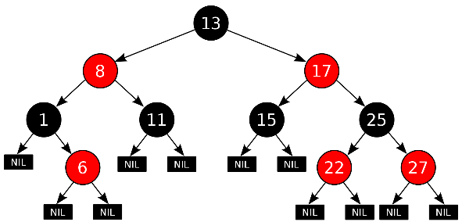
Recall: Red-Black tree example
Thread A
Insert(3) {
acquire(&treelock)
Tree.Insert(3)
release(&treelock)
}
treelock
Thread B
Insert(4) {
acquire(&treelock)
Tree.insert(4)
release(&treelock)
}
Get(6) {
acquire(&treelock)
Tree.search(6)
release(&treelock)
}
Tree-Based Set Data Structure
Here, the Lock is associated with the root of the tree
Restricts parallelism but makes sure that tree always consistent
No races at the operation level
Threads are exchange information through a consistent data structure
Could you make it faster with one lock per node? Perhaps, but must be careful!
Need to define invariants that are always true despite many simultaneous threads…

Slide 59
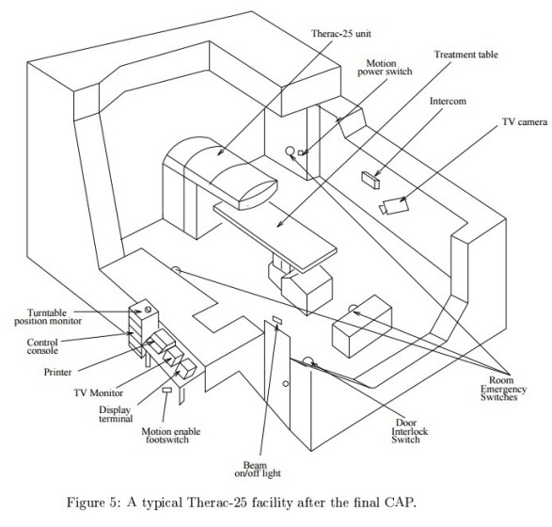
Concurrency is Hard!
Even for practicing engineers trying to write mission-critical, bulletproof code!
Threaded programs must work for all interleavings of thread instruction sequences
Cooperating threads inherently non-deterministic and non-reproducible
Really hard to debug unless carefully designed!
Therac-25: Radiation Therapy Machine with Unintended Overdoses (reading on course site)
Concurrency errors caused the death of a number of patients by misconfiguring the radiation production
Improper synchronization between input from operators and positioning software
Mars Pathfinder Priority Inversion (JPL Account)
Toyota Uncontrolled Acceleration (CMU Talk)
256.6K Lines of C Code, ~9-11K global variables
Inconsistent mutual exclusion on reads/writes

Slide 60
Conclusion
Concurrency accomplished by multiplexing CPU time:
Unloading current thread (PC, registers)
Loading new thread (PC, registers)
Such context switching may be voluntary (yield(), I/O) or involuntary (interrupts)
TCB + Stacks hold complete state of thread for restarting
Atomic Operation: an operation that always runs to completion or not at all
Synchronization: using atomic operations to ensure cooperation between threads
Mutual Exclusion: ensuring that only one thread does a particular thing at a time
One thread excludes the other while doing its task
Critical Section: piece of code that only one thread can execute at once. Only one thread at a time will get into this section of code
Locks: synchronization mechanism for enforcing mutual exclusion on critical sections to construct atomic operations

Slide 62

Producer-Consumer with a Bounded Buffer
Problem Definition
Producer(s) put things into a shared buffer
Consumer(s) take them out
Need synchronization to coordinate producer/consumer
Don’t want producer and consumer to have to work in lockstep, so put a fixed-size buffer between them
Need to synchronize access to this buffer
Producer needs to wait if buffer is full
Consumer needs to wait if buffer is empty
Example 1: GCC compiler
cpp | cc1 | cc2 | as | ld
Example 2: Coke machine
Producer can put limited number of Cokes in machine
Consumer can’t take Cokes out if machine is empty
Others: Web servers, Routers, ….
Producer
Buffer
Consumer
Producer
Consumer
Consumer

Slide 63
Circular Buffer Data Structure (sequential case)
w
typedef struct buf {
int write_index;
int read_index;
<type> *entries[BUFSIZE];
} buf_t;
r
d_{i+2}
d_{i}
d_{i+1}
Insert: write & bump write ptr (enqueue)
Remove: read & bump read ptr (dequeue)
How to tell if Full (on insert) Empty (on remove)?
And what do you do if it is?
What needs to be atomic?

Slide 64
Circular Buffer – first cut
mutex buf_lock = <initially unlocked>
Producer(item) {
acquire(&buf_lock);
while (buffer full) {}; // Wait for a free slot
enqueue(item); release(&buf_lock);
}
Will we ever come out of the wait loop?
Consumer() {
acquire(&buf_lock);
while (buffer empty) {}; // Wait for arrival
item = dequeue(); release(&buf_lock);
return item
}

Slide 65
Circular Buffer – 2nd cut
∅
mutex buf_lock = <initially unlocked>
Producer(item) {
acquire(&buf_lock);
while (buffer full) {release(&buf_lock); acquire(&buf_lock);}
enqueue(item); release(&buf_lock);
}
What happens when one is waiting for the other?
- Multiple cores ?
- Single core ?
Consumer() {
acquire(&buf_lock);
while (buffer empty) {release(&buf_lock); acquire(&buf_lock);}
item = dequeue(); release(&buf_lock);
return item
}

Slide 66
Higher-level Primitives than Locks
What is right abstraction for synchronizing threads that share memory?
Want as high a level primitive as possible
Good primitives and practices important!
Since execution is not entirely sequential, really hard to find bugs, since they happen rarely
UNIX is pretty stable now, but up until about mid-80s (10 years after started), systems running UNIX would crash every week or so – concurrency bugs
Synchronization is a way of coordinating multiple concurrent activities that are using shared state
This lecture and the next presents a some ways of structuring sharing

Slide 67
Recall: Semaphores
Semaphores are a kind of generalized lock
First defined by Dijkstra in late 60s
Main synchronization primitive used in original UNIX
Definition: a Semaphore has a non-negative integer value and supports the following two operations:
Down() or P(): an atomic operation that waits for semaphore to become positive, then decrements it by 1
Think of this as the wait() operation
Up() or V(): an atomic operation that increments the semaphore by 1, waking up a waiting P, if any
This of this as the signal() operation
Note that P() stands for “proberen” (to test) and V() stands for “verhogen” (to increment) in Dutch

Slide 68
Semaphores Like Integers Except…
Semaphores are like integers, except:
No negative values
Only operations allowed are P and V – can’t read or write value, except initially
Operations must be atomic
Two P’s together can’t decrement value below zero
Thread going to sleep in P won’t miss wakeup from V – even if both happen at same time
POSIX adds ability to read value, but technically not part of proper interface!
Semaphore from railway analogy
Here is a semaphore initialized to 2 for resource control:
Value=2
Value=1
Value=0
Value=1
Value=0
Value=2

Slide 69
Two Uses of Semaphores
Mutual Exclusion (initial value = 1)
Also called “Binary Semaphore” or “mutex”.
Can be used for mutual exclusion, just like a lock:
semaP(&mysem); // Critical section goes here semaV(&mysem);
Scheduling Constraints (initial value = 0)
Allow thread 1 to wait for a signal from thread 2
thread 2 schedules thread 1 when a given event occurs
Example: suppose you had to implement ThreadJoin which must wait for thread to terminate:
Initial value of semaphore = 0
ThreadJoin { semaP(&mysem); }
ThreadFinish { semaV(&mysem); }

Slide 70
Revisit Bounded Buffer: Correctness constraints for solution
Correctness Constraints:
Consumer must wait for producer to fill buffers, if none full (scheduling constraint)
Producer must wait for consumer to empty buffers, if all full (scheduling constraint)
Only one thread can manipulate buffer queue at a time (mutual exclusion)
Remember why we need mutual exclusion
Because computers are stupid
Imagine if in real life: the delivery person is filling the machine and somebody comes up and tries to stick their money into the machine
General rule of thumb: Use a separate semaphore for each constraint
Semaphore fullBuffers; // consumer’s constraint
Semaphore emptyBuffers;// producer’s constraint
Semaphore mutex; // mutual exclusion

Slide 71
Full Solution to Bounded Buffer (coke machine)
Semaphore fullSlots = 0; // Initially, no coke
Semaphore emptySlots = bufSize; // Initially, num empty slots
Semaphore mutex = 1; // No one using machine
Producer(item) { semaP(&emptySlots); // Wait until space semaP(&mutex); // Wait until machine free Enqueue(item); semaV(&mutex); semaV(&fullSlots); // Tell consumers there is // more coke }
Consumer() { semaP(&fullSlots); // Check if there’s a coke semaP(&mutex); // Wait until machine free item = Dequeue(); semaV(&mutex); semaV(&emptySlots); // tell producer need more return item; }
Critical sections using mutex protect integrity of the queue
fullSlots signals coke
emptySlots
signals space

Slide 72
Discussion about Solution
Decrease # of empty slots
Increase # of occupied slots
Why asymmetry?
Producer does: semaP(&emptyBuffer), semaV(&fullBuffer)
Consumer does: semaP(&fullBuffer), semaV(&emptyBuffer)
Is order of P’s important?
Yes! Can cause deadlock
Is order of V’s important?
No, except that it might affect scheduling efficiency
What if we have 2 producers or 2 consumers?
Do we need to change anything?
Decrease # of occupied slots
Increase # of empty slots
Producer(item) { semaP(&mutex); semaP(&emptySlots); Enqueue(item); semaV(&mutex); semaV(&fullSlots); } Consumer() { semaP(&fullSlots); semaP(&mutex); item = Dequeue(); semaV(&mutex); semaV(&emptySlots); return item; }

Slide 73
Where are we going with synchronization?
Programs
Shared Programs
Higher-level API
Locks Semaphores Monitors Send/Receive
Hardware
Load/Store Disable Ints Test&Set Compare&Swap
We are going to implement various higher-level synchronization primitives using atomic operations
Everything is pretty painful if only atomic primitives are load and store
Need to provide primitives useful at user-level
Talk about how to structure programs so that they are correct
Under any scheduling and number of processors

Slide 74
Conclusion
Concurrency accomplished by multiplexing CPU time:
Unloading current thread (PC, registers)
Loading new thread (PC, registers)
Such context switching may be voluntary (yield(), I/O) or involuntary (interrupts)
TCB + Stacks hold complete state of thread for restarting
Atomic Operation: an operation that always runs to completion or not at all
Synchronization: using atomic operations to ensure cooperation between threads
Mutual Exclusion: ensuring that only one thread does a particular thing at a time
One thread excludes the other while doing its task
Critical Section: piece of code that only one thread can execute at once. Only one thread at a time will get into this section of code
Locks: synchronization mechanism for enforcing mutual exclusion on critical sections to construct atomic operations
Semaphores: synchronization mechanism for enforcing resource constraints

