Slide 1
CS162 Operating Systems and Systems Programming Lecture 9 Synchronization 4: Monitors and Readers/Writers (Con’t), Process Structure, Device Drivers
February 16th, 2021
Profs. Natacha Crooks and Anthony D. Joseph
http://cs162.eecs.Berkeley.edu

Slide 2
Recall: Atomic Read-Modify-Write
test&set (&address) { /* most architectures */ result = M[address]; // return result from “address” and M[address] = 1; // set value at “address” to 1 return result; }
swap (&address, register) { /* x86 */ temp = M[address]; // swap register’s value to M[address] = register; // value at “address” register = temp; }
compare&swap (&address, reg1, reg2) { /* x86 (returns old value), 68000 */ if (reg1 == M[address]) { // If memory still == reg1, M[address] = reg2; // then put reg2 => memory return success; } else { // Otherwise do not change memory return failure; } }
load-linked&store-conditional(&address) { /* R4000, alpha */ loop: ll r1, M[address]; movi r2, 1; // Can do arbitrary computation sc r2, M[address]; beqz r2, loop; }

Slide 3
Recall: Better Locks using test&set
Can we build test&set locks without busy-waiting?
Mostly. Idea: only busy-wait to atomically check lock value
Note: sleep has to be sure to reset the guard variable
Why can’t we do it just before or just after the sleep?
int guard = 0; // Global Variable!
int mylock = FREE; // Interface: acquire(&mylock); // release(&mylock);
acquire(int *thelock) {
// Short busy-wait time while (test&set(guard)); if (*thelock == BUSY) {
put thread on wait queue;
go to sleep() & guard = 0;
// guard == 0 on wakup! } else { *thelock = BUSY; guard = 0; } }
release(int *thelock) { // Short busy-wait time while (test&set(guard)); if anyone on wait queue { take thread off wait queue Place on ready queue; } else { *thelock = FREE; } guard = 0;

Slide 4
Recall: Linux futex: Fast Userspace Mutex
#include <linux/futex.h>
#include <sys/time.h>
int futex(int *uaddr, int futex_op, int val,
const struct timespec *timeout );
uaddr points to a 32-bit value in user space
futex_op
FUTEX_WAIT – if val == *uaddr sleep till FUTEX_WAKE
Atomic check that condition still holds after we disable interrupts (in kernel!)
FUTEX_WAKE – wake up at most val waiting threads
FUTEX_FD, FUTEX_WAKE_OP, FUTEX_CMP_REQUEUE: More interesting operations!
timeout
ptr to a timespec structure that specifies a timeout for the op
Interface to the kernel sleep() functionality!
Let thread put themselves to sleep – conditionally!
futex is not exposed in libc; it is used within the implementation of pthreads
Can be used to implement locks, semaphores, monitors, etc…

Slide 5
Recall: Lock Using Atomic Instructions and Futex
typedef enum { UNLOCKED,LOCKED,CONTESTED } Lock;
Lock mylock = UNLOCKED; // Interface: acquire(&mylock);
// release(&mylock);
acquire(Lock *thelock) {
// If unlocked, grab lock!
if (compare&swap(thelock,UNLOCKED,LOCKED))
return;
// Keep trying to grab lock, sleep in futex
while (swap(mylock,CONTESTED) != UNLOCKED))
// Sleep unless someone releases here!
futex(thelock, FUTEX_WAIT, CONTESTED);
}
release(Lock *thelock) {
// If someone sleeping, if (swap(thelock,UNLOCKED) == CONTESTED)
futex(thelock,FUTEX_WAKE,1); }
Three (3) states:
UNLOCKED: No one has lock
LOCKED: One thread has lock
CONTESTED: Possibly more than one (with someone sleeping)
Clean interface!
Lock grabbed cleanly by either
compare_and_swap()
First swap()
No overhead if uncontested!
Could build semaphores in a similar way!

Slide 7
Recall: Monitors and Condition Variables
Monitor: a lock and zero or more condition variables for managing concurrent access to shared data
Use of Monitors is a programming paradigm
Some languages like Java provide monitors in the language
Condition Variable: a queue of threads waiting for something inside a critical section
Key idea: allow sleeping inside critical section by atomically releasing lock at time we go to sleep
Contrast to semaphores: Can’t wait inside critical section
Operations:
Wait(&lock): Atomically release lock and go to sleep. Re-acquire lock later, before returning.
Signal(): Wake up one waiter, if any
Broadcast(): Wake up all waiters
Rule: Must hold lock when doing condition variable ops!

Slide 8
Recall: Readers/Writers Problem
W
R
R
R
Motivation: Consider a shared database
Two classes of users:
Readers – never modify database
Writers – read and modify database
Is using a single lock on the whole database sufficient?
Like to have many readers at the same time
Only one writer at a time

Slide 9
Recall: Structure of Mesa Monitor Program
Monitors represent the synchronization logic of the program
Wait if necessary
Signal when change something so any waiting threads can proceed
Basic structure of mesa monitor-based program:
lock while (need to wait) { condvar.wait(); } unlock do something so no need to wait lock
condvar.signal();
unlock
Check and/or update state variables
Wait if necessary
Check and/or update
state variables

Slide 10
Recall: Basic Readers/Writers Solution
Correctness Constraints:
Readers can access database when no writers
Writers can access database when no readers or writers
Only one thread manipulates state variables at a time
Basic structure of a solution:
Reader() Wait until no writers Access data base Check out – wake up a waiting writer
Writer() Wait until no active readers or writers Access database Check out – wake up waiting readers or writer
State variables (Protected by a lock called “lock”):
int AR: Number of active readers; initially = 0
int WR: Number of waiting readers; initially = 0
int AW: Number of active writers; initially = 0
int WW: Number of waiting writers; initially = 0
Condition okToRead = NIL
Condition okToWrite = NIL

Slide 11
Recall: Code for a Reader
Reader() { // First check self into system acquire(&lock);
while ((AW + WW) > 0) { // Is it safe to read? WR++; // No. Writers exist cond_wait(&okToRead,&lock);// Sleep on cond var WR--; // No longer waiting }
AR++; // Now we are active! release(&lock);
// Perform actual read-only access AccessDatabase(ReadOnly);
// Now, check out of system acquire(&lock); AR--; // No longer active if (AR == 0 && WW > 0) // No other active readers cond_signal(&okToWrite);// Wake up one writer release(&lock); }
Why Release the Lock here?

Slide 12
Recall: Code for a Writer
Writer() { // First check self into system acquire(&lock);
while ((AW + AR) > 0) { // Is it safe to write? WW++; // No. Active users exist cond_wait(&okToWrite,&lock); // Sleep on cond var WW--; // No longer waiting }
AW++; // Now we are active! release(&lock);
// Perform actual read/write access AccessDatabase(ReadWrite);
// Now, check out of system acquire(&lock); AW--; // No longer active if (WW > 0){ // Give priority to writers cond_signal(&okToWrite);// Wake up one writer } else if (WR > 0) { // Otherwise, wake reader cond_broadcast(&okToRead); // Wake all readers } release(&lock); }
Why broadcast() here instead of signal()?
Why Give priority to writers?

Slide 13
Simulation of Readers/Writers Solution
Use an example to simulate the solution
Consider the following sequence of operators:
R1, R2, W1, R3
Initially: AR = 0, WR = 0, AW = 0, WW = 0

Slide 14
Simulation of Readers/Writers Solution
R1 comes along (no waiting threads)
AR = 0, WR = 0, AW = 0, WW = 0
Reader() { acquire(&lock)
while ((AW + WW) > 0) { // Is it safe to read? WR++; // No. Writers exist cond_wait(&okToRead,&lock);// Sleep on cond var WR--; // No longer waiting }
AR++; // Now we are active! release(&lock);
AccessDBase(ReadOnly);
acquire(&lock); AR--; if (AR == 0 && WW > 0) cond_signal(&okToWrite); release(&lock); }

Slide 15
Simulation of Readers/Writers Solution
R1 comes along (no waiting threads)
AR = 0, WR = 0, AW = 0, WW = 0
Reader() { acquire(&lock);
while ((AW + WW) > 0) { // Is it safe to read? WR++; // No. Writers exist cond_wait(&okToRead,&lock);// Sleep on cond var WR--; // No longer waiting }
AR++; // Now we are active! release(&lock);
AccessDBase(ReadOnly);
acquire(&lock); AR--; if (AR == 0 && WW > 0) cond_signal(&okToWrite); release(&lock); }

Slide 16
Simulation of Readers/Writers Solution
R1 comes along (no waiting threads)
AR = 1, WR = 0, AW = 0, WW = 0
Reader() { acquire(&lock);
while ((AW + WW) > 0) { // Is it safe to read? WR++; // No. Writers exist cond_wait(&okToRead,&lock);// Sleep on cond var WR--; // No longer waiting }
AR++; // Now we are active! release(&lock);
AccessDBase(ReadOnly);
acquire(&lock); AR--; if (AR == 0 && WW > 0) cond_signal(&okToWrite); release(&lock); }

Slide 17
Simulation of Readers/Writers Solution
R1 comes along (no waiting threads)
AR = 1, WR = 0, AW = 0, WW = 0
Reader() { acquire(&lock);
while ((AW + WW) > 0) { // Is it safe to read? WR++; // No. Writers exist cond_wait(&okToRead,&lock);// Sleep on cond var WR--; // No longer waiting }
AR++; // Now we are active! release(&lock);
AccessDBase(ReadOnly);
acquire(&lock); AR--; if (AR == 0 && WW > 0) cond_signal(&okToWrite); release(&lock); }
Why release the
lock here???

Slide 18
Simulation of Readers/Writers Solution
R1 accessing dbase (no other threads)
AR = 1, WR = 0, AW = 0, WW = 0
Reader() { acquire(&lock);
while ((AW + WW) > 0) { // Is it safe to read? WR++; // No. Writers exist cond_wait(&okToRead,&lock);// Sleep on cond var WR--; // No longer waiting }
AR++; // Now we are active! release(&lock);
AccessDBase(ReadOnly);
acquire(&lock); AR--; if (AR == 0 && WW > 0) cond_signal(&okToWrite); release(&lock); }

Slide 19
Simulation of Readers/Writers Solution
R2 comes along (R1 accessing dbase)
AR = 1, WR = 0, AW = 0, WW = 0
Reader() { acquire(&lock);
while ((AW + WW) > 0) { // Is it safe to read? WR++; // No. Writers exist cond_wait(&okToRead,&lock);// Sleep on cond var WR--; // No longer waiting }
AR++; // Now we are active! release(&lock);
AccessDBase(ReadOnly);
acquire(&lock); AR--; if (AR == 0 && WW > 0) cond_signal(&okToWrite); release(&lock); }

Slide 20
Simulation of Readers/Writers Solution
R2 comes along (R1 accessing dbase)
AR = 1, WR = 0, AW = 0, WW = 0
Reader() { acquire(&lock);
while ((AW + WW) > 0) { // Is it safe to read? WR++; // No. Writers exist cond_wait(&okToRead,&lock);// Sleep on cond var WR--; // No longer waiting }
AR++; // Now we are active! release(&lock);
AccessDBase(ReadOnly);
acquire(&lock); AR--; if (AR == 0 && WW > 0) cond_signal(&okToWrite); release(&lock); }

Slide 21
Simulation of Readers/Writers Solution
R2 comes along (R1 accessing dbase)
AR = 2, WR = 0, AW = 0, WW = 0
Reader() { acquire(&lock);
while ((AW + WW) > 0) { // Is it safe to read? WR++; // No. Writers exist cond_wait(&okToRead,&lock);// Sleep on cond var WR--; // No longer waiting }
AR++; // Now we are active! release(&lock);
AccessDBase(ReadOnly);
acquire(&lock); AR--; if (AR == 0 && WW > 0) cond_signal(&okToWrite); release(&lock); }

Slide 22
Simulation of Readers/Writers Solution
R2 comes along (R1 accessing dbase)
AR = 2, WR = 0, AW = 0, WW = 0
Reader() { acquire(&lock);
while ((AW + WW) > 0) { // Is it safe to read? WR++; // No. Writers exist cond_wait(&okToRead,&lock);// Sleep on cond var WR--; // No longer waiting }
AR++; // Now we are active! release(&lock);
AccessDBase(ReadOnly);
acquire(&lock); AR--; if (AR == 0 && WW > 0) cond_signal(&okToWrite); release(&lock); }

Slide 23
Simulation of Readers/Writers Solution
R1 and R2 accessing dbase
AR = 2, WR = 0, AW = 0, WW = 0
Reader() { acquire(&lock);
while ((AW + WW) > 0) { // Is it safe to read? WR++; // No. Writers exist cond_wait(&okToRead,&lock);// Sleep on cond var WR--; // No longer waiting }
AR++; // Now we are active! release(&lock);
AccessDBase(ReadOnly);
acquire(&lock); AR--; if (AR == 0 && WW > 0) cond_signal(&okToWrite); release(&lock); }
Assume readers take a while to access database
Situation: Locks released, only AR is non-zero

Slide 24
Simulation of Readers/Writers Solution
W1 comes along (R1 and R2 are still accessing dbase)
AR = 2, WR = 0, AW = 0, WW = 0
Writer() { acquire(&lock);
while ((AW + AR) > 0) { // Is it safe to write? WW++; // No. Active users exist cond_wait(&okToWrite,&lock);// Sleep on cond var WW--; // No longer waiting }
AW++; release(&lock);
AccessDBase(ReadWrite);
acquire(&lock); AW--; if (WW > 0){ cond_signal(&okToWrite); } else if (WR > 0) { cond_broadcast(&okToRead); } release(&lock); }

Slide 25
Simulation of Readers/Writers Solution
W1 comes along (R1 and R2 are still accessing dbase)
AR = 2, WR = 0, AW = 0, WW = 0
Writer() { acquire(&lock);
while ((AW + AR) > 0) { // Is it safe to write? WW++; // No. Active users exist cond_wait(&okToWrite,&lock);// Sleep on cond var WW--; // No longer waiting }
AW++; release(&lock);
AccessDBase(ReadWrite);
acquire(&lock); AW--; if (WW > 0){ cond_signal(&okToWrite); } else if (WR > 0) { cond_broadcast(&okToRead); } release(&lock); }

Slide 26
Simulation of Readers/Writers Solution
W1 comes along (R1 and R2 are still accessing dbase)
AR = 2, WR = 0, AW = 0, WW = 1
Writer() { acquire(&lock);
while ((AW + AR) > 0) { // Is it safe to write? WW++; // No. Active users exist cond_wait(&okToWrite,&lock);// Sleep on cond var WW--; // No longer waiting }
AW++; release(&lock);
AccessDBase(ReadWrite);
acquire(&lock); AW--; if (WW > 0){ cond_signal(&okToWrite); } else if (WR > 0) { cond_broadcast(&okToRead); } release(&lock); }
W1 cannot start because of readers

Slide 27
Simulation of Readers/Writers Solution
R3 comes along (R1 and R2 accessing dbase, W1 waiting)
AR = 2, WR = 0, AW = 0, WW = 1
Reader() { acquire(&lock);
while ((AW + WW) > 0) { // Is it safe to read? WR++; // No. Writers exist cond_wait(&okToRead,&lock);// Sleep on cond var WR--; // No longer waiting }
AR++; // Now we are active! release(&lock);
AccessDBase(ReadOnly);
acquire(&lock); AR--; if (AR == 0 && WW > 0) cond_signal(&okToWrite); release(&lock); }

Slide 28
Simulation of Readers/Writers Solution
R3 comes along (R1 and R2 accessing dbase, W1 waiting)
AR = 2, WR = 0, AW = 0, WW = 1
Reader() { acquire(&lock);
while ((AW + WW) > 0) { // Is it safe to read? WR++; // No. Writers exist cond_wait(&okToRead,&lock);// Sleep on cond var WR--; // No longer waiting }
AR++; // Now we are active! release(&lock);
AccessDBase(ReadOnly);
acquire(&lock); AR--; if (AR == 0 && WW > 0) cond_signal(&okToWrite); release(&lock); }

Slide 29
Simulation of Readers/Writers Solution
R3 comes along (R1 and R2 accessing dbase, W1 waiting)
AR = 2, WR = 1, AW = 0, WW = 1
Reader() { acquire(&lock);
while ((AW + WW) > 0) { // Is it safe to read? WR++; // No. Writers exist cond_wait(&okToRead,&lock);// Sleep on cond var WR--; // No longer waiting }
AR++; // Now we are active! lock.release();
AccessDBase(ReadOnly);
acquire(&lock); AR--; if (AR == 0 && WW > 0) cond_signal(&okToWrite); release(&lock); }

Slide 30
Simulation of Readers/Writers Solution
R3 comes along (R1, R2 accessing dbase, W1 waiting)
AR = 2, WR = 1, AW = 0, WW = 1
Reader() { acquire(&lock);
while ((AW + WW) > 0) { // Is it safe to read? WR++; // No. Writers exist cond_wait(&okToRead,&lock);// Sleep on cond var WR--; // No longer waiting }
AR++; // Now we are active! release(&lock);
AccessDBase(ReadOnly);
acquire(&lock); AR--; if (AR == 0 && WW > 0) cond_signal(&okToWrite); release(&lock); }
R3 cannot start because of writers (both AW & WW)

Slide 31
Simulation of Readers/Writers Solution
R1 and R2 accessing dbase, W1 and R3 waiting
AR = 2, WR = 1, AW = 0, WW = 1
Reader() { acquire(&lock);
while ((AW + WW) > 0) { // Is it safe to read? WR++; // No. Writers exist cond_wait(&okToRead,&lock);// Sleep on cond var WR--; // No longer waiting }
AR++; // Now we are active! release(&lock);
AccessDBase(ReadOnly);
acquire(&lock); AR--; if (AR == 0 && WW > 0) cond_signal(&okToWrite); release(&lock); }
Status:
R1 and R2 still reading
W1 and R3 waiting on okToWrite and okToRead, respectively

Slide 32
Simulation of Readers/Writers Solution
R2 finishes (R1 accessing dbase, W1 and R3 waiting)
AR = 2, WR = 1, AW = 0, WW = 1
Reader() { acquire(&lock);
while ((AW + WW) > 0) { // Is it safe to read? WR++; // No. Writers exist cond_wait(&okToRead,&lock);// Sleep on cond var WR--; // No longer waiting }
AR++; // Now we are active! release(&lock);
AccessDBase(ReadOnly);
acquire(&lock); AR--; if (AR == 0 && WW > 0) cond_signal(&okToWrite); release(&lock); }

Slide 33
Simulation of Readers/Writers Solution
R2 finishes (R1 accessing dbase, W1 and R3 waiting)
AR = 1, WR = 1, AW = 0, WW = 1
Reader() { acquire(&lock);
while ((AW + WW) > 0) { // Is it safe to read? WR++; // No. Writers exist cond_wait(&okToRead,&lock);// Sleep on cond var WR--; // No longer waiting }
AR++; // Now we are active! release(&lock);
AccessDBase(ReadOnly);
acquire(&lock); AR--; if (AR == 0 && WW > 0) cond_signal(&okToWrite); release(&lock); }

Slide 34
Simulation of Readers/Writers Solution
R2 finishes (R1 accessing dbase, W1 and R3 waiting)
AR = 1, WR = 1, AW = 0, WW = 1
Reader() { acquire(&lock);
while ((AW + WW) > 0) { // Is it safe to read? WR++; // No. Writers exist cond_wait(&okToRead,&lock);// Sleep on cond var WR--; // No longer waiting }
AR++; // Now we are active! release(&lock);
AccessDBase(ReadOnly);
acquire(&lock); AR--; if (AR == 0 && WW > 0) cond_signal(&okToWrite); release(&lock); }

Slide 35
Simulation of Readers/Writers Solution
R2 finishes (R1 accessing dbase, W1 and R3 waiting)
AR = 1, WR = 1, AW = 0, WW = 1
Reader() { acquire(&lock);
while ((AW + WW) > 0) { // Is it safe to read? WR++; // No. Writers exist cond_wait(&okToRead,&lock);// Sleep on cond var WR--; // No longer waiting }
AR++; // Now we are active! release(&lock);
AccessDBase(ReadOnly);
acquire(&lock); AR--; if (AR == 0 && WW > 0) cond_signal(&okToWrite); release(&lock); }

Slide 36
Simulation of Readers/Writers Solution
R1 finishes (W1 and R3 waiting)
AR = 1, WR = 1, AW = 0, WW = 1
Reader() { acquire(&lock);
while ((AW + WW) > 0) { // Is it safe to read? WR++; // No. Writers exist cond_wait(&okToRead,&lock);// Sleep on cond var WR--; // No longer waiting }
AR++; // Now we are active! release(&lock);
AccessDBase(ReadOnly);
acquire(&lock); AR--; if (AR == 0 && WW > 0) cond_signal(&okToWrite); release(&lock); }

Slide 37
Simulation of Readers/Writers Solution
R1 finishes (W1, R3 waiting)
AR = 0, WR = 1, AW = 0, WW = 1
Reader() { acquire(&lock);
while ((AW + WW) > 0) { // Is it safe to read? WR++; // No. Writers exist cond_wait(&okToRead,&lock);// Sleep on cond var WR--; // No longer waiting }
AR++; // Now we are active! release(&lock);
AccessDBase(ReadOnly);
acquire(&lock); AR--; if (AR == 0 && WW > 0) cond_signal(&okToWrite); release(&lock); }

Slide 38
Simulation of Readers/Writers Solution
R1 finishes (W1, R3 waiting)
AR = 0, WR = 1, AW = 0, WW = 1
Reader() { acquire(&lock);
while ((AW + WW) > 0) { // Is it safe to read? WR++; // No. Writers exist cond_wait(&okToRead,&lock);// Sleep on cond var WR--; // No longer waiting }
AR++; // Now we are active! release(&lock);
AccessDBase(ReadOnly);
acquire(&lock); AR--; if (AR == 0 && WW > 0) cond_signal(&okToWrite); release(&lock); }

Slide 39
Simulation of Readers/Writers Solution
R1 signals a writer (W1 and R3 waiting)
AR = 0, WR = 1, AW = 0, WW = 1
Reader() { acquire(&lock);
while ((AW + WW) > 0) { // Is it safe to read? WR++; // No. Writers exist cond_wait(&okToRead,&lock);// Sleep on cond var WR--; // No longer waiting }
AR++; // Now we are active! release(&lock);
AccessDBase(ReadOnly);
acquire(&lock); AR--; if (AR == 0 && WW > 0) cond_signal(&okToWrite); release(&lock); }
All readers done,
Signal writer W1

Slide 40
Simulation of Readers/Writers Solution
W1 gets signal (R3 still waiting)
AR = 0, WR = 1, AW = 0, WW = 1
Writer() { acquire(&lock);
while ((AW + AR) > 0) { // Is it safe to write? WW++; // No. Active users exist cond_wait(&okToWrite,&lock);// Sleep on cond var WW--; // No longer waiting }
AW++; release(&lock);
AccessDBase(ReadWrite);
acquire(&lock); AW--; if (WW > 0){ cond_signal(&okToWrite); } else if (WR > 0) { cond_broadcast(&okToRead); } release(&lock); }
Receive signal from R1

Slide 41
Simulation of Readers/Writers Solution
W1 gets signal (R3 still waiting)
AR = 0, WR = 1, AW = 0, WW = 0
Writer() { acquire(&lock);
while ((AW + AR) > 0) { // Is it safe to write? WW++; // No. Active users exist cond_wait(&okToWrite,&lock);// Sleep on cond var WW--; // No longer waiting }
AW++; release(&lock);
AccessDBase(ReadWrite);
acquire(&lock); AW--; if (WW > 0){ cond_signal(&okToWrite); } else if (WR > 0) { cond_broadcast(&okToRead); } release(&lock); }

Slide 42
Simulation of Readers/Writers Solution
W1 gets signal (R3 still waiting)
AR = 0, WR = 1, AW = 1, WW = 0
Writer() { acquire(&lock);
while ((AW + AR) > 0) { // Is it safe to write? WW++; // No. Active users exist cond_wait(&okToWrite,&lock);// Sleep on cond var WW--; // No longer waiting }
AW++; release(&lock);
AccessDBase(ReadWrite);
acquire(&lock); AW--; if (WW > 0){ cond_signal(&okToWrite); } else if (WR > 0) { cond_broadcast(&okToRead); } release(&lock); }

Slide 43
Simulation of Readers/Writers Solution
W1 accessing dbase (R3 still waiting)
AR = 0, WR = 1, AW = 1, WW = 0
Writer() { acquire(&lock);
while ((AW + AR) > 0) { // Is it safe to write? WW++; // No. Active users exist cond_wait(&okToWrite,&lock);// Sleep on cond var WW--; // No longer waiting }
AW++; release(&lock);
AccessDBase(ReadWrite);
acquire(&lock); AW--; if (WW > 0){ cond_signal(&okToWrite); } else if (WR > 0) { cond_broadcast(&okToRead); } release(&lock); }

Slide 44
Simulation of Readers/Writers Solution
W1 finishes (R3 still waiting)
AR = 0, WR = 1, AW = 1, WW = 0
Writer() { acquire(&lock);
while ((AW + AR) > 0) { // Is it safe to write? WW++; // No. Active users exist cond_wait(&okToWrite,&lock);// Sleep on cond var WW--; // No longer waiting }
AW++; release(&lock);
AccessDBase(ReadWrite);
acquire(&lock); AW--; if (WW > 0){ cond_signal(&okToWrite); } else if (WR > 0) { cond_broadcast(&okToRead); } release(&lock); }

Slide 45
Simulation of Readers/Writers Solution
W1 finishes (R3 still waiting)
AR = 0, WR = 1, AW = 0, WW = 0
Writer() { acquire(&lock);
while ((AW + AR) > 0) { // Is it safe to write? WW++; // No. Active users exist cond_wait(&okToWrite,&lock);// Sleep on cond var WW--; // No longer waiting }
AW++; release(&lock);
AccessDBase(ReadWrite);
acquire(&lock); AW--; if (WW > 0){ cond_signal(&okToWrite); } else if (WR > 0) { cond_broadcast(&okToRead); } release(&lock); }

Slide 46
Simulation of Readers/Writers Solution
W1 finishes (R3 still waiting)
AR = 0, WR = 1, AW = 0, WW = 0
Writer() { acquire(&lock);
while ((AW + AR) > 0) { // Is it safe to write? WW++; // No. Active users exist cond_wait(&okToWrite,&lock);// Sleep on cond var WW--; // No longer waiting }
AW++; release(&lock);
AccessDBase(ReadWrite);
acquire(&lock); AW--; if (WW > 0){ cond_signal(&okToWrite); } else if (WR > 0) { cond_broadcast(&okToRead); } release(&lock); }

Slide 47
Simulation of Readers/Writers Solution
W1 signaling readers (R3 still waiting)
AR = 0, WR = 1, AW = 0, WW = 0
Writer() { acquire(&lock);
while ((AW + AR) > 0) { // Is it safe to write? WW++; // No. Active users exist cond_wait(&okToWrite,&lock);// Sleep on cond var WW--; // No longer waiting }
AW++; release(&lock);
AccessDBase(ReadWrite);
acquire(&lock); AW--; if (WW > 0){ cond_signal(&okToWrite); } else if (WR > 0) { cond_broadcast(&okToRead); } release(&lock); }
No waiting writers,
Signal reader R3

Slide 48
Simulation of Readers/Writers Solution
R3 gets signal (no waiting threads)
AR = 0, WR = 1, AW = 0, WW = 0
Reader() { acquire(&lock);
while ((AW + WW) > 0) { // Is it safe to read? WR++; // No. Writers exist cond_wait(&okToRead,&lock);// Sleep on cond var WR--; // No longer waiting }
AR++; // Now we are active! release(&lock);
AccessDBase(ReadOnly);
acquire(&lock); AR--; if (AR == 0 && WW > 0) cond_signal(&okToWrite); release(&lock); }
Receive signal from W1

Slide 49
Simulation of Readers/Writers Solution
R3 gets signal (no waiting threads)
AR = 0, WR = 0, AW = 0, WW = 0
Reader() { acquire(&lock);
while ((AW + WW) > 0) { // Is it safe to read? WR++; // No. Writers exist cond_wait(&okToRead,&lock);// Sleep on cond var WR--; // No longer waiting }
AR++; // Now we are active! release(&lock);
AccessDBase(ReadOnly);
acquire(&lock); AR--; if (AR == 0 && WW > 0) cond_signal(&okToWrite); release(&lock); }

Slide 50
Simulation of Readers/Writers Solution
R3 accessing dbase (no waiting threads)
AR = 1, WR = 0, AW = 0, WW = 0
Reader() { acquire(&lock);
while ((AW + WW) > 0) { // Is it safe to read? WR++; // No. Writers exist cond_wait(&okToRead,&lock);// Sleep on cond var WR--; // No longer waiting }
AR++; // Now we are active! release(&lock);
AccessDBase(ReadOnly);
acquire(&lock); AR--; if (AR == 0 && WW > 0) cond_signal(&okToWrite); release(&lock); }

Slide 51
Simulation of Readers/Writers Solution
R3 finishes (no waiting threads)
AR = 1, WR = 0, AW = 0, WW = 0
Reader() { acquire(&lock);
while ((AW + WW) > 0) { // Is it safe to read? WR++; // No. Writers exist cond_wait(&okToRead,&lock);// Sleep on cond var WR--; // No longer waiting }
AR++; // Now we are active! release(&lock);
AccessDBase(ReadOnly);
acquire(&lock); AR--; if (AR == 0 && WW > 0) cond_signal(&okToWrite); release(&lock); }

Slide 52
Simulation of Readers/Writers Solution
R3 finishes (no waiting threads)
AR = 0, WR = 0, AW = 0, WW = 0
Reader() { acquire(&lock);
while ((AW + WW) > 0) { // Is it safe to read? WR++; // No. Writers exist cond_wait(&okToRead,&lock);// Sleep on cond var WR--; // No longer waiting }
AR++; // Now we are active! release(&lock);
AccessDbase(ReadOnly);
acquire(&lock); AR--; if (AR == 0 && WW > 0) cond_signal(&okToWrite); release(&lock); }
All DONE!
DBase is Idle

Slide 53
Questions
Can readers starve? Consider Reader() entry code:
while ((AW + WW) > 0) { // Is it safe to read? WR++; // No. Writers exist cond_wait(&okToRead,&lock);// Sleep on cond var WR--; // No longer waiting }
AR++; // Now we are active!
What if we erase the condition check in Reader exit?
AR--; // No longer active if (AR == 0 && WW > 0) // No other active readers cond_signal(&okToWrite);// Wake up one writer
Further, what if we turn the signal() into broadcast()
AR--; // No longer active cond_broadcast(&okToWrite); // Wake up sleepers
Finally, what if we use only one condition variable (call it “okContinue”) instead of two separate ones?
Both readers and writers sleep on this variable
Must use broadcast() instead of signal()

Slide 54
Use of Single CV: okContinue
Reader() { // check into system acquire(&lock);
while ((AW + WW) > 0) { WR++; cond_wait(&okContinue,&lock); WR--; }
AR++; release(&lock);
// read-only access AccessDbase(ReadOnly);
// check out of system acquire(&lock); AR--; if (AR == 0 && WW > 0) cond_signal(&okContinue); release(&lock); }
Writer() { // check into system acquire(&lock);
while ((AW + AR) > 0) { WW++; cond_wait(&okContinue,&lock); WW--; }
AW++; release(&lock);
// read/write access AccessDbase(ReadWrite);
// check out of system acquire(&lock); AW--; if (WW > 0){ cond_signal(&okContinue); } else if (WR > 0) { cond_broadcast(&okContinue); } release(&lock); }
What if we turn okToWrite and okToRead into okContinue (i.e. use only one condition variable instead of two)?

Slide 55
Use of Single CV: okContinue
Reader() { // check into system acquire(&lock);
while ((AW + WW) > 0) { WR++; cond_wait(&okContinue,&lock); WR--; }
AR++; release(&lock);
// read-only access AccessDbase(ReadOnly);
// check out of system acquire(&lock); AR--; if (AR == 0 && WW > 0) cond_signal(&okContinue); release(&lock); }
Writer() { // check into system acquire(&lock);
while ((AW + AR) > 0) { WW++; cond_wait(&okContinue,&lock); WW--; }
AW++; release(&lock);
// read/write access AccessDbase(ReadWrite);
// check out of system acquire(&lock); AW--; if (WW > 0){ cond_signal(&okContinue); } else if (WR > 0) { cond_broadcast(&okContinue); } release(&lock); }
Consider this scenario:
R1 arrives
W1, R2 arrive while R1 still reading → W1 and R2 wait for R1 to finish
Assume R1’s signal is delivered to R2 (not W1)

Slide 56
Use of Single CV: okContinue
Reader() { // check into system acquire(&lock);
while ((AW + WW) > 0) { WR++; cond_wait(&okContinue,&lock); WR--; }
AR++; release(&lock);
// read-only access AccessDbase(ReadOnly);
// check out of system acquire(&lock); AR--; if (AR == 0 && WW > 0) cond_broadcast(&okContinue); release(&lock); }
Writer() { // check into system acquire(&lock);
while ((AW + AR) > 0) { WW++; cond_wait(&okContinue,&lock); WW--; }
AW++; release(&lock);
// read/write access AccessDbase(ReadWrite);
// check out of system acquire(&lock); AW--; if (WW > 0 || WR > 0){ cond_broadcast(&okContinue); } release(&lock); }
Must broadcast() to sort things out!
Need to change to broadcast()!

Slide 58
Administrivia
Midterm 1: Thu February 18th, 5-6:30pm
Video Proctored, Use of computer to answer questions
More details as we get closer to exam
Midterm topics:
Everything up to lecture 9 – lecture will be released early
Homework 1 and Project 1 (high-level design) are fair game
Midterm Review: Tuesday February 16th, 5-7pm

Slide 60
Can we construct Monitors from Semaphores?
Locking aspect is easy: Just use a mutex
Can we implement condition variables this way?
Wait(Semaphore *thesema) { semaP(thesema); }
Signal(Semaphore *thesema) { semaV(thesema); }
Doesn’t work: Wait() may sleep with lock held
Does this work better?
Wait(Lock *thelock, Semaphore *thesema) { release(thelock); semaP(thesema); acquire(thelock); } Signal(Semaphore *thesema) {
semaV(thesema); }
No: Condition vars have no history, semaphores have history:
What if thread signals and no one is waiting? NO-OP
What if thread later waits? Thread Waits
What if thread V’s and noone is waiting? Increment
What if thread later does P? Decrement and continue

Slide 61
Construction of Monitors from Semaphores (con’t)
Problem with previous try:
P and V are commutative – result is the same no matter what order they occur
Condition variables are NOT commutative
Does this fix the problem?
Wait(Lock *thelock, Semaphore *thesema) { release(thelock); semaP(thesema); acquire(thelock); } Signal(Semaphore *thesema) { if semaphore queue is not empty semaV(thesema); }
Not legal to look at contents of semaphore queue
There is a race condition – signaler can slip in after lock release and before waiter executes semaphore.P()
It is actually possible to do this correctly
Complex solution for Hoare scheduling in book
Can you come up with simpler Mesa-scheduled solution?

Slide 62
Mesa Monitor Conclusion
Monitors represent the synchronization logic of the program
Wait if necessary
Signal when change something so any waiting threads can proceed
Typical structure of monitor-based program:
lock while (need to wait) { condvar.wait(); } unlock do something so no need to wait lock
condvar.signal();
unlock
Check and/or update state variables
Wait if necessary
Check and/or update
state variables

Slide 63
C-Language Support for Synchronization
C language: Pretty straightforward synchronization
Just make sure you know all the code paths out of a critical section
int Rtn() { acquire(&lock); … if (exception) { release(&lock); return errReturnCode; } … release(&lock); return OK; }
Watch out for setjmp/longjmp!
Can cause a non-local jump out of procedure
In example, procedure E calls longjmp, popping stack back to procedure B
If Procedure C had lock.acquire, problem!
Proc A
Proc B
Calls setjmp
Stack growth
Proc C
acquire(&lock)
Proc D
Proc E
Calls longjmp

Slide 64
Concurrency and Synchronization in C
Harder with more locks
void Rtn() { lock1.acquire(); … if (error) { lock1.release(); return; }
…
lock2.acquire();
…
if (error) {
lock2.release()
lock1.release();
return;
}
…
lock2.release();
lock1.release(); }
Is goto a solution???
void Rtn() { lock1.acquire(); … if (error) { goto release_lock1_and_return; }
…
lock2.acquire();
…
if (error) {
goto release_both_and_return;
}
…
release_both_and_return:
lock2.release();
release_lock1_and_return:
lock1.release(); }

Slide 65
C++ Language Support for Synchronization
Languages with exceptions like C++
Languages that support exceptions are problematic (easy to make a non-local exit without releasing lock)
Consider:
void Rtn() { lock.acquire(); … DoFoo(); … lock.release(); } void DoFoo() { … if (exception) throw errException; … }
Notice that an exception in DoFoo() will exit without releasing the lock!

Slide 66
C++ Language Support for Synchronization (con’t)
Must catch all exceptions in critical sections
Catch exceptions, release lock, and re-throw exception: void Rtn() { lock.acquire(); try { … DoFoo(); … } catch (…) { // catch exception lock.release(); // release lock throw; // re-throw the exception } lock.release(); } void DoFoo() { … if (exception) throw errException; … }

Slide 67
Much better: C++ Lock Guards
#include <mutex>
int global_i = 0;
std::mutex global_mutex;
void safe_increment() {
std::lock_guard<std::mutex> lock(global_mutex);
…
global_i++;
// Mutex released when ‘lock’ goes out of scope
}

Slide 68
Python with Keyword
More versatile than we show here (can be used to close files, database connections, etc.)
lock = threading.Lock()
…
with lock: # Automatically calls acquire()
some_var += 1
…
# release() called however we leave block

Slide 69
Java synchronized Keyword
Every Java object has an associated lock:
Lock is acquired on entry and released on exit from a synchronized method
Lock is properly released if exception occurs inside a synchronized method
Mutex execution of synchronized methods (beware deadlock)
class Account { private int balance; // object constructor public Account (int initialBalance) { balance = initialBalance; } public synchronized int getBalance() { return balance; } public synchronized void deposit(int amount) { balance += amount; } }

Slide 70
Java Support for Monitors
Along with a lock, every object has a single condition variable associated with it
To wait inside a synchronized method:
void wait();
void wait(long timeout);
To signal while in a synchronized method:
void notify();
void notifyAll();

Slide 72
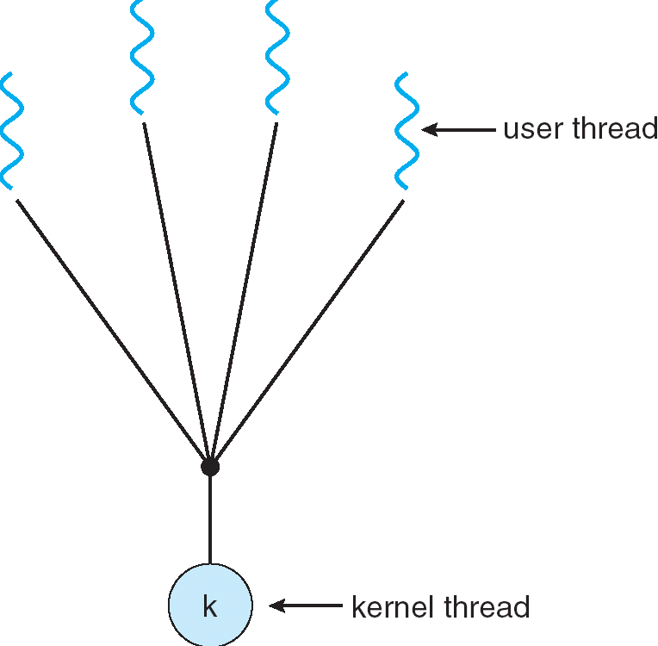
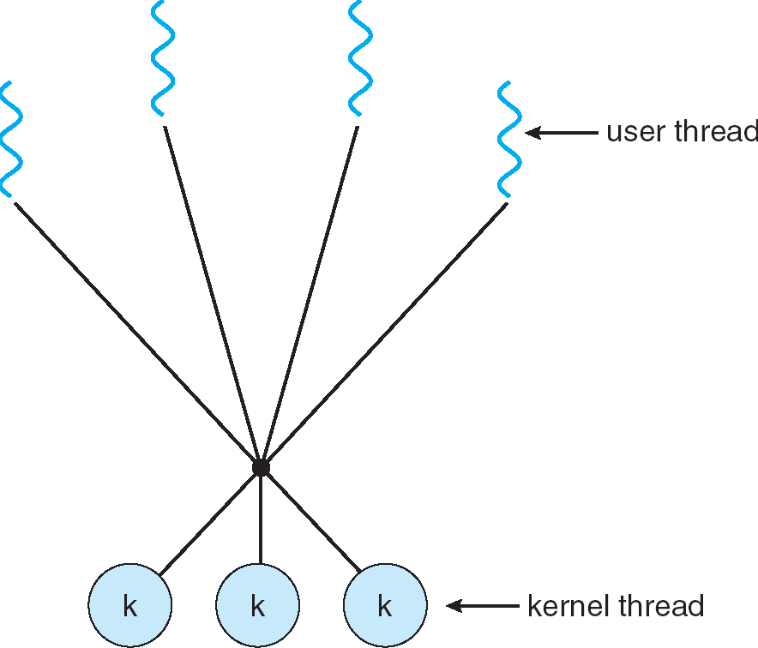
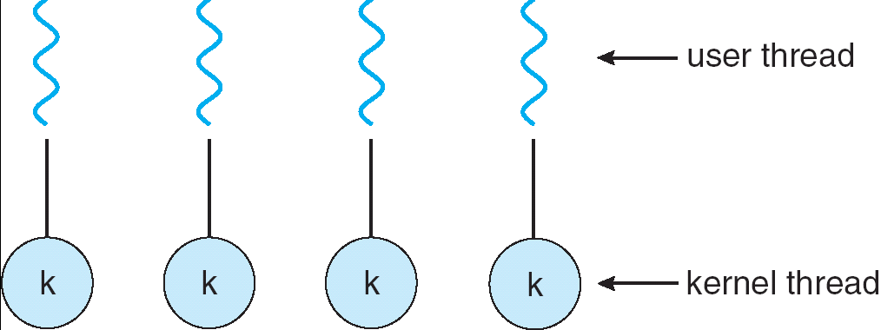
Recall: User/Kernel Threading Models
Almost all current implementations
Simple One-to-One
Threading Model
Many-to-One
Many-to-Many

Slide 73
Recall: Thread State in the Kernel
For every thread in a process, the kernel maintains:
The thread’s TCB
A kernel stack used for syscalls/interrupts/traps
This kernel-state is sometimes called the “kernel thread”
The “kernel thread” is suspended (but ready to go) when thread is running in user-space
Additionally, some threads just do work in the kernel
Still has TCB
Still has kernel stack
But not part of any process, and never executes in user mode

Slide 74
In Pintos, Processes are Single-Threaded
Pintos processes have only one thread
TCB: Single page (4 KiB)
Stack growing from the top (high addresses)
struct thread at the bottom (low addresses)
struct thread defines the TCB structure and PCB structure in Pintos
stack
regs
4 KiB
magic
… <fds>
pagedir
priority
stack
name
status
tid
Page Table
u/s
thread
Pintos: thread.c

Slide 75
(Aside): Linux “Task”
Linux “Kernel Thread”: 2 pages (8 KiB)
Stack and thread information on opposite sides
Containing stack and thread information + process descriptor
One task_struct per thread
stack
regs
task_struct (process descriptor)
8 KiB
sp
thread_info
state
priority
pid
address space
…
list elems
…
status
flags
*task

Slide 76
Multithreaded Processes (not in Pintos)
Traditional implementation strategy:
One PCB (process struct) per process
Each PCB contains (or stores pointers to) each thread’s TCB
Linux’s strategy:
One task_struct per thread
Threads belonging to the same process happen to share some resources
Like address space, file descriptor table, etc.
To what extent does this actually matter?

Slide 77
Aside: Polymorphic Linked Lists in C
Many places in the kernel need to maintain a “list of X”
This is tricky in C, which has no polymorphism
Essentially adding an interface to a package
In Linux and Pintos this is done by embedding a list_elem in the struct
Macros allow shift of view between object and list
You saw this in Homework 1
all_threads
ready_threads
Pintos: list.c

Slide 78
Recall: Multithreaded Stack Example
Consider the following code blocks:
proc A() {
B();
}
proc B() {
while(TRUE) {
yield();
}
}
Suppose we have 2 threads:
Threads S and T
Thread S
Thread T
A
A
B(while)
B(while)
Stack growth
yield
yield
run_new_thread
run_new_thread
switch
switch
Thread S's switch returns to Thread T's (and vice versa)

Slide 79
Recall: Kernel Crossing on Syscall or Interrupt
Time
user
stack
user
code
cs:eip
cs:eip
cs:eip
cs:eip
cs:eip
ss:esp
ss:esp
ss:esp
ss:esp
ss:esp
PTBR
PTBR
PTBR
PTBR
PTBR
cs:eip
cs:eip
cs:eip
ss:esp
ss:esp
ss:esp
ready to resume
kernel
code
processing
saves
…
iret
syscall / interrupt
TCB
TCB
TCB
TCB
TCB
kernel
thread
stack

Slide 80
Recall: Context Switch – Scheduling
Time
user
stack
user’
stack
user
code
Schedule
cs:eip
cs:eip
cs:eip
cs:eip
cs:eip
ss:esp
ss:esp
ss:esp
ss:esp
ss:esp’
PTBR
PTBR
PTBR
PTBR’
PTBR’
cs:eip
cs:eip
cs:eip’
ss:esp
ss:esp
ss:esp’
ready to resume
kernel
code
processing
saves
…
iret
syscall / interrupt
TCB
TCB
TCB
TCB
TCB
kernel
thread
stack
switch kernel threads
Pintos: switch.S

Slide 82
Kernel Structure So Far (1/3)
Kernel
Code
Process 1
Process 2
PCB 1
PCB 2
Globals
Kernel Stack
Kernel Stack
Heap
Process 1 Thread
Process 2 Thread
Stack
Stack
Code
Code
Globals
Globals
Heap
Heap

Slide 83
Kernel Structure So Far (2/3)
Process 1
Process 2
Kernel
Code
PCB 1
PCB 2
Globals
TCB 1.A
TCB 1.B
TCB 2.A
Heap
Kernel Stack
Kernel Stack
Kernel Stack
Process 1
Process 2 Thread A
Thread A
Thread B
Stack
Stack
Stack
Code
Code
Globals
Globals
Heap
Heap

Slide 84
Kernel Structure So Far (3/3)
Process 1
Process 2
Kernel
Code
Kernel
Thread 1
Kernel
Thread 2
PCB 1
PCB 2
Globals
TCB 1
TCB 2
TCB 1.A
TCB 1.B
TCB 2.A
Heap
Kernel Stack
Kernel Stack
Kernel Stack
Kernel Stack
Kernel Stack
Process 1
Process 2 Thread A
Thread A
Thread B
These two threads:
Are used internally by the kernel
Don’t correspond to any particular user thread or process
Stack
Stack
Stack
Code
Code
Globals
Globals
Heap
Heap

Slide 85
MT Kernel 1T Process ala Pintos/x86
code
data
magic #
magic #
list
list
priority
priority
stack
Kernel
status
tid
stack
User
status
tid
code
code
data
data
heap
***
heap
PC
IP
User
stack
User
stack
SP
K SP
Proc Regs
PL: #
Each user process/thread associated with a kernel thread, described by a 4KB page object containing TCB and kernel stack for the kernel thread
Notes:
See https://web.stanford.edu/class/cs140/projects/pintos/pintos_6.html
Always set to THREAD_MAGIC, which is just an arbitrary number defined in threads/thread.c, and used to detect stack overflow. thread_current() checks that the magic member of the running thread's struct thread is set to THREAD_MAGIC. Stack overflow tends to change this value, triggering the assertion. For greatest benefit, as you add members to struct thread, leave magic at the end. (see

Slide 86
In User thread, w/ Kernel thread waiting
code
data
magic #
magic #
list
list
priority
priority
stack
Kernel
status
tid
stack
User
status
tid
code
code
data
data
heap
***
heap
IP
User
stack
User
stack
SP
K SP
Proc Regs
PL: 3
x86 CPU holds interrupt SP in register
During user thread execution, associated kernel thread is “standing by”

Slide 87
In Kernel Thread: No User Component
code
data
magic #
list
priority
Kernel
stack
User
status
tid
code
code
data
data
heap
***
heap
IP
User
stack
User
stack
SP
K SP
Proc Regs
PL: 0
Kernel threads execute with small stack in thread structure
Pure kernel threads have no corresponding user-mode thread

Slide 88
User → Kernel (exceptions, syscalls)
code
data
magic #
list
priority
Kernel
stack
User
status
tid
code
code
data
data
heap
***
heap
IP
User
stack
User
stack
SP
K SP
Proc Regs
PL: 0
Mechanism to resume k-thread goes through interrupt vector

Slide 89
Kernel → User
code
data
magic #
magic #
list
list
priority
priority
stack
Kernel
status
tid
stack
User
status
tid
code
code
data
data
heap
***
heap
IP
User
stack
User
stack
SP
K SP
Proc Regs
PL: 3
Interrupt return (iret) restores user stack, IP, and PL

Slide 90
Pintos Interrupt Processing
intrNN_stub()
Wrapper for generic handler
***
0
intr_entry:
save regs as frame
set up kernel env.
call intr_handler
intr_exit:
restore regs
iret
push 0x20 (int #)
jmp intr_entry
0x20
push 0x21 (int #)
jmp intr_entry
***
255
Hardware interrupt vector
stubs.S

Slide 91
User → Kernel via interrupt vector
0
magic #
list
priority
stack
Kernel
status
tid
User
code
code
255
intr vector
data
data
heap
***
heap
IP
User
stack
User
stack
SP
K SP
Proc Regs
PL: 3
Interrupt transfers control through the Interrupt Vector (IDT in x86)
iret restores user stack and priority level (PL)

Slide 92
Switch to Kernel Thread for Process
code
data
magic #
list
priority
Kernel
stack
User
status
tid
code
code
data
data
heap
***
heap
IP
User
stack
User
stack
SP
K SP
Proc Regs
PL: 0

Slide 93
Pintos Interrupt Processing
interrupt.c
Wrapper for generic handler
Intr_handler(*frame)
- classify
- dispatch
- ack IRQ
- maybe thread yield
intrNN_stub()
0
***
intr_entry:
save regs as frame
set up kernel env.
call intr_handler
intr_exit:
restore regs
iret
push 0x20 (int #)
jmp intr_entry
0x20
push 0x21 (int #)
jmp intr_entry
timer_intr(*frame)
tick++
thread_tick()
0
***
255
0x20
timer.c
Hardware interrupt vector
stubs.S
Pintos intr_handlers

Slide 94
Timer may trigger thread switch
thread_tick
Updates thread counters
If quanta exhausted, sets yield flag
thread_yield
On path to rtn from interrupt
Sets current thread back to READY
Pushes it back on ready_list
Calls schedule to select next thread to run upon iret
Schedule (Next Lecture!)
Selects next thread to run
Calls switch_threads to change regs to point to stack for thread to resume
Sets its status to RUNNING
If user thread, activates the process
Returns back to intr_handler

Slide 95
Thread Switch (switch.S)
code
data
magic #
list
priority
Kernel
stack
User
status
tid
code
code
data
data
heap
***
heap
IP
User
stack
User
stack
SP
K SP
Proc Regs
PL: 0
switch_threads: save regs on current small stack, change SP, return from destination threads call to switch_threads

Slide 96
Pintos Return from Processing
interrupt.c
Wrapper for generic handler
Intr_handler(*frame)
- classify
- dispatch
- ack IRQ
- maybe thread yield
intrNN_stub()
0
***
intr_entry:
save regs as frame
set up kernel env.
call intr_handler
intr_exit:
restore regs
iret
push 0x20 (int #)
jmp intr_entry
0x20
push 0x20 (int #)
jmp intr_entry
timer_intr(*frame)
tick++
thread_tick()
0
***
255
0x20
timer.c
Hardware interrupt vector
Hardware interrupt vector
stubs.S
thread_yield()
- schedule
Resume Some Thread
Pintos intr_handlers
schedule()
- switch

Slide 97
Kernel → Different User Thread
code
data
magic #
magic #
list
list
priority
priority
stack
Kernel
status
stack
tid
status
User
tid
code
code
data
data
heap
***
heap
IP
User
stack
User
stack
SP
K SP
Proc Regs
PL: 3
iret restores user stack and priority level (PL)

Slide 98
Famous Quote WRT Scheduling: Dennis Richie
Dennis Richie, Unix V6, slp.c:
“If the new process paused because it was swapped out, set the stack level to the last call to savu(u_ssav). This means that the return which is executed immediately after the call to aretu actually returns from the last routine which did the savu.”
“You are not expected to understand this.”
Source: Dennis Ritchie, Unix V6 slp.c (context-switching code) as per The Unix Heritage Society(tuhs.org); gif by Eddie Koehler.
Included by Ali R. Butt in CS3204 from Virginia Tech

Slide 99
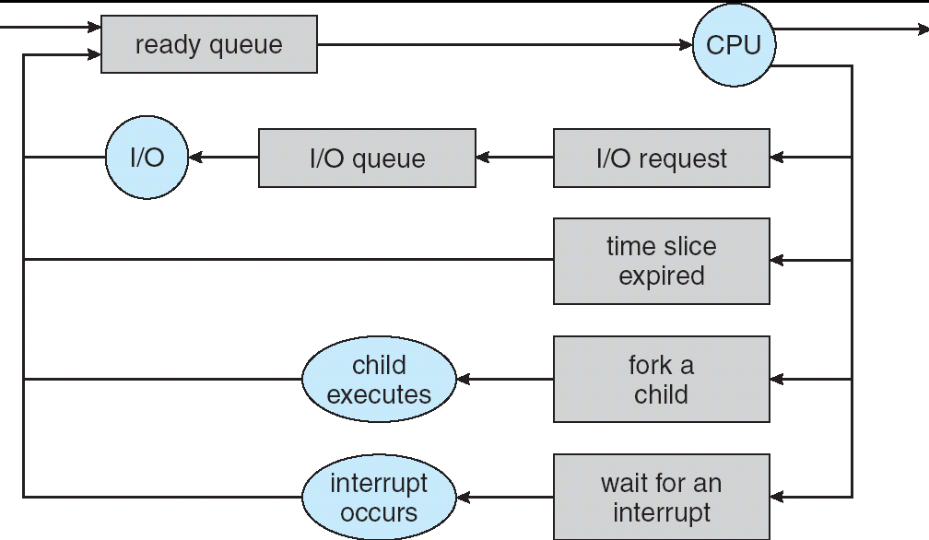
Recall: Scheduling
Question: How is the OS to decide which of several tasks to take off a queue?
Scheduling: deciding which threads are given access to resources from moment to moment
Often, we think in terms of CPU time, but could also think about access to resources like network BW or disk access
Next time: we dive into scheduling!

Slide 101
Recall: Address Space
“physical address”
0x000…
“virtual address”
Processor
translator
Memory
Program operates in an address space that is distinct from the physical memory space of the machine
Registers
Page Table
<Frame Addr>
0xFFF…

Slide 102
Understanding “Address Space”
Page table is the primary mechanism
Privilege Level determines which regions can be accessed
Which entries can be used
System (PL=0) can access all, User (PL=3) only part
Each process has its own address space
The “System” part of all of them is the same
All system threads share the same system address space and same memory

Slide 103
Page Table Mapping (Rough Idea)
(user process view of memory)
Code
Data
Heap
Stack
Data 2
Code
Data
Heap
Stack
0x000…
Stack 1
Heap 1
Code
Code 1
Static Data
Stack 2
Heap
Prog 1
Virtual
Address
Space 1
Data 1
Prog 2
Virtual
Address
Space 2
Heap 2
Code 2
OS code
Stack
OS data
Translation Map 1
OS heap/
Stacks
Translation Map 2
0xFFF…
Physical Address Space

Slide 104
User Process View of Memory
Physical Memory
Process Virtual Address Space
0xffffffff
Page Table
Page
kernel
Processor
registers
0xc0000000
argv
sp
stack
ip
heap
user data
user code
0x08048000
0x00000000

Slide 105
Processor Mode (Privilege Level)
Physical Memory
Process Virtual Address Space
0xffffffff
Page Table
Page
kernel
Processor
registers
0xc0000000
argv
sp
stack
u/s
ip
heap
user data
CPL:
3 - user
user code
0x08048000
0x00000000

Slide 106
Aside: x86 (32-bit) Page Table Entry
Page Table
u/s
Controls many aspects of access
Later – discuss page table organization
For 32 (64?) bit VAS, how large? vs size of memory?
Used sparsely
Pintos: page_dir.c

Slide 107
User → Kernel
Physical Memory
Process Virtual Address Space
Page Table
Page
0xffffffff
kernel
Processor
registers
0xc0000000
argv
sp
stack
u/s
ip
heap
user data
CPL:
3 - user
user code
0x08048000
0x00000000

Slide 108
User → Kernel
Physical Memory
Process Virtual Address Space
Page Table
Page
0xffffffff
kernel
ker data
Processor
registers
ker code
0xc0000000
argv
sp
sp
stack
u/s
ip
ip
heap
user data
CPL:
0 - sys
user code
0x08048000
0x00000000

Slide 109
Page Table Resides in Memory*
* In the simplest case. Actually more complex. More later.
Physical Memory
Process Virtual Address Space
Page Table
Page
0xffffffff
kernel
ker data
Processor
registers
ker code
0xc0000000
argv
sp
sp
stack
u/s
ip
ip
heap
user data
CPL:
0 - sys
user code
0x08048000
0x00000000
PTBR:

Slide 110
Kernel Portion of Address Space
Kernel memory is mapped into address space of every process
Contains the kernel code
Loaded when the machine booted
Explicitly mapped to physical memory
OS creates the page table
Used to contain all kernel data structures
Lists of processes/threads
Page tables
Open file descriptions, sockets, ttys, …
Kernel stack for each thread

Slide 111
1 Kernel Code, Many Kernel Stacks
Physical Memory
Process Virtual Address Space
Page Table
Page
0xffffffff
kernel
ker data
Processor
registers
ker code
0xc0000000
argv
sp
sp
stack
u/s
ip
ip
heap
user data
CPL:
0 - sys
user code
0x08048000
0x00000000
PTBR:

Slide 113

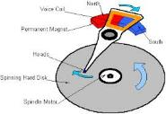




Recall: I/O and Storage Layers
Application / Service
High Level I/O
Streams
Low Level I/O
File Descriptors
What we’ve covered so far…
Syscall
open(), read(), write(), close(), …
Open File Descriptions
File System
Files/Directories/Indexes
I/O Driver
Commands and Data Transfers
What we’ll peek at next
Disks, Flash, Controllers, DMA

Slide 114
Layers of I/O…
User App:
length = read(input_fd, buffer, BUFFER_SIZE);
User library:
ssize_t read(int, void *, size_t) {
marshal args into registers
issue syscall
register result of syscall to rtn value
};
Application / Service
High Level I/O
Low Level I/O
Exception U→K, interrupt processing
Syscall
void syscall_handler (struct intr_frame *f) {
unmarshall call#, args from regs
dispatch : handlers[call#](args)
marshal results fo syscall ret
}
File System
I/O Driver
ssize_t vfs_read(struct file *file, char __user *buf, size_t count, loff_t *pos) {
User Process/File System relationship
call device driver to do the work
}
Device Driver

Slide 115

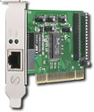
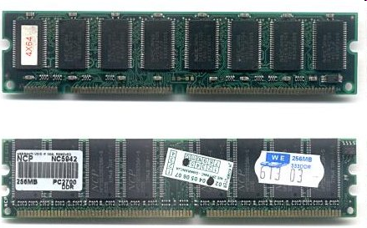
Many different types of I/O
The System Call Interface
Process
Management
Memory Management
Filesystems
Device Control
Networking
Concurrency, multitasking
Virtual memory
Files and dirs: the VFS
TTYs and device access
Connectivity
Architecture
Dependent
Code
Memory Manager
File System Types
Device Control
Network Subsystem
Block Devices
IF drivers

Slide 116
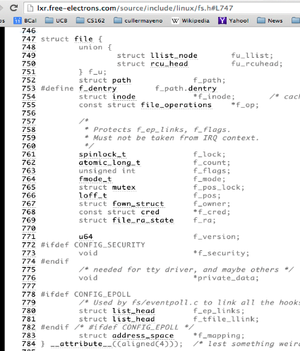
Recall: Internal OS File Description
Internal Data Structure describing everything about the file
Where it resides
Its status
How to access it
Pointer: struct file *file
Everything accessed with file descriptor has one of these
Struct file_operations *f_op: Describes how this particular device implements its operations
For disks: points to file operations
For pipes: points to pipe operations
For sockets: points to socket operations

Slide 117
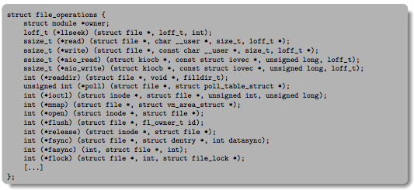
File_operations: Why everything can look like a file
Associated with particular hardware device or environment (i.e. file system)
Registers / Unregisters itself with the kernel
Handler functions for each of the file operations

Slide 118
File System: From Syscall to Driver
ssize_t vfs_read(struct file *file, char __user *buf, size_t count, loff_t *pos)
{
ssize_t ret;
if (!(file->f_mode & FMODE_READ)) return -EBADF;
if (!file->f_op || (!file->f_op->read && !file->f_op->aio_read))
return -EINVAL;
if (unlikely(!access_ok(VERIFY_WRITE, buf, count))) return -EFAULT;
ret = rw_verify_area(READ, file, pos, count);
if (ret >= 0) {
count = ret;
if (file->f_op->read)
ret = file->f_op->read(file, buf, count, pos);
else
ret = do_sync_read(file, buf, count, pos);
if (ret > 0) {
fsnotify_access(file->f_path.dentry);
add_rchar(current, ret);
}
inc_syscr(current);
}
return ret;
}
Read up to “count” bytes from “file” starting from “pos” into “buf”.
Return error or number of bytes read.
Linux: fs/read_write.c

Slide 119
File System: From Syscall to Driver
ssize_t vfs_read(struct file *file, char __user *buf, size_t count, loff_t *pos)
{
ssize_t ret;
if (!(file->f_mode & FMODE_READ)) return -EBADF;
if (!file->f_op || (!file->f_op->read && !file->f_op->aio_read))
return -EINVAL;
if (unlikely(!access_ok(VERIFY_WRITE, buf, count))) return -EFAULT;
ret = rw_verify_area(READ, file, pos, count);
if (ret >= 0) {
count = ret;
if (file->f_op->read)
ret = file->f_op->read(file, buf, count, pos);
else
ret = do_sync_read(file, buf, count, pos);
if (ret > 0) {
fsnotify_access(file->f_path.dentry);
add_rchar(current, ret);
}
inc_syscr(current);
}
return ret;
}
Make sure we are allowed to read this file
Linux: fs/read_write.c

Slide 120
File System: From Syscall to Driver
ssize_t vfs_read(struct file *file, char __user *buf, size_t count, loff_t *pos)
{
ssize_t ret;
if (!(file->f_mode & FMODE_READ)) return -EBADF;
if (!file->f_op || (!file->f_op->read && !file->f_op->aio_read))
return -EINVAL;
if (unlikely(!access_ok(VERIFY_WRITE, buf, count))) return -EFAULT;
ret = rw_verify_area(READ, file, pos, count);
if (ret >= 0) {
count = ret;
if (file->f_op->read)
ret = file->f_op->read(file, buf, count, pos);
else
ret = do_sync_read(file, buf, count, pos);
if (ret > 0) {
fsnotify_access(file->f_path.dentry);
add_rchar(current, ret);
}
inc_syscr(current);
}
return ret;
}
Check if file has read methods
Linux: fs/read_write.c

Slide 121
File System: From Syscall to Driver
ssize_t vfs_read(struct file *file, char __user *buf, size_t count, loff_t *pos)
{
ssize_t ret;
if (!(file->f_mode & FMODE_READ)) return -EBADF;
if (!file->f_op || (!file->f_op->read && !file->f_op->aio_read))
return -EINVAL;
if (unlikely(!access_ok(VERIFY_WRITE, buf, count))) return -EFAULT;
ret = rw_verify_area(READ, file, pos, count);
if (ret >= 0) {
count = ret;
if (file->f_op->read)
ret = file->f_op->read(file, buf, count, pos);
else
ret = do_sync_read(file, buf, count, pos);
if (ret > 0) {
fsnotify_access(file->f_path.dentry);
add_rchar(current, ret);
}
inc_syscr(current);
}
return ret;
}
Check whether we can write to buf (e.g., buf is in the user space range)
unlikely(): hint to branch prediction this condition is unlikely
Linux: fs/read_write.c

Slide 122
File System: From Syscall to Driver
ssize_t vfs_read(struct file *file, char __user *buf, size_t count, loff_t *pos)
{
ssize_t ret;
if (!(file->f_mode & FMODE_READ)) return -EBADF;
if (!file->f_op || (!file->f_op->read && !file->f_op->aio_read))
return -EINVAL;
if (unlikely(!access_ok(VERIFY_WRITE, buf, count))) return -EFAULT;
ret = rw_verify_area(READ, file, pos, count);
if (ret >= 0) {
count = ret;
if (file->f_op->read)
ret = file->f_op->read(file, buf, count, pos);
else
ret = do_sync_read(file, buf, count, pos);
if (ret > 0) {
fsnotify_access(file->f_path.dentry);
add_rchar(current, ret);
}
inc_syscr(current);
}
return ret;
}
Check whether we read from a valid range in the file.
Linux: fs/read_write.c

Slide 123
File System: From Syscall to Driver
ssize_t vfs_read(struct file *file, char __user *buf, size_t count, loff_t *pos)
{
ssize_t ret;
if (!(file->f_mode & FMODE_READ)) return -EBADF;
if (!file->f_op || (!file->f_op->read && !file->f_op->aio_read))
return -EINVAL;
if (unlikely(!access_ok(VERIFY_WRITE, buf, count))) return -EFAULT;
ret = rw_verify_area(READ, file, pos, count);
if (ret >= 0) {
count = ret;
if (file->f_op->read)
ret = file->f_op->read(file, buf, count, pos);
else
ret = do_sync_read(file, buf, count, pos);
if (ret > 0) {
fsnotify_access(file->f_path.dentry);
add_rchar(current, ret);
}
inc_syscr(current);
}
return ret;
}
If driver provide a read function (f_op->read) use it; otherwise use do_sync_read()
Linux: fs/read_write.c

Slide 124
File System: From Syscall to Driver
ssize_t vfs_read(struct file *file, char __user *buf, size_t count, loff_t *pos)
{
ssize_t ret;
if (!(file->f_mode & FMODE_READ)) return -EBADF;
if (!file->f_op || (!file->f_op->read && !file->f_op->aio_read))
return -EINVAL;
if (unlikely(!access_ok(VERIFY_WRITE, buf, count))) return -EFAULT;
ret = rw_verify_area(READ, file, pos, count);
if (ret >= 0) {
count = ret;
if (file->f_op->read)
ret = file->f_op->read(file, buf, count, pos);
else
ret = do_sync_read(file, buf, count, pos);
if (ret > 0) {
fsnotify_access(file->f_path.dentry);
add_rchar(current, ret);
}
inc_syscr(current);
}
return ret;
}
Notify the parent of this file that the file was read (see http://www.fieldses.org/~bfields/kernel/vfs.txt)
Linux: fs/read_write.c

Slide 125
File System: From Syscall to Driver
ssize_t vfs_read(struct file *file, char __user *buf, size_t count, loff_t *pos)
{
ssize_t ret;
if (!(file->f_mode & FMODE_READ)) return -EBADF;
if (!file->f_op || (!file->f_op->read && !file->f_op->aio_read))
return -EINVAL;
if (unlikely(!access_ok(VERIFY_WRITE, buf, count))) return -EFAULT;
ret = rw_verify_area(READ, file, pos, count);
if (ret >= 0) {
count = ret;
if (file->f_op->read)
ret = file->f_op->read(file, buf, count, pos);
else
ret = do_sync_read(file, buf, count, pos);
if (ret > 0) {
fsnotify_access(file->f_path.dentry);
add_rchar(current, ret);
}
inc_syscr(current);
}
return ret;
}
Update the number of bytes read by “current” task (for scheduling purposes)
Linux: fs/read_write.c

Slide 126
File System: From Syscall to Driver
ssize_t vfs_read(struct file *file, char __user *buf, size_t count, loff_t *pos)
{
ssize_t ret;
if (!(file->f_mode & FMODE_READ)) return -EBADF;
if (!file->f_op || (!file->f_op->read && !file->f_op->aio_read))
return -EINVAL;
if (unlikely(!access_ok(VERIFY_WRITE, buf, count))) return -EFAULT;
ret = rw_verify_area(READ, file, pos, count);
if (ret >= 0) {
count = ret;
if (file->f_op->read)
ret = file->f_op->read(file, buf, count, pos);
else
ret = do_sync_read(file, buf, count, pos);
if (ret > 0) {
fsnotify_access(file->f_path.dentry);
add_rchar(current, ret);
}
inc_syscr(current);
}
return ret;
}
Update the number of read syscalls by “current” task (for scheduling purposes)
Linux: fs/read_write.c

Slide 127
Device Drivers
Device Driver: Device-specific code in the kernel that interacts directly with the device hardware
Supports a standard, internal interface
Same kernel I/O system can interact easily with different device drivers
Special device-specific configuration supported with the ioctl() system call
Device Drivers typically divided into two pieces:
Top half: accessed in call path from system calls
implements a set of standard, cross-device calls like open(), close(), read(), write(), ioctl(), strategy()
This is the kernel’s interface to the device driver
Top half will start I/O to device, may put thread to sleep until finished
Bottom half: run as interrupt routine
Gets input or transfers next block of output
May wake sleeping threads if I/O now complete

Slide 128
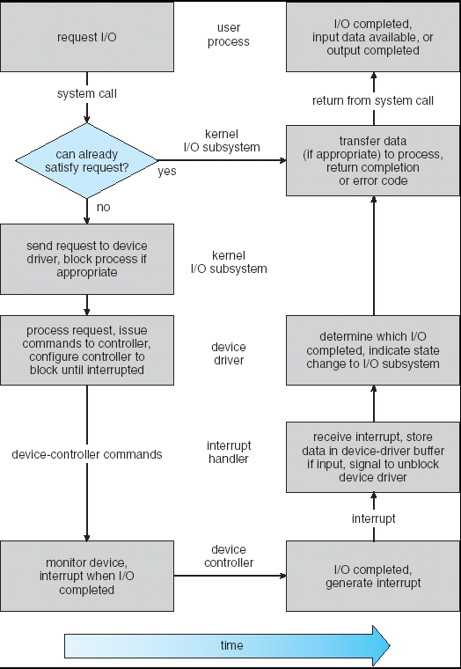
Life Cycle of An I/O Request
User
Program
Kernel I/O
Subsystem
Device Driver
Top Half
Device Driver
Bottom Half
Device
Hardware

Slide 129
Conclusion
Monitors: A lock plus one or more condition variables
Always acquire lock before accessing shared data
Use condition variables to wait inside critical section
Three Operations: Wait(), Signal(), and Broadcast()
Monitors represent the logic of the program
Wait if necessary
Signal when change something so any waiting threads can proceed
Monitors supported natively in a number of languages
Readers/Writers Monitor example
Shows how monitors allow sophisticated controlled entry to protected code
Kernel Thread: Stack+State for independent execution in kernel
Every user-level thread paired one-to-one with kernel thread
Kernel thread associated with user thread is “suspended” (ready to go) when user-level thread is running
Device Driver: Device-specific code in kernel that interacts directly with device hardware
Supports a standard, internal interface
Same kernel I/O system can interact easily with different device drivers

