Slide 1
CS162 Operating Systems and Systems Programming Lecture 12 Scheduling 3: Starvation (Finished), Deadlock
March 1st, 2022
Prof. Anthony Joseph and John Kubiatowicz
http://cs162.eecs.Berkeley.edu

Slide 2
Recall: Real-Time Scheduling
Goal: Predictability of Performance!
We need to predict with confidence worst case response times for systems!
In RTS, performance guarantees are:
Task- and/or class centric and often ensured a priori
In conventional systems, performance is:
System/throughput oriented with post-processing (… wait and see …)
Real-time is about enforcing predictability, and does not equal fast computing!!!
Hard real-time: for time-critical safety-oriented systems
Meet all deadlines (if at all possible)
Ideally: determine in advance if this is possible
Earliest Deadline First (EDF), Least Laxity First (LLF), Rate-Monitonic Scheduling (RMS), Deadline Monotonic Scheduling (DM)
Soft real-time: for multimedia
Attempt to meet deadlines with high probability
Constant Bandwidth Server (CBS)

Slide 3
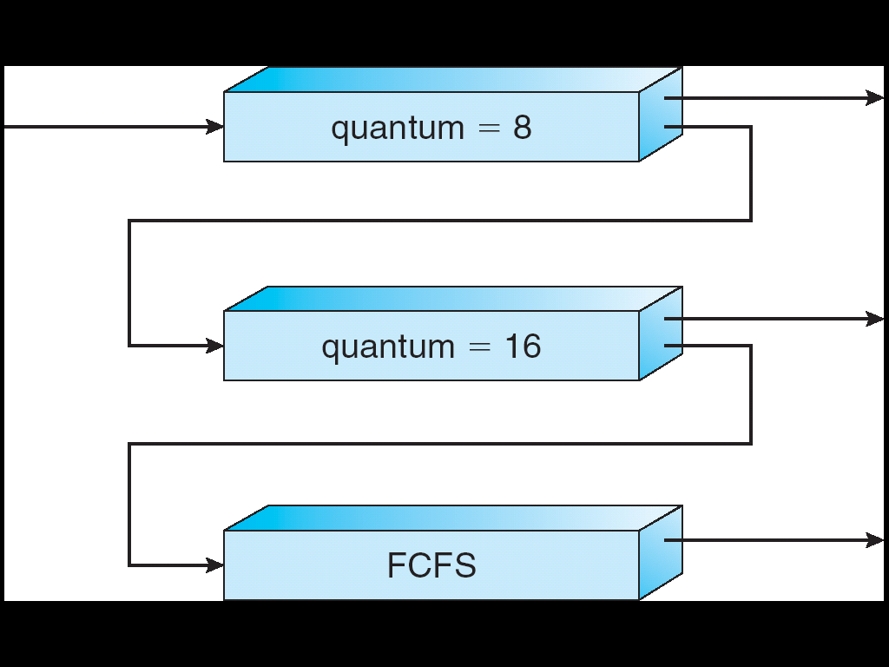
Are SRTF and MLFQ Prone to Starvation?
Long-Running Compute Tasks Demoted to Low Priority
In SRTF, long jobs are starved in favor of short ones
Same fundamental problem as priority scheduling
MLFQ is an approximation of SRTF, so it suffers from the same problem

Slide 4
Cause for Starvation: Priorities?
The policies we’ve studied so far:
Always prefer to give the CPU to a prioritized job
Non-prioritized jobs may never get to run
But priorities were a means, not an end
Our end goal was to serve a mix of CPU-bound, I/O bound, and Interactive jobs effectively on common hardware
Give the I/O bound ones enough CPU to issue their next file operation and wait (on those slow discs)
Give the interactive ones enough CPU to respond to an input and wait (on those slow humans)
Let the CPU bound ones grind away without too much disturbance

Slide 5
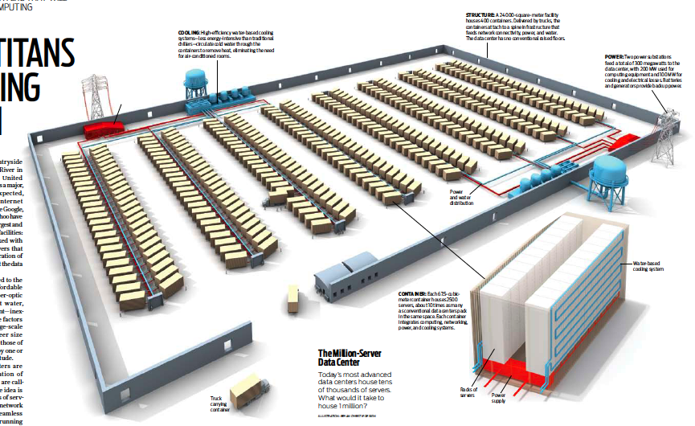
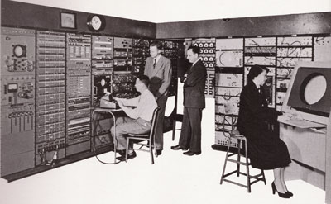
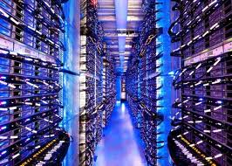
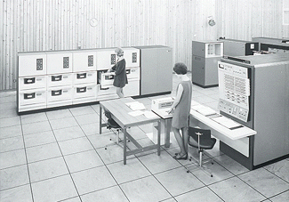
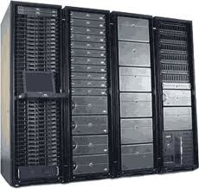
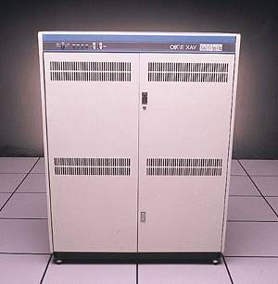
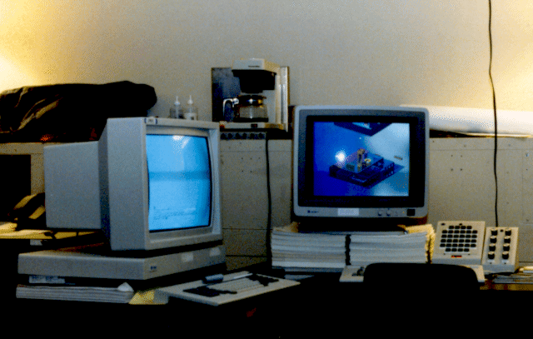

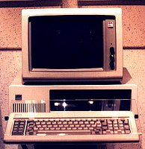





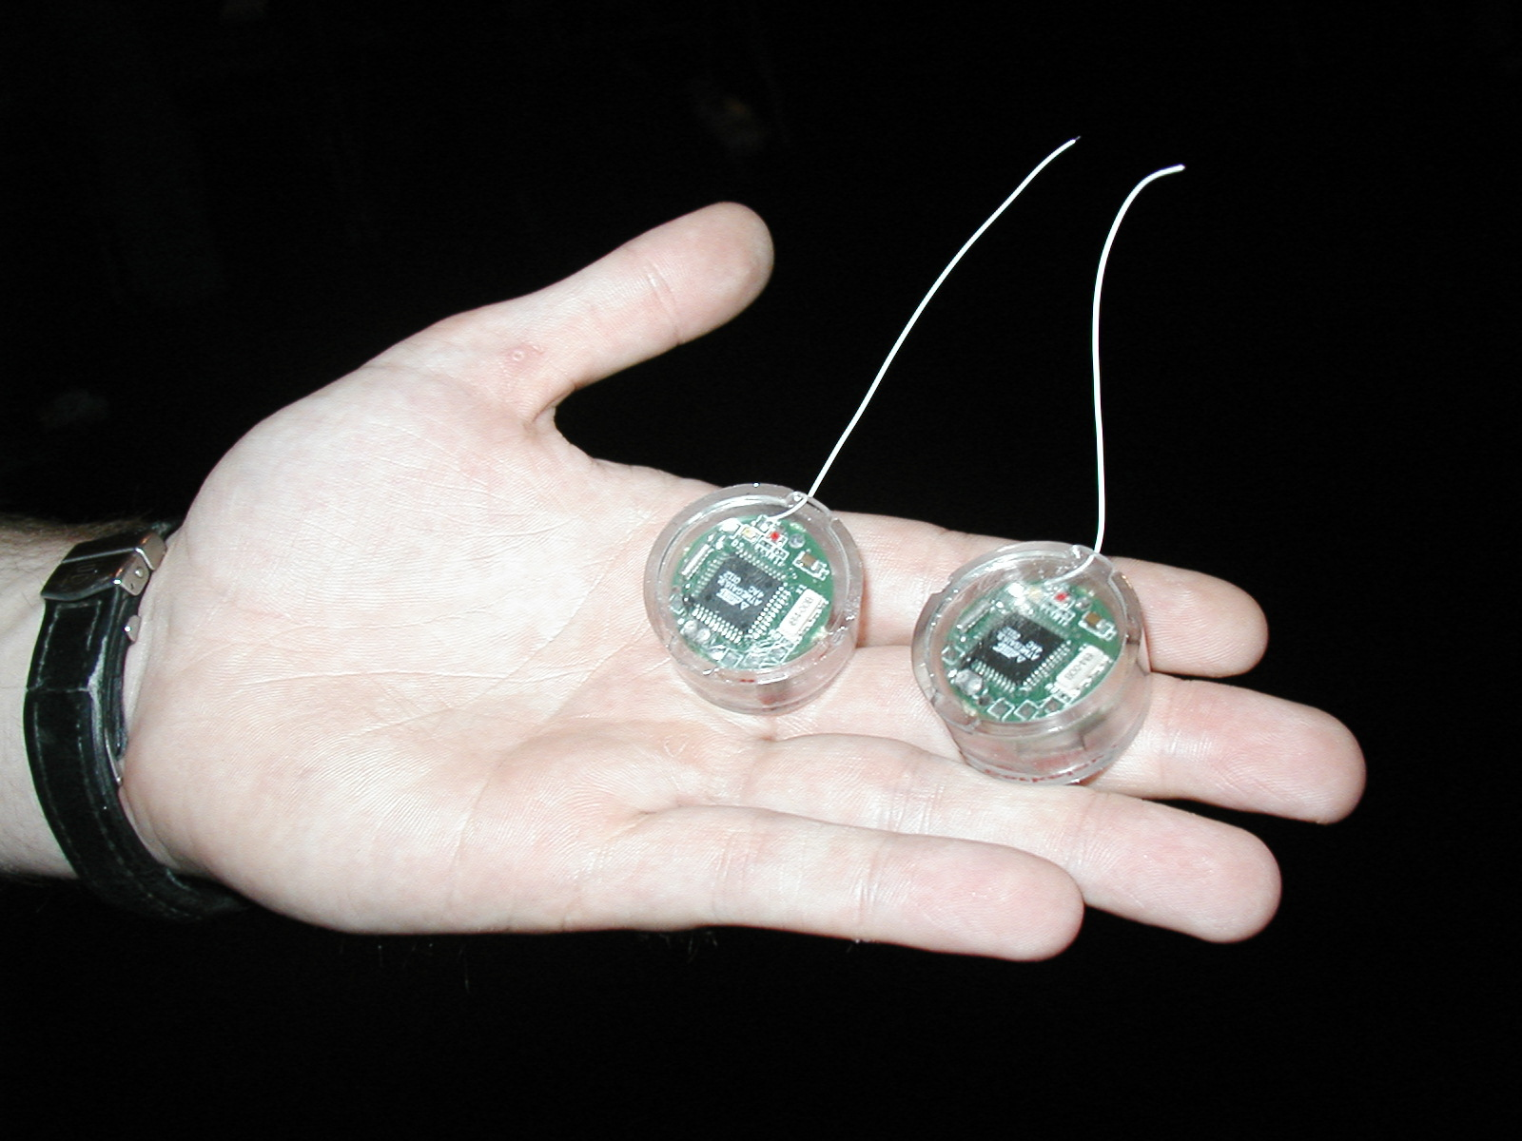
Recall: Changing Landscape…
Computers
Per Person
Number crunching, Data Storage, Massive Inet Services,
ML, …
1:10⁶
Mainframe
Bell’s Law: New computer class every 10 years
Mini
1:10³
Workstation
Productivity,
Interactive
PC
Laptop
1:1
PDA
Cell
Streaming from/to the physical world
10³:1
years
Mote!
The Internet of Things!

Slide 6
Changing Landscape of Scheduling
Priority-based scheduling rooted in “time-sharing”
Allocating precious, limited resources across a diverse workload
CPU bound, vs interactive, vs I/O bound
80’s brought about personal computers, workstations, and servers on networks
Different machines of different types for different purposes
Shift to fairness and avoiding extremes (starvation)
90’s emergence of the web, rise of internet-based services, the data-center-is-the-computer
Server consolidation, massive clustered services, huge flashcrowds
It’s about predictability, 95th percentile performance guarantees

Slide 7
Does prioritizing some jobs necessarily starve those that aren’t prioritized?

Slide 8
Key Idea: Proportional-Share Scheduling
The policies we’ve studied so far:
Always prefer to give the CPU to a prioritized job
Non-prioritized jobs may never get to run
Instead, we can share the CPU proportionally
Give each job a share of the CPU according to its priority
Low-priority jobs get to run less often
But all jobs can at least make progress (no starvation)

Slide 9
Recall: Lottery Scheduling
Q _{i}
Q _{i+1}
time
Given a set of jobs (the mix), provide each with a share of a resource
e.g., 50% of the CPU for Job A, 30% for Job B, and 20% for Job C
Idea: Give out tickets according to the proportion each should receive,
Every quantum (tick): draw one at random, schedule that job (thread) to run

Slide 10
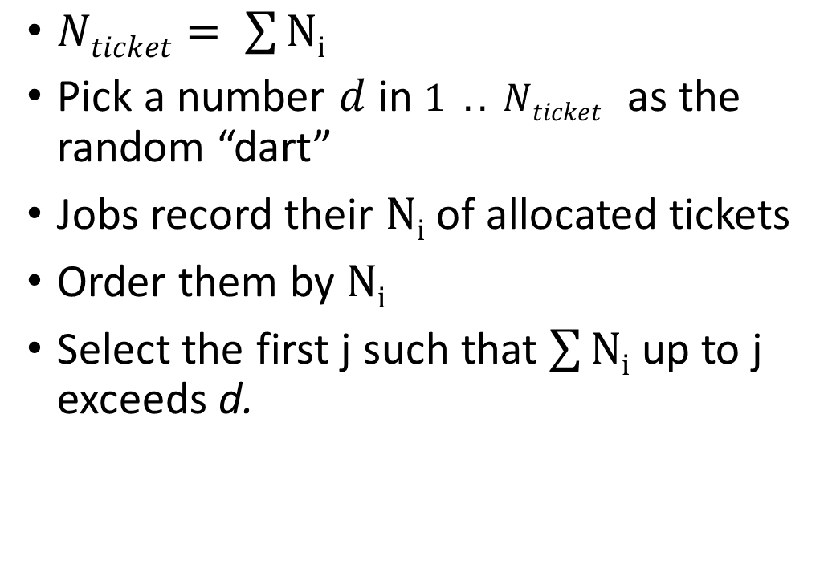
Lottery Scheduling: Simple Mechanism
10
$Nticket= \sum{Ni}$
Pick a number $d$ in $1 .. Nticket$ as the random “dart”
Jobs record their $Ni$ of allocated tickets
Order them by $Ni$
Select the first j such that $\sum{Ni}$ up to j exceeds d.
1

Slide 11
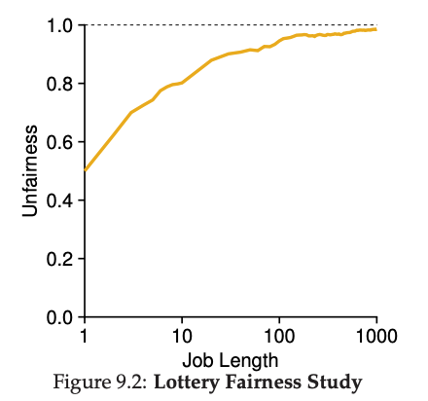
Unfairness
E.g., Given two jobs A and B of same run time (# Qs) that are each supposed to receive 50%,
U = finish time of first / finish time of last
As a function of run time

Slide 12
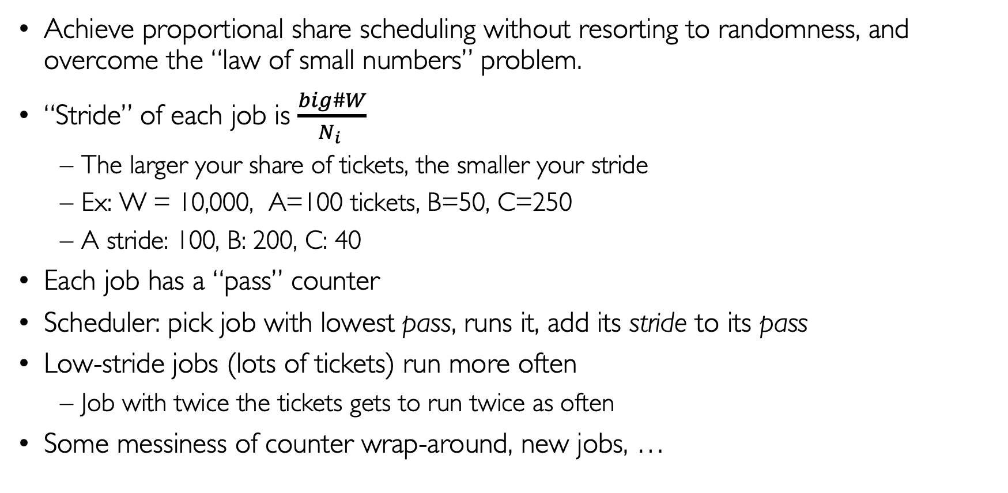
Stride Scheduling
Achieve proportional share scheduling without resorting to randomness, and overcome the “law of small numbers” problem.
“Stride” of each job is $\frac{big\#W}{N_{i} }$
The larger your share of tickets, the smaller your stride
Ex: W = 10,000, A=100 tickets, B=50, C=250
A stride: 100, B: 200, C: 40
Each job has a “pass” counter
Scheduler: pick job with lowest pass, runs it, add its stride to its pass
Low-stride jobs (lots of tickets) run more often
Job with twice the tickets gets to run twice as often
Some messiness of counter wrap-around, new jobs, …

Slide 13

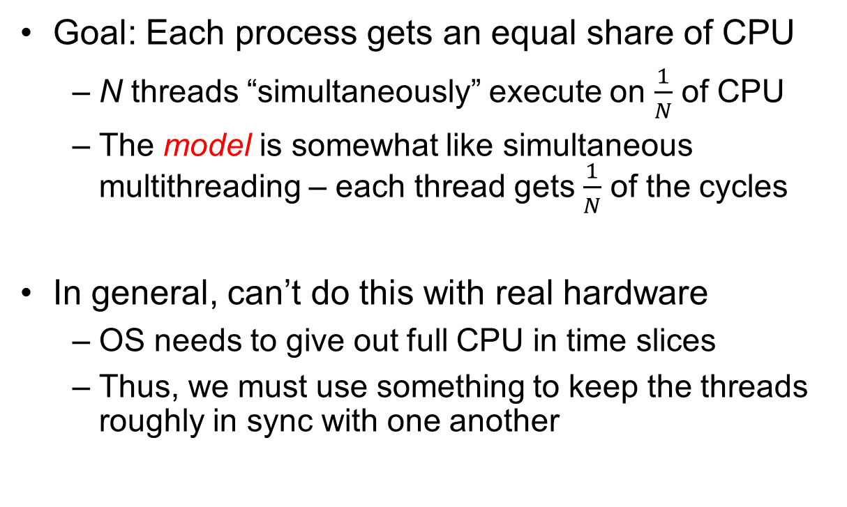
Linux Completely Fair Scheduler (CFS)
Goal: Each process gets an equal share of CPU
N threads “simultaneously” execute on $\frac{1}{N}$ of CPU
The model is somewhat like simultaneous multithreading – each thread gets $\frac{1}{N}$ of the cycles
In general, can’t do this with real hardware
OS needs to give out full CPU in time slices
Thus, we must use something to keep the threads roughly in sync with one another
Model: “Perfectly” subdivided CPU:
$$\frac{1}{N}$$
T₁
T₂
T₃
CPU Time

Slide 14
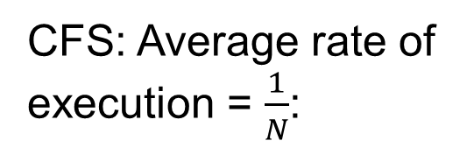

Linux Completely Fair Scheduler (CFS)
Basic Idea: track CPU time per thread and schedule threads to match up average rate of execution
Scheduling Decision:
“Repair” illusion of complete fairness
Choose thread with minimum CPU time
Closely related to Fair Queueing
Use a heap-like scheduling queue for this…
O(log N) to add/remove threads, where N is number of threads
Sleeping threads don’t advance their CPU time, so they get a boost when they wake up again…
Get interactivity automatically!
CFS: Average rate of execution = $\frac{1}{N}$:
T₁
$$\frac{1}{N}$$
T₃
CPU Time
T₂

Slide 15
Linux CFS: Responsiveness/Starvation Freedom
In addition to fairness, we want low response time and starvation freedom
Make sure that everyone gets to run at least a bit!
Constraint 1: Target Latency
Period of time over which every process gets service
Quanta = Target_Latency / n
Target Latency: 20 ms, 4 Processes
Each process gets 5ms time slice
Target Latency: 20 ms, 200 Processes
Each process gets 0.1ms time slice (!!!)
Recall Round-Robin: large context switching overhead if slice gets to small

Slide 16
Linux CFS: Throughput
Goal: Throughput
Avoid excessive overhead
Constraint 2: Minimum Granularity
Minimum length of any time slice
Target Latency 20 ms, Minimum Granularity 1 ms, 200 processes
Each process gets 1 ms time slice

Slide 17
Aside: Priority in Unix – Being Nice
The industrial operating systems of the 60s and 70’s provided priority to enforced desired usage policies.
When it was being developed at Berkeley, instead it provided ways to “be nice”.
nice values range from -20 to 19
Negative values are “not nice”
If you wanted to let your friends get more time, you would nice up your job
Scheduler puts higher nice-value tasks (lower priority) to sleep more …
In O(1) scheduler, this translated fairly directly to priority (and time slice)
How does this idea translate to CFS?
Change the rate of CPU cycles given to threads to change relative priority

Slide 18
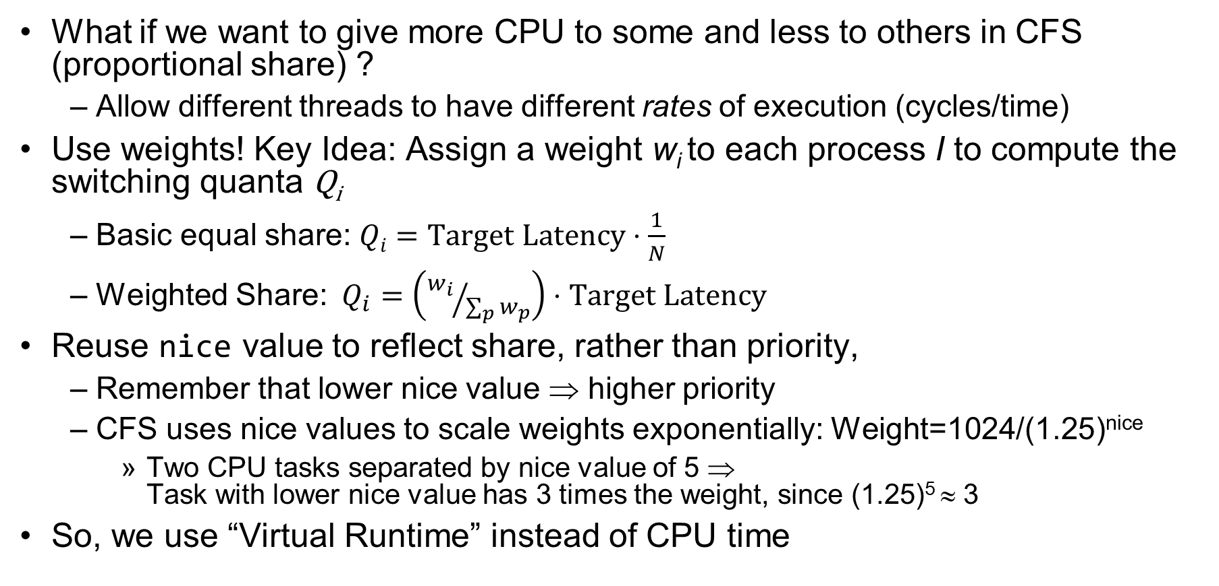
Linux CFS: Proportional Shares
What if we want to give more CPU to some and less to others in CFS (proportional share) ?
Allow different threads to have different rates of execution (cycles/time)
Use weights! Key Idea: Assign a weight w_{i} to each process I to compute the switching quanta Q_{i}
Basic equal share: $Qi=Target Latency⋅\frac{1}{N}$
Weighted Share:$Q_{i}=\left({w_{i}}/{\sum_{p}{w_{p}}}\right)⋅Target Latency$
Reuse nice value to reflect share, rather than priority,
Remember that lower nice value ⇒ higher priority
CFS uses nice values to scale weights exponentially: Weight=1024/(1.25)^{nice}
Two CPU tasks separated by nice value of 5 ⇒ Task with lower nice value has 3 times the weight, since (1.25)⁵ ≈ 3
So, we use “Virtual Runtime” instead of CPU time

Slide 19
Example: Linux CFS: Proportional Shares
Target Latency = 20ms
Minimum Granularity = 1ms
Example: Two CPU-Bound Threads
Thread A has weight 1
Thread B has weight 4
Time slice for A? 4 ms
Time slice for B? 16 ms

Slide 20
Linux CFS: Proportional Shares
16 (w_{B}=4)
B
Physical
CPU Time
Virtual
CPU Time
B
A
4 (w_{A}=1)
A
Track a thread's virtual runtime rather than its true physical runtime
Higher weight: Virtual runtime increases more slowly
Lower weight: Virtual runtime increases more quickly
Scheduler’s Decisions are based on Virtual CPU Time
Use of Red-Black tree to hold all runnable processes as sorted on vruntime variable
O(1) time to find next thread to run (top of heap!)
O(log N) time to perform insertions/deletions
Cache the item at far left (item with earliest vruntime)
When ready to schedule, grab version with smallest vruntime (which will be item at the far left).

Slide 21
Choosing the Right Scheduler
I Care About: | Then Choose:
CPU Throughput | FCFS
Avg. Response Time | SRTF Approximation
I/O Throughput | SRTF Approximation
Fairness (CPU Time) | Linux CFS
Fairness – Wait Time to Get CPU | Round Robin
Meeting Deadlines | EDF
Favoring Important Tasks | Priority

Slide 22
A Final Word On Scheduling
When do the details of the scheduling policy and fairness really matter?
When there aren’t enough resources to go around
When should you simply buy a faster computer?
(Or network link, or expanded highway, or …)
One approach: Buy it when it will pay for itself in improved response time
Perhaps you’re paying for worse response time in reduced productivity, customer angst, etc…
Might think that you should buy a faster X when X is utilized 100%, but usually, response time goes to infinity as utilization⇒100%
An interesting implication of this curve:
Most scheduling algorithms work fine in the “linear” portion of the load curve, fail otherwise
Argues for buying a faster X when hit “knee” of curve
Response
time
100%
Utilization

Slide 23
Administrivia
Prof Joseph’s office hours: Tuesdays 1-2pm and Thursdays 12-1 (room TBD)
Project 1 (code, report, evals) all due TODAY (Tuesday 3/1)
Homework 2 is due this Thursday 3/3
Midterm 2 conflict requests are due this Friday 3/4

Slide 24
Deadlock: A Deadly type of Starvation
Starvation: thread waits indefinitely
Example, low-priority thread waiting for resources constantly in use by high-priority threads
Deadlock: circular waiting for resources
Thread A owns Res 1 and is waiting for Res 2 Thread B owns Res 2 and is waiting for Res 1
Deadlock ⇒ Starvation but not vice versa
Starvation can end (but doesn’t have to)
Deadlock can’t end without external intervention
Thread
A
Wait
For
Owned
By
Res 1
Res 2
Owned
By
Wait
For
Thread
B
Notes:
Now let's look at some key problems we face when synchronizing or scheduling concurrent tasks.

Slide 25
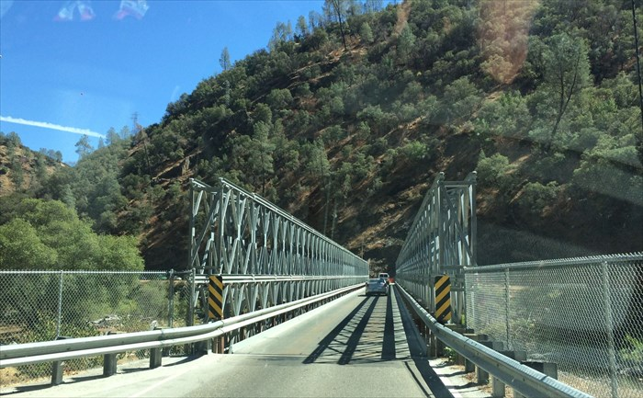
Example: Single-Lane Bridge Crossing
CA 140 to Yosemite National Park

Slide 26
Bridge Crossing Example
Each segment of road can be viewed as a resource
Car must own the segment under them
Must acquire segment that they are moving into
For bridge: must acquire both halves
Traffic only in one direction at a time
Deadlock: Shown above when two cars in opposite directions meet in middle
Each acquires one segment and needs next
Deadlock resolved if one car backs up (preempt resources and rollback)
Several cars may have to be backed up
Starvation (not Deadlock):
East-going traffic really fast ⇒ no one gets to go west
Owned
By
Wait
For
West Half
East Half
Honk!
Owned
By
Wait
For

Slide 27
Deadlock with Locks
Thread A:
x.Acquire();
y.Acquire();
…
y.Release();
x.Release();
Thread B:
y.Acquire();
x.Acquire();
…
x.Release();
y.Release();
Thread
A
Owned
By
Wait
For
Lock x
Lock y
Wait
For
Thread
B
Owned
By
This lock pattern exhibits non-deterministic deadlock
Sometimes it happens, sometimes it doesn’t!
This is really hard to debug!

Slide 28
Deadlock with Locks: “Unlucky” Case
Thread A:
x.Acquire();
y.Acquire(); <stalled>
<unreachable>
…
y.Release();
x.Release();
Thread B:
y.Acquire();
x.Acquire(); <stalled>
<unreachable>
…
x.Release();
y.Release();
Thread
A
Owned
By
Wait
For
Lock x
Lock y
Wait
For
Thread
B
Owned
By
Neither thread will get to run ⇒ Deadlock

Slide 29
Deadlock with Locks: “Lucky” Case
Thread A:
x.Acquire();
y.Acquire();
…
y.Release();
x.Release();
Thread B:
y.Acquire();
x.Acquire();
…
x.Release();
y.Release();
Sometimes, schedule won’t trigger deadlock!

Slide 30
Train Example (Wormhole-Routed Network)
Circular dependency (Deadlock!)
Each train wants to turn right, but is blocked by other trains
Similar problem to multiprocessor networks
Wormhole-Routed Network: Messages trail through network like a “worm”
Fix? Imagine grid extends in all four directions
Force ordering of channels (tracks)
Protocol: Always go east-west first, then north-south
Called “dimension ordering” (X then Y)
Disallowed
By Rule

Slide 31
Other Types of Deadlock
Threads often block waiting for resources
Locks
Terminals
Printers
CD drives
Memory
Threads often block waiting for other threads
Pipes
Sockets
You can deadlock on any of these!

Slide 32
Deadlock with Space
Thread A:
AllocateOrWait(1 MB)
AllocateOrWait(1 MB)
Free(1 MB)
Free(1 MB)
Thread B
AllocateOrWait(1 MB)
AllocateOrWait(1 MB)
Free(1 MB)
Free(1 MB)
If only 2 MB of space, we get same deadlock situation

Slide 33
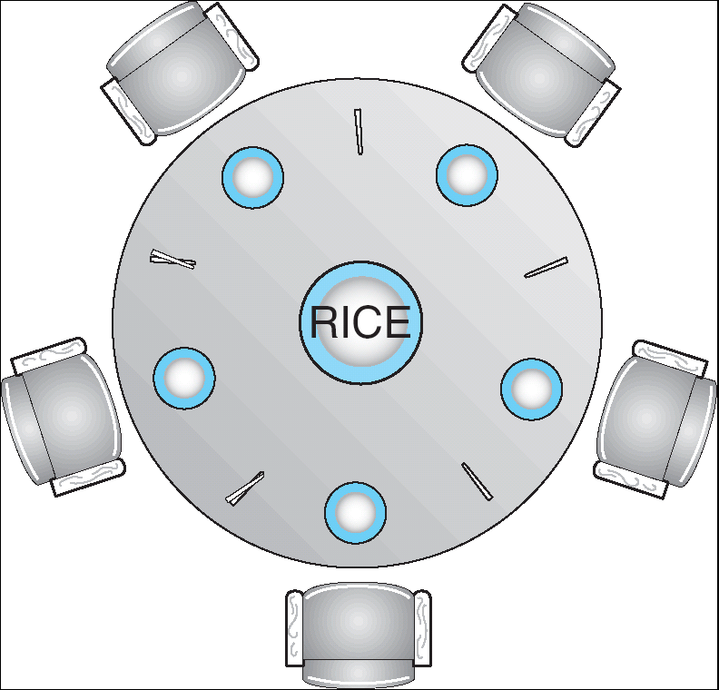
Dining Lawyers Problem
Five chopsticks/Five lawyers (really cheap restaurant)
Free-for all: Lawyer will grab any one they can
Need two chopsticks to eat
What if all grab at same time?
Deadlock!
How to fix deadlock?
Make one of them give up a chopstick (Hah!)
Eventually everyone will get chance to eat
How to prevent deadlock?
Never let lawyer take last chopstick if no hungry lawyer has two chopsticks afterwards
Can we formalize this requirement somehow?

Slide 34
Four requirements for occurrence of Deadlock
Mutual exclusion
Only one thread at a time can use a resource.
Hold and wait
Thread holding at least one resource is waiting to acquire additional resources held by other threads
No preemption
Resources are released only voluntarily by the thread holding the resource, after thread is finished with it
Circular wait
There exists a set {T₁, …, T_{n}} of waiting threads
T₁ is waiting for a resource that is held by T₂
T₂ is waiting for a resource that is held by T₃
…
T_{n} is waiting for a resource that is held by T₁

Slide 35
Detecting Deadlock: Resource-Allocation Graph
System Model
A set of Threads T₁, T₂, . . ., T_{n}
Resource types R₁, R₂, . . ., R_{m}
CPU cycles, memory space, I/O devices
Each resource type R_{i} has W_{i} instances
Each thread utilizes a resource as follows:
Request() / Use() / Release()
Resource-Allocation Graph:
V is partitioned into two types:
T = {T₁, T₂, …, T_{n}}, the set threads in the system.
R = {R₁, R₂, …, R_{m}}, the set of resource types in system
request edge – directed edge T₁ → R_{j}
assignment edge – directed edge R_{j} → T_{i}
Symbols
T₁
T₂
R₁
R₂

Slide 36
Resource-Allocation Graph Examples
Model:
request edge – directed edge T₁ → R_{j}
assignment edge – directed edge R_{j} → T_{i}
R₁
R₂
R₁
R₂
R₁
T₂
T₁
T₂
T₃
T₁
T₂
T₃
T₁
T₃
R₃
T₄
R₄
R₃
R₂
R₄
Simple Resource
Allocation Graph
Allocation Graph With Deadlock
Allocation Graph With Cycle, but
No Deadlock

Slide 37
Deadlock Detection Algorithm
Let [X] represent an m-ary vector of non-negative integers (quantities of resources of each type):
[FreeResources]: Current free resources each type [Request_{X}]: Current requests from thread X [Alloc_{X}]: Current resources held by thread X
See if tasks can eventually terminate on their own
[Avail] = [FreeResources] Add all nodes to UNFINISHED do {
done = true Foreach node in UNFINISHED { if ([Request_{node}] <= [Avail]) { remove node from UNFINISHED [Avail] = [Avail] + [Alloc_{node}] done = false } } } until(done)
Nodes left in UNFINISHED ⇒ deadlocked
R₁
T₂
T₁
T₃
T₄
R₂

Slide 38
How should a system deal with deadlock?
Four different approaches:
Deadlock prevention: write your code in a way that it isn’t prone to deadlock
Deadlock recovery: let deadlock happen, and then figure out how to recover from it
Deadlock avoidance: dynamically delay resource requests so deadlock doesn’t happen
Deadlock denial: ignore the possibility of deadlock
Modern operating systems:
Make sure the system isn’t involved in any deadlock
Ignore deadlock in applications
“Ostrich Algorithm”

Slide 39
Techniques for Preventing Deadlock
Infinite resources
Include enough resources so that no one ever runs out of resources. Doesn’t have to be infinite, just large
Give illusion of infinite resources (e.g. virtual memory)
Examples:
Bay bridge with 12,000 lanes. Never wait!
Infinite disk space (not realistic yet?)
No Sharing of resources (totally independent threads)
Not very realistic
Don’t allow waiting
How the phone company avoids deadlock
Call Mom in Toledo, works way through phone network, but if blocked get busy signal.
Technique used in Ethernet/some multiprocessor nets
Everyone speaks at once. On collision, back off and retry
Inefficient, since have to keep retrying
Consider: driving to San Francisco; when hit traffic jam, suddenly you’re transported back home and told to retry!

Slide 40
(Virtually) Infinite Resources
Thread A
AllocateOrWait(1 MB)
AllocateOrWait(1 MB)
Free(1 MB)
Free(1 MB)
Thread B
AllocateOrWait(1 MB)
AllocateOrWait(1 MB)
Free(1 MB)
Free(1 MB)
With virtual memory we have “infinite” space so everything will just succeed, thus above example won’t deadlock
Of course, it isn’t actually infinite, but certainly larger than 2MB!

Slide 41
Techniques for Preventing Deadlock
Make all threads request everything they’ll need at the beginning.
Problem: Predicting future is hard, tend to over-estimate resources
Example:
If need 2 chopsticks, request both at same time
Don’t leave home until we know no one is using any intersection between here and where you want to go; only one car on the Bay Bridge at a time
Force all threads to request resources in a particular order preventing any cyclic use of resources
Thus, preventing deadlock
Example (x.Acquire(), y.Acquire(), z.Acquire(),…)
Make tasks request disk, then memory, then…
Keep from deadlock on freeways around SF by requiring everyone to go clockwise

Slide 42
Summary
Four conditions for deadlocks
Mutual exclusion
Hold and wait
No preemption
Circular wait
Techniques for addressing Deadlock
Deadlock prevention:
write your code in a way that it isn’t prone to deadlock
Deadlock recovery:
let deadlock happen, and then figure out how to recover from it
Deadlock avoidance:
dynamically delay resource requests so deadlock doesn’t happen
Banker’s Algorithm provides on algorithmic way to do this
Deadlock denial:
ignore the possibility of deadlock

