Slide 1
CS162 Operating Systems and Systems Programming Lecture 13 Memory 1: Address Translation and Virtual Memory
March 3rd, 2022
Prof. Anthony Joseph and John Kubiatowicz
http://cs162.eecs.Berkeley.edu

Slide 2
Recall: Deadlock is A Deadly type of Starvation
Starvation: thread waits indefinitely
Example, low-priority thread waiting for resources constantly in use by high-priority threads
Deadlock: circular waiting for resources
Thread A owns Res 1 and is waiting for Res 2 Thread B owns Res 2 and is waiting for Res 1
Deadlock ⇒ Starvation but not vice versa
Starvation can end (but doesn’t have to)
Deadlock can’t end without external intervention
Thread
A
Wait
For
Owned
By
Res 1
Res 2
Owned
By
Wait
For
Thread
B
Notes:
Now let's look at some key problems we face when synchronizing or scheduling concurrent tasks.

Slide 3
Recall: Four requirements for occurrence of Deadlock
Mutual exclusion
Only one thread at a time can use a resource.
Hold and wait
Thread holding at least one resource is waiting to acquire additional resources held by other threads
No preemption
Resources are released only voluntarily by the thread holding the resource, after thread is finished with it
Circular wait
There exists a set {T₁, …, T_{n}} of waiting threads
T₁ is waiting for a resource that is held by T₂
T₂ is waiting for a resource that is held by T₃
…
T_{n} is waiting for a resource that is held by T₁

Slide 4
Recall: Techniques for Preventing Deadlock
Make all threads request everything they’ll need at the beginning.
Problem: Predicting future is hard, tend to over-estimate resources
Example:
If need 2 chopsticks, request both at same time
Don’t leave home until we know no one is using any intersection between here and where you want to go; only one car on the Bay Bridge at a time
Force all threads to request resources in a particular order preventing any cyclic use of resources
Thus, preventing deadlock
Example (x.Acquire(), y.Acquire(), z.Acquire(),…)
Make tasks request disk, then memory, then…
Keep from deadlock on freeways around SF by requiring everyone to go clockwise

Slide 5
Request Resources Atomically (1)
Rather than:
Thread A:
x.Acquire();
y.Acquire();
…
y.Release();
x.Release();
Thread B:
y.Acquire();
x.Acquire();
…
x.Release();
y.Release();
Consider instead:
Thread A:
Acquire_both(x, y);
…
y.Release();
x.Release();
Thread B:
Acquire_both(y, x);
…
x.Release();
y.Release();

Slide 6
Request Resources Atomically (2)
Or consider this:
Thread A
z.Acquire();
x.Acquire();
y.Acquire();
z.Release();
…
y.Release();
x.Release();
Thread B
z.Acquire();
y.Acquire();
x.Acquire();
z.Release();
…
x.Release();
y.Release();

Slide 7
Acquire Resources in Consistent Order
Rather than:
Thread A:
x.Acquire();
y.Acquire();
…
y.Release();
x.Release();
Thread B:
y.Acquire();
x.Acquire();
…
x.Release();
y.Release();
Consider instead:
Thread A:
x.Acquire();
y.Acquire();
…
y.Release();
x.Release();
Thread B:
x.Acquire();
y.Acquire();
…
x.Release();
y.Release();
Does it matter in which order the locks are released?

Slide 8
Review: Train Example (Wormhole-Routed Network)
Circular dependency (Deadlock!)
Each train wants to turn right
Blocked by other trains
Similar problem to multiprocessor networks
Fix? Imagine grid extends in all four directions
Force ordering of channels (tracks)
Protocol: Always go east-west first, then north-south
Called “dimension ordering” (X then Y)
Disallowed
By Rule

Slide 9
Techniques for Recovering from Deadlock
Terminate thread, force it to give up resources
In Bridge example, Godzilla picks up a car, hurls it into the river. Deadlock solved!
Hold dining lawyer in contempt and take away in handcuffs
But, not always possible – killing a thread holding a mutex leaves world inconsistent
Preempt resources without killing off thread
Take away resources from thread temporarily
Doesn’t always fit with semantics of computation
Roll back actions of deadlocked threads
Hit the rewind button on TiVo, pretend last few minutes never happened
For bridge example, make one car roll backwards (may require others behind him)
Common technique in databases (transactions)
Of course, if you restart in exactly the same way, may reenter deadlock once again
Many operating systems use other options

Slide 10
Another view of virtual memory: Pre-empting Resources
Thread A:
AllocateOrWait(1 MB)
AllocateOrWait(1 MB)
Free(1 MB)
Free(1 MB)
Thread B:
AllocateOrWait(1 MB)
AllocateOrWait(1 MB)
Free(1 MB)
Free(1 MB)
Before: With virtual memory we have “infinite” space so everything will just succeed, thus above example won’t deadlock
Of course, it isn’t actually infinite, but certainly larger than 2MB!
Alternative view: we are “pre-empting” memory when paging out to disk, and giving it back when paging back in
This works because thread can’t use memory when paged out

Slide 11
Techniques for Deadlock Avoidance
Idea: When a thread requests a resource, OS checks if it would result in deadlock
If not, it grants the resource right away
If so, it waits for other threads to release resources
THIS DOES NOT WORK!!!!
Example:
Thread A:
x.Acquire();
y.Acquire();
…
y.Release();
x.Release();
Thread B:
y.Acquire();
x.Acquire();
…
x.Release();
y.Release();
Blocks…
Wait?
But it’s already too late…

Slide 12
Deadlock Avoidance: Three States
Safe state
System can delay resource acquisition to prevent deadlock
Unsafe state
No deadlock yet…
But threads can request resources in a pattern that unavoidably leads to deadlock
Deadlocked state
There exists a deadlock in the system
Also considered “unsafe”
Deadlock avoidance: prevent system from reaching an unsafe state

Slide 13
Deadlock Avoidance
Idea: When a thread requests a resource, OS checks if it would result in deadlock an unsafe state
If not, it grants the resource right away
If so, it waits for other threads to release resources
Example:
Thread A:
x.Acquire();
y.Acquire();
…
y.Release();
x.Release();
Thread B:
y.Acquire();
x.Acquire();
…
x.Release();
y.Release();
Wait until Thread A releases mutex X

Slide 14
Banker’s Algorithm for Avoiding Deadlock
Toward right idea:
State maximum (max) resource needs in advance
Allow particular thread to proceed if:
(available resources - #requested) ≥ max remaining that might be needed by any thread
Banker’s algorithm (less conservative):
Allocate resources dynamically
Evaluate each request and grant if some ordering of threads is still deadlock free afterward
Technique: pretend each request is granted, then run deadlock detection algorithm, substituting: ([Max_{node}]-[Alloc_{node}] <= [Avail]) for ([Request_{node}] <= [Avail]) Grant request if result is deadlock free (conservative!)

Slide 15
Banker’s Algorithm for Avoiding Deadlock
[Avail] = [FreeResources] Add all nodes to UNFINISHED do {
done = true Foreach node in UNFINISHED { if ([Request_{node}] <= [Avail]) { remove node from UNFINISHED [Avail] = [Avail] + [Alloc_{node}] done = false } } } until(done)
Toward right idea:
State maximum (max) resource needs in advance
Allow particular thread to proceed if:
(available resources - #requested) ≥ max remaining that might be needed by any thread
Banker’s algorithm (less conservative):
Allocate resources dynamically
Evaluate each request and grant if some ordering of threads is still deadlock free afterward
Technique: pretend each request is granted, then run deadlock detection algorithm, substituting: ([Max_{node}]-[Alloc_{node}] <= [Avail]) for ([Request_{node}] <= [Avail]) Grant request if result is deadlock free (conservative!)

Slide 16
Banker’s Algorithm for Avoiding Deadlock
[Avail] = [FreeResources] Add all nodes to UNFINISHED do {
done = true Foreach node in UNFINISHED { if ([Max_{node}]-[Alloc_{node}] <= [Avail]) { remove node from UNFINISHED [Avail] = [Avail] + [Alloc_{node}] done = false } } } until(done)
Toward right idea:
State maximum (max) resource needs in advance
Allow particular thread to proceed if:
(available resources - #requested) ≥ max remaining that might be needed by any thread
Banker’s algorithm (less conservative):
Allocate resources dynamically
Evaluate each request and grant if some ordering of threads is still deadlock free afterward
Technique: pretend each request is granted, then run deadlock detection algorithm, substituting: ([Max_{node}]-[Alloc_{node}] <= [Avail]) for ([Request_{node}] <= [Avail]) Grant request if result is deadlock free (conservative!)

Slide 17
Banker’s Algorithm for Avoiding Deadlock
Toward right idea:
State maximum (max) resource needs in advance
Allow particular thread to proceed if:
(available resources - #requested) ≥ max remaining that might be needed by any thread
Banker’s algorithm (less conservative):
Allocate resources dynamically
Evaluate each request and grant if some ordering of threads is still deadlock free afterward
Technique: pretend each request is granted, then run deadlock detection algorithm, substituting: ([Max_{node}]-[Alloc_{node}] <= [Avail]) for ([Request_{node}] <= [Avail]) Grant request if result is deadlock free (conservative!)
Keeps system in a “SAFE” state: there exists a sequence {T₁, T₂, … T_{n}} with T₁ requesting all remaining resources, finishing, then T₂ requesting all remaining resources, etc..

Slide 18
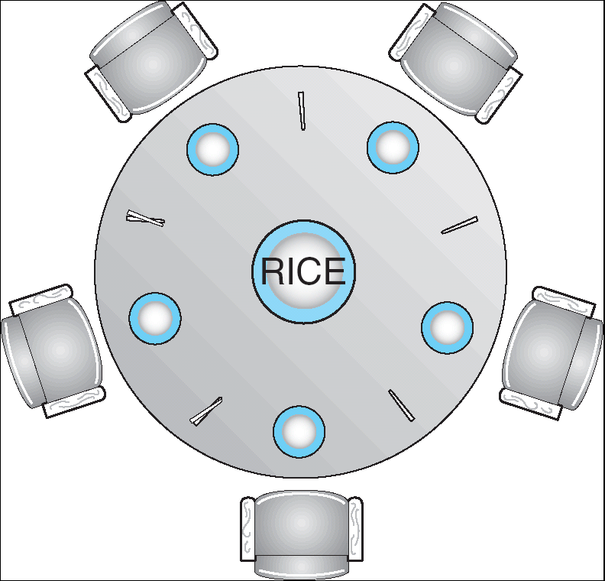
Banker’s Algorithm Example
Banker’s algorithm with dining lawyers
“Safe” (won’t cause deadlock) if when try to grab chopstick either:
Not last chopstick
Is last chopstick but someone will have two afterwards
What if k-handed lawyers? Don’t allow if:
It’s the last one, no one would have k
It’s 2nd to last, and no one would have k-1
It’s 3rd to last, and no one would have k-2
…

Slide 19
Deadlock Summary
Four conditions for deadlocks
Mutual exclusion
Hold and wait
No preemption
Circular wait
Techniques for addressing Deadlock
Deadlock prevention:
write your code in a way that it isn’t prone to deadlock
Deadlock recovery:
let deadlock happen, and then figure out how to recover from it
Deadlock avoidance:
dynamically delay resource requests so deadlock doesn’t happen
Banker’s Algorithm provides on algorithmic way to do this
Deadlock denial:
ignore the possibility of deadlock

Slide 20
Virtualizing Resources
Physical Reality: Different Processes/Threads share the same hardware
Need to multiplex CPU (Just finished: scheduling)
Need to multiplex use of Memory (starting today)
Need to multiplex disk and devices (later in term)
Why worry about memory sharing?
The complete working state of a process and/or kernel is defined by its data in memory (and registers)
Consequently, cannot just let different threads of control use the same memory
Physics: two different pieces of data cannot occupy the same locations in memory
Probably don’t want different threads to even have access to each other’s memory if in different processes (protection)
Notes:
Now we're going to talk about other ways we can virtualize resources.
Seen: virtualizing CPU by multiplexing many processes and threads onto it (scheduling)
Now: memory

Slide 21
Recall: Four Fundamental OS Concepts
Thread: Execution Context
Fully describes program state
Program Counter, Registers, Execution Flags, Stack
Address space (with or w/o translation)
Set of memory addresses accessible to program (for read or write)
May be distinct from memory space of the physical machine (in which case programs operate in a virtual address space)
Process: an instance of a running program
Protected Address Space + One or more Threads
Dual mode operation / Protection
Only the “system” has the ability to access certain resources
Combined with translation, isolates programs from each other and the OS from programs

Slide 22
THE BASICS: Address/Address Space
Address Space:
2^{k} “things”
Address:
“Things” here usually means “bytes” (8 bits)
k bits
What is 2¹⁰ bytes (where a byte is appreviated as “B”)?
2¹⁰ B = 1024B = 1 KB (for memory, 1K = 1024, not 1000)
How many bits to address each byte of 4KB page?
4KB = 4×1KB = 4× 2¹⁰= 2¹²⇒ 12 bits
How much memory can be addressed with 20 bits? 32 bits? 64 bits?
Use 2^{k}

Slide 23
Address Space, Process Virtual Address Space
Definition: Set of accessible addresses and the state associated with them
2³² = ~4 billion bytes on a 32-bit machine
How many 32-bit numbers fit in this address space?
32-bits = 4 bytes, so 2³²/4 = 2³⁰=~1billion
What happens when processor reads or writes to an address?
Perhaps acts like regular memory
Perhaps causes I/O operation
(Memory-mapped I/O)
Causes program to abort (segfault)?
Communicate with another program
…
0x000…
code
Static Data
heap
stack
0xFFF…

Slide 24
Recall: Process Address Space: typical structure
0x000…
Code Segment
PC:
SP:
Static Data
heap
Processor
registers
sbrk syscall
Stack Segment
0xFFF…

Slide 25
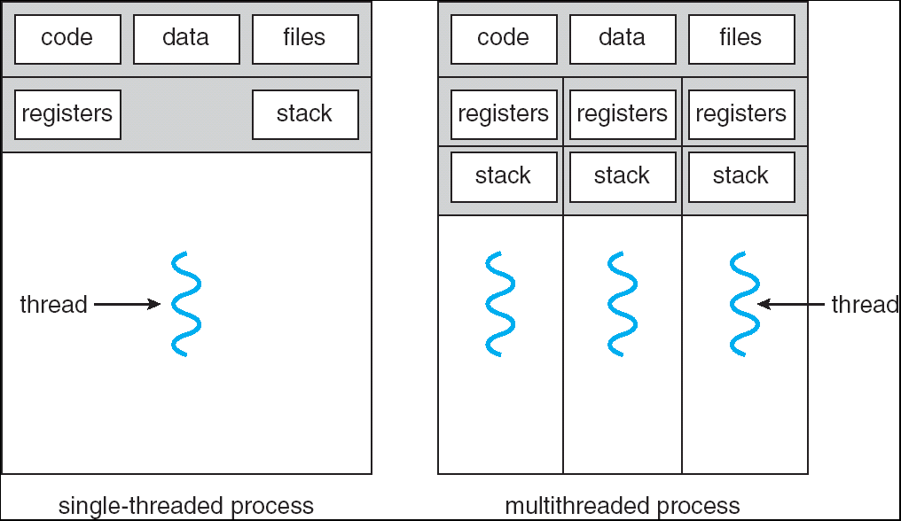
Recall: Single and Multithreaded Processes
Threads encapsulate concurrency
“Active” component
Address space encapsulate protection:
“Passive” component
Keeps bugs from crashing the entire system
Why have multiple threads per address space?

Slide 26
Important Aspects of Memory Multiplexing
Protection:
Prevent access to private memory of other processes
Different pages of memory can be given special behavior (Read Only, Invisible to user programs, etc).
Kernel data protected from User programs
Programs protected from themselves
Translation:
Ability to translate accesses from one address space (virtual) to a different one (physical)
When translation exists, processor uses virtual addresses, physical memory uses physical addresses
Side effects:
Can be used to avoid overlap
Can be used to give uniform view of memory to programs
Controlled overlap:
Separate state of threads should not collide in physical memory. Obviously, unexpected overlap causes chaos!
Conversely, would like the ability to overlap when desired (for communication)

Slide 27
Alternative View: Interposing on Process Behavior
OS interposes on process’ I/O operations
How? All I/O happens via syscalls.
OS interposes on process’ CPU usage
How? Interrupt lets OS preempt current thread
Question: How can the OS interpose on process’ memory accesses?
Too slow for the OS to interpose every memory access
Translation: hardware support to accelerate the common case
Page fault: uncommon cases trap to the OS to handle

Slide 28
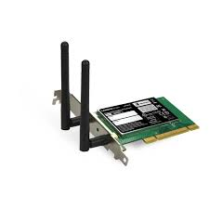
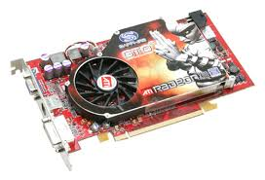


Recall: Loading
Threads
Address Spaces
Windows
Processes
Files
Sockets
Software
OS Hardware Virtualization
Hardware
ISA
Memory
Processor
Protection Boundary
OS
Ctrlr
storage
Networks
Displays
Inputs

Slide 29
Binding of Instructions and Data to Memory
Assume 4byte words
0x300 = 4 * 0x0C0
0x0C0 = 0000 1100 0000
0x300 = 0011 0000 0000
Process view of memory
Physical addresses
data1: dw 32
…
start: lw r1,0(data1)
jal checkit
loop: addi r1, r1, -1
bnz r1, loop …
checkit: …
0x0300 00000020
… …
0x0900 8C2000C0
0x0904 0C000280
0x0908 2021FFFF
0x090C 14200242
…
0x0A00

Slide 30
Binding of Instructions and Data to Memory
Physical
Memory
0x0000
0x0300
00000020
Process view of memory
Physical addresses
data1: dw 32
…
start: lw r1,0(data1)
jal checkit
loop: addi r1, r1, -1
bnz r1, loop …
checkit: …
0x0300 00000020
… …
0x0900 8C2000C0
0x0904 0C000280
0x0908 2021FFFF
0x090C 14200242
…
0x0A00
0x0900
8C2000C0
0C000340
2021FFFF
14200242
0xFFFF

Slide 31
Second copy of program from previous example
Physical
Memory
0x0000
0x0300
App X
Process view of memory
Physical addresses
data1: dw 32
…
start: lw r1,0(data1)
jal checkit
loop: addi r1, r1, -1
bnz r1, loop …
checkit: …
0x0300 00000020
… …
0x0900 8C2000C0
0x0904 0C000280
0x0908 2021FFFF
0x090C 14200242
…
0x0A00
0x0900
?
0xFFFF
Need address translation!

Slide 32
Second copy of program from previous example
Physical Memory
0x0000
0x0300
App X
Process view of memory
Physical addresses
data1: dw 32
…
start: lw r1,0(data1)
jal checkit
loop: addi r1, r1, -1
bnz r1, loop …
checkit: …
0x1300 00000020
… …
0x1900 8C2004C0
0x1904 0C000680
0x1908 2021FFFF
0x190C 14200642
…
0x1A00
0x0900
0x1300
00000020
0x1900
8C2004C0
0C000680
2021FFFF
14200642
One of many possible translations!
Where does translation take place?
Compile time, Link/Load time, or Execution time?
0xFFFF

Slide 33
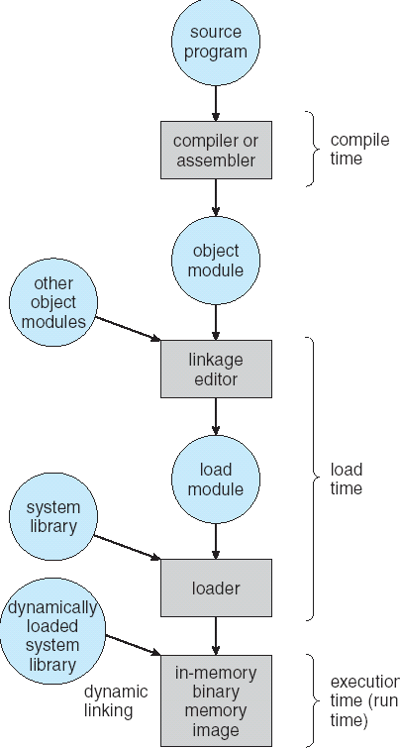
From Program to Process
Preparation of a program for execution involves components at:
Compile time (i.e., “gcc”)
Link/Load time (UNIX “ld” does link)
Execution time (e.g., dynamic libs)
Addresses can be bound to final values anywhere in this path
Depends on hardware support
Also depends on operating system
Dynamic Libraries
Linking postponed until execution
Small piece of code (i.e. the stub), locates appropriate memory-resident library routine
Stub replaces itself with the address of the routine, and executes routine

Slide 34

Recall: Uniprogramming
Uniprogramming (no Translation or Protection)
Application always runs at same place in physical memory since only one application at a time
Application can access any physical address
Application given illusion of dedicated machine by giving it reality of a dedicated machine
0xFFFFFFFF
Operating
System
Valid 32-bit
Addresses
Application
0x00000000

Slide 35
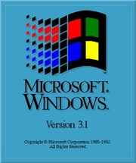
Primitive Multiprogramming
Multiprogramming without Translation or Protection
Must somehow prevent address overlap between threads
Use Loader/Linker: Adjust addresses while program loaded into memory (loads, stores, jumps)
Everything adjusted to memory location of program
Translation done by a linker-loader (relocation)
Common in early days (… till Windows 3.x, 95?)
With this solution, no protection: bugs in any program can cause other programs to crash or even the OS
0xFFFFFFFF
Operating
System
Application2
0x00020000
Application1
0x00000000

Slide 36

Multiprogramming with Protection
Can we protect programs from each other without translation?
Yes: Base and Bound!
Used by, e.g., Cray-1 supercomputer
0xFFFFFFFF
Operating
System
Bound= 0x10000
Base = 0x20000
Application2
0x00020000
Application1
0x00000000

Slide 37
Recall: Base and Bound (No Translation)
0000…
code
Still protects OS and isolates program
Requires relocating loader
No addition on address path
Static Data
heap
stack
Base
Original Program
1000…
1000…
0000…
code
code
>=
Program
address
1010…
Static Data
Static Data
heap
heap
Bound
<
1100…
stack
1100…
stack
0100…
FFFF…

Slide 38
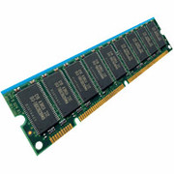
Recall: General Address translation
Virtual
Addresses
Physical
Addresses
CPU
MMU
Untranslated read or write
Consequently, two views of memory:
View from the CPU (what program sees, virtual memory)
View from memory (physical memory)
Translation box (Memory Management Unit or MMU) converts between the two views
Translation ⇒ much easier to implement protection!
If task A cannot even gain access to task B’s data, no way for A to adversely affect B
With translation, every program can be linked/loaded into same region of user address space

Slide 39
Recall: Base and Bound (with Translation)
0000…
code
Addresses translated on-the-fly
Static Data
heap
stack
Base Address
1000…
Original Program
1000…
code
Program
address
0010…
0000…
Static Data
code
1010…
heap
Static Data
<
heap
Bound
stack
1100…
0100…
stack
0100…
Hardware relocation
Can the program touch OS?
Can it touch other programs?
FFFF…

Slide 40
Issues with Simple B&B Method
process 6
process 6
process 6
process 6
process 5
process 5
process 5
process 9
process 9
process 11
process 2
process 10
OS
OS
OS
OS
Fragmentation problem over time
Not every process is same size ⇒ memory becomes fragmented over time
Missing support for sparse address space
Would like to have multiple chunks/program (Code, Data, Stack, Heap, etc)
Hard to do inter-process sharing
Want to share code segments when possible
Want to share memory between processes
Helped by providing multiple segments per process

Slide 41
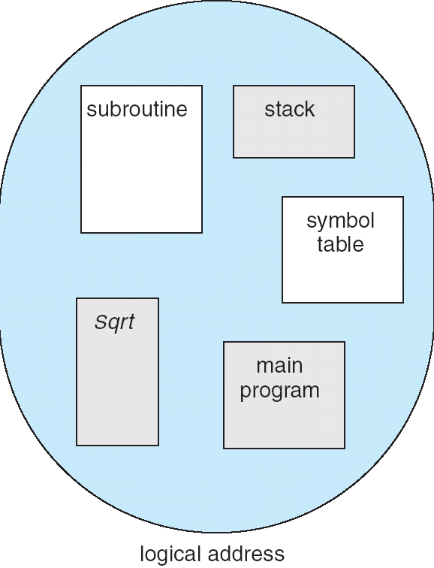
More Flexible Segmentation
1
1
1
4
2
3
2
2
4
3
user view of
memory space
physical
memory space
Logical View: multiple separate segments
Typical: Code, Data, Stack
Others: memory sharing, etc
Each segment is given region of contiguous memory
Has a base and limit
Can reside anywhere in physical memory

Slide 42
Implementation of Multi-Segment Model
Virtual
Address
offset
>
Error
Seg #
Offset
Base0
Limit0
V
Base1
Limit1
V
Base2
Limit2
V
Base2
Limit2
V
Physical
Address
Base3
Limit3
N
+
Base4
Limit4
V
Base5
Limit5
N
Base6
Limit6
N
Base7
Limit7
V
Check Valid
Segment map resides in processor
Segment number mapped into base/limit pair
Base added to offset to generate physical address
Error check catches offset out of range
As many chunks of physical memory as entries
Segment addressed by portion of virtual address
However, could be included in instruction instead:
x86 Example: mov [es:bx],ax.
What is “V/N” (valid / not valid)?
Can mark segments as invalid; requires check as well
Access
Error

Slide 43
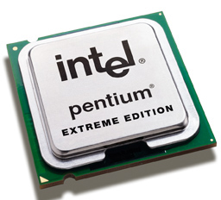
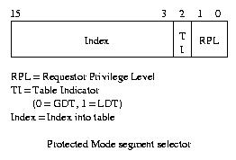
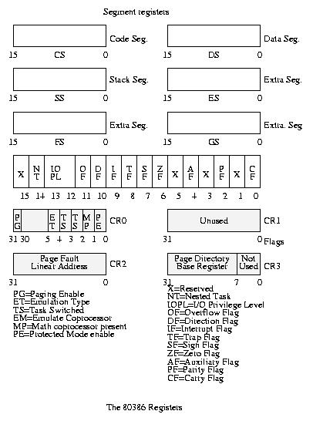
Intel x86 Special Registers
80386 Special Registers
Typical Segment Register
Current Priority is RPL of Code Segment (CS)
Segmentation can’t be just “turned off”
What if we just want to use paging?
Set base and bound to all of memory, in all segments

Slide 44
Example: Four Segments (16 bit addresses)
Seg ID # | Base | Limit
0 (code) | 0x4000 | 0x0800
1 (data) | 0x4800 | 0x1400
2 (shared) | 0xF000 | 0x1000
3 (stack) | 0x0000 | 0x3000
Seg
Offset
15
14
13
0
Virtual Address Format
0x0000
0x0000
0x4000
0x8000
0xC000
Virtual
Address Space
Physical
Address Space

Slide 45
Example: Four Segments (16 bit addresses)
Seg ID # | Base | Limit
0 (code) | 0x4000 | 0x0800
1 (data) | 0x4800 | 0x1400
2 (shared) | 0xF000 | 0x1000
3 (stack) | 0x0000 | 0x3000
Seg
Offset
15
14
13
0
Virtual Address Format
SegID = 0
0x0000
0x0000
0x4000
0x4000
0x4800
0x8000
0xC000
Virtual
Address Space
Physical
Address Space

Slide 46
Example: Four Segments (16 bit addresses)
Seg ID # | Base | Limit
0 (code) | 0x4000 | 0x0800
1 (data) | 0x4800 | 0x1400
2 (shared) | 0xF000 | 0x1000
3 (stack) | 0x0000 | 0x3000
Seg
Offset
15
14
13
0
Virtual Address Format
SegID = 0
0x0000
0x0000
SegID = 1
0x4000
0x4000
0x4800
0x5C00
0x8000
0xC000
Virtual
Address Space
Physical
Address Space

Slide 47
Example: Four Segments (16 bit addresses)
Seg ID # | Base | Limit
0 (code) | 0x4000 | 0x0800
1 (data) | 0x4800 | 0x1400
2 (shared) | 0xF000 | 0x1000
3 (stack) | 0x0000 | 0x3000
Seg
Offset
15
14
13
0
Virtual Address Format
SegID = 0
0x0000
0x0000
SegID = 1
0x4000
Might
be shared
0x4000
0x4800
0x5C00
0x8000
Space for
Other Apps
0xC000
0xF000
Shared with
Other Apps
Virtual
Address Space
Physical
Address Space

Slide 48
Example of Segment Translation (16bit address)
0x240 main: la $a0, varx 0x244 jal strlen
… …
0x360 strlen: li $v0, 0 ;count 0x364 loop: lb $t0, ($a0) 0x368 beq $r0,$t0, done
… …
0x4050 varx dw 0x314159
Seg ID # | Base | Limit
0 (code) | 0x4000 | 0x0800
1 (data) | 0x4800 | 0x1400
2 (shared) | 0xF000 | 0x1000
3 (stack) | 0x0000 | 0x3000
Let’s simulate a bit of this code to see what happens (PC=0x240):
Fetch 0x0240 (0000 0010 0100 0000). Virtual segment #? 0; Offset? 0x240
Physical address? Base=0x4000, so physical addr=0x4240
Fetch instruction at 0x4240. Get “la $a0, varx”
Move 0x4050 → $a0, Move PC+4→PC

Slide 49
Example of Segment Translation (16bit address)
0x240 main: la $a0, varx 0x244 jal strlen
… …
0x360 strlen: li $v0, 0 ;count 0x364 loop: lb $t0, ($a0) 0x368 beq $r0,$t0, done
… …
0x4050 varx dw 0x314159
Seg ID # | Base | Limit
0 (code) | 0x4000 | 0x0800
1 (data) | 0x4800 | 0x1400
2 (shared) | 0xF000 | 0x1000
3 (stack) | 0x0000 | 0x3000
Let’s simulate a bit of this code to see what happens (PC=0x240):
Fetch 0x0240 (0000 0010 0100 0000). Virtual segment #? 0; Offset? 0x240
Physical address? Base=0x4000, so physical addr=0x4240
Fetch instruction at 0x4240. Get “la $a0, varx”
Move 0x4050 → $a0, Move PC+4→PC
Fetch 0x244. Translated to Physical=0x4244. Get “jal strlen” Move 0x0248 → $ra (return address!), Move 0x0360 → PC

Slide 50
Example of Segment Translation (16bit address)
0x240 main: la $a0, varx 0x244 jal strlen
… …
0x360 strlen: li $v0, 0 ;count 0x364 loop: lb $t0, ($a0) 0x368 beq $r0,$t0, done
… …
0x4050 varx dw 0x314159
Seg ID # | Base | Limit
0 (code) | 0x4000 | 0x0800
1 (data) | 0x4800 | 0x1400
2 (shared) | 0xF000 | 0x1000
3 (stack) | 0x0000 | 0x3000
Let’s simulate a bit of this code to see what happens (PC=0x240):
Fetch 0x0240 (0000 0010 0100 0000). Virtual segment #? 0; Offset? 0x240
Physical address? Base=0x4000, so physical addr=0x4240
Fetch instruction at 0x4240. Get “la $a0, varx”
Move 0x4050 → $a0, Move PC+4→PC
Fetch 0x244. Translated to Physical=0x4244. Get “jal strlen” Move 0x0248 → $ra (return address!), Move 0x0360 → PC
Fetch 0x360. Translated to Physical=0x4360. Get “li $v0, 0” Move 0x0000 → $v0, Move PC+4→PC

Slide 51
Example of Segment Translation (16bit address)
0x0240 main: la $a0, varx 0x0244 jal strlen
… …
0x0360 strlen: li $v0, 0 ;count 0x0364 loop: lb $t0, ($a0) 0x0368 beq $r0,$t0, done
… …
0x4050 varx dw 0x314159
Seg ID # | Base | Limit
0 (code) | 0x4000 | 0x0800
1 (data) | 0x4800 | 0x1400
2 (shared) | 0xF000 | 0x1000
3 (stack) | 0x0000 | 0x3000
Let’s simulate a bit of this code to see what happens (PC=0x0240):
Fetch 0x0240 (0000 0010 0100 0000). Virtual segment #? 0; Offset? 0x240
Physical address? Base=0x4000, so physical addr=0x4240
Fetch instruction at 0x4240. Get “la $a0, varx”
Move 0x4050 → $a0, Move PC+4→PC
Fetch 0x0244. Translated to Physical=0x4244. Get “jal strlen” Move 0x0248 → $ra (return address!), Move 0x0360 → PC
Fetch 0x0360. Translated to Physical=0x4360. Get “li $v0, 0” Move 0x0000 → $v0, Move PC+4→PC
Fetch 0x0364. Translated to Physical=0x4364. Get “lb $t0, ($a0)” Since $a0 is 0x4050, try to load byte from 0x4050
Translate 0x4050 (0100 0000 0101 0000). Virtual segment #? 1; Offset? 0x50 Physical address? Base=0x4800, Physical addr = 0x4850,
Load Byte from 0x4850→$t0, Move PC+4→PC

Slide 52
Observations about Segmentation
Translation on every instruction fetch, load or store
Virtual address space has holes
Segmentation efficient for sparse address spaces
When it is OK to address outside valid range?
This is how the stack (and heap?) allowed to grow
For instance, stack takes fault, system automatically increases size of stack
Need protection mode in segment table
For example, code segment would be read-only
Data and stack would be read-write (stores allowed)
What must be saved/restored on context switch?
Segment table stored in CPU, not in memory (small)
Might store all of processes memory onto disk when switched (called “swapping”)

Slide 53
Administrivia
Prof Joseph’s office hours: Tuesdays 1-2pm and Thursdays 12-1 (room TBD)
Homework 2 is due TODAY (Thursday 3/3)
Midterm 2 conflict requests are due TOMORROW (Friday 3/4)

Slide 54
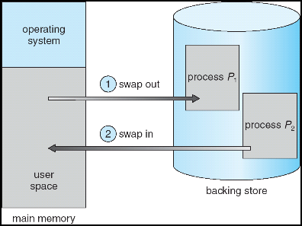
What if not all segments fit in memory?
Extreme form of Context Switch: Swapping
To make room for next process, some or all of the previous process is moved to disk
Likely need to send out complete segments
This greatly increases the cost of context-switching
What might be a desirable alternative?
Some way to keep only active portions of a process in memory at any one time
Need finer granularity control over physical memory

Slide 55
Problems with Segmentation
Must fit variable-sized chunks into physical memory
May move processes multiple times to fit everything
Limited options for swapping to disk
Fragmentation: wasted space
External: free gaps between allocated chunks
Internal: don’t need all memory within allocated chunks

Slide 56
Recall: General Address Translation
Code
Data
Heap
Stack
Data 2
Code
Data
Heap
Stack
Stack 1
Heap 1
Code 1
Stack 2
Prog 1
Virtual
Address
Space 1
Data 1
Prog 2
Virtual
Address
Space 2
Heap 2
Code 2
OS code
Translation Map 1
OS data
Translation Map 2
OS heap &
Stacks
Physical Address Space

Slide 57
Paging: Physical Memory in Fixed Size Chunks
Solution to fragmentation from segments?
Allocate physical memory in fixed size chunks (“pages”)
Every chunk of physical memory is equivalent
Can use simple vector of bits to handle allocation: 00110001110001101 … 110010
Each bit represents page of physical memory 1 ⇒ allocated, 0 ⇒ free
Should pages be as big as our previous segments?
No: Can lead to lots of internal fragmentation
Typically have small pages (1K-16K)
Consequently: need multiple pages/segment

Slide 58
How to Implement Simple Paging?
Virtual Address:
Virtual
Page #
Offset
PageTablePtr
page #0
V,R
Physical
Page #
Offset
page #1
V,R
page #1
V,R
page #2
V,R,W
Physical Address
PageTableSize
>
page #3
V,R,W
Check Perm
Access Error
page #4
N
page #5
V,R,W
Access
Error
Page Table (One per process)
Resides in physical memory
Contains physical page and permission for each virtual page (e.g. Valid bits, Read, Write, etc)
Virtual address mapping
Offset from Virtual address copied to Physical Address
Example: 10 bit offset ⇒ 1024-byte pages
Virtual page # is all remaining bits
Example for 32-bits: 32-10 = 22 bits, i.e. 4 million entries
Physical page # copied from table into physical address
Check Page Table bounds and permissions

Slide 59
Simple Page Table Example
Example (4 byte pages)
0x00
0000 0000
0x00
a
b
c
d
0001 0000
0x04
0
4
i
j
k
l
0x04
0000 0100
1
0000 1100
0x05!
e
f
g
h
3
2
1
0000 0100
0x08
0x06?
0x08
0000 1000
Page
Table
0x0C
i
j
k
l
e
f
g
h
0x09?
0x0E!
0x10
Virtual
Memory
0000 0110
0000 1110
a
b
c
d
0000 1001
0000 0101
Physical
Memory
Notes:
What is virtual address 0x6? 1|10 = 3|2 = 0xE
What is virtual address 0x9? 10|01 = 1|1 = 0x5

Slide 60
What about Sharing?
Virtual Address
(Process A):
Virtual
Page #
Offset
PageTablePtrA
page #0
V,R
page #1
V,R
page #2
V,R,W
page #2
V,R,W
page #3
V,R,W
Shared
Page
page #4
N
page #5
V,R,W
PageTablePtrB
page #0
V,R
page #1
N
This physical page
appears in address
space of both processes
page #2
V,R,W
page #3
N
page #4
V,R
page #4
V,R
page #5
V,R,W
Virtual Address
(Process B):
Virtual
Page #
Offset

Slide 61
Where is page sharing used ?
The “kernel region” of every process has the same page table entries
The process cannot access it at user level
But on U->K switch, kernel code can access it AS WELL AS the region for THIS user
What does the kernel need to do to access other user processes?
Different processes running same binary!
Execute-only, but do not need to duplicate code segments
User-level system libraries (execute only)
Shared-memory segments between different processes
Can actually share objects directly between processes
Must map page into same place in address space!
This is a limited form of the sharing that threads have within a single process

Slide 62
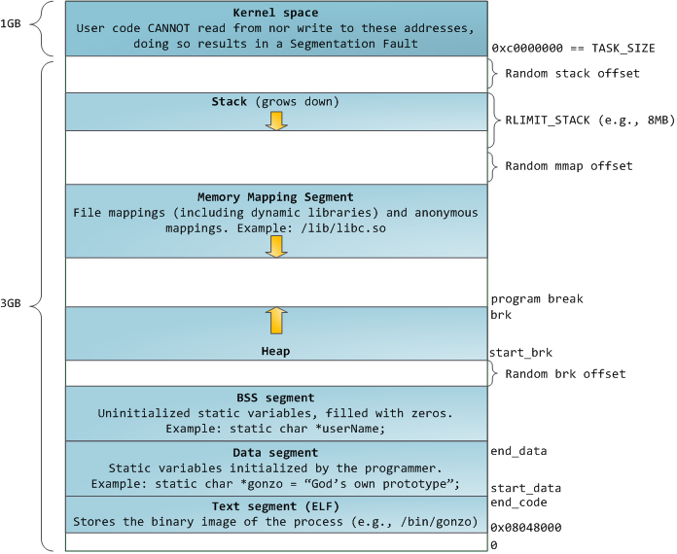
Memory Layout for Linux 32-bit (Pre-Meltdown patch!)
http://static.duartes.org/img/blogPosts/linuxFlexibleAddressSpaceLayout.png

Slide 63
Some simple security measures
Address Space Randomization
Position-Independent Code ⇒ can place user code anywhere in address space
Random start address makes much harder for attacker to cause jump to code that it seeks to take over
Stack & Heap can start anywhere, so randomize placement
Kernel address space isolation
Don’t map whole kernel space into each process, switch to kernel page table
Meltdown⇒map none of kernel into user mode!

Slide 64
Summary: Paging
Virtual memory view
Page Table
11111 11101
11110 11100
11101 null
11100 null
11011 null
11010 null
11001 null
11000 null
10111 null
10110 null
10101 null
10100 null
10011 null
10010 10000
10001 01111
10000 01110
01111 null
01110 null
01101 null
01100 null
01011 01101
01010 01100
01001 01011
01000 01010
00111 null
00110 null
00101 null
00100 null
00011 00101
00010 00100
00001 00011
00000 00010
Physical memory view
1111 1111
1110 1111
1111 0000
stack
stack
1110 0000
1100 0000
heap
1000 0000
heap
0111 000
data
data
0101 000
0100 0000
code
code
0001 0000
0000 0000
0000 0000
page #
offset

Slide 65
Summary: Paging
Virtual memory view
Page Table
11111 11101
11110 11100
11101 null
11100 null
11011 null
11010 null
11001 null
11000 null
10111 null
10110 null
10101 null
10100 null
10011 null
10010 10000
10001 01111
10000 01110
01111 null
01110 null
01101 null
01100 null
01011 01101
01010 01100
01001 01011
01000 01010
00111 null
00110 null
00101 null
00100 null
00011 00101
00010 00100
00001 00011
00000 00010
Physical memory view
1111 1111
stack
1110 0000
stack
1110 0000
1100 0000
What happens if stack grows to 1110 0000?
heap
1000 0000
heap
0111 000
data
data
0101 000
0100 0000
code
code
0001 0000
0000 0000
0000 0000
page #
offset

Slide 66
Summary: Paging
Virtual memory view
Page Table
11111 11101
11110 11100
11101 10111
11100 10110
11011 null
11010 null
11001 null
11000 null
10111 null
10110 null
10101 null
10100 null
10011 null
10010 10000
10001 01111
10000 01110
01111 null
01110 null
01101 null
01100 null
01011 01101
01010 01100
01001 01011
01000 01010
00111 null
00110 null
00101 null
00100 null
00011 00101
00010 00100
00001 00011
00000 00010
Physical memory view
1111 1111
stack
1110 0000
stack
1110 0000
1100 0000
stack
Allocate new pages where room!
heap
1000 0000
heap
0111 000
data
data
0101 000
Challenge: Table size equal to # of pages in virtual memory!
0100 0000
code
code
0001 0000
0000 0000
0000 0000
page #
offset

Slide 67
How big do things get?
32-bit address space => 2³² bytes (4 GB)
Note: “b” = bit, and “B” = byte
And for memory:
“K”(kilo) = 2¹⁰ = 1024 ≈ 10³ (But not quite!): Sometimes called “Ki” (Kibi)
“M”(mega) = 2²⁰ = (1024)² = 1,048,576 ≈ 10⁶ (But not quite!): Sometimes called “Mi” (Mibi)
“G”(giga) = 2³⁰ = (1024)³ = 1,073,741,824 ≈ 10⁹ (But not quite!): Sometimes called “Gi” (Gibi)
Typical page size: 4 KB
how many bits of the address is that ? (remember 2¹⁰ = 1024)
Ans – 4KB = 4×2¹⁰ = 2¹² ⇒ 12 bits of the address
So how big is the simple page table for each process?
2³²/2¹² = 2²⁰ (that’s about a million entries) x 4 bytes each => 4 MB
When 32-bit machines got started (vax 11/780, intel 80386), 16 MB was a LOT of memory
How big is a simple page table on a 64-bit processor (x86_64)?
2⁶⁴/2¹² = 2⁵²(that’s 4.5×10¹⁵ or 4.5 exa-entries)×8 bytes each = 36×10¹⁵ bytes or 36 exa-bytes!!!! This is a ridiculous amount of memory!
This is really a lot of space – for only the page table!!!
The address space is sparse, i.e. has holes that are not mapped to physical memory
So, most of this space is taken up by page tables mapped to nothing

Slide 68
Page Table Discussion
What needs to be switched on a context switch?
Page table pointer and limit
What provides protection here?
Translation (per process) and dual-mode!
Can’t let process alter its own page table!
Analysis
Pros
Simple memory allocation
Easy to share
Con: What if address space is sparse?
E.g., on UNIX, code starts at 0, stack starts at (2³¹-1)
With 1K pages, need 2 million page table entries!
Con: What if table really big?
Not all pages used all the time ⇒ would be nice to have working set of page table in memory
Simple Page table isway too big!
Does it all need to be in memory?
How about multi-level paging?
or combining paging and segmentation
Notes:
What if page size is very small? VAX had a 512-byte page size = lots of space for page table entries
What if page size is really big? Wastes space inside of page (internal fragmentation)

Slide 69
Summary
Segment Mapping
Segment registers within processor
Segment ID associated with each access
Often comes from portion of virtual address
Can come from bits in instruction instead (x86)
Each segment contains base and limit information
Offset (rest of address) adjusted by adding base
Page Tables
Memory divided into fixed-sized chunks of memory
Virtual page number from virtual address mapped through page table to physical page number
Offset of virtual address same as physical address
Large page tables can be placed into virtual memory
Next Time: Multi-Level Tables
Virtual address mapped to series of tables
Permit sparse population of address space

