Slide 1
CS162 Operating Systems and Systems Programming Lecture 16 Memory 4: Demand Paging Policies
March 15th, 2022
Prof. Anthony Joseph and John Kubiatowicz
http://cs162.eecs.Berkeley.edu

Slide 2
Recall 61C: Average Memory Access Time
Proc
Used to compute access time probabilistically:
AMAT = Hit Rate_{L1} x Hit Time_{L1} + Miss Rate_{L1} x Miss Time_{L1}
Hit Rate_{L1} + Miss Rate_{L1} = 1 Hit Time_{L1} = Time to get value from L1 cache. Miss Time_{L1} = Hit Time_{L1} + Miss Penalty_{L1} Miss Penalty_{L1} = AVG Time to get value from lower level (DRAM)
So, AMAT = Hit Time_{L1} + Miss Rate_{L1} x Miss Penalty_{L1}
What about more levels of hierarchy?
AMAT = Hit Time_{L1} + Miss Rate_{L1} x Miss Penalty_{L1}
Miss Penalty_{L1} = AVG time to get value from lower level (L2) = Hit Time_{L2} + Miss Rate_{L2} x Miss Penalty_{L2} Miss Penalty_{L2} = Average Time to fetch from below L2 (DRAM)
AMAT = Hit Time_{L1} +
Miss Rate_{L1} x (Hit Time_{L2} + Miss Rate_{L2} x Miss Penalty_{L2})
And so on … (can do this recursively for more levels!)
L1 Cache
DRAM
Proc
L1 Cache
L2 Cache
DRAM

Slide 3
Recall: Caching Applied to Address Translation
Virtual
Address
TLB
Physical
Memory
CPU
Physical
Address
Cached?
Yes
No
Save
Result
Translate
(MMU)
Data Read or Write
(untranslated)
Question is one of page locality: does it exist?
Instruction accesses spend a lot of time on the same page (accesses sequential)
Stack accesses have definite locality of reference
Data accesses have less page locality, but still some…
Can we have a TLB hierarchy?
Sure: multiple levels at different sizes/speeds

Slide 4
Management & Access to the Memory Hierarchy
Managed in Hardware
Managed in Software - OS
?
Processor
Secondary Storage (Disk)
TLB
PT
L2 Cache
Registers
L1 Cache
Secondary Storage (SSD)
PT
PT
Main
Memory
(DRAM)
PT
TLB
L3 Cache (shared)
L2 Cache
Registers
L1 Cache
Accessed in Hardware
Speed (ns):
0.3
1
3
10-30
100
100,000 (0.1 ms)
10,000,000
(10 ms)
Size (bytes):
100Bs
10kBs
100kBs
MBs
GBs
100GBs
TBs
Notes:
The design goal is to present the user with as much memory as is available in the cheapest technology (points to the disk).
While by taking advantage of the principle of locality, we like to provide the user an average access speed that is very close to the speed that is offered by the fastest technology.
(We will go over this slide in details in the next lecture on caches).
+1 = 16 min. (X:56)

Slide 5
Page Fault ⇒ Demand Paging
Process
virtual address
physical address
MMU
page#
PT
instruction
frame#
retry
page fault
offset
exception
frame#
Operating System
offset
update PT entry
Page Fault Handler
load page from disk
scheduler

Slide 6
Demand Paging as Caching, …
What “block size”? - 1 page (e.g, 4 KB)
What “organization” ie. direct-mapped, set-assoc., fully-associative?
Fully associative since arbitrary virtual → physical mapping
How do we locate a page?
First check TLB, then page-table traversal
What is page replacement policy? (i.e. LRU, Random…)
This requires more explanation… (kinda LRU)
What happens on a miss?
Go to lower level to fill miss (i.e. disk)
What happens on a write? (write-through, write back)
Definitely write-back – need dirty bit!

Slide 7
Illusion of Infinite Memory
∞
TLB
Page
Table
Physical
Memory
512 MB
Disk
500GB
Virtual
Memory
4 GB
Disk is larger than physical memory ⇒
In-use virtual memory can be bigger than physical memory
Combined memory of running processes much larger than physical memory
More programs fit into memory, allowing more concurrency
Principle: Transparent Level of Indirection (page table)
Supports flexible placement of physical data
Data could be on disk or somewhere across network
Variable location of data transparent to user program
Performance issue, not correctness issue

Slide 8
Review: What is in a PTE?
What is in a Page Table Entry (or PTE)?
Pointer to next-level page table or to actual page
Permission bits: valid, read-only, read-write, write-only
Example: Intel x86 architecture PTE:
2-level page tabler (10, 10, 12-bit offset)
Intermediate page tables called “Directories”
P: Present (same as “valid” bit in other architectures)
W: Writeable
U: User accessible
PWT: Page write transparent: external cache write-through
PCD: Page cache disabled (page cannot be cached)
A: Accessed: page has been accessed recently
D: Dirty (PTE only): page has been modified recently
PS: Page Size: PS=1⇒4MB page (directory only). Bottom 22 bits of virtual address serve as offset
Page Frame Number
(Physical Page Number)
Free
(OS)
0
PS
D
A
PCD
PWT
U
W
P
31-12
11-9
8
7
6
5
4
3
2
1
0

Slide 9
Demand Paging Mechanisms
PTE makes demand paging implementatable
Valid ⇒ Page in memory, PTE points at physical page
Not Valid ⇒ Page not in memory; use info in PTE to find it on disk when necessary
Suppose user references page with invalid PTE?
Memory Management Unit (MMU) traps to OS
Resulting trap is a “Page Fault”
What does OS do on a Page Fault?:
Choose an old page to replace
If old page modified (“D=1”), write contents back to disk
Change its PTE and any cached TLB to be invalid
Load new page into memory from disk
Update page table entry, invalidate TLB for new entry
Continue thread from original faulting location
TLB for new page will be loaded when thread continued!
While pulling pages off disk for one process, OS runs another process from ready queue
Suspended process sits on wait queue
Cache

Slide 10
Origins of Paging
Keep most of the address space on disk
Disks provide most of the storage
Actively swap pages to/from
Relatively small memory, for many processes
Keep memory full of the frequently accesses pages
P
Many clients on dumb terminals running different programs
. . .

Slide 11

Very Different Situation Today
Powerful system
Huge memory
Huge disk
Single user

Slide 12
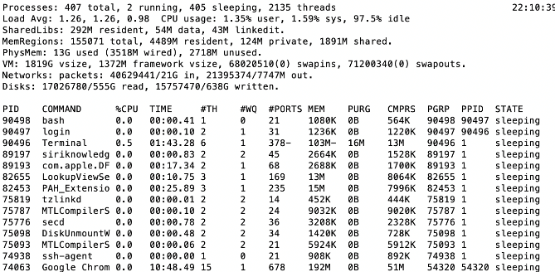
A Picture on one machine
Memory stays about 75% used, 25% for dynamics
A lot of it is shared 1.9 GB

Slide 13
Many Uses of Virtual Memory and “Demand Paging” …
Extend the stack
Allocate a page and zero it
Extend the heap (sbrk of old, today mmap)
Process Fork
Create a copy of the page table
Entries refer to parent pages – NO-WRITE
Shared read-only pages remain shared
Copy page on write
Exec
Only bring in parts of the binary in active use
Do this on demand
MMAP to explicitly share region (or to access a file as RAM)

Slide 14
Classic: Loading an executable into memory
disk (huge)
memory
info
data
code
exe
.exe
lives on disk in the file system
contains contents of code & data segments, relocation entries and symbols
OS loads it into memory, initializes registers (and initial stack pointer)
program sets up stack and heap upon initialization: crt0 (C runtime init)

Slide 15
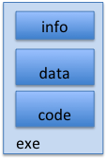
Create Virtual Address Space of the Process
disk (huge)
process VAS
memory
kernel
user page
frames
stack
sbrk
user pagetable
heap
data
kernel code & data
code
Utilized pages in the VAS are backed by a page block on disk
Called the backing store or swap file
Typically in an optimized block store, but can think of it like a file

Slide 16
Create Virtual Address Space of the Process
disk (huge, TB)
process VAS (GBs)
memory
kernel
stack
user page
frames
stack
heap
heap
user pagetable
data
data
code
kernel code & data
code
User Page table maps entire VAS
All the utilized regions are backed on disk
swapped into and out of memory as needed
For every process

Slide 17
Create Virtual Address Space of the Process
VAS
[per process]
disk (huge, TB)
PT
memory
kernel
stack
user page
frames
stack
heap
heap
user pagetable
data
data
code
kernel code & data
code
User Page table maps entire VAS
Resident pages to the frame in memory they occupy
The portion of it that the HW needs to access must be resident in memory

Slide 18
Provide Backing Store for VAS
VAS
[per process]
disk (huge, TB)
memory
kernel
stack
user page
frames
stack
heap
heap
user pagetable
data
data
code
kernel code & data
code
User Page table maps entire VAS
Resident pages mapped to memory frames
For all other pages, OS must record where to find them on disk

Slide 19
What Data Structure Maps Non-Resident Pages to Disk?
FindBlock(PID, page#) → disk_block
Some OSs utilize spare space in PTE for paged blocks
Like the PT, but purely software
Where to store it?
In memory – can be compact representation if swap storage is contiguous on disk
Could use hash table (like Inverted PT)
Usually want backing store for resident pages too
May map code segment directly to on-disk image
Saves a copy of code to swap file
May share code segment with multiple instances of the program

Slide 20
Provide Backing Store for VAS
disk (huge, TB)
VAS 1
PT 1
memory
kernel
stack
stack
stack
heap
user page
frames
heap
heap
data
VAS 2
PT 2
data
code
user pagetable
data
kernel
code
stack
kernel code & data
heap
data
code

Slide 21
On page Fault …
disk (huge, TB)
VAS 1
PT 1
memory
kernel
stack
stack
stack
heap
user page
frames
heap
heap
data
VAS 2
PT 2
data
code
user pagetable
data
kernel
code
stack
kernel code
& data
heap
data
active process & PT
code

Slide 22
On page Fault … find & start load
disk (huge, TB)
VAS 1
PT 1
memory
kernel
stack
stack
stack
heap
user page
frames
heap
heap
data
VAS 2
PT 2
data
code
user pagetable
data
kernel
code
stack
kernel code & data
heap
data
active process & PT
code

Slide 23
On page Fault … schedule other P or T
disk (huge, TB)
VAS 1
PT 1
memory
kernel
stack
stack
stack
heap
user page
frames
heap
heap
data
VAS 2
PT 2
data
code
user pagetable
data
kernel
code
stack
kernel code & data
heap
data
active process & PT
code

Slide 24
On page Fault … update PTE
disk (huge, TB)
VAS 1
PT 1
memory
kernel
stack
stack
stack
heap
user page
frames
heap
heap
data
VAS 2
PT 2
data
code
user pagetable
data
kernel
code
stack
kernel code & data
heap
data
active process & PT
code

Slide 25
Eventually reschedule faulting thread
disk (huge, TB)
VAS 1
PT 1
memory
kernel
stack
stack
stack
heap
user page
frames
heap
heap
data
VAS 2
PT 2
data
code
user pagetable
data
kernel
code
stack
kernel code & data
heap
data
active process & PT
code

Slide 26
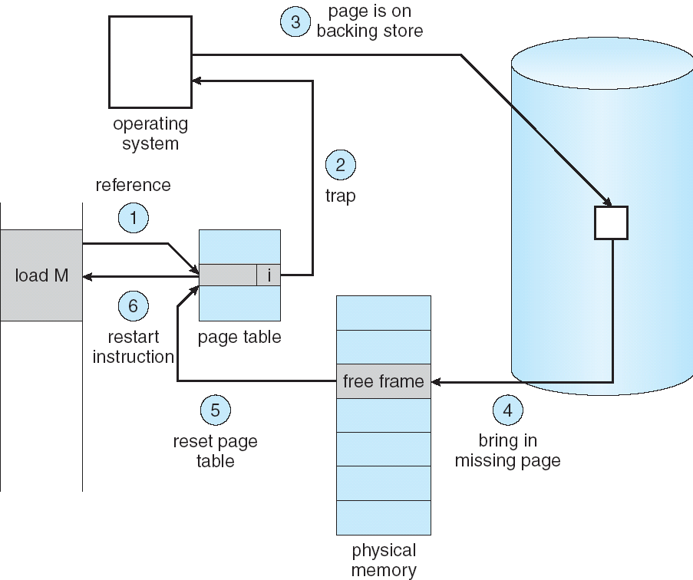
Summary: Steps in Handling a Page Fault

Slide 27
Some questions we need to answer!
During a page fault, where does the OS get a free frame?
Keeps a free list
Unix runs a “reaper” if memory gets too full
Schedule dirty pages to be written back on disk
Zero (clean) pages which haven’t been accessed in a while
As a last resort, evict a dirty page first
How can we organize these mechanisms?
Work on the replacement policy
How many page frames/process?
Like thread scheduling, need to “schedule” memory resources:
Utilization? fairness? priority?
Allocation of disk paging bandwidth

Slide 28
Working Set Model
As a program executes it transitions through a sequence of “working sets” consisting of varying sized subsets of the address space
Address
Time

Slide 29
Cache Behavior under WS model
1
new working set fits
Hit Rate
0
Cache Size
Amortized by fraction of time the Working Set is active
Transitions from one WS to the next
Capacity, Conflict, Compulsory misses
Applicable to memory caches and pages. Others ?

Slide 30
Another model of Locality: Zipf
Likelihood of accessing item of rank r is α 1/rª
Although rare to access items below the top few, there are so many that it yields a “heavy tailed” distribution
Substantial value from even a tiny cache
Substantial misses from even a very large cache

Slide 31
Demand Paging Cost Model
Since Demand Paging like caching, can compute average access time! (“Effective Access Time”)
EAT = Hit Rate x Hit Time + Miss Rate x Miss Time
EAT = Hit Time + Miss Rate x Miss Penalty
Example:
Memory access time = 200 nanoseconds
Average page-fault service time = 8 milliseconds
Suppose p = Probability of miss, 1-p = Probably of hit
Then, we can compute EAT as follows:
EAT = 200ns + p x 8 ms
= 200ns + p x 8,000,000ns
If one access out of 1,000 causes a page fault, then EAT = 8.2 μs:
This is a slowdown by a factor of 40!
What if want slowdown by less than 10%?
EAT < 200ns x 1.1 ⇒ p < 2.5 x 10⁻⁶
This is about 1 page fault in 400,000!

Slide 32
What Factors Lead to Misses in Page Cache?
Compulsory Misses:
Pages that have never been paged into memory before
How might we remove these misses?
Prefetching: loading them into memory before needed
Need to predict future somehow! More later
Capacity Misses:
Not enough memory. Must somehow increase available memory size.
Can we do this?
One option: Increase amount of DRAM (not quick fix!)
Another option: If multiple processes in memory: adjust percentage of memory allocated to each one!
Conflict Misses:
Technically, conflict misses don’t exist in virtual memory, since it is a “fully-associative” cache
Policy Misses:
Caused when pages were in memory, but kicked out prematurely because of the replacement policy
How to fix? Better replacement policy

Slide 33
Administrivia
Midterm 2: Coming up on Thursday 3/17 7-9pm
Topics: up until Lecture 16 (today): Scheduling, Deadlock, Address Translation, Virtual Memory, Caching, TLBs, Demand Paging
Review Session was yesterday
Slides and recording are available on the course website

Slide 34
Page Replacement Policies
Why do we care about Replacement Policy?
Replacement is an issue with any cache
Particularly important with pages
The cost of being wrong is high: must go to disk
Must keep important pages in memory, not toss them out
FIFO (First In, First Out)
Throw out oldest page. Be fair – let every page live in memory for same amount of time.
Bad – throws out heavily used pages instead of infrequently used
RANDOM:
Pick random page for every replacement
Typical solution for TLB’s. Simple hardware
Pretty unpredictable – makes it hard to make real-time guarantees
MIN (Minimum):
Replace page that won’t be used for the longest time
Great (provably optimal), but can’t really know future…
But past is a good predictor of the future …

Slide 35
Replacement Policies (Con’t)
LRU (Least Recently Used):
Replace page that hasn’t been used for the longest time
Programs have locality, so if something not used for a while, unlikely to be used in the near future.
Seems like LRU should be a good approximation to MIN.
How to implement LRU? Use a list:
On each use, remove page from list and place at head
LRU page is at tail
Problems with this scheme for paging?
Need to know immediately when page used so that can change position in list…
Many instructions for each hardware access
In practice, people approximate LRU (more later)
Page 6
Page 7
Page 1
Page 2
Head
Tail (LRU)

Slide 36
Example: FIFO (strawman)
Suppose we have 3 page frames, 4 virtual pages, and following reference stream:
A B C A B D A D B C B
Consider FIFO Page replacement:
FIFO: 7 faults
When referencing D, replacing A is bad choice, since need A again right away
Ref:
Page:
A
B
C
A
B
D
A
D
B
C
B
1
A
D
C
2
B
A
3
C
B

Slide 37
Example: MIN / LRU
Suppose we have the same reference stream:
A B C A B D A D B C B
Consider MIN Page replacement:
MIN: 5 faults
Where will D be brought in? Look for page not referenced farthest in future
What will LRU do?
Same decisions as MIN here, but won’t always be true!
Ref:
Page:
A
B
C
A
B
D
A
D
B
C
B
1
A
C
2
B
3
C
D

Slide 38
Is LRU guaranteed to perform well?
Consider the following: A B C D A B C D A B C D
LRU Performs as follows (same as FIFO here):
Every reference is a page fault!
Fairly contrived example of working set of N+1 on N frames
Ref:
Page:
A
B
C
D
A
B
C
D
A
B
C
D
1
A
D
C
B
2
B
A
D
C
3
C
B
A
D

Slide 39
When will LRU perform badly?
Consider the following: A B C D A B C D A B C D
LRU Performs as follows (same as FIFO here):
Every reference is a page fault!
MIN Does much better:
Ref:
Page:
A
B
C
D
A
B
C
D
A
B
C
D
1
A
D
C
B
2
B
A
D
C
3
C
B
A
D
Ref:
Page:
A
B
C
D
A
B
C
D
A
B
C
D
1
A
B
2
B
C
3
C
D

Slide 40
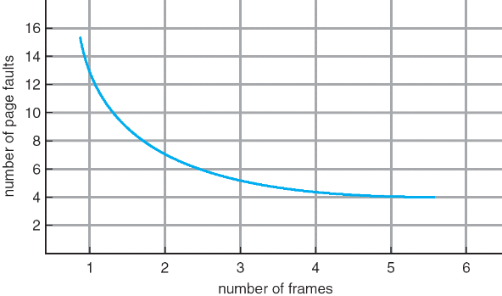
Graph of Page Faults Versus The Number of Frames
One desirable property: When you add memory the miss rate drops (stack property)
Does this always happen?
Seems like it should, right?
No: Bélády’s anomaly
Certain replacement algorithms (FIFO) don’t have this obvious property!

Slide 41
Adding Memory Doesn’t Always Help Fault Rate
Does adding memory reduce number of page faults?
Yes for LRU and MIN
Not necessarily for FIFO! (Called Bélády’s anomaly)
After adding memory:
With FIFO, contents can be completely different
In contrast, with LRU or MIN, contents of memory with X pages are a subset of contents with X+1 Page
Ref:
Page:
A
B
C
D
A
B
E
A
B
C
D
E
1
A
D
E
2
B
A
C
3
C
B
D
Ref:
Page:
A
B
C
D
A
B
E
A
B
C
D
E
1
A
E
D
2
B
A
E
3
C
B
4
D
C

Slide 42
Approximating LRU: Clock Algorithm
Set of all pages
in Memory
Single Clock Hand:
Advances only on page fault!
Check for pages not used recently
Mark pages as not used recently
Clock Algorithm: Arrange physical pages in circle with single clock hand
Approximate LRU (approximation to approximation to MIN)
Replace an old page, not the oldest page
Details:
Hardware “use” bit per physical page (called “accessed” in Intel architecture):
Hardware sets use bit on each reference
If use bit isn’t set, means not referenced in a long time
Some hardware sets use bit in the TLB; must be copied back to PTE when TLB entry gets replaced
On page fault:
Advance clock hand (not real time)
Check use bit: 1→ used recently; clear and leave alone 0→ selected candidate for replacement

Slide 43
Clock Algorithm: More details
Set of all pages
in Memory
Single Clock Hand
Will always find a page or loop forever?
Even if all use bits set, will eventually loop all the way around ⇒ FIFO
What if hand moving slowly?
Good sign or bad sign?
Not many page faults
or find page quickly
What if hand is moving quickly?
Lots of page faults and/or lots of reference bits set
One way to view clock algorithm:
Crude partitioning of pages into two groups: young and old
Why not partition into more than 2 groups?

Slide 44
N^{th} Chance version of Clock Algorithm
N^{th} chance algorithm: Give page N chances
OS keeps counter per page: # sweeps
On page fault, OS checks use bit:
1 → clear use and also clear counter (used in last sweep)
0 → increment counter; if count=N, replace page
Means that clock hand has to sweep by N times without page being used before page is replaced
How do we pick N?
Why pick large N? Better approximation to LRU
If N ~ 1K, really good approximation
Why pick small N? More efficient
Otherwise might have to look a long way to find free page
What about “modified” (or “dirty”) pages?
Takes extra overhead to replace a dirty page, so give dirty pages an extra chance before replacing?
Common approach:
Clean pages, use N=1
Dirty pages, use N=2 (and write back to disk when N=1)

Slide 45
Recall: Meaning of PTE bits
Which bits of a PTE entry are useful to us for the Clock Algorithm? Remember Intel PTE:
The “Present” bit (called “Valid” elsewhere):
P==0: Page is invalid and a reference will cause page fault
P==1: Page frame number is valid and MMU is allowed to proceed with translation
The “Writable” bit (could have opposite sense and be called “Read-only”):
W==0: Page is read-only and cannot be written.
W==1: Page can be written
The “Accessed” bit (called “Use” elsewhere):
A==0: Page has not been accessed (or used) since last time software set A→0
A==1: Page has been accessed (or used) since last time software set A→0
The “Dirty” bit (called “Modified” elsewhere):
D==0: Page has not been modified (written) since PTE was loaded
D==1: Page has changed since PTE was loaded
PTE:
Page Frame Number
(Physical Page Number)
Free
(OS)
0
PS
D
A
PCD
PWT
U
W
P
31-12
11-9
8
7
6
5
4
3
2
1
0

Slide 46
Clock Algorithms Variations
Do we really need hardware-supported “modified” bit?
No. Can emulate it using read-only bit
Need software DB of which pages are allowed to be written (needed this anyway)
We will tell MMU that pages have more restricted permissions than the actually do to force page faults (and allow us notice when page is written)
Algorithm (Clock-Emulated-M):
Initially, mark all pages as read-only (W→0), even writable data pages. Further, clear all software versions of the “modified” bit → 0 (page not dirty)
Writes will cause a page fault. Assuming write is allowed, OS sets software “modified” bit → 1, and marks page as writable (W→1).
Whenever page written back to disk, clear “modified” bit → 0, mark read-only

Slide 47
Clock Algorithms Variations (continued)
Do we really need a hardware-supported “use” bit?
No. Can emulate it similar to above (e.g. for read operation)
Kernel keeps a “use” bit and “modified” bit for each page
Algorithm (Clock-Emulated-Use-and-M):
Mark all pages as invalid, even if in memory. Clear emulated “use” bits → 0 and “modified” bits → 0 for all pages (not used, not dirty)
Read or write to invalid page traps to OS to tell use page has been used
OS sets “use” bit → 1 in software to indicate that page has been “used”. Further: 1) If read, mark page as read-only, W→0 (will catch future writes) 2) If write (and write allowed), set “modified” bit → 1, mark page as writable (W→1)
When clock hand passes, reset emulated “use” bit → 0 and mark page as invalid again
Note that “modified” bit left alone until page written back to disk
Remember, however, clock is just an approximation of LRU!
Can we do a better approximation, given that we have to take page faults on some reads and writes to collect use information?
Need to identify an old page, not oldest page!
Answer: second chance list

Slide 48
Second-Chance List Algorithm (VAX/VMS)
LRU victim
Directly
Mapped Pages
Marked: RW
List: FIFO
Overflow
Second
Chance List
Marked: Invalid
List: LRU
Access
Page-in
From disk
New
Active Pages
New
SC Victims
Split memory in two: Active list (RW), SC list (Invalid)
Access pages in Active list at full speed
Otherwise, Page Fault
Always move overflow page from end of Active list to front of Second-chance list (SC) and mark invalid
Desired Page On SC List: move to front of Active list, mark RW
Not on SC list: page in to front of Active list, mark RW; page out LRU victim at end of SC list

Slide 49
Second-Chance List Algorithm (continued)
How many pages for second chance list?
If 0 ⇒ FIFO
If all ⇒ LRU, but page fault on every page reference
Pick intermediate value. Result is:
Pro: Few disk accesses (page only goes to disk if unused for a long time)
Con: Increased overhead trapping to OS (software / hardware tradeoff)
With page translation, we can adapt to any kind of access the program makes
Later, we will show how to use page translation / protection to share memory between threads on widely separated machines
History: The VAX architecture did not include a “use” bit. Why did that omission happen???
Strecker (architect) asked OS people, they said they didn’t need it, so didn’t implement it
He later got blamed, but VAX did OK anyway

Slide 50
Summary
Replacement policies
FIFO: Place pages on queue, replace page at end
MIN: Replace page that will be used farthest in future
LRU: Replace page used farthest in past
Clock Algorithm: Approximation to LRU
Arrange all pages in circular list
Sweep through them, marking as not “in use”
If page not “in use” for one pass, than can replace
N^{th}-chance clock algorithm: Another approximate LRU
Give pages multiple passes of clock hand before replacing
Second-Chance List algorithm: Yet another approximate LRU
Divide pages into two groups, one of which is truly LRU and managed on page faults.
Working Set:
Set of pages touched by a process recently
Thrashing: a process is busy swapping pages in and out
Process will thrash if working set doesn’t fit in memory
Need to swap out a process

