Slide 1
CS162 Operating Systems and Systems Programming Lecture 20 Filesystems 2: Filesystem Design (Con’t), Filesystem Case Studies
March 6th, 2022
Prof. Anthony Joseph and John Kubiatowicz
http://cs162.eecs.Berkeley.edu

Slide 2
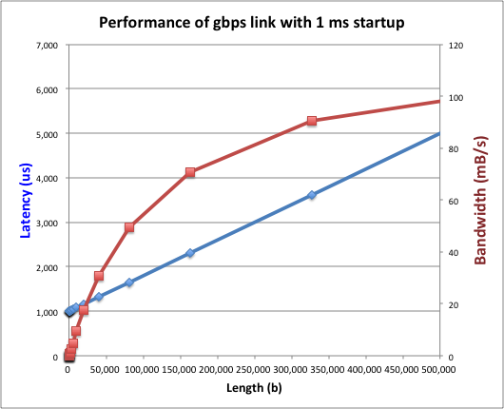
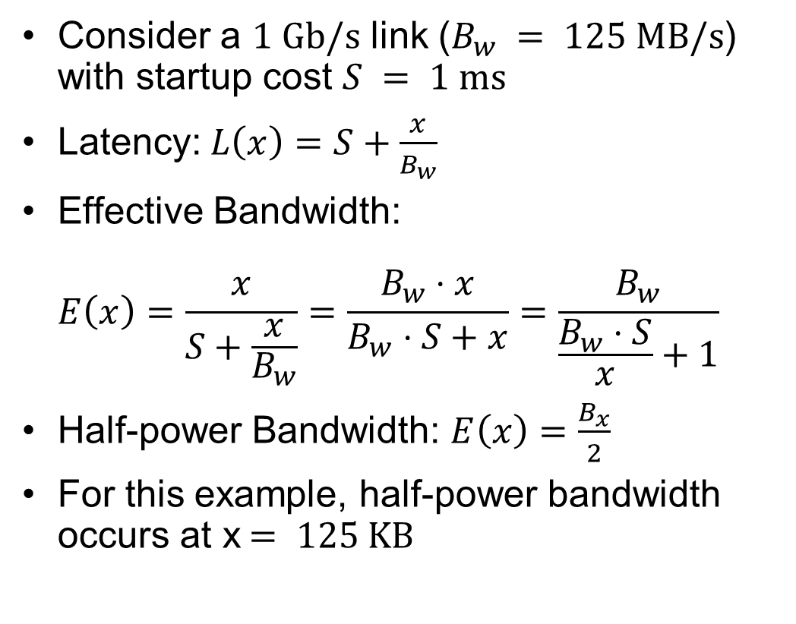
Recall: I/O Performance (Network Example)
Consider a $1 \text{Gb}\text{/}\text{s}$ link ($B_{w} = 125 \text{MB}\text{/}\text{s}$) with startup cost $S = 1 \text{ms}$
Latency:$L\left(x\right)=S+\frac{x}{B_{w}}$
Effective Bandwidth: $E\left(x\right)=\frac{x}{S+\frac{x}{B_{w}}}=\frac{B_{w}⋅x}{B_{w}⋅S+x}=\frac{B_{w}}{\frac{B_{w}⋅S}{x}+1}$
Half-power Bandwidth: $E\left(x\right)=\frac{B_{x}}{2}$
For this example, half-power bandwidth occurs at x$= 125 \text{KB}$
Length (x)

Slide 3
Recall: A Few Queuing Theory Results
Assumptions:
System in equilibrium; No limit to the queue
Time between successive arrivals is random and memoryless
Parameters that describe our system:
λ: mean number of arriving customers/second
T_{ser}: mean time to service a customer (“m1”)
C: squared coefficient of variance = σ²/m1²
μ: service rate = 1/T_{ser}
u: server utilization (0≤u≤1): u = λ/μ = λ × T_{ser}
Parameters we wish to compute:
T_{q}: Time spent in queue
L_{q}: Length of queue = λ × T_{q} (by Little’s law)
Results:
Memoryless service distribution (C = 1): (an “M/M/1 queue”):
T_{q} = T_{ser} x u/(1 – u)
General service distribution (no restrictions), 1 server (an “M/G/1 queue”):
T_{q} = T_{ser} x ½(1+C) x u/(1 – u)
Why does response/queueing delay grow unboundedly even though the utilization is < 1 ?
Queue
Server
Arrival Rate
λ
Service Rate
μ=1/T_{ser}
300
Response
Time (ms)
200
100
0
0%
100%
Throughput (Utilization)
(% total BW)

Slide 4
Recall: When is Disk Performance Highest?
When there are big sequential reads, or
When there is so much work to do that they can be piggy backed (reordering queues—one moment)
OK to be inefficient when things are mostly idle
Bursts are both a threat and an opportunity
<your idea for optimization goes here>
Waste space for speed?
Other techniques:
Reduce overhead through user level drivers
Reduce the impact of I/O delays by doing other useful work in the meantime

Slide 5
Disk Scheduling (1/3)
Disk can do only one request at a time; What order do you choose to do queued requests?
FIFO Order
Fair among requesters, but order of arrival may be to random spots on the disk ⇒ Very long seeks
SSTF: Shortest seek time first
Pick the request that’s closest on the disk
Although called SSTF, today must include rotational delay in calculation, since rotation can be as long as seek
Con: SSTF good at reducing seeks, but may lead to starvation
User
Requests
2,2
5,2
7,2
3,10
2,1
2,3
Head
3
Disk Head
2
1
4

Slide 6
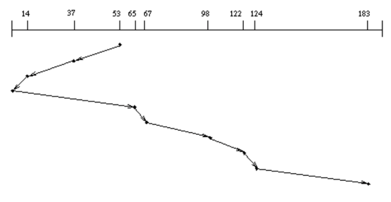
Disk Scheduling (2/3)
Disk can do only one request at a time; What order do you choose to do queued requests?
SCAN: Implements an Elevator Algorithm: take the closest request in the direction of travel
No starvation, but retains flavor of SSTF
User
Requests
2,2
5,2
7,2
3,10
2,1
2,3
Head

Slide 7
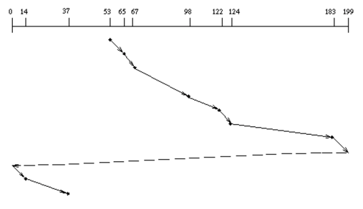
Disk Scheduling (3/3)
Disk can do only one request at a time; What order do you choose to do queued requests?
C-SCAN: Circular-Scan: only goes in one direction
Skips any requests on the way back
Fairer than SCAN, not biased towards pages in middle
User
Requests
2,2
5,2
7,2
3,10
2,1
2,3
Head

Slide 8
Recall: How do we Hide I/O Latency?
Blocking Interface: “Wait”
When request data (e.g., read() system call), put process to sleep until data is ready
When write data (e.g., write() system call), put process to sleep until device is ready for data
Non-blocking Interface: “Don’t Wait”
Returns quickly from read or write request with count of bytes successfully transferred to kernel
Read may return nothing, write may write nothing
Asynchronous Interface: “Tell Me Later”
When requesting data, take pointer to user’s buffer, return immediately; later kernel fills buffer and notifies user
When sending data, take pointer to user’s buffer, return immediately; later kernel takes data and notifies user

Slide 9

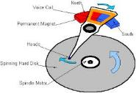




Recall: I/O and Storage Layers
Application / Service
High Level I/O
Streams
Low Level I/O
File Descriptors
What we covered in Lecture 4
Syscall
open(), read(), write(), close(), …
Open File Descriptions
File System
Files/Directories/Indexes
What we will cover next…
I/O Driver
Commands and Data Transfers
Disks, Flash, Controllers, DMA
What we just covered…

Slide 10
From Storage to File Systems
I/O API and
syscalls
Variable-Size Buffer
Memory Address
Logical Index, Typically 4 KB
File System
Block
Flash Trans. Layer
Hardware Devices
Sector(s)
Sector(s)
Sector(s)
Phys. Block
Phys Index., 4KB
Physical Index,
512B or 4KB
Erasure Page
HDD
SSD

Slide 11
Building a File System
File System: Layer of OS that transforms block interface of disks (or other block devices) into Files, Directories, etc.
Classic OS situation: Take limited hardware interface (array of blocks) and provide a more convenient/useful interface with:
Naming: Find file by name, not block numbers
Organize file names with directories
Organization: Map files to blocks
Protection: Enforce access restrictions
Reliability: Keep files intact despite crashes, hardware failures, etc.

Slide 12
Recall: User vs. System View of a File
User’s view:
Durable Data Structures
System’s view (system call interface):
Collection of Bytes (UNIX)
Doesn’t matter to system what kind of data structures you want to store on disk!
System’s view (inside OS):
Collection of blocks (a block is a logical transfer unit, while a sector is the physical transfer unit)
Block size ≥ sector size; in UNIX, block size is 4KB

Slide 13

Translation from User to System View
File (Bytes)
File
System
What happens if user says: “give me bytes 2 – 12?”
Fetch block corresponding to those bytes
Return just the correct portion of the block
What about writing bytes 2 – 12?
Fetch block, modify relevant portion, write out block
Everything inside file system is in terms of whole-size blocks
Actual disk I/O happens in blocks
read/write smaller than block size needs to translate and buffer

Slide 14
Administrivia
Midterm 3: Thursday 4/28
All material from term
Project 3 Design Document: Next Monday (4/11)
If you have any group issues going on, make sure you:
Make sure that your TA understands what is happing
Make sure that you reflect these issues on your group evaluations

Slide 15
Disk Management
Basic entities on a disk:
File: user-visible group of blocks arranged sequentially in logical space
Directory: user-visible index mapping names to files
The disk is accessed as linear array of sectors
How to identify a sector?
Physical position
Sectors is a vector [cylinder, surface, sector]
Not used anymore
OS/BIOS must deal with bad sectors
Logical Block Addressing (LBA)
Every sector has integer address
Controller translates from address ⇒ physical position
Shields OS from structure of disk

Slide 16
What Does the File System Need?
Track free disk blocks
Need to know where to put newly written data
Track which blocks contain data for which files
Need to know where to read a file from
Track files in a directory
Find list of file's blocks given its name
Where do we maintain all of this?
Somewhere on disk

Slide 17
Data Structures on Disk
Bit different than data structures in memory
Access a block at a time
Can't efficiently read/write a single word
Have to read/write full block containing it
Ideally want sequential access patterns
Durability
Ideally, file system is in meaningful state upon shutdown
This obviously isn't always the case…

Slide 18
File System Design

Slide 19
Critical Factors in File System Design
(Hard) Disks Performance !!!
Maximize sequential access, minimize seeks
Open before Read/Write
Can perform protection checks and look up where the actual file resource are, in advance
Size is determined as they are used !!!
Can write (or read zeros) to expand the file
Start small and grow, need to make room
Organized into directories
What data structure (on disk) for that?
Need to carefully allocate / free blocks
Such that access remains efficient

Slide 20
Components of a File System
File path
Directory
Structure
File
Header
Structure
One Block = multiple sectors
Ex: 512 sector, 4K block
File number
“inumber”
Data blocks
“inode”
…

Slide 21
Recall: Abstract Representation of a Process
Process
Suppose that we execute
open(“foo.txt”)
and that the result is 3
Next, suppose that we execute
read(3, buf, 100)
and that the result is 100
Thread’s Regs
Address Space (Memory)
…
User Space
Kernel Space
File Descriptors
Open File Description
3
Not shown: Initially contains 0, 1, and 2 (stdin, stdout, stderr)
File: foo.txt
Position: 100

Slide 22
Components of a File System
Process
Open file description is better described as remembering the inumber (file number) of the file, not its name
Thread’s Regs
Address Space (Memory)
…
User Space
Kernel Space
File Descriptors
Open File Description
3
File: foo.txt inumber
Position: 100
Not shown: Initially contains 0, 1, and 2 (stdin, stdout, stderr)

Slide 23
Components of a File System
file name
offset
file number
offset
storage block
directory structure
index structure (“inode”)
Open performs Name Resolution
Translates path name into a “file number”
Read and Write operate on the file number
Use file number as an “index” to locate the blocks
4 components:
directory, index structure, storage blocks, free space map

Slide 24
How to get the File Number?
Look up in directory structure
A directory is a file containing <file_name : file_number> mappings
File number could be a file or another directory
Operating system stores the mapping in the directory in a format it interprets
Each <file_name : file_number> mapping is called a directory entry
Process isn’t allowed to read the raw bytes of a directory
The read function doesn’t work on a directory
Instead, see readdir, which iterates over the map without revealing the raw bytes
Why shouldn’t the OS let processes read/write the bytes of a directory?

Slide 25
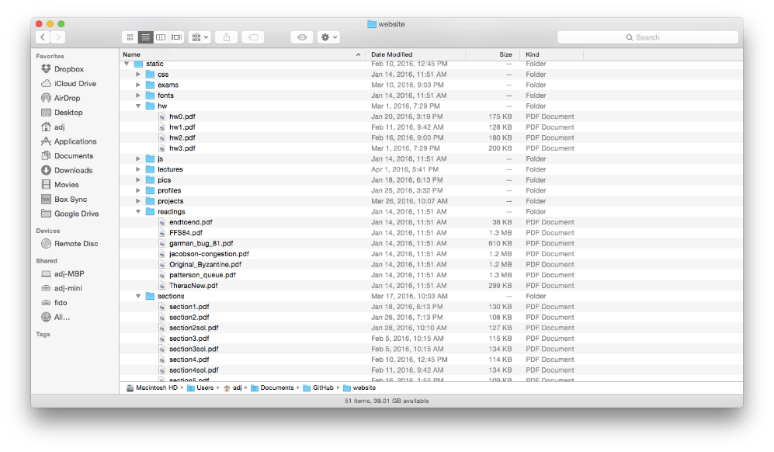
Directories

Slide 26
Directory Abstraction
Directories are specialized files
Contents: List of pairs <file name, file number>
System calls to access directories
open / creat / readdir traverse the structure
mkdir / rmdir add/remove entries
link / unlink (rm)
libc support
DIR * opendir (const char *dirname)
struct dirent * readdir (DIR *dirstream)
int readdir_r (DIR *dirstream, struct dirent *entry, struct dirent **result)
/usr
/usr/lib
/usr/lib4.3
/usr/lib4.3/foo

Slide 27
Directory Structure
How many disk accesses to resolve “/my/book/count”?
Read in file header for root (fixed spot on disk)
Read in first data block for root
Table of file name/index pairs.
Search linearly – ok since directories typically very small
Read in file header for “my”
Read in first data block for “my”; search for “book”
Read in file header for “book”
Read in first data block for “book”; search for “count”
Read in file header for “count”
Current working directory: Per-address-space pointer to a directory used for resolving file names
Allows user to specify relative filename instead of absolute path (say CWD=“/my/book” can resolve “count”)

Slide 28
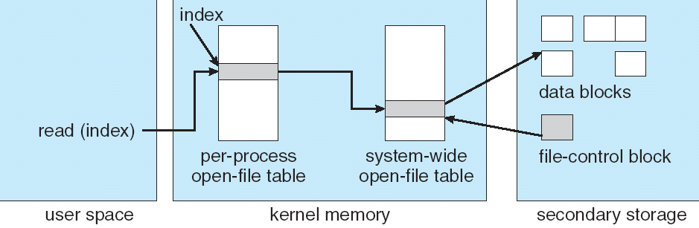
In-Memory File System Structures
fd
(fd)
inode
Open syscall: find inode on disk from pathname (traversing directories)
Create “in-memory inode” in system-wide open file table
One entry in this table no matter how many instances of the file are open
Read/write syscalls look up in-memory inode using the file handle

Slide 29
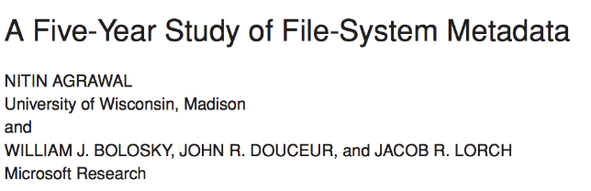
Characteristics of Files
Published in FAST 2007

Slide 30
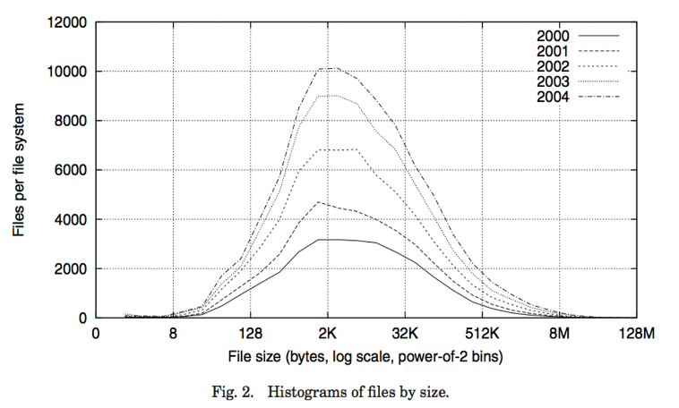
Observation #1: Most Files Are Small

Slide 31
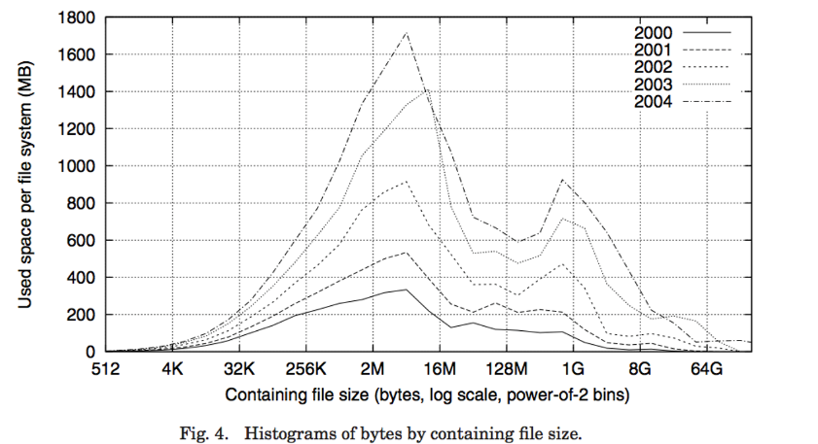
Observation #2: Most Bytes are in Large Files

Slide 32
Case Study: FAT: File Allocation Table
MS-DOS, 1977
Still widely used!

Slide 33
FAT (File Allocation Table)
Assume (for now) we have a way to translate a path to a “file number”
i.e., a directory structure
Disk Storage is a collection of Blocks
Just hold file data (offset o = < B, x >)
Example: file_read 31, < 2, x >
Index into FAT with file number
Follow linked list to block
Read the block from disk into memory
FAT
Disk Blocks
0:
0:
File number
31:
File 31, Block 0
File 31, Block 1
File 31, Block 2
File 31, Block 2
N-1:
N-1:
memory

Slide 34
FAT (File Allocation Table)
File is a collection of disk blocks
FAT is linked list 1-1 with blocks
File number is index of root of block list for the file
File offset: block number and offset within block
Follow list to get block number
Unused blocks marked free
Could require scan to find
Or, could use a free list
FAT
Disk Blocks
0:
0:
File number
31:
File 31, Block 0
File 31, Block 1
free
File 31, Block 2
N-1:
N-1:
memory

Slide 35
FAT (File Allocation Table)
File is a collection of disk blocks
FAT is linked list 1-1 with blocks
File number is index of root of block list for the file
File offset: block number and offset within block
Follow list to get block number
Unused blocks marked free
Could require scan to find
Or, could use a free list
FAT
Disk Blocks
0:
0:
File number
31:
File 31, Block 0
File 31, Block 1
free
File 31, Block 2
N-1:
N-1:
memory

Slide 36
FAT (File Allocation Table)
File is a collection of disk blocks
FAT is linked list 1-1 with blocks
File number is index of root of block list for the file
File offset: block number and offset within block
Follow list to get block number
Unused blocks marked free
Could require scan to find
Or, could use a free list
Ex: file_write(31, < 3, y >)
Grab free block
Linking them into file
FAT
Disk Blocks
0:
0:
File number
31:
File 31, Block 0
File 31, Block 1
File 31, Block 3
free
File 31, Block 2
N-1:
N-1:
memory

Slide 37
FAT (File Allocation Table)
Where is FAT stored?
On disk
How to format a disk?
Zero the blocks, mark FAT entries “free”
How to quick format a disk?
Mark FAT entries “free”
Simple: can implement in device firmware
FAT
Disk Blocks
0:
0:
File #1
31:
File 31, Block 0
File 31, Block 1
File 31, Block 3
free
File #2
File 31, Block 2
N-1:
N-1:
memory

Slide 38
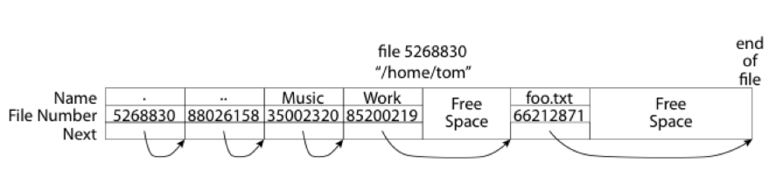
FAT: Directories
A directory is a file containing <file_name: file_number> mappings
Free space for new/deleted entries
In FAT: file attributes are kept in directory (!!!)
Not directly associated with the file itself
Each directory a linked list of entries
Requires linear search of directory to find particular entry
Where do you find root directory (“/”)?
At well-defined place on disk
For FAT, this is at block 2 (there are no blocks 0 or 1)
Remaining directories

Slide 39
FAT Discussion
Suppose you start with the file number:
Time to find block?
Block layout for file?
Sequential access?
Random access?
Fragmentation?
Small files?
Big files?
FAT
Disk Blocks
0:
0:
File #1
31:
File 31, Block 0
File 31, Block 1
File 31, Block 3
free
File #2
File 31, Block 2
N-1:
N-1:
memory

Slide 40
Case Study: Unix File System (Berkeley FFS)

Slide 41
Inodes in Unix (Including Berkeley FFS)
File Number is index into set of inode arrays
Index structure is an array of inodes
File Number (inumber) is an index into the array of inodes
Each inode corresponds to a file and contains its metadata
So, things like read/write permissions are stored with file, not in directory
Allows multiple names (directory entries) for a file
Inode maintains a multi-level tree structure to find storage blocks for files
Great for little and large files
Asymmetric tree with fixed sized blocks
Original inode format appeared in BSD 4.1 (more following)
Berkeley Standard Distribution Unix!
Part of your heritage!
Similar structure for Linux Ext 2/3

Slide 42
Inode Structure

Slide 43
File Atributes
User
Group
9 basic access control bits
- UGO x RWX
SetUID bit
- execute at owner permissions rather than user
SetGID bit
- execute at group’s permissions

Slide 44

Small Files: 12 Pointers Direct to Data Blocks
Direct pointers
4kB blocks ⇒ sufficient for files up to 48KB

Slide 45
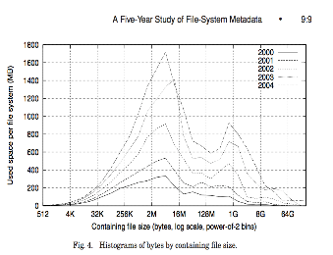
Large Files: 1-, 2-, 3-level indirect pointers
Indirect pointers
- point to a disk block
containing only pointers
- 4 kB blocks => 1024 ptrs
=> 4 MB @ level 2
=> 4 GB @ level 3
=> 4 TB @ level 4
48 KB
+4 MB
+4 GB
+4 TB

Slide 46
Putting it All Together: On-Disk Index
Sample file in multilevel indexed format:
10 direct ptrs, 1K blocks
How many accesses for block #23? (assume file header accessed on open)?
Two: One for indirect block, one for data
How about block #5?
One: One for data
Block #340?
Three: double indirect block, indirect block, and data

Slide 47
Recall: Critical Factors in File System Design
(Hard) Disk Performance !!!
Maximize sequential access, minimize seeks
Open before Read/Write
Can perform protection checks and look up where the actual file resource are, in advance
Size is determined as they are used !!!
Can write (or read zeros) to expand the file
Start small and grow, need to make room
Organized into directories
What data structure (on disk) for that?
Need to carefully allocate / free blocks
Such that access remains efficient

Slide 48
Recall: Magnetic Disks
Track
Sector
Cylinders: all the tracks under the head at a given point on all surfaces
Read/write data is a three-stage process:
Seek time: position the head/arm over the proper track
Rotational latency: wait for desired sector to rotate under r/w head
Transfer time: transfer a block of bits (sector) under r/w head
Head
Cylinder
Platter
Disk Latency = Queueing Time + Controller time +
Seek Time + Rotation Time + Xfer Time
Software
Queue
(Device Driver)
Hardware
Controller
Media Time
(Seek+Rot+Xfer)
Request
Result

Slide 49
Fast File System (BSD 4.2, 1984)
Same inode structure as in BSD 4.1
same file header and triply indirect blocks like we just studied
Some changes to block sizes from 1024⇒4096 bytes for performance
Paper on FFS: “A Fast File System for UNIX”
Marshall McKusick, William Joy, Samuel Leffler and Robert Fabry
Off the “resources” page of course website – Take a look!
Optimization for Performance and Reliability:
Distribute inodes among different tracks to be closer to data
Uses bitmap allocation in place of freelist
Attempt to allocate files contiguously
10% reserved disk space
Skip-sector positioning (mentioned later)

Slide 50
FFS Changes in Inode Placement: Motivation
In early UNIX and DOS/Windows’ FAT file system, headers stored in special array in outermost cylinders
Fixed size, set when disk is formatted
At formatting time, a fixed number of inodes are created
Each is given a unique number, called an “inumber”
Problem #1: Inodes all in one place (outer tracks)
Head crash potentially destroys all files by destroying inodes
Inodes not close to the data that the point to
To read a small file, seek to get header, seek back to data
Problem #2: When create a file, don’t know how big it will become (in UNIX, most writes are by appending)
How much contiguous space do you allocate for a file?
Makes it hard to optimize for performance

Slide 51
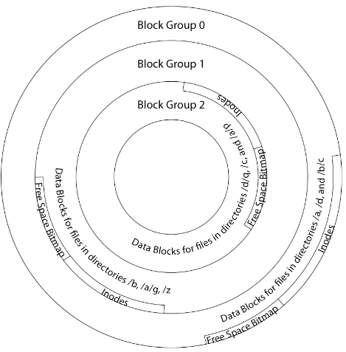
FFS Locality: Block Groups
The UNIX BSD 4.2 (FFS) distributed the header information (inodes) closer to the data blocks
Often, inode for file stored in same “cylinder group” as parent directory of the file
makes an “ls” of that directory run very fast
File system volume divided into set of block groups
Close set of tracks
Data blocks, metadata, and free space interleaved within block group
Avoid huge seeks between user data and system structure
Put directory and its files in common block group

Slide 52
FFS Locality: Block Groups (Con’t)
First-Free allocation of new file blocks
To expand file, first try successive blocks in bitmap, then choose new range of blocks
Few little holes at start, big sequential runs at end of group
Avoids fragmentation
Sequential layout for big files
Important: keep 10% or more free!
Reserve space in the Block Group
Summary: FFS Inode Layout Pros
For small directories, can fit all data, file headers, etc. in same cylinder ⇒ no seeks!
File headers much smaller than whole block (a few hundred bytes), so multiple headers fetched from disk at same time
Reliability: whatever happens to the disk, you can find many of the files (even if directories disconnected)

Slide 53
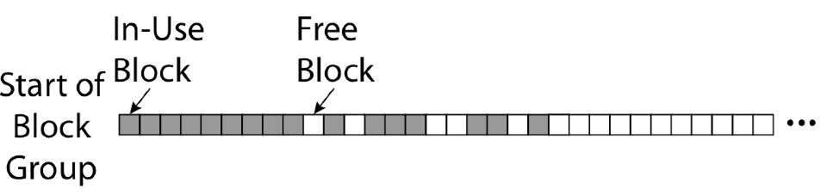
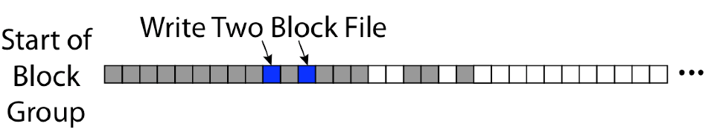
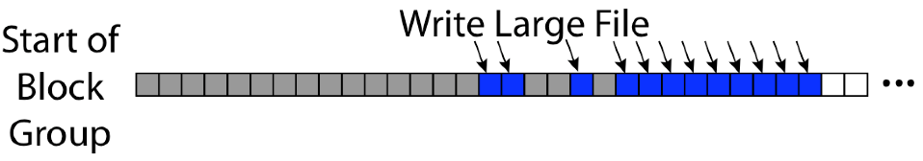
UNIX 4.2 BSD FFS First Fit Block Allocation
Fills in the small holes at the start of block group
Avoids fragmentation, leaves contiguous free space at end

Slide 54
Attack of the Rotational Delay
Problem 3: Missing blocks due to rotational delay
Issue: Read one block, do processing, and read next block. In meantime, disk has continued turning: missed next block! Need 1 revolution/block!
Solution1: Skip sector positioning (“interleaving”)
Place the blocks from one file on every other block of a track: give time for processing to overlap rotation
Can be done by OS or in modern drives by the disk controller
Solution 2: Read ahead: read next block right after first, even if application hasn’t asked for it yet
This can be done either by OS (read ahead)
By disk itself (track buffers) - many disk controllers have internal RAM that allows them to read a complete track
Modern disks + controllers do many things “under the covers”
Track buffers, elevator algorithms, bad block filtering
Skip Sector
Track Buffer
(Holds complete track)

Slide 55
UNIX 4.2 BSD FFS
Pros
Efficient storage for both small and large files
Locality for both small and large files
Locality for metadata and data
No defragmentation necessary!
Cons
Inefficient for tiny files (a 1 byte file requires both an inode and a data block)
Inefficient encoding when file is mostly contiguous on disk
Need to reserve 10-20% of free space to prevent fragmentation

Slide 56
Conclusion
File System:
Transforms blocks into Files and Directories
Optimize for access and usage patterns
Maximize sequential access, allow efficient random access
File (and directory) defined by header, called “inode”
Naming: translating from user-visible names to actual sys resources
Directories used for naming for local file systems
Linked or tree structure stored in files
File Allocation Table (FAT) Scheme
Linked-list approach
Very widely used: Cameras, USB drives, SD cards
Simple to implement, but poor performance and no security
Look at actual file access patterns
Many small files, but large files take up all the space!
4.2 BSD Fast File System: Multi-level inode header to describe files
Inode contains ptrs to actual blocks, indirect blocks, double indirect blocks, etc.
Optimizations for sequential access: start new files in open ranges of free blocks, rotational optimization

