Slide 1
CS162 Operating Systems and Systems Programming Lecture 24 Networking and TCP/IP (Con’t), RPC, Distributed File Systems
April 21st, 2022
Prof. Anthony Joseph and John Kubiatowicz
http://cs162.eecs.Berkeley.edu

Slide 2
Recall: Distributed Consensus Making
Consensus problem
All nodes propose a value
Some nodes might crash and stop responding
Eventually, all remaining nodes decide on the same value from set of proposed values
Distributed Decision Making
Choose between “true” and “false”
Or Choose between “commit” and “abort”
Equally important (but often forgotten!): make it durable!
How do we make sure that decisions cannot be forgotten?
This is the “D” of “ACID” in a regular database
In a global-scale system?
What about erasure coding or massive replication?
Like BlockChain applications!

Slide 3
Recall: Two-Phase Commit Protocol
Persistent stable log on each machine: keep track of whether commit has happened
If a machine crashes, when it wakes up it first checks its log to recover state of world at time of crash
Prepare Phase:
The global coordinator requests that all participants will promise to commit or rollback the transaction
Participants record promise in log, then acknowledge
If anyone votes to abort, coordinator writes "Abort" in its log and tells everyone to abort; each records "Abort" in log
Commit Phase:
After all participants respond that they are prepared, then the coordinator writes "Commit" to its log
Then asks all nodes to commit; they respond with ACK
After receive ACKs, coordinator writes "Got Commit" to log
Log used to guarantee that all machines either commit or don’t

Slide 4
Distributed Decision Making Discussion (1/2)
Why is distributed decision making desirable?
Fault Tolerance!
A group of machines can come to a decision even if one or more of them fail during the process
Simple failure mode called “failstop” (different modes later)
After decision made, result recorded in multiple places
Why is 2PC not subject to the General’s paradox?
Because 2PC is about all nodes eventually coming to the same decision – not necessarily at the same time!
Allowing us to reboot and continue allows time for collecting and collating decisions

Slide 5
Distributed Decision Making Discussion (2/2)
Undesirable feature of Two-Phase Commit: Blocking
One machine can be stalled until another site recovers:
Site B writes "prepared to commit" record to its log, sends a "yes" vote to the coordinator (site A) and crashes
Site A crashes
Site B wakes up, check its log, and realizes that it has voted "yes" on the update. It sends a message to site A asking what happened. At this point, B cannot decide to abort, because update may have committed
B is blocked until A comes back
A blocked site holds resources (locks on updated items, pages pinned in memory, etc) until learns fate of update

Slide 6
Alternatives to 2PC
Three-Phase Commit: One more phase, allows nodes to fail or block and still make progress.
PAXOS: An alternative used by Google and others that does not have 2PC blocking problem
Develop by Leslie Lamport (Turing Award Winner)
No fixed leader, can choose new leader on fly, deal with failure
Some think this is extremely complex!
RAFT: PAXOS alternative from John Osterhout (Stanford)
Simpler to describe complete protocol
What happens if one or more of the nodes is malicious?
Malicious: attempting to compromise the decision making
Use a more hardened decision making process: Byzantine Agreement and Block Chains

Slide 7
Byzantine General’s Problem
Lieutenant
Attack!
Attack!
Attack!
Attack!
Retreat!
Attack!
Attack!
Lieutenant
Retreat!
General
Attack!
Lieutenant
Malicious!
Byazantine General’s Problem (n players):
One General and n-1 Lieutenants
Some number of these (f) can be insane or malicious
The commanding general must send an order to his n-1 lieutenants such that the following Integrity Constraints apply:
IC1: All loyal lieutenants obey the same order
IC2: If the commanding general is loyal, then all loyal lieutenants obey the order he sends

Slide 8
Byzantine General’s Problem (con’t)
Impossibility Results:
Cannot solve Byzantine General’s Problem with n=3 because one malicious player can mess up things
With f faults, need n > 3f to solve problem
Various algorithms exist to solve problem
Original algorithm has #messages exponential in n
Newer algorithms have message complexity O(n²)
One from MIT, for instance (Castro and Liskov, 1999)
Use of BFT (Byzantine Fault Tolerance) algorithm
Allow multiple machines to make a coordinated decision even if some subset of them (< n/3 ) are malicious
General
General
Attack!
Attack!
Attack!
Retreat!
Lieutenant
Lieutenant
Lieutenant
Lieutenant
Retreat!
Retreat!
Request
Distributed
Decision

Slide 9
Is a BlockChain a Distributed Decision Making Algorithm?
Tentative Head #1
Root
Block
Tentative Head #2
Hash Ptr
The “Block Chain”
BlockChain: a chain of blocks connected by hashes to root block
The Hash Pointers are unforgeable (assumption)
The Chain has no branches except perhaps for heads
Blocks are considered “authentic” part of chain when they have authenticity info in them
How is the head chosen?
Some consensus algorithm
In many BlockChain algorithms (e.g. BitCoin, Ethereum), the head is chosen by solving hard problem
This is the job of “miners” who try to find “nonce” info that makes hash over block have specified number of zero bits in it
The result is a “Proof of Work” (POW)
Selected blocks above (green) have POW in them and can be included in chains
Longest chain wins

Slide 10
Is a Blockchain a Distributed Decision Making Algorithm? (Con’t)
Miner:
Tries to solve POW problem
Observer:
Tracks state of BlockChain
Miner:
Tries to solve POW problem
Observer:
Tracks state of BlockChain
Proposal
Observer:
Tracks state of BlockChain
Root
Block
Root
Block
Hash Ptr
Root
Block
Root
Block
Hash Ptr
Hash Ptr
Root
Block
Hash Ptr
Epidemic
Replication
Hash Ptr
Observer:
Tracks state of BlockChain
Observer:
Tracks state of BlockChain
Observer:
Tracks state of BlockChain
Observer:
Tracks state of BlockChain
Observer:
Tracks state of BlockChain
Miner:
Tries to solve POW problem
Observer:
Tracks state of BlockChain
Root
Block
Root
Block
Hash Ptr
Root
Block
Hash Ptr
Root
Block
Hash Ptr
Root
Block
Hash Ptr
Root
Block
Root
Block
Hash Ptr
Hash Ptr
Hash Ptr
Decision means: Proposal is locked into BlockChain
Could be Commit/Abort decision
Could be Choice of Value, State Transition, ….
NAK: Didn’t make it into the block chain (must retry!)
Anyone in world can verify the result of decision making!
Proposal

Slide 11
Network Protocols
Networking protocols: many levels
Physical level: mechanical and electrical network (e.g., how are 0 and 1 represented)
Link level: packet formats/error control (for instance, the CSMA/CD protocol)
Network level: network routing, addressing
Transport Level: reliable message delivery
Protocols on today’s Internet:
WWW
e-mail
NFS
ssh
RPC
Transport
UDP
TCP
Network
IP
Physical/Link
Ethernet
WiFi
LTE

Slide 12

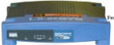


Broadcast Networks
Broadcast Network: Shared Communication Medium
Shared Medium can be a set of wires
Inside a computer, this is called a bus
All devices simultaneously connected to devices
Originally, Ethernet was a broadcast network
All computers on local subnet connected to one another
More examples (wireless: medium is air): cellular phones (GSM, CDMA, and LTE), WiFi
Processor
I/O
Device
I/O
Device
I/O
Device
Memory
Internet

Slide 13
Broadcast Networks Details
Header
(Dest:2)
Body
(Data)
ID:1
(ignore)
Message
ID:3
(sender)
ID:4
(ignore)
ID:2
(receive)
Media Access Control (MAC) Address:
48-bit physical address for hardware interface
Every device (in the world!?) has a unique address
Delivery: When you broadcast a packet, how does a receiver know who it is for? (packet goes to everyone!)
Put header on front of packet: [ Destination MAC Addr | Packet ]
Everyone gets packet, discards if not the target
In Ethernet, this check is done in hardware
No OS interrupt if not for particular destination

Slide 14
Carrier Sense, Multiple Access/Collision Detection
Ethernet (early 80’s): first practical local area network
It is the most common LAN for UNIX, PC, and Mac
Use wire instead of radio, but still broadcast medium
Key advance was in arbitration called CSMA/CD: Carrier sense, multiple access/collision detection
Carrier Sense: don’t send unless idle
Don’t mess up communications already in process
Collision Detect: sender checks if packet trampled.
If so, abort, wait, and retry.
Backoff Scheme: Choose wait time before trying again
How long to wait after trying to send and failing?
What if everyone waits the same length of time? Then, they all collide again at some time!
Must find way to break up shared behavior with nothing more than shared communication channel
Adaptive randomized waiting strategy:
Adaptive and Random: First time, pick random wait time with some initial mean. If collide again, pick random value from bigger mean wait time. Etc.
Randomness is important to decouple colliding senders
Scheme figures out how many people are trying to send!

Slide 15
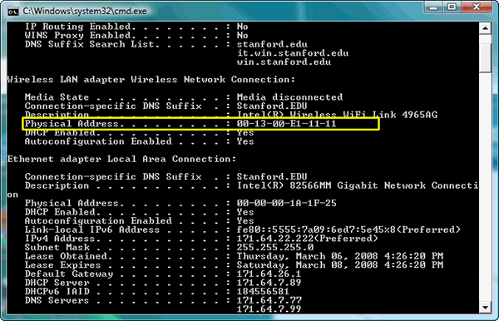
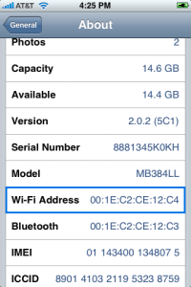
MAC Address: Unique Physical Address of Interface
Application
Present.
Session
Can easily find MAC addr. on your machine/device:
E.g., ifconfig (Linux, Mac OS X), ipconfig (Windows)
Transport
Network
Datalink
Physical
Wi-Fi MAC address
Wired/Ethernet MAC address

Slide 16
Point-to-point networks
Switch
Router
Internet
Why have a shared bus at all? Why not simplify and only have point-to-point links + routers/switches?
Originally wasn’t cost-effective, now hardware is cheap!
Point-to-point network: a network in which every physical wire is connected to only two computers
Switch: a bridge that transforms a shared-bus (broadcast) configuration into a point-to-point network
Adaptively figures out which ports have which MAC addresses
Router: a device that acts as a junction between physical networks to transfer data packets among them
Routes between switching domains using (for instance) IP addresses

Slide 17

The Internet Protocol (IP)
Application
Present.
Session
Internet Protocol: Internet’s network layer
Service it provides: “Best-Effort” Packet Delivery
Tries it’s “best” to deliver packet to its destination
Packets may be lost
Packets may be corrupted
Packets may be delivered out of order
IP Is a Datagram service!
Routes across many physical switching domains (subnets)
Transport
Network
Datalink
Physical
source
destination
IP network

Slide 18
IPv4 Address Space
IP Address: a 32-bit integer used as destination of IP packet
Often written as four dot-separated integers, with each integer from 0—255 (thus representing 8x4=32 bits)
Example CS file server is: 169.229.60.83 ≡ 0xA9E53C53
Internet Host: a computer connected to the Internet
Host has one or more IP addresses used for routing
Some of these may be private and unavailable for routing
Not every computer has a unique IP address
Groups of machines may share a single IP address
In this case, machines have private addresses behind a “Network Address Translation” (NAT) gateway
Subnet: network connecting hosts with related IP addresses
A subnet is identified by 32-bit value, with the bits which differ set to zero, followed by a slash and a mask
Example: 128.32.131.0/24 designates a subnet in which all the addresses look like 128.32.131.XX
Same subnet: 128.32.131.0/255.255.255.0
Mask: The number of matching prefix bits
Expressed as a single value (e.g., 24) or a set of ones in a 32-bit value (e.g., 255.255.255.0)
Often routing within subnet is by MAC address (smart switches)

Slide 19
Address Ranges in IPv4
IP address space divided into prefix-delimited ranges:
Class A: NN.0.0.0/8
NN is 1–126 (126 of these networks)
16,777,214 IP addresses per network
10.xx.yy.zz is private
127.xx.yy.zz is loopback
Class B: NN.MM.0.0/16
NN is 128–191, MM is 0-255 (16,384 of these networks)
65,534 IP addresses per network
172.[16-31].xx.yy are private
Class C: NN.MM.LL.0/24
NN is 192–223, MM and LL 0-255 (2,097,151 of these networks)
254 IP addresses per networks
192.168.xx.yy are private
Address ranges are often owned by organizations
Can be further divided into subnets

Slide 20
IPv4 Packet Format
IP Packet Format:
IP Datagram: an unreliable, unordered, packet sent from source to destination
Function of network – deliver datagrams!
IP Header
Length
Size of datagram
(header+data)
Flags &
Fragmentation
to split large
messages
0
15
16
31
IP Ver4
4
IHL
ToS
Total length(16-bits)
16-bit identification
flags
13-bit frag off
IP header
20 bytes
Time to
Live (hops)
TTL
protocol
16-bit header checksum
32-bit source IP address
Type of
transport
protocol
32-bit destination IP address
options (if any)
Data

Slide 21
Wide Area Network
Wide Area Network (WAN): network that covers a broad area (e.g., city, state, country, entire world)
E.g., Internet is a WAN
WAN connects multiple physical (datalink) layer networks (LANs)
Datalink layer networks are connected by routers
Different LANs can use different communication technology (e.g., wireless, cellular, optics, wired)
Host A
(IP A)
R4
Host B
(IP B)
R2
R3
R1

Slide 22
Routers
Forward each packet received on an incoming link to an outgoing link based on packet’s destination IP address (towards its destination)
Store & forward: packets are buffered before being forwarded
Forwarding table: mapping between IP address and the output link
incoming links
Router
outgoing links
Memory

Slide 23
Packet Forwarding
Upon receiving a packet, a router
read the IP destination address of the packet
consults its forwarding table → output port
forwards packet to corresponding output port
Default route (for subnets without explicit entries)
Forward to more authoritative router
Host A
(IP A)
R4
Host B
(IP B)
IP B
R2
R3
R1

Slide 24

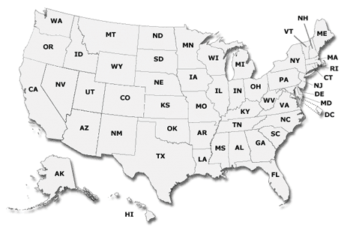

IP Addresses vs. MAC Addresses
Why not use MAC addresses for routing?
Doesn’t scale
Analogy
MAC address → SSN
IP address → (unreadable) home address
MAC address: uniquely associated with device for the entire lifetime of the device
IP address: changes as the device location changes
Your notebook IP address at school is different from home
1051 Euclid Ave
Berkeley, CA 94722
10 7th Street NW
Washington, DC 21115

Slide 25

IP Addresses vs. MAC Addresses
Why does packet forwarding using IP addr. scale?
Because IP addresses can be aggregated
E.g., all IP addresses at UC Berkeley start with 0xA9E5, i.e., any address of form 0xA9E5**** belongs to Berkeley
Thus, a router in NY needs to keep a single entry for all hosts at Berkeley
If we were using MAC addresses the NY router would need to maintain an entry for every Berkeley host!!
Analogy:
Give this letter to person with SSN: 123-45-6789 vs.
Give this letter to “John Smith, 123 First Street, LA, US”

Slide 26
Setting up Routing Tables
How do you set up routing tables?
Internet has no centralized state!
No single machine knows entire topology
Topology constantly changing (faults, reconfiguration, etc.)
Need dynamic algorithm that acquires routing tables
Ideally, have one entry per subnet or portion of address
Could have “default” routes that send packets for unknown subnets to a different router that has more information
Possible algorithm for acquiring routing table
Routing table has “cost” for each entry
Includes number of hops to destination, congestion, etc.
Entries for unknown subnets have infinite cost
Neighbors periodically exchange routing tables
If neighbor knows cheaper route to a subnet, replace your entry with neighbors entry (+1 for hop to neighbor)
In reality:
Internet has networks of many different scales
Different algorithms run at different scales

Slide 27
Administrivia
Midterm 3: Thursday 4/28: 7-9PM
All course material
Review session Monday 4/25 1-3PM

Slide 28

Naming in the Internet
Name
⇒
Address
How to map human-readable names to IP addresses?
E.g. www.berkeley.edu ⇒ 128.32.139.48
E.g. www.google.com ⇒ different addresses depending on location, and load
Why is this necessary?
IP addresses are hard to remember
IP addresses change:
Say, Server 1 crashes gets replaced by Server 2
Or – google.com handled by different servers
Mechanism: Domain Naming System (DNS)

Slide 29
Domain Name System
Top-level
edu
com
169.229.131.81
MIT
berkeley.edu
berkeley
Mit.edu
www
calmail
eecs
128.32.61.103
eecs.berkeley.edu
www
DNS is a hierarchical mechanism for naming
Name divided in domains, right to left: www.eecs.berkeley.edu
Each domain owned by a particular organization
Top level handled by ICANN (Internet Corporation for Assigned Numbers and Names)
Subsequent levels owned by organizations
Resolution: series of queries to successive servers
Caching: queries take time, so results cached for period of time
128.32.139.48

Slide 30
How Important is Correct Resolution?
If attacker manages to give incorrect mapping:
Can get someone to route to server, thinking that they are routing to a different server
Get them to log into “bank” – give up username and password
Is DNS Secure?
Definitely a weak link
What if “response” returned from different server than original query?
Get person to use incorrect IP address!
Attempt to avoid substitution attacks:
Query includes random number which must be returned
In July 2008, hole in DNS security located!
Dan Kaminsky (security researcher) discovered an attack that broke DNS globally
One person in an ISP convinced to load particular web page, then all users of that ISP end up pointing at wrong address
High profile, highly advertised need for patching DNS
Big press release, lots of mystery
Security researchers told no speculation until patches applied

Slide 31
Network Layering
Layering: building complex services from simpler ones
Each layer provides services needed by higher layers by utilizing services provided by lower layers
The physical/link layer is pretty limited
Packets are of limited size (called the “Maximum Transfer Unit or MTU: often 200-1500 bytes in size)
Routing is limited to within a physical link (wire) or perhaps through a switch
Our goal in the following is to show how to construct a secure, ordered, message service routed to anywhere:
Physical Reality: Packets | Abstraction: Messages
Limited Size (MTU) | Arbitrary Size
Unordered (sometimes) | Ordered
Unreliable | Reliable
Machine-to-machine | Process-to-process
Only on local area net | Routed anywhere
Asynchronous | Synchronous
Insecure | Secure

Slide 32
Recall: IPv4 Packet Format
IP Packet Format:
IP Datagram: an unreliable, unordered, packet sent from source to destination
Function of network – deliver datagrams!
IP Header
Length
Size of datagram
(header+data)
Flags &
Fragmentation
to split large
messages
0
15
16
31
IP Ver4
4
IHL
ToS
Total length(16-bits)
16-bit identification
flags
13-bit frag off
IP header
20 bytes
Time to
Live (hops)
TTL
protocol
16-bit header checksum
32-bit source IP address
Type of
transport
protocol
32-bit destination IP address
options (if any)
Data

Slide 33
Building a messaging service on IP
Process to process communication
Basic routing gets packets from machine→machine
What we really want is routing from process→process
Add “ports”, which are 16-bit identifiers
A communication channel (connection) defined by 5 items: [source addr, source port, dest addr, dest port, protocol]
For example: The Unreliable Datagram Protocol (UDP)
Layered on top of basic IP (IP Protocol 17)
Datagram: an unreliable, unordered, packet sent from source user → dest user (Call it UDP/IP)
Important aspect: low overhead!
Often used for high-bandwidth video streams
Many uses of UDP considered “anti-social” – none of the “well-behaved” aspects of (say) TCP/IP
IP Header
(20 bytes)
16-bit source port
16-bit destination port
16-bit UDP length
16-bit UDP checksum
UDP Data

Slide 34
Internet Architecture: Five Layers
Lower three layers implemented everywhere
Top two layers implemented only at hosts
Application
sockets
sockets
Application
Transport
Transport
Network
Network
Network
Datalink
Datalink
Datalink
Physical
Physical
Physical
Host A
Router
Host B

Slide 35
Internet Architecture: Five Layers
Communication goes down to physical network
Then from network peer to peer
Then up to relevant layer
Application
sockets
sockets
Application
Transport
Transport
Network
Network
Network
Datalink
Datalink
Datalink
Physical
Physical
Physical
Host A
Router
Host B

Slide 36
Layering Analogy: Packets in Envelopes
Application
Present.
Session
Transport
Application Layer
Application Layer
Network
Data
Data
Datalink
Physical
Transport Layer
Trans.
Hdr.
Data
Trans.
Hdr.
Data
Transport Layer
Network Layer
Net.
Hdr.
Trans.
Hdr.
Data
Net.
Hdr.
Trans.
Hdr.
Data
Network Layer
Datalink Layer
Frame
Hdr.
Net.
Hdr.
Trans.
Hdr.
Data
Frame
Hdr.
Net.
Hdr.
Trans.
Hdr.
Data
Datalink Layer
Physical Layer
Physical Layer
101010100110101110
101010100110101110

Slide 37
Internet Transport Protocols
Application
Present.
Session
Datagram service (UDP): IP Protocol 17
No-frills extension of “best-effort” IP
Multiplexing/Demultiplexing among processes
Reliable, in-order delivery (TCP): IP Protocol6
Connection set-up & tear-down
Discarding corrupted packets (segments)
Retransmission of lost packets (segments)
Flow control
Congestion control
Other examples:
DCCP (33), Datagram Congestion Control Protocol
RDP (26), Reliable Data Protocol
SCTP (132), Stream Control Transmission Protocol
Transport
Network
Datalink
Physical

Slide 38
Recall: Sockets in concept
Client
Server
Create Server Socket
Create Client Socket
Bind it to an Address
(host:port)
Connect it to server (host:port)
Listen for Connection
Accept syscall()
Connection Socket
Connection Socket
write request
read request
read response
write response
Close Client Socket
Close Connection Socket
Close Server Socket

Slide 39
Reliable Message Delivery: the Problem
All physical networks can garble and/or drop packets
Physical media: packet not transmitted/received
If transmit close to maximum rate, get more throughput – even if some packets get lost
If transmit at lowest voltage such that error correction just starts correcting errors, get best power/bit
Congestion: no place to put incoming packet
Point-to-point network: insufficient queue at switch/router
Broadcast link: two host try to use same link
In any network: insufficient buffer space at destination
Rate mismatch: what if sender send faster than receiver can process?
Reliable Message Delivery on top of Unreliable Packets
Need some way to make sure that packets actually make it to receiver
Every packet received at least once
Every packet received at most once
Can combine with ordering: every packet received by process at destination exactly once and in order

Slide 40
Transmission Control Protocol (TCP)
Stream in:
Stream out:
Router
Router
..zyxwvuts
gfedcba
Transmission Control Protocol (TCP)
TCP (IP Protocol 6) layered on top of IP
Reliable byte stream between two processes on different machines over Internet (read, write, flush)
TCP Details
Fragments byte stream into packets, hands packets to IP
IP may also fragment by itself
Uses window-based acknowledgement protocol (to minimize state at sender and receiver)
“Window” reflects storage at receiver – sender shouldn’t overrun receiver’s buffer space
Also, window should reflect speed/capacity of network – sender shouldn’t overload network
Automatically retransmits lost packets
Adjusts rate of transmission to avoid congestion
A “good citizen”

Slide 41
Problem: Dropped Packets
All physical networks can garble or drop packets
Physical hardware problems (bad wire, bad signal)
Therefore, IP can garble or drop packets
It doesn't repair this itself (end-to-end principle!)
Building reliable message delivery
Confirm that packets aren't garbled
Confirm that packets arrive exactly once

Slide 42
Using Acknowledgements
A
B
A
B
Packet
Packet
Timeout
ACK
Packet
ACK
How to ensure transmission of packets?
Detect garbling at receiver via checksum, discard if bad
Receiver acknowledges (by sending “ACK”) when packet received properly at destination
Timeout at sender: if no ACK, retransmit
Some questions:
If the sender doesn’t get an ACK, does that mean the receiver didn’t get the original message?
No
What if ACK gets dropped? Or if message gets delayed?
Sender doesn’t get ACK, retransmits, Receiver gets message twice, ACK each
Notes:
- So how can we ensure delivery of packets over an unreliable network?

Slide 43
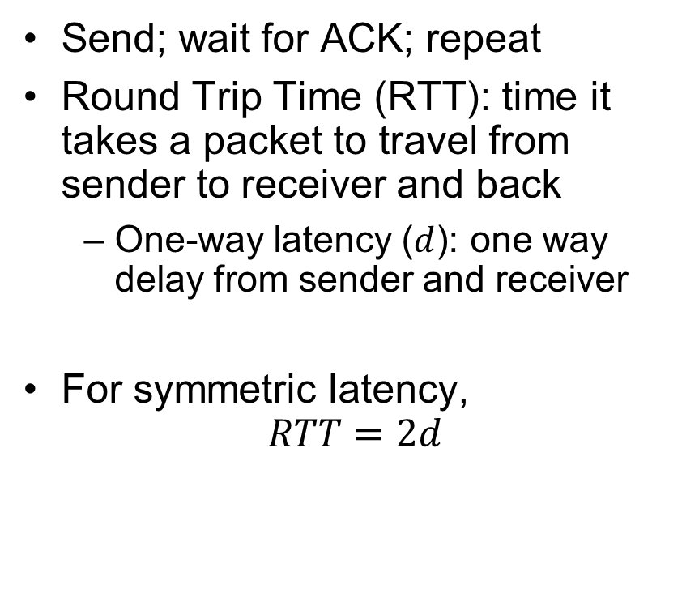
Stop-and-Wait (No Packet Loss)
Send; wait for ACK; repeat
Round Trip Time ($\text{RTT}$): time it takes a packet to travel from sender to receiver and back
One-way latency ($d$): one way delay from sender and receiver
For symmetric latency,
$$RTT=2d$$
Sender
Receiver
1
d
RTT
ACK 1
2
RTT
ACK 2
3
Time

Slide 44
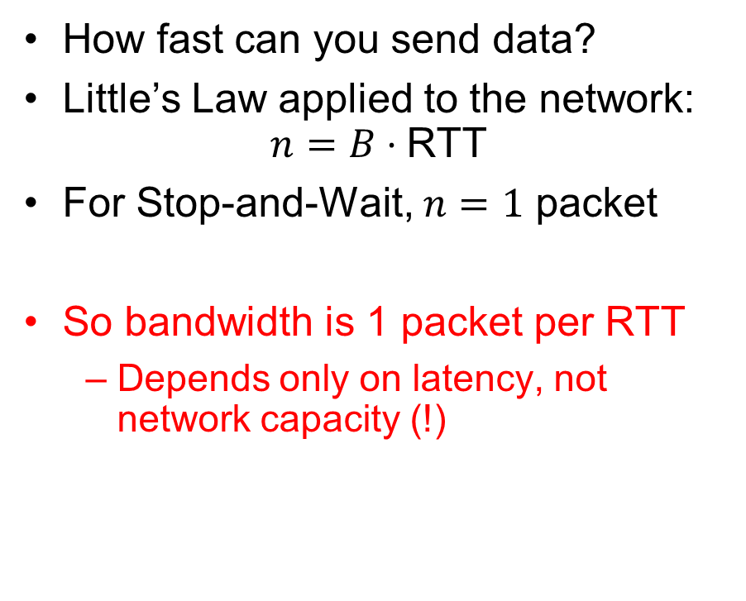
Stop-and-Wait (No Packet Loss)
How fast can you send data?
Little’s Law applied to the network:
$$n=B⋅\text{RTT}$$
For Stop-and-Wait, $n=1$ packet
So bandwidth is 1 packet per RTT
Depends only on latency, not network capacity (!)
Sender
Receiver
1
d
RTT
ACK 1
2
RTT
ACK 2
3
Time

Slide 45
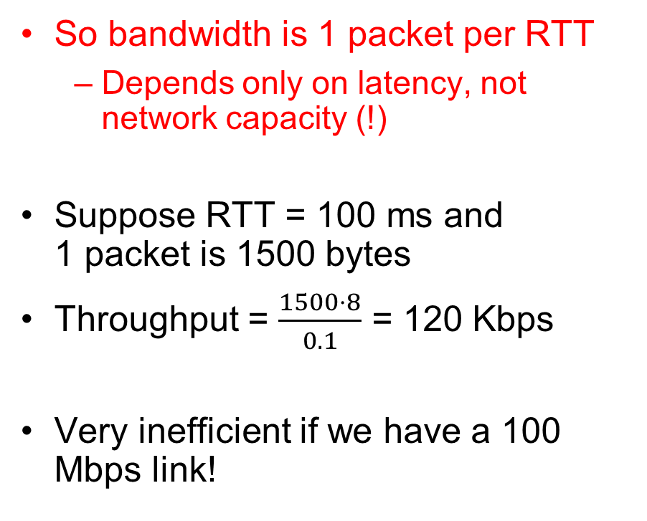
Stop-and-Wait (No Packet Loss)
So bandwidth is 1 packet per RTT
Depends only on latency, not network capacity (!)
Suppose RTT = 100 ms and 1 packet is 1500 bytes
Throughput = $\frac{1500⋅8}{0.1}$ = 120 Kbps
Very inefficient if we have a 100 Mbps link!
Sender
Receiver
1
d
RTT
ACK 1
2
RTT
ACK 2
3
Time

Slide 46
Stop-and-Wait with Packet Loss
Loss recovery relies on timeouts
How to choose a good timeout?
Too short – lots of duplication
Too long – packet loss is really disruptive!
How to deal with duplication?
Retransmission certainly opens up the possibility for
Sender
Receiver
1
RTT
ACK 1
timeout
1
Time

Slide 47
How to Deal with Message Duplication?
Solution: put sequence number in message to identify re-transmitted packets
Receiver checks for duplicate number’s; Discard if detected
Requirements:
Sender keeps copy of unACK’d messages
Easy: only need to buffer messages
Receiver tracks possible duplicate messages
Hard: when ok to forget about received message?
Alternating-bit protocol:
Send one message at a time; don’t send next message until ACK received
Sender keeps last message; receiver tracks sequence number of last message received
Pros: simple, small overhead
Con: doesn’t work if network can delay or duplicate messages arbitrarily
Sender
Receiver
Pkt #0
ACK #0
Pkt #1
ACK #1
Pkt #0
ACK #0

Slide 48
Advantages of Moving Away From Stop-and-Wait
Larger space of acknowledgements
Pipelining: don’t wait for ACK before sending next packet
ACKs serve dual purpose:
Reliability: Confirming packet received
Ordering: Packets can be reordered at destination
How much data is in flight now?
Bytes in-flight: W_{send} = RTT × B
Here B is in “bytes/second”
W_{send} ≡ Sender’s “Window Size”
Packets in flight = (W_{send} / packet size)
How long does the sender have to keep the packets around?
How long does the receiver have to keep the packets’ data?
What if sender is sending packets faster than the receiver can process the data?
Sender
Receiver
RTT
d
Time

Slide 49
Recall: Communication Between Processes
write(wfd, wbuf, wlen);
Process A
Process B
In-Memory Queue
n = read(rfd,rbuf, rmax);
Data written by A is held in memory until B reads it
Queue has a fixed capacity
Writing to the queue blocks if the queue if full
Reading from the queue blocks if the queue is empty
POSIX provides this abstraction in the form of pipes

Slide 50
Buffering in a TCP Connection
Host 1
Host 2
Process A
Process B
Send Queue
Data (Packets)
Receive Queue
Separate pair of queues per TCP connection
Receive Queue
Data (Packets)
Send Queue
A single TCP connection needs four in-memory queues:
Send buffer: add data on write syscall, remove data when ACK received
Receive buffer: add data when packets received, remove data on read syscall

Slide 51
Window Size: Space in Receive Queue
Host 1
Host 2
Process A
Process B
Send Queue
Data (Packets)
Receive Queue
Separate pair of queues per TCP connection
Receive Queue
Data (Packets)
Send Queue
A host’s window size for a TCP connection is how much remaining space it has in its receive queue
A host advertises its window size in every TCP packet it sends!
Sender never sends more than receiver’s advertised window size

Slide 52
Sliding Window Protocol
TCP sender knows receiver’s window size, and aims never to exceed it
But packets that it previously send may arrive, filling the window size!
Rule: TCP sender ensures that:
Number of Sent but UnACKed Bytes < Receiver’s Advertised Window Size
Can send new packets as long as sent-but-unacked packets haven’t already filled the advertised window size

Slide 53
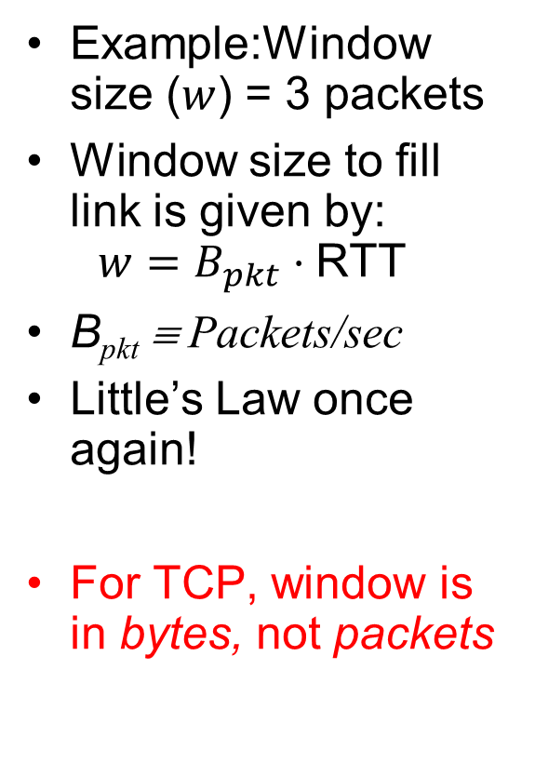
Sliding Window (No Packet Loss)
Example:Window size ($w$) = 3 packets
Window size to fill link is given by: $w=B_{pkt}⋅\text{RTT}$
B_{pkt} ≡ Packets/sec
Little’s Law once again!
For TCP, window is in bytes, not packets
Unacked packets that sender sent
Out-of-seq packets
in receiver’s window
{1}
1
{1, 2}
2
{}
{1, 2, 3}
3
{}
{2, 3, 4}
4
{}
{3, 4, 5}
5
.
.
.
{4, 5, 6}
6
.
.
.
Time
Sender
Receiver

Slide 54
TCP Windows and Sequence Numbers: PER BYTE!
Sequence Numbers
Sent
ACK’d
Sent
not ACK’d
Not yet
sent
Sender
Received
Given to app
Received
Buffered
Not yet
received
Receiver
Sender has three regions:
Sequence regions
sent and ACK’d
sent and not ACK’d
not yet sent
Window (colored region) adjusted by sender
Receiver has three regions:
Sequence regions
received and ACK’d (given to application)
received and buffered
not yet received (or discarded because out of order)

Slide 55
Window-Based Acknowledgements (TCP)
100
140
190
230
260
300
340
380
400
Seq:100
Size:40
Seq:140
Size:50
Seq:190
Size:40
Seq:230
Size:30
Seq:260
Size:40
Seq:300
Size:40
Seq:340
Size:40
Seq:380
Size:20
A:100/300
Seq:100
A:140/260
Seq:140
A:190/210
Seq:230
A:190/210
Seq:260
A:190/210
Seq:300
A:190/210
Retransmit!
Seq:190
A:340/60
Seq:340
A:380/20
Seq:380
A:400/0

Slide 56
Summary
TCP: Reliable byte stream between two processes on different machines over Internet (read, write, flush)
Uses window-based acknowledgement protocol
Congestion-avoidance dynamically adapts sender window to account for congestion in network

