Slide 1
CS162 Operating Systems and Systems Programming Lecture 25 RPC, NFS and AFS
April 26th, 2022
Prof. Anthony Joseph and John Kubiatowicz
http://cs162.eecs.Berkeley.edu

Slide 2
Recall: Transmission Control Protocol (TCP)
Stream in:
Stream out:
Router
Router
..zyxwvuts
gfedcba
Transmission Control Protocol (TCP)
TCP (IP Protocol 6) layered on top of IP
Reliable byte stream between two processes on different machines over Internet (read, write, flush)
TCP Details
Fragments byte stream into packets, hands packets to IP
IP may also fragment by itself
Uses window-based acknowledgement protocol (to minimize state at sender and receiver)
“Window” reflects storage at receiver – sender shouldn’t overrun receiver’s buffer space
Also, window should reflect speed/capacity of network – sender shouldn’t overload network
Automatically retransmits lost packets
Adjusts rate of transmission to avoid congestion
A “good citizen”

Slide 3
Congestion
Too much data trying to flow through some part of the network
IP’s solution: Drop packets
What happens to TCP connection?
Lots of retransmission – wasted work and wasted bandwidth (when bandwidth is scarce)

Slide 4
Congestion Avoidance
Congestion
How long should timeout be for re-sending messages?
Too long → wastes time if message lost
Too short → retransmit even though ACK will arrive shortly
Stability problem: more congestion ⇒ ACK is delayed ⇒ unnecessary timeout ⇒ more traffic ⇒ more congestion
Closely related to window size at sender: too big means putting too much data into network
How does the sender’s window size get chosen?
Must be less than receiver’s advertised buffer size
Try to match the rate of sending packets with the rate that the slowest link can accommodate
Sender uses an adaptive algorithm to decide size of N
Goal: fill network between sender and receiver
Basic technique: slowly increase size of window until acknowledgements start being delayed/lost
TCP solution: “slow start” (start sending slowly)
If no timeout, slowly increase window size (throughput) by 1 for each ACK received
Timeout ⇒ congestion, so cut window size in half
“Additive Increase, Multiplicative Decrease”
Notes:
2nd thing we use window-based acknowledgment protocol for:
Avoid overwhelming network

Slide 5
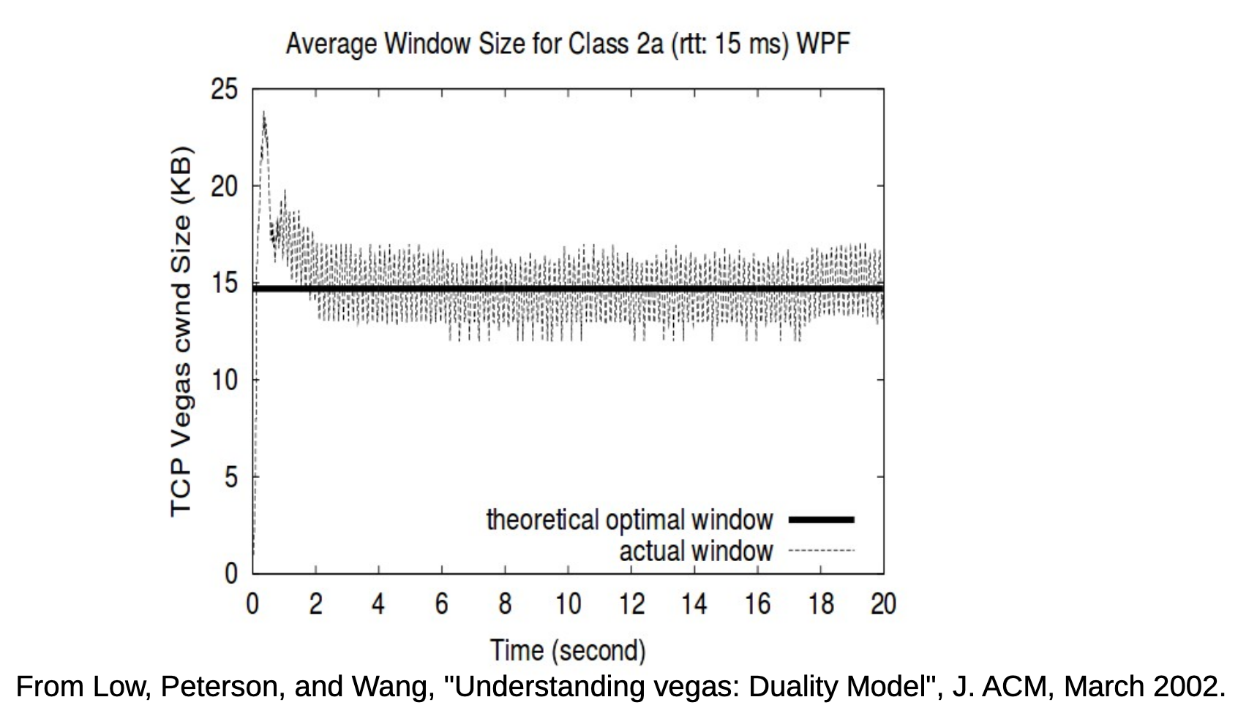
Congestion Management
TCP artificially restricts the window size if it sees packet loss
Careful control loop to make sure:
We don’t send too fast and overwhelm the network
We utilize most of the bandwidth the network has available
In general, these are conflicting goals!

Slide 6
Recall: Connection Setup over TCP/IP
Server
Socket
Request Connection
new
socket
socket
Connection
socket
connection
Client
Server
5-Tuple identifies each connection:
Source IP Address
Destination IP Address
Source Port Number
Destination Port Number
Protocol (always TCP here)
Often, Client Port “randomly” assigned
Done by OS during client socket setup
Server Port often “well known”
80 (web), 443 (secure web), 25 (sendmail), etc
Well-known ports from 0—1023

Slide 7
Establishing TCP Service
Open connection: 3-way handshaking
Reliable byte stream transfer from (IPa, TCP_Port1) to (IPb, TCP_Port2)
Indication if connection fails: Reset
Close (tear-down) connection

Slide 8
Sockets in concept
Client
Server
Create Server Socket
Create Client Socket
Bind it to an Address
(host:port)
Connect it to server (host:port)
Listen for Connection
Accept syscall()
Connection Socket
Connection Socket
write request
read request
read response
write response
Close Client Socket
Close Connection Socket
Close Server Socket

Slide 9
Open Connection: 3-Way Handshake
Client (initiator)
Server
Server calls listen() to wait for a new connection
Client calls connect() providing server’s IP address and port number
Each side sends SYN packet proposing an initial sequence number (one for each sender) and ACKs the other
listen()
connect()
SYN, SeqNum = x
SYN and ACK, SeqNum = y and Ack = x + 1
time
ACK, Ack = y + 1
allocate buffer space,
connection enqueued
accept() dequeues connection

Slide 10
Sockets in concept
Client
Server
Create Server Socket
Create Client Socket
Bind it to an Address
(host:port)
Connect it to server (host:port)
Listen for Connection
Accept syscall()
Connection Socket
Connection Socket
write request
read request
read response
write response
Close Client Socket
Close Connection Socket
Close Server Socket

Slide 11
Close Connection: 4-Way Teardown
Connection is not closed until both sides agree
Host 1
Host 2
close()
FIN
FIN ACK
If multiple FDs on Host 1 refer to this connection, all of them must be closed
Same for close() call on Host 2
Any calls to read() return 0
data
OS discards data (no socket to give it to)
FIN
close()
FIN ACK
OS deallocates connection state
Can retransmit FIN ACK if it is lost
timeout
OS deallocates connection state

Slide 12
Recall: Distributed Applications Build With Messages
How do you actually program a distributed application?
Need to synchronize multiple threads, running on different machines
No shared memory, so cannot use test&set
One Abstraction: send/receive messages
Already atomic: no receiver gets portion of a message and two receivers cannot get same message
Interface:
Mailbox (mbox): temporary holding area for messages
Includes both destination location and queue
Send(message,mbox)
Send message to remote mailbox identified by mbox
Receive(buffer,mbox)
Wait until mbox has message, copy into buffer, and return
If threads sleeping on this mbox, wake up one of them
Send
Network
Receive

Slide 13
Question: Data Representation
An object in memory has a machine-specific binary representation
Threads within a single process have the same view of what’s in memory
Easy to compute offsets into fields, follow pointers, etc.
In the absence of shared memory, externalizing an object requires us to turn it into a sequential sequence of bytes
Serialization/Marshalling: Express an object as a sequence of bytes
Deserialization/Unmarshalling: Reconstructing the original object from its marshalled form at destination

Slide 14
Simple Data Types
uint32_t x;
Suppose I want to write a x to a file
First, open the file: FILE* f = fopen(“foo.txt”, “w”);
Then, I have two choices:
fprintf(f, “%lu”, x);
fwrite(&x, sizeof(uint32_t), 1, f);
Or equivalently, write(fd, &x, sizeof(uint32_t)); (perhaps with a loop to be safe)
Neither one is “wrong” but sender and receiver should be consistent!

Slide 15
Machine Representation
Consider using the machine representation:
fwrite(&x, sizeof(uint32_t), 1, f);
How do we know if the recipient represents x in the same way?
For pipes, is this a problem?
What about for sockets?

Slide 16
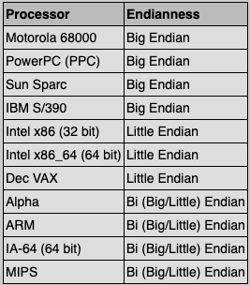
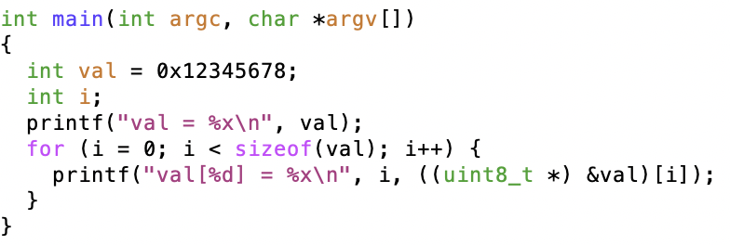
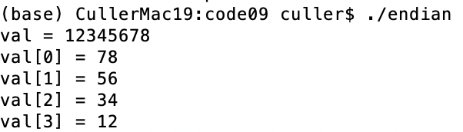
Endianness
For a byte-address machine, which end of a machine-recognized object (e.g., int) does its byte-address refer to?
Big Endian: address is the most-significant bits
Little Endian: address is the least-significant bits

Slide 17
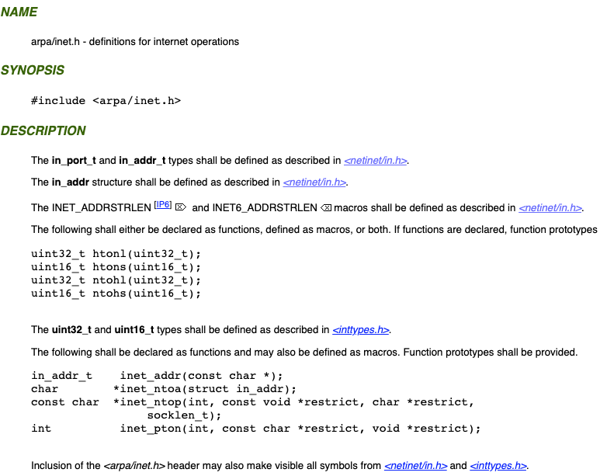
What Endian is the Internet?
Big Endian
Network byte order
Vs. “host byte order”

Slide 18
Dealing with Endianness
Decide on an “on-wire” endianness
Convert from native endianness to “on-wire” endianness before sending out data (serialization/marshalling)
uint32_t htonl(uint32_t) and uint16_t htons(uint16_t) convert from native endianness to network endianness (big endian)
Convert from “on-wire” endianness to native endianness when receiving data (deserialization/unmarshalling)
uint32_t ntohl(uint32_t) and uint16_t ntohs(uint16_t) convert from network endianness to native endianness (big endian)

Slide 19
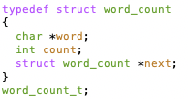
What About Richer Objects?
Consider word_count_t of Homework 0 and 1 …
Each element contains:
An int
A pointer to a string (of some length)
A pointer to the next element
fprintf_words writes these as a sequence of lines (character strings with \n) to a file stream
What if you wanted to write the whole list as a binary object (and read it back as one)?
How do you represent the string?
Does it make any sense to write the pointer?

Slide 20
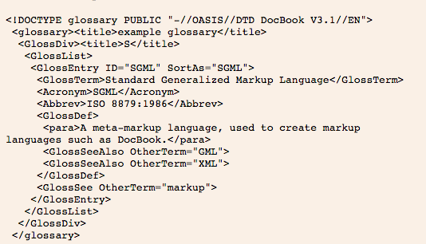
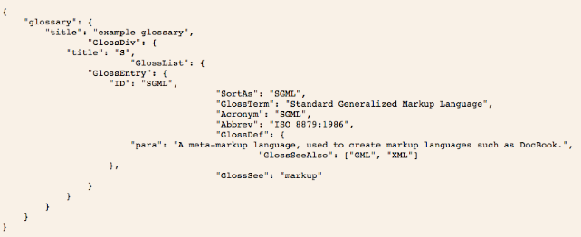
Data Serialization Formats
JSON and XML are commonly used in web applications
Lots of ad-hoc formats

Slide 21
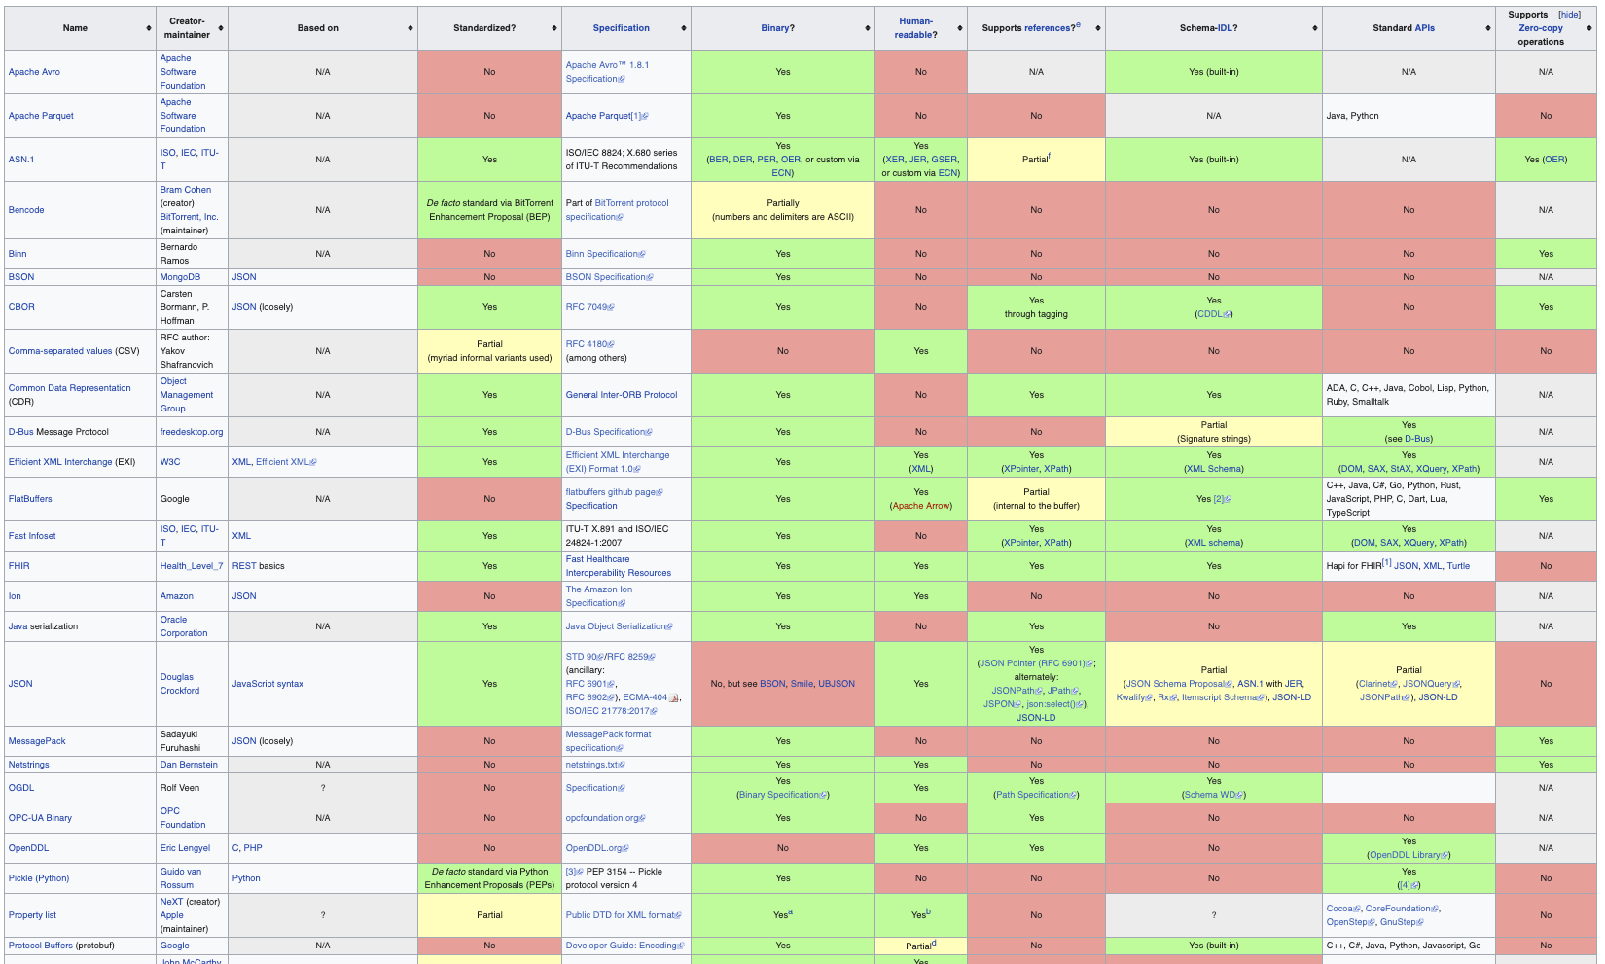
Data Serialization Formats

Slide 22
Remote Procedure Call (RPC)
Raw messaging is a bit too low-level for programming
Must wrap up information into message at source
Must decide what to do with message at destination
May need to sit and wait for multiple messages to arrive
And must deal with machine representation by hand
Another option: Remote Procedure Call (RPC)
Calls a procedure on a remote machine
Idea: Make communication look like an ordinary function call
Automate all of the complexity of translating between representations
Client calls: remoteFileSystem→Read("rutabaga");
Translated automatically into call on server: fileSys→Read("rutabaga");

Slide 23
RPC Concept
bundle
args
Client (caller)
r = f(v1, v2);
call
Client
Stub
send
return
receive
unbundle
ret vals
bundle
ret vals
Server (callee)
res_t f(a1, a2)
return
Server
Stub
send
call
receive
unbundle
args

Slide 24
RPC Information Flow
bundle
args
Client (caller)
r = f(v1, v2);
call
Client
Stub
send
Packet
Handler
return
receive
unbundle
ret vals
Machine A
Network
Network
Machine B
bundle
ret vals
Server (callee)
res_t f(a1, a2)
return
Server
Stub
send
Packet
Handler
Server
Stub
call
receive
unbundle
args
unbundle
args

Slide 25
RPC Implementation
Request-response message passing (under covers!)
“Stub” provides glue on client/server
Client stub is responsible for “marshalling” arguments and “unmarshalling” the return values
Server-side stub is responsible for “unmarshalling” arguments and “marshalling” the return values.
Marshalling involves (depending on system)
Converting values to a canonical form, serializing objects, copying arguments passed by reference, etc.

Slide 26
RPC Details (1/3)
Equivalence with regular procedure call
Parameters ⇔ Request Message
Result ⇔ Reply message
Name of Procedure: Passed in request message
Return Address: mbox2 (client return mail box)
Stub generator: Compiler that generates stubs
Input: interface definitions in an “interface definition language (IDL)”
Contains, among other things, types of arguments/return
Output: stub code in the appropriate source language
Code for client to pack message, send it off, wait for result, unpack result and return to caller
Code for server to unpack message, call procedure, pack results, send them off
Notes:
…
- You might imagine that this stub code, to marshal arguments and make requests over the network, looks similar for many different remote function calls. We can actually generate it automatically, with a compiler!

Slide 27
RPC Details (2/3)
Cross-platform issues:
What if client/server machines are different architectures/ languages?
Convert everything to/from some canonical form
Tag every item with an indication of how it is encoded (avoids unnecessary conversions)
How does client know which mbox (destination queue) to send to?
Need to translate name of remote service into network endpoint (Remote machine, port, possibly other info)
Binding: the process of converting a user-visible name into a network endpoint
This is another word for “naming” at network level
Static: fixed at compile time
Dynamic: performed at runtime

Slide 28
RPC Details (3/3)
Dynamic Binding
Most RPC systems use dynamic binding via name service
Name service provides dynamic translation of service → mbox
Why dynamic binding?
Access control: check who is permitted to access service
Fail-over: If server fails, use a different one
What if there are multiple servers?
Could give flexibility at binding time
Choose unloaded server for each new client
Could provide same mbox (router level redirect)
Choose unloaded server for each new request
Only works if no state carried from one call to next
What if multiple clients?
Pass pointer to client-specific return mbox in request

Slide 29
Problems with RPC: Non-Atomic Failures
Different failure modes in dist. system than on a single machine
Consider many different types of failures
User-level bug causes address space to crash
Machine failure, kernel bug causes all processes on same machine to fail
Some machine is compromised by malicious party
Before RPC: whole system would crash/die
After RPC: One machine crashes/compromised while others keep working
Can easily result in inconsistent view of the world
Did my cached data get written back or not?
Did server do what I requested or not?
Answer? Distributed transactions/Byzantine Commit

Slide 30
Problems with RPC: Performance
RPC is not performance transparent:
Cost of Procedure call « same-machine RPC « network RPC
Overheads: Marshalling, Stubs, Kernel-Crossing, Communication
Programmers must be aware that RPC is not free
Caching can help, but may make failure handling complex

Slide 31
Cross-Domain Communication/Location Transparency
How do address spaces communicate with one another?
Shared Memory with Semaphores, monitors, etc…
File System
Pipes (1-way communication)
“Remote” procedure call (2-way communication)
RPC’s can be used to communicate between address spaces on different machines or the same machine
Services can be run wherever it’s most appropriate
Access to local and remote services looks the same
Examples of RPC systems:
CORBA (Common Object Request Broker Architecture)
DCOM (Distributed COM)
RMI (Java Remote Method Invocation)

Slide 32
Microkernel operating systems
Example: split kernel into application-level servers.
File system looks remote, even though on same machine
Why split the OS into separate domains?
Fault isolation: bugs are more isolated (build a firewall)
Enforces modularity: allows incremental upgrades of pieces of software (client or server)
Location transparent: service can be local or remote
For example in the X windowing system: Each X client can be on a separate machine from X server; Neither has to run on the machine with the frame buffer.
App
App
App
App
File
sys
windows
file system
Windowing
address
spaces
RPC
VM
Networking
Threads
threads
Monolithic Structure
Microkernel Structure

Slide 33

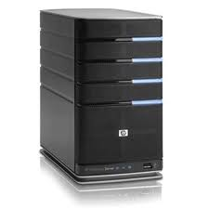
Network-Attached Storage and the CAP Theorem
Network
Consistency:
Changes appear to everyone in the same serial order
Availability:
Can get a result at any time
Partition-Tolerance
System continues to work even when network becomes partitioned
Consistency, Availability, Partition-Tolerance (CAP) Theorem: Cannot have all three at same time
Otherwise known as “Brewer’s Theorem”

Slide 34
Administrivia
Midterm 3: Thursday 4/28: 7-9PM
All course material
Review session Monday 4/25 1-3PM

Slide 35

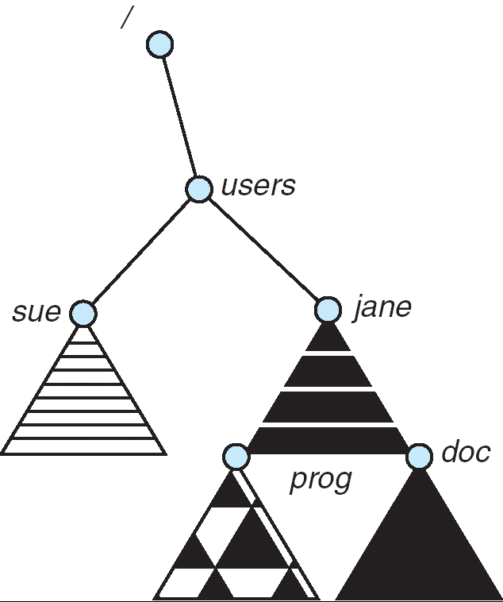
Distributed File Systems
Read File
Network
Data
Client
Server
mount
adj:/jane
Transparent access to files stored on a remote disk
Mount remote files into your local file system
Directory in local file system refers to remote files
e.g., /users/jane/prog/foo.c on laptop actually refers to /prog/foo.c on adj.cs.berkeley.edu
Naming Choices:
[Hostname,localname]: Filename includes server
No location or migration transparency, except through DNS remapping
A global name space: Filename unique in “world”
Can be served by any server
mount
coeus:/sue
mount
adj:/prog

Slide 36

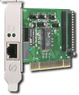
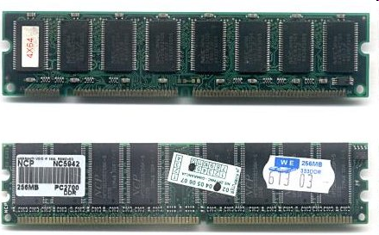
Enabling Design: VFS
The System Call Interface
Process
Management
Memory Management
Filesystems
Device Control
Networking
Concurrency, multitasking
Virtual memory
Files and dirs: the VFS
TTYs and device access
Connectivity
Architecture
Dependent
Code
Memory Manager
File System Types
Device Control
Network Subsystem
Block Devices
IF drivers

Slide 37
Recall: Layers of I/O…
User App:
length = read(input_fd, buffer, BUFFER_SIZE);
User library:
ssize_t read(int, void *, size_t) {
marshal args into registers
issue syscall
register result of syscall to rtn value
};
Application / Service
High Level I/O
Low Level I/O
Exception U→K, interrupt processing
Syscall
void syscall_handler (struct intr_frame *f) {
unmarshall call#, args from regs
dispatch : handlers[call#](args)
marshal results fo syscall ret
}
File System
I/O Driver
ssize_t vfs_read(struct file *file, char __user *buf, size_t count, loff_t *pos) {
User Process/File System relationship
call device driver to do the work
}
Device Driver

Slide 38
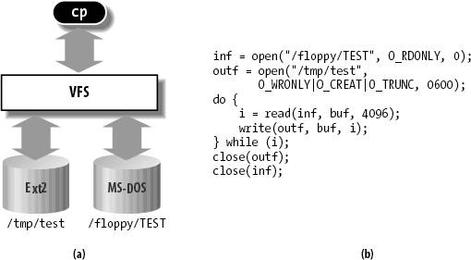
Virtual Filesystem Switch
VFS: Virtual abstraction similar to local file system
Provides virtual superblocks, inodes, files, etc
Compatible with a variety of local and remote file systems
provides object-oriented way of implementing file systems
VFS allows the same system call interface (the API) to be used for different types of file systems
The API is to the VFS interface, rather than any specific type of file system

Slide 39
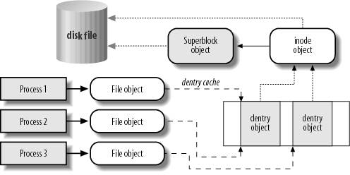
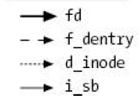
VFS Common File Model in Linux
Four primary object types for VFS:
superblock object: represents a specific mounted filesystem
inode object: represents a specific file
dentry object: represents a directory entry
file object: represents open file associated with process
There is no specific directory object (VFS treats directories as files)
May need to fit the model by faking it
Example: make it look like directories are files
Example: make it look like have inodes, superblocks, etc.

Slide 40
Simple Distributed File System
Read (RPC)
Return (Data)
Client
Write (RPC)
Server
cache
ACK
Client
Remote Disk: Reads and writes forwarded to server
Use Remote Procedure Calls (RPC) to translate file system calls into remote requests
No local caching, but can be cache at server-side
Advantage: Server provides consistent view of file system to multiple clients
Problems? Performance!
Going over network is slower than going to local memory
Lots of network traffic/not well pipelined
Server can be a bottleneck

Slide 41
Use of caching to reduce network load
Crash!
Crash!
read(f1)
→V1
cache
Read (RPC)
read(f1)→V1
read(f1)→V1
F1:V1
Return (Data)
read(f1)→V1
Client
cache
Write (RPC)
Server
F1:V1
F1:V2
ACK
cache
write(f1)
→OK
F1:V2
read(f1)→V2
Client
Idea: Use caching to reduce network load
In practice: use buffer cache at source and destination
Advantage: if open/read/write/close can be done locally, don’t need to do any network traffic…fast!
Problems:
Failure:
Client caches have data not committed at server
Cache consistency!
Client caches not consistent with server/each other

Slide 42
Dealing with Failures
What if server crashes? Can client wait until it comes back and just continue making requests?
Changes in server's cache but not in disk are lost
What if there is shared state across RPC's?
Client opens file, then does a seek
Server crashes
What if client wants to do another read?
Similar problem: What if client removes a file but server crashes before acknowledgement?

Slide 43
Stateless Protocol
Stateless Protocol: A protocol in which all information required to service a request is included with the request
Even better: Idempotent Operations – repeating an operation multiple times is same as executing it just once (e.g., storing to a mem addr.)
Client: timeout expires without reply, just run the operation again (safe regardless of first attempt)
Recall HTTP: Also a stateless protocol
Include cookies with request to simulate a session

Slide 44
Case Study: Network File System (NFS)
Three Layers for NFS system
UNIX file-system interface: open, read, write, close calls + file descriptors
VFS layer: distinguishes local from remote files
Calls the NFS protocol procedures for remote requests
NFS service layer: bottom layer of the architecture
Implements the NFS protocol
NFS Protocol: RPC for file operations on server
XDR Serialization standard for data format independence
Reading/searching a directory
manipulating links and directories
accessing file attributes/reading and writing files
Write-through caching: Modified data committed to server’s disk before results are returned to the client
lose some of the advantages of caching
time to perform write() can be long
Need some mechanism for readers to eventually notice changes! (more on this later)

Slide 45
NFS Continued
NFS servers are stateless; each request provides all arguments require for execution
E.g. reads include information for entire operation, such as ReadAt(inumber,position), not Read(openfile)
No need to perform network open() or close() on file – each operation stands on its own
Idempotent: Performing requests multiple times has same effect as performing them exactly once
Example: Server crashes between disk I/O and message send, client resend read, server does operation again
Example: Read and write file blocks: just re-read or re-write file block – no other side effects
Example: What about “remove”? NFS does operation twice and second time returns an advisory error
Failure Model: Transparent to client system
Is this a good idea? What if you are in the middle of reading a file and server crashes?
Options (NFS Provides both):
Hang until server comes back up (next week?)
Return an error. (Of course, most applications don’t know they are talking over network)

Slide 46
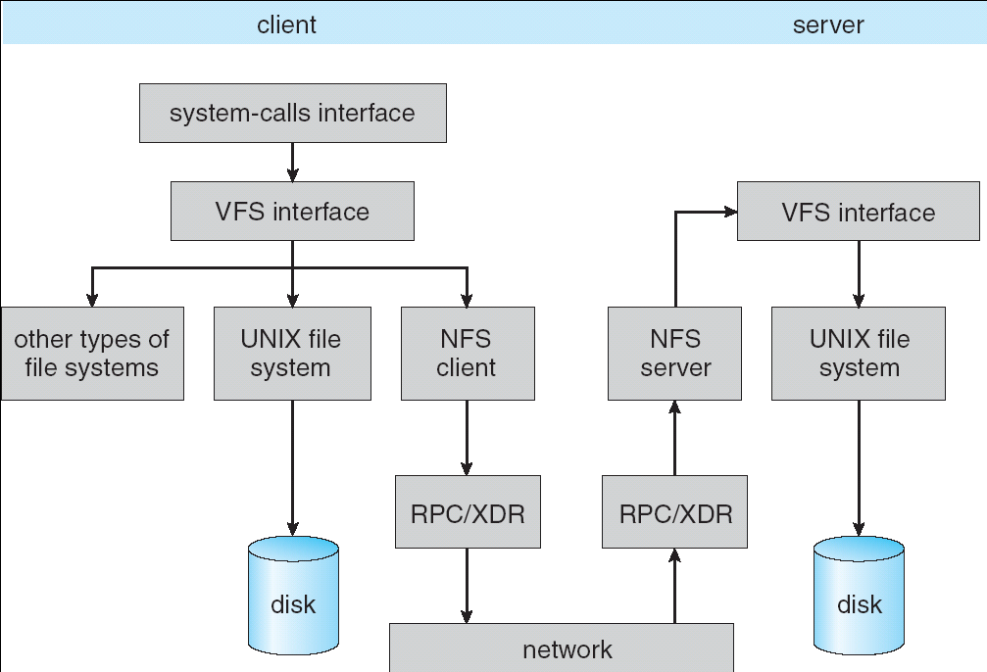
NFS Architecture

Slide 47
NFS Cache consistency
NFS protocol: weak consistency
Client polls server periodically to check for changes
Polls server if data hasn’t been checked in last 3-30 seconds (exact timeout it tunable parameter).
Thus, when file is changed on one client, server is notified, but other clients use old version of file until timeout.
What if multiple clients write to same file?
In NFS, can get either version (or parts of both)
Completely arbitrary!
cache
F1 still ok?
F1:V2
F1:V1
No: (F1:V2)
Client
cache
Write (RPC)
Server
F1:V2
ACK
cache
F1:V2
Client

Slide 48
Sequential Ordering Constraints
What sort of cache coherence might we expect?
i.e. what if one CPU changes file, and before it’s done, another CPU reads file?
Example: Start with file contents = “A”
What would we actually want?
Assume we want distributed system to behave exactly the same as if all processes are running on single system
If read finishes before write starts, get old copy
If read starts after write finishes, get new copy
Otherwise, get either new or old copy
For NFS:
If read starts more than 30 seconds after write, get new copy; otherwise, could get partial update
Client 1:
Read: gets A
Write B
Read: parts of B or C
Client 2:
Read: gets A or B
Write C
Client 3:
Read: parts of B or C
Time

Slide 49
NFS Pros and Cons
NFS Pros:
Simple, Highly portable
NFS Cons:
Sometimes inconsistent!
Doesn’t scale to large # clients
Must keep checking to see if caches out of date
Server becomes bottleneck due to polling traffic

Slide 50
Andrew File System
Andrew File System (AFS, late 80’s) → DCE DFS (commercial product)
Callbacks: Server records who has copy of file
On changes, server immediately tells all with old copy
No polling bandwidth (continuous checking) needed
Write through on close
Changes not propagated to server until close()
Session semantics: updates visible to other clients only after the file is closed
As a result, do not get partial writes: all or nothing!
Although, for processes on local machine, updates visible immediately to other programs who have file open
In AFS, everyone who has file open sees old version
Don’t get newer versions until reopen file

Slide 51
Andrew File System (con’t)
Data cached on local disk of client as well as memory
On open with a cache miss (file not on local disk):
Get file from server, set up callback with server
On write followed by close:
Send copy to server; tells all clients with copies to fetch new version from server on next open (using callbacks)
What if server crashes? Lose all callback state!
Reconstruct callback information from client: go ask everyone “who has which files cached?”
AFS Pro: Relative to NFS, less server load:
Disk as cache ⇒ more files can be cached locally
Callbacks ⇒ server not involved if file is read-only
For both AFS and NFS: central server is bottleneck!
Performance: all writes→server, cache misses→server
Availability: Server is single point of failure
Cost: server machine’s high cost relative to workstation

Slide 52
Summary (1/2)
TCP: Reliable byte stream between two processes on different machines over Internet (read, write, flush)
Uses window-based acknowledgement protocol
Congestion-avoidance dynamically adapts sender window to account for congestion in network
Remote Procedure Call (RPC): Call procedure on remote machine or in remote domain
Provides same interface as procedure
Automatic packing and unpacking of arguments without user programming (in stub)
Adapts automatically to different hardware and software architectures at remote end

Slide 53
Summary (2/2)
Distributed File System:
Transparent access to files stored on a remote disk
Caching for performance
VFS: Virtual File System layer (Or Virtual Filesystem Switch)
Provides mechanism which gives same system call interface for different types of file systems
Cache Consistency: Keeping client caches consistent with one another
If multiple clients, some reading and some writing, how do stale cached copies get updated?
NFS: check periodically for changes
AFS: clients register callbacks to be notified by server of changes

Slide 54
Thank you!
File Systems
Address Space
Concurrency
Reliability, Security, Cloud
Distributed Systems
OS Concepts
intro
Thanks for all your great questions!
Good Bye! You have all been great!

