Slide 1
CS162 Operating Systems and Systems Programming Lecture 5 Sockets and IPC (Finished) Concurrency: Processes and Threads
February 1st, 2022
Prof. Anthony Joseph and John Kubiatowicz
http://cs162.eecs.Berkeley.edu

Slide 2
Recall: Key Unix I/O Design Concepts
Uniformity – Everything Is a File!
file operations, device I/O, and interprocess communication through open, read/write, close
Allows simple composition of programs
find | grep | wc …
Open before use
Provides opportunity for access control and arbitration
Sets up the underlying machinery, i.e., data structures
Byte-oriented
Even if blocks are transferred, addressing is in bytes
Kernel buffered reads
Streaming and block devices looks the same, read blocks yielding processor to other task
Kernel buffered writes
Completion of out-going transfer decoupled from the application, allowing it to continue
Explicit close

Slide 3
Recall: Low-Level vs High-Level file API
Low-level direct use of syscall interface: open(), read(), write(), close()
Opening of file returns file descriptor: int myfile = open(…);
File descriptor only meaningful to kernel
Index into process (PDB) which holds pointers to kernel-level structure (“file description”) describing file.
Every read() or write() causes syscall no matter how small (could read a single byte)
Consider loop to get 4 bytes at a time using read():
Each iteration enters kernel for 4 bytes.
High-level buffered access: fopen(), fread(), fwrite(), fclose()
Opening of file returns ptr to FILE: FILE *myfile = fopen(…);
FILE structure is user space contains:
a chunk of memory for a buffer
the file descriptor for the file (fopen() will call open() automatically)
Every fread() or fwrite() filters through buffer and may not call read() or write() on every call.
Consider loop to get 4 bytes at a time using fread():
First call to fread() calls read() for block of bytes (say 1024). Puts in buffer and returns first 4 to user.
Subsequent fread() grab bytes from buffer

Slide 4
Recall: Low-Level vs. High-Level File API
Low-Level Operation:
High-Level Operation:
ssize_t read(…) {
};
ssize_t fread(…) {
};
Check buffer for contents
Return data to caller if available
asm code … syscall # into %eax
put args into registers %ebx, …
special trap instruction
asm code … syscall # into %eax
put args into registers %ebx, …
special trap instruction
Kernel:
Kernel:
get args from regs
dispatch to system func
Do the work to read from the file
Store return value in %eax
get args from regs
dispatch to system func
Do the work to read from the file
Store return value in %eax
get return values from regs
get return values from regs
Return data to caller
Update buffer with excess data
Return data to caller

Slide 5
Recall: Sockets: An Endpoint for Communication
Key Idea: Communication across the world looks like File I/O
Sockets: Endpoint for Communication
Queues to temporarily hold results
Connection: Two Sockets Connected Over the network ⇒ IPC over network!
How to open()?
What is the namespace?
How are they connected in time?
write(wfd, wbuf, wlen);
Process
Socket
Socket
Process
n = read(rfd, rbuf, rmax);

Slide 6
Recall: Connection Setup over TCP/IP
Client Side
Server Side
Server
Socket
Server Listening:
Server IP addr
well-known port,
Protocol (TCP/IP)
Connection request:
Client IP addr
Client Port
Protocol (TCP/IP)
Request Connection
new
socket
socket
socket
connection
Special kind of socket: server socket
Has file descriptor
Can’t read or write
Two operations:
listen(): Start allowing clients to connect
accept(): Create a new socket for a particular client

Slide 7
Recall: Connection Setup over TCP/IP
Client Side
Server Side
Server
Socket
Server Listening:
Server IP addr
well-known port,
Protocol (TCP/IP)
Connection request:
Client IP addr
Client Port
Protocol (TCP/IP)
Request Connection
new
socket
socket
socket
connection
5-Tuple identifies each connection:
Source IP Address
Destination IP Address
Source Port Number
Destination Port Number
Protocol (always TCP here)
Often, Client Port “randomly” assigned
Done by OS during client socket setup
Server Port often “well known”
80 (web), 443 (secure web), 25 (sendmail), etc
Well-known ports from 0—1023

Slide 8


Web Server
Request
Reply
Client
Web Server

Slide 9
Client-Server Models
Client 1
Client 2
Server
***
Client n
File servers, web, FTP, Databases, …
Many clients accessing a common server

Slide 10
Sockets in concept
Client
Server
Create Server Socket
Create Client Socket
Bind it to an Address
(host:port)
Connect it to server (host:port)
Listen for Connection
Accept syscall()
Connection Socket
Connection Socket
write request
read request
read response
write response
Close Client Socket
Close Connection Socket
Close Server Socket

Slide 11
Client Protocol
char *host_name, *port_name;
// Create a socket
struct addrinfo *server = lookup_host(host_name, port_name);
int sock_fd = socket(server->ai_family, server->ai_socktype,
server->ai_protocol);
// Connect to specified host and port
connect(sock_fd, server->ai_addr, server->ai_addrlen);
// Carry out Client-Server protocol
run_client(sock_fd);
/* Clean up on termination */
close(sock_fd);
char *host_name, *port_name;
// Create a socket
struct addrinfo *server = lookup_host(host_name, port_name);
int sock_fd = socket(server->ai_family, server->ai_socktype,
server->ai_protocol);
// Connect to specified host and port
connect(sock_fd, server->ai_addr, server->ai_addrlen);
// Carry out Client-Server protocol
run_client(sock_fd);
/* Clean up on termination */
close(sock_fd);

Slide 12
Server Protocol (v1)
// Create socket to listen for client connections
char *port_name;
struct addrinfo *server = setup_address(port_name);
int server_socket = socket(server->ai_family, server->ai_socktype, server->ai_protocol);
// Bind socket to specific port
bind(server_socket, server->ai_addr, server->ai_addrlen);
// Start listening for new client connections
listen(server_socket, MAX_QUEUE);
while (1) {
// Accept a new client connection, obtaining a new socket
int conn_socket = accept(server_socket, NULL, NULL);
serve_client(conn_socket);
close(conn_socket);
}
close(server_socket);
// Create socket to listen for client connections
char *port_name;
struct addrinfo *server = setup_address(port_name);
int server_socket = socket(server->ai_family, server->ai_socktype, server->ai_protocol);
// Bind socket to specific port
bind(server_socket, server->ai_addr, server->ai_addrlen);
// Start listening for new client connections
listen(server_socket, MAX_QUEUE);
while (1) {
// Accept a new client connection, obtaining a new socket
int conn_socket = accept(server_socket, NULL, NULL);
serve_client(conn_socket);
close(conn_socket);
}
close(server_socket);

Slide 13
How Could the Server Protect Itself?
Handle each connection in a separate process
This will mean that the logic serving each request will be “sandboxed” away from the main server process

Slide 14
Sockets With Protection (each connection has own process)
Client
Server
Create Server Socket
Create Client Socket
Bind it to an Address
(host:port)
Connect it to server (host:port)
Listen for Connection
Accept syscall()
Connection Socket
Connection Socket
Child
Parent
Close Listen Socket
Close Connection Socket
write request
read request
read response
write response
Wait for child
Close Client Socket
Close Connection Socket
Close Server Socket

Slide 15
Server Protocol (v2)
// Socket setup code elided…
listen(server_socket, MAX_QUEUE);
while (1) {
// Accept a new client connection, obtaining a new socket
int conn_socket = accept(server_socket, NULL, NULL);
pid_t pid = fork();
if (pid == 0) {
close(server_socket);
serve_client(conn_socket);
close(conn_socket);
exit(0);
} else {
close(conn_socket);
wait(NULL);
}
}
close(server_socket);
// Socket setup code elided…
listen(server_socket, MAX_QUEUE);
while (1) {
// Accept a new client connection, obtaining a new socket
int conn_socket = accept(server_socket, NULL, NULL);
pid_t pid = fork();
if (pid == 0) {
close(server_socket);
serve_client(conn_socket);
close(conn_socket);
exit(0);
} else {
close(conn_socket);
wait(NULL);
}
}
close(server_socket);

Slide 16
Concurrent Server
So far, in the server:
Listen will queue requests
Buffering present elsewhere
But server waits for each connection to terminate before servicing the next
A concurrent server can handle and service a new connection before the previous client disconnects

Slide 17
Sockets With Protection and Concurrency
Client
Server
Create Server Socket
Create Client Socket
Bind it to an Address
(host:port)
Connect it to server (host:port)
Listen for Connection
Accept syscall()
Connection Socket
Connection Socket
Child
Parent
Close Listen Socket
Close Connection Socket
write request
read request
read response
write response
Close Client Socket
Close Connection Socket
Close Server Socket

Slide 18
Server Protocol (v3)
// Socket setup code elided…
listen(server_socket, MAX_QUEUE);
while (1) {
// Accept a new client connection, obtaining a new socket
int conn_socket = accept(server_socket, NULL, NULL);
pid_t pid = fork();
if (pid == 0) {
close(server_socket);
serve_client(conn_socket);
close(conn_socket);
exit(0);
} else {
close(conn_socket);
//wait(NULL);
}
}
close(server_socket);
// Socket setup code elided…
listen(server_socket, MAX_QUEUE);
while (1) {
// Accept a new client connection, obtaining a new socket
int conn_socket = accept(server_socket, NULL, NULL);
pid_t pid = fork();
if (pid == 0) {
close(server_socket);
serve_client(conn_socket);
close(conn_socket);
exit(0);
} else {
close(conn_socket);
//wait(NULL);
}
}
close(server_socket);

Slide 19
Server Address: Itself
struct addrinfo *setup_address(char *port) {
struct addrinfo *server;
struct addrinfo hints;
memset(&hints, 0, sizeof(hints));
hints.ai_family = AF_UNSPEC;
hints.ai_socktype = SOCK_STREAM;
hints.ai_flags = AI_PASSIVE;
getaddrinfo(NULL, port, &hints, &server);
return server;
}
Accepts any connections on the specified port

Slide 20
Client: Getting the Server Address
struct addrinfo *lookup_host(char *host_name, char *port) {
struct addrinfo *server;
struct addrinfo hints;
memset(&hints, 0, sizeof(hints));
hints.ai_family = AF_UNSPEC;
hints.ai_socktype = SOCK_STREAM;
int rv = getaddrinfo(host_name, port_name,
&hints, &server);
if (rv != 0) {
printf("getaddrinfo failed: %s\n", gai_strerror(rv));
return NULL;
}
return server;
}

Slide 21
Concurrent Server without Protection
Spawn a new thread to handle each connection
Main thread initiates new client connections without waiting for previously spawned threads
Why give up the protection of separate processes?
More efficient to create new threads
More efficient to switch between threads

Slide 22
Sockets with Concurrency, without Protection
Client
Server
Create Server Socket
Create Client Socket
Bind it to an Address
(host:port)
Connect it to server (host:port)
Listen for Connection
Accept syscall()
Connection Socket
Connection Socket
pthread_create
Spawned Thread
write request
read request
Main Thread
read response
write response
Close Client Socket
Close Connection Socket
Close Server Socket

Slide 23
Thread Pools: More Later!
Problem with previous version: Unbounded Threads
When web-site becomes too popular – throughput sinks
Instead, allocate a bounded “pool” of worker threads, representing the maximum level of multiprogramming
Master
Thread
queue
Thread Pool
master() { allocThreads(worker,queue); while(TRUE) { con=AcceptCon(); Enqueue(queue,con); wakeUp(queue); } }
worker(queue) { while(TRUE) { con=Dequeue(queue); if (con==null) sleepOn(queue); else ServiceWebPage(con); } }

Slide 24
Administrivia
Kubiatowicz Office Hours:
1-2pm, Tuesday & Wednesday
Friday was drop deadline. If you forgot to drop, we can’t help you!
You need to speak with advisor services in your department about how to drop
Recommendation: Read assigned readings before lecture
Group sign up should have happened already
If you don’t have 4 members in your group, we will try to find you other partners
Want everyone in your group to have the same TA
Go to your assigned section on Friday, starting this week!
Midterm 1 conflicts
We will handle these conflicts next week

Slide 25

Administrivia (Con’t)
Back in person this week!
Please be up-to-date with vaccinations and wear masks!
You should have a green pass if you come to class
I will be in VLSB 2050 on Tuesday/Thursday 3:30-5:00
Will be trying to get synchronous zoom working. May take a couple of tries to get right
Screen Cast for sure. If I can project it, it will be recorded…
We will be trying to make virtual options available for people who are sick
Start Planning on how your group will collaborate on projects!
Meet regularly, in person as regularly as possible
We will have more suggestions on collaborating as term goes on
Virtual Interactions: Plan ways of also collaborating remotely
Virtual Coffee Hours with your group (with camera)
Regular Brainstorming meetings?
Try to meet multiple times a week
Hello!
Hi!

Slide 26
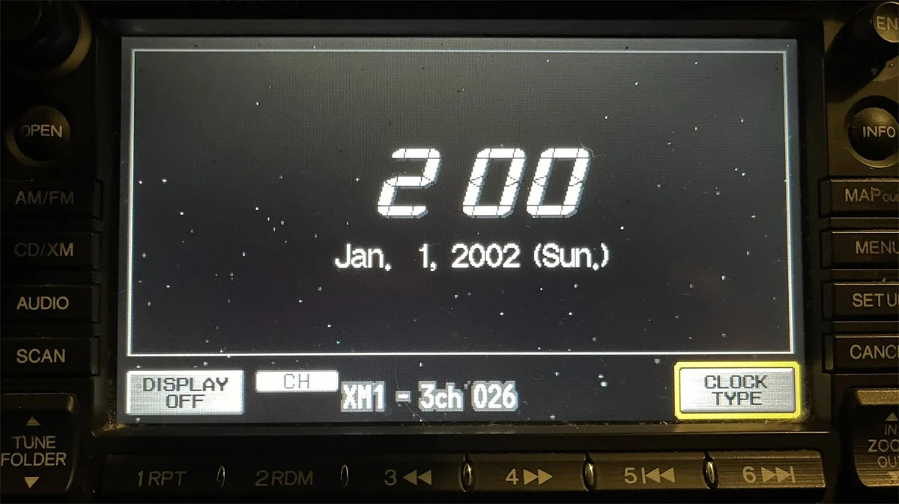


Computers (Cars/other things) in the news
Y2K22? January 2022 saw a whole new class of bugs:
Well, welcome to Y2K22 bugs. If you write a date/time in YYMMDDHHMM format (which is year, month, day, hour, and minute), it now exceeds 31 bits!
Meaning – if they use unsigned instead of signed 32-bit numbers it breaks!
So, a bunch of systems are now broken:
Exchange (Email)
Email Security/Firewall
Honda Car Clocks/Navigation Systems

Slide 27
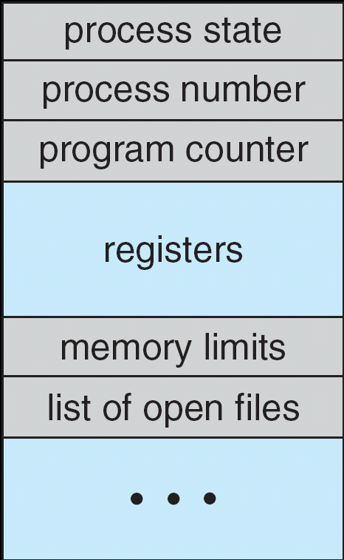
Recall: The Process Control Block
Kernel represents each process as a process control block (PCB)
Status (running, ready, blocked, …)
Register state (when not ready)
Process ID (PID), User, Executable, Priority, …
Execution time, …
Memory space, translation, …
Kernel Scheduler maintains a data structure containing the PCBs
Give out CPU to different processes
This is a Policy Decision
Give out non-CPU resources
Memory/IO
Another policy decision
Process Control
Block

Slide 28
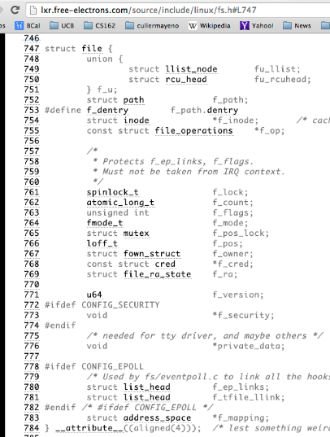
Recall: What’s in an Open File Description?
For our purposes, the two most important things are:
Where to find the file data on disk
The current position within the file

Slide 29
Abstract Representation of a Process
Process
Suppose that we execute
open(“foo.txt”)
and that the result is 3
Thread’s Regs
Address Space (Memory)
…
User Space
Kernel Space
File Descriptors
Open File Description
3
Not shown: Initially contains 0, 1, and 2 (stdin, stdout, stderr)
File: foo.txt
Position: 0

Slide 30
Abstract Representation of a Process
Process
Suppose that we execute
open(“foo.txt”)
and that the result is 3
Next, suppose that we execute
read(3, buf, 100)
and that the result is 100
Thread’s Regs
Address Space (Memory)
…
User Space
Kernel Space
File Descriptors
Open File Description
3
Not shown: Initially contains 0, 1, and 2 (stdin, stdout, stderr)
File: foo.txt
Position: 0

Slide 31
Abstract Representation of a Process
Process
Suppose that we execute
open(“foo.txt”)
and that the result is 3
Next, suppose that we execute
read(3, buf, 100)
and that the result is 100
Thread’s Regs
Address Space (Memory)
…
User Space
Kernel Space
File Descriptors
Open File Description
3
Not shown: Initially contains 0, 1, and 2 (stdin, stdout, stderr)
File: foo.txt
Position: 100

Slide 32
Abstract Representation of a Process
Process
Suppose that we execute
open(“foo.txt”)
and that the result is 3
Next, suppose that we execute
read(3, buf, 100)
and that the result is 100
Finally, suppose that we execute
close(3)
Thread’s Regs
Address Space (Memory)
…
User Space
Kernel Space
File Descriptors
Open File Description
3
Not shown: Initially contains 0, 1, and 2 (stdin, stdout, stderr)
File: foo.txt
Position: 100

Slide 33
Instead of Closing, let’s fork()!
Process 1
Process 2
Thread’s Regs
Address Space (Memory)
File descriptor is copied
Open file description is aliased
Thread’s Regs
Address Space (Memory)
…
…
User Space
Kernel Space
File Descriptors
File Descriptors
Open File Description
3
3
Not shown: Initially contains 0, 1, and 2 (stdin, stdout, stderr)
File: foo.txt
Position: 100

Slide 34
Open File Description is Aliased
Process 1
Process 2
read(3, buf, 100)
Thread’s Regs
Address Space (Memory)
Thread’s Regs
Address Space (Memory)
…
…
User Space
Kernel Space
File Descriptors
File Descriptors
Open File Description
3
3
Not shown: Initially contains 0, 1, and 2 (stdin, stdout, stderr)
File: foo.txt
Position: 100

Slide 35
Open File Description is Aliased
Process 1
Process 2
read(3, buf, 100)
Thread’s Regs
Address Space (Memory)
Thread’s Regs
Address Space (Memory)
…
…
User Space
Kernel Space
File Descriptors
File Descriptors
Open File Description
3
3
Not shown: Initially contains 0, 1, and 2 (stdin, stdout, stderr)
File: foo.txt
Position: 200

Slide 36
Open File Description is Aliased
Process 1
Process 2
read(3, buf, 100)
read(3, buf, 100)
Thread’s Regs
Address Space (Memory)
Thread’s Regs
Address Space (Memory)
…
…
User Space
Kernel Space
File Descriptors
File Descriptors
Open File Description
3
3
Not shown: Initially contains 0, 1, and 2 (stdin, stdout, stderr)
File: foo.txt
Position: 200

Slide 37
Open File Description is Aliased
Process 1
Process 2
read(3, buf, 100)
read(3, buf, 100)
Thread’s Regs
Address Space (Memory)
Thread’s Regs
Address Space (Memory)
…
…
User Space
Kernel Space
File Descriptors
File Descriptors
Open File Description
3
3
Not shown: Initially contains 0, 1, and 2 (stdin, stdout, stderr)
File: foo.txt
Position: 300

Slide 38
File Descriptor is Copied
Process 1
Process 2
read(3, buf, 100)
close(3)
read(3, buf, 100)
Thread’s Regs
Address Space (Memory)
Thread’s Regs
Address Space (Memory)
…
…
User Space
Kernel Space
File Descriptors
File Descriptors
Open File Description
3
3
Not shown: Initially contains 0, 1, and 2 (stdin, stdout, stderr)
File: foo.txt
Position: 300

Slide 39
File Descriptor is Copied
Process 1
Process 2
read(3, buf, 100)
close(3)
read(3, buf, 100)
Thread’s Regs
Address Space (Memory)
Thread’s Regs
Address Space (Memory)
Open file description remains alive until no file descriptors in any process refer to it
…
…
User Space
Kernel Space
File Descriptors
File Descriptors
Open File Description
3
Not shown: Initially contains 0, 1, and 2 (stdin, stdout, stderr)
File: foo.txt
Position: 300

Slide 40
Why is Aliasing the Open File Description a Good Idea?
It allows for shared resources between processes

Slide 41
Recall: In POSIX, Everything is a “File”
Identical interface for:
Files on disk
Devices (terminals, printers, etc.)
Regular files on disk
Networking (sockets)
Local interprocess communication (pipes, sockets)
Based on the system calls open(), read(), write(), and close()

Slide 42
Example: Shared Terminal Emulator
When you fork() a process, the parent’s and child’s printf outputs go to the same terminal

Slide 43
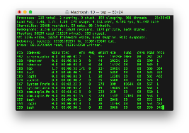
Example: Shared Terminal Emulator
Process 1
Process 2
Thread’s Regs
Address Space (Memory)
Thread’s Regs
Address Space (Memory)
…
…
User Space
Kernel Space
Terminal Emulator
File Descriptors
File Descriptors
0
1
2
0
1
2

Slide 44
Example: Shared Terminal Emulator
Process 1
Process 2
close(0)
Thread’s Regs
Address Space (Memory)
Thread’s Regs
Address Space (Memory)
…
…
User Space
Kernel Space
Terminal Emulator
File Descriptors
File Descriptors
0
1
2
0
1
2

Slide 45
Example: Shared Terminal Emulator
Process 1
Process 2
close(0)
Thread’s Regs
Address Space (Memory)
Thread’s Regs
Address Space (Memory)
If one process closes stdin (0), it remains open in other processes
…
…
User Space
Kernel Space
Terminal Emulator
File Descriptors
File Descriptors
0
1
2
0
1
2

Slide 46
Other Examples
Shared network connections after fork()
Allows handling each connection in a separate process
We’ll explore this next time
Shared access to pipes
Useful for interprocess communication
And in writing a shell (Homework 2)

Slide 47
Recall: How do we Multiplex Processes?
The current state of process held in a process control block (PCB):
This is a “snapshot” of the execution and protection environment
Only one PCB active at a time
Give out CPU time to different processes (Scheduling):
Only one process “running” at a time
Give more time to important processes
Give pieces of resources to different processes (Protection):
Controlled access to non-CPU resources
Example mechanisms:
Memory Trnslation: Give each process their own address space
Kernel/User duality: Arbitrary multiplexing of I/O through system calls
Process Control
Block

Slide 48
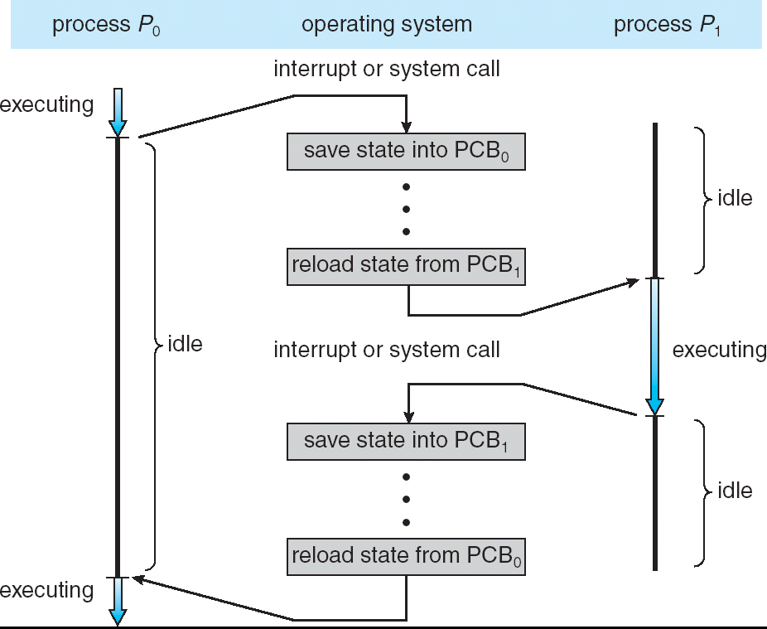
Recall: CPU Switch From Process A to Process B
User Mode
Kernel/System Mode
User Mode

Slide 49
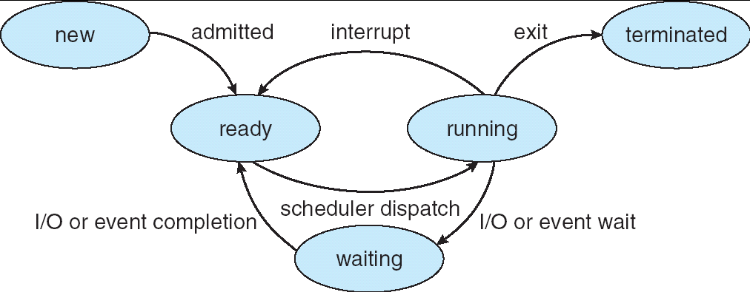
Lifecycle of a Process
As a process executes, it changes state:
new: The process is being created
ready: The process is waiting to run
running: Instructions are being executed
waiting: Process waiting for some event to occur
terminated: The process has finished execution

Slide 50
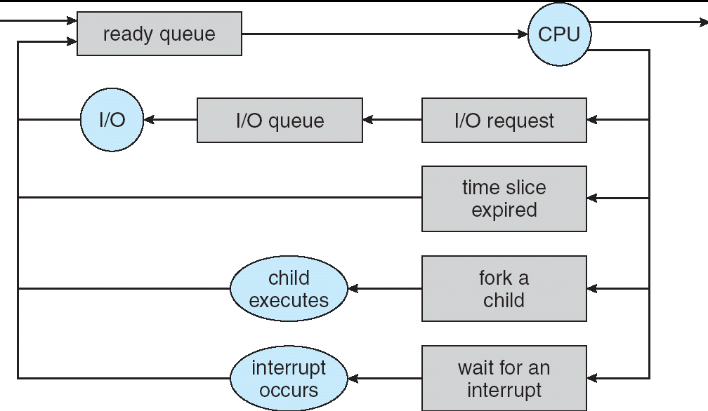
Process Scheduling
PCBs move from queue to queue as they change state
Decisions about which order to remove from queues are Scheduling decisions
Many algorithms possible (few weeks from now)

Slide 51
Ready Queue And Various I/O Device Queues
Process not running ⇒ PCB is in some scheduler queue
Separate queue for each device/signal/condition
Each queue can have a different scheduler policy
Ready
Queue
Head
Other
State
PCB₉
Link
Other
State
PCB₆
Link
Other
State
PCB₁₆
Link
Tail
Registers
Registers
Registers
USB
Unit 0
Head
Tail
Disk
Unit 0
Head
Other
State
PCB₂
Link
Other
State
PCB₃
Link
Tail
Registers
Registers
Disk
Unit 2
Head
Tail
Other
State
PCB₈
Ether
Netwk 0
Link
Head
Tail
Registers

Slide 52
Modern Process with Threads
Thread: a sequential execution stream within process (Sometimes called a “Lightweight process”)
Process still contains a single Address Space
No protection between threads
Multithreading: a single program made up of a number of different concurrent activities
Sometimes called multitasking, as in Ada …
Why separate the concept of a thread from that of a process?
Discuss the “thread” part of a process (concurrency)
Separate from the “address space” (protection)
Heavyweight Process ≡ Process with one thread

Slide 53
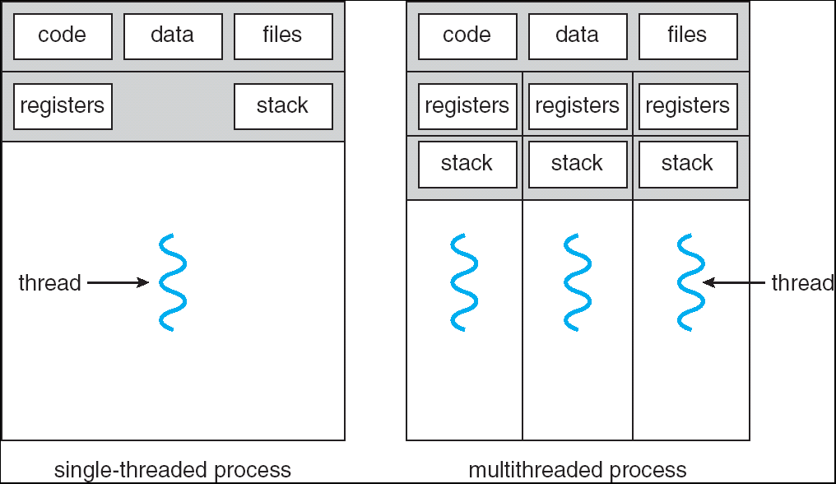
Single and Multithreaded Processes
Threads encapsulate concurrency: “Active” component
Address spaces encapsulate protection: “Passive” part
Keeps buggy program from trashing the system
Why have multiple threads per address space?
Notes:
Sometimes need parallelism for a single job, and processes are very expensive – to start, switch between, and to communicate between

Slide 54
Thread State
State shared by all threads in process/address space
Content of memory (global variables, heap)
I/O state (file descriptors, network connections, etc)
State “private” to each thread
Kept in TCB ≡ Thread Control Block
CPU registers (including, program counter)
Execution stack – what is this?
Execution Stack
Parameters, temporary variables
Return PCs are kept while called procedures are executing

Slide 55
Shared vs. Per-Thread State

Slide 56
Execution Stack Example
A(int tmp) {
if (tmp<2)
B();
printf(tmp);
}
B() {
C();
}
C() {
A(2);
}
A(1);
A:
A+1:
A+2:
B:
B+1:
C:
C+1:
exit:
Stack holds temporary results
Permits recursive execution
Crucial to modern languages

Slide 57
Execution Stack Example
A: tmp=1
ret=exit
A(int tmp) {
if (tmp<2)
B();
printf(tmp);
}
B() {
C();
}
C() {
A(2);
}
A(1);
Stack
Pointer
A:
A+1:
A+2:
B:
B+1:
C:
C+1:
exit:
Stack holds temporary results
Permits recursive execution
Crucial to modern languages

Slide 58
Execution Stack Example
A: tmp=1
ret=exit
A(int tmp) {
if (tmp<2)
B();
printf(tmp);
}
B() {
C();
}
C() {
A(2);
}
A(1);
Stack
Pointer
A:
A+1:
A+2:
B:
B+1:
C:
C+1:
exit:
Stack holds temporary results
Permits recursive execution
Crucial to modern languages

Slide 59
Execution Stack Example
A: tmp=1
ret=exit
A(int tmp) {
if (tmp<2)
B();
printf(tmp);
}
B() {
C();
}
C() {
A(2);
}
A(1);
Stack
Pointer
A:
A+1:
A+2:
B:
B+1:
C:
C+1:
exit:
Stack holds temporary results
Permits recursive execution
Crucial to modern languages

Slide 60
Execution Stack Example
A: tmp=1
ret=exit
A(int tmp) {
if (tmp<2)
B();
printf(tmp);
}
B() {
C();
}
C() {
A(2);
}
A(1);
A:
A+1:
A+2:
B:
B+1:
C:
C+1:
exit:
B: ret=A+2
Stack
Pointer
Stack holds temporary results
Permits recursive execution
Crucial to modern languages

Slide 61
Execution Stack Example
A: tmp=1
ret=exit
A(int tmp) {
if (tmp<2)
B();
printf(tmp);
}
B() {
C();
}
C() {
A(2);
}
A(1);
A:
A+1:
A+2:
B:
B+1:
C:
C+1:
exit:
B: ret=A+2
Stack
Pointer
Stack holds temporary results
Permits recursive execution
Crucial to modern languages

Slide 62
Execution Stack Example
A: tmp=1
ret=exit
A(int tmp) {
if (tmp<2)
B();
printf(tmp);
}
B() {
C();
}
C() {
A(2);
}
A(1);
A:
A+1:
A+2:
B:
B+1:
C:
C+1:
exit:
B: ret=A+2
C: ret=B+1
Stack
Pointer
Stack holds temporary results
Permits recursive execution
Crucial to modern languages

Slide 63
Execution Stack Example
A: tmp=1
ret=exit
A(int tmp) {
if (tmp<2)
B();
printf(tmp);
}
B() {
C();
}
C() {
A(2);
}
A(1);
A:
A+1:
A+2:
B:
B+1:
C:
C+1:
exit:
B: ret=A+2
C: ret=B+1
A: tmp=2
ret=C+1
Stack
Pointer
Stack Growth
Stack holds temporary results
Permits recursive execution
Crucial to modern languages

Slide 64
Execution Stack Example
A: tmp=1
ret=exit
A(int tmp) {
if (tmp<2)
B();
printf(tmp);
}
B() {
C();
}
C() {
A(2);
}
A(1);
A:
A+1:
A+2:
B:
B+1:
C:
C+1:
exit:
B: ret=A+2
C: ret=B+1
A: tmp=2
ret=C+1
Stack
Pointer
Stack Growth
Output:
>2
Stack holds temporary results
Permits recursive execution
Crucial to modern languages

Slide 65
Execution Stack Example
A: tmp=1
ret=exit
A(int tmp) {
if (tmp<2)
B();
printf(tmp);
}
B() {
C();
}
C() {
A(2);
}
A(1);
A:
A+1:
A+2:
B:
B+1:
C:
C+1:
exit:
B: ret=A+2
C: ret=B+1
A: tmp=2
ret=C+1
Stack
Pointer
Stack Growth
Output:
>2
Stack holds temporary results
Permits recursive execution
Crucial to modern languages

Slide 66
Execution Stack Example
A: tmp=1
ret=exit
A(int tmp) {
if (tmp<2)
B();
printf(tmp);
}
B() {
C();
}
C() {
A(2);
}
A(1);
A:
A+1:
A+2:
B:
B+1:
C:
C+1:
exit:
B: ret=A+2
C: ret=B+1
Stack
Pointer
Output:
>2
Stack holds temporary results
Permits recursive execution
Crucial to modern languages

Slide 67
Execution Stack Example
A: tmp=1
ret=exit
A(int tmp) {
if (tmp<2)
B();
printf(tmp);
}
B() {
C();
}
C() {
A(2);
}
A(1);
A:
A+1:
A+2:
B:
B+1:
C:
C+1:
exit:
B: ret=A+2
Stack
Pointer
Output:
>2
Stack holds temporary results
Permits recursive execution
Crucial to modern languages

Slide 68
Execution Stack Example
A: tmp=1
ret=exit
A(int tmp) {
if (tmp<2)
B();
printf(tmp);
}
B() {
C();
}
C() {
A(2);
}
A(1);
Stack
Pointer
A:
A+1:
A+2:
B:
B+1:
C:
C+1:
exit:
Output:
>2 1
Stack holds temporary results
Permits recursive execution
Crucial to modern languages

Slide 69
Execution Stack Example
A: tmp=1
ret=exit
A(int tmp) {
if (tmp<2)
B();
printf(tmp);
}
B() {
C();
}
C() {
A(2);
}
A(1);
Stack
Pointer
A:
A+1:
A+2:
B:
B+1:
C:
C+1:
exit:
Output:
>2 1
Stack holds temporary results
Permits recursive execution
Crucial to modern languages

Slide 70
Execution Stack Example
A(int tmp) {
if (tmp<2)
B();
printf(tmp);
}
B() {
C();
}
C() {
A(2);
}
A(1);
Output:
>2 1
Stack holds temporary results
Permits recursive execution
Crucial to modern languages

Slide 71
Execution Stack Example
A: tmp=1
ret=exit
A(int tmp) {
if (tmp<2)
B();
printf(tmp);
}
B() {
C();
}
C() {
A(2);
}
A(1);
Stack
Pointer
B: ret=A+2
C: ret=b+1
A: tmp=2
ret=C+1
Stack Growth
Stack holds temporary results
Permits recursive execution
Crucial to modern languages

Slide 72
Motivational Example for Threads
Imagine the following C program:
main() {
ComputePI(“pi.txt”);
PrintClassList(“classlist.txt”);
}
What is the behavior here?
Program would never print out class list
Why? ComputePI would never finish

Slide 73
Use of Threads
Version of program with Threads (loose syntax):
main() {
ThreadFork(ComputePI, “pi.txt” ));
ThreadFork(PrintClassList, “classlist.txt”));
}
What does ThreadFork() do?
Start independent thread running given procedure
What is the behavior here?
Now, you would actually see the class list
This should behave as if there are two separate CPUs
CPU1
CPU2
CPU1
CPU2
CPU1
CPU2
Time

Slide 74
Memory Footprint: Two-Threads
If we stopped this program and examined it with a debugger, we would see
Two sets of CPU registers
Two sets of Stacks
Questions:
How do we position stacks relative to each other?
What maximum size should we choose for the stacks?
What happens if threads violate this?
How might you catch violations?
Stack 1
Stack 2
Address Space
Heap
Global Data
Code

Slide 75
OS Library API for Threads: pthreads
pThreads: POSIX standard for thread programming [POSIX.1c, Threads extensions (IEEE Std 1003.1c-1995)]
int pthread_create(pthread_t *thread, const pthread_attr_t *attr, void *(*start_routine)(void*), void *arg);
thread is created executing start_routine with arg as its sole argument.
return is implicit call to pthread_exit
void pthread_exit(void *value_ptr);
terminates the thread and makes value_ptr available to any successful join
int pthread_yield();
causes the calling thread to yield the CPU to other threads
int pthread_join(pthread_t thread, void **value_ptr);
suspends execution of the calling thread until the target thread terminates.
On return with a non-NULL value_ptr the value passed to pthread_exit() by the terminating thread is made available in the location referenced by value_ptr.
prompt% man pthread
https://pubs.opengroup.org/onlinepubs/7908799/xsh/pthread.h.html

Slide 76
Dispatch Loop
Conceptually, the dispatching loop of the operating system looks as follows:
Loop {
RunThread();
ChooseNextThread();
SaveStateOfCPU(curTCB);
LoadStateOfCPU(newTCB);
}
This is an infinite loop
One could argue that this is all that the OS does
Should we ever exit this loop???
When would that be?
Notes:
Emergency crash of operating system called “panic()”

Slide 77
Running a thread
Consider first portion: RunThread()
How do I run a thread?
Load its state (registers, PC, stack pointer) into CPU
Load environment (virtual memory space, etc)
Jump to the PC
How does the dispatcher get control back?
Internal events: thread returns control voluntarily
External events: thread gets preempted
Notes:
OS’s have almost human characteristics – unpredictable, hard to understand, …
Different things share the same CPU – one thread, then another
Similar to schizophrenia, like the movie Sybil, one body shared by several people, say we start with Dave Patterson
Threads are like the personalities of the CPU. First one thread/personality uses the CPU, then another,…

Slide 78
Internal Events
Blocking on I/O
The act of requesting I/O implicitly yields the CPU
Waiting on a “signal” from other thread
Thread asks to wait and thus yields the CPU
Thread executes a yield()
Thread volunteers to give up CPU
computePI() {
while(TRUE) {
ComputeNextDigit();
yield();
}
}
Notes:
Yield is for really nice people – Ever see two people at the supermarket checkout line? You first, no you first, …

Slide 79
Stack for Yielding Thread
ComputePI
yield
Trap to OS
kernel_yield
Stack growth
run_new_thread
switch
How do we run a new thread?
run_new_thread() {
newThread = PickNewThread();
switch(curThread, newThread);
ThreadHouseKeeping(); /* Do any cleanup */
}
How does dispatcher switch to a new thread?
Save anything next thread may trash: PC, regs, stack pointer
Maintain isolation for each thread

Slide 80
What Do the Stacks Look Like?
Consider the following code blocks:
proc A() {
B();
}
proc B() {
while(TRUE) {
yield();
}
}
Suppose we have 2 threads:
Threads S and T
Thread S
Thread T
A
A
B(while)
B(while)
Stack growth
yield
yield
run_new_thread
run_new_thread
switch
switch

Slide 81
Saving/Restoring state (often called “Context Switch)
Switch(tCur,tNew) {
/* Unload old thread */
TCB[tCur].regs.r7 = CPU.r7;
…
TCB[tCur].regs.r0 = CPU.r0;
TCB[tCur].regs.sp = CPU.sp;
TCB[tCur].regs.retpc = CPU.retpc; /*return addr*/
/* Load and execute new thread */
CPU.r7 = TCB[tNew].regs.r7;
…
CPU.r0 = TCB[tNew].regs.r0;
CPU.sp = TCB[tNew].regs.sp;
CPU.retpc = TCB[tNew].regs.retpc;
return; /* Return to CPU.retpc */
}

Slide 82
Switch Details (continued)
What if you make a mistake in implementing switch?
Suppose you forget to save/restore register 32
Get intermittent failures depending on when context switch occurred and whether new thread uses register 32
System will give wrong result without warning
Can you devise an exhaustive test to test switch code?
No! Too many combinations and inter-leavings
Cautionary tale:
For speed, Topaz kernel saved one instruction in switch()
Carefully documented! Only works as long as kernel size < 1MB
What happened?
Time passed, People forgot
Later, they added features to kernel (no one removes features!)
Very weird behavior started happening
Moral of story: Design for simplicity

Slide 83
Conclusion
Socket: an abstraction of a network I/O queue (IPC mechanism)
Processes have two parts
One or more Threads (Concurrency)
Address Spaces (Protection)
Concurrency accomplished by multiplexing CPU Time:
Unloading current thread (PC, registers)
Loading new thread (PC, registers)
Such context switching may be voluntary (yield(), I/O operations) or involuntary (timer, other interrupts)

