Slide 1
CS162 Operating Systems and Systems Programming Lecture 6 Synchronization 1: Concurrency and Mutual Exclusion
February 3rd, 2022
Prof. Anthony Joseph and John Kubiatowicz
http://cs162.eecs.Berkeley.edu

Slide 2
Recall: Connection Setup over TCP/IP
Client Side
Server Side
Server
Socket
Server Listening:
Server IP addr
well-known port,
Protocol (TCP/IP)
Connection request:
Client IP addr
Client Port
Protocol (TCP/IP)
Request Connection
new
socket
socket
socket
connection
5-Tuple identifies each connection:
Source IP Address
Destination IP Address
Source Port Number
Destination Port Number
Protocol (always TCP here)
Often, Client Port “randomly” assigned
Done by OS during client socket setup
Server Port often “well known”
80 (web), 443 (secure web), 25 (sendmail), etc
Well-known ports from 0—1023

Slide 3
Recall: Server Protocol (v3)
// Socket setup code elided…
listen(server_socket, MAX_QUEUE);
while (1) {
// Accept a new client connection, obtaining a new socket
int conn_socket = accept(server_socket, NULL, NULL);
pid_t pid = fork();
if (pid == 0) {
close(server_socket);
serve_client(conn_socket);
close(conn_socket);
exit(0);
} else {
close(conn_socket);
// wait(NULL);
}
}
close(server_socket);
// Socket setup code elided…
listen(server_socket, MAX_QUEUE);
while (1) {
// Accept a new client connection, obtaining a new socket
int conn_socket = accept(server_socket, NULL, NULL);
pid_t pid = fork();
if (pid == 0) {
close(server_socket);
serve_client(conn_socket);
close(conn_socket);
exit(0);
} else {
close(conn_socket);
// wait(NULL);
}
}
close(server_socket);

Slide 4
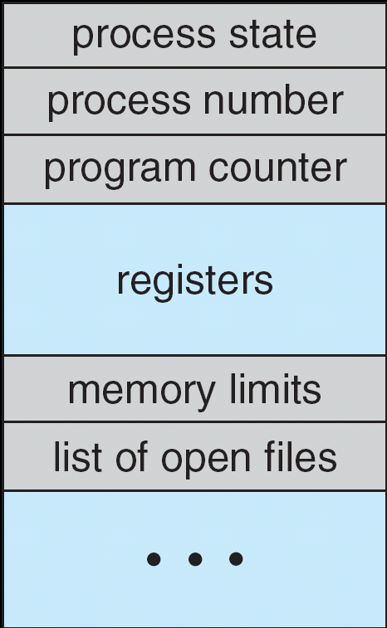
Recall: Multiplexing Processes: The Process Control Block
Kernel represents each process as a process control block (PCB)
Status (running, ready, blocked, …)
Register state (when not ready)
Process ID (PID), User, Executable, Priority, …
Execution time, …
Memory space, translation, …
Kernel Scheduler maintains a data structure containing the PCBs
Give out CPU to different processes
This is a Policy Decision
Give out non-CPU resources
Memory/IO
Another policy decision
Process Control
Block

Slide 5
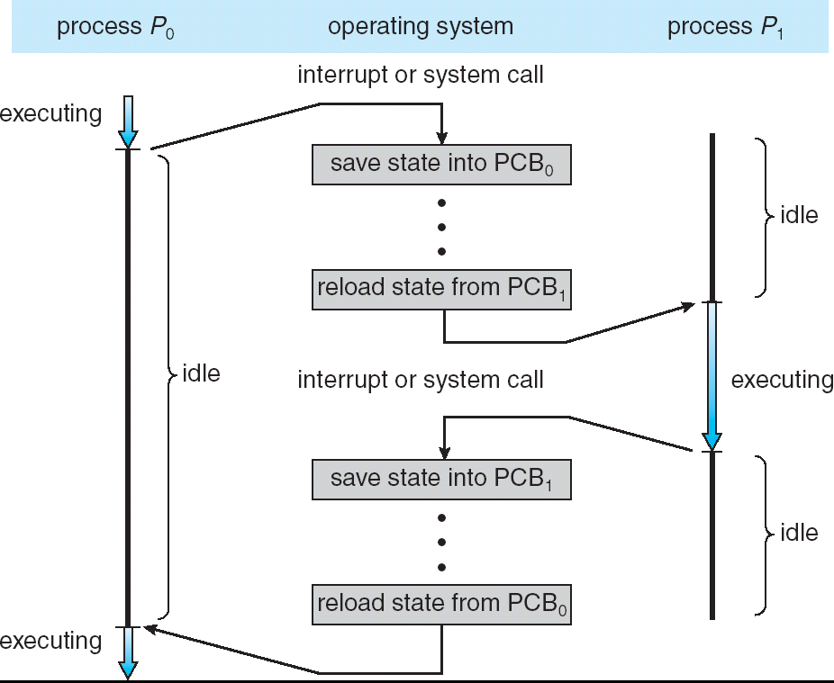
Recall: CPU Switch From Process A to Process B
User Mode
Kernel/System Mode
User Mode

Slide 6
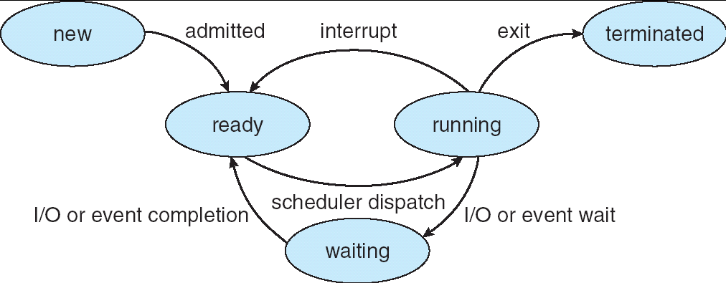
Recall: Lifecycle of a Process or Thread
As a process executes, it changes state:
new: The process/thread is being created
ready: The process is waiting to run
running: Instructions are being executed
waiting: Process waiting for some event to occur
terminated: The process has finished execution

Slide 7
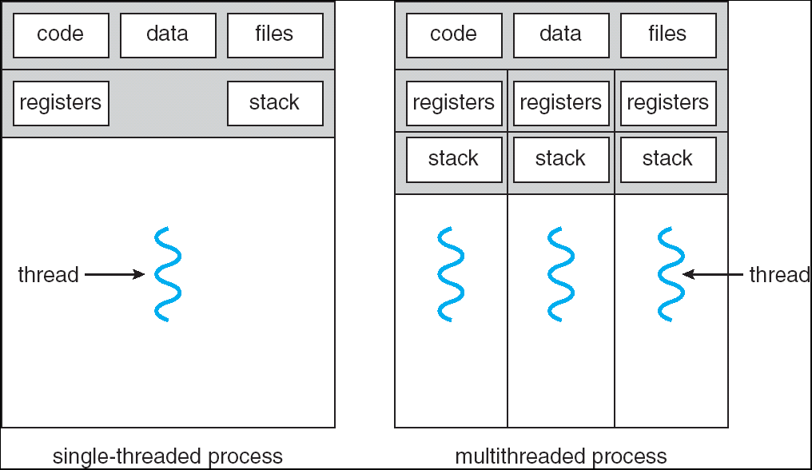
Recall: Single and Multithreaded Processes
Threads encapsulate concurrency: “Active” component
Address spaces encapsulate protection: “Passive” part
Keeps buggy program from trashing the system
Why have multiple threads per address space?
Notes:
Sometimes need parallelism for a single job, and processes are very expensive – to start, switch between, and to communicate between

Slide 8
Recall: Shared vs. Per-Thread State

Slide 9
The Core of Concurrency: the Dispatch Loop
Conceptually, the scheduling loop of the operating system looks as follows:
Loop {
RunThread();
ChooseNextThread();
SaveStateOfCPU(curTCB);
LoadStateOfCPU(newTCB);
}
This is an infinite loop
One could argue that this is all that the OS does
Should we ever exit this loop???
When would that be?
Notes:
Emergency crash of operating system called “panic()”

Slide 10
Running a thread
Consider first portion: RunThread()
How do I run a thread?
Load its state (registers, PC, stack pointer) into CPU
Load environment (virtual memory space, etc)
Jump to the PC
How does the dispatcher get control back?
Internal events: thread returns control voluntarily
External events: thread gets preempted
Notes:
OS’s have almost human characteristics – unpredictable, hard to understand, …
Different things share the same CPU – one thread, then another
Similar to schizophrenia, like the movie Sybil, one body shared by several people, say we start with Dave Patterson
Threads are like the personalities of the CPU. First one thread/personality uses the CPU, then another,…

Slide 11
Internal Events
Blocking on I/O
The act of requesting I/O implicitly yields the CPU
Waiting on a “signal” from other thread
Thread asks to wait and thus yields the CPU
Thread executes a yield()
Thread volunteers to give up CPU
computePI() {
while(TRUE) {
ComputeNextDigit();
yield();
}
}
Notes:
Yield is for really nice people – Ever see two people at the supermarket checkout line? You first, no you first, …

Slide 12
Stack for Yielding Thread
ComputePI
yield
Trap to OS
kernel_yield
Stack growth
run_new_thread
switch
How do we run a new thread?
run_new_thread() {
newThread = PickNewThread();
switch(curThread, newThread);
ThreadHouseKeeping(); /* Do any cleanup */
}
How does dispatcher switch to a new thread?
Save anything next thread may trash: PC, regs, stack pointer
Maintain isolation for each thread

Slide 13
What Do the Stacks Look Like?
Consider the following code blocks:
proc A() {
B();
}
proc B() {
while(TRUE) {
yield();
}
}
Suppose we have 2 threads:
Threads S and T
Thread S
Thread T
A
A
B(while)
B(while)
Stack growth
yield
yield
run_new_thread
run_new_thread
switch
switch
Thread S's switch returns to Thread T's (and vice versa)

Slide 14
Saving/Restoring state (often called “Context Switch)
Switch(tCur,tNew) {
/* Unload old thread */
TCB[tCur].regs.r7 = CPU.r7;
…
TCB[tCur].regs.r0 = CPU.r0;
TCB[tCur].regs.sp = CPU.sp;
TCB[tCur].regs.retpc = CPU.retpc; /*return addr*/
/* Load and execute new thread */
CPU.r7 = TCB[tNew].regs.r7;
…
CPU.r0 = TCB[tNew].regs.r0;
CPU.sp = TCB[tNew].regs.sp;
CPU.retpc = TCB[tNew].regs.retpc;
return; /* Return to CPU.retpc */
}

Slide 15
Switch Details (continued)
What if you make a mistake in implementing switch?
Suppose you forget to save/restore register 32
Get intermittent failures depending on when context switch occurred and whether new thread uses register 32
System will give wrong result without warning
Can you devise an exhaustive test to test switch code?
No! Too many combinations and inter-leavings
Cautionary tale:
For speed, Topaz kernel saved one instruction in switch()
Carefully documented! Only works as long as kernel size < 1MB
What happened?
Time passed, People forgot
Later, they added features to kernel (no one removes features!)
Very weird behavior started happening
Moral of story: Design for simplicity

Slide 16
Administrivia
Project 1 in full swing! Released Yesterday!
We expect that your design document will give intuitions behind your designs, not just a dump of pseudo-code
Think of this you are in a company and your TA is you manager
Paradox: need code for design document?
Not full code, just enough prove you have thought through complexities of design
Should be attending your permanent discussion section!
Discussion section attendance is mandatory, but don’t come if sick!!
We have given a mechanism to make up for missed sections—see piazza
We will have a rotating recording of sections for later viewing as well
Midterm 1: February 17th, 7-9PM (Two weeks from today!)
Fill out conflict request by tomorrow!

Slide 17
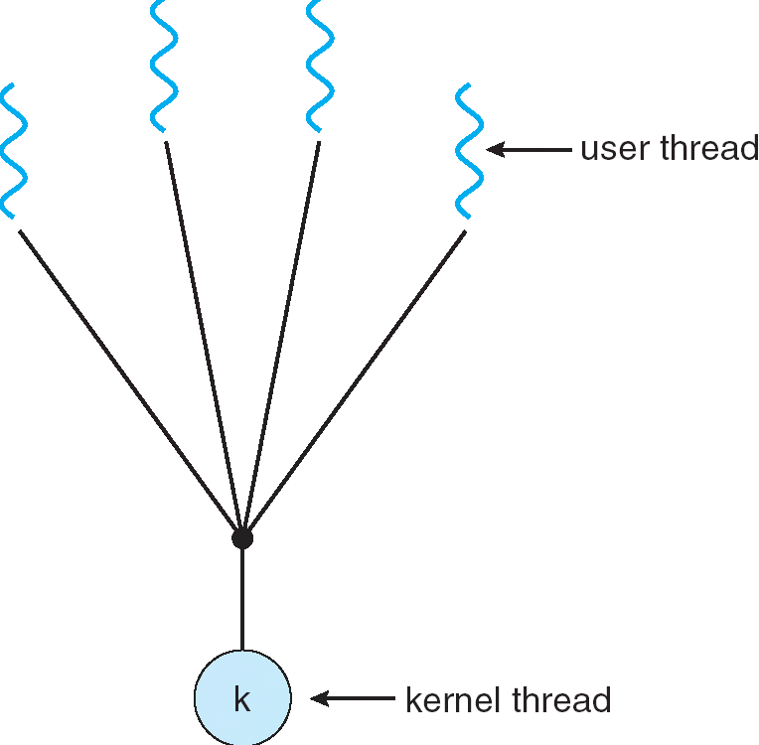
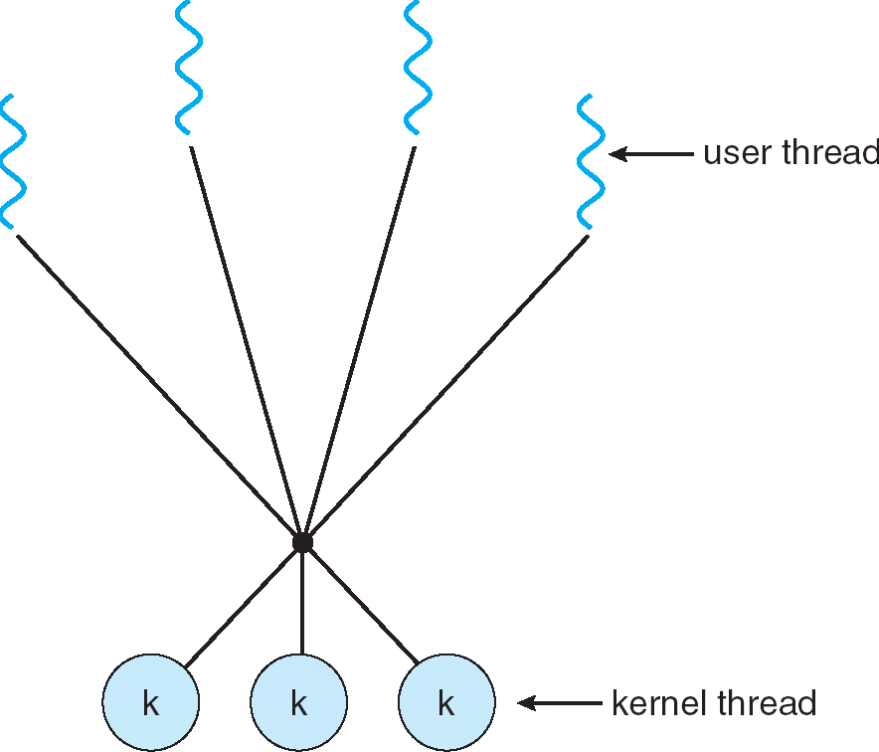
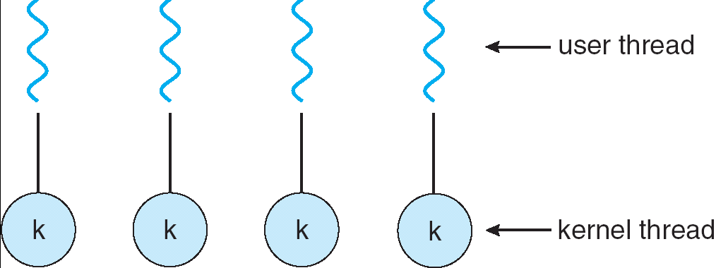
Are we still switching contexts with previous examples?
Yes, but much cheaper than switching processes
No need to change address space
Some numbers from Linux:
Frequency of context switch: 10-100ms
Switching between processes: 3-4 μsec.
Switching between threads: 100 ns
Even cheaper: switch threads (using “yield”) in user-space!
What we are talking about in Today’s lecture
Simple One-to-One
Threading Model
Many-to-One
Many-to-Many

Slide 18
What happens when thread blocks on I/O?
CopyFile
read
Trap to OS
Stack growth
kernel_read
run_new_thread
switch
What happens when a thread requests a block of data from the file system?
User code invokes a system call
Read operation is initiated
Run new thread/switch
Thread communication similar
Wait for Signal/Join
Networking

Slide 19
External Events
What happens if thread never does any I/O, never waits, and never yields control?
Could the ComputePI program grab all resources and never release the processor?
What if it didn’t print to console?
Must find way that dispatcher can regain control!
Answer: utilize external events
Interrupts: signals from hardware or software that stop the running code and jump to kernel
Timer: like an alarm clock that goes off every some milliseconds
If we make sure that external events occur frequently enough, can ensure dispatcher runs
Notes:
Patterson’s a nice guy, so he gives up the body after using it for awhile and let’s John Kubitowicz have it.
But Kubi’s not so nice, so he won’t give up control…
If you want to wake up for a final, you set your clock, or ask your roommate to pour water over your head – OS does the same

Slide 20
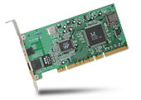
Recall: Interrupt Controller
Interrupt Mask
Priority Encoder
IntID
CPU
Interrupt
Int Disable
Timer
Software
Interrupt
Control
NMI
Network
Interrupts invoked with interrupt lines from devices
Interrupt controller chooses interrupt request to honor
Interrupt identity specified with ID line
Mask enables/disables interrupts
Priority encoder picks highest enabled interrupt
Software Interrupt Set/Cleared by Software
CPU can disable all interrupts with internal flag
Non-Maskable Interrupt line (NMI) can’t be disabled

Slide 21
Example: Network Interrupt
Raise priority
(set mask)
Reenable All Ints
Save registers
Dispatch to Handler
…
Transfer Network Packet from hardware to Kernel Buffers
…
Restore registers
Clear current Int
Disable All Ints
Restore priority
(clear Mask)
RTI
...
add $r1,$r2,$r3
subi $r4,$r1,#4
slli $r4,$r4,#2
...
PC saved
Disable All Ints
Kernel Mode
External Interrupt
Pipeline Flush
“Interrupt Handler”
...
lw $r2,0($r4)
lw $r3,4($r4)
add $r2,$r2,$r3
sw 8($r4),$r2
...
Restore PC
Enable all Ints
User Mode
An interrupt is a hardware-invoked context switch
No separate step to choose what to run next
Always run the interrupt handler immediately

Slide 22
Use of Timer Interrupt to Return Control
Solution to our dispatcher problem
Use the timer interrupt to force scheduling decisions
Timer Interrupt routine:
TimerInterrupt() { DoPeriodicHouseKeeping(); run_new_thread(); }
Some Routine
Interrupt
TimerInterrupt
Stack growth
run_new_thread
switch

Slide 23
ThreadFork(): Create a New Thread
ThreadFork() is a user-level procedure that creates a new thread and places it on ready queue
Arguments to ThreadFork()
Pointer to application routine (fcnPtr)
Pointer to array of arguments (fcnArgPtr)
Size of stack to allocate
Implementation
Sanity check arguments
Enter Kernel-mode and Sanity Check arguments again
Allocate new Stack and TCB
Initialize TCB and place on ready list (Runnable)

Slide 24
How do we initialize TCB and Stack?
Initialize Register fields of TCB
Stack pointer made to point at stack
PC return address ⇒ OS (asm) routine ThreadRoot()
Two arg registers (a0 and a1) initialized to fcnPtr and fcnArgPtr, respectively
Initialize stack data?
Minimal initialization ⇒setup return to go to beginning of ThreadRoot()
Important part of stack frame is in registers for RISC-V (ra)
X86: need to push a return address on stack
Think of stack frame as just before body of ThreadRoot() really gets started
ThreadRoot stub
Stack growth
Initial Stack

Slide 25
How does Thread get started?
Other Thread
ThreadRoot
A
B(while)
Stack growth
yield
run_new_thread
New Thread
switch
ThreadRoot stub
Eventually, run_new_thread() will select this TCB and return into beginning of ThreadRoot()
This really starts the new thread

Slide 26
How does a thread get started?
Other Thread
SetupNewThread(tNew) {
…
TCB[tNew].regs.sp = newStackPtr;
TCB[tNew].regs.retpc = &ThreadRoot;
TCB[tNew].regs.r0 = fcnPtr TCB[tNew].regs.r1 = fcnArgPtr
}
ThreadRoot
A
B(while)
Stack growth
yield
run_new_thread
New Thread
switch
ThreadRoot stub
How do we make a new thread?
Setup TCB/kernel thread to point at new user stack and ThreadRoot code
Put pointers to start function and args in registers or top of stack
This depends heavily on the calling convention (i.e. RISC-V vs x86)
Eventually, run_new_thread() will select this TCB and return into beginning of ThreadRoot()
This really starts the new thread

Slide 27
What does ThreadRoot() look like?
ThreadRoot() is the root for the thread routine:
ThreadRoot(fcnPTR,fcnArgPtr) {
DoStartupHousekeeping();
UserModeSwitch(); /* enter user mode */
Call fcnPtr(fcnArgPtr);
ThreadFinish();
}
Startup Housekeeping
Includes things like recording start time of thread
Other statistics
Stack will grow and shrink with execution of thread
Final return from thread returns into ThreadRoot() which calls ThreadFinish()
ThreadFinish() wake up sleeping threads
ThreadRoot
Thread Code *fcnPtr()
Stack growth
Running Stack

Slide 28
Processes vs. Threads: One Core
Process 1
Process N
Switch overhead:
Same process: low
Different proc.: high
Protection
Same proc: low
Different proc: high
Sharing overhead
Same proc: low
Different proc: high
Parallelism: no
threads
threads
Mem.
Mem.
…
IO
state
…
…
IO
state
CPU
state
CPU
state
CPU
state
CPU
state
CPU sched.
OS
1 thread at a time
CPU
(1 core)

Slide 29
Processes vs. Threads: MultiCore
Process 1
Process N
Switch overhead:
Same process: low
Different proc.: high
Protection
Same proc: low
Different proc: high
Sharing overhead
Same proc: low
Different proc, simultaneous core: medium
Different proc, offloaded core: high
Parallelism: yes
threads
threads
Mem.
Mem.
…
IO
state
…
…
IO
state
CPU
state
CPU
state
CPU
state
CPU
state
CPU sched.
OS
4 threads at a time
Core 1
Core 2
Core 3
Core 4

Slide 30
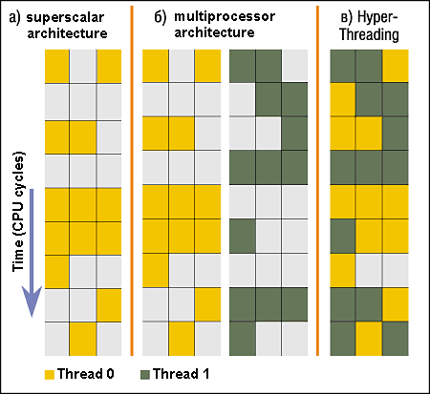
Recall: Simultaneous MultiThreading/Hyperthreading
Hardware scheduling technique
Superscalar processors can execute multiple instructions that are independent.
Hyperthreading duplicates register state to make a second “thread,” allowing more instructions to run.
Can schedule each thread as if were separate CPU
But, sub-linear speedup!
Original technique called “Simultaneous Multithreading”
http://www.cs.washington.edu/research/smt/index.html
SPARC, Pentium 4/Xeon (“Hyperthreading”), Power 5
Colored blocks show
instructions executed
Notes:
Intel seems to be discarding SMT in Silvermont because of power problems

Slide 31
Processes vs. Threads: Hyper-Threading
Process 1
Process N
threads
threads
Switch overhead between hardware-threads: very-low (done in hardware)
Contention for ALUs/FPUs may hurt performance
Mem.
Mem.
…
IO
state
…
…
IO
state
CPU
state
CPU
state
CPU
state
CPU
state
CPU sched.
OS
hardware-threads
(hyperthreading)
8 threads at a time
Core 1
Core 2
Core 3
Core 4
CPU

Slide 32
Threads vs Address Spaces: Options
One
Many
# of addr spaces:
# threads
Per AS:
One
MS/DOS, early Macintosh
Traditional UNIX
Many
Embedded systems (Geoworks, VxWorks, JavaOS,etc)
JavaOS, Pilot(PC)
Mach, OS/2, Linux
Windows 10
Win NT to XP, Solaris, HP-UX, OS X
Most operating systems have either
One or many address spaces
One or many threads per address space

Slide 33
Multiprocessing vs Multiprogramming
Some Definitions:
Multiprocessing ≡ Multiple CPUs
Multiprogramming ≡ Multiple Jobs or Processes
Multithreading ≡ Multiple threads per Process
What does it mean to run two threads “concurrently”?
Scheduler is free to run threads in any order and interleaving: FIFO, Random, …
Dispatcher can choose to run each thread to completion or time-slice in big chunks or small chunks
A
Multiprocessing
B
C
A
B
C
Multiprogramming
A
B
C
A
B
C
B

Slide 34
Correctness for systems with concurrent threads
If dispatcher can schedule threads in any way, programs must work under all circumstances
Can you test for this?
How can you know if your program works?
Independent Threads:
No state shared with other threads
Deterministic ⇒ Input state determines results
Reproducible ⇒ Can recreate Starting Conditions, I/O
Scheduling order doesn’t matter (if switch() works!!!)
Cooperating Threads:
Shared State between multiple threads
Non-deterministic
Non-reproducible
Non-deterministic and Non-reproducible means that bugs can be intermittent
Sometimes called “Heisenbugs”

Slide 35
Interactions Complicate Debugging
Is any program truly independent?
Every process shares the file system, OS resources, network, etc
Extreme example: buggy device driver causes thread A to crash “independent thread” B
You probably don’t realize how much you depend on reproducibility:
Example: Evil C compiler
Modifies files behind your back by inserting errors into C program unless you insert debugging code
Example: Debugging statements can overrun stack
Non-deterministic errors are really difficult to find
Example: Memory layout of kernel+user programs
depends on scheduling, which depends on timer/other things
Original UNIX had a bunch of non-deterministic errors
Example: Something which does interesting I/O
User typing of letters used to help generate secure keys
Notes:
Adding printf statements can cause stack overruns or changing timing/interleaving
What if non-deterministic error only occurs once a week? You’re pulling all-nighters to find it, your eyelids droop, and whiz, the error happens and you missed it.

Slide 36
Why allow cooperating threads?
People cooperate; computers help/enhance people’s lives, so computers must cooperate
By analogy, the non-reproducibility/non-determinism of people is a notable problem for “carefully laid plans”
Advantage 1: Share resources
One computer, many users
One bank balance, many ATMs
What if ATMs were only updated at night?
Embedded systems (robot control: coordinate arm & hand)
Advantage 2: Speedup
Overlap I/O and computation
Many different file systems do read-ahead
Multiprocessors – chop up program into parallel pieces
Advantage 3: Modularity
More important than you might think
Chop large problem up into simpler pieces
To compile, for instance, gcc calls cpp | cc1 | cc2 | as | ld
Makes system easier to extend

Slide 37
Recall: High-level Example: Web Server
Server must handle many requests
Non-cooperating version:
serverLoop() {
con = AcceptCon();
ProcessFork(ServiceWebPage(),con);
}
What are some disadvantages of this technique?
Notes:
Expensive to start new process, heavyweight context switch overhead (changing address spaces)

Slide 38


Recall: Threaded Web Server
Now, use a single process
Multithreaded (cooperating) version:
serverLoop() {
connection = AcceptCon();
ThreadFork(ServiceWebPage(),connection);
}
Looks almost the same, but has many advantages:
Can share file caches kept in memory, results of CGI scripts, other things
Threads are much cheaper to create than processes, so this has a lower per-request overhead
Question: would a user-level (say one-to-many) thread package make sense here?
When one request blocks on disk, all block…
What about Denial of Service attacks or digg / Slash-dot effects?

Slide 39

Thread Pools: Bounded Concurrency
Problem with previous version: Unbounded Threads
When web-site becomes too popular – throughput sinks
Instead, allocate a bounded “pool” of worker threads, representing the maximum level of multiprogramming
Master
Thread
queue
Thread Pool
master() { allocThreads(worker,queue); while(TRUE) { con=AcceptCon(); Enqueue(queue,con); wakeUp(queue); } }
worker(queue) { while(TRUE) { con=Dequeue(queue); if (con==null) sleepOn(queue); else ServiceWebPage(con); } }

Slide 40
Correctness with Concurrent Threads?
Non-determinism:
Scheduler can run threads in any order
Scheduler can switch threads at any time
This can make testing very difficult
Independent Threads
No state shared with other threads
Deterministic, reproducible conditions
Cooperating Threads
Shared state between multiple threads
Goal: Correctness by Design

Slide 41
ATM Bank Server
ATM server problem:
Service a set of requests
Do so without corrupting database
Don’t hand out too much money

Slide 42
ATM bank server example
Suppose we wanted to implement a server process to handle requests from an ATM network:
BankServer() { while (TRUE) { ReceiveRequest(&op, &acctId, &amount); ProcessRequest(op, acctId, amount); } }
ProcessRequest(op, acctId, amount) { if (op == deposit) Deposit(acctId, amount); else if … }
Deposit(acctId, amount) { acct = GetAccount(acctId); /* may use disk I/O */ acct->balance += amount; StoreAccount(acct); /* Involves disk I/O */ }
How could we speed this up?
More than one request being processed at once
Event driven (overlap computation and I/O)
Multiple threads (multi-proc, or overlap comp and I/O)

Slide 43
Event Driven Version of ATM server
Suppose we only had one CPU
Still like to overlap I/O with computation
Without threads, we would have to rewrite in event-driven style
Example
BankServer() { while(TRUE) { event = WaitForNextEvent(); if (event == ATMRequest) StartOnRequest(); else if (event == AcctAvail) ContinueRequest(); else if (event == AcctStored) FinishRequest(); } }
This technique is used for graphical programming
Complication:
What if we missed a blocking I/O step?
What if we have to split code into hundreds of pieces which could be blocking?

Slide 44
Can Threads Make This Easier?
Threads yield overlapped I/O and computation without “deconstructing” code into non-blocking fragments
One thread per request
Requests proceeds to completion, blocking as required:
Deposit(acctId, amount) { acct = GetAccount(actId); /* May use disk I/O */ acct->balance += amount; StoreAccount(acct); /* Involves disk I/O */ }
Unfortunately, shared state can get corrupted: Thread 1 Thread 2 load r1, acct->balance load r1, acct->balance add r1, amount2 store r1, acct->balance add r1, amount1 store r1, acct->balance

Slide 45
Recall: Possible Executions

Slide 46
Problem is at the Lowest Level
Most of the time, threads are working on separate data, so scheduling doesn’t matter:
Thread A Thread B
x = 1; y = 2;
However, what about (Initially, y = 12):
Thread A Thread B
x = 1; y = 2;
x = y+1; y = y*2;
What are the possible values of x?
Or, what are the possible values of x below?
Thread A Thread B
x = 1; x = 2;
X could be 1 or 2 (non-deterministic!)
Could even be 3 for serial processors:
Thread A writes 0001, B writes 0010 → scheduling order ABABABBA yields 3!
Notes:
X could be (13, 5, 3)

Slide 47
Atomic Operations
To understand a concurrent program, we need to know what the underlying indivisible operations are!
Atomic Operation: an operation that always runs to completion or not at all
It is indivisible: it cannot be stopped in the middle and state cannot be modified by someone else in the middle
Fundamental building block – if no atomic operations, then have no way for threads to work together
On most machines, memory references and assignments (i.e. loads and stores) of words are atomic
Consequently – weird example that produces “3” on previous slide can’t happen
Many instructions are not atomic
Double-precision floating point store often not atomic
VAX and IBM 360 had an instruction to copy a whole array

Slide 48
Locks
Lock: prevents someone from doing something
Lock before entering critical section and before accessing shared data
Unlock when leaving, after accessing shared data
Wait if locked
Important idea: all synchronization involves waiting
Locks need to be allocated and initialized:
structure Lock mylock or pthread_mutex_t mylock;
lock_init(&mylock) or mylock = PTHREAD_MUTEX_INITIALIZER;
Locks provide two atomic operations:
acquire(&mylock) – wait until lock is free; then mark it as busy
After this returns, we say the calling thread holds the lock
release(&mylock) – mark lock as free
Should only be called by a thread that currently holds the lock
After this returns, the calling thread no longer holds the lock

Slide 49
Fix banking problem with Locks!
Identify critical sections (atomic instruction sequences) and add locking:
Deposit(acctId, amount) {
acquire(&mylock) // Wait if someone else in critical section! acct = GetAccount(actId); acct->balance += amount; StoreAccount(acct);
release(&mylock) // Release someone into critical section }
Must use SAME lock (mylock) with all of the methods (Withdraw, etc…)
Shared with all threads!
Critical Section
Thread B
Thread A
Thread C
Threads serialized by lock through critical section.
Only one thread at a time
acquire(&mylock)
Thread C
Critical Section
Thread B
Thread A
release(&mylock)
Thread A
Thread B

Slide 50
Conclusion
Processes have two parts
Threads (Concurrency)
Address Spaces (Protection)
Various textbooks talk about processes
When this concerns concurrency, really talking about thread portion of a process
When this concerns protection, talking about address space portion of a process
Concurrent threads are a very useful abstraction
Allow transparent overlapping of computation and I/O
Allow use of parallel processing when available
Concurrent threads introduce problems when accessing shared data
Programs must be insensitive to arbitrary interleavings
Without careful design, shared variables can become completely inconsistent

