Slide 1
CS162 Operating Systems and Systems Programming Lecture 9 Synchronization 4: Semaphores (Con’t), Monitors and Readers/Writers
February 15th, 2022
Prof. Anthony Joseph and John Kubiatowicz
http://cs162.eecs.Berkeley.edu

Slide 2
Recall: Atomic Read-Modify-Write
test&set (&address) { /* most architectures */ result = M[address]; // return result from “address” and M[address] = 1; // set value at “address” to 1 return result; }
swap (&address, register) { /* x86 */ temp = M[address]; // swap register’s value to M[address] = register; // value at “address” register = temp; }
compare&swap (&address, reg1, reg2) { /* x86 (returns old value), 68000 */ if (reg1 == M[address]) { // If memory still == reg1, M[address] = reg2; // then put reg2 => memory return success; } else { // Otherwise do not change memory return failure; } }
load-linked&store-conditional(&address) { /* R4000, alpha */ loop: ll r1, M[address]; movi r2, 1; // Can do arbitrary computation sc r2, M[address]; beqz r2, loop; }

Slide 3
Recall: Better Locks using test&set
Can we build test&set locks without busy-waiting?
Mostly. Idea: only busy-wait to atomically check lock value
Note: sleep has to be sure to reset the guard variable
Why can’t we do it just before or just after the sleep?
int guard = 0; // Global Variable!
int mylock = FREE; // Interface: acquire(&mylock); // release(&mylock);
acquire(int *thelock) {
// Short busy-wait time while (test&set(guard)); if (*thelock == BUSY) {
put thread on wait queue;
go to sleep() & guard = 0;
// guard == 0 on wakup! } else { *thelock = BUSY; guard = 0; } }
release(int *thelock) { // Short busy-wait time while (test&set(guard)); if anyone on wait queue { take thread off wait queue Place on ready queue; } else { *thelock = FREE; } guard = 0;

Slide 4
Recall: Linux futex: Fast Userspace Mutex
#include <linux/futex.h>
#include <sys/time.h>
int futex(int *uaddr, int futex_op, int val,
const struct timespec *timeout );
uaddr points to a 32-bit value in user space
futex_op
FUTEX_WAIT – if val == *uaddr sleep till FUTEX_WAIT
Atomic check that condition still holds after we disable interrupts (in kernel!)
FUTEX_WAKE – wake up at most val waiting threads
FUTEX_FD, FUTEX_WAKE_OP, FUTEX_CMP_REQUEUE: More interesting operations!
timeout
ptr to a timespec structure that specifies a timeout for the op
Interface to the kernel sleep() functionality!
Let thread put themselves to sleep – conditionally!
futex is not exposed in libc; it is used within the implementation of pthreads
Can be used to implement locks, semaphores, monitors, etc…

Slide 5
Recall: Lock Using Atomic Instructions and Futex
Three (3) states:
UNLOCKED: No one has lock
LOCKED: One thread has lock
CONTESTED: Possibly more than one (with someone sleeping)
Clean interface!
Lock grabbed cleanly by either
compare_and_swap()
First swap()
No overhead if uncontested!
Could build semaphores in a similar way!
typedef enum { UNLOCKED,LOCKED,CONTESTED } Lock;
Lock mylock = UNLOCKED; // Interface: acquire(&mylock);
// release(&mylock);
acquire(Lock *thelock) {
// If unlocked, grab lock!
if (compare&swap(thelock,UNLOCKED,LOCKED))
return;
// Keep trying to grab lock, sleep in futex
while (swap(mylock,CONTESTED) != UNLOCKED))
// Sleep unless someone releases hear!
futex(thelock, FUTEX_WAIT, CONTESTED);
}
release(Lock *thelock) {
// If someone sleeping, if (swap(thelock,UNLOCKED) == CONTESTED)
futex(thelock,FUTEX_WAKE,1); }

Slide 6

Recall: Producer-Consumer with a Bounded Buffer
Problem Definition
Producer(s) put things into a shared buffer
Consumer(s) take them out
Need synchronization to coordinate producer/consumer
Don’t want producer and consumer to have to work in lockstep, so put a fixed-size buffer between them
Need to synchronize access to this buffer
Producer needs to wait if buffer is full
Consumer needs to wait if buffer is empty
Example 1: GCC compiler
cpp | cc1 | cc2 | as | ld
Example 2: Coke machine
Producer can put limited number of Cokes in machine
Consumer can’t take Cokes out if machine is empty
Others: Web servers, Routers, ….
Producer
Buffer
Consumer
Producer
Consumer
Consumer

Slide 7
Recall: Circular Buffer Data Structure (sequential case)
w
typedef struct buf {
int write_index;
int read_index;
<type> *entries[BUFSIZE];
} buf_t;
r
d_{i+2}
d_{i}
d_{i+1}
Insert: write & bump write ptr (enqueue)
Remove: read & bump read ptr (dequeue)
How to tell if Full (on insert) Empty (on remove)?
And what do you do if it is?
What needs to be atomic?

Slide 8
Recall: Circular Buffer – first cut
mutex buf_lock = <initially unlocked>
Producer(item) {
acquire(&buf_lock);
while (buffer full) {}; // Wait for a free slot
enqueue(item); release(&buf_lock);
}
Will we ever come out of the wait loop?
Consumer() {
acquire(&buf_lock);
while (buffer empty) {}; // Wait for arrival
item = dequeue(); release(&buf_lock);
return item
}

Slide 9
Circular Buffer – 2nd cut
∅
mutex buf_lock = <initially unlocked>
Producer(item) {
acquire(&buf_lock);
while (buffer full) {release(&buf_lock); acquire(&buf_lock);}
enqueue(item); release(&buf_lock);
}
What happens when one is waiting for the other?
- Multiple cores ?
- Single core ?
Consumer() {
acquire(&buf_lock);
while (buffer empty) {release(&buf_lock); acquire(&buf_lock);}
item = dequeue(); release(&buf_lock);
return item
}

Slide 10
Higher-level Primitives than Locks
What is right abstraction for synchronizing threads that share memory?
Want as high a level primitive as possible
Good primitives and practices important!
Since execution is not entirely sequential, really hard to find bugs, since they happen rarely
UNIX is pretty stable now, but up until about mid-80s (10 years after started), systems running UNIX would crash every week or so – concurrency bugs
Synchronization is a way of coordinating multiple concurrent activities that are using shared state
This lecture presents some ways to structuring sharing

Slide 11
Semaphores
Semaphores are a kind of generalized lock
First defined by Dijkstra in late 60s
Main synchronization primitive used in original UNIX
Definition: a Semaphore has a non-negative integer value and supports the following operations:
Set value when you initialize
Down() or P(): an atomic operation that waits for semaphore to become positive, then decrements it by 1
Think of this as the wait() operation
Up() or V(): an atomic operation that increments the semaphore by 1, waking up a waiting P, if any
This of this as the signal() operation
Technically examining value after initialization is not allowed.

Slide 12
Semaphores Like Integers Except…
Semaphores are like integers, except:
No negative values
Only operations allowed are P and V – can’t read or write value, except initially
Operations must be atomic
Two P’s together can’t decrement value below zero
Thread going to sleep in P won’t miss wakeup from V – even if both happen at same time
POSIX adds ability to read value, but technically not part of proper interface!
Semaphore from railway analogy
Here is a semaphore initialized to 2 for resource control:
Value=2
Value=1
Value=0
Value=1
Value=0
Value=2

Slide 13
Two Uses of Semaphores
Mutual Exclusion (initial value = 1)
Also called “Binary Semaphore” or “mutex”.
Can be used for mutual exclusion, just like a lock:
semaP(&mysem); // Critical section goes here semaV(&mysem);
Scheduling Constraints (initial value = 0)
Allow thread 1 to wait for a signal from thread 2
thread 2 schedules thread 1 when a given event occurs
Example: suppose you had to implement ThreadJoin which must wait for thread to terminate:
Initial value of semaphore = 0
ThreadJoin { semaP(&mysem); }
ThreadFinish { semaV(&mysem); }

Slide 14
Revisit Bounded Buffer: Correctness constraints for solution
Correctness Constraints:
Consumer must wait for producer to fill buffers, if none full (scheduling constraint)
Producer must wait for consumer to empty buffers, if all full (scheduling constraint)
Only one thread can manipulate buffer queue at a time (mutual exclusion)
Remember why we need mutual exclusion
Because computers are stupid
Imagine if in real life: the delivery person is filling the machine and somebody comes up and tries to stick their money into the machine
General rule of thumb: Use a separate semaphore for each constraint
Semaphore fullBuffers; // consumer’s constraint
Semaphore emptyBuffers;// producer’s constraint
Semaphore mutex; // mutual exclusion

Slide 15
Full Solution to Bounded Buffer (coke machine)
Semaphore fullSlots = 0; // Initially, no coke
Semaphore emptySlots = bufSize; // Initially, num empty slots
Semaphore mutex = 1; // No one using machine
Producer(item) { semaP(&emptySlots); // Wait until space semaP(&mutex); // Wait until machine free Enqueue(item); semaV(&mutex); semaV(&fullSlots); // Tell consumers there is // more coke }
Consumer() { semaP(&fullSlots); // Check if there’s a coke semaP(&mutex); // Wait until machine free item = Dequeue(); semaV(&mutex); semaV(&emptySlots); // tell producer need more return item; }
Critical sections using mutex protect integrity of the queue
fullSlots signals coke
emptySlots
signals space

Slide 16
Discussion about Solution
Decrease # of empty slots
Increase # of occupied slots
Why asymmetry?
Producer does: semaP(&emptyBuffer), semaV(&fullBuffer)
Consumer does: semaP(&fullBuffer), semaV(&emptyBuffer)
Is order of P’s important?
Yes! Can cause deadlock
Is order of V’s important?
No, except that it might affect scheduling efficiency
What if we have 2 producers or 2 consumers?
Do we need to change anything?
Decrease # of occupied slots
Increase # of empty slots
Producer(item) { semaP(&mutex); semaP(&emptySlots); Enqueue(item); semaV(&mutex); semaV(&fullSlots); } Consumer() { semaP(&fullSlots); semaP(&mutex); item = Dequeue(); semaV(&mutex); semaV(&emptySlots); return item; }

Slide 17
Semaphores are good but…Monitors are better!
Semaphores are a huge step up; just think of trying to do the bounded buffer with only loads and stores or even with locks!
Problem is that semaphores are dual purpose:
They are used for both mutex and scheduling constraints
Example: the fact that flipping of P’s in bounded buffer gives deadlock is not immediately obvious. How do you prove correctness to someone?
Cleaner idea: Use locks for mutual exclusion and condition variables for scheduling constraints
Definition: Monitor: a lock and zero or more condition variables for managing concurrent access to shared data
Some languages like Java provide this natively
Most others use actual locks and condition variables
A “Monitor” is a paradigm for concurrent programming!
Some languages support monitors explicitly

Slide 18
Administrivia
Midterm Thursday (February 17)!
No class on day of midterm
7-9PM
All materials up to today’s lecture!
Head TA will be posting where you are supposed to go
We have 3 primary rooms, and others
If you are sick, let us know.
Do not come to the midterm!
No class on Thursday

Slide 19
Condition Variables
How do we change the consumer() routine to wait until something is on the queue?
Could do this by keeping a count of the number of things on the queue (with semaphores), but error prone
Condition Variable: a queue of threads waiting for something inside a critical section
Key idea: allow sleeping inside critical section by atomically releasing lock at time we go to sleep
Contrast to semaphores: Can’t wait inside critical section
Operations:
Wait(&lock): Atomically release lock and go to sleep. Re-acquire lock later, before returning.
Signal(): Wake up one waiter, if any
Broadcast(): Wake up all waiters
Rule: Must hold lock when doing condition variable ops!

Slide 20
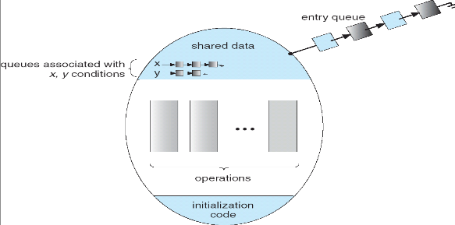
Monitor with Condition Variables
Lock: the lock provides mutual exclusion to shared data
Always acquire before accessing shared data structure
Always release after finishing with shared data
Lock initially free
Condition Variable: a queue of threads waiting for something inside a critical section
Key idea: make it possible to go to sleep inside critical section by atomically releasing lock at time we go to sleep
Contrast to semaphores: Can’t wait inside critical section

Slide 21
Synchronized Buffer (with condition variable)
Here is an (infinite) synchronized queue:
lock buf_lock; // Initially unlocked condition buf_CV; // Initially empty queue queue; // Actual queue!
Producer(item) { acquire(&buf_lock); // Get Lock enqueue(&queue,item); // Add item cond_signal(&buf_CV); // Signal any waiters release(&buf_lock); // Release Lock }
Consumer() { acquire(&buf_lock); // Get Lock while (isEmpty(&queue)) { cond_wait(&buf_CV, &buf_lock); // If empty, sleep } item = dequeue(&queue); // Get next item release(&buf_lock); // Release Lock return(item); }

Slide 22
Mesa vs. Hoare monitors
Need to be careful about precise definition of signal and wait. Consider a piece of our dequeue code:
while (isEmpty(&queue)) { cond_wait(&buf_CV,&buf_lock); // If nothing, sleep } item = dequeue(&queue); // Get next item
Why didn’t we do this? if (isEmpty(&queue)) { cond_wait(&buf_CV,&buf_lock); // If nothing, sleep } item = dequeue(&queue); // Get next item
Answer: depends on the type of scheduling
Mesa-style: Named after Xerox-Park Mesa Operating System
Most OSes use Mesa Scheduling!
Hoare-style: Named after British logician Tony Hoare

Slide 23
Hoare monitors
Signaler gives up lock, CPU to waiter; waiter runs immediately
Then, Waiter gives up lock, processor back to signaler when it exits critical section or if it waits again
On first glance, this seems like good semantics
Waiter gets to run immediately, condition is still correct!
Most textbooks talk about Hoare scheduling
However, hard to do, not really necessary!
Forces a lot of context switching (inefficient!)
…
acquire(&buf_lock);
…
cond_signal(&buf_CV);
…
release(&buf_lock);
acquire(&buf_lock);
…
if (isEmpty(&queue)) {
cond_wait(&buf_CV,&buf_lock); } …
release(&buf_lock);
Lock, CPU
Lock, CPU

Slide 24
Mesa monitors
Signaler keeps lock and processor
Waiter placed on ready queue with no special priority
Practically, need to check condition again after wait
By the time the waiter gets scheduled, condition may be false again – so, just check again with the “while” loop
Most real operating systems do this!
More efficient, easier to implement
Signaler’s cache state, etc still good
Put waiting thread on ready queue
…
acquire(&buf_lock)
…
cond_signal(&buf_CV);
…
release(&buf_lock));
acquire(&buf_lock);
…
while (isEmpty(&queue)) { cond_wait(&buf_CV,&buf_lock); } …
lock.Release();
schedule thread (sometime later!)

Slide 25
Circular Buffer – 3rd cut (Monitors, pthread-like)
lock buf_lock = <initially unlocked>
condition producer_CV = <initially empty>
condition consumer_CV = <initially empty>
Producer(item) {
acquire(&buf_lock);
while (buffer full) { cond_wait(&producer_CV, &buf_lock); }
enqueue(item);
cond_signal(&consumer_CV); release(&buf_lock);
}
What does thread do when it is waiting?
- Sleep, not busywait!
Consumer() {
acquire(buf_lock);
while (buffer empty) { cond_wait(&consumer_CV, &buf_lock); }
item = dequeue();
cond_signal(&producer_CV);
release(buf_lock);
return item
}

Slide 26
Again: Why the while Loop?
MESA semantics
For most operating systems, when a thread is woken up by signal(), it is simply put on the ready queue
It may or may not reacquire the lock immediately!
Another thread could be scheduled first and "sneak in" to empty the queue
Need a loop to re-check condition on wakeup
Is this busy waiting?

Slide 27
Readers/Writers Problem
W
R
R
R
Motivation: Consider a shared database
Two classes of users:
Readers – never modify database
Writers – read and modify database
Is using a single lock on the whole database sufficient?
Like to have many readers at the same time
Only one writer at a time

Slide 28
Basic Structure of Mesa Monitor Program
Monitors represent the synchronization logic of the program
Wait if necessary
Signal when change something so any waiting threads can proceed
Basic structure of mesa monitor-based program:
lock while (need to wait) { condvar.wait(); } unlock do something so no need to wait lock
condvar.signal();
unlock
Check and/or update state variables
Wait if necessary
Check and/or update
state variables

Slide 29
Basic Readers/Writers Solution
Correctness Constraints:
Readers can access database when no writers
Writers can access database when no readers or writers
Only one thread manipulates state variables at a time
Basic structure of a solution:
Reader() Wait until no writers Access data base Check out – wake up a waiting writer
Writer() Wait until no active readers or writers Access database Check out – wake up waiting readers or writer
State variables (Protected by a lock called “lock”):
int AR: Number of active readers; initially = 0
int WR: Number of waiting readers; initially = 0
int AW: Number of active writers; initially = 0
int WW: Number of waiting writers; initially = 0
Condition okToRead = NIL
Condition okToWrite = NIL

Slide 30
Code for a Reader
Reader() { // First check self into system acquire(&lock);
while ((AW + WW) > 0) { // Is it safe to read? WR++; // No. Writers exist cond_wait(&okToRead,&lock);// Sleep on cond var WR--; // No longer waiting }
AR++; // Now we are active! release(&lock);
// Perform actual read-only access AccessDatabase(ReadOnly);
// Now, check out of system acquire(&lock); AR--; // No longer active if (AR == 0 && WW > 0) // No other active readers cond_signal(&okToWrite);// Wake up one writer release(&lock); }
Why Release the Lock here?

Slide 31
Code for a Writer
Writer() { // First check self into system acquire(&lock);
while ((AW + AR) > 0) { // Is it safe to write? WW++; // No. Active users exist cond_wait(&okToWrite,&lock); // Sleep on cond var WW--; // No longer waiting }
AW++; // Now we are active! release(&lock);
// Perform actual read/write access AccessDatabase(ReadWrite);
// Now, check out of system acquire(&lock); AW--; // No longer active if (WW > 0){ // Give priority to writers cond_signal(&okToWrite);// Wake up one writer } else if (WR > 0) { // Otherwise, wake reader cond_broadcast(&okToRead); // Wake all readers } release(&lock); }
Why broadcast() here instead of signal()?
Why Give priority to writers?

Slide 32
Simulation of Readers/Writers Solution
Use an example to simulate the solution
Consider the following sequence of operators:
R1, R2, W1, R3
Initially: AR = 0, WR = 0, AW = 0, WW = 0

Slide 33
Simulation of Readers/Writers Solution
R1 comes along (no waiting threads)
AR = 0, WR = 0, AW = 0, WW = 0
Reader() { acquire(&lock)
while ((AW + WW) > 0) { // Is it safe to read? WR++; // No. Writers exist cond_wait(&okToRead,&lock);// Sleep on cond var WR--; // No longer waiting }
AR++; // Now we are active! release(&lock);
AccessDBase(ReadOnly);
acquire(&lock); AR--; if (AR == 0 && WW > 0) cond_signal(&okToWrite); release(&lock); }

Slide 34
Simulation of Readers/Writers Solution
R1 comes along (no waiting threads)
AR = 0, WR = 0, AW = 0, WW = 0
Reader() { acquire(&lock);
while ((AW + WW) > 0) { // Is it safe to read? WR++; // No. Writers exist cond_wait(&okToRead,&lock);// Sleep on cond var WR--; // No longer waiting }
AR++; // Now we are active! release(&lock);
AccessDBase(ReadOnly);
acquire(&lock); AR--; if (AR == 0 && WW > 0) cond_signal(&okToWrite); release(&lock); }

Slide 35
Simulation of Readers/Writers Solution
R1 comes along (no waiting threads)
AR = 1, WR = 0, AW = 0, WW = 0
Reader() { acquire(&lock);
while ((AW + WW) > 0) { // Is it safe to read? WR++; // No. Writers exist cond_wait(&okToRead,&lock);// Sleep on cond var WR--; // No longer waiting }
AR++; // Now we are active! release(&lock);
AccessDBase(ReadOnly);
acquire(&lock); AR--; if (AR == 0 && WW > 0) cond_signal(&okToWrite); release(&lock); }

Slide 36
Simulation of Readers/Writers Solution
R1 comes along (no waiting threads)
AR = 1, WR = 0, AW = 0, WW = 0
Reader() { acquire(&lock);
while ((AW + WW) > 0) { // Is it safe to read? WR++; // No. Writers exist cond_wait(&okToRead,&lock);// Sleep on cond var WR--; // No longer waiting }
AR++; // Now we are active! release(&lock);
AccessDBase(ReadOnly);
acquire(&lock); AR--; if (AR == 0 && WW > 0) cond_signal(&okToWrite); release(&lock); }
Why release the
lock here???

Slide 37
Simulation of Readers/Writers Solution
R1 accessing dbase (no other threads)
AR = 1, WR = 0, AW = 0, WW = 0
Reader() { acquire(&lock);
while ((AW + WW) > 0) { // Is it safe to read? WR++; // No. Writers exist cond_wait(&okToRead,&lock);// Sleep on cond var WR--; // No longer waiting }
AR++; // Now we are active! release(&lock);
AccessDBase(ReadOnly);
acquire(&lock); AR--; if (AR == 0 && WW > 0) cond_signal(&okToWrite); release(&lock); }

Slide 38
Simulation of Readers/Writers Solution
R2 comes along (R1 accessing dbase)
AR = 1, WR = 0, AW = 0, WW = 0
Reader() { acquire(&lock);
while ((AW + WW) > 0) { // Is it safe to read? WR++; // No. Writers exist cond_wait(&okToRead,&lock);// Sleep on cond var WR--; // No longer waiting }
AR++; // Now we are active! release(&lock);
AccessDBase(ReadOnly);
acquire(&lock); AR--; if (AR == 0 && WW > 0) cond_signal(&okToWrite); release(&lock); }

Slide 39
Simulation of Readers/Writers Solution
R2 comes along (R1 accessing dbase)
AR = 1, WR = 0, AW = 0, WW = 0
Reader() { acquire(&lock);
while ((AW + WW) > 0) { // Is it safe to read? WR++; // No. Writers exist cond_wait(&okToRead,&lock);// Sleep on cond var WR--; // No longer waiting }
AR++; // Now we are active! release(&lock);
AccessDBase(ReadOnly);
acquire(&lock); AR--; if (AR == 0 && WW > 0) cond_signal(&okToWrite); release(&lock); }

Slide 40
Simulation of Readers/Writers Solution
R2 comes along (R1 accessing dbase)
AR = 2, WR = 0, AW = 0, WW = 0
Reader() { acquire(&lock);
while ((AW + WW) > 0) { // Is it safe to read? WR++; // No. Writers exist cond_wait(&okToRead,&lock);// Sleep on cond var WR--; // No longer waiting }
AR++; // Now we are active! release(&lock);
AccessDBase(ReadOnly);
acquire(&lock); AR--; if (AR == 0 && WW > 0) cond_signal(&okToWrite); release(&lock); }

Slide 41
Simulation of Readers/Writers Solution
R2 comes along (R1 accessing dbase)
AR = 2, WR = 0, AW = 0, WW = 0
Reader() { acquire(&lock);
while ((AW + WW) > 0) { // Is it safe to read? WR++; // No. Writers exist cond_wait(&okToRead,&lock);// Sleep on cond var WR--; // No longer waiting }
AR++; // Now we are active! release(&lock);
AccessDBase(ReadOnly);
acquire(&lock); AR--; if (AR == 0 && WW > 0) cond_signal(&okToWrite); release(&lock); }

Slide 42
Simulation of Readers/Writers Solution
R1 and R2 accessing dbase
AR = 2, WR = 0, AW = 0, WW = 0
Reader() { acquire(&lock);
while ((AW + WW) > 0) { // Is it safe to read? WR++; // No. Writers exist cond_wait(&okToRead,&lock);// Sleep on cond var WR--; // No longer waiting }
AR++; // Now we are active! release(&lock);
AccessDBase(ReadOnly);
acquire(&lock); AR--; if (AR == 0 && WW > 0) cond_signal(&okToWrite); release(&lock); }
Assume readers take a while to access database
Situation: Locks released, only AR is non-zero

Slide 43
Simulation of Readers/Writers Solution
W1 comes along (R1 and R2 are still accessing dbase)
AR = 2, WR = 0, AW = 0, WW = 0
Writer() { acquire(&lock);
while ((AW + AR) > 0) { // Is it safe to write? WW++; // No. Active users exist cond_wait(&okToWrite,&lock);// Sleep on cond var WW--; // No longer waiting }
AW++; release(&lock);
AccessDBase(ReadWrite);
acquire(&lock); AW--; if (WW > 0){ cond_signal(&okToWrite); } else if (WR > 0) { cond_broadcast(&okToRead); } release(&lock); }

Slide 44
Simulation of Readers/Writers Solution
W1 comes along (R1 and R2 are still accessing dbase)
AR = 2, WR = 0, AW = 0, WW = 0
Writer() { acquire(&lock);
while ((AW + AR) > 0) { // Is it safe to write? WW++; // No. Active users exist cond_wait(&okToWrite,&lock);// Sleep on cond var WW--; // No longer waiting }
AW++; release(&lock);
AccessDBase(ReadWrite);
acquire(&lock); AW--; if (WW > 0){ cond_signal(&okToWrite); } else if (WR > 0) { cond_broadcast(&okToRead); } release(&lock); }

Slide 45
Simulation of Readers/Writers Solution
W1 comes along (R1 and R2 are still accessing dbase)
AR = 2, WR = 0, AW = 0, WW = 1
Writer() { acquire(&lock);
while ((AW + AR) > 0) { // Is it safe to write? WW++; // No. Active users exist cond_wait(&okToWrite,&lock);// Sleep on cond var WW--; // No longer waiting }
AW++; release(&lock);
AccessDBase(ReadWrite);
acquire(&lock); AW--; if (WW > 0){ cond_signal(&okToWrite); } else if (WR > 0) { cond_broadcast(&okToRead); } release(&lock); }
W1 cannot start because of readers

Slide 46
Simulation of Readers/Writers Solution
R3 comes along (R1 and R2 accessing dbase, W1 waiting)
AR = 2, WR = 0, AW = 0, WW = 1
Reader() { acquire(&lock);
while ((AW + WW) > 0) { // Is it safe to read? WR++; // No. Writers exist cond_wait(&okToRead,&lock);// Sleep on cond var WR--; // No longer waiting }
AR++; // Now we are active! release(&lock);
AccessDBase(ReadOnly);
acquire(&lock); AR--; if (AR == 0 && WW > 0) cond_signal(&okToWrite); release(&lock); }

Slide 47
Simulation of Readers/Writers Solution
R3 comes along (R1 and R2 accessing dbase, W1 waiting)
AR = 2, WR = 0, AW = 0, WW = 1
Reader() { acquire(&lock);
while ((AW + WW) > 0) { // Is it safe to read? WR++; // No. Writers exist cond_wait(&okToRead,&lock);// Sleep on cond var WR--; // No longer waiting }
AR++; // Now we are active! release(&lock);
AccessDBase(ReadOnly);
acquire(&lock); AR--; if (AR == 0 && WW > 0) cond_signal(&okToWrite); release(&lock); }

Slide 48
Simulation of Readers/Writers Solution
R3 comes along (R1 and R2 accessing dbase, W1 waiting)
AR = 2, WR = 1, AW = 0, WW = 1
Reader() { acquire(&lock);
while ((AW + WW) > 0) { // Is it safe to read? WR++; // No. Writers exist cond_wait(&okToRead,&lock);// Sleep on cond var WR--; // No longer waiting }
AR++; // Now we are active! lock.release();
AccessDBase(ReadOnly);
acquire(&lock); AR--; if (AR == 0 && WW > 0) cond_signal(&okToWrite); release(&lock); }

Slide 49
Simulation of Readers/Writers Solution
R3 comes along (R1, R2 accessing dbase, W1 waiting)
AR = 2, WR = 1, AW = 0, WW = 1
Reader() { acquire(&lock);
while ((AW + WW) > 0) { // Is it safe to read? WR++; // No. Writers exist cond_wait(&okToRead,&lock);// Sleep on cond var WR--; // No longer waiting }
AR++; // Now we are active! release(&lock);
AccessDBase(ReadOnly);
acquire(&lock); AR--; if (AR == 0 && WW > 0) cond_signal(&okToWrite); release(&lock); }
R3 cannot start because of writers (both AW & WW)

Slide 50
Simulation of Readers/Writers Solution
R1 and R2 accessing dbase, W1 and R3 waiting
AR = 2, WR = 1, AW = 0, WW = 1
Reader() { acquire(&lock);
while ((AW + WW) > 0) { // Is it safe to read? WR++; // No. Writers exist cond_wait(&okToRead,&lock);// Sleep on cond var WR--; // No longer waiting }
AR++; // Now we are active! release(&lock);
AccessDBase(ReadOnly);
acquire(&lock); AR--; if (AR == 0 && WW > 0) cond_signal(&okToWrite); release(&lock); }
Status:
R1 and R2 still reading
W1 and R3 waiting on okToWrite and okToRead, respectively

Slide 51
Simulation of Readers/Writers Solution
R2 finishes (R1 accessing dbase, W1 and R3 waiting)
AR = 2, WR = 1, AW = 0, WW = 1
Reader() { acquire(&lock);
while ((AW + WW) > 0) { // Is it safe to read? WR++; // No. Writers exist cond_wait(&okToRead,&lock);// Sleep on cond var WR--; // No longer waiting }
AR++; // Now we are active! release(&lock);
AccessDBase(ReadOnly);
acquire(&lock); AR--; if (AR == 0 && WW > 0) cond_signal(&okToWrite); release(&lock); }

Slide 52
Simulation of Readers/Writers Solution
R2 finishes (R1 accessing dbase, W1 and R3 waiting)
AR = 1, WR = 1, AW = 0, WW = 1
Reader() { acquire(&lock);
while ((AW + WW) > 0) { // Is it safe to read? WR++; // No. Writers exist cond_wait(&okToRead,&lock);// Sleep on cond var WR--; // No longer waiting }
AR++; // Now we are active! release(&lock);
AccessDBase(ReadOnly);
acquire(&lock); AR--; if (AR == 0 && WW > 0) cond_signal(&okToWrite); release(&lock); }

Slide 53
Simulation of Readers/Writers Solution
R2 finishes (R1 accessing dbase, W1 and R3 waiting)
AR = 1, WR = 1, AW = 0, WW = 1
Reader() { acquire(&lock);
while ((AW + WW) > 0) { // Is it safe to read? WR++; // No. Writers exist cond_wait(&okToRead,&lock);// Sleep on cond var WR--; // No longer waiting }
AR++; // Now we are active! release(&lock);
AccessDBase(ReadOnly);
acquire(&lock); AR--; if (AR == 0 && WW > 0) cond_signal(&okToWrite); release(&lock); }

Slide 54
Simulation of Readers/Writers Solution
R2 finishes (R1 accessing dbase, W1 and R3 waiting)
AR = 1, WR = 1, AW = 0, WW = 1
Reader() { acquire(&lock);
while ((AW + WW) > 0) { // Is it safe to read? WR++; // No. Writers exist cond_wait(&okToRead,&lock);// Sleep on cond var WR--; // No longer waiting }
AR++; // Now we are active! release(&lock);
AccessDBase(ReadOnly);
acquire(&lock); AR--; if (AR == 0 && WW > 0) cond_signal(&okToWrite); release(&lock); }

Slide 55
Simulation of Readers/Writers Solution
R1 finishes (W1 and R3 waiting)
AR = 1, WR = 1, AW = 0, WW = 1
Reader() { acquire(&lock);
while ((AW + WW) > 0) { // Is it safe to read? WR++; // No. Writers exist cond_wait(&okToRead,&lock);// Sleep on cond var WR--; // No longer waiting }
AR++; // Now we are active! release(&lock);
AccessDBase(ReadOnly);
acquire(&lock); AR--; if (AR == 0 && WW > 0) cond_signal(&okToWrite); release(&lock); }

Slide 56
Simulation of Readers/Writers Solution
R1 finishes (W1, R3 waiting)
AR = 0, WR = 1, AW = 0, WW = 1
Reader() { acquire(&lock);
while ((AW + WW) > 0) { // Is it safe to read? WR++; // No. Writers exist cond_wait(&okToRead,&lock);// Sleep on cond var WR--; // No longer waiting }
AR++; // Now we are active! release(&lock);
AccessDBase(ReadOnly);
acquire(&lock); AR--; if (AR == 0 && WW > 0) cond_signal(&okToWrite); release(&lock); }

Slide 57
Simulation of Readers/Writers Solution
R1 finishes (W1, R3 waiting)
AR = 0, WR = 1, AW = 0, WW = 1
Reader() { acquire(&lock);
while ((AW + WW) > 0) { // Is it safe to read? WR++; // No. Writers exist cond_wait(&okToRead,&lock);// Sleep on cond var WR--; // No longer waiting }
AR++; // Now we are active! release(&lock);
AccessDBase(ReadOnly);
acquire(&lock); AR--; if (AR == 0 && WW > 0) cond_signal(&okToWrite); release(&lock); }

Slide 58
Simulation of Readers/Writers Solution
R1 signals a writer (W1 and R3 waiting)
AR = 0, WR = 1, AW = 0, WW = 1
Reader() { acquire(&lock);
while ((AW + WW) > 0) { // Is it safe to read? WR++; // No. Writers exist cond_wait(&okToRead,&lock);// Sleep on cond var WR--; // No longer waiting }
AR++; // Now we are active! release(&lock);
AccessDBase(ReadOnly);
acquire(&lock); AR--; if (AR == 0 && WW > 0) cond_signal(&okToWrite); release(&lock); }
All readers done,
Signal writer W1

Slide 59
Simulation of Readers/Writers Solution
W1 gets signal (R3 still waiting)
AR = 0, WR = 1, AW = 0, WW = 1
Writer() { acquire(&lock);
while ((AW + AR) > 0) { // Is it safe to write? WW++; // No. Active users exist cond_wait(&okToWrite,&lock);// Sleep on cond var WW--; // No longer waiting }
AW++; release(&lock);
AccessDBase(ReadWrite);
acquire(&lock); AW--; if (WW > 0){ cond_signal(&okToWrite); } else if (WR > 0) { cond_broadcast(&okToRead); } release(&lock); }
Receive signal from R1

Slide 60
Simulation of Readers/Writers Solution
W1 gets signal (R3 still waiting)
AR = 0, WR = 1, AW = 0, WW = 0
Writer() { acquire(&lock);
while ((AW + AR) > 0) { // Is it safe to write? WW++; // No. Active users exist cond_wait(&okToWrite,&lock);// Sleep on cond var WW--; // No longer waiting }
AW++; release(&lock);
AccessDBase(ReadWrite);
acquire(&lock); AW--; if (WW > 0){ cond_signal(&okToWrite); } else if (WR > 0) { cond_broadcast(&okToRead); } release(&lock); }

Slide 61
Simulation of Readers/Writers Solution
W1 gets signal (R3 still waiting)
AR = 0, WR = 1, AW = 1, WW = 0
Writer() { acquire(&lock);
while ((AW + AR) > 0) { // Is it safe to write? WW++; // No. Active users exist cond_wait(&okToWrite,&lock);// Sleep on cond var WW--; // No longer waiting }
AW++; release(&lock);
AccessDBase(ReadWrite);
acquire(&lock); AW--; if (WW > 0){ cond_signal(&okToWrite); } else if (WR > 0) { cond_broadcast(&okToRead); } release(&lock); }

Slide 62
Simulation of Readers/Writers Solution
W1 accessing dbase (R3 still waiting)
AR = 0, WR = 1, AW = 1, WW = 0
Writer() { acquire(&lock);
while ((AW + AR) > 0) { // Is it safe to write? WW++; // No. Active users exist cond_wait(&okToWrite,&lock);// Sleep on cond var WW--; // No longer waiting }
AW++; release(&lock);
AccessDBase(ReadWrite);
acquire(&lock); AW--; if (WW > 0){ cond_signal(&okToWrite); } else if (WR > 0) { cond_broadcast(&okToRead); } release(&lock); }

Slide 63
Simulation of Readers/Writers Solution
W1 finishes (R3 still waiting)
AR = 0, WR = 1, AW = 1, WW = 0
Writer() { acquire(&lock);
while ((AW + AR) > 0) { // Is it safe to write? WW++; // No. Active users exist cond_wait(&okToWrite,&lock);// Sleep on cond var WW--; // No longer waiting }
AW++; release(&lock);
AccessDBase(ReadWrite);
acquire(&lock); AW--; if (WW > 0){ cond_signal(&okToWrite); } else if (WR > 0) { cond_broadcast(&okToRead); } release(&lock); }

Slide 64
Simulation of Readers/Writers Solution
W1 finishes (R3 still waiting)
AR = 0, WR = 1, AW = 0, WW = 0
Writer() { acquire(&lock);
while ((AW + AR) > 0) { // Is it safe to write? WW++; // No. Active users exist cond_wait(&okToWrite,&lock);// Sleep on cond var WW--; // No longer waiting }
AW++; release(&lock);
AccessDBase(ReadWrite);
acquire(&lock); AW--; if (WW > 0){ cond_signal(&okToWrite); } else if (WR > 0) { cond_broadcast(&okToRead); } release(&lock); }

Slide 65
Simulation of Readers/Writers Solution
W1 finishes (R3 still waiting)
AR = 0, WR = 1, AW = 0, WW = 0
Writer() { acquire(&lock);
while ((AW + AR) > 0) { // Is it safe to write? WW++; // No. Active users exist cond_wait(&okToWrite,&lock);// Sleep on cond var WW--; // No longer waiting }
AW++; release(&lock);
AccessDBase(ReadWrite);
acquire(&lock); AW--; if (WW > 0){ cond_signal(&okToWrite); } else if (WR > 0) { cond_broadcast(&okToRead); } release(&lock); }

Slide 66
Simulation of Readers/Writers Solution
W1 signaling readers (R3 still waiting)
AR = 0, WR = 1, AW = 0, WW = 0
Writer() { acquire(&lock);
while ((AW + AR) > 0) { // Is it safe to write? WW++; // No. Active users exist cond_wait(&okToWrite,&lock);// Sleep on cond var WW--; // No longer waiting }
AW++; release(&lock);
AccessDBase(ReadWrite);
acquire(&lock); AW--; if (WW > 0){ cond_signal(&okToWrite); } else if (WR > 0) { cond_broadcast(&okToRead); } release(&lock); }
No waiting writers,
Signal reader R3

Slide 67
Simulation of Readers/Writers Solution
R3 gets signal (no waiting threads)
AR = 0, WR = 1, AW = 0, WW = 0
Reader() { acquire(&lock);
while ((AW + WW) > 0) { // Is it safe to read? WR++; // No. Writers exist cond_wait(&okToRead,&lock);// Sleep on cond var WR--; // No longer waiting }
AR++; // Now we are active! release(&lock);
AccessDBase(ReadOnly);
acquire(&lock); AR--; if (AR == 0 && WW > 0) cond_signal(&okToWrite); release(&lock); }
Receive signal from W1

Slide 68
Simulation of Readers/Writers Solution
R3 gets signal (no waiting threads)
AR = 0, WR = 0, AW = 0, WW = 0
Reader() { acquire(&lock);
while ((AW + WW) > 0) { // Is it safe to read? WR++; // No. Writers exist cond_wait(&okToRead,&lock);// Sleep on cond var WR--; // No longer waiting }
AR++; // Now we are active! release(&lock);
AccessDBase(ReadOnly);
acquire(&lock); AR--; if (AR == 0 && WW > 0) cond_signal(&okToWrite); release(&lock); }

Slide 69
Simulation of Readers/Writers Solution
R3 accessing dbase (no waiting threads)
AR = 1, WR = 0, AW = 0, WW = 0
Reader() { acquire(&lock);
while ((AW + WW) > 0) { // Is it safe to read? WR++; // No. Writers exist cond_wait(&okToRead,&lock);// Sleep on cond var WR--; // No longer waiting }
AR++; // Now we are active! release(&lock);
AccessDBase(ReadOnly);
acquire(&lock); AR--; if (AR == 0 && WW > 0) cond_signal(&okToWrite); release(&lock); }

Slide 70
Simulation of Readers/Writers Solution
R3 finishes (no waiting threads)
AR = 1, WR = 0, AW = 0, WW = 0
Reader() { acquire(&lock);
while ((AW + WW) > 0) { // Is it safe to read? WR++; // No. Writers exist cond_wait(&okToRead,&lock);// Sleep on cond var WR--; // No longer waiting }
AR++; // Now we are active! release(&lock);
AccessDBase(ReadOnly);
acquire(&lock); AR--; if (AR == 0 && WW > 0) cond_signal(&okToWrite); release(&lock); }

Slide 71
Simulation of Readers/Writers Solution
R3 finishes (no waiting threads)
AR = 0, WR = 0, AW = 0, WW = 0
Reader() { acquire(&lock);
while ((AW + WW) > 0) { // Is it safe to read? WR++; // No. Writers exist cond_wait(&okToRead,&lock);// Sleep on cond var WR--; // No longer waiting }
AR++; // Now we are active! release(&lock);
AccessDbase(ReadOnly);
acquire(&lock); AR--; if (AR == 0 && WW > 0) cond_signal(&okToWrite); release(&lock); }
All DONE!
DBase is Idle

Slide 72
Questions
Can readers starve? Consider Reader() entry code:
while ((AW + WW) > 0) { // Is it safe to read? WR++; // No. Writers exist cond_wait(&okToRead,&lock);// Sleep on cond var WR--; // No longer waiting }
AR++; // Now we are active!
What if we erase the condition check in Reader exit?
AR--; // No longer active if (AR == 0 && WW > 0) // No other active readers cond_signal(&okToWrite);// Wake up one writer
Further, what if we turn the signal() into broadcast()
AR--; // No longer active cond_broadcast(&okToWrite); // Wake up sleepers
Finally, what if we use only one condition variable (call it “okContinue”) instead of two separate ones?
Both readers and writers sleep on this variable
Must use broadcast() instead of signal()

Slide 73
Use of Single CV: okContinue
Reader() { // check into system acquire(&lock);
while ((AW + WW) > 0) { WR++; cond_wait(&okContinue,&lock); WR--; }
AR++; release(&lock);
// read-only access AccessDbase(ReadOnly);
// check out of system acquire(&lock); AR--; if (AR == 0 && WW > 0) cond_signal(&okContinue); release(&lock); }
Writer() { // check into system acquire(&lock);
while ((AW + AR) > 0) { WW++; cond_wait(&okContinue,&lock); WW--; }
AW++; release(&lock);
// read/write access AccessDbase(ReadWrite);
// check out of system acquire(&lock); AW--; if (WW > 0){ cond_signal(&okContinue); } else if (WR > 0) { cond_broadcast(&okContinue); } release(&lock); }
What if we turn okToWrite and okToRead into okContinue (i.e. use only one condition variable instead of two)?

Slide 74
Use of Single CV: okContinue
Reader() { // check into system acquire(&lock);
while ((AW + WW) > 0) { WR++; cond_wait(&okContinue,&lock); WR--; }
AR++; release(&lock);
// read-only access AccessDbase(ReadOnly);
// check out of system acquire(&lock); AR--; if (AR == 0 && WW > 0) cond_signal(&okContinue); release(&lock); }
Writer() { // check into system acquire(&lock);
while ((AW + AR) > 0) { WW++; cond_wait(&okContinue,&lock); WW--; }
AW++; release(&lock);
// read/write access AccessDbase(ReadWrite);
// check out of system acquire(&lock); AW--; if (WW > 0){ cond_signal(&okContinue); } else if (WR > 0) { cond_broadcast(&okContinue); } release(&lock); }
Consider this scenario:
R1 arrives
W1, R2 arrive while R1 still reading → W1 and R2 wait for R1 to finish
Assume R1’s signal is delivered to R2 (not W1)

Slide 75
Use of Single CV: okContinue
Reader() { // check into system acquire(&lock);
while ((AW + WW) > 0) { WR++; cond_wait(&okContinue,&lock); WR--; }
AR++; release(&lock);
// read-only access AccessDbase(ReadOnly);
// check out of system acquire(&lock); AR--; if (AR == 0 && WW > 0) cond_broadcast(&okContinue); release(&lock); }
Writer() { // check into system acquire(&lock);
while ((AW + AR) > 0) { WW++; cond_wait(&okContinue,&lock); WW--; }
AW++; release(&lock);
// read/write access AccessDbase(ReadWrite);
// check out of system acquire(&lock); AW--; if (WW > 0 || WR > 0){ cond_broadcast(&okContinue); } release(&lock); }
Need to change to broadcast()!
Must broadcast() to sort things out!

Slide 76
Can we construct Monitors from Semaphores?
Locking aspect is easy: Just use a mutex
Can we implement condition variables this way?
Wait(Semaphore *thesema) { semaP(thesema); }
Signal(Semaphore *thesema) { semaV(thesema); }
Doesn’t work: Wait() may sleep with lock held
Does this work better?
Wait(Lock *thelock, Semaphore *thesema) { release(thelock); semaP(thesema); acquire(thelock); } Signal(Semaphore *thesema) {
semaV(thesema); }
No: Condition vars have no history, semaphores have history:
What if thread signals and no one is waiting? NO-OP
What if thread later waits? Thread Waits
What if thread V’s and noone is waiting? Increment
What if thread later does P? Decrement and continue

Slide 77
Construction of Monitors from Semaphores (con’t)
Problem with previous try:
P and V are commutative – result is the same no matter what order they occur
Condition variables are NOT commutative
Does this fix the problem?
Wait(Lock *thelock, Semaphore *thesema) { release(thelock); semaP(thesema); acquire(thelock); } Signal(Semaphore *thesema) { if semaphore queue is not empty semaV(thesema); }
Not legal to look at contents of semaphore queue
There is a race condition – signaler can slip in after lock release and before waiter executes semaphore.P()
It is actually possible to do this correctly
Complex solution for Hoare scheduling in book
Can you come up with simpler Mesa-scheduled solution?

Slide 78
Mesa Monitor Conclusion
Monitors represent the synchronization logic of the program
Wait if necessary
Signal when change something so any waiting threads can proceed
Typical structure of monitor-based program:
lock while (need to wait) { condvar.wait(); } unlock do something so no need to wait lock
condvar.signal();
unlock
Check and/or update state variables
Wait if necessary
Check and/or update
state variables

Slide 79
C-Language Support for Synchronization
C language: Pretty straightforward synchronization
Just make sure you know all the code paths out of a critical section
int Rtn() { acquire(&lock); … if (exception) { release(&lock); return errReturnCode; } … release(&lock); return OK; }
Watch out for setjmp/longjmp!
Can cause a non-local jump out of procedure
In example, procedure E calls longjmp, poping stack back to procedure B
If Procedure C had lock.acquire, problem!
Proc A
Proc B
Calls setjmp
Stack growth
Proc C
acquire(&lock)
Proc D
Proc E
Calls longjmp

Slide 80
Concurrency and Synchronization in C
Harder with more locks
void Rtn() { lock1.acquire(); … if (error) { lock1.release(); return; }
…
lock2.acquire();
…
if (error) {
lock2.release()
lock1.release();
return;
}
…
lock2.release();
lock1.release(); }
Is goto a solution???
void Rtn() { lock1.acquire(); … if (error) { goto release_lock1_and_return; }
…
lock2.acquire();
…
if (error) {
goto release_both_and_return;
}
…
release_both_and_return:
lock2.release();
release_lock1_and_return:
lock1.release(); }

Slide 81
C++ Language Support for Synchronization
Languages with exceptions like C++
Languages that support exceptions are problematic (easy to make a non-local exit without releasing lock)
Consider:
void Rtn() { lock.acquire(); … DoFoo(); … lock.release(); } void DoFoo() { … if (exception) throw errException; … }
Notice that an exception in DoFoo() will exit without releasing the lock!

Slide 82
C++ Language Support for Synchronization (con’t)
Must catch all exceptions in critical sections
Catch exceptions, release lock, and re-throw exception: void Rtn() { lock.acquire(); try { … DoFoo(); … } catch (…) { // catch exception lock.release(); // release lock throw; // re-throw the exception } lock.release(); } void DoFoo() { … if (exception) throw errException; … }

Slide 83
Much better: C++ Lock Guards
#include <mutex>
int global_i = 0;
std::mutex global_mutex;
void safe_increment() {
std::lock_guard<std::mutex> lock(global_mutex);
…
global_i++;
// Mutex released when ‘lock’ goes out of scope
}

Slide 84
Python with Keyword
More versatile than we show here (can be used to close files, database connections, etc.)
lock = threading.Lock()
…
with lock: # Automatically calls acquire()
some_var += 1
…
# release() called however we leave block

Slide 85
Java synchronized Keyword
Every Java object has an associated lock:
Lock is acquired on entry and released on exit from a synchronized method
Lock is properly released if exception occurs inside a synchronized method
Mutex execution of synchronized methods (beware deadlock)
class Account { private int balance; // object constructor public Account (int initialBalance) { balance = initialBalance; } public synchronized int getBalance() { return balance; } public synchronized void deposit(int amount) { balance += amount; } }

Slide 86
Java Support for Monitors
Along with a lock, every object has a single condition variable associated with it
To wait inside a synchronized method:
void wait();
void wait(long timeout);
To signal while in a synchronized method:
void notify();
void notifyAll();

Slide 87
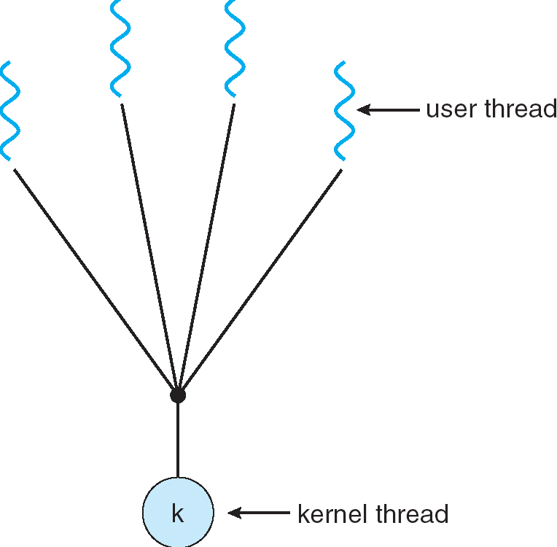
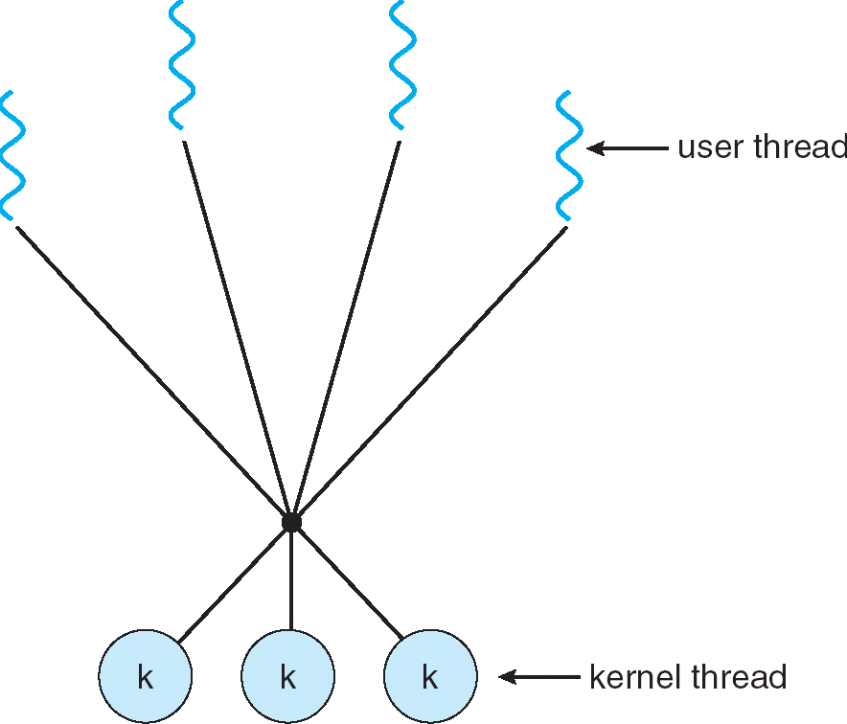
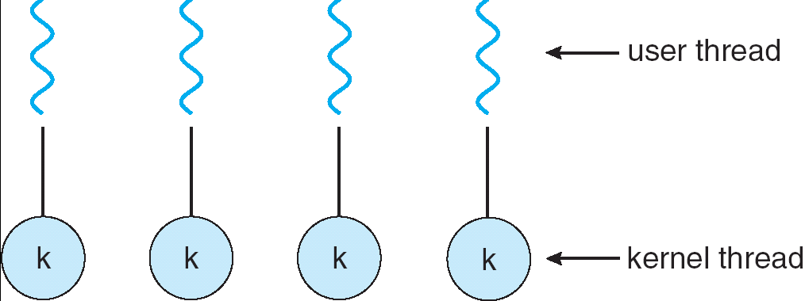
Recall: User/Kernel Threading Models
Almost all current implementations
Simple One-to-One
Threading Model
Many-to-One
Many-to-Many

Slide 88
Recall: Thread State in the Kernel
For every thread in a process, the kernel maintains:
The thread’s TCB
A kernel stack used for syscalls/interrupts/traps
This kernel-state is sometimes called the “kernel thread”
The “kernel thread” is suspended (but ready to go) when thread is running in user-space
Additionally, some threads just do work in the kernel
Still has TCB
Still has kernel stack
But not part of any process, and never executes in user mode

Slide 89
In Pintos, Processes are Single-Threaded
Pintos processes have only one thread
TCB: Single page (4 KiB)
Stack growing from the top (high addresses)
struct thread at the bottom (low addresses)
struct thread defines the TCB structure and PCB structure in Pintos
stack
regs
4 KiB
magic
… <fds>
pagedir
priority
stack
name
status
tid
Page Table
u/s
thread
Pintos: thread.c

Slide 90
(Aside): Linux “Task”
Linux “Kernel Thread”: 2 pages (8 KiB)
Stack and thread information on opposite sides
Containing stack and thread information + process descriptor
One task_struct per thread
stack
regs
task_struct (process descr)
8 KiB
sp
thread_info
state
priority
pid
address space
…
list elems
…
status
flags
*task

Slide 91
Multithreaded Processes (not in Pintos)
Traditional implementation strategy:
One PCB (process struct) per process
Each PCB contains (or stores pointers to) each thread’s TCB
Linux’s strategy:
One task_struct per thread
Threads belonging to the same process happen to share some resources
Like address space, file descriptor table, etc.
To what extent does this actually matter?

Slide 92
Aside: Polymorphic Linked Lists in C
Many places in the kernel need to maintain a “list of X”
This is tricky in C, which has no polymorphism
Essentially adding an interface to a package
In Linux and Pintos this is done by embedding a list_elem in the struct
Macros allow shift of view between object and list
You saw this in Homework 1
all_threads
ready_threads
Pintos: list.c

Slide 93
Kernel Structure So Far (1/3)
Kernel
Code
Process 1
Process 2
PCB 1
PCB 2
Globals
Kernel Stack
Kernel Stack
Heap
Process 1 Thread
Process 2 Thread
Stack
Stack
Code
Code
Globals
Globals
Heap
Heap

Slide 94
Kernel Structure So Far (2/3)
Process 1
Process 2
Kernel
Code
PCB 1
PCB 2
Globals
TCB 1.A
TCB 1.B
TCB 2.A
Heap
Kernel Stack
Kernel Stack
Kernel Stack
Process 1
Process 2 Thread A
Thread A
Thread B
Stack
Stack
Stack
Code
Code
Globals
Globals
Heap
Heap

Slide 95
Kernel Structure So Far (3/3)
Process 1
Process 2
Kernel
Code
Kernel
Thread 1
Kernel
Thread 2
PCB 1
PCB 2
Globals
TCB 1
TCB 2
TCB 1.A
TCB 1.B
TCB 2.A
Heap
Kernel Stack
Kernel Stack
Kernel Stack
Kernel Stack
Kernel Stack
Process 1
Process 2 Thread A
Thread A
Thread B
These two threads:
Are used internally by the kernel
Don’t correspond to any particular user thread or process
Stack
Stack
Stack
Code
Code
Globals
Globals
Heap
Heap

Slide 96
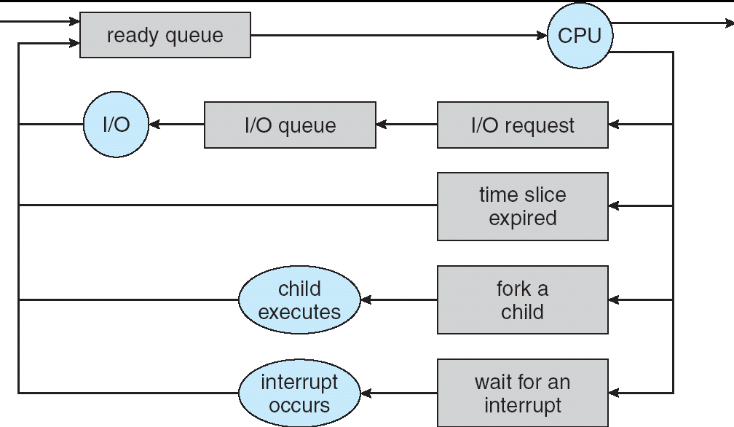
Recall: Scheduling
Question: How is the OS to decide which of several tasks to take off a queue?
Scheduling: deciding which threads are given access to resources from moment to moment
Often, we think in terms of CPU time, but could also think about access to resources like network BW or disk access
Next time: we dive into scheduling!

Slide 97
Recall: Address Space
“physical address”
0x000…
“virtual address”
Processor
translator
Memory
Program operates in an address space that is distinct from the physical memory space of the machine
Registers
Page Table
<Frame Addr>
0xFFF…

Slide 98
Understanding “Address Space”
Page table is the primary mechanism
Privilege Level determines which regions can be accessed
Which entries can be used
System (PL=0) can access all, User (PL=3) only part
Each process has its own address space
The “System” part of all of them is the same
All system threads share the same system address space and same memory

Slide 99
Page Table Mapping (Rough Idea)
(user process
view of memory)
Code
Data
Heap
Stack
Data 2
Code
Data
Heap
Stack
Stack 1
0x000…
Heap 1
Code
Code 1
Stack 2
Static Data
Prog 1
Virtual
Address
Space 1
Data 1
Prog 2
Virtual
Address
Space 2
Heap
Heap 2
Code 2
OS code
OS data
Stack
Translation Map 1
OS heap/
Stacks
Translation Map 2
0xFFF…
Physical Address Space

Slide 100
User Process View of Memory
Process Virtual Address Space
Physical Memory
0xffffffff
kernel
Page Table
Page
Processor
registers
0xc0000000
argv
sp
stack
ip
heap
user data
user code
0x08048000
0x00000000

Slide 101
Processor Mode (Privilege Level)
Process Virtual Address Space
Physical Memory
0xffffffff
kernel
Page Table
Page
Processor
registers
0xc0000000
argv
sp
stack
ip
u/s
heap
user data
CPL:
3 - user
user code
0x08048000
0x00000000

Slide 102
Aside: x86 (32-bit) Page Table Entry
Page Table
u/s
Controls many aspects of access
Later – discuss page table organization
For 32 (64?) bit VAS, how large? vs size of memory?
Used sparsely
Pintos: page_dir.c

Slide 103
User → Kernel
Process Virtual Address Space
Physical Memory
0xffffffff
kernel
Page Table
Page
Processor
registers
0xc0000000
argv
sp
stack
ip
u/s
heap
user data
CPL:
3 - user
user code
0x08048000
0x00000000

Slide 104
User → Kernel
Process Virtual Address Space
Physical Memory
0xffffffff
kernel
Page Table
Page
ker data
Processor
registers
ker code
0xc0000000
argv
sp
sp
stack
ip
u/s
ip
heap
user data
CPL:
0 - sys
user code
0x08048000
0x00000000

Slide 105
Page Table Resides in Memory*
* In the simplest case. Actually more complex. More later.
Process Virtual Address Space
Physical Memory
0xffffffff
kernel
Page Table
Page
ker data
Processor
registers
ker code
0xc0000000
argv
sp
sp
stack
ip
u/s
ip
heap
user data
CPL:
0 - sys
user code
0x08048000
0x00000000
PTBR:

Slide 106
Kernel Portion of Address Space
Kernel memory is mapped into address space of every process
Contains the kernel code
Loaded when the machine booted
Explicitly mapped to physical memory
OS creates the page table
Used to contain all kernel data structures
Lists of processes/threads
Page tables
Open file descriptions, sockets, ttys, …
Kernel stack for each thread

Slide 107
1 Kernel Code, Many Kernel Stacks
Process Virtual Address Space
Physical Memory
0xffffffff
kernel
Page Table
Page
ker data
Processor
registers
ker code
0xc0000000
argv
sp
sp
stack
ip
u/s
ip
heap
user data
CPL:
0 - sys
user code
0x08048000
0x00000000
PTBR:

Slide 108
Conclusion
Semaphores: Like integers with restricted interface
Two operations:
P(): Wait if zero; decrement when becomes non-zero
V(): Increment and wake a sleeping task (if exists)
Can initialize value to any non-negative value
Use separate semaphore for each constraint
Monitors: A lock plus one or more condition variables
Always acquire lock before accessing shared data
Use condition variables to wait inside critical section
Three Operations: Wait(), Signal(), and Broadcast()
Monitors represent the logic of the program
Wait if necessary
Signal when change something so any waiting threads can proceed
Monitors supported natively in a number of languages
Readers/Writers Monitor example
Shows how monitors allow sophisticated controlled entry to protected code

