Slide 1
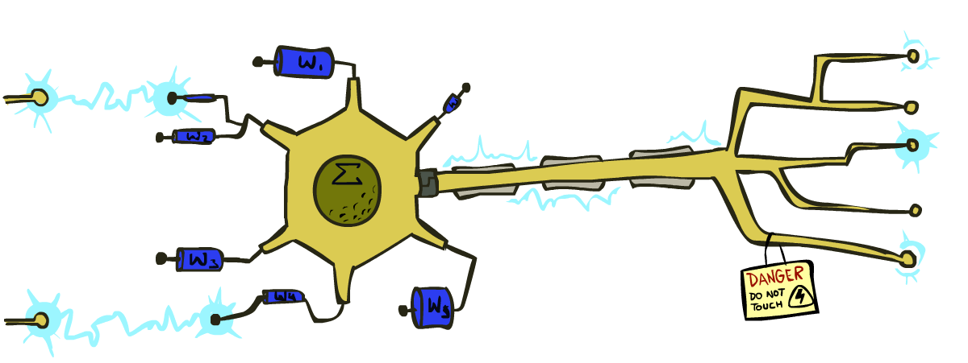
CS 188: Artificial Intelligence
Perceptrons and Logistic Regression
Instructor: Pieter Abbeel -- University of California, Berkeley
[These slides were created by Dan Klein, Pieter Abbeel, Anca Dragan, Sergey Levine. All CS188 materials are at http://ai.berkeley.edu.]

Slide 2
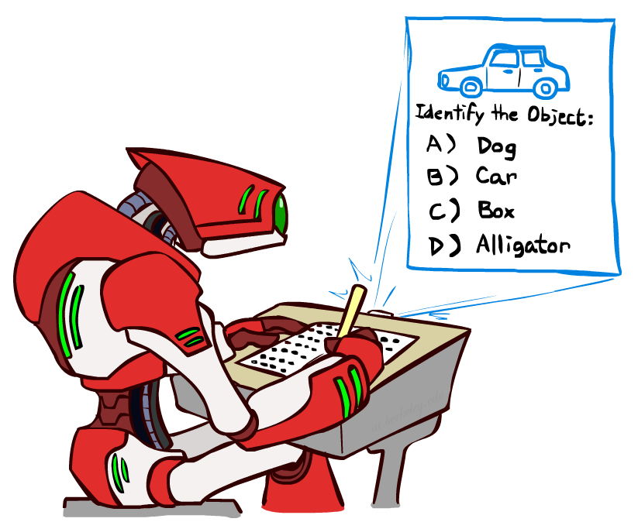

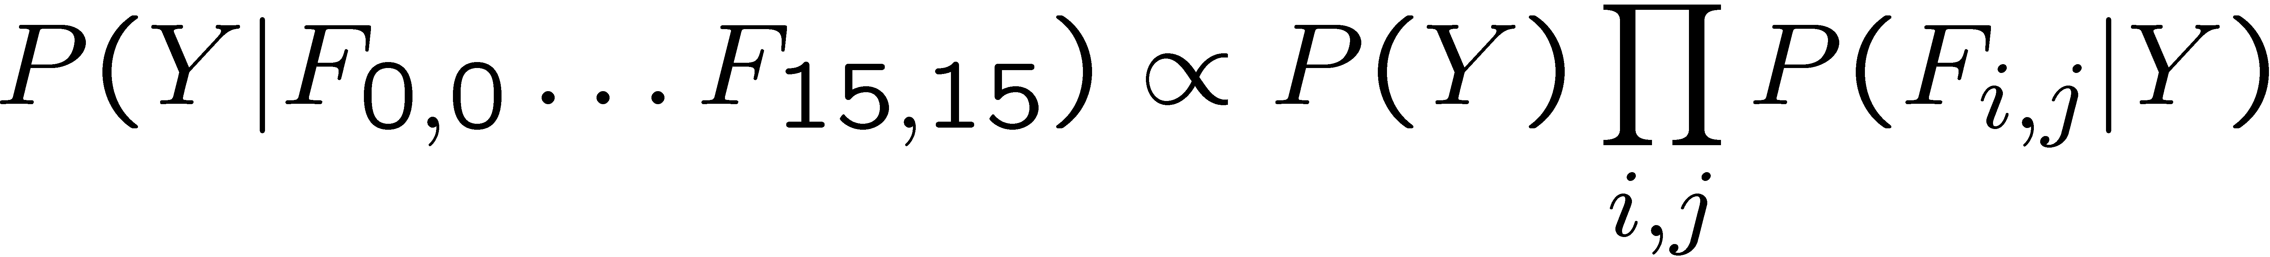
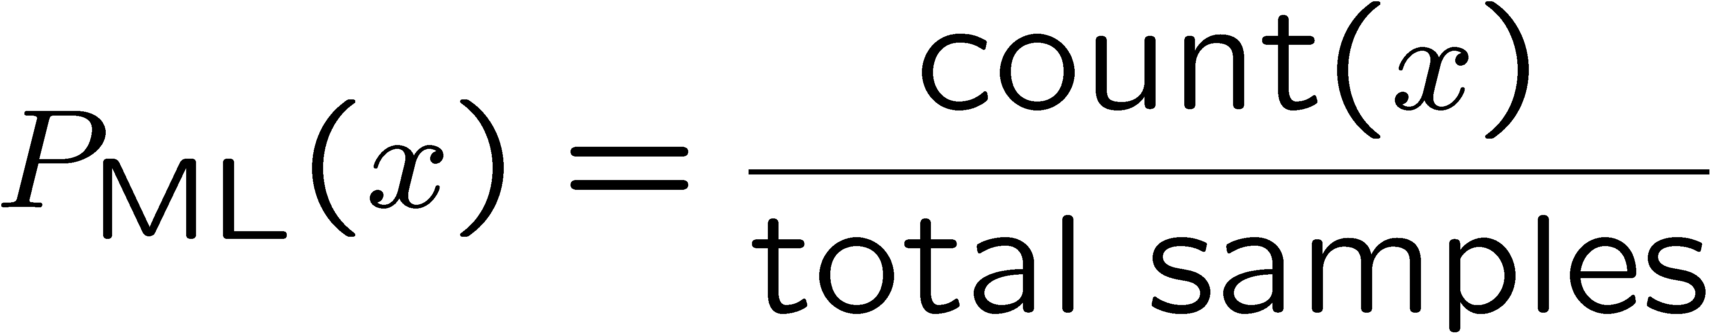
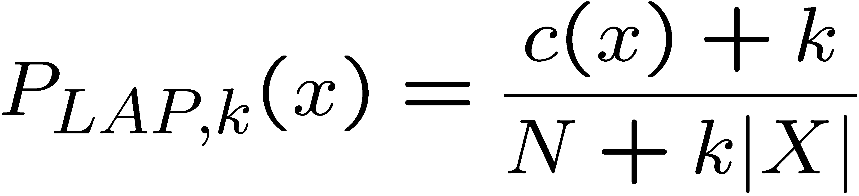
Last Time
Classification: given inputs x, predict labels (classes) y
Naïve Bayes
Parameter estimation:
MLE, MAP, priors
Laplace smoothing
Training set, held-out set, test set
Y
F₁
F₂
F_{n}

Slide 3
Workflow
Training
Data
Phase 1: Train model on Training Data. Choice points for “tuning”
Attributes / Features
Model types: Naïve Bayes vs. Perceptron vs. Logistic Regression vs. Neural Net etc..
Model hyperparameters
E.g. Naïve Bayes – Laplace k
E.g. Logistic Regression – weight regularization
E.g. Neural Net – architecture, learning rate, …
Make sure good performance on training data (why?)
Phase 2: Evaluate on Hold-Out Data
If Hold-Out performance is close to Train performance
We achieved good generalization, onto Phase 3! ☺
If Hold-Out performance is much worse than Train performance
We overfitted to the training data! ☹
Take inspiration from the errors and:
Either: go back to Phase 1 for tuning (typically: make the model less expressive)
Or: if we are out of options for tuning while maintaining high train accuracy, collect more data (i.e., let the data drive generalization, rather than the tuning/regularization) and go to Phase 1
Phase 3: Report performance on Test Data
Possible outer-loop: Collect more data ☺
Held-Out
Data
Test
Data

Slide 4
Practical Tip: Baselines
First step: get a baseline
Baselines are very simple “straw man” procedures
Help determine how hard the task is
Help know what a “good” accuracy is
Weak baseline: most frequent label classifier
Gives all test instances whatever label was most common in the training set
E.g. for spam filtering, might label everything as ham
Accuracy might be very high if the problem is skewed
E.g. calling everything “ham” gets 66%, so a classifier that gets 70% isn’t very good…
For real research, usually use previous work as a (strong) baseline

Slide 5
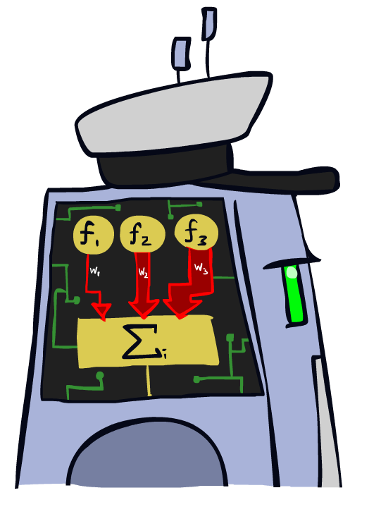
Linear Classifiers

Slide 6
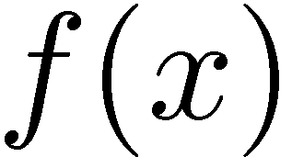

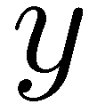

Feature Vectors
Hello,
Do you want free printr cartriges? Why pay more when you can get them ABSOLUTELY FREE! Just
# free : 2
YOUR_NAME : 0
MISSPELLED : 2
FROM_FRIEND : 0
...
SPAM
or
+
PIXEL-7,12 : 1
PIXEL-7,13 : 0
...
NUM_LOOPS : 1
...
“2”

Slide 7
Some (Simplified) Biology
Very loose inspiration: human neurons

Slide 8
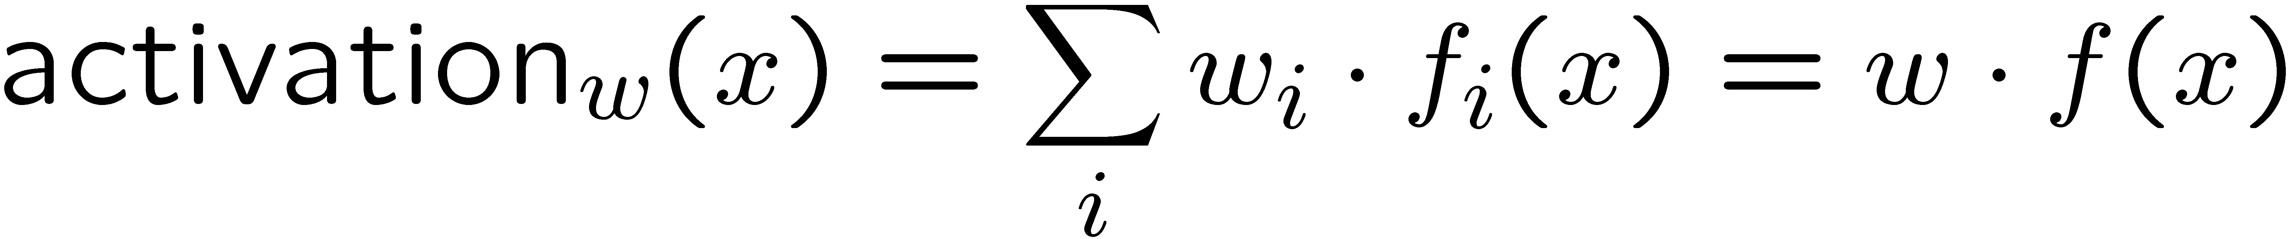
Linear Classifiers
Inputs are feature values
Each feature has a weight
Sum is the activation
If the activation is:
Positive, output +1
Negative, output -1
w₁
f₁
Σ
w₂
>0?
f₂
w₃
f₃

Slide 9


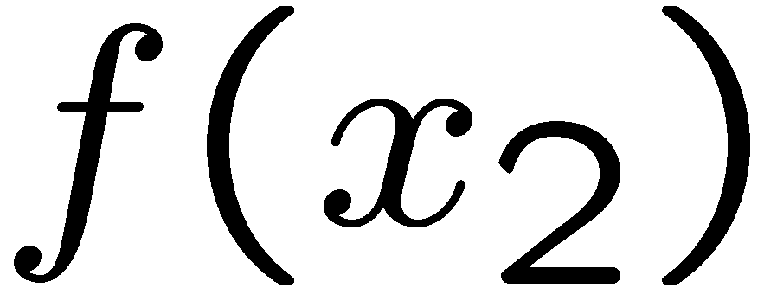
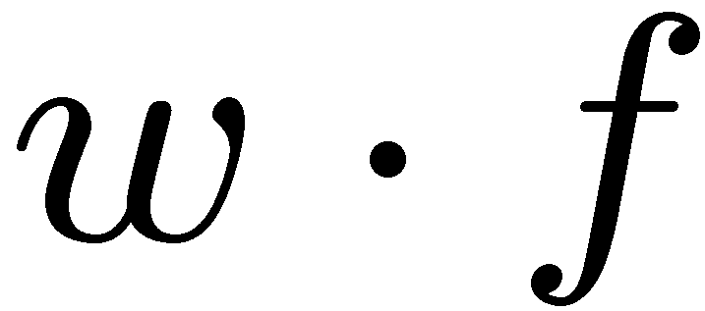
Weights
Binary case: compare features to a weight vector
Learning: figure out the weight vector from examples
# free : 4
YOUR_NAME :-1
MISSPELLED : 1
FROM_FRIEND :-3
...
# free : 2
YOUR_NAME : 0
MISSPELLED : 2
FROM_FRIEND : 0
...
# free : 0
YOUR_NAME : 1
MISSPELLED : 1
FROM_FRIEND : 1
...
Dot product positive means the positive class

Slide 10
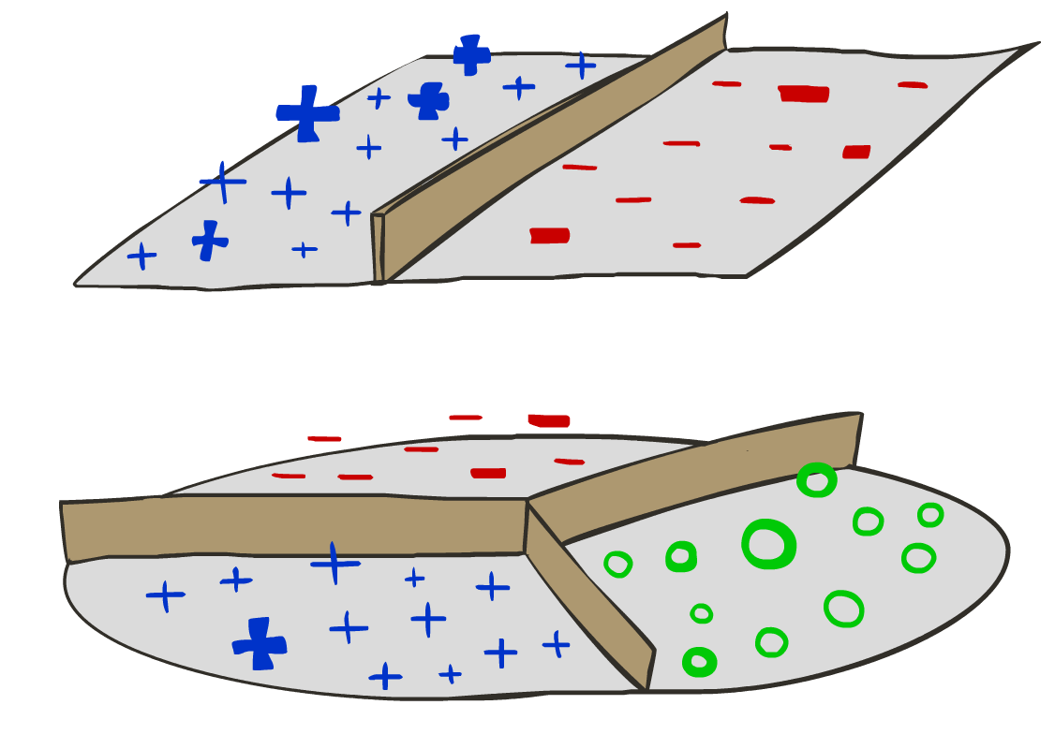
Decision Rules

Slide 11

Binary Decision Rule
In the space of feature vectors
Examples are points
Any weight vector is a hyperplane
One side corresponds to Y=+1
Other corresponds to Y=-1
money
2
1
BIAS : -3
free : 4
money : 2
...
0
0
1
free

Slide 12
Binary Decision Rule
In the space of feature vectors
Examples are points
Any weight vector is a hyperplane
One side corresponds to Y=+1
Other corresponds to Y=-1
money
2
1
free : 4
money : 2
0
0
1
free

Slide 13
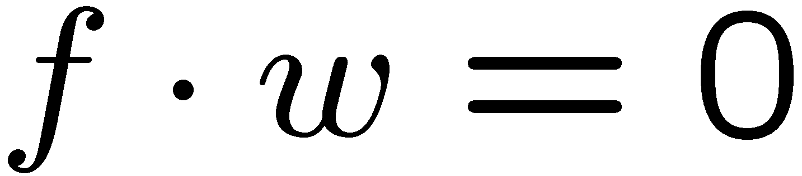
Binary Decision Rule
In the space of feature vectors
Examples are points
Any weight vector is a hyperplane
One side corresponds to Y=+1
Other corresponds to Y=-1
money
2
+1 = SPAM
1
BIAS : -3
free : 4
money : 2
...
0
-1 = HAM
0
1
free

Slide 14
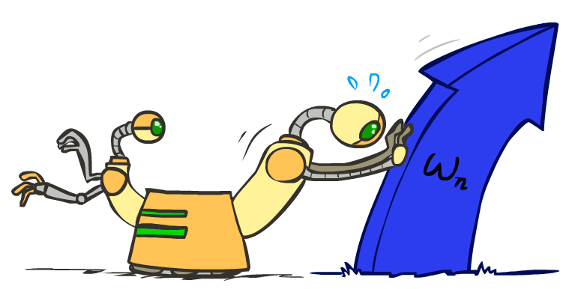
Weight Updates

Slide 15
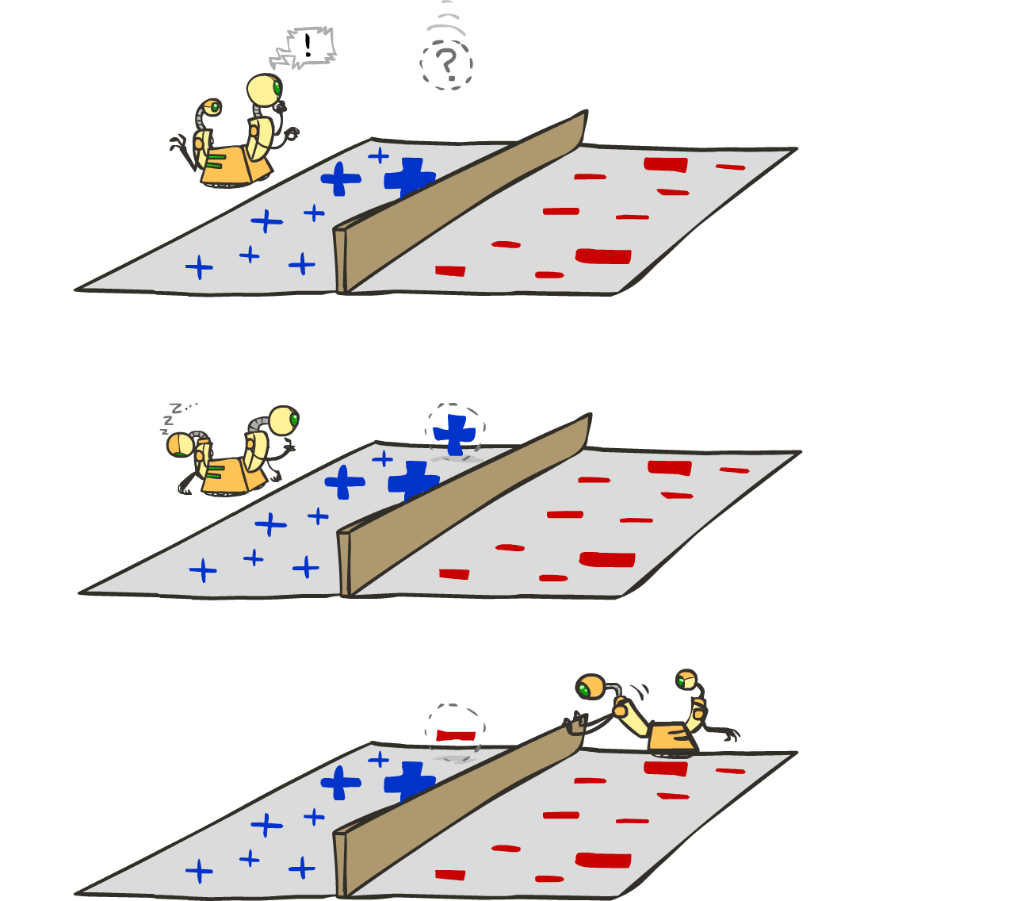
Learning: Binary Perceptron
Start with weights = 0
For each training instance:
Classify with current weights
If correct (i.e., y=y*), no change!
If wrong: adjust the weight vector
Notes:
http://isl.ira.uka.de/neuralNetCourse/2004/VL_11_5/Perceptron.html

Slide 16
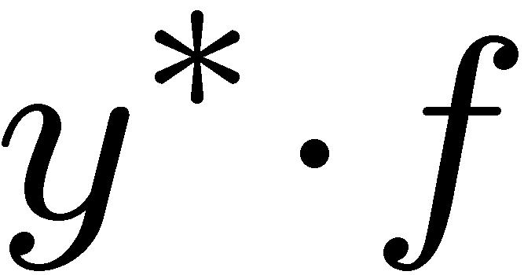
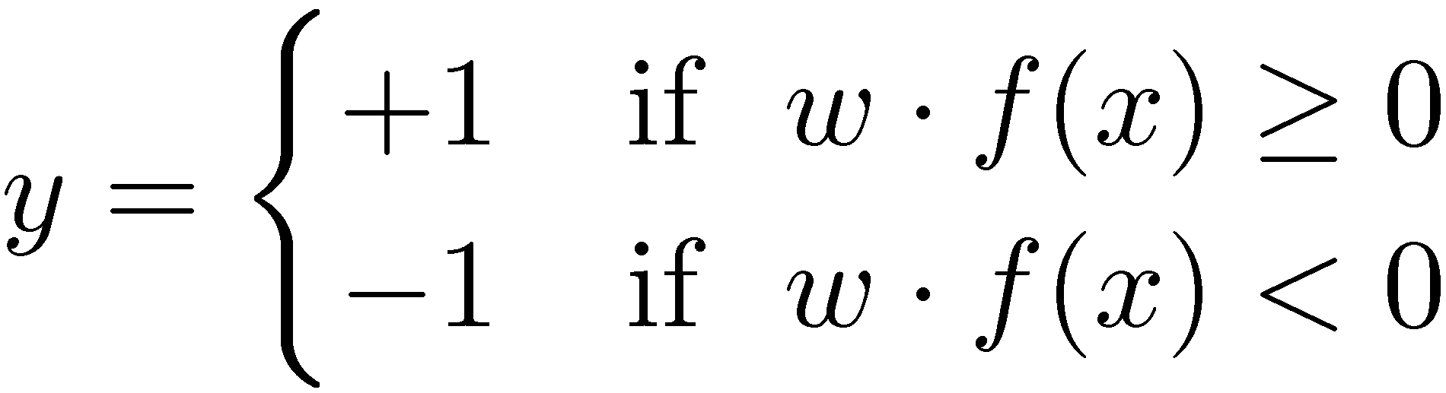

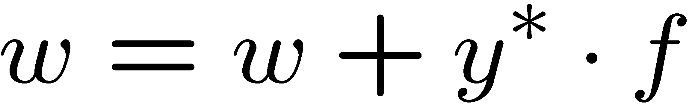
Learning: Binary Perceptron
Start with weights = 0
For each training instance:
Classify with current weights
If correct (i.e., y=y*), no change!
If wrong: adjust the weight vector by adding or subtracting the feature vector. Subtract if y* is -1.
Before: w f
After: wf + y*f f
f f >=0
Notes:
http://isl.ira.uka.de/neuralNetCourse/2004/VL_11_5/Perceptron.html

Slide 17
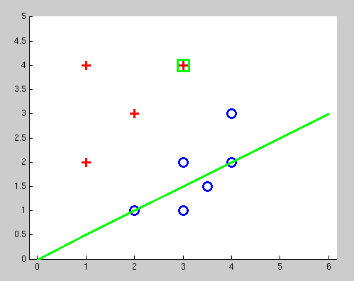
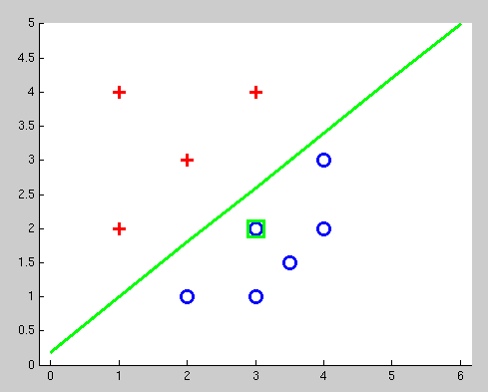
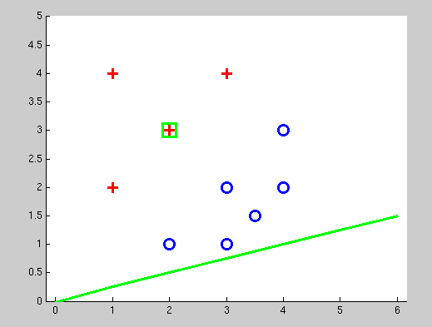
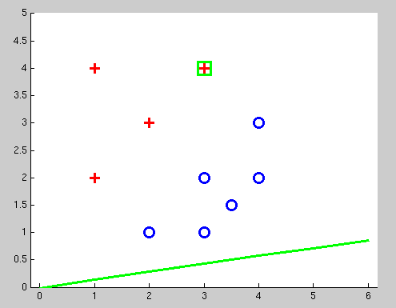
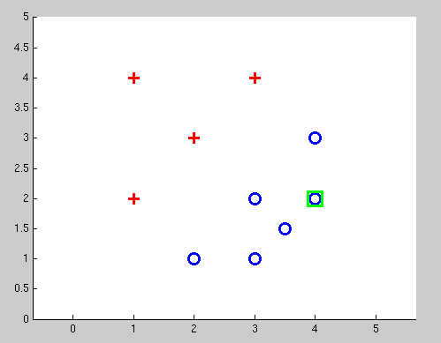
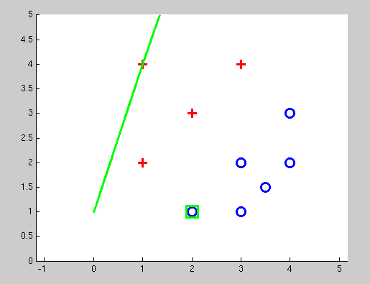
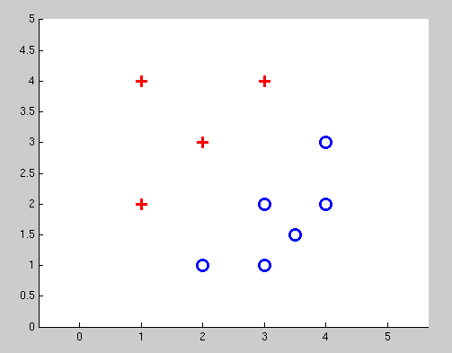
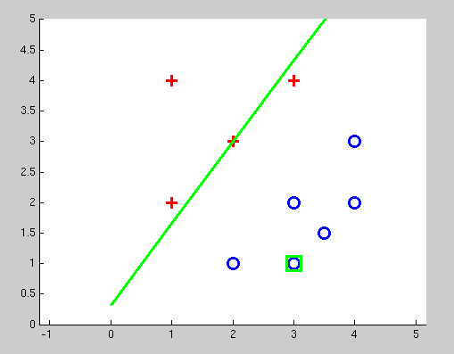
Examples: Perceptron
Separable Case

Slide 18


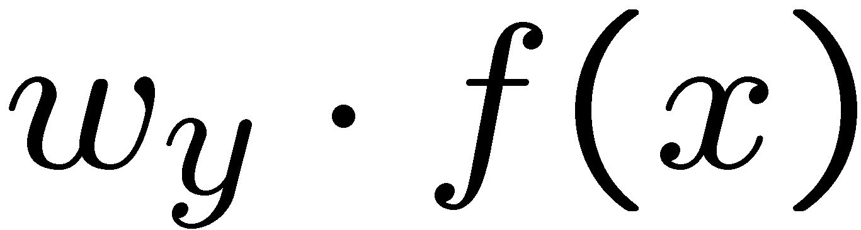



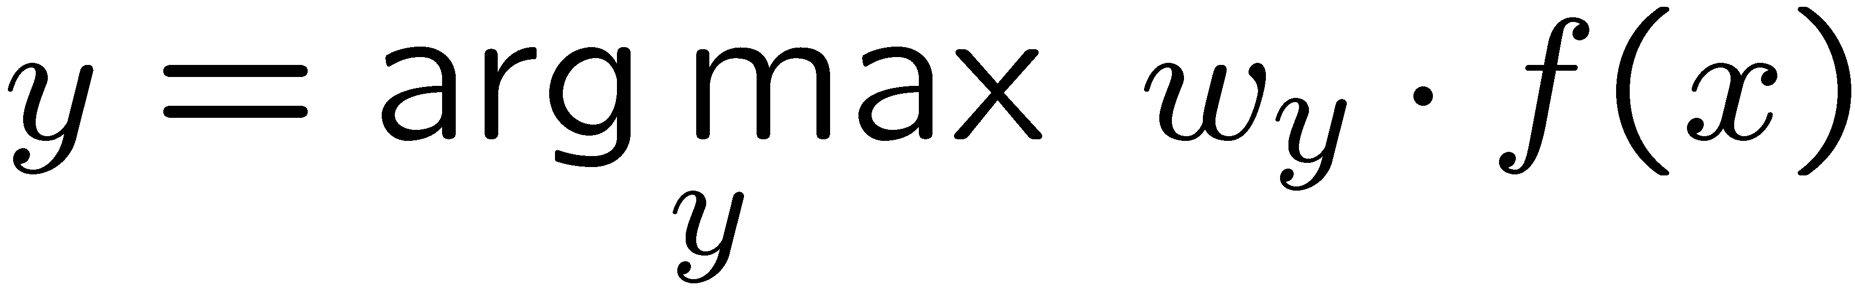
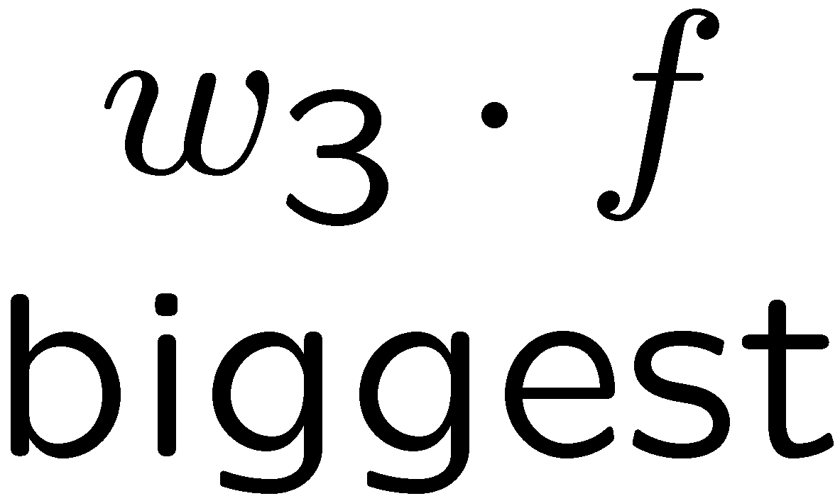
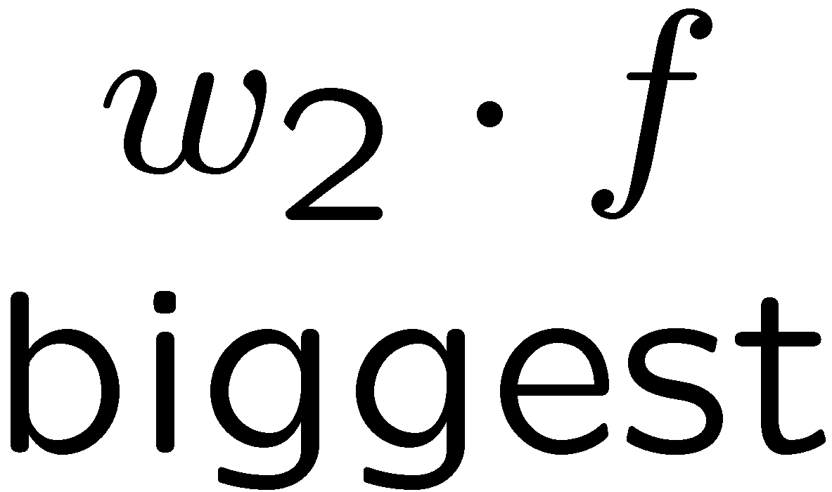
Multiclass Decision Rule
If we have multiple classes:
A weight vector for each class:
Score (activation) of a class y:
Prediction highest score wins
Binary = multiclass where the negative class has weight zero
Notes:
Picture only true for equal size ws; if we had a really big or really small w1 yellow are would change

Slide 19



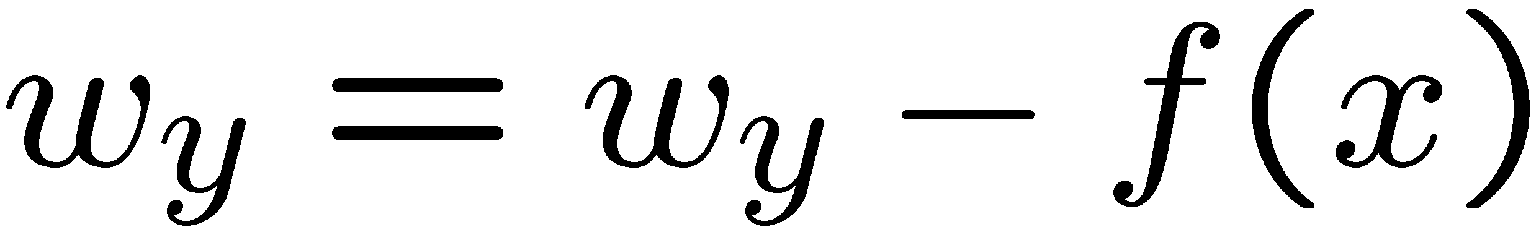
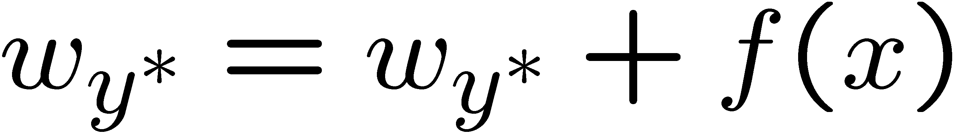
Learning: Multiclass Perceptron
Start with all weights = 0
Pick up training examples one by one
Predict with current weights
If correct, no change!
If wrong: lower score of wrong answer, raise score of right answer

Slide 20



Example: Multiclass Perceptron
“win the vote”
[1 1 0 1 1]
“win the election”
[1 1 0 0 1]
“win the game”
[1 1 1 0 1]
3
0
1
-2
0
3
0
-2
BIAS : 1
win : 0
game : 0
vote : 0
the : 0
...
0
-1
0
-1
-1
1
0
1
-1
0
BIAS : 0
win : 0
game : 0
vote : 0
the : 0
...
1
1
0
1
1
0
0
-1
1
0
BIAS : 0
win : 0
game : 0
vote : 0
the : 0
...

Slide 21
Properties of Perceptrons
Separable
Separability: true if some parameters get the training set perfectly correct
Convergence: if the training is separable, perceptron will eventually converge (binary case)
Mistake Bound: the maximum number of mistakes (binary case) related to the margin or degree of separability
Non-Separable

Slide 22
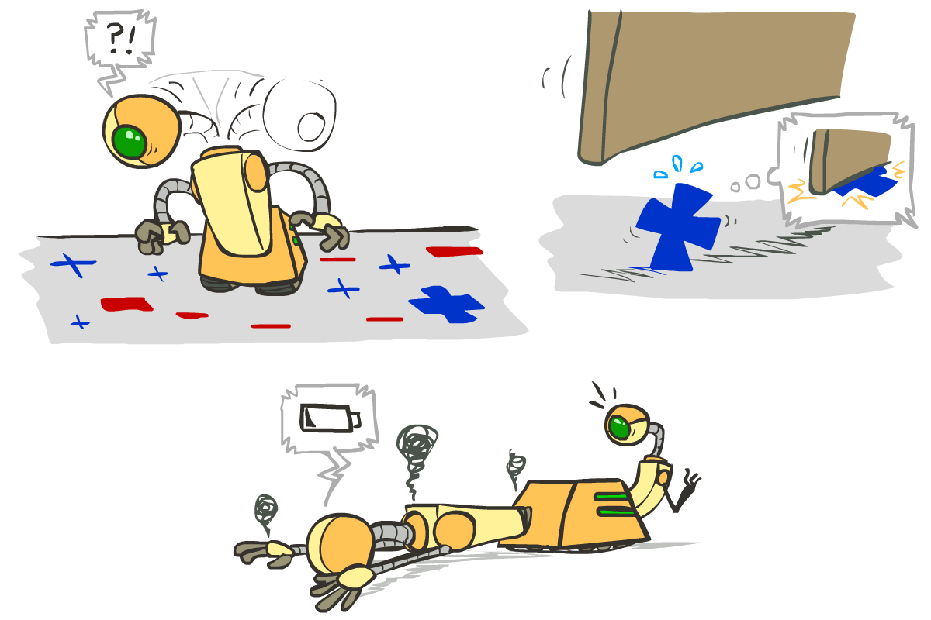





Problems with the Perceptron
Noise: if the data isn’t separable, weights might thrash
Averaging weight vectors over time can help (averaged perceptron)
Mediocre generalization: finds a “barely” separating solution
Overtraining: test / held-out accuracy usually rises, then falls
Overtraining is a kind of overfitting

Slide 23
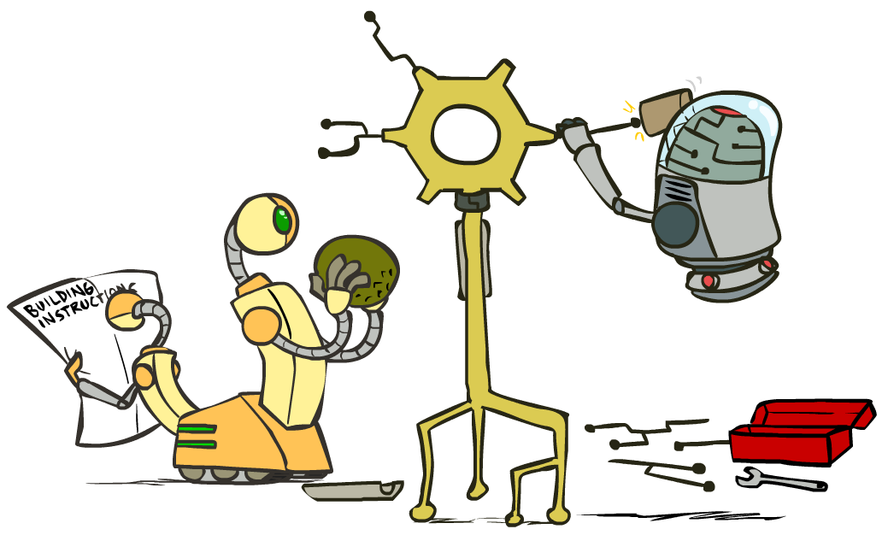
Improving the Perceptron

Slide 24
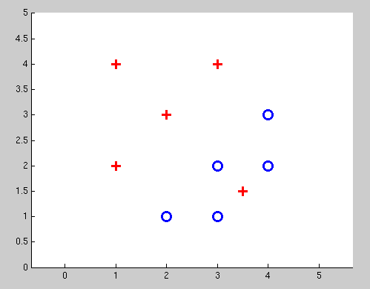
Non-Separable Case: Deterministic Decision
Even the best linear boundary makes at least one mistake

Slide 25
Non-Separable Case: Probabilistic Decision
0.9 | 0.1
0.7 | 0.3
0.5 | 0.5
0.3 | 0.7
0.1 | 0.9

Slide 26
How to get probabilistic decisions?
Perceptron scoring:
If very positive → want probability going to 1
If very negative → want probability going to 0
Sigmoid function

Slide 27



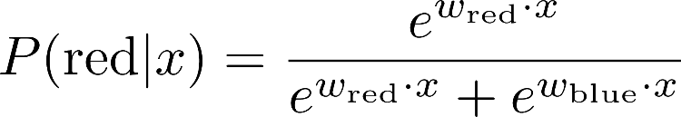
A 1D Example
definitely blue
not sure
definitely red
probability increases exponentially as we move away from boundary
normalizer

Slide 28
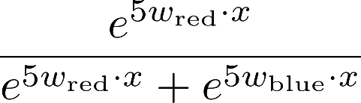
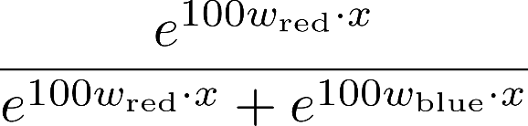

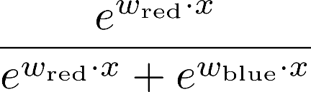
The Soft Max

Slide 29
Best w?
Maximum likelihood estimation:
with:
= Logistic Regression

Slide 30
Separable Case: Deterministic Decision – Many Options

Slide 31
Separable Case: Probabilistic Decision – Clear Preference
0.7 | 0.3
0.5 | 0.5
0.7 | 0.3
0.3 | 0.7
0.5 | 0.5
0.3 | 0.7

Slide 32
Multiclass Logistic Regression
Recall Perceptron:
A weight vector for each class:
Score (activation) of a class y:
Prediction highest score wins
How to make the scores into probabilities?
original activations
softmax activations

Slide 33
Best w?
Maximum likelihood estimation:
with:
= Multi-Class Logistic Regression

Slide 34
Next Lecture
Optimization
i.e., how do we solve:

