Slide 1


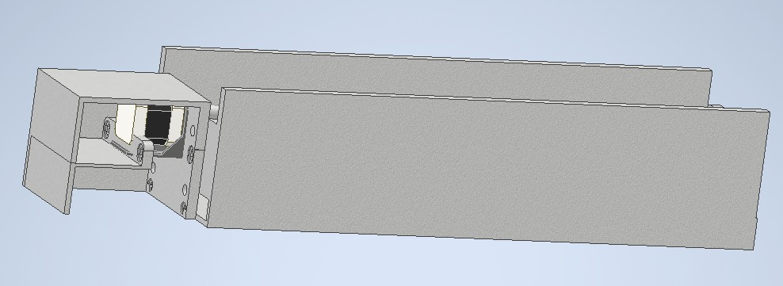
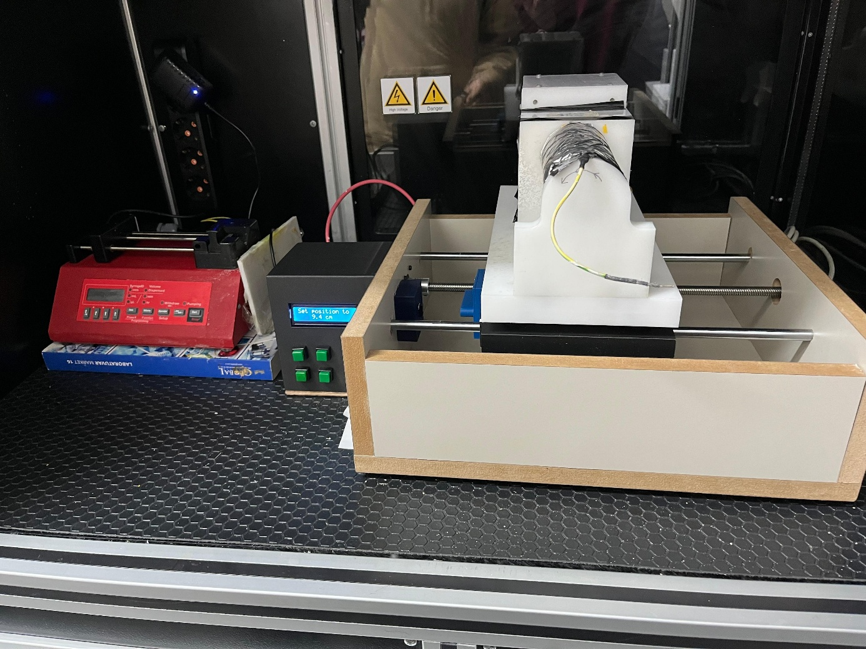
CNC Router Integrated Electrospinning System
ENG 401
INTERDISCIPLINARY ENGINEERING DESIGN PROJECT
MEE
Aykut Uzunoğlu Azad Aslan Bertan Erdoğan
Berke Savaştürk Bilal Yıldırım Sultan Etyemez
Batuhan Adaşoğlu Mehmet Berke Parlat
Melih Burak Kılıç Nihat Haktan Mumcu
Hasan Ali Şarbak Zeynep Sude Varol
BME
Student 4 Name SURNAME
Student 5 Name SURNAME
Student email adress
DEPARTMENTS: MEE-BME
Supervisors: Assist. Prof. Dr. Özgün Başer Assoc. Prof. Dr. Barış Bıdıklı Assoc. Prof. Dr. Ozan Karaman
ÖZET
MATERIALS & METHODS
RESULTS AND DISCUSSION
Bu rapor CNC Router Entegreli Electrospinning Kolektör sistemini anlatmaktadır. Platform, güvenilir ve verimli bir çalışma için gerekli olan X ekseni boyunca hassas doğrusal hareketi sağlamaktadır. Sistem, hareket kontrolü için bir step motor dahil olmak üzere mekanik ve elektronik bileşenleri entegre etmekte ve Arduino kullanılarak programlanmaktadır. Tork iletimi için bir kaplin kullanan platform, pürüzsüz ve hassas hareket sağlamak için bir bilyalı vida mekanizması üzerinde çalışmaktadır. Platform, biyomedikal uygulamalar için uygun hale getirilmiş bir şekilde, stabilite, dayanıklılık ve kolay bakım için tasarlanmıştır. Kontrol sistemi, hassas çalışma, uyarlanabilirlik ve kullanıcı dostu kontrol sağlayan Arduino tabanlı bir programlama ile geliştirilmiştir. Bu proje, otomatikleştirilmiş biyomedikal sistemlerdeki daha ileri yenilikler için bir basamak taşı görevi görerek, pratik yenilik ve mühendislik sinerjisine vurgu yapmaktadır.
Anahtar kelimeler: CNC ROUTER, X-AXIS, ARDUINO
1 Screw Shaft
2 Support Shaft
2 6000ZZ Bearing
4 Flange Linear Bearing
1 Nema 17 Stepper Motor
1 A4988 motor driver
1 Arduino Uno - 1 L2C LCD
5 Button - Jumper Cables
Assembly procedure:
Attach the boards together with screws.
Connect the motor, buttons and LCD to the appropriate pins of the Arduino using jumper wires and attach the board platform and the button-LCD chamber.
In conclusion, the proposed design for the electrospinning system integrates a router-based approach that enhances the precision, efficiency, and reliability of the entire process. A lead screw mechanism has been incorporated to precisely adjust the distance between the syringe and the rotating drum. This mechanism enables accurate control of the drum's position, ensuring that the polymer solution is deposited as intended. This results in a smoother, more uniform, and controlled fiber collection process, which plays a key role in improving the quality of the produced fibers during the electrospinning process.
Finally, the CNC Router Integrated Electrospinning System was successfully developed, integrating precise mechanical and electronic components. The construction phase is complete, and the system is currently undergoing testing to evaluate its performance.In conclusion, the system enhances precision, stability, and usability. Further testing will help optimize its performance for future applications.
INTRODUCTION
Advancements in biomedical engineering often rely on the integration of precise mechanical systems and cutting-edge electronic control technologies. Among these, electrospinning has emerged as a crucial technique for producing nanofibers with applications in tissue engineering, drug delivery, and other biomedical fields. However, the efficiency and precision of electrospinning processes can be significantly enhanced through automation. This project presents the design and development of a CNC Router Integrated Electrospinning Collector System, a platform tailored to meet the operational demands of modern biomedical applications.
ABSTRACT
This report describes the design and development of a CNC Router Integrated Electrospinning Collector System. The platform ensures precise linear motion along the X-axis, meeting the requirements for reliable and efficient operation. The system integrates mechanical and electronic components, including a stepper motor for motion control, and is programmed using Arduino. The platform utilizes a coupling for torque transmission and operates on a ball screw mechanism, ensuring smooth and accurate motion. The platform is designed for stability, durability, and ease of maintenance, making it well-suited for biomedical applications. The control system is developed using Arduino-based programming, enabling precise operation, adaptability, and user-friendly control. This project serves as a stepping stone for further advancements in automated biomedical systems, emphasizing practical innovation and engineering synergy.
Keywords: CNC ROUTER, X-AXIS, ARDUINO
PURPOSE OF THE STUDY
Figure 2. Conceptual Design
The purpose of the study is to design and develop a CNC Router Integrated Electrospinning Collector System that ensures precise and reliable linear motion along the X-axis to improve the adjustability of the drum collector of the electrospinning. The system is specifically aimed at addressing the challenges associated with automated biomedical applications by integrating mechanical and electronic components, such as a stepper motor and ball screw mechanism, while utilizing Arduino-based programming for adaptability and user-friendly control.
Wp. No | Name and Objectives of Work Packages | Timefram (..-.. Month)
1 | Literature Review | 1.-2
1.1 | Literature Review for Electrospinning | 1st month
1.2 | Literature Review for CNC Router | 2nd month
2 | Prototype design | 3.
2.1 | CNC Router design | 3rd month
2.2 | Electronic system design | 3rd month
2.3 | Selection of the appropriate engine according to the system | 3rd month
3 | Production process and assembly | 3.-4.
3.1 | CNC Router Production | 3rd month
3.2 | Mechanical Assembly | 4th month
3.3 | System software and control integration | 4th month
 | Electronic Assembly | 4th month
4 | System check and calibration | 4.
EXPERIMENTAL SETUP
SUSTAINABLE DEVELOPMENT GOAL AND TARGET
In our project, we planned to use a lead screw mechanism to precisely adjust the distance between the syringe and the rotating drum. Based on the measurements, we decided to create a design with a lead screw in the center and two support rods on each side. The lead screw, equipped with a gear mechanism, is driven by a motor. By moving the lead screw back and forth, the motor precisely controls the proximity of the drum to the syringe. This setup ensures accurate deposition of the polymer solution and proper fiber collection during the electrospinning process. The use of the lead screw mechanism allows for fine adjustments during electrospinning, significantly improving the system's precision and stability.
9. INDUSTRY, INNOVATION AND INFRASTRUCTURE
Target 9.5 Enhance scientific research, upgrade the technological capabilities of industrial sectors in all countries, in particular developing countries, including, by 2030, encouraging innovation and substantially increasing the number of research and development workers per 1 million people and public and private research and development spending
This project increases technological capabilities of Biomedical sectors.
Table 1. Work Time Table
CONTRIBUTIONS OF DEPARTMENTS
REFERENCES
MEE: Design of parts, Designing of the electrical system, Assembly of the system
BME: Experimentation of the System
[1] Zhang, Y., et al. (2017). "Design and application of collectors in electrospinning: A review." Journal of Nanomaterials, 2017, Article ID 7025312.
[2] Li, D., & Xia, Y. (2004). "Electrospinning of nanofibers: Reinventing the wheel?" Advanced Materials, 16(14), 1151-1170.
Figure 1. Image of the System

