Slide 1
Model-Based Project: Door Mechanism System
Prepared by İsmail Uğur Demiral, Mehmet Berke Parlat, Emin Yazar, Hasan Ünlü

Slide 2
Introduction
The project designs a state-space controller for a door mechanism system powered by a DC motor. MATLAB and Simulink are used for validation.

Slide 3
System Description
Components:
• DC Motor: Drives the door via rotational motion.
• Gear Mechanism: Translates motor torque to door movement.
Motivation: Enhances convenience and security.

Slide 4
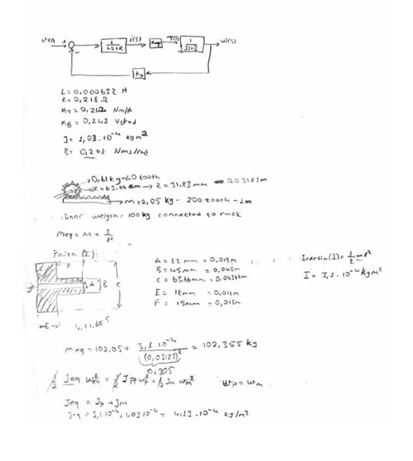
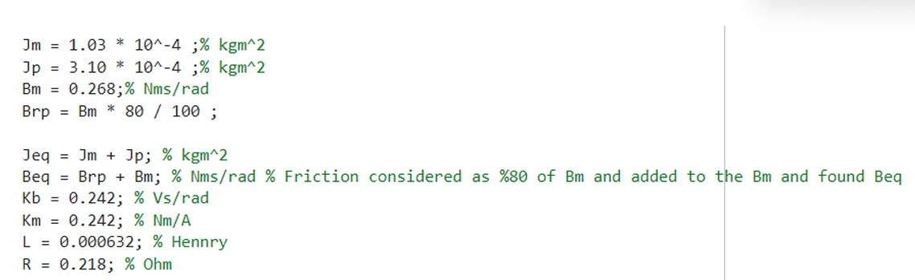
Mathematical Modelling

Slide 5
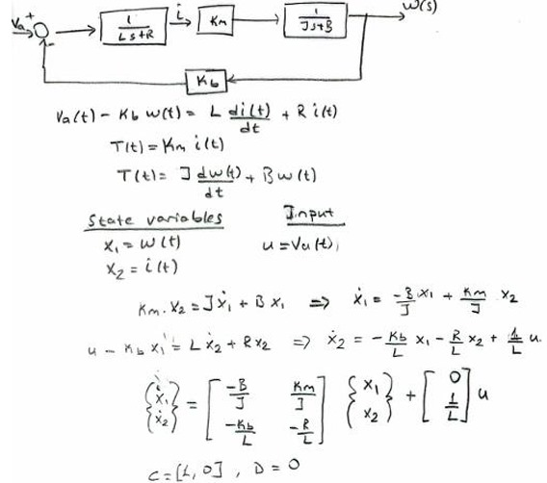
State Veriables

Slide 6
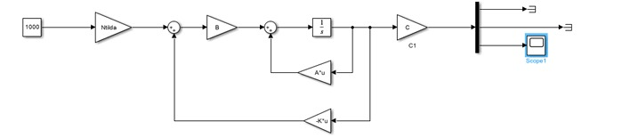
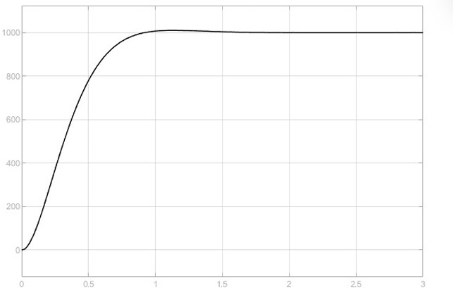
Simulink Model
A Simulink block diagram was created to simulate the system's behavior.
Output of Closed Loop System

Slide 7
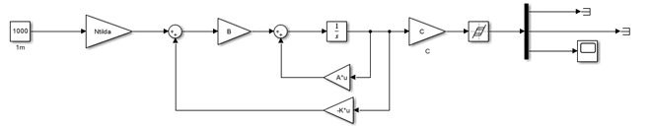
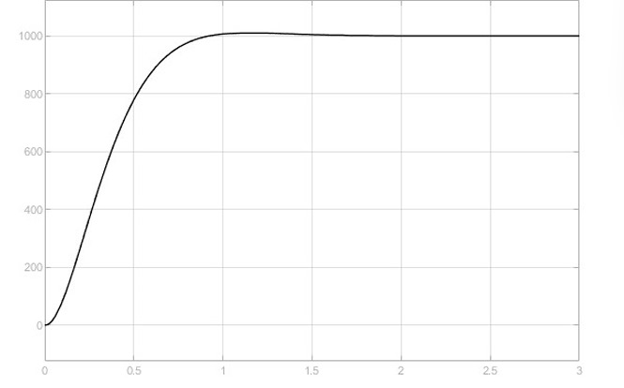

Slide 8
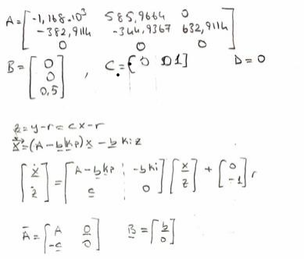
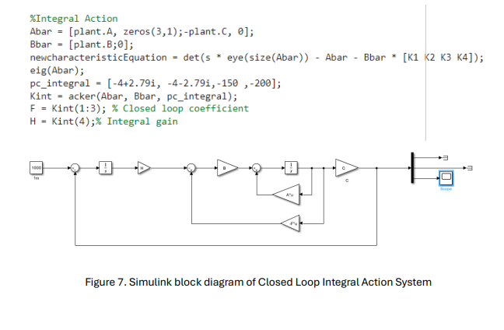
Integral Action

Slide 9
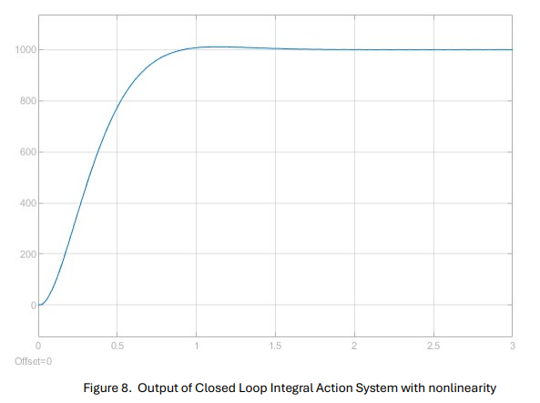

Slide 10
Conclusion
The project successfully designed and analyzed a state-space controller for a door mechanism system, achieving stability, minimized overshoot, and zero steady-state error.

