Slide 1

HeartRisk AI: Predicting Cardiovascular Health
EHB420E TERM PROJECT
BERKE TÜYLEK
040170247
Notes:
Hello, today I will introduce the deep neural network (DNN) model I developed to predict heart disease. This model was trained to predict whether patients have heart disease based on their clinical data.

Slide 2
Heart Disease Prediction Using Deep Neural Networks
A deep neural network (DNN) model has been developed to predict the risk of having heart disease. Based on a patient’s clinical data, the model predicts whether they have heart disease.
Data Source: UCI Heart Disease dataset was used (Cleveland Heart Disease dataset).
URL: https://archive.ics.uci.edu/dataset/45/heart+disease

Slide 3
DATASET AND FEATURES
Properties: Contains 13 properties and 1 target column.
Data Set Content: Contains features such as age, gender, chest pain type (cp), blood pressure, cholesterol, exercise, etc. Target Value: Whether there is heart disease (binary: 0 = no disease, 1 = disease).
Numerical Features: Age, blood pressure, cholesterol, maximum heart rate, etc.
Categorical Features: Gender, exercise status, chest pain type, etc.
Notes:
First, I would like to talk about the dataset and its features. As you can see in the slide, our dataset contains 13 features and 1 target column. The features are divided into numerical and categorical categories. Examples of numerical features include age and blood pressure, while categorical features include gender and chest pain type.

Slide 4
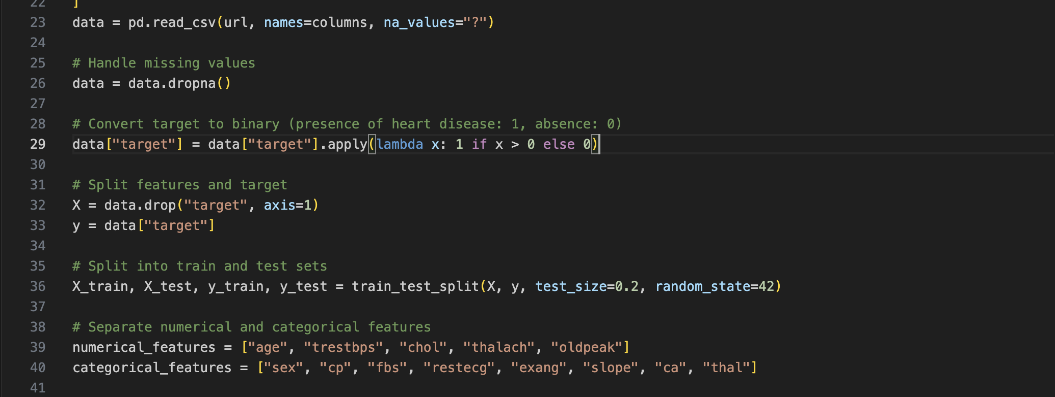
DATA PREPROCESSING
Cleaning Missing Data: Missing values ​​(?) in the data were deleted.
Converting Target Value to Binary: I made the target column binary (0 and 1) to indicate whether there is heart disease.
Separation of Attributes: Data was separated into numerical and categorical attributes.
Notes:
Next, a detailed data processing procedure was followed. This included steps like removing missing data, adjusting columns, and various processes to prepare the data for modeling. The target column was marked as 0 and 1. To indicate the presence of heart disease, the target column was made binary (0 and 1).

Slide 5
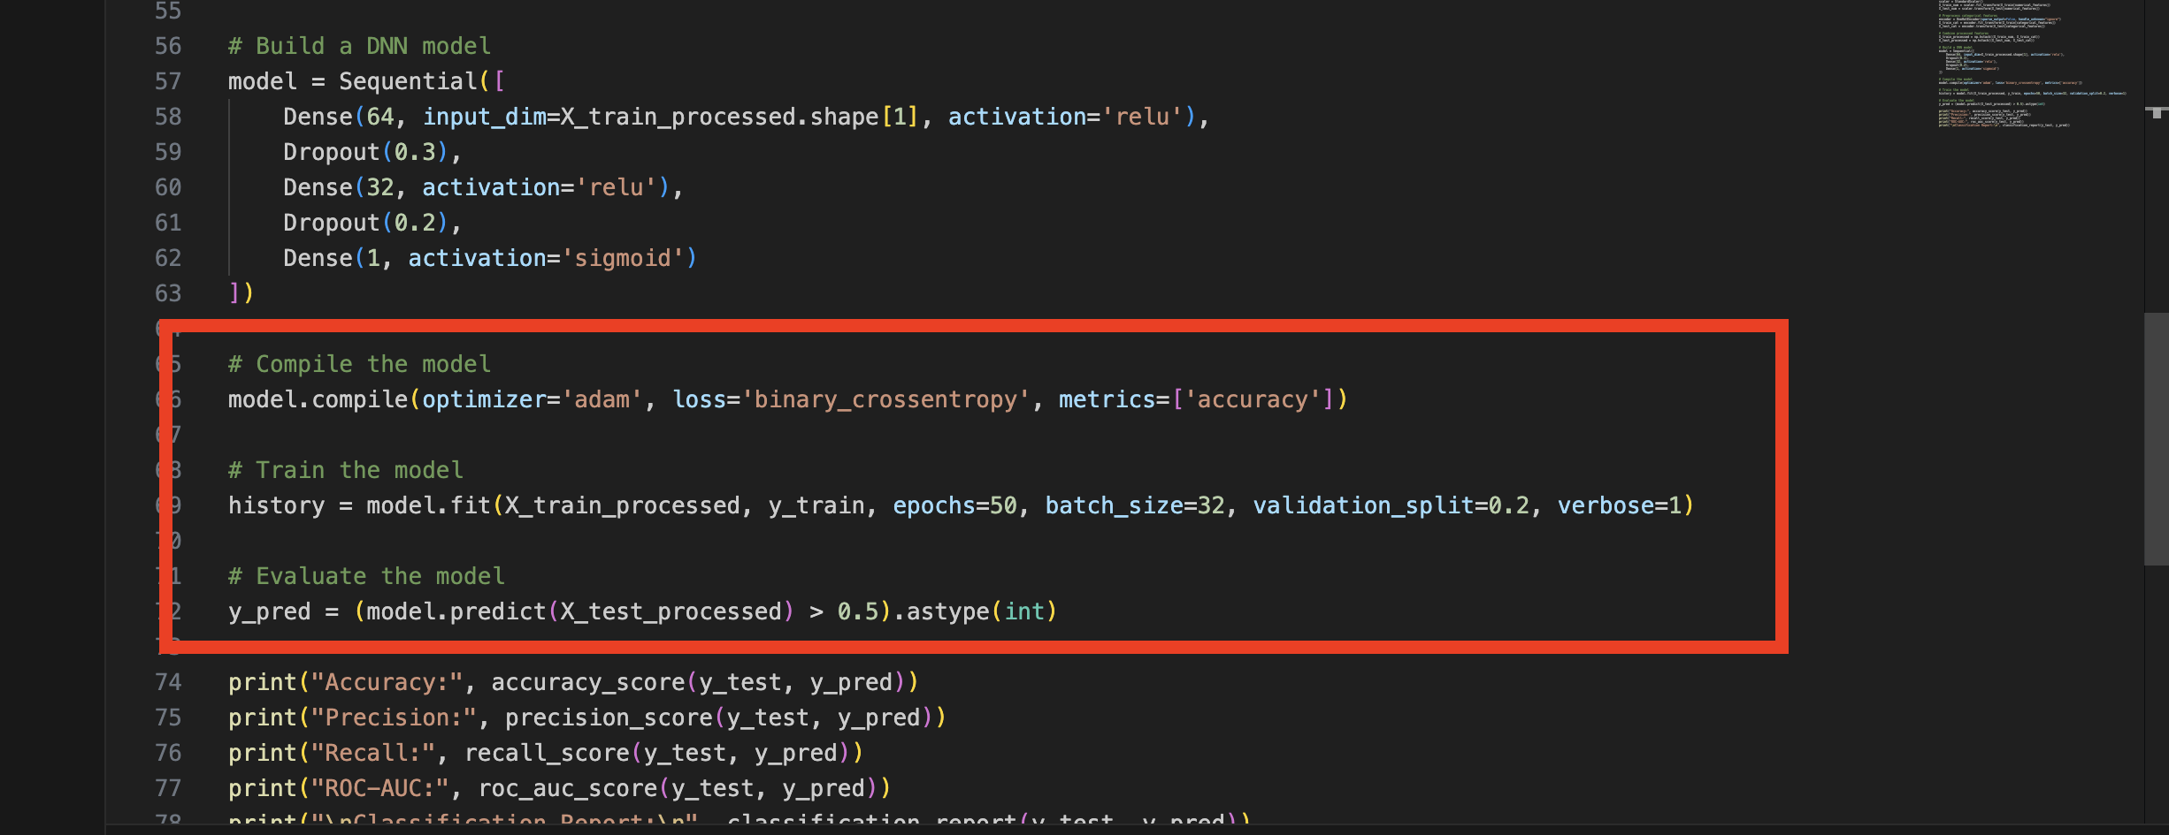
MODEL STRUCTURE
Model Type: Deep Neural Network (DNN).
Layers:Input Layer: Input layer determined by the number of features.
Intermediate Layers: Two dense layers consisting of 64 and 32 neurons.
Dropout: Two dropout layers (0.3 and 0.2) to prevent overfitting.
Output Layer: Heart disease risk prediction with sigmoid activation function.
Notes:
In the model structure, 80% of the processed data was used for training and 20% for testing. The necessary code for optimization was added, and training parameters were defined. You can see these parameters in the slide.

Slide 6
MODEL STRUCTURE
Training Data and Test Data: Data were divided into 80% training and 20% testing.
Optimization Method: Adam optimization was used.
Loss Function: Binary cross-entropy loss function.
Training Parameters: 50 epochs, batch size = 32, validation split = 0.2.
Model Performance:
Accuracy: Indicates how accurate the model's predictions are.
Precision: Indicates how accurate the model's positive predictions are.
Recall: Indicates how well the model detects true positives.
ROC-AUC Score: An important evaluation metric that shows the overall success rate of the model.
Notes:
Four metrics were set to evaluate the model's performance. These metrics will be used to measure how well the model performs. Now, I will explain the results the model obtained and the metrics in more detail.

Slide 7
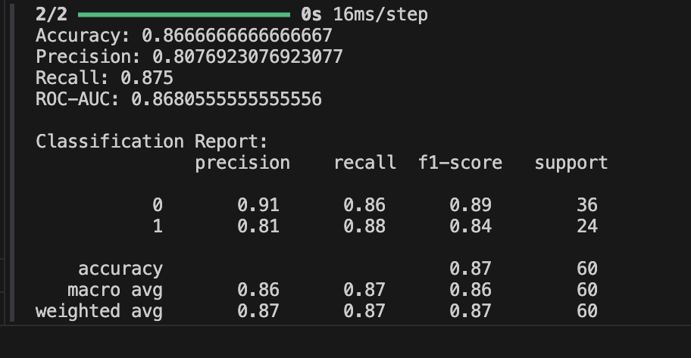
RESULTS
Notes:
Accuracy: 0.87 Represents the overall accuracy of the model, the ratio of correctly predicted instances to the total number of instances.The model performs quite well with an accuracy of 87%, meaning it correctly predicts the outcomes 87% of the time.

Slide 8
ANALYSIS
The model has been successfully trained to predict heart disease, and the evaluated metrics show that the model generally performs well. However, the following can be done to achieve better results:
Deeper Models: Deeper networks or different models (e.g. Convolutional Neural Networks or more complex DNN structures) can be tried to improve the accuracy of the model.
Different Feature Engineering: Adding new features to the data or transforming existing features to better represent them can improve the performance of the model.
Unweighted Loss Functions: Weighted loss functions can be used according to the importance of false negatives and false positives in imbalanced data sets.
Notes:
The model performs well overall, especially in detecting people with heart disease, with a high recall of 0.88. This is crucial as early detection of heart disease can be life-saving.There is a good balance between precision and recall, but to improve further, especially the precision, model adjustments may be considered.
These metrics suggest the model is well-balanced and accurate, but with minor improvements, it could perform even better.

