Slide 1
Predicting Car Accident Severity

Slide 2
Traffic accidents are a social issue that causes many deaths or financial losses worldwide.
According to the data recorded in 2019, 36,096 fatal accidents occurred.
Although fatal accidents decreased compared to the previous year, the number of fatal accidents is still unacceptable.
Our aim in this study is to focus on the factors that cause car accidents. For this purpose, the factors causing car accidents were analyzed and classified.

Slide 3
Data Acquisition and Cleaning
The data set is seattle traffic severity data, which has been recorded since 2004 provided by the ibm course.
In total, 194673 rows and 38 features in the raw dataset.
There is no duplicate.
Cleaned data contains 12 features.

Slide 4
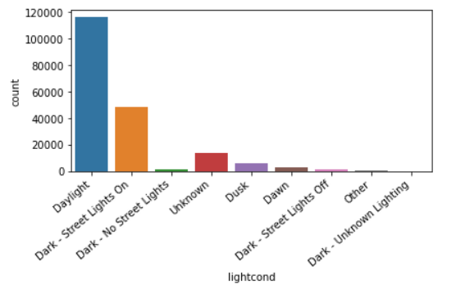
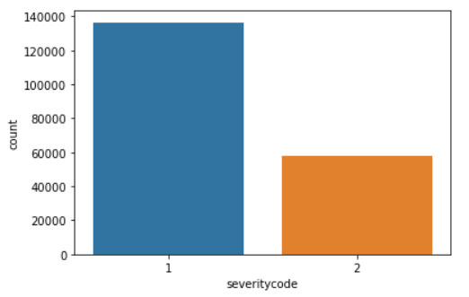
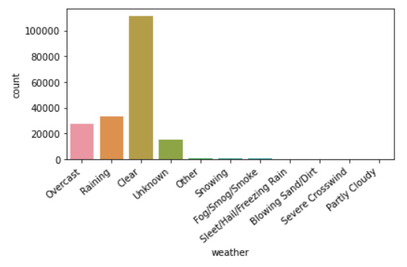
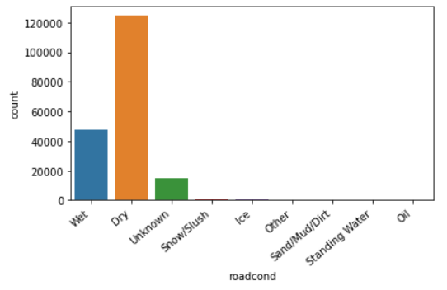
Graphics Related to Features

Slide 5
Classification Models
XGBoost
Logistic Regression
Decision Tree
Booster: gbtree
Verbosity: 1
KNN
n_neighbors = 5
Weights = uniform
C = 0.01
Solver = liblinear
Random Forest
n_estimators = 100
Criterion = gini
Criterion = entropy
max_depth = 4
GradientBoost
Loss: deviance
learning_rate: 0.1
n_estimators: 100

Slide 6
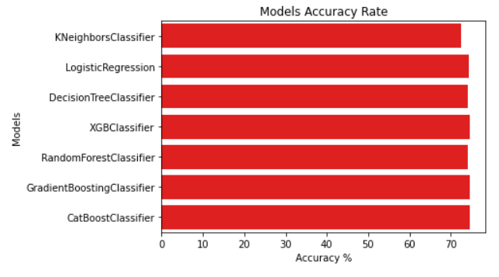
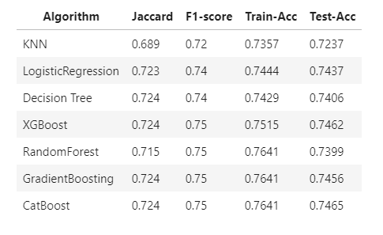
Results
This table contains the evaluation of the algorithms.
By a small margin, Catboost was determined as the best model.

Slide 7
Conclusion
We have obtained beautiful models using classification algorithms.
We avoided overfitting and underfitting situation.
Catboost algorithm was determined as the best model by a small margin.
Future Projects:
Parameter tuning will be done.
High relationship features will be added.

