Slide 1


Whole Exome Sequencing Annotation
Berk Gürdamar, MSc

Slide 2
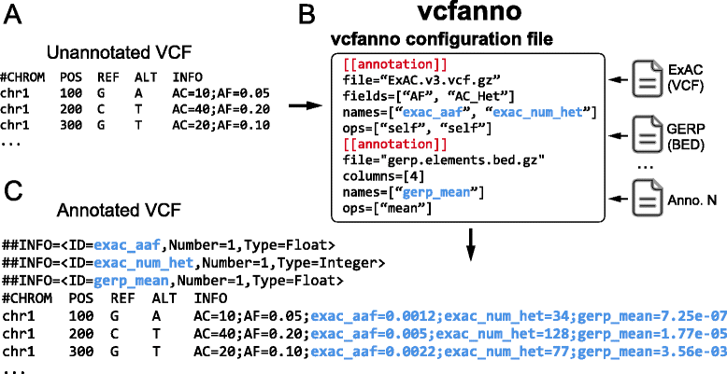
Vcfanno
~85,000 variants per second with 50 attributes from 17 commonly used genome annotation resources
*annotates only clinvar, required for vcf2db
https://github.com/brentp/vcfanno
https://genomebiology.biomedcentral.com/articles/10.1186/s13059-016-0973-5

Slide 3
Ensembl Variant Effect Predictor (VEP)
--hgvsg = Add genomic HGVS nomenclature based on the input chromosome name.
--total_length = Give cDNA, CDS and protein positions as Position/Length.
--everything = Shortcut flag to switch on all of the following:
--sift b, --polyphen b, --ccds, --hgvs, --symbol, --numbers, --domains, --regulatory, --canonical, --protein, --biotype, --af, --af_1kg, --af_esp, --af_gnomade, --af_gnomadg, --max_af, --pubmed, --uniprot, --mane, --tsl, --appris, --variant_class, --gene_phenotype, --mirna
https://genomebiology.biomedcentral.com/articles/10.1186/s13059-016-0974-4

Slide 4
vcf2db
Create Gemini compatible database for hg38
Pedigree file
Family ID
Individual ID
Paternal ID
Maternal ID
Sex (1=male, 2=female, other=unknown)
Phenotype (-9=missing, 0=missing, 1=unaffected, 2=affected)
FAM001 1 0 0 1 2
FAM001 2 0 0 1 2
https://github.com/quinlan-lab/vcf2db

Slide 5
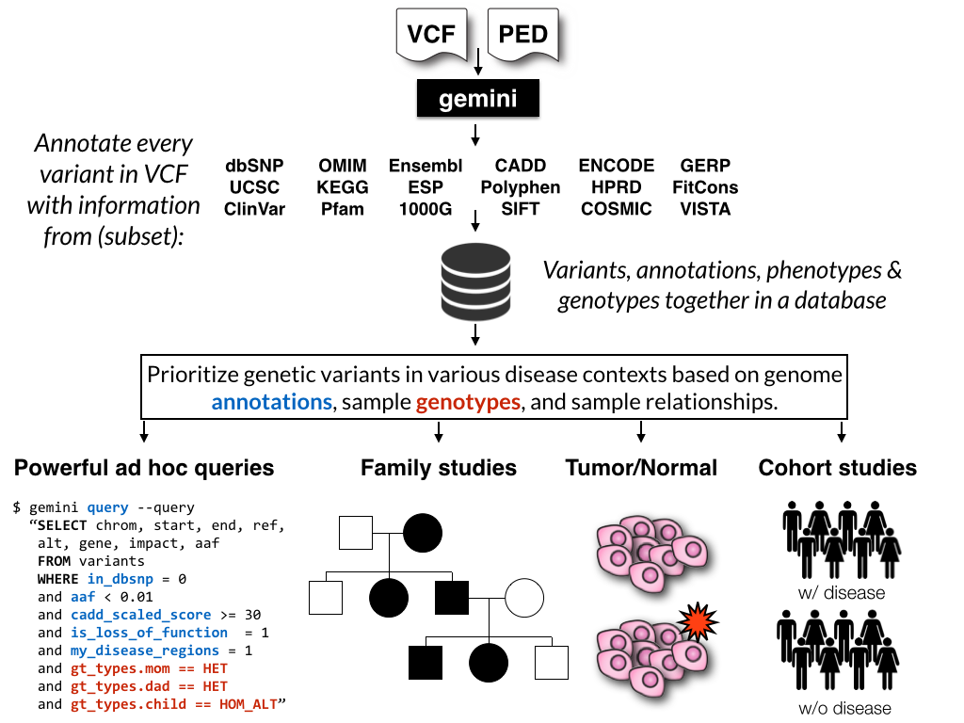
gemini
--gt-filter \
"(gt_types.1094PC0012 == HET or \ gt_types.1094PC0005 == HOM_REF) \ and (gt_types.1094PC0013 == HET)"
--gt-filter \
"gt_depths.sample1 >= 20 and \ gt_depths.sample2 >= 20 and \ gt_depths.sample3 >= 20"
https://gemini.readthedocs.io/en/latest/
https://pubmed.ncbi.nlm.nih.gov/23874191/

Slide 6
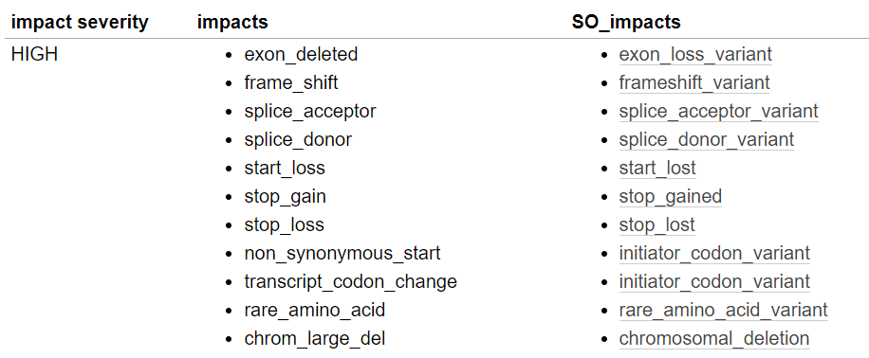
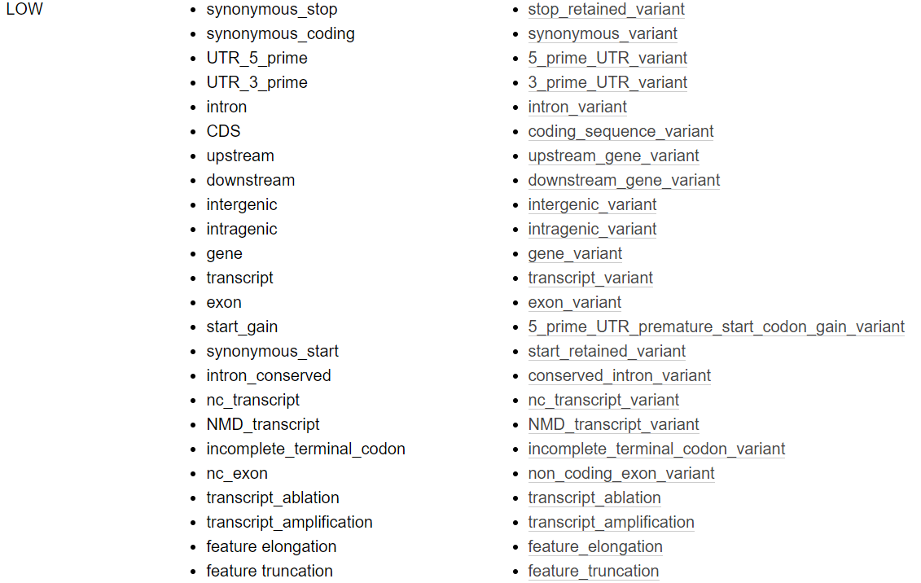
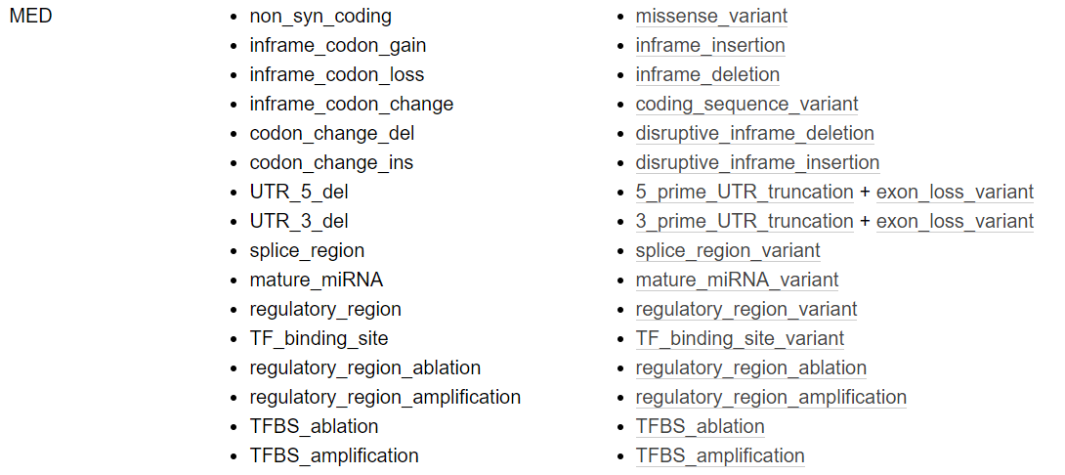
gemini - impact_severity

Slide 7
InterVar
Clinical interpretation of genetic variants by the ACMG-AMP 2015 guidelines.
Uses Annovar for annotation (https://www.ncbi.nlm.nih.gov/pmc/articles/PMC2938201/)
Parameters:
table_annovar.pl = generate a tab-delimited output file with many columns, each representing one set of annotations
annotate_variation.pl = does annotation
convert2annovar.pl = convert input format to annovar format
input_type = input file type, Avinput (Annovar’s format), VCF (VCF with single sample), VCF_m (VCF with multiple samples)
https://www.ncbi.nlm.nih.gov/pmc/articles/PMC5294755/
https://github.com/WGLab/InterVar

Slide 8
Final Report
R CMD BATCH /home/projects/ejprd_istanbul_workshop/scripts/final_report_script.R \
/home/projects/ejprd_istanbul_workshop/{user_id}/annotation/sample.hg38_multianno.txt.intervar \
/home/projects/ejprd_istanbul_workshop/{user_id}/annotation/sample.query.txt \
/home/projects/ejprd_istanbul_workshop/{user_id}/annotation/sample.hg38_multianno.txt \
/home/projects/ejprd_istanbul_workshop/{user_id}/annotation/sample.final.annotation.tsv
Parameters:
sample.hg38_multianno.txt.intervar = ACMG Classification
sample.query.txt = Annotation
sample.hg38_multianno.txt = In silico scores
sample.final.annotation.tsv = Final report

