Slide 1
Whole Exome Sequencing Basics
Berk Gürdamar, MSc

Slide 2
Basics of Sequencing and Basic Terminology

Slide 3
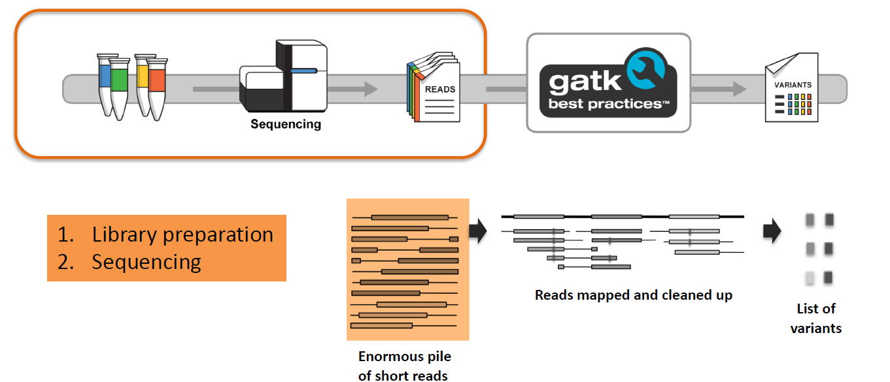
Our Goal
GATK Workshop Slide Set Gujarat, India Mar. 2-5, 2020

Slide 4
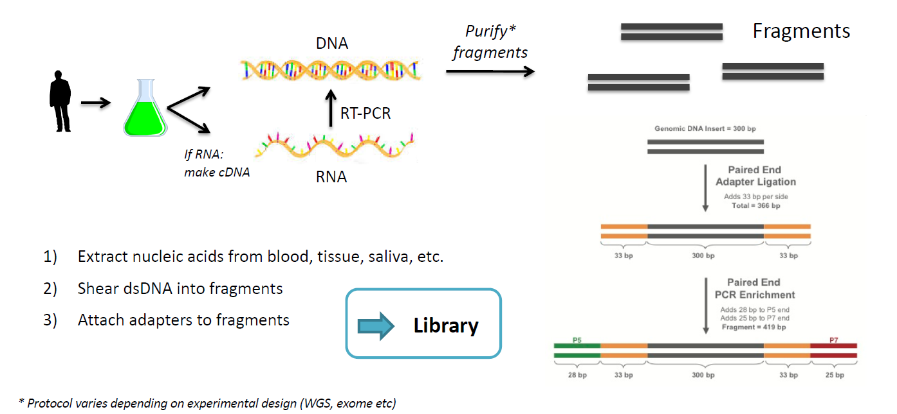
Procedure
GATK Workshop Slide Set Gujarat, India Mar. 2-5, 2020

Slide 5
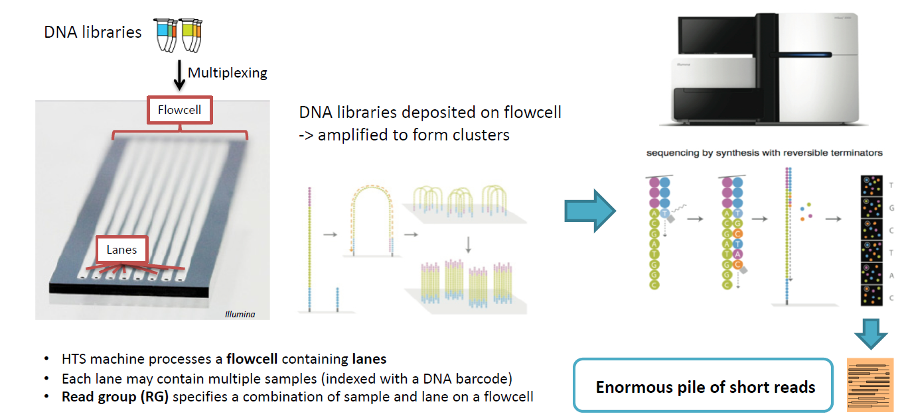
Procedure
GATK Workshop Slide Set Gujarat, India Mar. 2-5, 2020

Slide 6
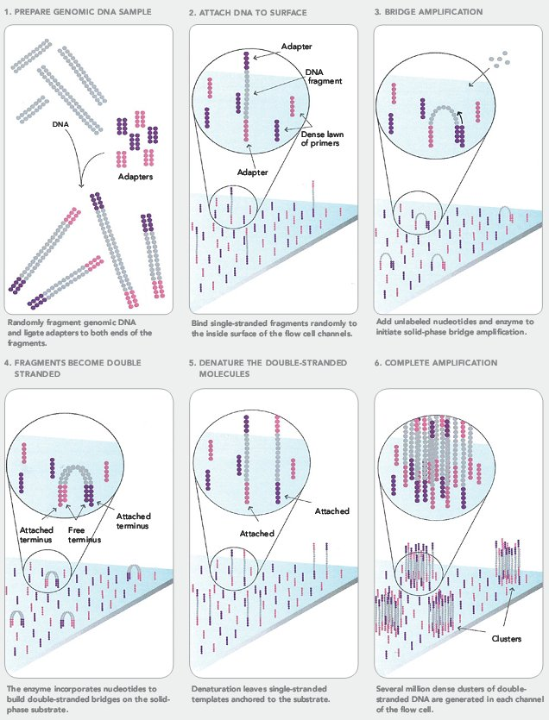
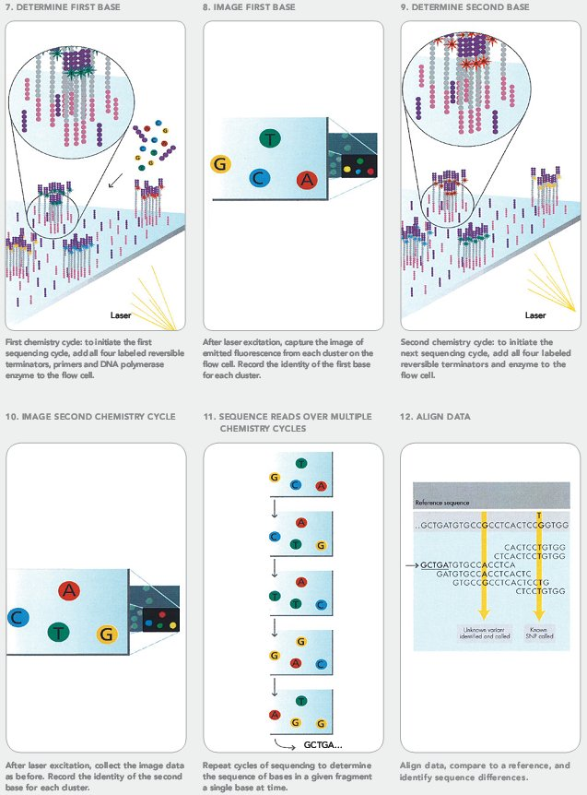
Actual Sequencing - Illumina
Illumina Sequencing by Synthesis: https://youtu.be/fCd6B5HRaZ8

Slide 7
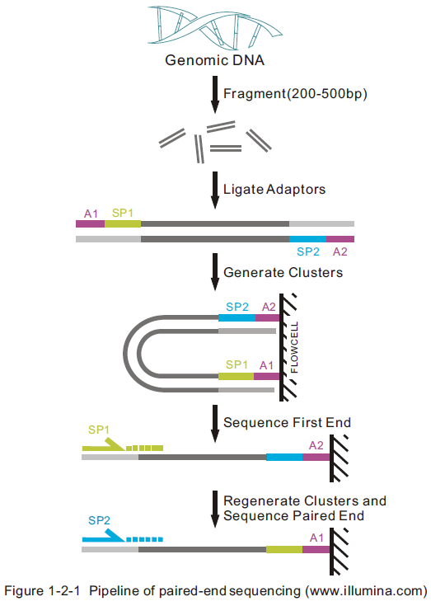
Terminology – Pair-end Sequencing

Slide 8
Terminology – Pair-end Sequencing
https://www.illumina.com/science/technology/next-generation-sequencing/paired-end-vs-single-read-sequencing.html

Slide 9
Pair-end Reads Advantage
DNA fragments are typically longer than the measured read lengths
For many applications, it is greatly advantageous to be able to measure (if not the entire fragment) at least both ends of it
Recommended for genomic variation and genome assembly analyses
from The Biostar Handbook

Slide 10
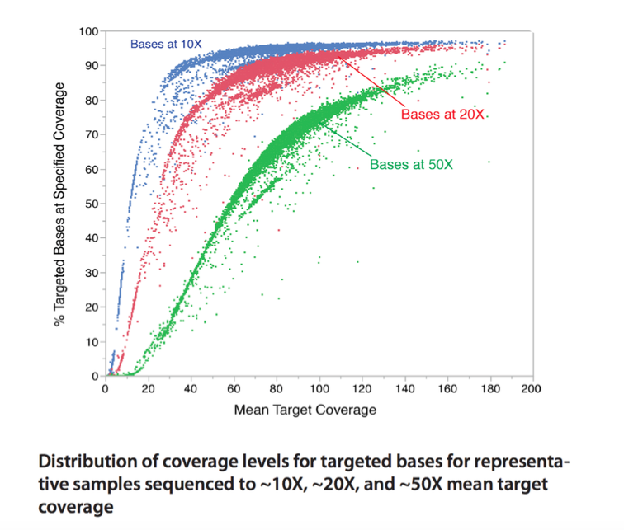
Terminology – Coverage
GATK Workshop Slide Set University of Pretoria South Africa, 22-26 June, 2015

Slide 11
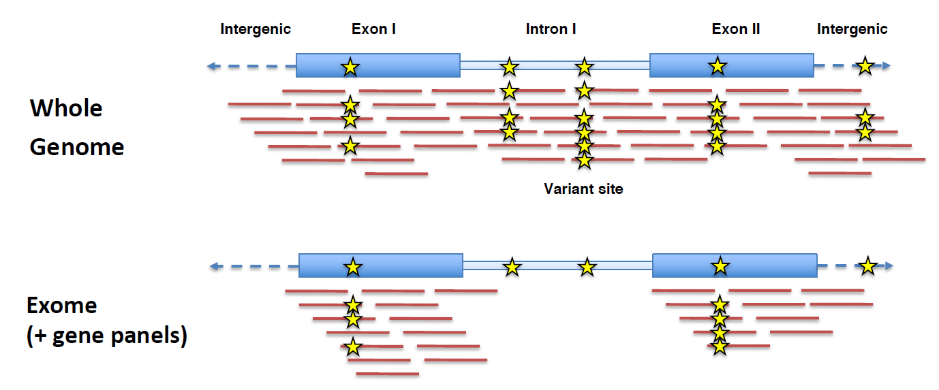
WGS vs WES
GATK Workshop Slide Set Gujarat, India Mar. 2-5, 2020

Slide 12
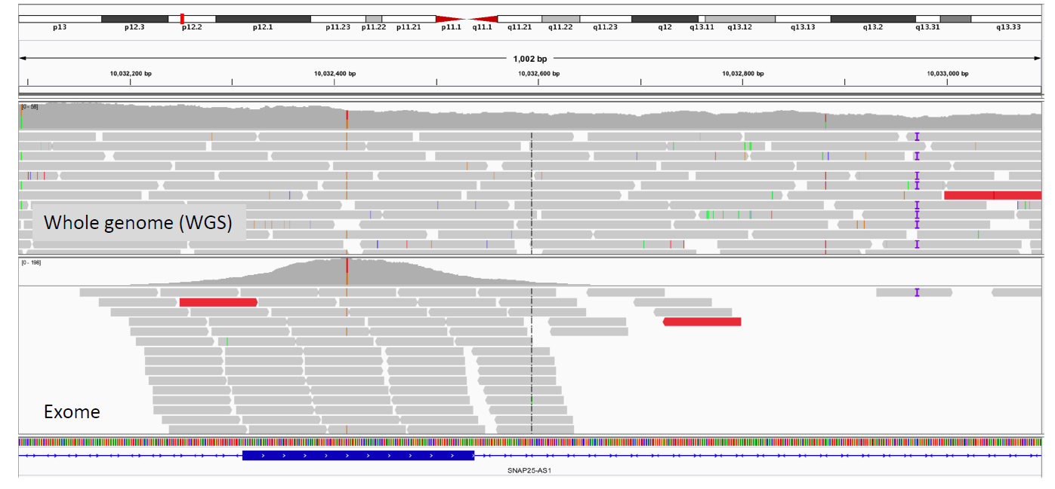
WGS vs WES
GATK Workshop Slide Set Gujarat, India Mar. 2-5, 2020

Slide 13
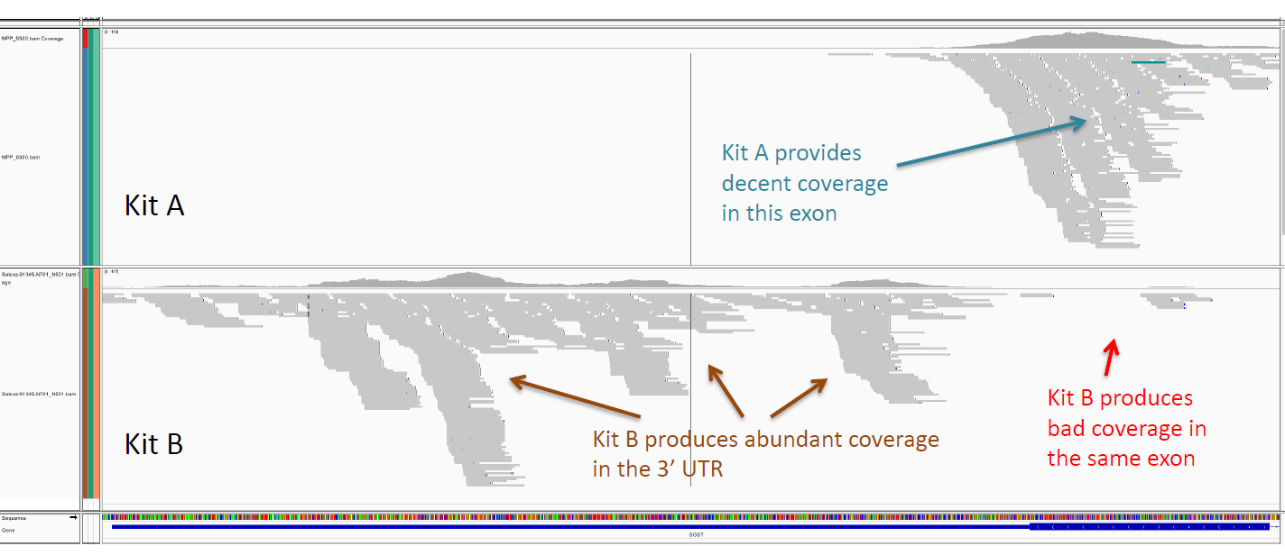
Exome Kits
GATK Workshop Slide Set Gujarat, India Mar. 2-5, 2020

Slide 14
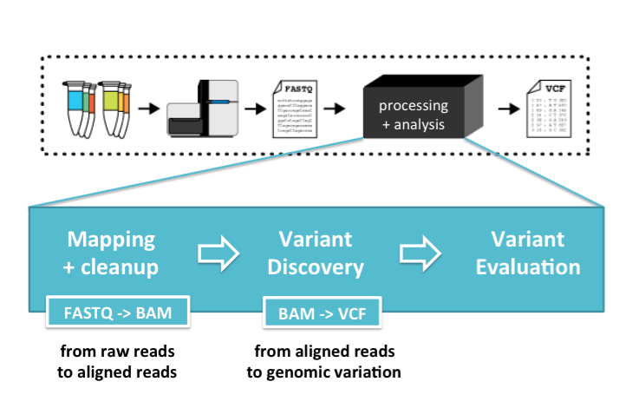
GATK Workshop Slide Set University of Pretoria South Africa, 22-26 June, 2015

Slide 15
Important File Formats

Slide 16
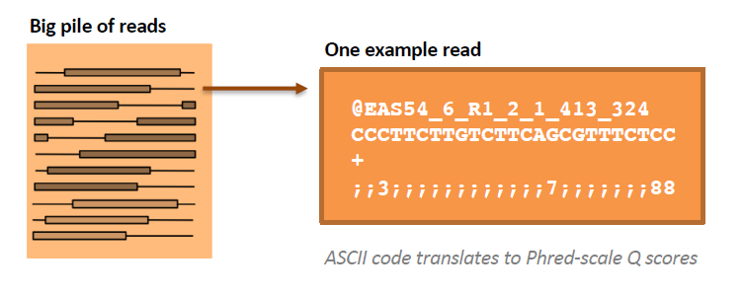
Important File Format #1: FASTQ (raw reads)
Simple extension from traditional FASTA format.
Each block has 4 elements (in 4 lines) :
Sequence Name (read name, group, etc.)
Sequence
+ (optional: Sequence name again)
Associated quality score

Slide 17
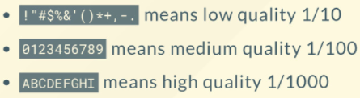
Quality Scores
Phred value = −10 x log₁₀(ε) (*ε: Error Rate) e.g.:
90% confidence >> 10% ε = 10⁻¹ >> Phred Q10 >> ASCII 74 = J
99% confidence >> 1% ε = 10⁻² >> Phred Q20 >> ASCII 84 = T
99.9% confidence >> 0.1% ε = 10⁻³ >> Phred Q30 >> ASCII 94 = ^
There are different encoding schemes as well !!

Slide 18
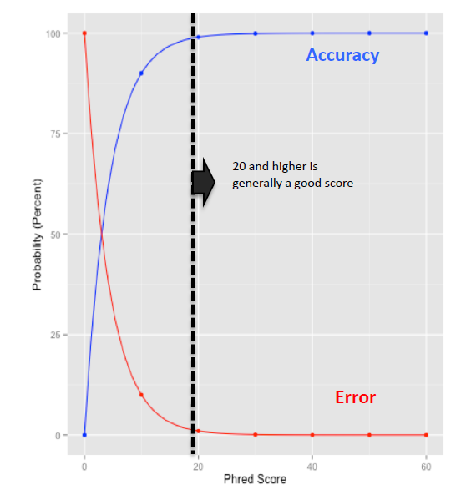
Meaning of Phred Scores

Slide 19
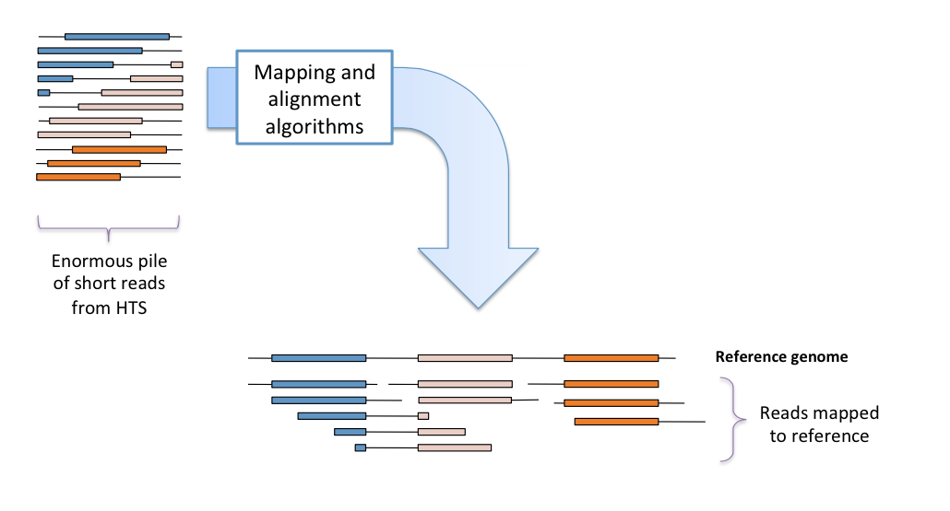
Alignment
BWA for DNA
STAR for RNAseq
GATK Workshop Slide Set University of Pretoria South Africa, 22-26 June, 2015

Slide 20
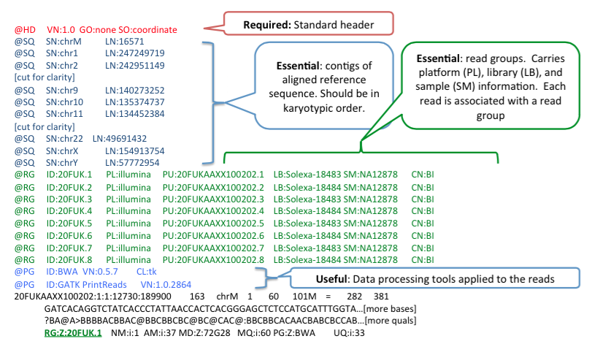
SAM Headers

Slide 21
Important File Format #2: SAM/BAM(aligned reads)
Sequence Alignment Map / Binary Alignment Map
Query Name
FLAG
Reference Name
Position
Mapping Quality
CIGAR
Mate Name
Position of Mate
Template Length (Reference)
Sequence
Quality String
Predefined Tags
https://zymoresearch.eu/blogs/blog/what-are-sam-and-bam-files

Slide 22
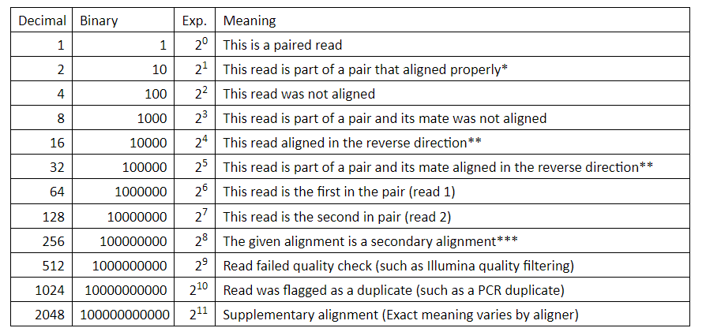
Important File Format #2: SAM/BAM(aligned reads)
Sequence Alignment Map / Binary Alignment Map
FLAG value is 99 (64 + 32 + 2 + 1) indicating that:
The read is the first in pair (read 1)
The paired-end mate of this read mapped in the reverse direction
The read was part of a properly aligning pair
The read was paired
https://zymoresearch.eu/blogs/blog/what-are-sam-and-bam-files

Slide 23
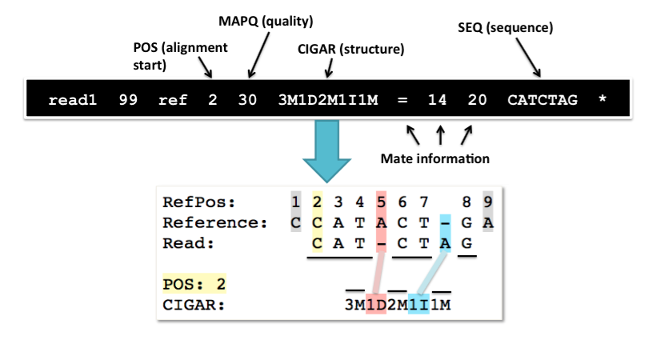
CIGAR – Explanation
GATK Workshop Slide Set University of Pretoria South Africa, 22-26 June, 2015
Notes:
Compact Idiosyncratic Gapped Alignment Report

Slide 24
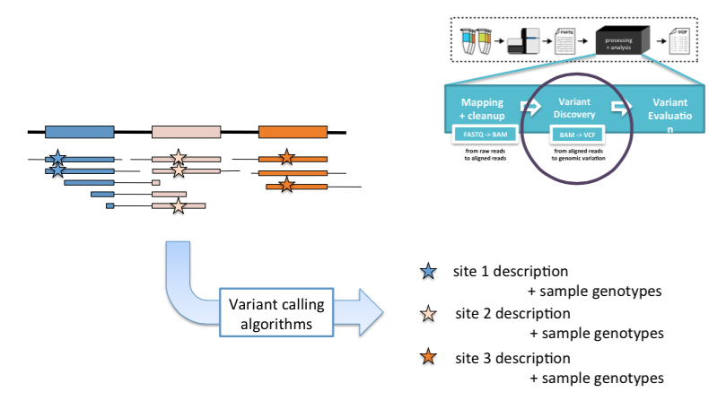
Important File Format #3: VCF Genomic Variation
GATK Workshop Slide Set University of Pretoria South Africa, 22-26 June, 2015

Slide 25
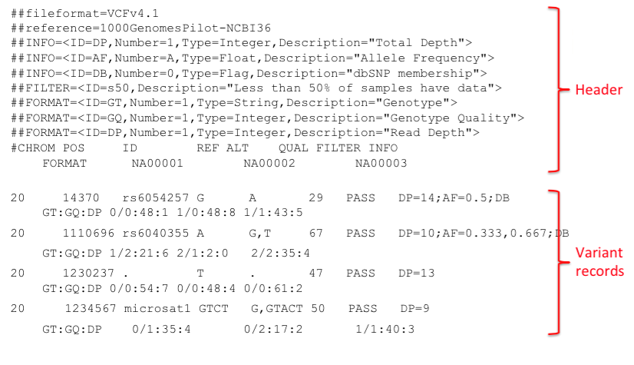
VCF Format

