Slide 1
Offline reconstruction toolbox for gSlider-SMS data
Congyu Liao, Ph.D., cliao2@mgh.Harvard.edu
Kawin Setsompop, Ph.D., Kawin.Setsompop@mgh.harvard.edu

Slide 2
Overview
Preparation
Loading gSlider data
Loading B1 maps
gSlider reconstruction with B1 & T1 correction

Slide 3
Warning: your workstation should have more than 16GB RAM and 32 GB storage to reconstruct the gSlider data!!

Slide 4

Preparation:
The magnitude images of gSlider data
The phase images of gSlider data
Calculated B1 maps with matched slice FOV
Convert all acquired dicoms to nifti (.nii) data. (e.g. use mricron software to convert dicom data)
Use the magnitude images of gSlider data to generate brain mask by using FSL BET function. (e.g. use such BET function to create a brain mask:
  bet xxxx.nii f_out.nii -f .25 -m (xxx.nii is the name of the magnitude images)

Slide 5
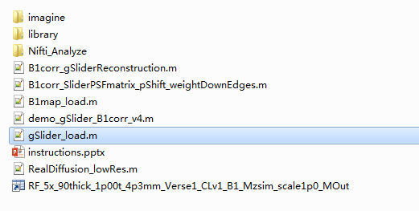
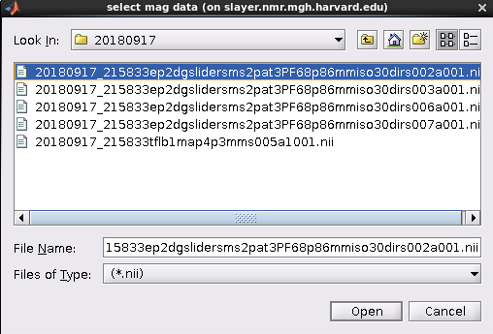
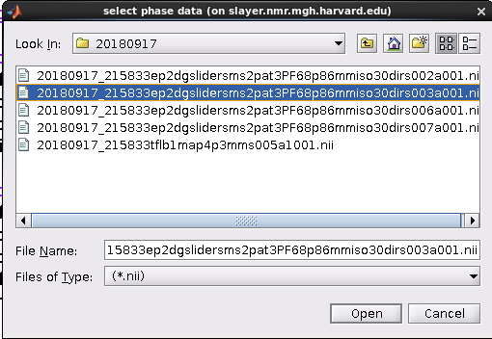
Loading gSlider data
step1
step2
step3
Run “gSlider_load.m”
Select nifti file of magnitude data
Select nifiti file of phase data

Slide 6
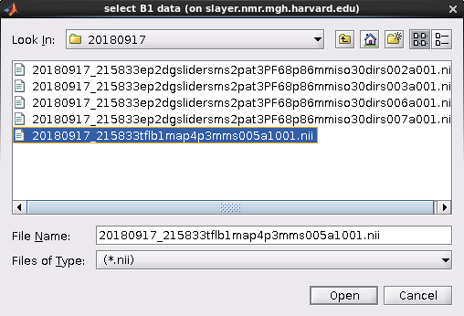
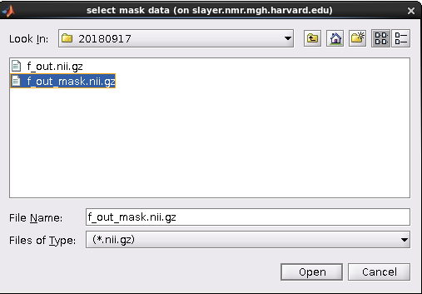
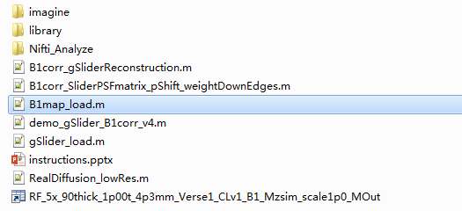
Loading B1 maps
step1
step2
step3
Run “B1map_load.m”
Select nifiti file of B1 maps
Select generated brain mask
Warning: The slice FOV [(slice thickness+slice gap)*Nslices ] of B1 maps should match the slice FOV of gSlider data!

Slide 7
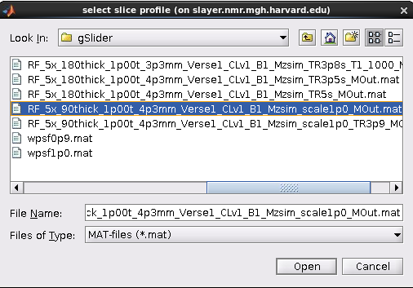
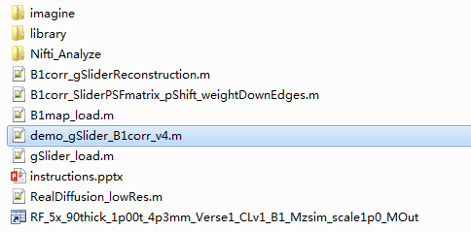
gSlider reconstruction with B1 & T1 correction
step1
step2
Run “demo_gSlider_B1corr_v4.m”
Select slice profile matrix “RF_5x_90thick_1p00t_4p3mm_Verse1_CLv1_B1_Mzsim_scale1p0_Mout.mat”
Wait and get final reconstructed super-resolution images:
“Img_SuperRes”

