Slide 1

BBL588E Advanced Topics in Image Analysis Term Project Presentation
Cassava Leaf Disease Classification
704241020 - Alper Berkin YAZICI
704241023 - Furkan GÜNEY
14.01.2025

Slide 2

Problem Definition
Problem
Cassava is a vital crop for millions globally, but its production is severely threatened by diseases like Cassava Mosaic Disease (CMD) and Cassava Brown Streak Disease (CBSD). Accurate and timely identification of these diseases is essential to prevent significant yield losses and support food security. This project aims to develop a deep learning-based solution to automate cassava leaf disease detection using image classification.
Challenges
The classification task comes with challenges such as variability in leaf patterns across the same disease class, imbalanced datasets favoring some diseases over others, and environmental factors like lighting and background noise in images. Additionally, deploying such solutions in resource-constrained regions adds complexity to the problem.
Goals
The goal is to design a robust model using transfer learning to achieve high accuracy in disease detection, while addressing challenges like class imbalance and noisy data. Ultimately, the project aims to provide an accessible tool for farmers to improve cassava crop management and reduce losses.

Slide 3
About Dataset
From Kaggle : https://www.kaggle.com/competitions/cassava-leaf-disease-classification/data
It contains 21,397 labeled images of cassava leaves, categorized into five classes:
Cassava Bacterial Blight (CBB)
Cassava Brown Streak Disease (CBSD)
Cassava Green Mottle (CGM)
Cassava Mosaic Disease (CMD)
Healthy
Each image is labeled with a class corresponding to the health status or disease affecting the cassava leaf. The dataset is imbalanced, with some classes having significantly more samples than others, posing an additional challenge for model training.
The images vary in quality, lighting, and background, simulating real-world conditions. This diversity makes the dataset highly representative and ideal for training models to generalize well in practical applications.

Slide 4
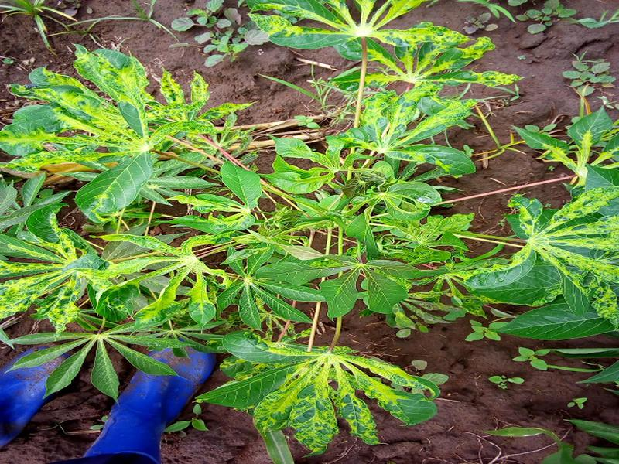
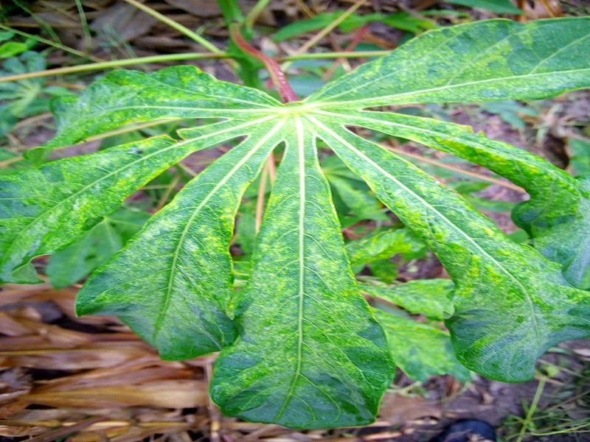
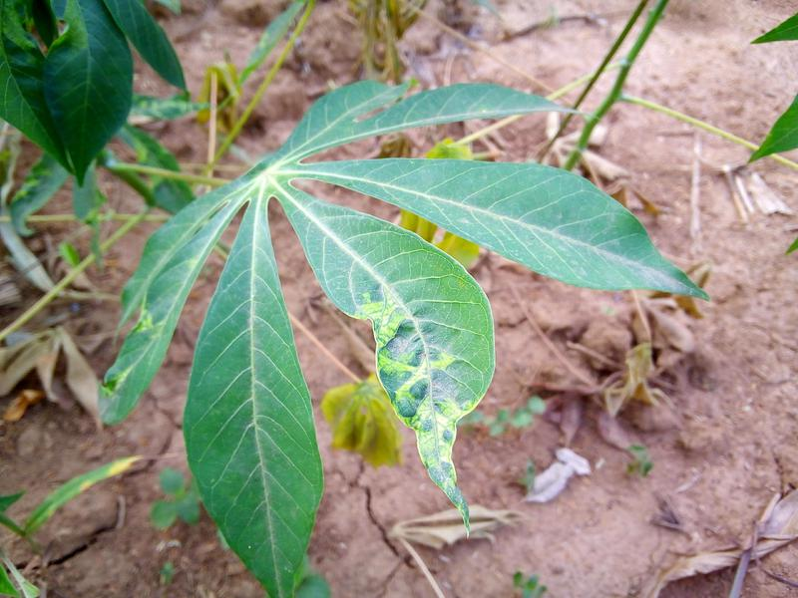
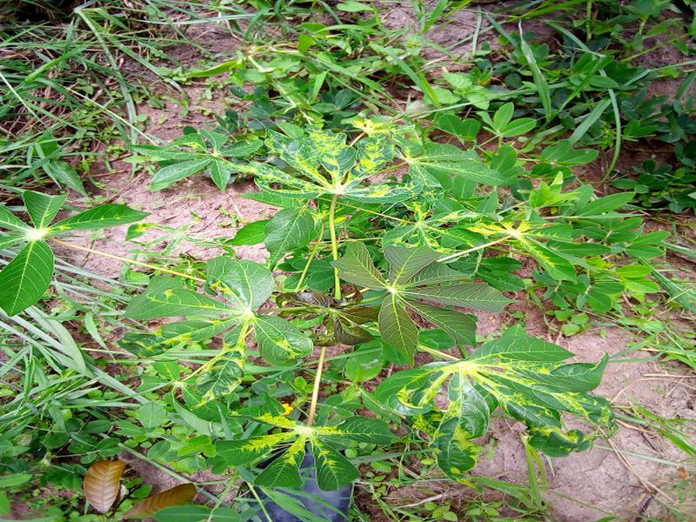
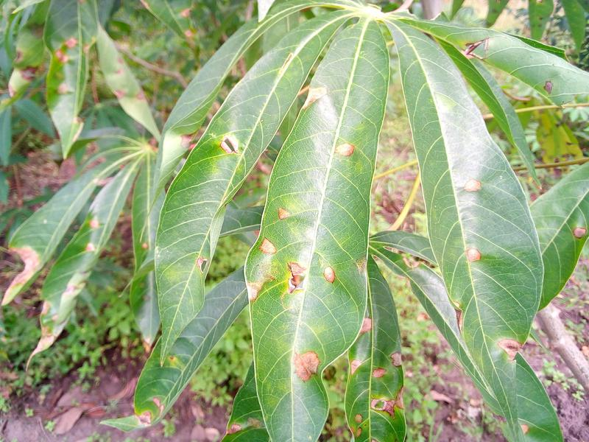
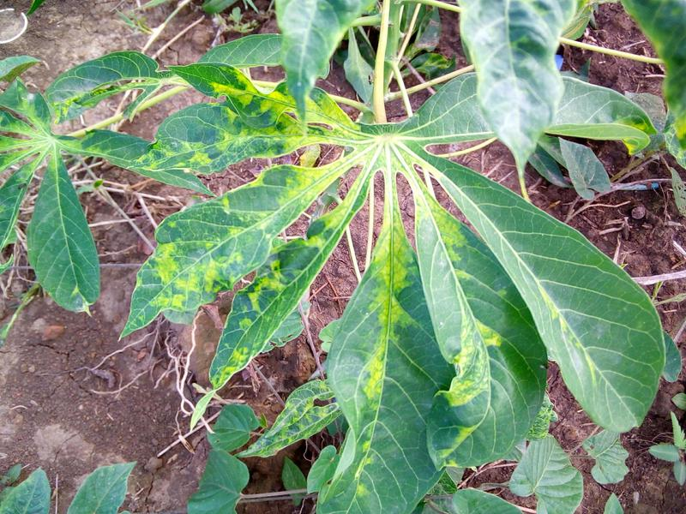
About Dataset

Slide 5
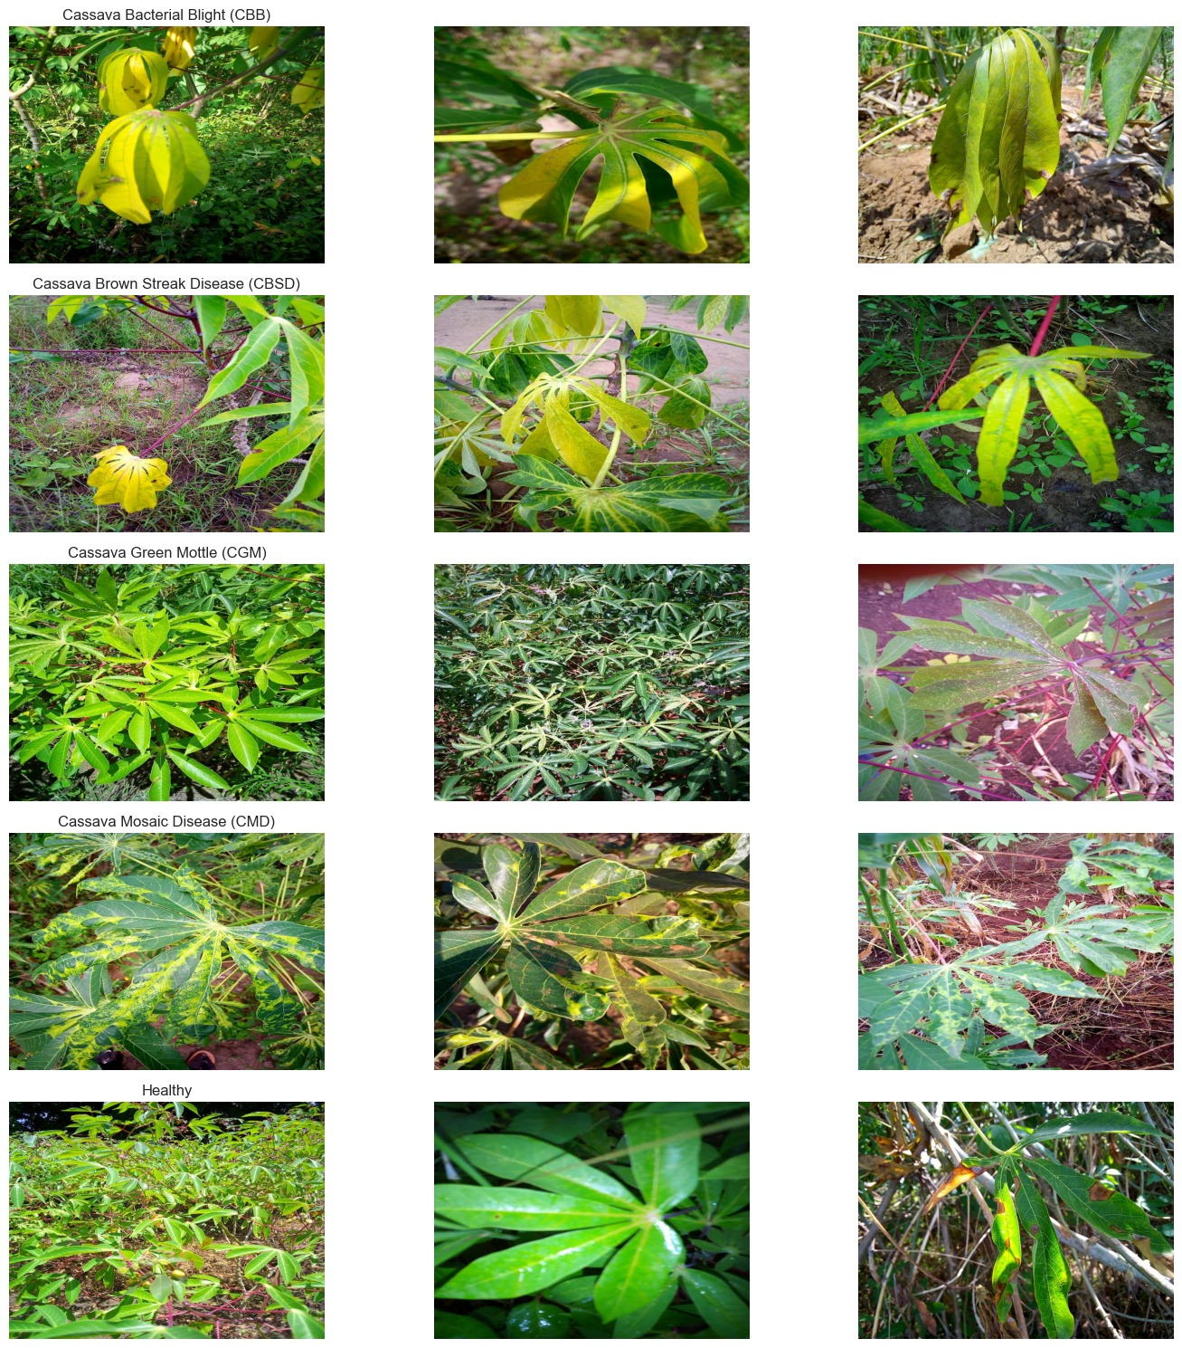
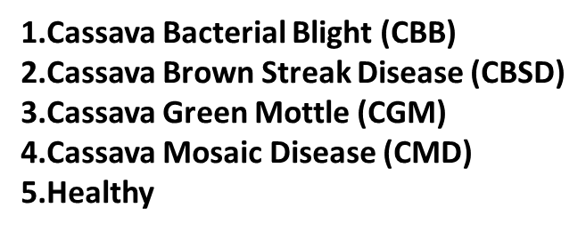
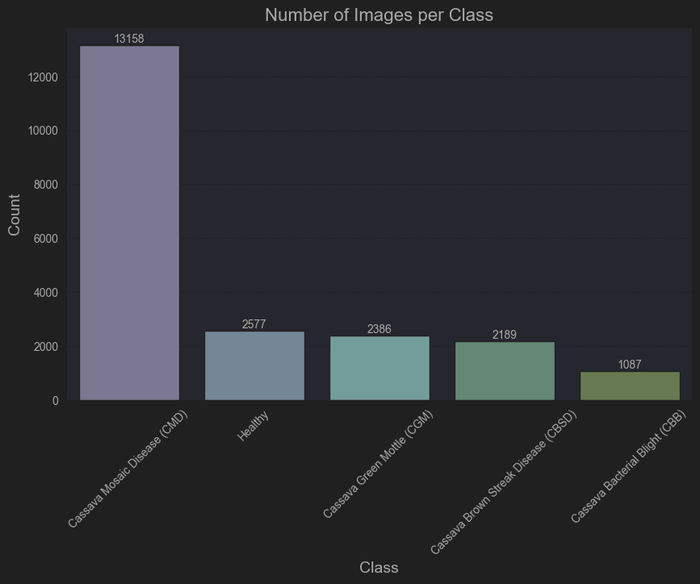
Class Distribution

Slide 6
Data Preprocessing
Data Loading and Labeling: The training data was loaded from train.csv, and class labels were mapped using label_num_to_disease_map.json.
Exploratory Data Analysis (EDA): The class distribution was analyzed and visualized. Sample images from each class were displayed for further insights.
Data Augmentation: Techniques such as rotation, zoom, flipping, shifting, and shearing were applied to increase data diversity.
Train-Validation Split: The dataset was split into 80% for training and 20% for validation, with separate data generators created for both.

Slide 7
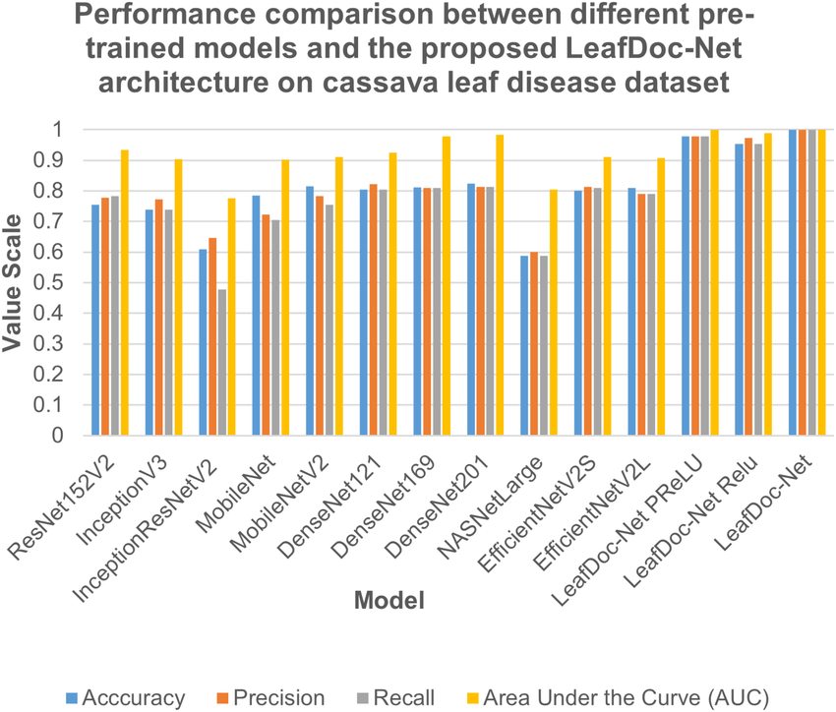
Model Architecture
Total params: 4,055,976
Trainable params: 4,013,953
Non-trainable params: 42,023
Our EfficientNet CNN has 239 layers.

Slide 8
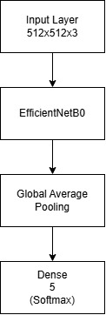
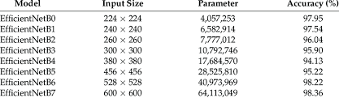
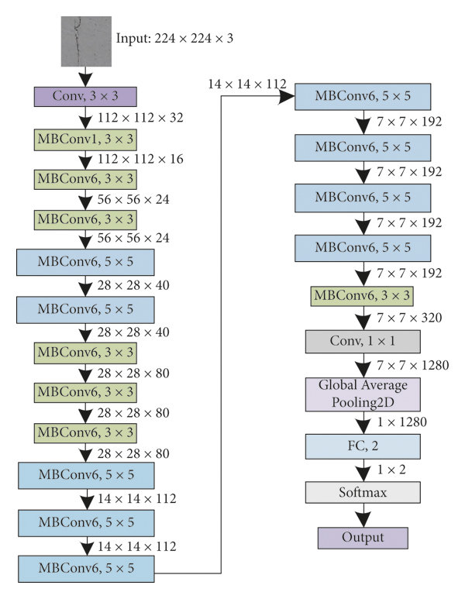
Model Architecture
Total params: 4,055,976
Trainable params: 4,013,953
Non-trainable params: 42,023
Our EfficientNet CNN has 239 layers.

Slide 9
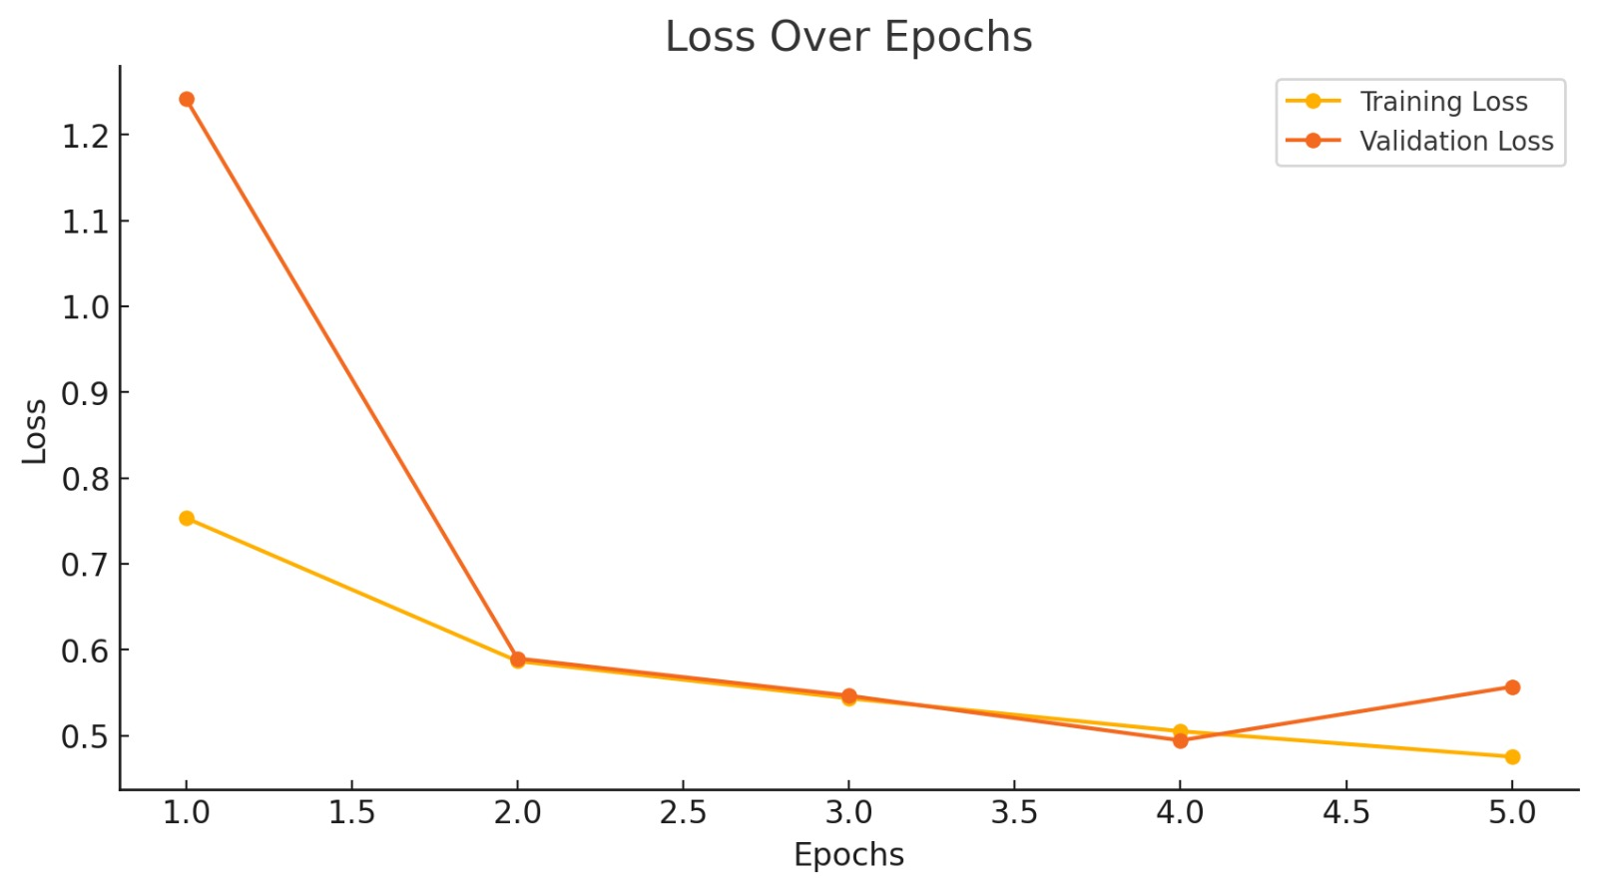
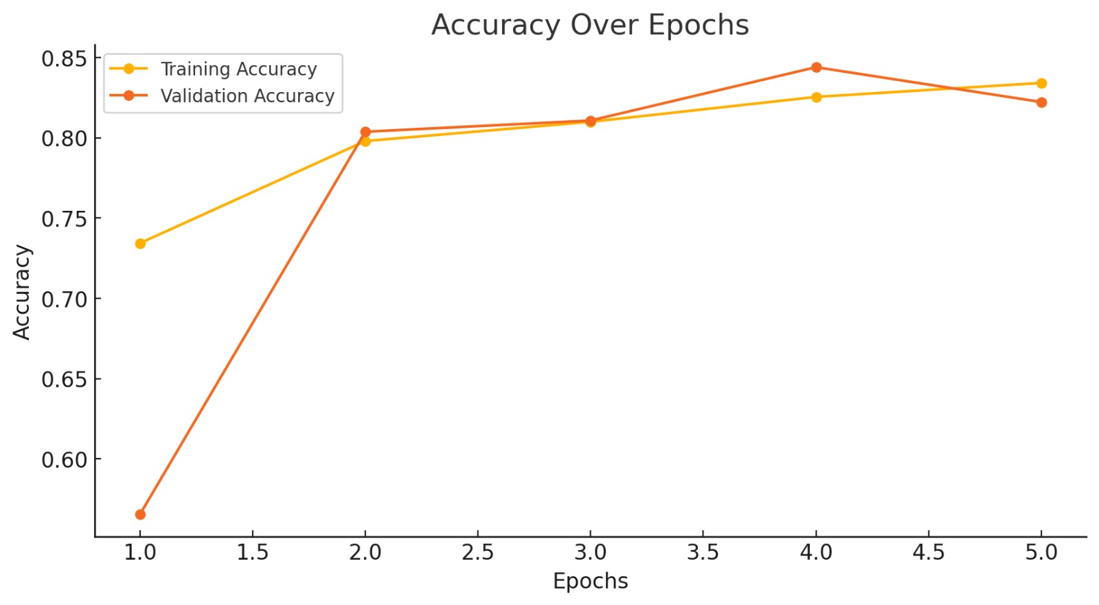
Training Process
Training was conducted over 5 epochs with a batch size of 4. Early stopping was applied to terminate the training process when validation performance plateaued, ensuring the prevention of overfitting. The training and validation accuracy trends (Figure 1) show consistent improvement across epochs, with the model achieving stable accuracy by the final epoch. Similarly, the training and validation loss curves exhibit a steady reduction, reflecting effective learning throughout the training process. These results demonstrate the model's ability to generalize well to the validation set while maintaining robust performance during training.

Slide 10
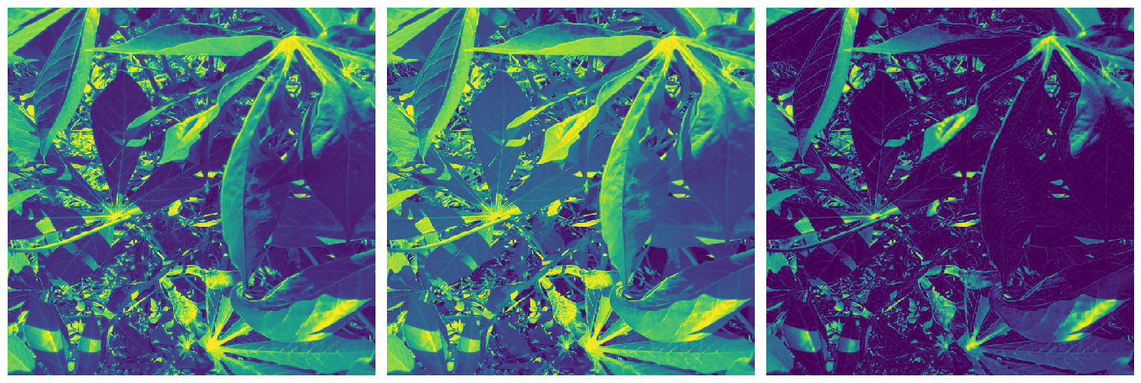
Layer Visualization

Slide 11
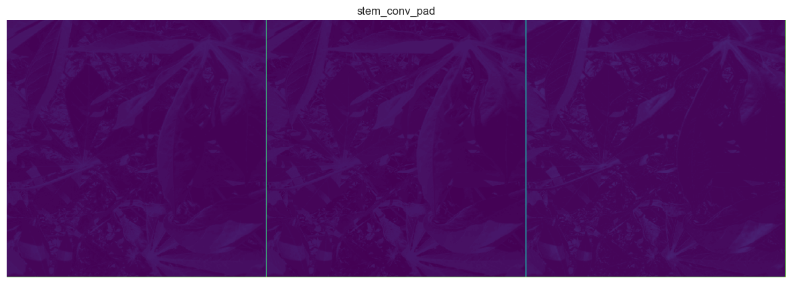
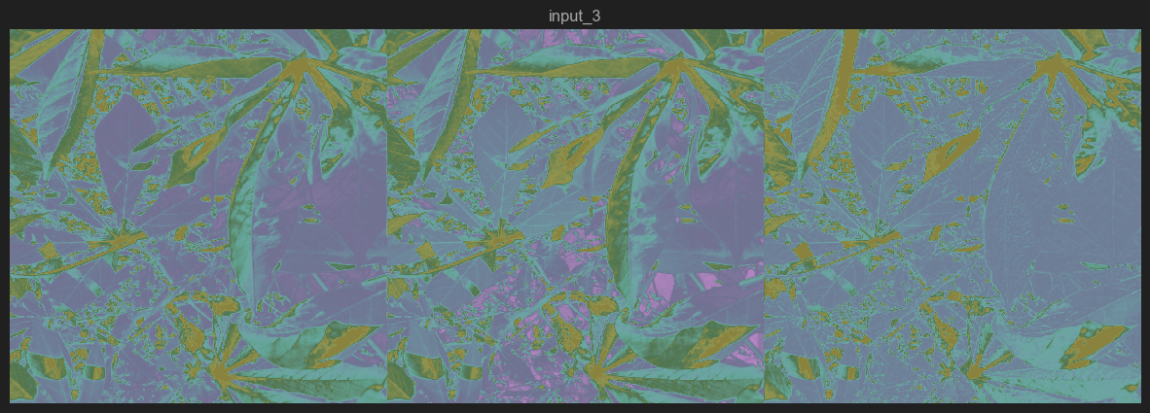

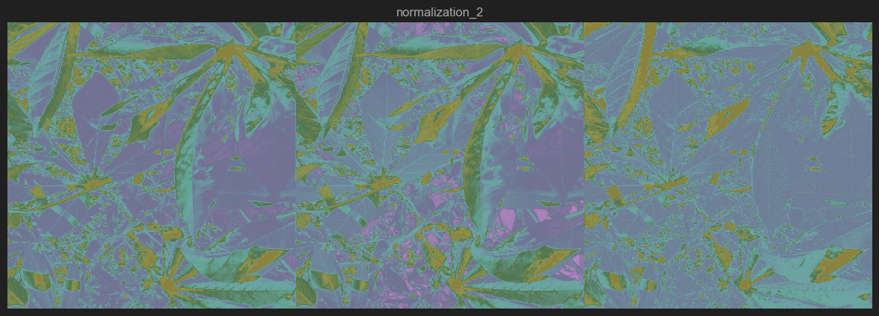
Layer Visualization
rescaling
convolution
normalization

Slide 12
Evaluation
Final validation accuracy reached approximately 84%.

Slide 13
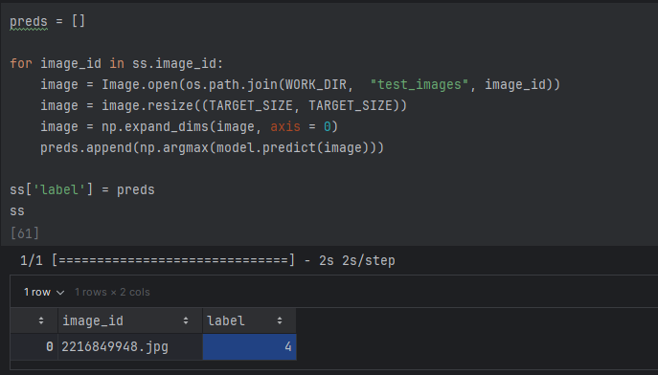
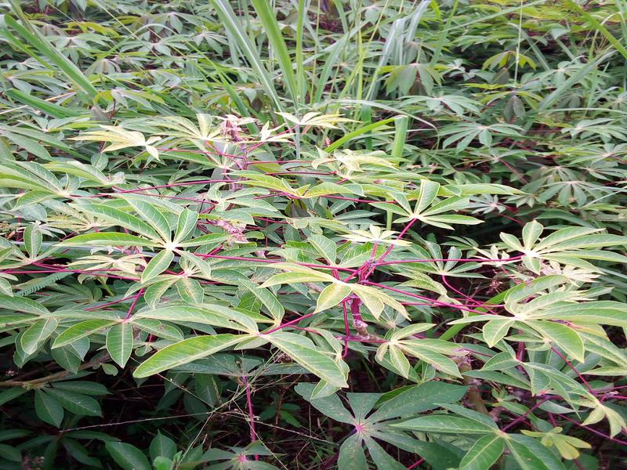
Results

Slide 14

BBL588E Advanced Topics in Image Analysis Term Project Presentation
704241020- Alper Berkin YAZICI
704241023-Furkan GÜNEY
14.01.2025

