Slide 1
Lab1
2020/Mar/8

Slide 2
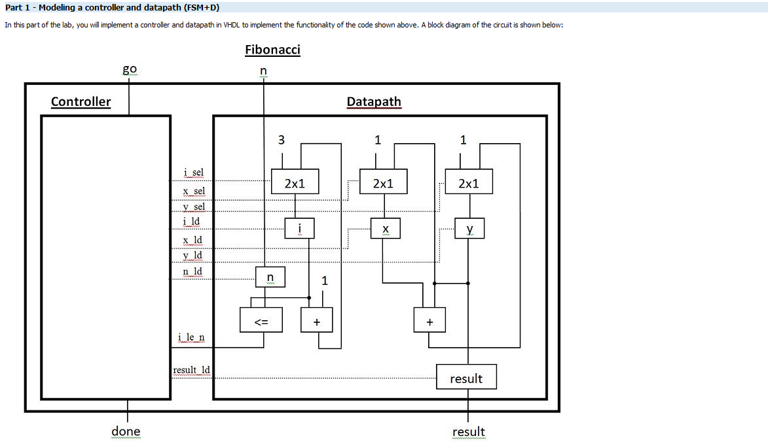
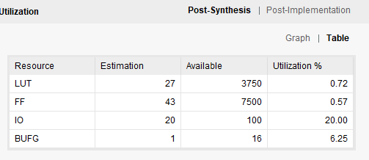
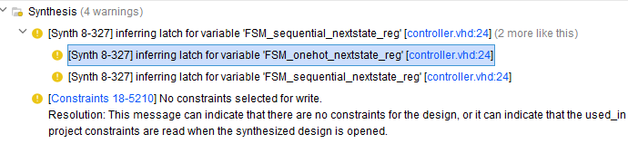
FSM+D

Slide 3
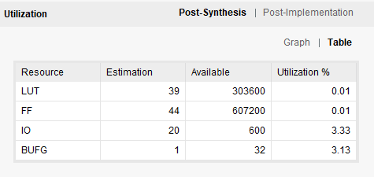
FSMD using 1FSM process
library ieee;
use ieee.std_logic_1164.all;
use ieee.numeric_std.all;
entity fib_toplevel2_1fsm is
port (
go : in std_logic;
n : in std_logic_vector(7 downto 0);
clk, rst : in std_logic;
done : out std_logic;
result : out std_logic_vector(7 downto 0));
end fib_toplevel2_1fsm;
architecture STR of fib_toplevel2_1fsm is
type STATE_TYPE is (STATE_0, STATE_INIT_DATA, STATE_NEW_DATA, STATE_SUM_DATA, STATE_DONE);
signal state, nextstate : STATE_TYPE;
signal s_done : std_logic;
begin
done <= '1' when s_done = '1' else '0';
process(clk, rst,n)
variable a,b,c : integer range 0 to 255 :=0;
variable index, v_n : integer range 0 to 255 :=0;
begin
v_n := to_integer(unsigned(n));
if (rst = '1') then
state <= STATE_0;
elsif (clk'event and clk='1') then
case state is
when STATE_0 =>
if (go = '1') then
state <= STATE_INIT_DATA;
else
state <= STATE_0;
end if;
when STATE_INIT_DATA =>
s_done <= '0';
a:= 1;
b:= 1;
index:= 1;
c:= 0;
if (go = '1') then
state <= STATE_SUM_DATA;
else
state <= STATE_0;
end if;
when STATE_SUM_DATA =>
s_done <= '0';
c := a+b;
index := index + 1;
if (go = '1') then
state <= STATE_NEW_DATA;
else
state <= STATE_0;
end if;
when STATE_NEW_DATA =>
s_done <= '0';
if (go = '1' and index <= v_n) then
state <= STATE_SUM_DATA;
a:= b;
b:= c;
elsif (go = '1' and index > v_n) then
state <= STATE_DONE;
else
state <= STATE_0;
end if;
when STATE_DONE =>
s_done <= '1';
result <= std_logic_vector(to_unsigned(c,8));
state <= STATE_0;
when others =>
null;
end case;
end if;
end process;
end STR;

Slide 4
Summary
FSM+D seems to well design and less LUT than FSMD
1process FSM is easy to write
2process FSM is difficult to write due to sync+async combination

