Slide 1

The Impact of Travel Time on Daily Mood
Berk Naşbacı 32464

Slide 2


MY DATASET
Date and day of the week
Route
Weather Condition
Departure time
Total duration of each tripStress levels before and after the trip
Highest temperature and lowest temperature

Slide 3
MY HYPOTHESIS
Null Hypothesis(H0): There is no significant relationship between travel duration and stress level differences. Increase in travel duration do not significantly affect stress level differences before and after the trip.
Alternative Hypothesis(H1): There is a significant relationship between travel duration and stress level differences. As travel duration increases, stress level differences before and after the trip also increase.

Slide 4
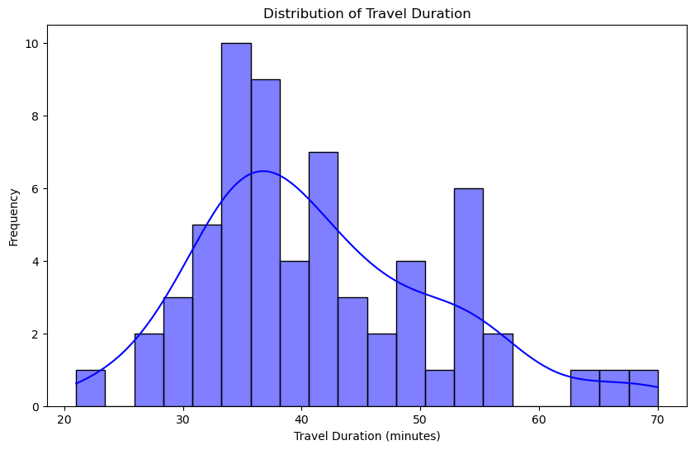
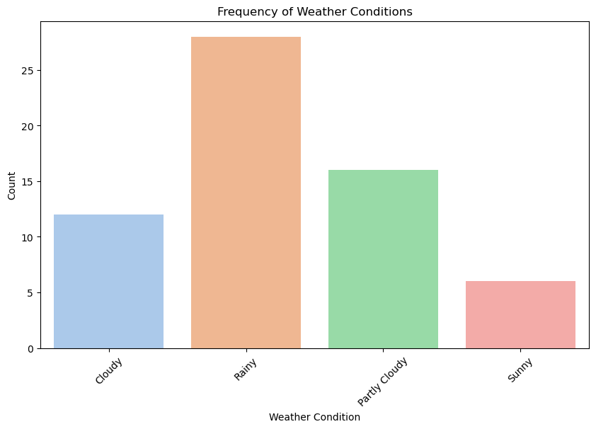
UNIVARIATE ANALYSIS
The histogram is used to analyze the distribution of travel durations, providing insights into how long trips typically take.
Travel Duration Statistics:
Mean: 41.55 minutes
Median: 39.50 minutes
Mode: 35 minutes
The chart illustrates the frequency of different weather conditions observed throughout December.

Slide 5
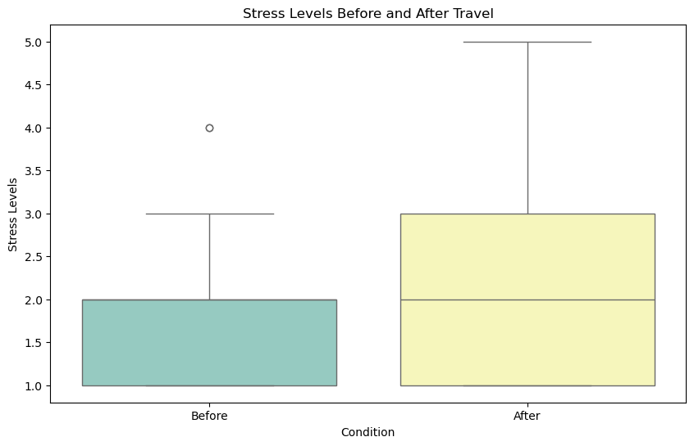
BIVARIATE ANALYSIS
This boxplot shows that my stress levels tend to increase after the journey.

Slide 6
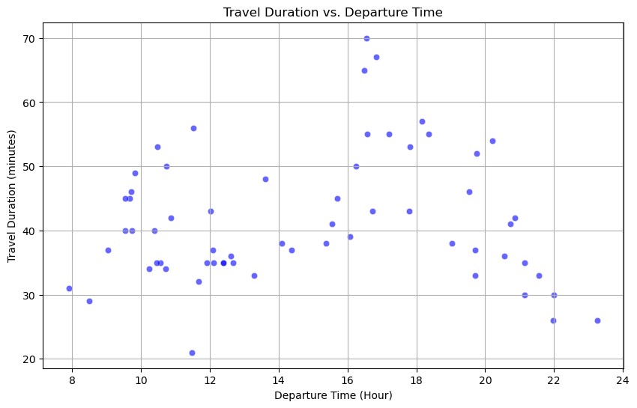
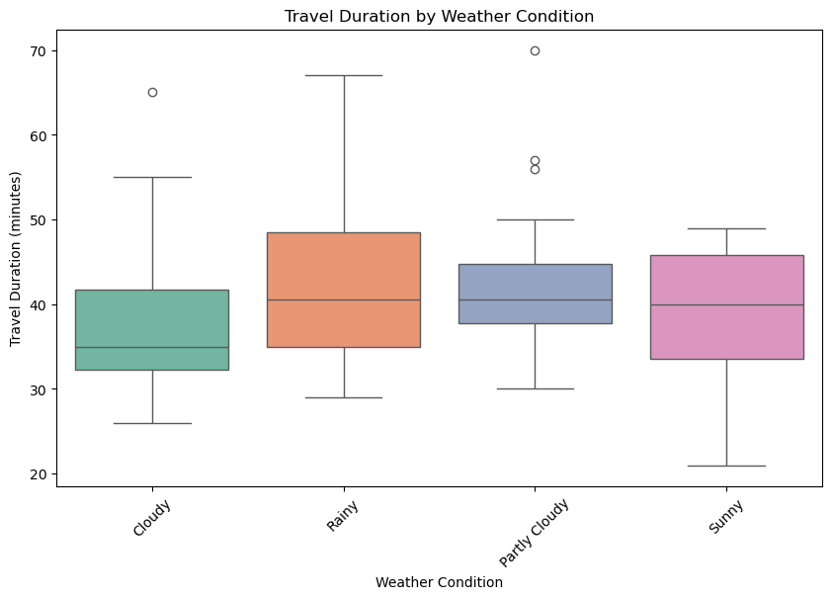
BIVARIATE ANALYSIS
This scatterplot demonstrates that during commute times, such as morning and evening peak hours, the travel duration tends to increase.
This boxplot illustrates that travel duration tends to increase during rainy weathe

Slide 7
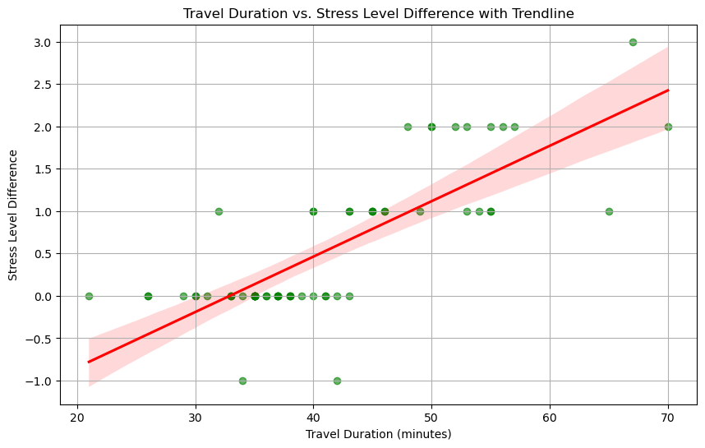
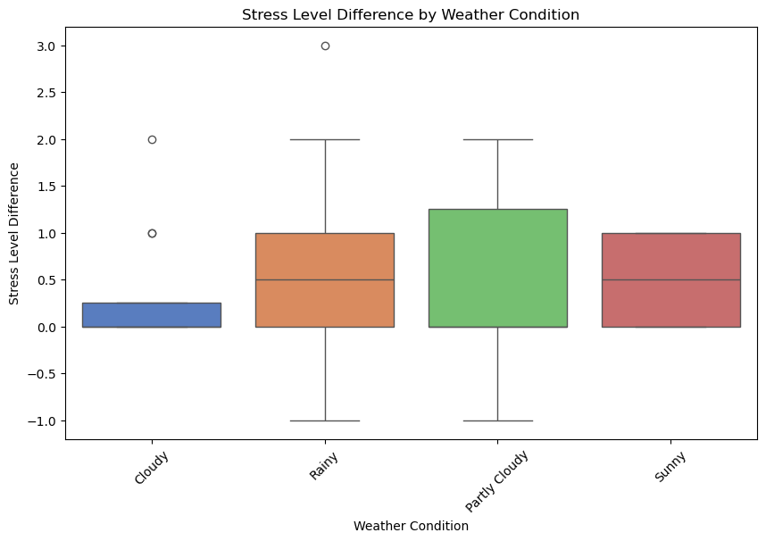
BIVARIATE ANALYSIS
This scartterplot with trendline shows that as travel duration increases, stress levels tend to rise.

Slide 8
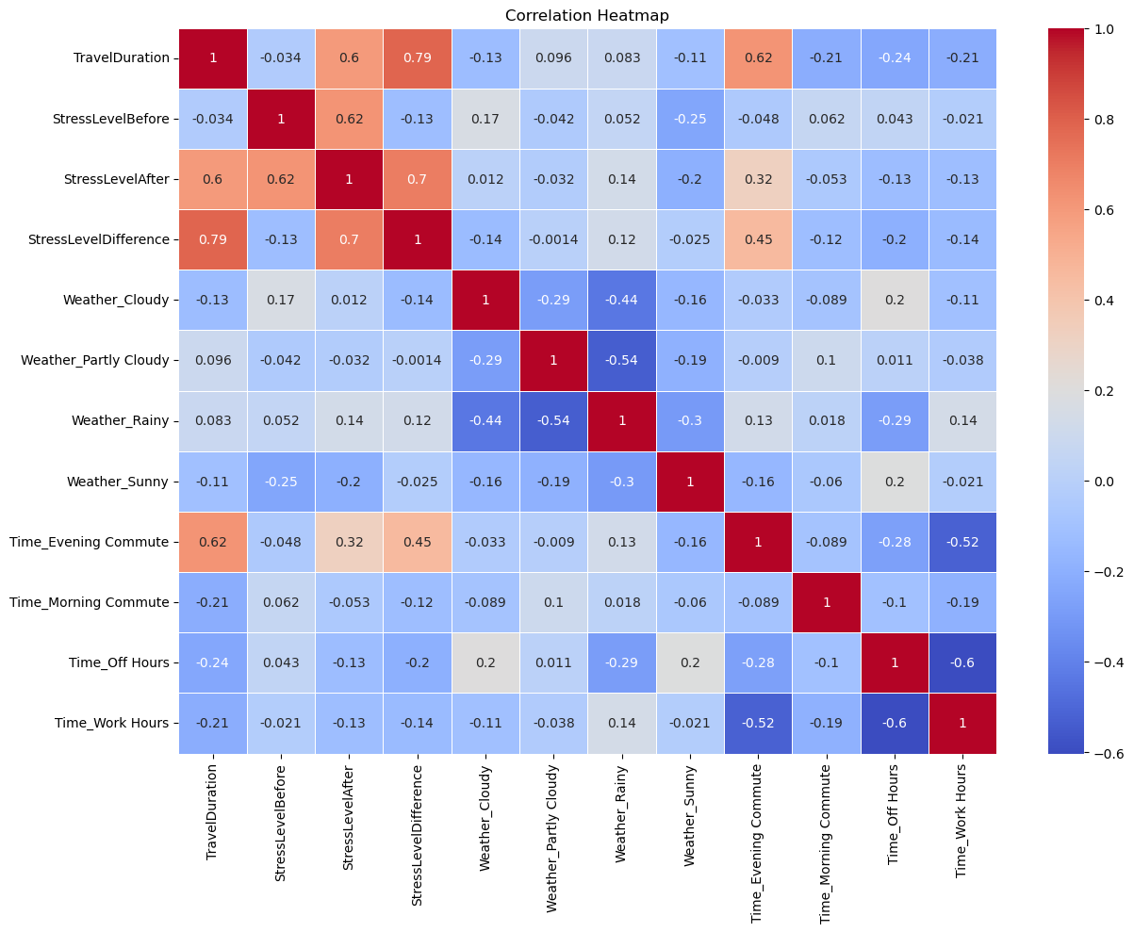
MULTIVARIATE ANALYSIS
Correlation Heatmap:
Strong Correlations:
TravelDuration and StressLevelDifference : 0.79
TravelDuration and StressLevelAfter : 0.6

Slide 9
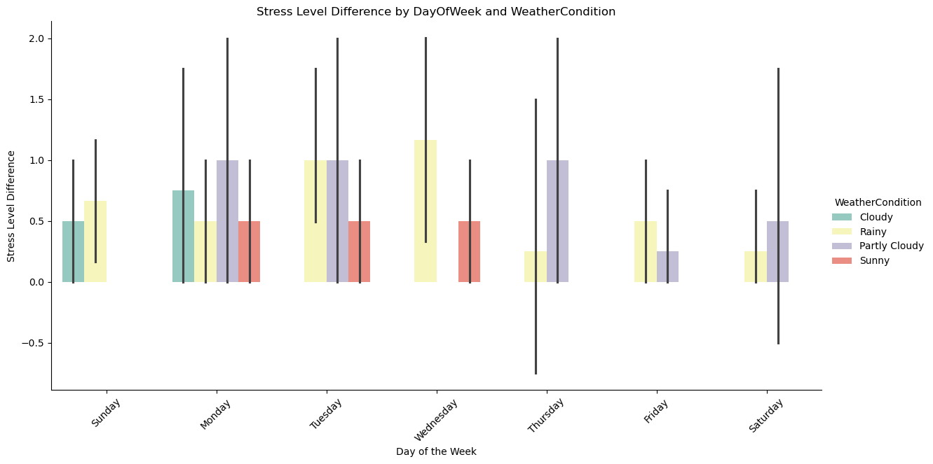
MULTIVARIATE ANALYSIS
On Fridays and weekends, the stress level difference is noticeably lower compared to other weekdays.

Slide 10
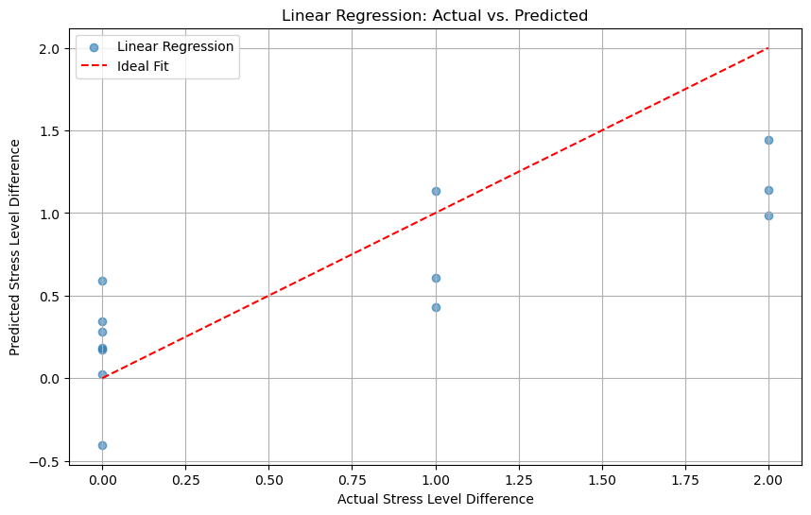
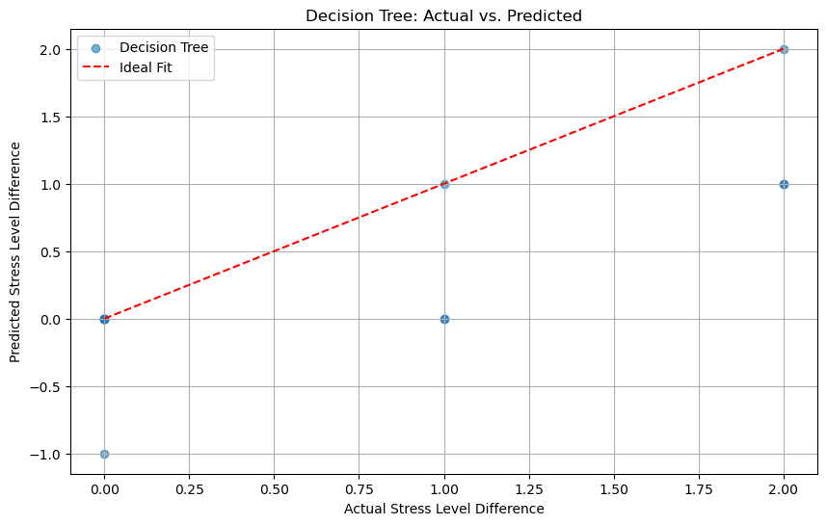
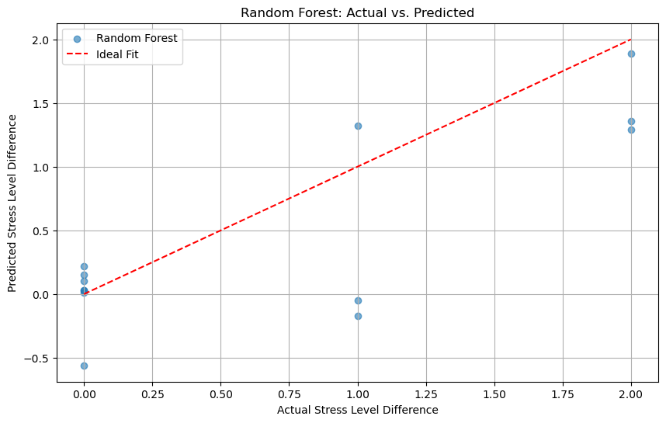
REGRESSION ANALYSIS
Linear regression
Decision tree
Random forest
Linear Regression Results:
Mean Squared Error: 0.26
R² Score: 0.62
Decision Tree Results:
Mean Squared Error: 0.38
R² Score: 0.43
Random Forest Results:
Mean Squared Error: 0.30
R² Score: 0.56
Best performing model is Linear Regression as we get R² Score: 0.62

Slide 11
CONCLUSION
Pearson Correlation Coefficient: 0.79
The p-value is less than 0.05.
We reject the null hypothesis. There is a significant relationship between travel duration and stress level differences.

