Slide 1
BERTopic
a short introduction

Slide 2
Motivation
Compared to classical methods (LDA, NMF) that represent docs as „bag-of-words“: embedding-based clustering approach
Difference to previous embedding-based approaches: How to represent cluster? Words close to cluster centroid VS BERTopic: modified TF-IDF

Slide 3
Algorithm
Phase 1:
Document embeddings via a pretrained LM (many diff. LM work -> speed vs perf)
Phase 2:
Reduce embedding dim. (UMAP) & cluster documents s.t. semantically similar clusters (HDBSCAN)
Phase 3:
Extract topic representation of cluster with class-based TF-IDF
Data
Result: document clusters & topic representation

Slide 4
Details #1
Used LM: Sentence-BERT framework (SBERT) -> algorithm „scales“ with future/better LMs
Used cluster alg: HDBSCAN – hierarchical soft clustering approach -> allows unrelated docs to be assigned to no cluster (modelled as noise in the data) -> empirically shown: UMAP & HDBSCAN work well together

Slide 5
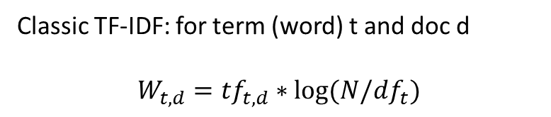
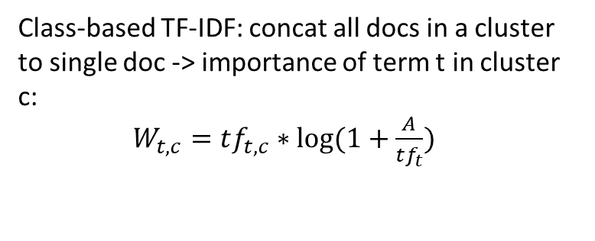
Details #2
Classic TF-IDF: for term (word) t and doc d
$$W_{t,d}=tf_{t,d}∗log⁡(N/df_{t})$$
Class-based TF-IDF: concat all docs in a cluster to single doc -> importance of term t in cluster c:
$W_{t,c}=tf_{t,c}∗log⁡(1+\frac{A}{tf_{t}})$
Avg #words per doc
Term-frequency, e.g. #{t in d}/#{words in d}
Inverse doc freq.: #docs/#{docs with t}
Frequency of term t in all clusters
Generate topic-word distributions for each cluster of documents;
Can achieve #topics=preset value BY merging least common topic with most similar topic (based on c-TF-IDF)

Slide 6
Experimental Setup
Uses OCTIS for comparison of algs (data, preprocessing, results)
Datasets: 20NewsGroups, BBCNew and Trump‘s tweets
Preprocess for first two: remove punctuation/stopwords/docs with #words < 5, lemmatization, lowercase all tokens
Compare BERTopic with different LMs and LDA, NMF, CTM, Top2Vec
Evaluation: topic coherence with NPMI [-1,1] and topic diversity with % of unique words for all topics [0,1] <-> are only an indicator of human judgement & running times

Slide 7
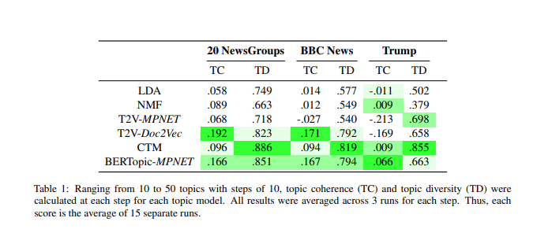
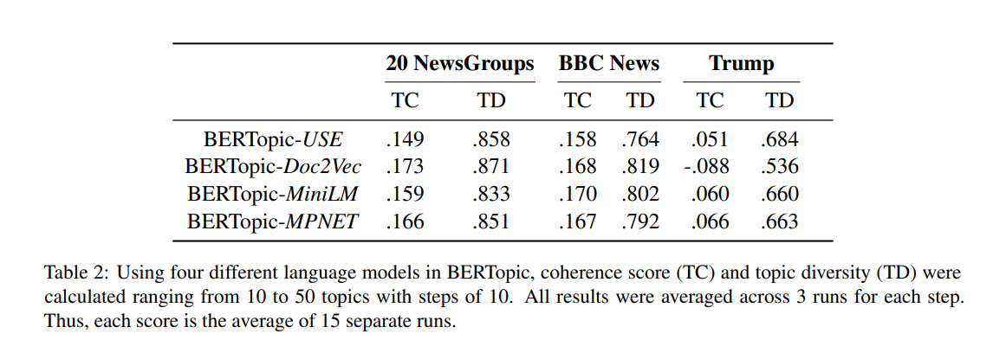
Results #1

Slide 8
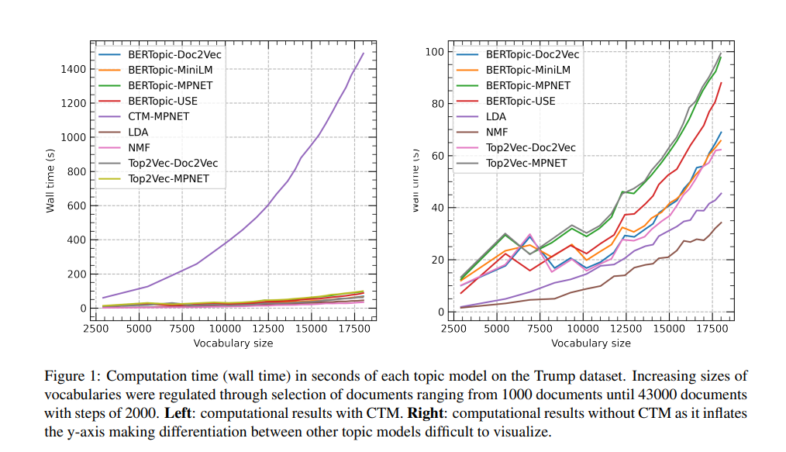
Results #2

Slide 9
Strengths/Weaknesses
+ | -
Competitive with all LMs used here Separation of embedding docs and representing topics Represent topics as distribution of words (via c-TF-IDF) | Assumes one topic per document Topic representation is with „bag-of-words“ approach VS contextual representation -> makes words describing a topic often similar

Slide 10
References
BERTopic: Neural topic modeling with a class-based TF-IDF procedure
https://arxiv.org/abs/2203.05794

