Slide 1
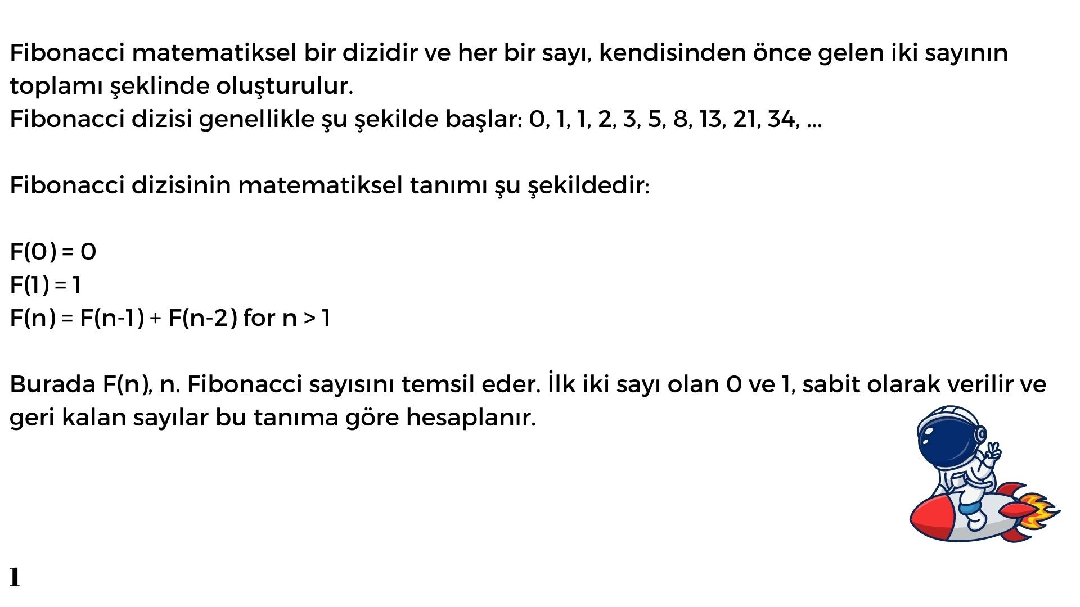
Bugbul_algoritma.ipynb - Colaboratory (google.com)

Slide 2
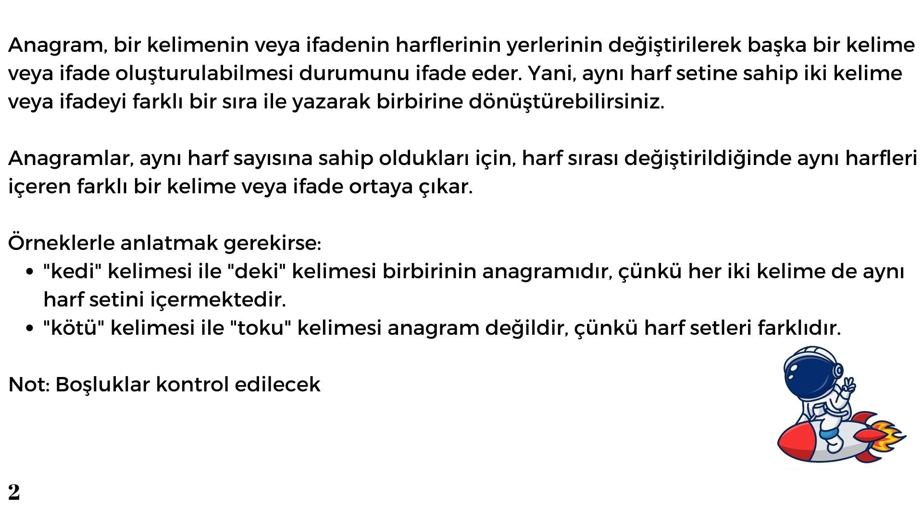
Bugbul_algoritma.ipynb - Colaboratory (google.com)

Slide 3
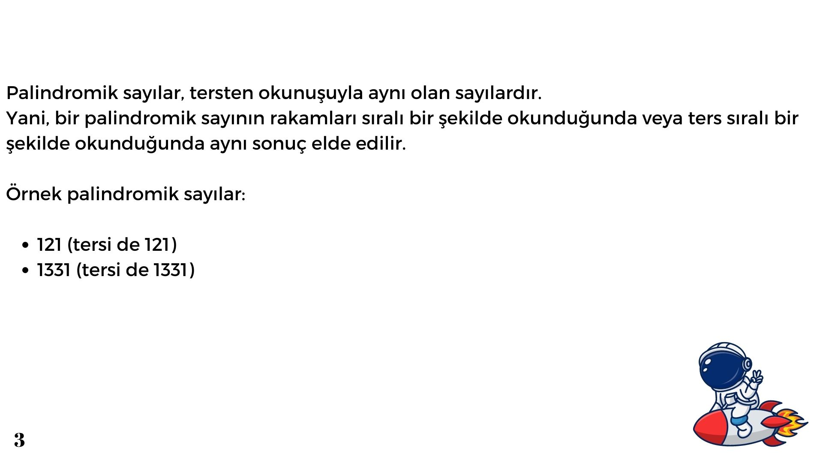
Bugbul_algoritma.ipynb - Colaboratory (google.com)

Slide 4
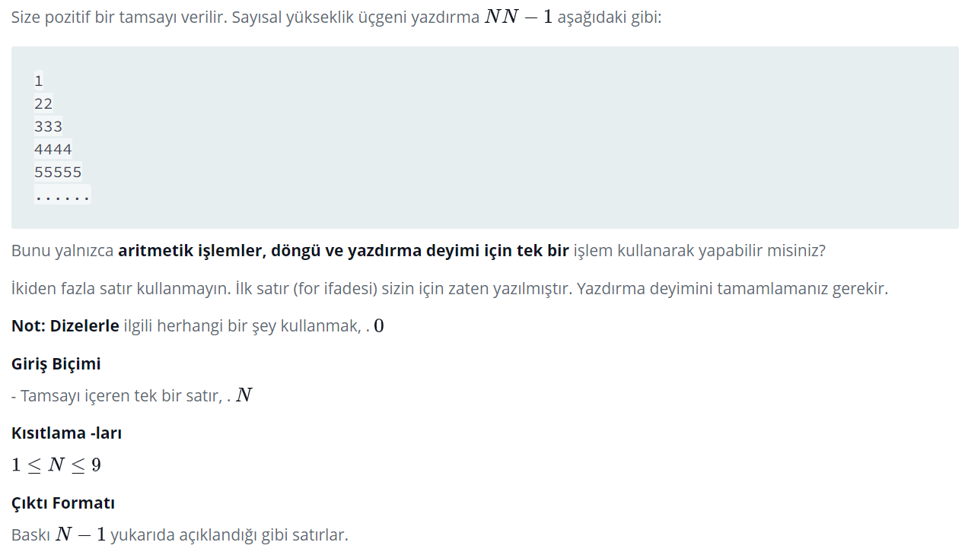
Bugbul_algoritma.ipynb - Colaboratory (google.com)

Slide 5
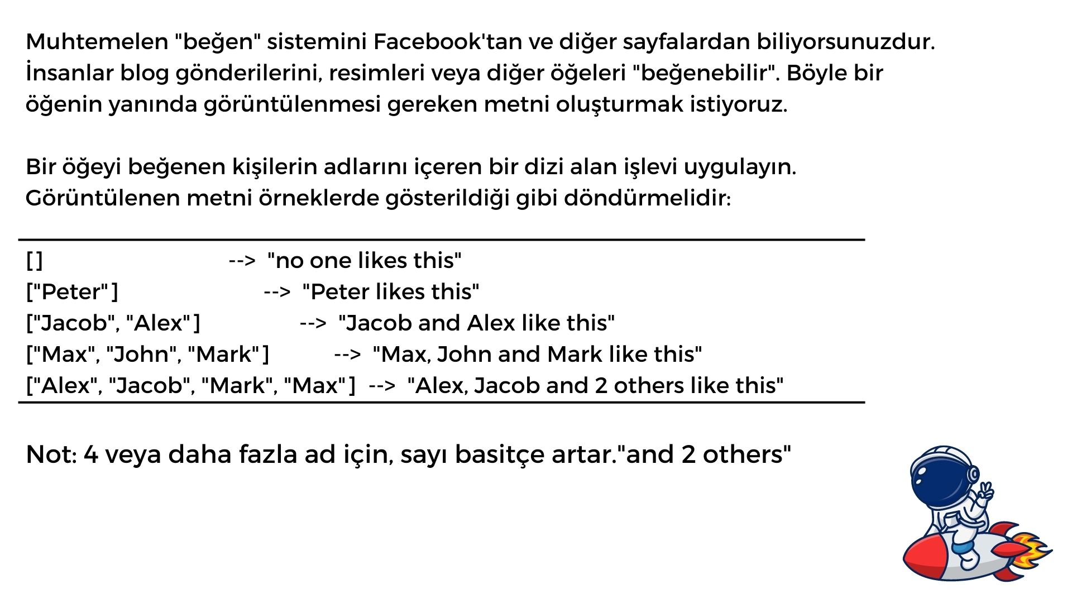

Slide 6
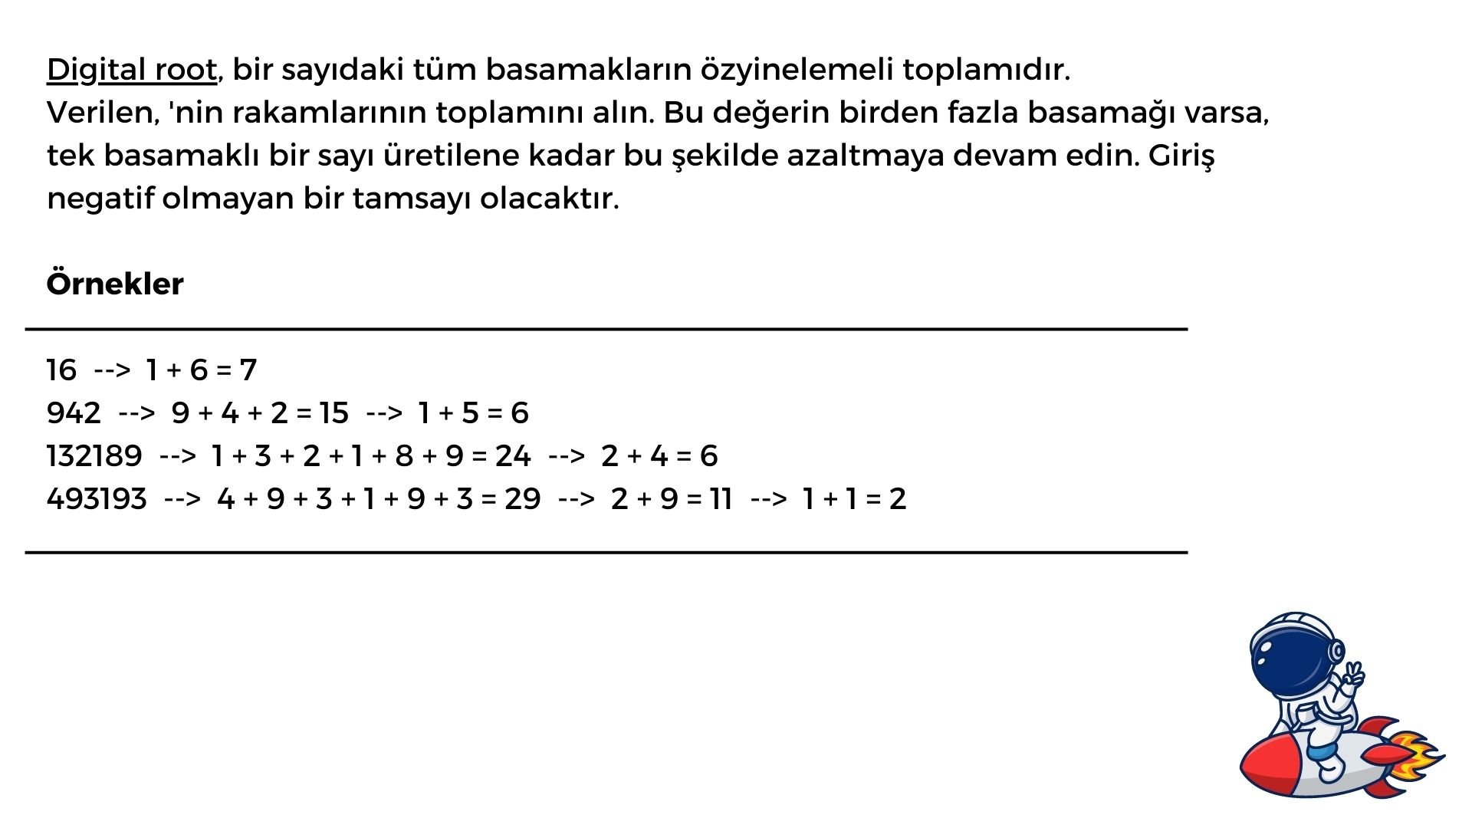

Slide 7
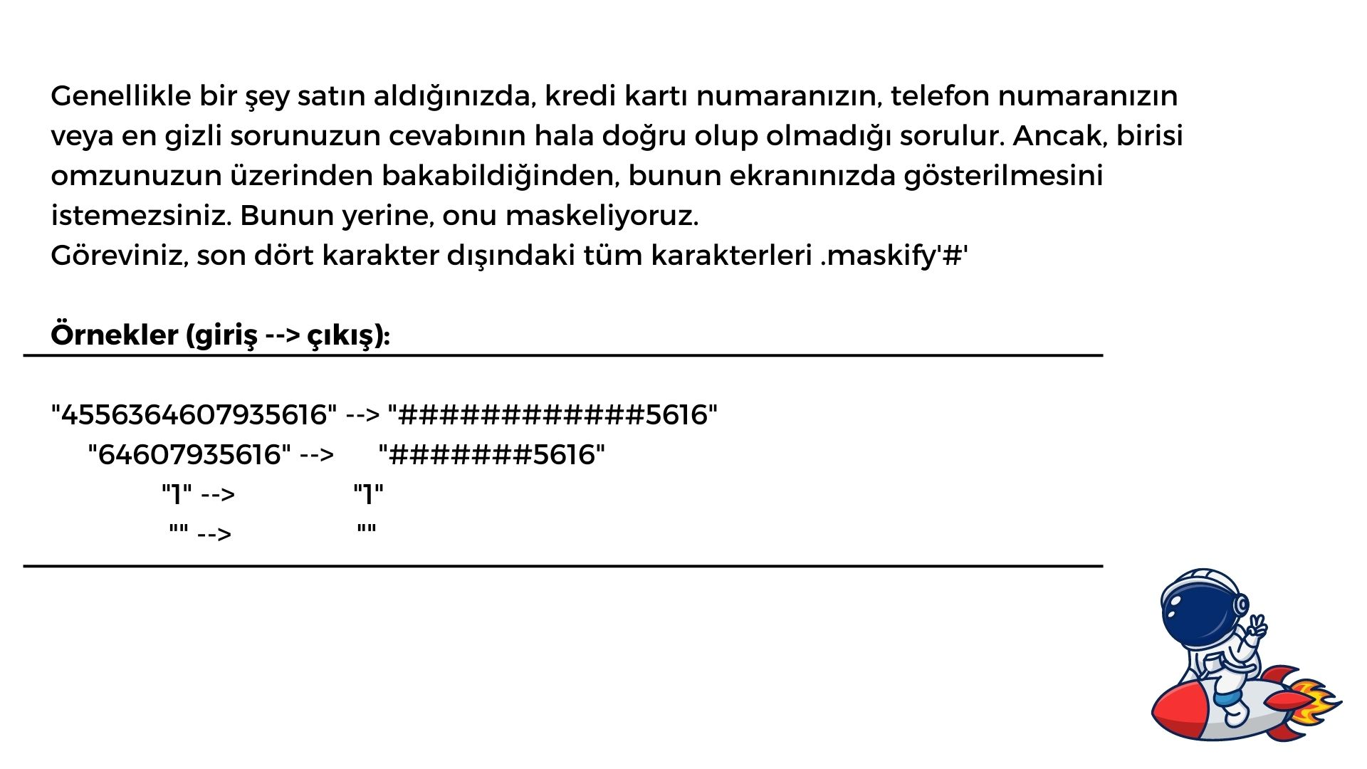

Slide 8
