Slide 1
Reddit pediction model
Bernard Kurka
December 20, 2018

Slide 2
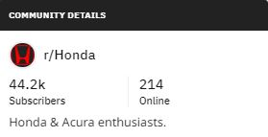


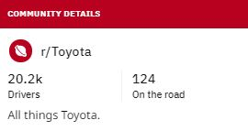
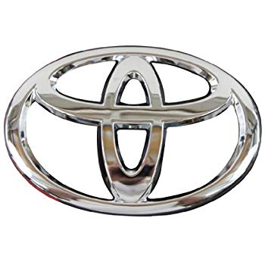
Problem:
Honda
Subreddit post
Predict
Toyota

Slide 3
Problem:
Honda
Subreddit post
Predict
Toyota
Stakeholder benefit:
Understand client`s preferences
Product improvement
More Sales
$$$

Slide 4
Data Gathering and Cleaning:
Loop through community posts
Storing in Data Frame
Data Cleaning
Using Reddit`s API
1,5 sleep
Json Dic
Saved data in csv
Duplicate rows
Special char
Double splace
Pandas
2 CSV files
Aprox 950 rows each.

Slide 5

Preprocessing:
Feature Engineering
Post title
Steam title and body words
PorterStemmer
LancasterStemmer
Post body
Post ups
Number of comments in a post
WordNetLemmatizer
Split Train and Test Subsets
Test subset with 25% of data.
No need to Stratify (classes are balanced).

Slide 6
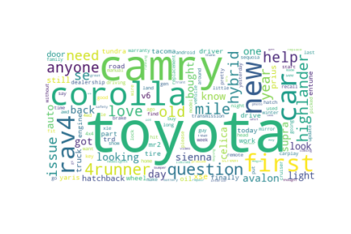
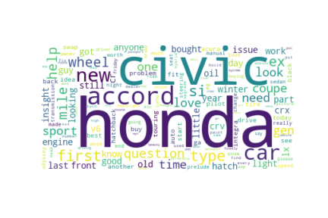
Exploring Data:
Most frequent words:
Toyota:
Honda:

Slide 7
Modeling:
Multinomial Naive Bayes classifier (Using CountVectorizer)
Honda and Toyota Words score impact:
~0.04 score reduction

Slide 8
Modeling:
Multinomial Naive Bayes classifier (Using CountVectorizer)
Honda and Toyota Words score impact:
~0.4 score reduction
Scored the model with 4 diferent steamming:

Slide 9
Modeling:
Multinomial Naive Bayes classifier
Choosing features:

Slide 10
Modeling:
Choosing model:
Most models overfit.
Similar scores in test and cross validation.
Chose Random forest because of similar test scores.
* GridSearchCV score

Slide 11
Modeling:
Tuning Hyper parameter:
Max_depth = 68,
Other parameters set as default

Slide 12
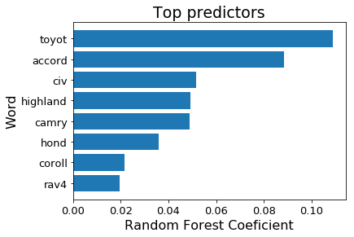
Modeling:
Random Forest biggest feature coefficients:

Slide 13
Best sellers cars vs best predictors:
2017 best sellers are among the best predicting features.
CR-V Honda´s best selling Honda car, it´s coefficient rank is 14.

Slide 14
Improvements:
Business insights:
Further examination if there is a difference in CR-V and Accord client engagement / satisfaction.
Discuss and evaluate if model can be used to predict 2018 best sellers.
Model improvements:
Include ‘Hond’ and ‘Toyot’ as stop words.
Compare Naive Base coefficientes with Random Forest.
Run Sentiment analysis in posts and group by car name.

