Slide 1
FINAL COURSE PROJECT
QoR Surrogate Modeling
for Early HLS-to-ASIC
Decision Making
Early signal
→
Backend QoR
Can final OpenROAD QoR be estimated from information
available before backend physical implementation?
Berk Yonder - 10994918
Advanced Computer Architectures
Politecnico di Milano
Instructor: Prof. Christian Pilato
2026
Notes:
Good morning. This project asks a practical early-design question: before running complete backend physical implementation, can we estimate final ASIC quality of results well enough to make better decisions? The focus is not on replacing OpenROAD. It is on ranking, filtering, or prioritizing HLS configurations before committing expensive backend effort.

Slide 2
02
Motivation: reduce backend effort, not replace physical design
Design-space exploration produces many HLS configurations, while final place and route is the expensive stage.
Question
Intended use
Can early features predict
final area and timing well enough
to choose backend candidates?
•
rank candidate configurations
•
filter weak options early
•
prioritize backend runs
Surrogate = Decision support. OpenROAD remains the final physical-design authority.
Advanced Computer Architectures | Politecnico di Milano
2 / 10
Notes:
The motivation is not to eliminate the backend flow. Complete OpenROAD implementation provides the labels and remains the authority for final physical design. The intended value is earlier decision support: use a predictor to rank, filter, or prioritize configurations, so expensive backend runs can be focused on the most informative or promising candidates.

Slide 3
03
Implemented source-to-backend workflow
Parsing and modeling stages are implemented as Python scripts in the repository.
PolyBench/C
kernels
→
Static
features
→
Bambu/HLS
reports
→
Yosys
statistics
→
OpenROAD
QoR labels
→
Regression
models
Static parsing: extract_static_features.py | Yosys: parse_yosys_reports.py | OpenROAD: parse_openroad_reports.py
Modeling: train_baseline.py · train_feature_engineered_models.py · train_rigorous_feature_models.py · train_ablation_models.py
Only features available before final OpenROAD are used for the main surrogate inputs.
Advanced Computer Architectures | Politecnico di Milano
3 / 10
Notes:
This is the complete implemented workflow. It begins from PolyBench C kernels. Lightweight static parsing extracts code-structure counts; Bambu contributes scheduling, structural, resource, and estimated-area metrics; Yosys adds synthesis structure; and OpenROAD reports provide final labels. The repository separates parsing, preprocessing, model training, and physical-effect analysis into scripts rather than hiding the process in a notebook.

Slide 4
04
Dataset progression: 864 to 79 to 18
864
79
18
18 runs
→
→
early Bambu/HLS configurations
usable Yosys-statistics configurations
complete OpenROAD QoR labels
17 @ 10 ns
+ 1 aggressive-clock
The supervised regression problem is deliberately small because final backend outputs are the expensive labels.
Interpret results as an initial feasibility study - not a production predictor.
Advanced Computer Architectures | Politecnico di Milano
4 / 10
Notes:
The dataset progression defines the scope of the evidence. The project generated 864 early Bambu HLS configurations, but only 79 had usable Yosys statistics, and 18 had complete final OpenROAD labels. The main backend subset has 17 benchmark-diverse runs at 10 nanoseconds plus one aggressive-clock run. The shrinking dataset reflects the increasing cost and complexity of moving through synthesis and backend implementation.

Slide 5
05
Early inputs, final targets, and leakage prevention
Valid pre-OpenROAD feature groups
Prediction targets
•
configuration: clock, dataset size, memory policy, DSP, optimization
Final ASIC area
Critical-path delay
Total power (exploratory)
•
static C: lines, loops, branches, accesses, operations
•
Bambu/HLS: control steps, states, area estimate, registers, mux area
Leakage rule
•
Yosys: wires, wire bits, cells, memories, processes, modules
Post-routing: analysis only.
Violations, DEF wirelength,
route guides, DRC.
•
derived ratios from the same early information
Advanced Computer Architectures | Politecnico di Milano
5 / 10
Notes:
The main modeling inputs are intentionally limited to information available before final OpenROAD. This includes configuration, static source-code counts, Bambu HLS features, Yosys statistics, and ratios derived only from those features. The targets are final area and critical-path delay, with total power treated as exploratory. Post-routing descriptors are valuable for analysis, but including them in an early model would leak backend information.

Slide 6
06
Validation tests generalization to unseen benchmark kernels
Models evaluated
Main evaluation: GroupKFold by benchmark
•
Linear / Ridge / Elastic Net
TRAIN
TEST
•
Random Forest / Gradient Boosting
one complete
benchmark kernel
all non-held-out benchmark kernels
•
Gaussian Process / PLS / PCA variants
•
Feature-group comparisons
Random splits can share benchmark-specific structure across train/test and therefore look optimistic.
NMAE = MAE / mean(|y|) → normalized prediction error, not accuracy
Advanced Computer Architectures | Politecnico di Milano
6 / 10
Notes:
Several validation settings were explored, but the reported headline evaluation is GroupKFold by benchmark. Each validation fold holds out a complete benchmark kernel. This is more demanding and more realistic than a random split, because random train and test partitions can share benchmark-specific structure. The metric is MAE normalized by the mean absolute target value. It is normalized error, not accuracy.

Slide 7
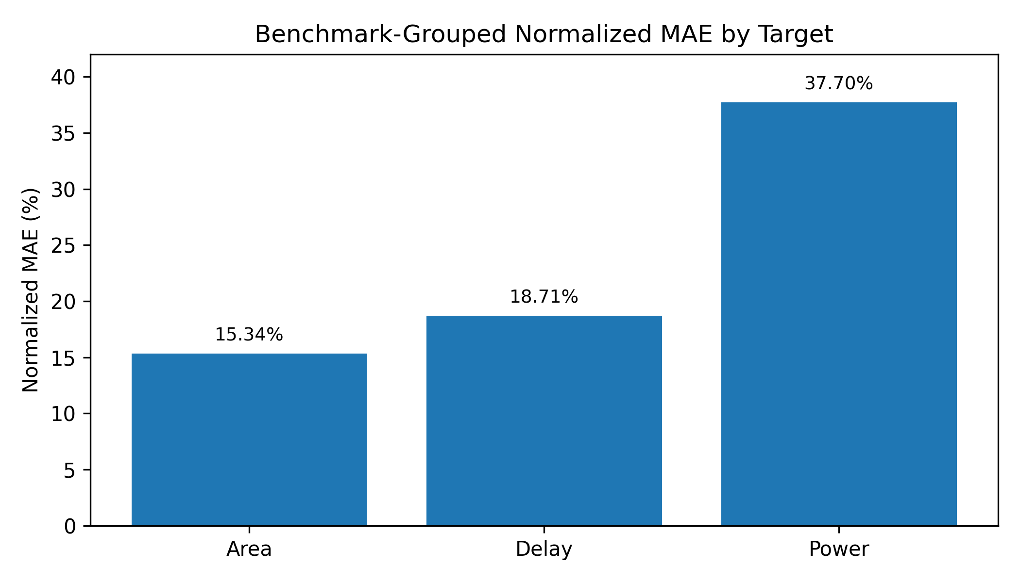
07
GroupKFold results: area strongest, power exploratory
15.34%
18.71%
37.70%
Area NMAE
MAE: 6637.11
Delay NMAE
MAE: 0.763 ns
Power NMAE
MAE: 0.0157 W
Best setup
Elastic Net
raw pre-OpenROAD
Elastic Net
derived ratios
Elastic Net
Yosys-only
Report Figure 1 - normalized MAE
Power: exploratory - skewed and clock-sensitive.
Advanced Computer Architectures | Politecnico di Milano
7 / 10
Notes:
These are the headline results under benchmark-grouped validation. Final ASIC area is the strongest target: Elastic Net with the raw pre-OpenROAD feature matrix achieves 6,637.11 MAE and 15.34 percent NMAE. Delay is promising at 0.763 nanoseconds and 18.71 percent NMAE using derived ratios. Power has 37.70 percent NMAE using Yosys-only features, but it must remain exploratory because its distribution is skewed and clock-sensitive.

Slide 8
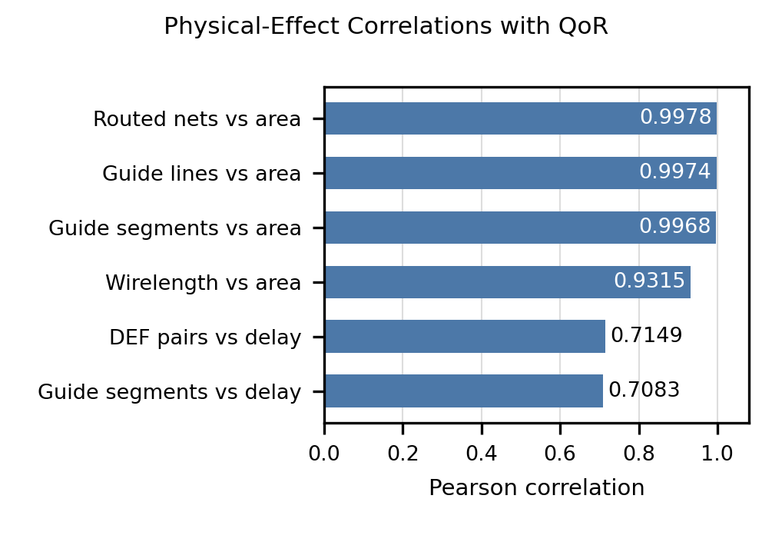
08
Physical effects: post-routing analysis only
Observed artifacts and closure
18 DEF + route guide + DRC reports
Setup / hold / max-slew: 0 violations
Max capacitance: 3 total, 2 max/design
Selected correlations
Area: routed nets 0.9978 · guide nonempty 0.9974
Area: guide segments 0.9968 · approx. wirelength 0.9315
Delay: DEF pairs 0.7149 · guide segments 0.7083
Report Figure 2 - post-routing correlations
Wirelength is Manhattan-distance approximation from DEF coordinate sequences - not official router wirelength. DRC: 12 clean/empty, 6 possible violations, 7 keyword hits (max 2).
Advanced Computer Architectures | Politecnico di Milano
8 / 10
Notes:
The report also analyzes physical effects after implementation. Every OpenROAD run had a final DEF, route guide, and DRC report. No setup, hold, or maximum-slew violations were found, while maximum-capacitance violations totaled three. The correlation figure shows strong selected relationships between routing complexity indicators and final area, with moderate selected relationships to delay. These are explanatory observations only. They cannot be early inputs because they exist only after routing.

Slide 9
09
Limitations define the next experiments
Current limitations
Most useful next steps
•
only 18 complete OpenROAD labels
•
add backend labels systematically across configurations and constraints
•
one aggressive-clock run and limited power diversity
•
select runs with active learning or uncertainty sampling
•
no systematically measured wall-clock speed-up
•
improve static features with AST / LLVM analysis
•
static extraction is lightweight pattern-based parsing
•
enrich Yosys and pre-routing complexity proxies
Power: use transformations, robust models, clock-normalized targets, or separate clock regimes.
Advanced Computer Architectures | Politecnico di Milano
9 / 10
Notes:
The strongest limitation is the small labeled backend subset. That also makes fold-to-fold behavior sensitive, particularly for power. Runtime and speed-up were not systematically measured, so the project does not claim a measured acceleration. The next experiments are straightforward: add systematically sampled backend labels, use active learning or uncertainty sampling, improve static code analysis with AST or LLVM methods, and create pre-routing proxies for routing complexity.

Slide 10
10
Conclusion: useful early signal, measured scope
A complete, reproducible source-to-backend modeling pipeline was implemented.
1
Useful early signal
2
Realistic evaluation
3
Appropriate scope
Area: 15.34% NMAE
Delay: 18.71% NMAE
GroupKFold holds out
complete benchmarks
Feasibility study;
not a replacement for OpenROAD
Main next step: more diverse OpenROAD labels for robustness.
Advanced Computer Architectures | Politecnico di Milano
10 / 10
Notes:
To conclude, the project delivers a complete source-to-backend workflow and establishes initial feasibility for early prediction of final area and timing. The evidence is strongest for area, promising for timing, and exploratory for power. The benchmark-grouped setup makes the result more meaningful than a random split. The key next step is not a more complicated model first; it is collecting more systematic and diverse OpenROAD-labeled data.

