Slide 1
Movie Rating System
PRESENTED BY:
Omkar Reddy Seelam
Rishabh Berlia
Shivasankar Gunasekaran

Slide 2
OVERVIEW
An online Movie Rating System as a web-application using Spring MVC
Users can view/give and ratings/reviews to movies.
Features like filtering based on Genre and Year of release could be done and sorting based on the rating are available.

Slide 3
USE CASES IMPLEMENTED
User can Sign-up in the system depending on his/her role
User can log-in/log-out to/from system
The User can Rate/Review a Movie
The Critic can Request to Add a new Movie
The Admin/Moderator can Add a new Movie or approve a Critic’s request
The User can Delete their own review
The User can Flag a Review
The User can Delete the flagged review

Slide 4
DESIGN PATTERNS
Factory Method
Proxy
Singleton
MVC (Architectural Pattern)

Slide 5
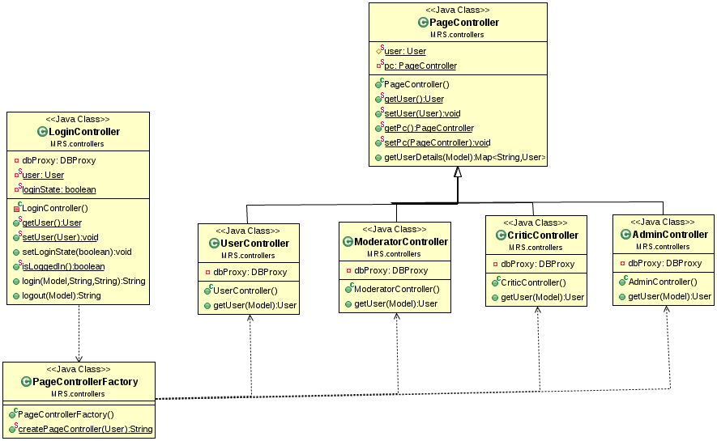
Factory Method Design Pattern for LoginController

Slide 6
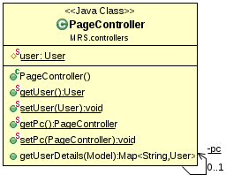
Singleton Design Pattern for PageController

Slide 7
FUTURE DESIGN PATTERNS
Memento : To save user preferences
Flyweight : To store pictures of movie items as flyweight objects.

Slide 8
ANTI PATTERNS
BLOB
Initially had a Single Controller in the Class Diagram
Separated the controller into different controllers related to specific class/task.

Slide 9
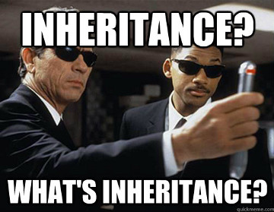
THANK YOU

