Slide 1
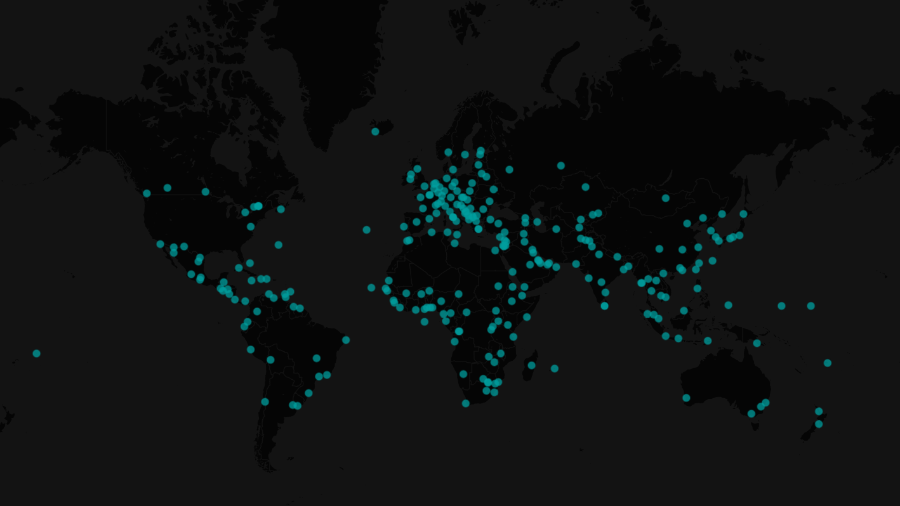
IMPACTHACK 2020

Slide 2
THE ROOM WHERE IT HAPPENS:
US DIPLOMACY ACROSS THE GLOBE

Slide 3
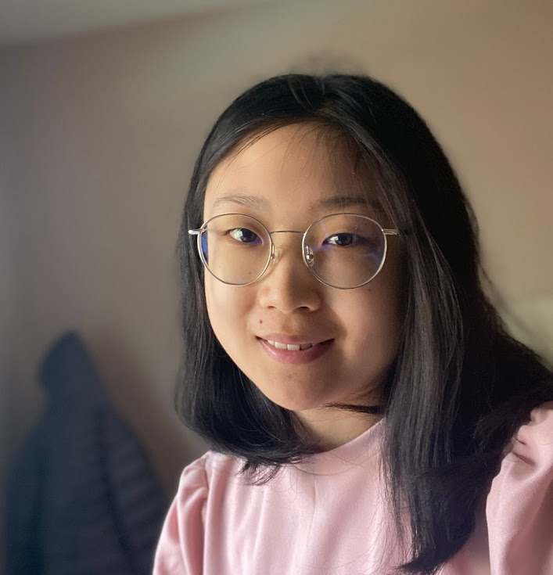
Background
Application:
https://sfansf.shinyapps.io/us-diplomacy/
Portfolio:
https://sfan95.github.io/
Connect with me:
https://www.linkedin.com/in/sherryfansf/
https://github.com/sfan95
sherrysnowf@gmail.com

