Slide 1
AirBnB
Berlin
- Varinja Hartmann -

Slide 2
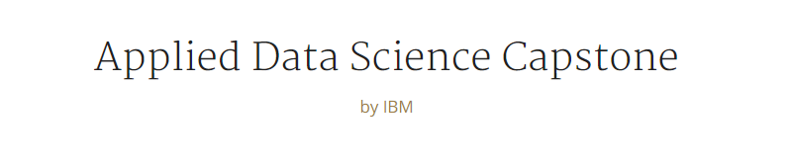
For week 1, you will required to submit the following:
A description of the problem and a discussion of the background. (15 marks)
A description of the data and how it will be used to solve the problem. (15 marks)

Slide 3
A description of the problem and a discussion of the background
Problem: Airbnb Prices – What determines the Airbnb price?
Imagine you are thinking about renting out your apartment on Airbnb from time to time. But you don’t know what to ask for.
What variable determines the most the price of rent of an Airbnb? Bedrooms, review scores, the neighborhood, etc.?
Can you predict the price for each Berlin neighborhood using listing descriptions?
  Visualize the data in a heatmap.
  Predicting in which area I could get my highest Airbnb rate.
  In the neighborhood you have selected what kind of things are there to see? (use Foursquare)
  My neighborhood is Steglitz-Zehlendorf

Slide 4
A description of the data and how it will be used to solve the problem
Data Acquisition and Cleaning
Airbnb Prices, Neighbourhoud Ratings from Inside Airbnb Dataset: http://insideairbnb.com/get-the-data.html
Using: http://data.insideairbnb.com/germany/be/berlin/2019-07-11/visualisations/listings.csv
  In total 24395 rows and 16 features
Duplicate, highly similar features were dropped
Cleaned data contains 24 features
https://eu-gb.dataplatform.cloud.ibm.com/analytics/notebooks/v2/05736402-c2de-4e09-bc50-0f5962bea4a0/view?access_token=99c4e5e8fb78d961c59eaf40106ebbbc52936f00a587953719b7c3c6864745dc

Slide 5
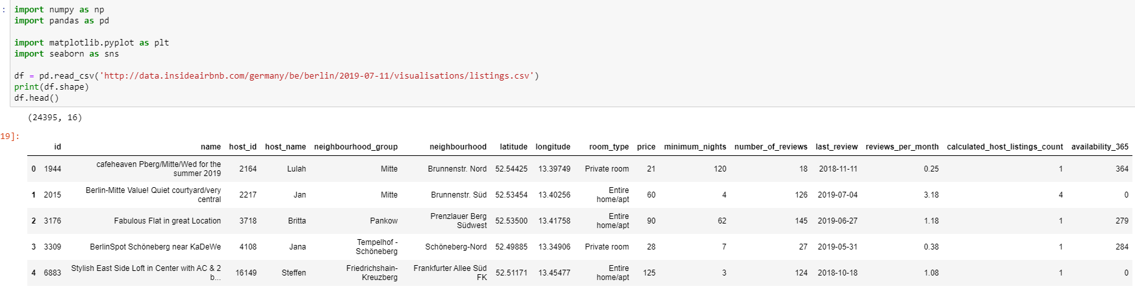
First Glance at the Data
The size of the dataset is 24395 rows and 16 columns
Lets check if id and host-id are unique.
For evaluating the price
  I will be using the categorical data neighbourhood_group and neighbourhood maybe also both latitude/longitude if the first are inconclusive.
  Room type
The column ‘Availability_365’ I will for now ignore as this is not important for my questions.

Slide 6
Week 2
Still in progress till the 30th. 10.2019
Please dont count this for week 1 – as not needed.

Slide 7
Capstone Project - The Battle of Neighborhoods (Week 2)
For the second week, the final deliverables of the project will be:
A link to your Notebook on your Github repository, showing your code. (15 marks)
A full report consisting of all of the following components (15 marks):
Introduction where you discuss the business problem and who would be interested in this project.
Data where you describe the data that will be used to solve the problem and the source of the data.
Methodology section which represents the main component of the report where you discuss and describe any exploratory data analysis that you did, any inferential statistical testing that you performed, if any, and what machine learnings were used and why.
Results section where you discuss the results.
Discussion section where you discuss any observations you noted and any recommendations you can make based on the results.
Conclusion section where you conclude the report.

Slide 8
A link to your Notebook:
The following link shows you my notebook and code:
https://eu-gb.dataplatform.cloud.ibm.com/analytics/notebooks/v2/16e59f11-ccff-4dea-9bb7-0edf32c3fad5/view?access_token=b60ad5ab434887f6de6c4de39f39ab0be892530ae1b1b6287705173bf39a6a1c

Slide 9
Business Problem:
In order to set a price for my Airbnb apartment I need to analyze the dataframe in look at the different features that may / may not impact the AirBnb price.
Data distribution for neighbourhood_group and room_type.
Price compared to neighbourhood_group and room_type.
How do reviews per month affect the Price?
How does the number of reviews affect the price for neighbourhood_group and room_type?
Linear Relation between sights (foursquare) and price – What can I see in the neighborhood where I found the best price-Airbnb rate?

