Slide 1
Face Mask Detection using Pytorch
EECS 220P
Runlongli
Date: 2021/03/07

Slide 2


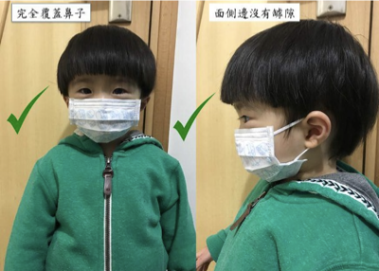
Dataset - Face Mask Detection
The COVID-19 epidemic is spreading all over the world during past two years.
Thus, some public place needs machines and algorithms to check if everyone wears mask properly. The Face Mask Detection dataset contains 853 images belonging to the 3 classes(wear masks, not wear masks, wear masks improperly). The face position information is recorded in the XML document. Because one image may contain several faces, in my test , dataset is divided into 2850 images for training and 1222 images for testing.
wear masks improperly
not wear masks
wear masks
Notes:
In the recent two years, the covid-19 is spreading all over the world. Thus, some public place needs machines and algorithms to check if everyone wears mask properly. The dataset I choose is related to it.
The Face Mask Detection dataset contains 853 images belonging to the 3 classes(wear masks, not wear masks, wear masks improperly).
The face position information is recorded in the XML document.
Because one image may contain several faces, in my test , dataset is divided into (two thousound eight hundred and fifty )2850 images for training and (one thousand two hundred and twenty two)1222 images for testing.

Slide 3
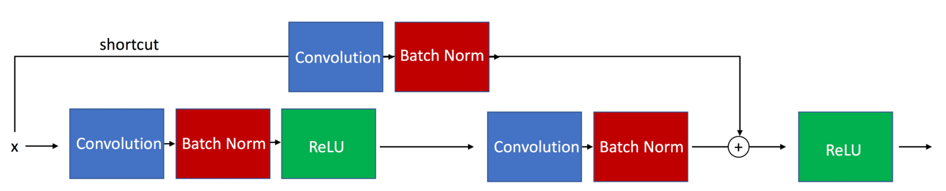
Difference Between AlexNet & ResNet
AlexNet
AlexNet neural network model is a high-capacity model that consists of five convolutional layers and three fully connected layers. The layer order is like below:
2 * convolutional layer-pooling layer
2 * convolutional layer
1 * convolutional layer-pooling layer
3 * fully connected layers.
ResNet
ResNet use skip connections, a technology which skips training from a few layers and connects directly to the output to solve the degradation problem associated with deep neural architectures. It has 2 residual blocks and one linear fully connected layers.
Notes:
AlexNet neural network model is a high-capacity model that consists of five convolutional layers and three fully connected layers. The first five were convolutional layers, some of them followed by max-pooling layers, and the last three were fully connected layers which can be used for image classification.It also uses ReLU activation function to achive faster speed.Each convolutional layer consists of convolutional filters and a nonlinear activation function ReLU. ReLU’s advantage is that it saves more time than tanh.
ResNet uses a new structure called skip connections, a technology which skips training from a few layers and connects directly to the output to solve the degradation problem. So the model uses several ResNet blocks in deep neural architectures. Below is ResNet structure.
There are two take ways from residential blocks: 1. Adding new layers would not hurt the model’s performance as regularization will skip over them if those layers were not useful. 2. If the new layers were useful, even with the presence of regularization, the weights or kernels of the layers will be non-zero and model performance could increase slightly. It has 2 residual blocks and one linear fully connected layers.

Slide 4
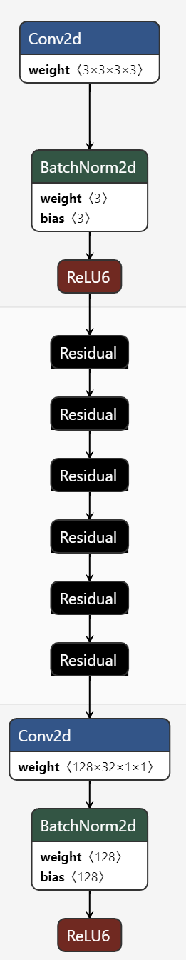
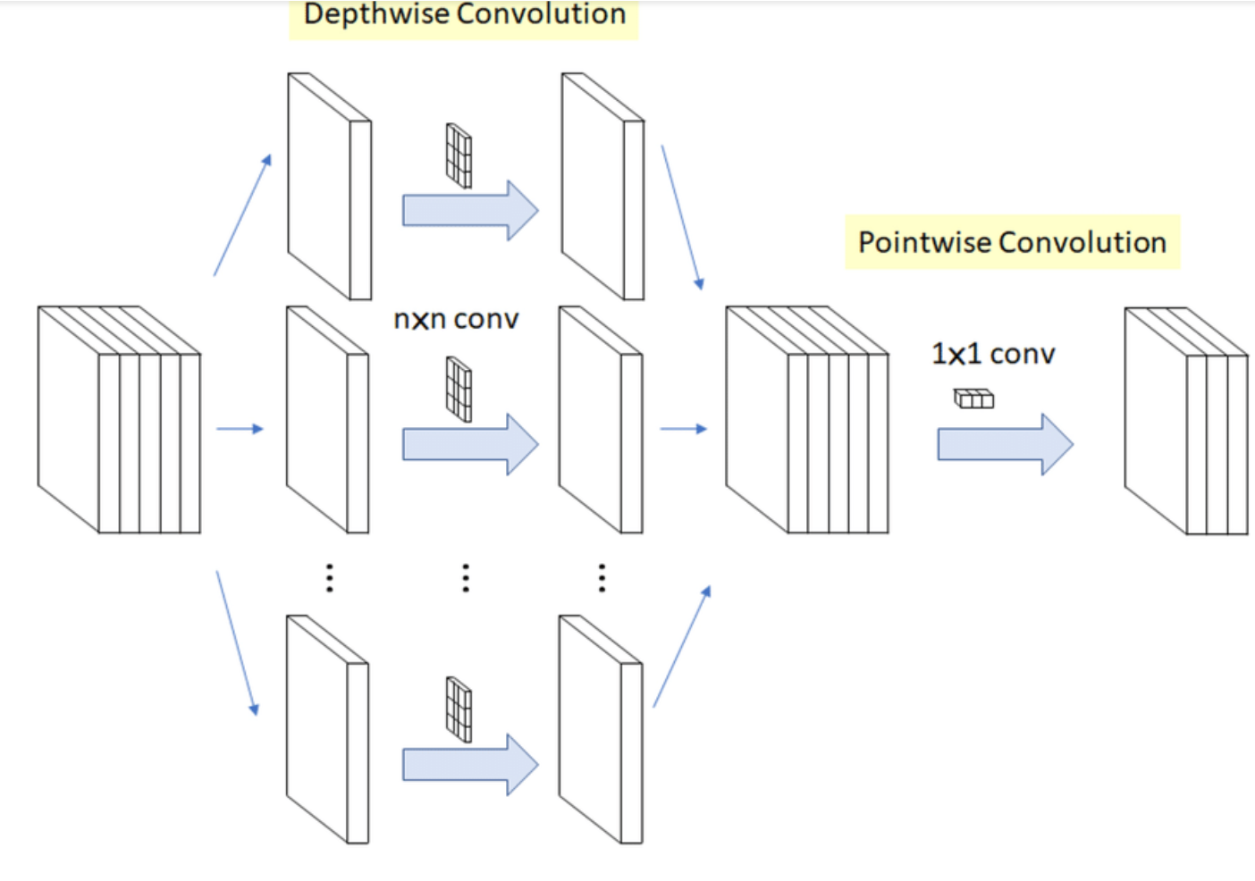
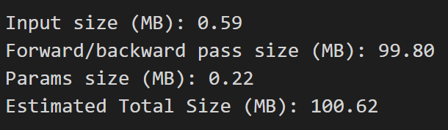
Difference Between MobileNet V1 & New Net
MobileNet V1
Compared with common neural networks, MobileNet V1 is a small, low-latency, low-power model which has more use cases like mobile devices. It is a lightweight neural network based on pipeline structure, using Depth wise Separable Convolution to build the model. It has 13 depthwise Separable layers and one average pooling layer.
Combined Net
Compared with MobileNet V1, I add the residual connection to reduce the degradation probelm and achive better performance. It uses 6 residual blocks, and each block uses depthwise separable convolution.
Notes:
Compared with common neural networks, MobileNet V1 is a small model which has more use cases like mobile devices.It uses Depth wise Separable Convolution to build the model. The depthwise separable convolution deals the spatial and depth dimension which can effiectively reduce the computation complexity. With two hyperparameters, Width Multiplier α and Resolution Multiplier ρ, developers can choose the appropriate model based on their application and resource constraints.
And then I want to discuss about New net which combines the MobileNet V1 and ResNet
Compared with MobileNet V1, I add the residual connection to reduce the degradation probelm and achive better performance. It uses 6 residual blocks and in each block uses depthwise separable convolution to reduce complexity.
As we can see in the image, it costs less space than MobileNetV1.

Slide 5
Results
Name-Model | LR | Activation Function | epoch | inference Time | Training Time | accuray | Model Size
AlexNet | 0.01 | Adam | 100 | 20.67min | 20.67min | 77.55% | 226.27MB
ResNet | 0.01 | Adam | 100 | 19.13min | 19.13min | 93.50% | 13.25MB
MobileNet V1 | 0.01 | Adam | 100 | 27.96min | 27.96min | 94.85% | 137.06MB
Combined Net | 0.01 | Adam | 100 | 25.68min | 25.68min | 95.46% | 100.62MB
Notes:
Here is the results of testing those four models on Face Mask Detection using Pytorch. As we can see the learning rate is set as 0.01 and the Activation Function is Adam because it can have better performance in tests. In the four models, Combined Net achieved higher accuracy ninety five percent and relatively shorter time than MobileNet V1 ,also it has smaller model size.

Slide 6
Conclusion
During this month, I learned three different neural network models and used Pytorch to realized their application on face mask detection dataset. In the final project, I combined the ResNet and the MobileNet depthwise structure and realized a model which has higher accuracy and faster training speed. Because the new model uses residual connection to reduce degradation problem like ResNet, also it uses depthwise struecture which can reduce the computation time. Thus, it can achieve better performance.

