Slide 1
Project 1: Study of Electricity Prices in the United States
Group Members:
Gabriel Pivaro | Jocelyn Flores | Joshua Rhoads | Justin Chow | Kimberly Flores

Slide 2
Introduction of Resources
There has been a diversification of electricity sources in the past few decades. We are seeking out any other factors that have led to an increase or a decrease in the cost in the electricity depending on the location in the United States.
The US Energy Information Administration (EIA) is responsible for the data collection associated with the energy sectors in the US and covers data on coal, petroleum, natural gas, electric, renewable and nuclear energy. We used their API to pull data for energy costs and usage during the last 10 years. The EIA also reports the number of power plants in the US, their source of energy and where the plants are located.
The US Census Bureau is responsible for conducting its decennial census among over 130 surveys and programs a year with the ultimate goal of producing data regarding the public and the economy. We collected data from the Census Bureau in the form of CSV files for population density.
Notes:
Justin

Slide 3
Research Questions
Is there any correlation between Electricity prices vs Population?
Does the number of Power Plants correlate with the Electricity price?
Does Electricity Generation correlate to Electricity price?
Is Consumption related to Electricity prices?
There are states where electricity is regulated. Does being regulated by local agencies matter?
Notes:
Justin

Slide 4
How is Price Measured?
Price in the United States is commonly measured in Cents per Kilowatt-Hour (kWh).
The average US household consumes about 10,972 kWh a year (914 kWh per month)
Common Use Appliance Examples:
Central Air Conditioning: 3.0 kWh per hour (actively running)
Refrigerator: 150 kWh per month
Water Heater (Electric): 380 - 500 kWh per month
Electric Dryer: 2.5 - 4.0 kWh per load of laundry
Notes:
Justin

Slide 5
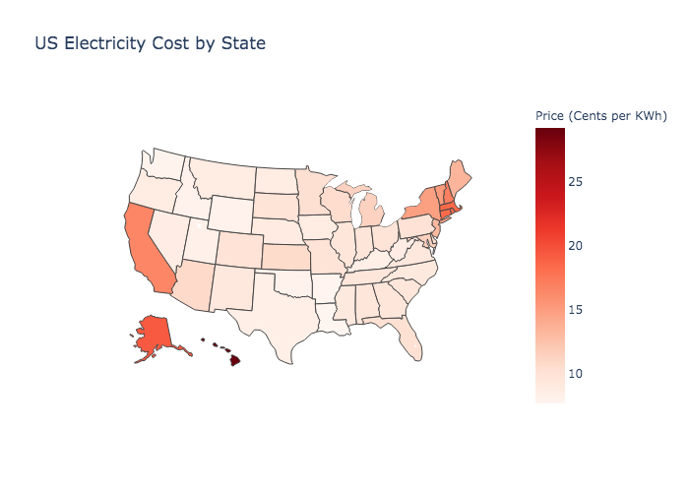
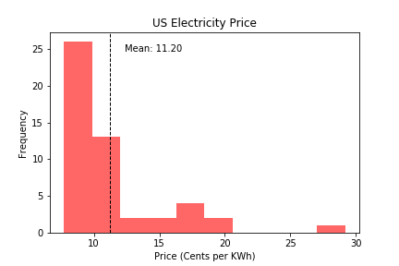
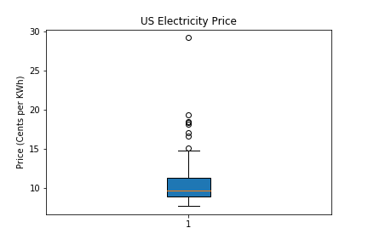
US Electricity Price Outlook
Notes:
Normality Test: 1.0689553471458046e-09 for price in 2018.
Price:
mean 11.2048
std 4.0581
min 7.7100
max 29.1800
Justin

Slide 6
Electricity Price vs. Population
IIs there any correlation between Electricity prices vs Population?

Slide 7
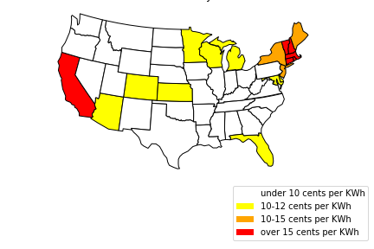
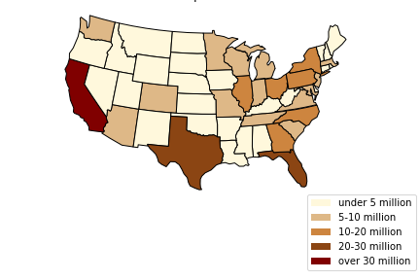
Electricity Price vs Population
2019
Alaska: under 10 cents per kWh
Hawaii: over 15 cents per KWh
Alaska: under 5 million
Hawaii: under 5 million
States with Most Expensive Electricity
Hawaii
Alaska
Connecticut
Most Populous States
California
Texas
Florida
Notes:
Justin

Slide 8
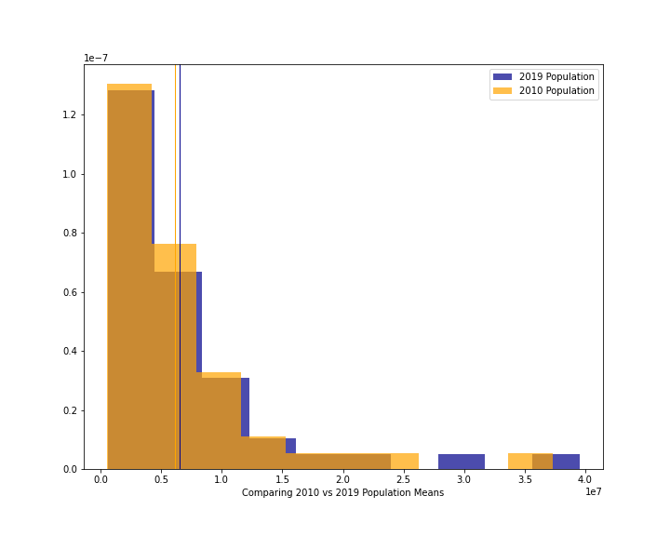
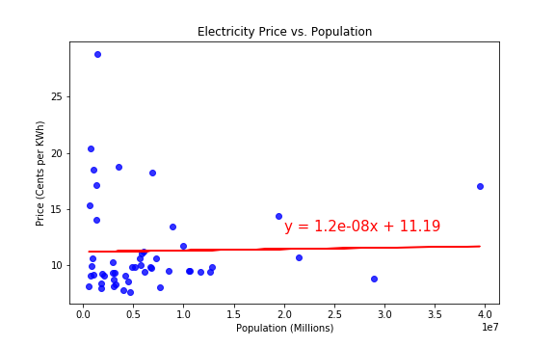
When compared statistically, comparing price vs consumption had very weak (r = 0.02) correlation.
Conclusion:
Population within a state does not affect electricity price within a state.
Notes:
Plainly speaking, the population does
Justin

Slide 9
Electricity Price vs. Number of Power Plants
Does the number of power plants correlate the electricity price?
Notes:
Gabriel script: Thanks Justin. Another aspect of Electricity price that we analyzed is the relationship between price and the number of power plants.

Slide 10
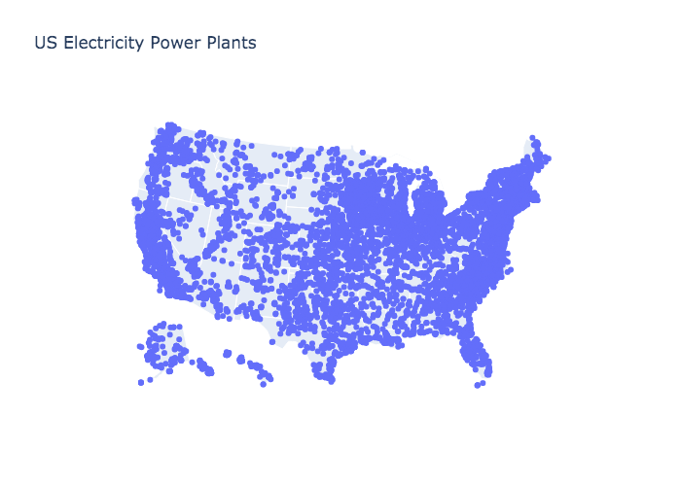
Price by State and Power Plant Distribution
Notes:
Gabriel script: Based on our data, the number of power plants in 2018 was 10964. On the left side, we show the Electricity price by state. On the right side, we show the power plant distribution over all the states.
We can see that there are power plants spread all over the US territory. Even isolated states like Hawaii and Alaska have power plants inside their territories.

Slide 11
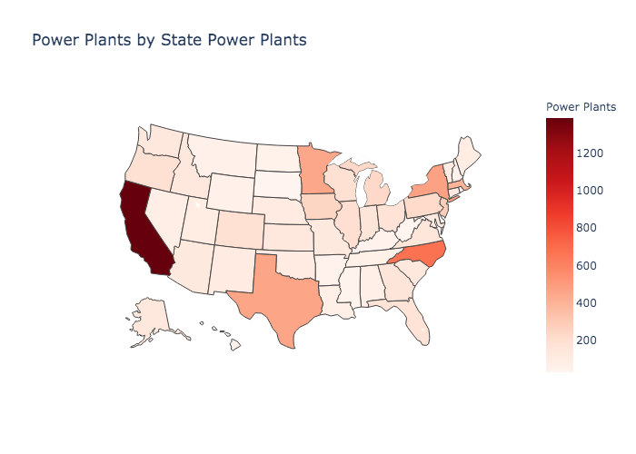
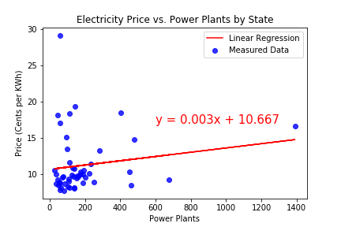
Number of Power Plants and Price
Notes:
Gabriel script: Our goal was to discover if the number of power plants in the state has any influence on the electricity price on that state. For that, we calculated the correlation between price and the number of power plants. We discover a weak correlation, given by a 0.16 correlation coefficient. The scatter plot with the linear regression results is shown on the right-side plot.
To our surprise, having more power plants does not mean have lower electricity prices. We have, for example, California, which has more than 10% of the total power plants in the US and is one of the states with the highest electricity price.

Slide 12
Price vs. Production
Does amount of electricity produced correlate to Electricity price?
Notes:
Gabriel script: Besides the number of power plants, we also consider the amount of electricity generated by each state.

Slide 13
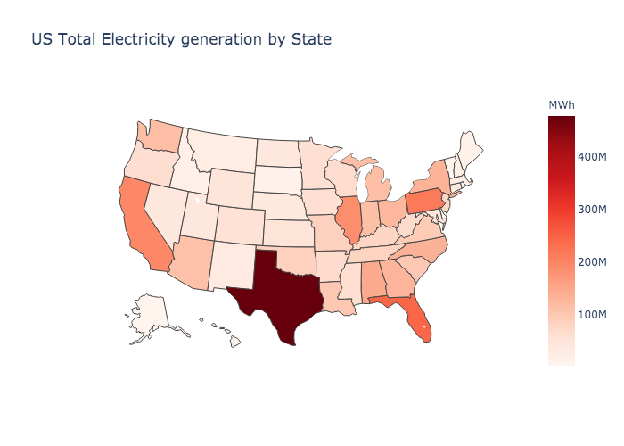
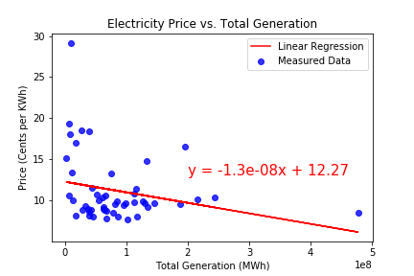
Price vs. Electricity Generation
Notes:
Gabriel script: Texas is the state with the highest amount of electricity generated, as can be seen on the left-side plot. Isolated states, like Alaska and Hawaii, have the lowest production amount. Again, we found a weak correlation of -0.25 between electricity generation and price.
In overall, production does not seem to affect the price within a state.
I will pass to Joshua, that will explain about Electricity Consumption and price.

Slide 14
Electricity Price vs. Consumption
Is the rate of consumption related to Electricity prices?

Slide 15
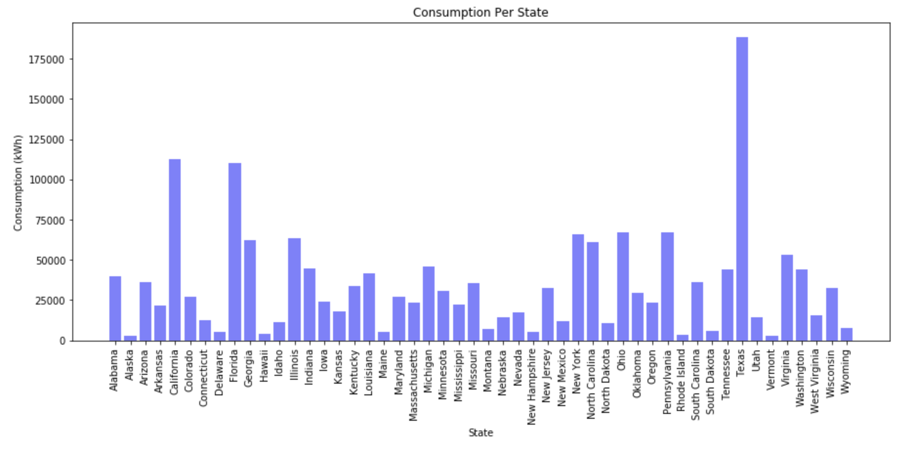
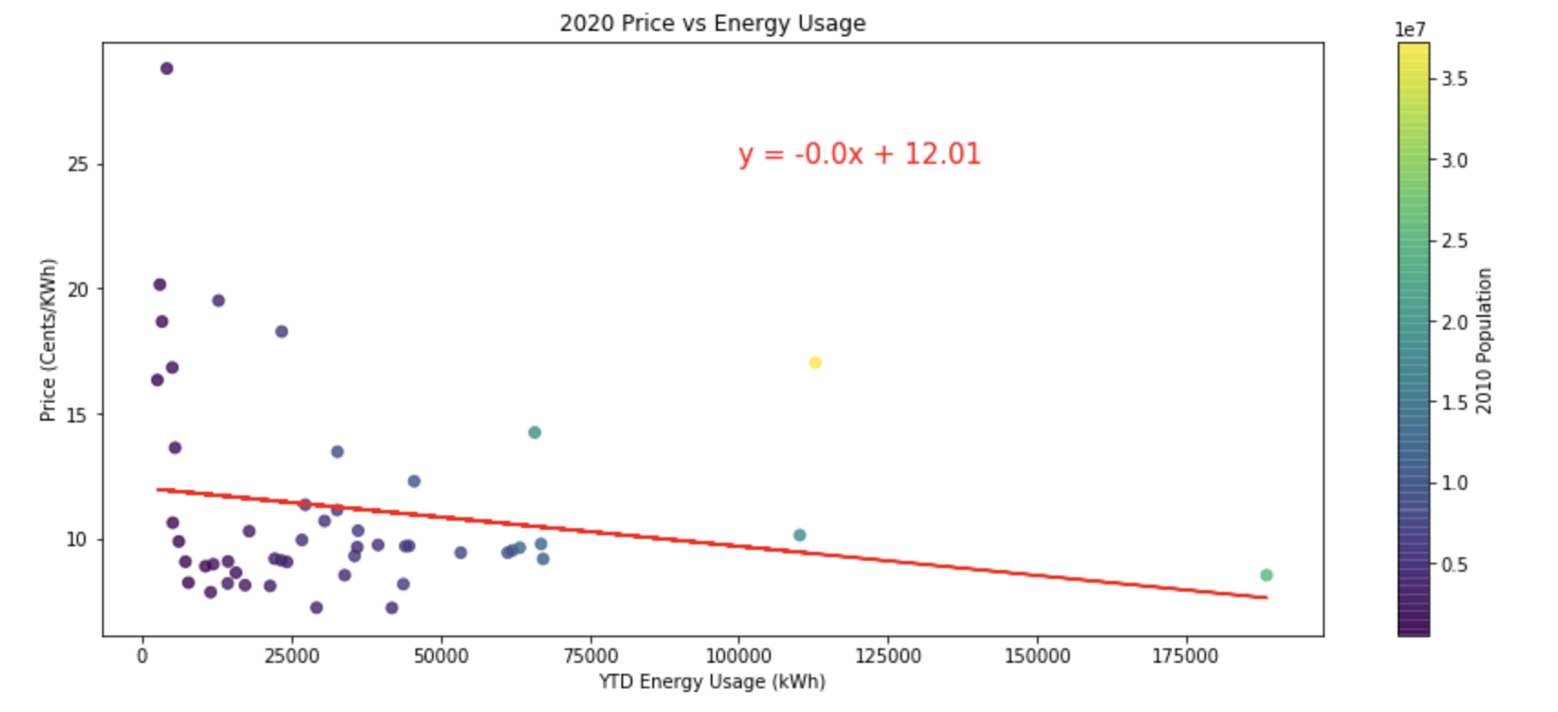
Electricity Consumption
Notes:
The correlation coefficient between 2020 YTD sales and Price for regulated states is -0.19
The correlation p-val between 2020 YTD sales and Price for regulated states is 0.19287191432442444
The consumption by state is shown in the left hand side of this slide. Showing Texas as the largest consumer and Vermont as the least. All but 3 states use less than 25,000 kWh. The right hand side shows the scatter plot of these with the price as the dependent variable showing little correlation between electricity consumption and price. Texas is on the far right bottom corner and has a low cost regardless of how high the consumption. This is likely due to outside factors like California, who uses a tier system to price the electricity. The more you move up in the tier system, the more you pay. Which is would explain why California has a higher population and a lower consumption than that of Texas.

Slide 16
Price vs. Regulation
Being regulated by local agencies matter?

Slide 17
Deregulation
In 1992, the passing of the Energy Policy Act opened the market for deregulation. The Energy Policy Act’s goals were to increase the use of clean energy and energy efficiency. It broadened choices for utilities and created new rate-making standards.
Deregulation allows the end customer the choice the energy provider and compare rates.
The following states are currently deregulated: California, Connecticut, Delaware, Illinois, Massachusetts, Maryland, Maine, Michigan, Montana, New Hampshire, New Jersey, New York, Ohio, Pennsylvania, Rhode Island, and Texas.
Did opening the market for competitors decrease the overall price that end customers pay for electricity?

Slide 18
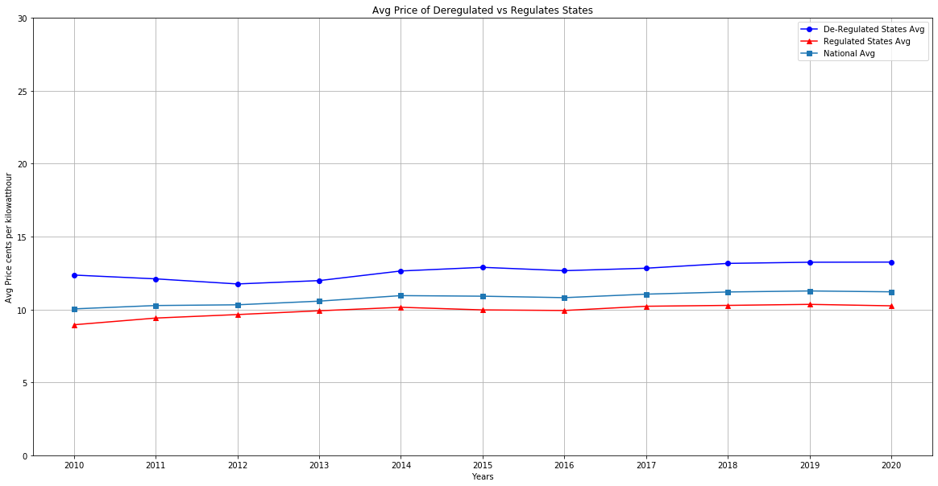
Deregulated vs. Regulated States
Notes:
The price difference between deregulated and regulated states stay consistent throughout the years, at around 2-3 cents per kilowatthour

Slide 19
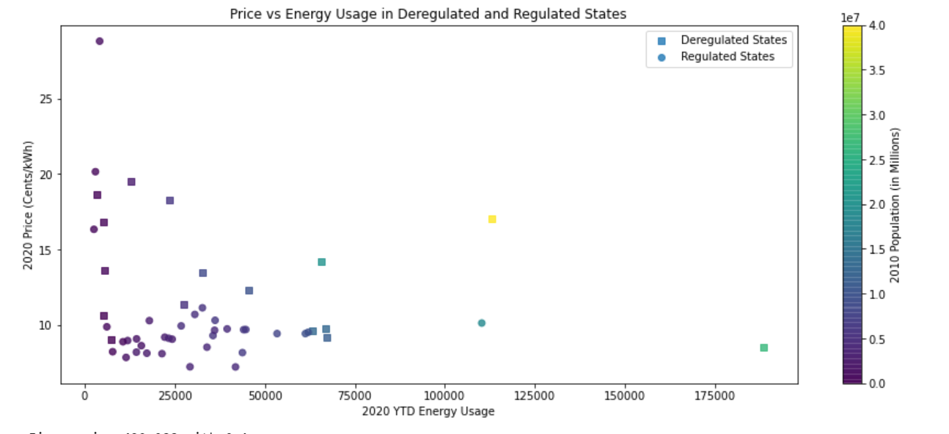
Deregulated vs. Regulated States
Notes:
Ttest_indResult(statistic=2.552795913721027, pvalue=0.015751149234073045)
Texas - Right bottom, green square: High usage but also large population and low cost
California: Yellow Square in middle. Higher cost, higher population and higher than the average usage
Florida, green circle: Low cost, higher usage, higher population.
New York, Turquoise square: higher end in terms of usage, pretty high population, higher than average price.
Lonely purple circle: Hawaii. Isolated in both the graph and in life. Lower usage, HIGHEST cost.
Regulated States: Highest cost: HI, AK, VT, WI, MN. 19.51 - 16.83. Lowest cost: TX, MT, OH, IL, PA. 8.52 - 9.77.
Hawaii's dependence on imported petroleum, much of which is used for electricity generation, contribute to Hawaii having the highest average retail electricity price for all sectors s of any state. 50% solar energy in 2018.
Texas is the largest energy-producing and energy-consuming state in the nation. The industrial sector, including its refineries and petrochemical plants, accounts for half of the energy consumed in the state. These graphs are including all sectors and not just residential.
Deregulated States: Highest cost: CT, RI, MA, CA, NH. 19.51 - 16.83. Lowest cost: TX, MT, OH, IL, PA. 8.52 - 9.77.

Slide 20
Conclusion

Slide 21
Conclusions and findings
Of all data sets considered, only one was found to be statistically significant, with a p-value of .015:
Regulated Pricing
However, in practical terms the pricing difference is about 2 cents per kWh when taken in aggregate.
Electricity pricing is likely to have many other contributing factors, of which only 5 were examined within the confines of this project. The study could be expanded to identify and rank other contributing factors.
Notes:
Out of all the data sets, we found that the regulation/deregulation had the most statistical relevance than any of our other variables, with a p-value of 0.015. (point zero one 5). This means that on average there is a 2-3 cent per kilo watt hour difference between a regulated state and de regulated state.
Even though this was the most statistically relevant, there might be other contributing factors that could also influence pricing, it could be that the other variables combined, such as consumption, source of generation of electricity or infrastructure costs have an effect on the price. Or outside factors such as local politics. For example, as seen from Hawaii and California, where they are mandating that a good percentage of their electricity generation come from renewable resources.
If given more time, we could delve deeper into other variables or combined variables to determine what really drives the prices in all the states.
Prices vary by locality based on the availability of power plants and fuels, local fuel costs, and pricing regulations. In 2019, annual average electricity prices ranged from about 28.33¢ per kWh in Hawaii to about 7.65¢ per kWh in Louisiana. Prices in Hawaii are high relative to other states mainly because the majority of its electricity is generated with petroleum fuels.

Slide 22
Data Clean up process and Data Considerations
Data Clean up:
We gathered data from different sources such as EIA and the US Census Website. From the US Census website, there was a lot of additional information provided, such as US territory and District of Columbia information. We did add a column for State Abbreviations since some of the population density files only had state name.
Data Considerations:
The price for electricity is calculated by cents per kilowatt-hour.
Since we are still in 2020, we averaged the price per quarter and the sales per quarter to get the 2020 Avg Price and 2020 sales so far.
The price and sales data gathered from the API also includes a breakdown of different sectors such as: Residential, Industrial, Commercial and Transportation. For this project we decided we will be considering all sectors
We have the number of power plants in the US, however we didn’t plot energy production per plant
The latest information we have for the Power Plants is from 2018 because that is the latest published.
The number of regulated states and deregulated differ; there are 16 deregulated states.
We used the 2010 density index

Slide 23
Questions?

Slide 24
Data Sources
U.S. Energy Information Administration (EIA)
https://www.eia.gov/opendata/
United States Environmental Protection Agency
https://www.epa.gov/energy/data-explorer
United States Census
https://www.census.gov/data/datasets.html

