Slide 1
ANTIGRAVITY IN THE WET LAB
From Chatbot to Colleague:
Your On-Call Junior Bioinformatician
Accelerating Candida research from raw assays to reproducible publication figures
Berman Lab • Yeast Biology Meeting

Slide 2
CORE TAKEAWAY
If You Remember One Thing From This Presentation
Write bespoke scientific software for your domain without knowing how to program.
The 3 Ingredients You Need
• 1. Domain Expertise: You know the biology, assays, controls, and key questions.
• 2. A Little Tech Ability: Basic comfort with files, tools, and logical workflows.
• 3. Time to Play Around: Willingness to experiment interactively and steer the agent.
• The Core Formula: With these three, you can build custom software without coding.
Why This Is a Game Changer
• Coding Optional: Learning Python or R from scratch may no longer be mandatory.
• Bespoke Lab Solutions: Wet-lab researchers can build custom analyses independently.
• Improving Fast: Agentic tools are advancing rapidly—human language is the UI.
• Unlock New Science: Accelerates current work and opens possibilities once out of reach.

Slide 3
PART I: THE PARADIGM SHIFT
The Wet-Lab Reality & The Programming Bottleneck
Our lab generates rich, complex data—but manual coding and web chatbots slow us down.
The High-Throughput Wet-Lab Reality
• Routine & Fancy Data: Growth curves, DDAs, spot assays, plus WGS and proteomics.
• No 'One Shoe Fits All': Every project has unique strains, layouts, and analysis needs.
• Limited Tech Access: Bioinformaticians aren't available for day-to-day plotting tasks.
• DIY Requirement: We must analyze and visualize our own data for papers and talks.
• The Web Chatbot Habit: Most of us use ChatGPT or Claude web UIs to write R/Python.
The Bottleneck & Industry Shift
• Slow to Write & Manage: Chatbot copy-pasting is tedious and builds up technical debt.
• Fragile Code: Ad-hoc scripts break easily when plate layouts or columns change.
• Stolen Bench Time: Hours spent fixing syntax errors are hours lost from biology.
• The Industry Secret: My programmer & bioinfo friends haven't typed code in a year.
• Interactive AI Dev: They build projects in human language with fast agent feedback.

Slide 4
PART I: THE PARADIGM SHIFT
Web Chatbots vs. Antigravity Environment
Moving from question-oriented browser chats to a goal-oriented local platform.
Web Chatbots (Local or Web UI)
• Disconnected from Files: Cannot see your workspace, raw data files, or existing scripts.
• Copy-Paste Friction: Copy prompt -> paste code -> run in terminal -> copy error back.
• No Execution Power: Writes code in a vacuum without testing if it actually runs.
• Technical Debt: Produces isolated snippets that grow hard to maintain.
• Mental Model: Like texting a friend who can't see your computer screen.
Antigravity Development Environment
• Native Workspace Access: Directly reads your CSVs, image folders, configs, and scripts.
• Autonomous Execution: Runs scripts in your local Conda environment and checks output.
• Self-Correction Loop: Reads errors, edits code, and re-runs—making it goal-oriented!
• Local AI Platform: Google Gemini ecosystem, with support for Anthropic Claude too.
• Mental Model: A dedicated junior bioinformatician you can task and teach fast.

Slide 5
PART I: THE PARADIGM SHIFT
Division of Labor: Scientist vs. Coding Agent
You define the biological rules and ground truth; the agent handles implementation.
1. You (Senior Scientist): Specification
• Input Data Context: Explain plate formats, OD600 units, time steps, and blanks.
• Visual Target: Specify plot types, axes, groupings, and 300-DPI export format.
• Math & Normalization: Define blank subtraction, WT baselines (CBS138), and metrics.
• Statistical Rules: Choose hypothesis tests (ANOVA, Mann-Whitney) and replicates.
• Ground-Truth Audit: Verify results against biological reality and control datasets.
2. Agent (Junior Bioinformatician): Execution
• Data Parsing: Writes parsers to clean, reshape, and validate raw exports.
• Library Chaining: Connects pandas, scipy.stats, seaborn, and matplotlib.
• Math Implementation: Codes normalizations, curve fits, derivatives, and stat tests.
• Autonomous Debugging: Runs code locally, reads tracebacks, and fixes bugs automatically.
• Publication Styling: Formats legends, fonts, palettes, and vector SVG/PNG outputs.

Slide 6
PART II: WHAT DID I DO WITH AGY?
Project 1: The Autonomous Paper Reproducer
Taking a genomics paper (PDF or URL) and reproducing its results from scratch.
5 Steps the AI Performed Autonomously
• 1. Extract & Install Tools: Found exact versions; patched old source code for modern OSes.
• 2. Fast Data Downloads: Fetched raw repository reads and optimized slow downloads.
• 3. Infer Execution Order: Figured out how tools connect and in what sequence to run.
• 4. Reproduce Figures: Generated plots from tool outputs and compared to the paper.
• 5. Runtime Adaptation: Optimized space and runtime for laptop vs. SLURM cluster.
Project Status & Key Takeaway
• Learning Project: Built to test how far AGY can push complex genomics workflows.
• Preliminary Figures Ready: Still in development, but already produces working figures.
• End-to-End Proof: Proved the autonomous reproduction pipeline works in practice.
• Zero Manual Code: I didn't write a single line of code across the entire project!

Slide 7
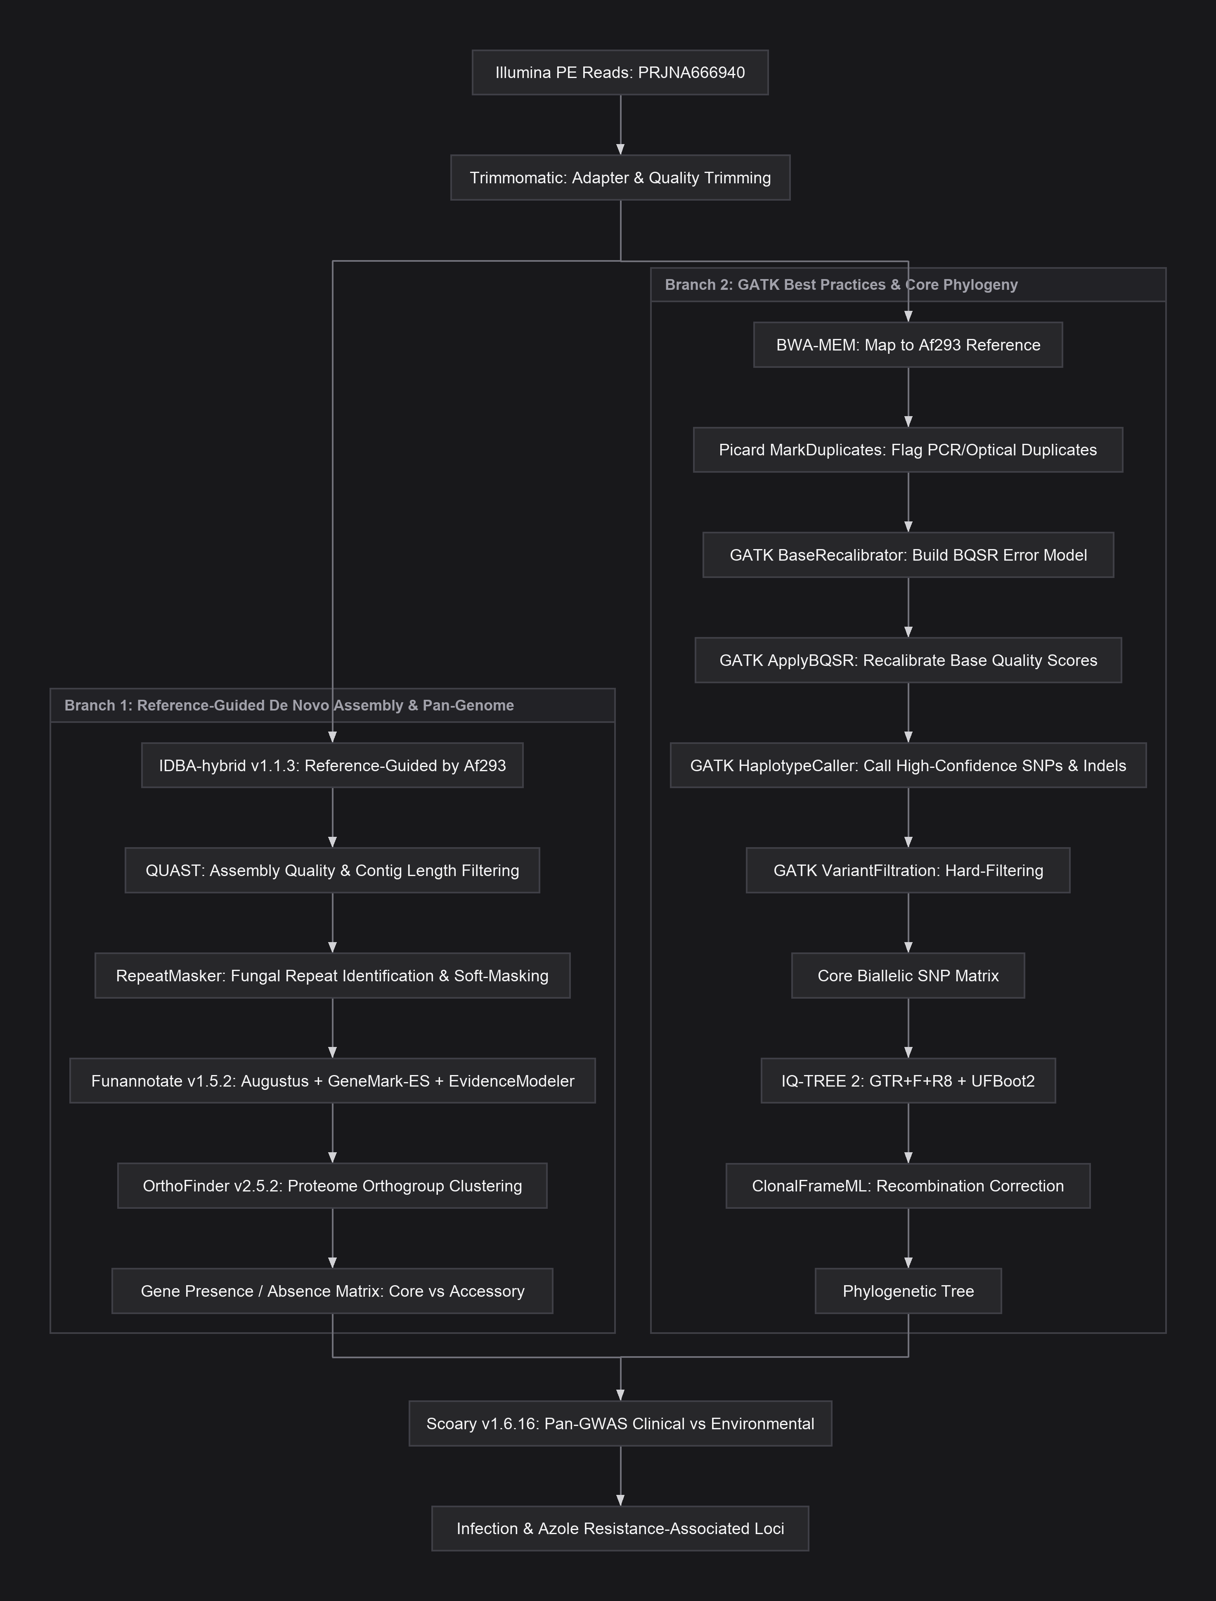
PART II: WHAT DID I DO WITH AGY?
Case Study 1: The Branching Pipeline Architecture
The branching execution pathway AGY inferred automatically from the paper.
Inferred Execution Pathway
• Stage 1 (Environment): Parsed methods text and built a dedicated Conda environment.
• Stage 2 (OS Patching): Patched legacy C/C++ tools from source to run on macOS.
• Stage 3 (Fast Streaming): Streamed raw FASTQ reads in parallel from ENA via aria2c.
• Stage 4 (Branching DAG): Split reads into De Novo Pan-Genome vs. GATK SNP Phylogeny.
• Stage 5 (Convergence): Merged gene matrix and tree in Scoary for resistance GWAS.
Inferred Branching Pipeline (paper-repro-flow.svg)

Slide 8
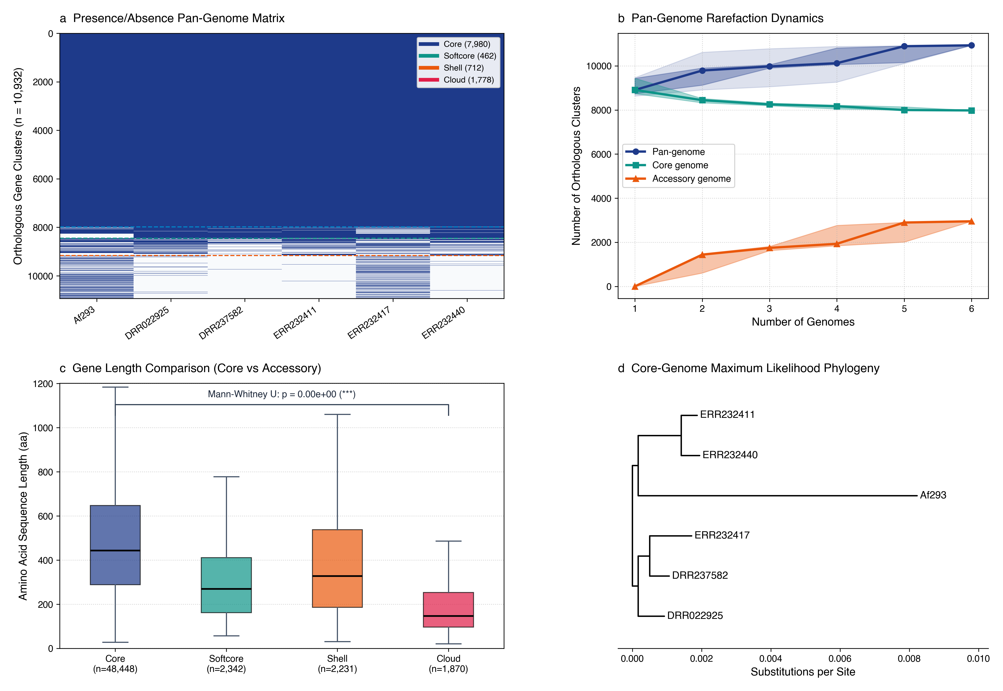
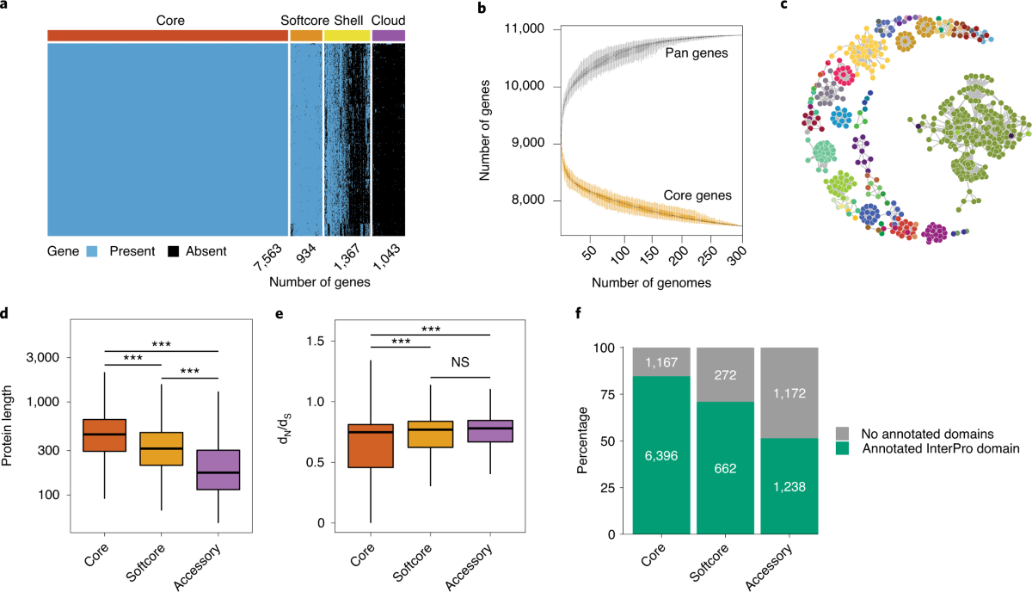
PART II: WHAT DID I DO WITH AGY?
Case Study 2: Pipeline Figures vs. Published Paper
Side-by-side comparison of Barber et al. (2021) Figure 1 and AGY's autonomous reproduction.
Published Paper: Barber et al. (2021) Figure 1
Original pan-genome matrix, rarefaction curves, and gene lengths
AGY Pipeline Output (Preliminary Reproduction)
Generated from raw reads with zero manual coding

Slide 9
PART II: WHAT DID I DO WITH AGY?
Project 2: Rescuing the Petite Paper Figures
Turning years of dispersed data and 5 bloated Jupyter notebooks into one clean project.
The Real-World Notebook Chaos
• 5 Bloated Notebooks: Years of dispersed data and exploratory plots in messy cells.
• Hidden Final Figures: Hard to remember where publishable figures lived or how to run them.
• Uncoordinated Colors: Color palettes didn't match across figures or notebooks.
• Sharing Nightmare: Providing working code and data to journals or peers was impractical.
Refactoring With Antigravity
• Weeks of Manual Work: Refactoring all 5 notebooks by hand would have taken me weeks.
• Marking Target Cells: I helped AGY by marking the cells containing real production figures.
• Prompt-Driven Build: With careful prompts, I tasked AGY to consolidate the whole project.
• Zero Manual Code: Transformed into a clean, modular repository without typing code.

Slide 10
PART II: WHAT DID I DO WITH AGY?
Case Study 2: The Unified Figure Pipeline
One script generates all figures on demand, hooked up to a live Google Sheet.
The Consolidated Architecture
• Single Execution Point: One script (`main.py`) generates all or specific figures on demand.
• Documented Data Folder: Collected and organized all raw data into a single documented folder.
• Easy Figure Polish: Refined legends, labels, sizes, and visual artifacts via prompts.
• Ready for Typesetting: Reproducible code and data ready for publication and peer review.
Live Google Sheets Palette Sync
• Online Color Config: Figure generation connects directly to an online Google Sheet.
• Collaborator Friendly: Co-authors can edit and test color palettes in the spreadsheet.
• Instant Updates: Re-running the script applies the new sheet colors across all figures.
• Clean Separation: Visual styling is decoupled from the core analysis code.

Slide 11
PART II: WHAT DID I DO WITH AGY?
The 15-Minute Mystery: Cross-Platform Debugging
How AGY autonomously solved a silent Windows crash that left me flabbergasted.
The Silent Crash on Windows
• Worked on macOS: The Petite figure pipeline ran flawlessly on my Mac laptop.
• Failed for Anastasia: When shared with Anastasia on Windows, it failed immediately.
• Completely Silent: No warning, no error, no crash report—it just exited silently.
• Finding the Line: I isolated the crash to a matplotlib plotting call and passed it to AGY.
Solved Autonomously in 15 Minutes
• Autonomous Investigation: AGY analyzed the matplotlib call and Windows runtime behavior.
• Root Cause Identified: Realized the silent crash was a Windows-specific matplotlib issue.
• Clean Environment Fix: Solved it automatically by setting an environment variable.
• Massive Time Saver: Would have taken me hours to debug—AGY did it in 15 minutes!

Slide 12
LIVE DEMONSTRATION
LIVE DEMO: The Petite Paper Figure Generator
Live walkthrough of ~/dev/petite_paper: one script, cloud palette sync, publication figures.
• Single-Command Run: Run `python main.py --figure 2` live to generate 300-DPI figures.
• Google Sheets Sync: Change a color in Google Sheets, re-run, and watch the plot update.
• Organized Data & Code: Tour the unified `data/` folder, documentation, and modular scripts.
• Rapid Visual Polish: Tweak labels, legends, or layout via prompt and re-render in seconds.

Slide 13
PART III: WHAT DO YOU NEED?
Domain Expertise: Responsibility Is Still Yours!
You need strong domain knowledge to spot errors and explain what to fix.
The Johannes Proteomics Story
• Wrong Normalization: In my proteomics work, AGY normalized the dataset incorrectly.
• Why It Happened: I hadn't explained what the data was or how it was pre-processed.
• Domain Expert Catch: Johannes spotted the error—otherwise it would have altered results.
• The Core Lesson: Never trust AI blindly. Responsibility for the results is still yours!
How to Audit Core Analysis Code
• Demand Explanations: Make AGY explain its math in detail and document it in comments.
• Ask for Tests: Have the agent write automated tests for core calculations.
• Use Ground Truths: Run pipelines on known control datasets first to verify accuracy.
• Inspect & Guide: Be ready to explain in detail what went wrong and how to fix it.

Slide 14
PART III: WHAT DO YOU NEED?
Technical & Architectural Knowledge
Good architecture prevents code bloat, slow runs, and wasted tokens as projects grow.
Why Technical Intuition Helps
• Coding Isn't Obsolete: Intuitive understanding helps you catch mistakes early.
• Animation Bug Story: AGY first wrote flawed slide XML rules; human intuition fixed it.
• Working != Well-Built: Working AI code can still hide bloat and poor architecture.
• The Cost of Bloat: Messy code burns tokens, runs slowly, and degrades as projects grow.
Key Architectural Rules
• No Hard-Coded Values: Never hard-code names or numbers—compute them or use text configs.
• No Code Duplication: Keep shared data loading and plotting logic in reusable functions.
• Readable Config Files: Store parameters in simple text files you can edit directly.
• Occasional Refactors: Use stronger reasoning models periodically to clean up the codebase.

Slide 15
PART III: WHAT DO YOU NEED?
The Golden Rule: Work With Text & Code, Not Images
Code is text! Never ask the AI to edit scientific figure images directly.
Why Direct Image Editing Fails
• AIs Aren't Magicians: Image models paint pixels—they distort data and hallucinate labels.
• Un-reproducible Tweaks: Manual edits in Illustrator leave no record of how a plot was made.
• New Data Pain: When new replicates arrive, manual image edits must be redone.
• Hard to Manage: Direct image edits can't be tracked, audited, or batch-updated.
The Deterministic Code Workflow
• Raw Data -> Code -> Plot: Give AGY raw data and have it write code to analyze and plot it.
• Edit Code for Tweaks: Need a label moved or color changed? Have AGY edit the script.
• 100% Deterministic: Re-running the script always produces the exact same figure.
• Easy to Manage: Text code is clean, searchable, and easy to maintain over time.

Slide 16
PART IV: WORKING WITH ANTIGRAVITY
How AGY Works: Projects & Conversations
Local project folders, fresh conversation sessions, and real-time supervision.
Project Folders & Fresh Chats
• Local Project Folder: Everything inside your project folder is considered local and safe.
• Copy Needed Files In: AGY asks before touching outside files—copy what you need inside.
• Chats Start Fresh: Every new conversation starts with zero memory of prior chats.
• Seed via AGENTS.md & @: Auto-load rules via `AGENTS.md` and reference files/chats with `@`.
Live Monitoring & Course Correction
• See Tools Running Live: Watch terminal commands and file edits happen in real time.
• Thought Process Note: Shows active steps (though recent versions hide raw chain-of-thought).
• Stop & Correct Course: Interrupt the agent anytime if it heads in the wrong direction.
• Per-Chat Controls: Pick the model and thinking effort for each conversation.

Slide 17
PART IV: WORKING WITH ANTIGRAVITY
Managing the Context Window
For LLMs, only the context exists—keep conversations short and focused.
Context Limits & Compaction
• Only Context Exists: If it isn't in the active context window, the LLM doesn't know it.
• Auto-Compaction Drop: When context fills up, old turns get summarized and performance drops.
• Many Short Chats Win: One short chat per feature, panel, or bug beats one giant chat.
• Use /compact Wisely: Run `/compact` when context fills up AND the last task finished cleanly.
Interactive Context Visualizer
Open in browser: context_visualizer.html
• Visual Token Bucket: See how `AGENTS.md`, chat turns, and file scans fill memory.
• Attention Dilution: Watch focus drop as old logs and large CSV dumps pile up.
• CLI vs. App Stats: Usage stats show in CLI (harder to spot in App)—watch chat length!
• Golden Rule: Start a fresh conversation whenever you move to a new task.

Slide 18
PART IV: WORKING WITH ANTIGRAVITY
Models & Thinking Effort: Matching the Task
Switch between fast and deep-reasoning models to balance speed and token cost.
Choosing the Right Model
• Bigger = Pricier: Stronger models have larger contexts, but burn token quotas faster.
• Cheap Models for Routine: Use fast models (Flash) to find files or make quick text edits.
• Strong Models for Hard Tasks: Use Pro or Claude Sonnet/Opus for debugging and refactoring.
• Switch Anytime: Change models between tasks so you don't waste quota.
Thinking Levels & Chatbot Coaching
• Deep vs. Shallow Thinking: Dial from 'shallow' (fast, cheap) to 'deep' (slower, thorough).
• When to Think Deep: Use deep thinking for tough bugs and multi-file architecture.
• Ask Gemini for Advice: Ask a chatbot to engineer your prompt and recommend a model.
• Command Tips: Chatbots can also suggest which AGY slash commands fit your task.

Slide 19
PART IV: WORKING WITH ANTIGRAVITY
Effective Prompting & Interactive Steering
How to communicate clearly with coding agents for reliable scientific code.
Writing Clear Scientific Prompts
• Be Specific: State exact inputs, axes, units, stat tests, and figure formats.
• Explain Data History: Tell AGY what the numbers mean and any prior normalizations.
• Set Clear Guardrails: 'Keep `data/` read-only', 'No hard-coded names', 'Use CBS138 WT'.
• Request Sanity Checks: Ask AGY to print summary stats and explain its math first.
Meta-Prompting & Steering
• Prompt Engineering Help: Ask Gemini or Claude web chat to draft your AGY prompt.
• Work Incrementally: Break work into steps: parse files -> check stats -> plot figure.
• Steer in Real Time: Stop the agent early if you spot a wrong biological assumption.
• Point With @ Mentions: Use `@filename` to focus the agent on exact scripts and tables.

Slide 20
PART V: THE BEST PRACTICES TOOLKIT
Institutional Memory: AGENTS.md
The key document auto-loaded into every conversation in your project.
What Goes Into AGENTS.md?
• Auto-Loaded Every Chat: Seeds every new conversation so AGY works fast without scanning.
• Goal & File Overview: Explains the project goal and maps out key folders and scripts.
• Tool Permissions: Lists which tools and commands the AI can (and cannot!) run.
• Rules & Invariants: Defines writing style, visual standards, and coding guardrails.
Example: Berman Lab AGENTS.md
# Lab Project Guidelines
## Visual Standards
- Colors: Sync from Google Sheet palette
- Fonts: Arial, min 10pt tick labels
- Output: Save 300-DPI PNG & vector SVG
## Candida Conventions
- WT reference: CBS138 (ATCC 2001)
- No hard-coded strain names in code
## Project Rules
- Raw data in `data/` (STRICTLY READ-ONLY)
- Run scripts via `./env/bin/python`

Slide 21
PART V: THE BEST PRACTICES TOOLKIT
Slash Command: /plan — Architect First
Ask AGY to draft an editable plan before starting any big chunk of work.
Why Use /plan?
• For Big Tasks: Use when starting a major feature or parsing a new file format.
• Read & Edit Iteratively: Review the proposed plan and refine steps before coding starts.
• Precise Instructions: Gives the agent a clear, approved blueprint to follow.
• Peace of Mind: Ensures the agent is on the right track before touching files.
Example Wet-Lab /plan Workflow
• Prompt: /plan 'Parse Tecan exports and plot 48h Candida growth curves'
• Step 1 (Inspect): Check raw ASCII headers and extract time-stamped OD600 values.
• Step 2 (Clean): Subtract media blanks and flag wells with evaporation spikes.
• Step 3 (Metrics): Fit splines to compute max growth rate (Vmax) and lag time.
• Step 4 (Plot): Render 300-DPI facet grids grouped by strain and drug dose.

Slide 22
PART V: THE BEST PRACTICES TOOLKIT
Slash Command: /grill-me — Resolve Ambiguities
Instruct the agent to ask you about anything it's unsure of before execution.
How /grill-me Works
• Agent Interviews You: AGY asks clarifying questions instead of guessing silently.
• Great With /plan: Use alongside `/plan` or by itself before complex analyses.
• Catches Biology Details: Surfaces unspoken rules about blanks, dilutions, and endpoints.
• Prevents Wrong Math: Eliminates bad assumptions before a single line of code runs.
Example /grill-me Dialogue
• Prompt: /grill-me 'Calculate MIC50 for our fluconazole disk assays'
• Agent Q1: 'Is 50% inhibition relative to untreated growth or media blank?'
• Agent Q2: 'Trailing growth appears at 48h—should we score at 24h or 48h?'
• Agent Q3: 'How should we handle resistant strains that never drop below 50%?'
• Impact: 2 minutes of Q&A prevents hours of re-running flawed analyses.

Slide 23
PART V: THE BEST PRACTICES TOOLKIT
Slash Command: /learn — Capture Lessons
Tell the agent to learn from a completed task and update AGENTS.md or skills.
How /learn Builds Memory
• Run After Finishing: Instructs AGY to extract lessons from what it just accomplished.
• Updates AGENTS.md: Writes new project rules into `AGENTS.md` or creates a new skill.
• Fixes Stuck Loops: Especially useful if the agent got stuck in a loop you helped solve.
• Zero Instructions Needed: Can be called as a bare `/learn` command all by itself!
Case Study: Learning Slide Animations
• The Challenge: Teaching AGY how to animate cards and bullets in this presentation.
• Running /learn: Once we fixed the XML logic, we ran `/learn` to save the pattern.
• Saved Rule 1: Use the `pptx_animations` helper module—never write raw XML.
• Saved Rule 2: 1–2 cards: reveal bullets on click; 3+ cards: reveal whole cards.
• Result: Every future chat followed our animation rules automatically!

Slide 24
PART V: THE BEST PRACTICES TOOLKIT
Skills: Reusable Functions for AI Agents
Self-contained task instructions, guardrails, and tools that the AI can invoke.
What Are Agent Skills?
• Functions for AI: Describe a specific task, how to do it, guardrails, and tools.
• Built-In & Imported: Use AGY's many built-in skills or import skills made by others.
• Write Your Own: Package any recurring lab workflow into a custom skill.
• Share Across the Lab: Commit skills to Git so every lab member can reuse them.
My Palette Skill & Lab Ideas
• Master Palette Skill: Takes general rules or a color site URL and builds the master palette.
• Auto-Config Sync: Populates the full figure configuration list automatically.
• Judy's Writing Skill: Turn writing course lessons into a skill that checks manuscripts.
• Assay QC Skills: Create shared skills for standardizing DDA and growth curve QC.

Slide 25
PART V: THE BEST PRACTICES TOOLKIT
Safety, Security & Data Backups
How to protect your raw data and review agent code before execution.
Safety Boundaries & Risks
• Outside Folder Prompts: AGY asks before touching outside files (can even get annoying!).
• Can Modify Local Files: Be careful—running tools CAN modify or delete files by mistake.
• Hidden Access in Code: Generated scripts can still access outside paths when executed.
• Review Before Running: Always check what generated code does before running it.
Practical Backup Strategy
• Copy Data Into Project: Put a working copy of raw data inside your local project folder.
• Keep Archival Backups: Store untouched master copies on Dropbox, Google Drive, or NAS.
• Read-Only data/ Rule: Tell AGY in `AGENTS.md` never to modify files inside `data/`.
• Git + Cloud Archives: Use Git and Dropbox together so you can always recover files.

Slide 26
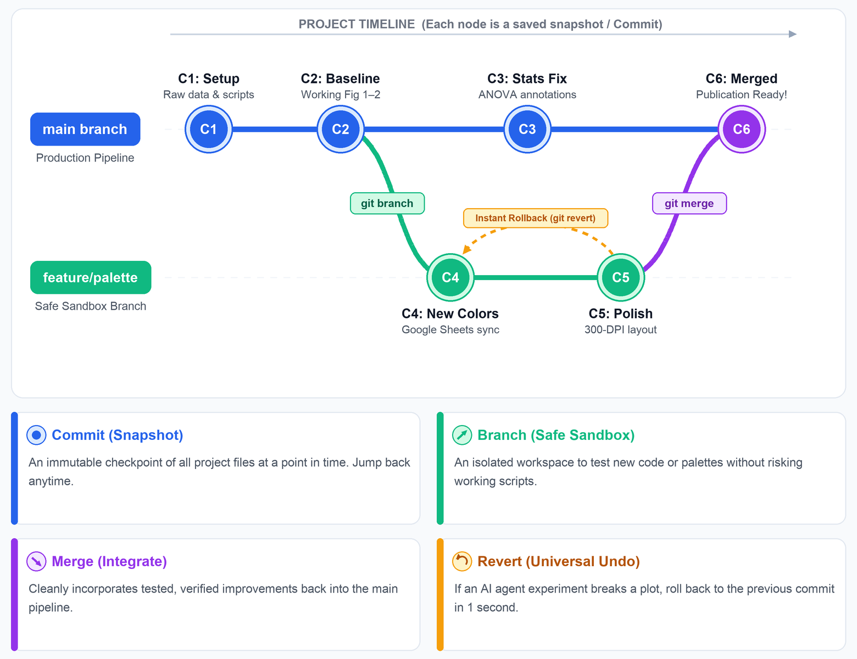
PART V: THE BEST PRACTICES TOOLKIT
Git, GitHub & Parallel Worktrees
Track changes, roll back mistakes, collaborate safely, and run tasks in parallel.
Why Use Git & GitHub?
• Track & Roll Back: Keep a full history of changes and undo broken edits in seconds.
• Safe Collaboration: Private GitHub repos let Anastasia and me share code safely.
• Never Store Secrets: Never commit passwords or API keys into your Git repository!
• Git Worktrees: Advanced feature to run multiple tasks in parallel without conflict.
Schematic: How Version Control Works
Visual model of commits, branches, merges, and instant rollbacks

Slide 27
PART VI: NEXT STEPS
Personal Missions & Legacy Lab Tools
Immediate ideas for lab members and maintaining our classic lab software.
Lab Member Missions
• Ze'ev (DDA Panel Creator): Feed its GitHub issues to AGY—finish them all within a week!
• Shani (Consolidate Work): Move from Claude UI to AGY and unify your analysis project.
• Sofya (Transposon QC): Build final quality assessments and exploratory plots for libraries.
• Alona (Claude in AGY): Plug your Claude sub into AGY, or test the Claude Code CLI.
• Judy (Data & Writing Skills): Analyze data independently, and turn writing rules into skills!
Maintaining Classic Lab Tools
• Revive Older Tools: Maintain OD Normalizer, Scanalyzer, diskImageR, and even Ymap.
• No Programmer Required: Fix and update legacy tools without needing the original author.
• Doable With Setup: Requires initial project setup per tool, then steerable in plain English.
• Shared Lab Assets: Keep our core yeast analysis tools alive and modern for everyone.

Slide 28
PART VI: NEXT STEPS
Subscriptions, Quotas & Model Options
Navigating free tiers, TAU academic subscriptions, and API keys.
Gemini Tiers & TAU Pricing
• AGY App Is Free: Free tier included, though quotas can run out quickly with heavy use.
• TAU Gemini Pro (550 NIS/yr): Check if TAU's license covers developer API quotas or just web chat.
• Private Sub (~75 NIS/mo): Standard developer subscription or API billing is ~900 NIS/year.
• Other TAU Access: TAU has OpenAI & Microsoft access (Copilot is weaker for code).
Claude vs. Gemini for Biology
• Plug In Claude Models: Connect Claude 3.5/3.7 Sonnet or Opus to AGY via API keys.
• Gemini Pro Is Enough: While Claude is praised for code, Gemini Pro met all my bio needs.
• Very Cost-Effective: Gemini Pro handled both of my biology pipelines at low cost.
• Try It Today: Start with the free tier on a small lab dataset this week!

Slide 29
BONUS CHEATSHEET
8 Habits for Reliable Agentic Science
Keep this handy: essential rules of thumb for working with Antigravity.
Setup & Context (Habits 1–4)
• 1. Copy Raw Data In: Keep archival backups on Dropbox/NAS; keep local `data/` read-only.
• 2. Seed via AGENTS.md: Document goals, files, allowed tools, and style rules once.
• 3. Plan & Grill First: Run `/plan` and `/grill-me` before coding to align on details.
• 4. Many Short Chats: Use one short chat per feature or figure so context stays sharp.
Execution & Safety (Habits 5–8)
• 5. Compact Wisely: Use `/compact` after a task finishes cleanly before context fills up.
• 6. Capture Fixes (/learn): Run `/learn` after solving bugs or loops to update `AGENTS.md`.
• 7. Edit Code, Not Images: Never edit figures directly—have AGY update the plotting script.
• 8. Use Git & Audit Math: Commit milestones to Git, and always verify core math on controls.

