Slide 1
Where Y2Y's values agree — and where they diverge
12 value positions (6 scenarios × 2 climate futures for refugia) × 51 near-optimal plans each
30% of the region; existing PAs locked in — they are 15% of the region (50% of the budget) and already bank 12–19% of every value (35/40 ecosystem groups present) — remarkably AVERAGE land for these values
Every plan keeps every value theme within 5% of its best
Representativeness block curated before this run (rule R0): 40 ecosystem features kept of 40 — anthropogenic biomes, a point-record class, sub-grain slivers and one uninformative envelope removed; two duplicate footprints merged
The spine of the story: VALUE (where a theme is rich) is not IRREPLACEABILITY (where near-optimal plans cannot do without it)
Notes:
Context slide. Methods live in the study plan v0.16.1; this package = director_package_spec v1.6.

Slide 2
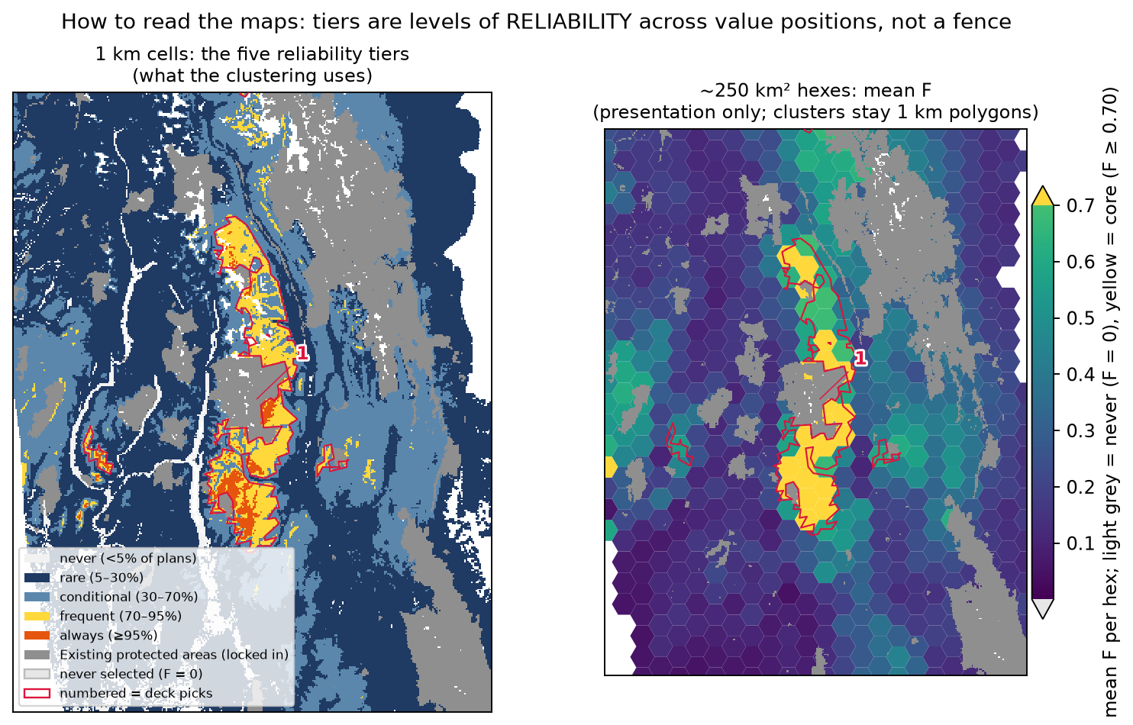
How to read the maps
Grey = existing protected areas (fixed in every plan)
1 km tiers drive the clustering; cluster outlines are 1 km polygons, not hex unions
Hexes (~250 km²) are for legibility only — our DISPLAY hex ≈ the national 30×30 analysis's PLANNING unit (100 km²); our analysis runs at 1 km², two orders of magnitude finer ('this valley', not 'this ecodistrict')
51 near-optimal plans × 12 value positions, versus 4 plans in the national analysis
53°N marked: see the E17 one-pager

Slide 3
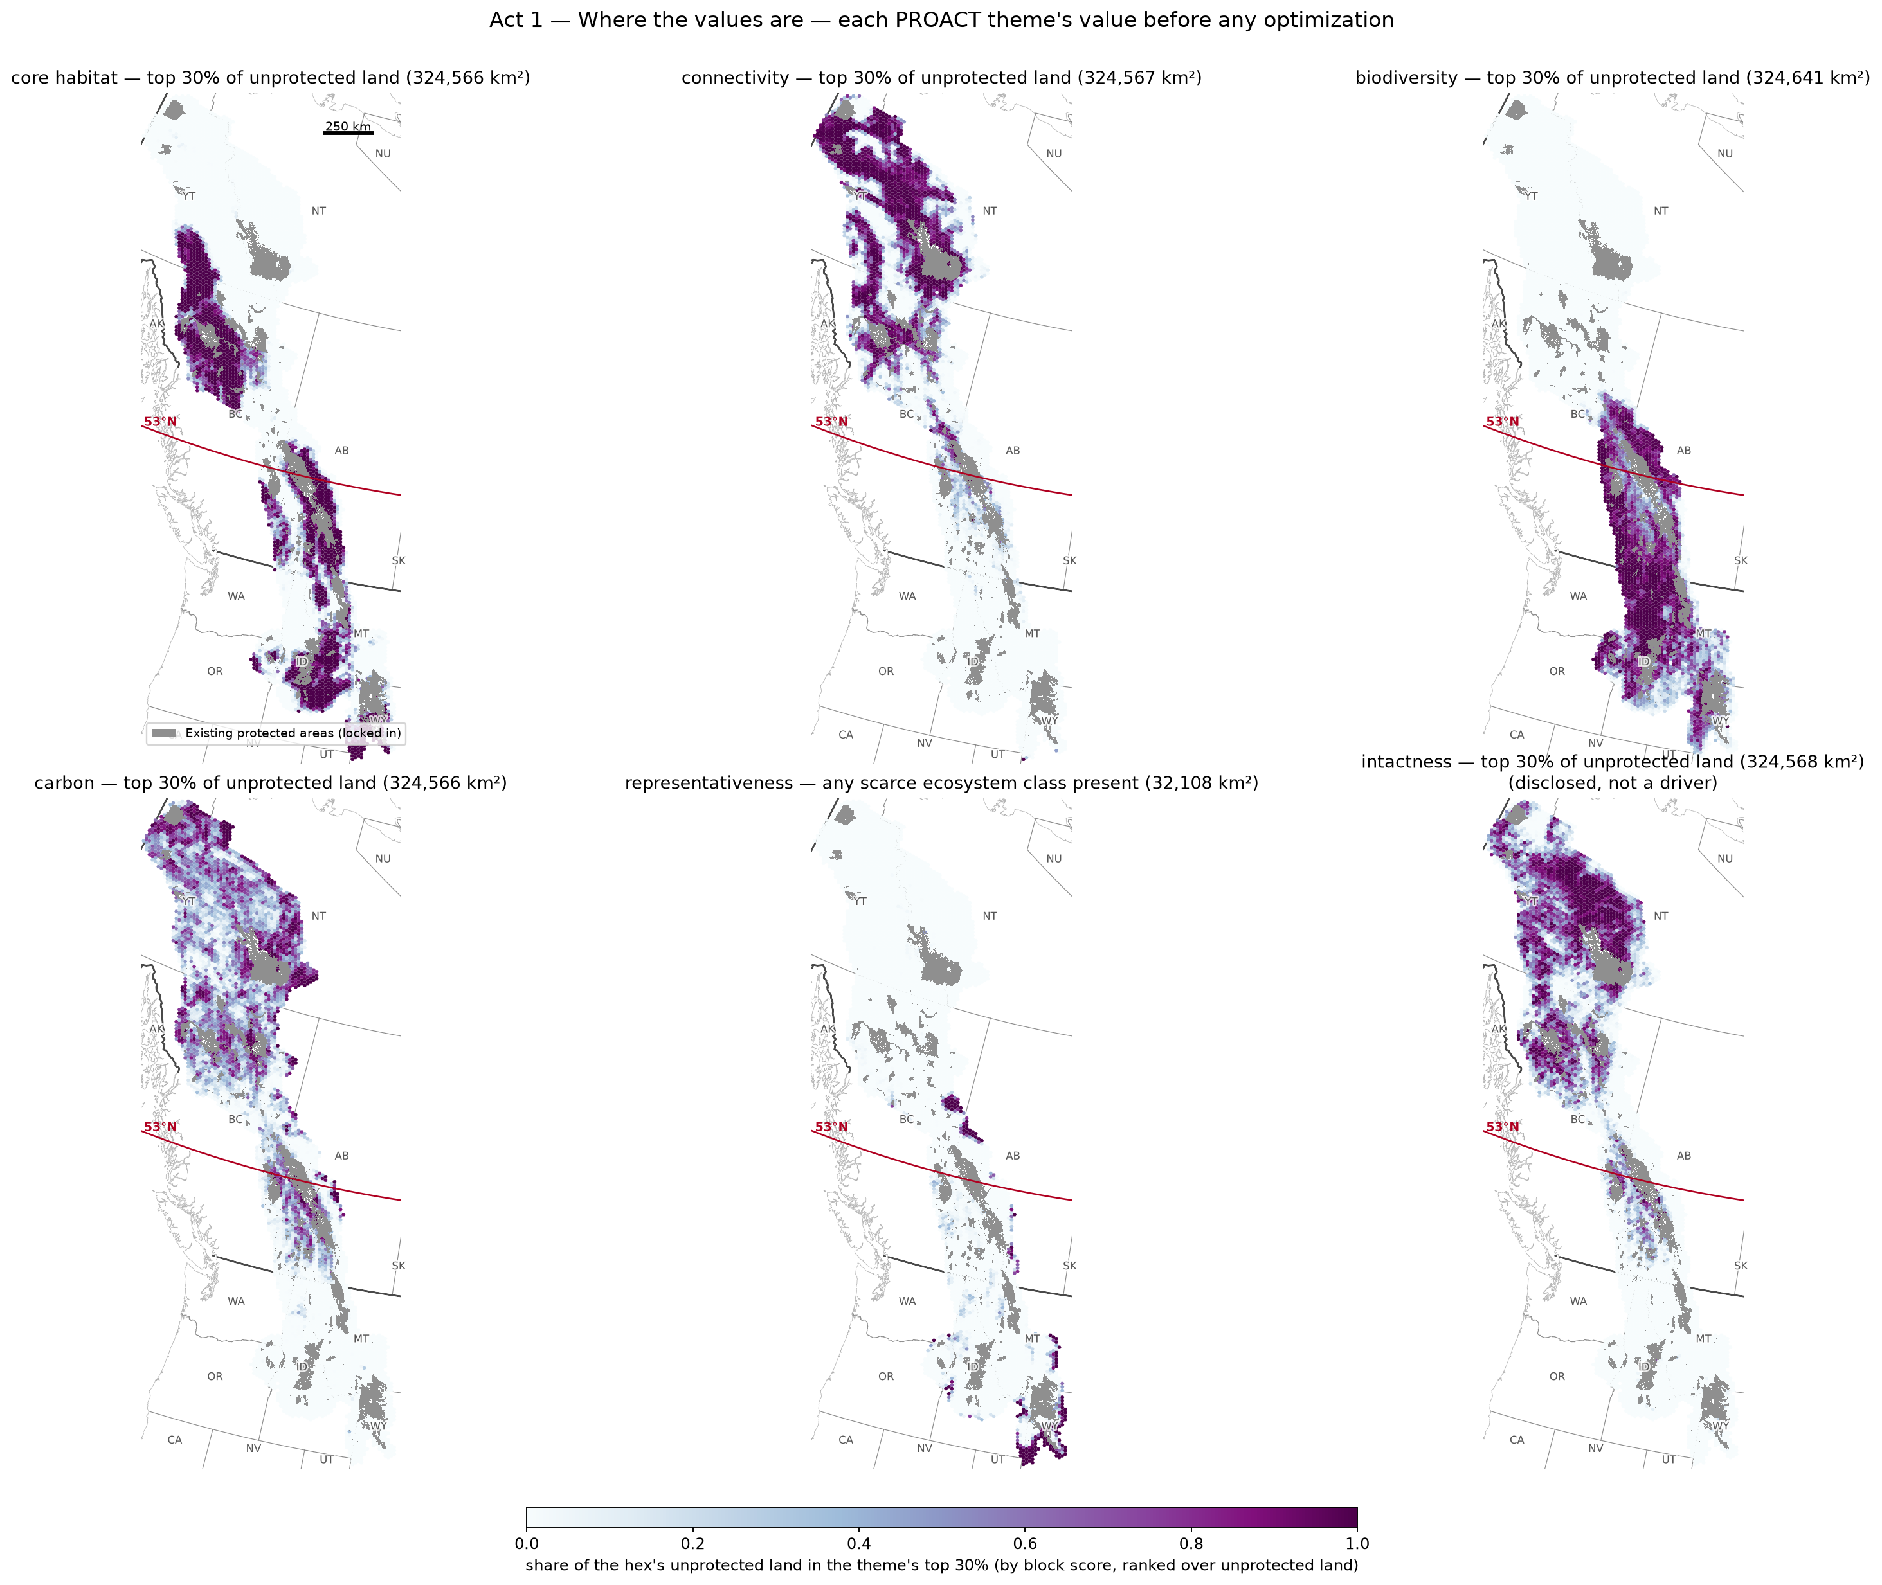
Act 1 — Where the values are
Each PROACT theme's value before any optimization: the top 30% of unprotected land by that theme (share per hex)
Footprints: core habitat 324,566 km², connectivity 324,567 km², biodiversity 324,641 km², carbon 324,566 km², representativeness 32,108 km²
Representativeness votes as presence of a scarce ecosystem class (≤1% of the region each); intactness shown sixth — disclosed, not a driver
This is the map directors already hold in their heads — the national analyses (Currie, Jung) stop here; the next acts ask what of it can be promised

Slide 4
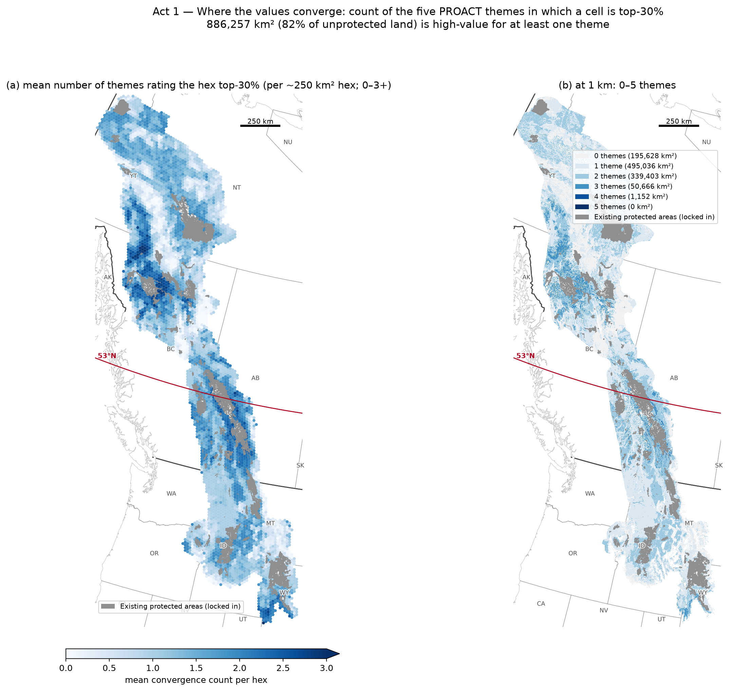
Act 1 — Where the values converge
Count of the five themes (0–5) in which a cell is top-30%: 0: 195,628 km², 1: 495,036 km², 2: 339,403 km², 3: 50,666 km², 4: 1,152 km², 5: 0 km²
886,257 km² (82% of unprotected land) is high-value for at least one theme
Value is not irreplaceability: Acts 2–3 show how much of this the ensemble can promise

Slide 5
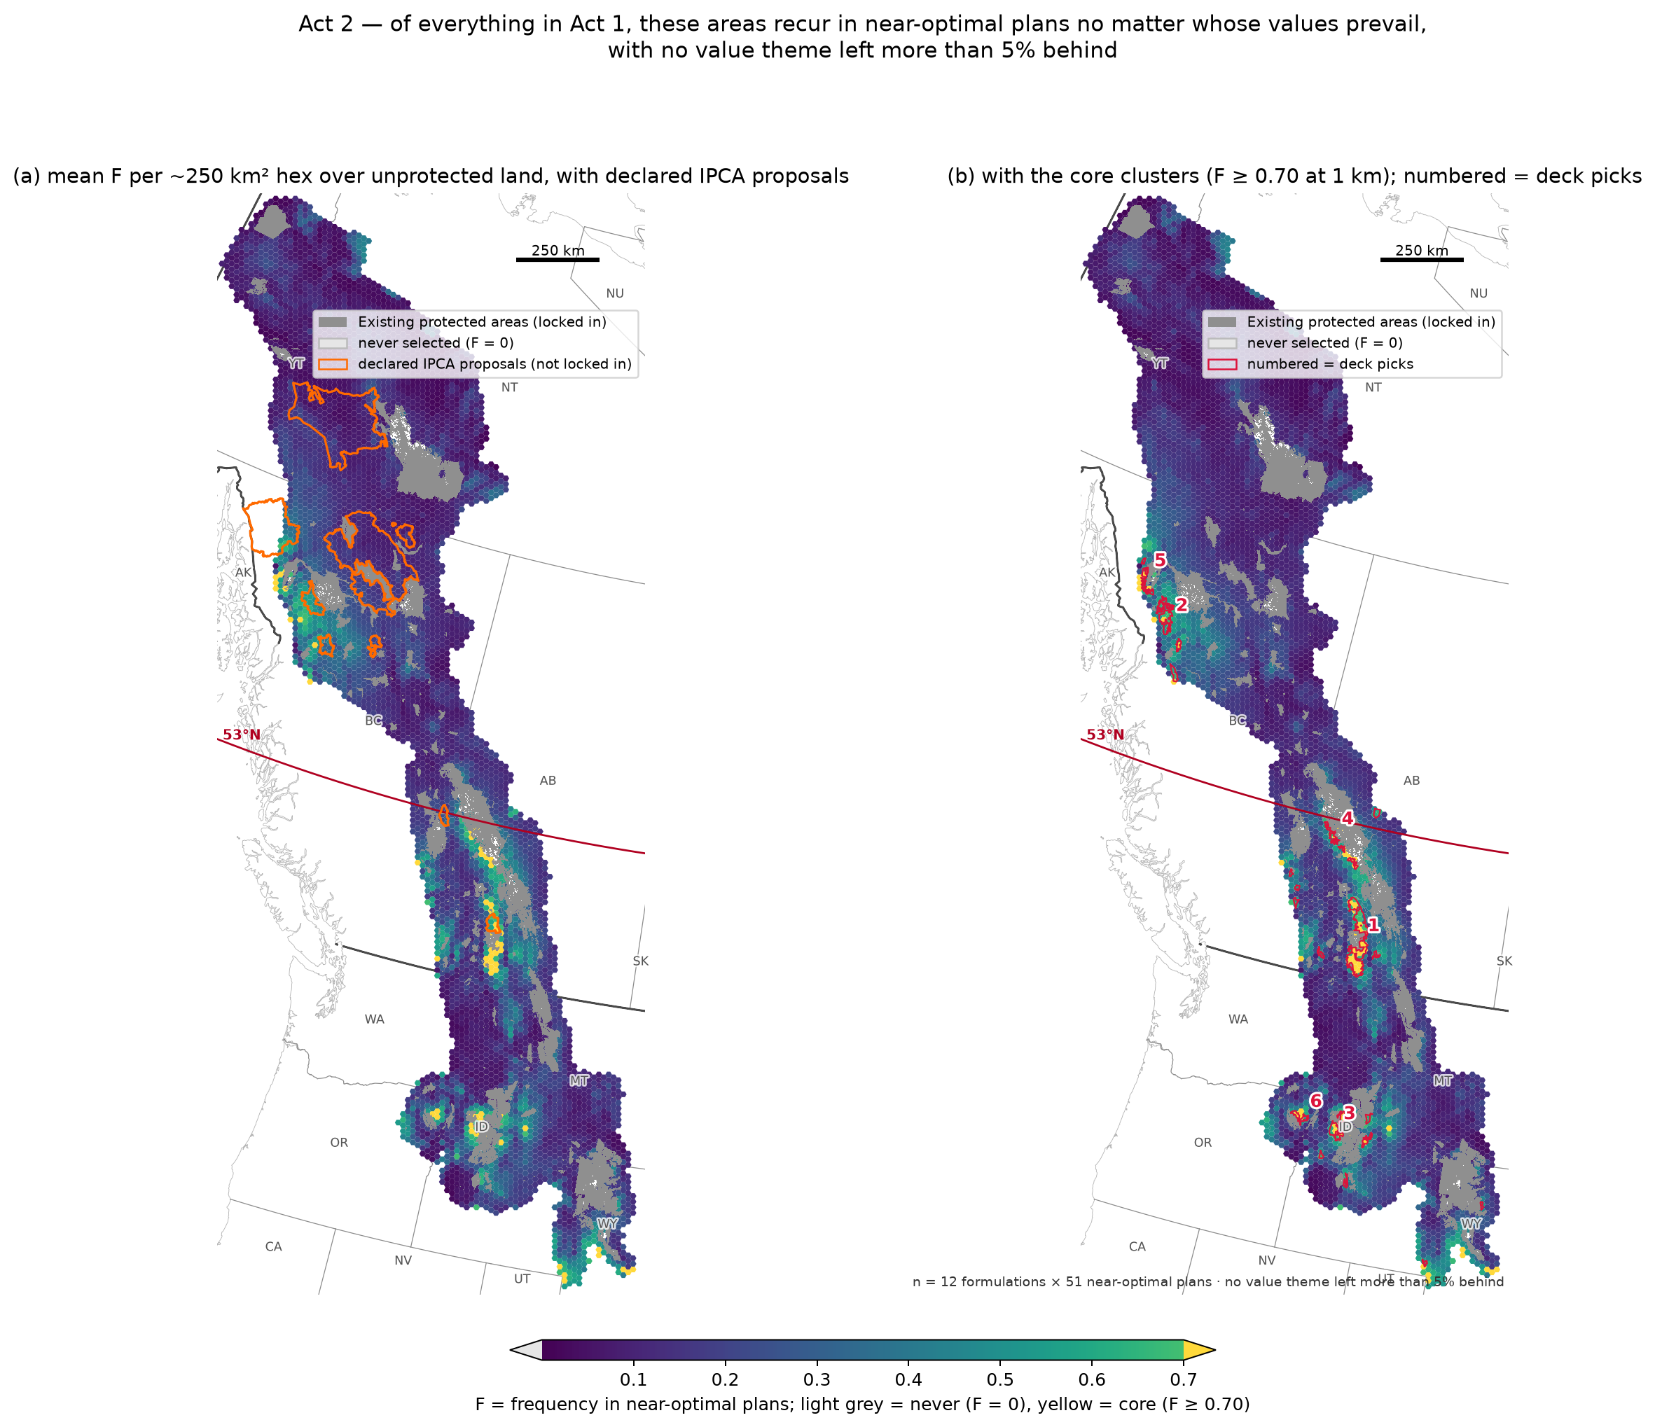
Act 2 — Core irreplaceability
Of everything in Act 1, these areas recur in near-optimal plans no matter whose values prevail: 16,895 km² (F ≥ 0.70 across all 12 positions)
No value theme left more than 5% behind in any plan
Numbered = the largest core clusters (full register in the appendix)

Slide 6
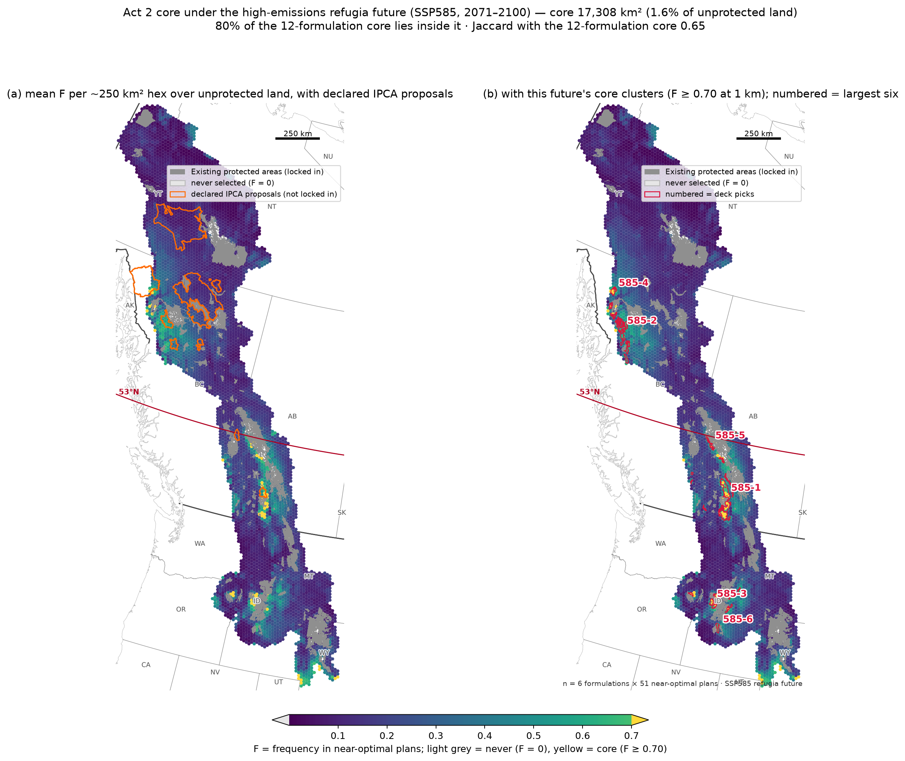
Act 2 core under the high-emissions refugia future
6 value positions at SSP585: core 17,308 km²
80% of the 12-position core lies inside it
The 12-position core = what survives BOTH refugia futures

Slide 7
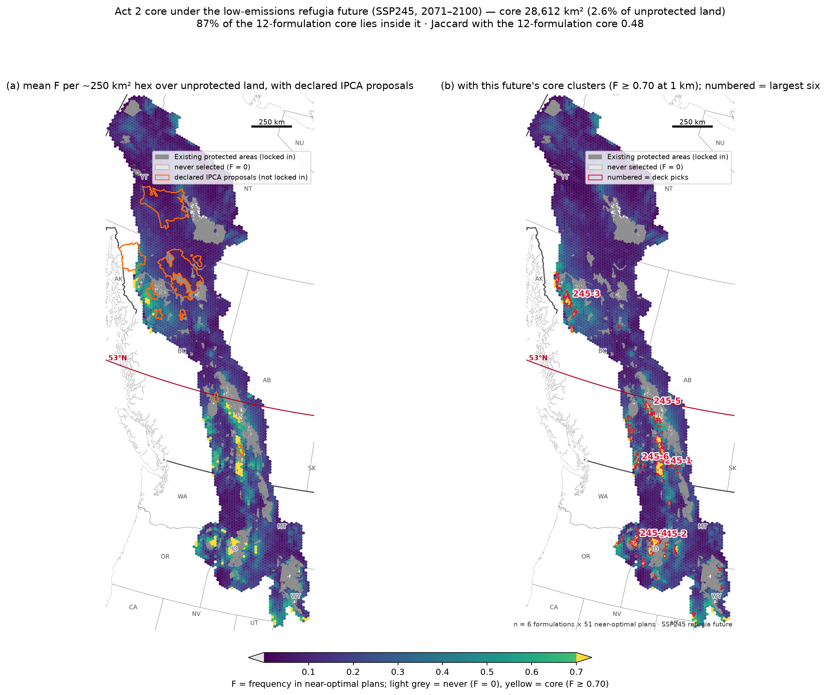
Act 2 core under the low-emissions refugia future
6 value positions at SSP245: core 28,612 km²
87% of the 12-position core lies inside it
The 12-position core = what survives BOTH refugia futures

Slide 8
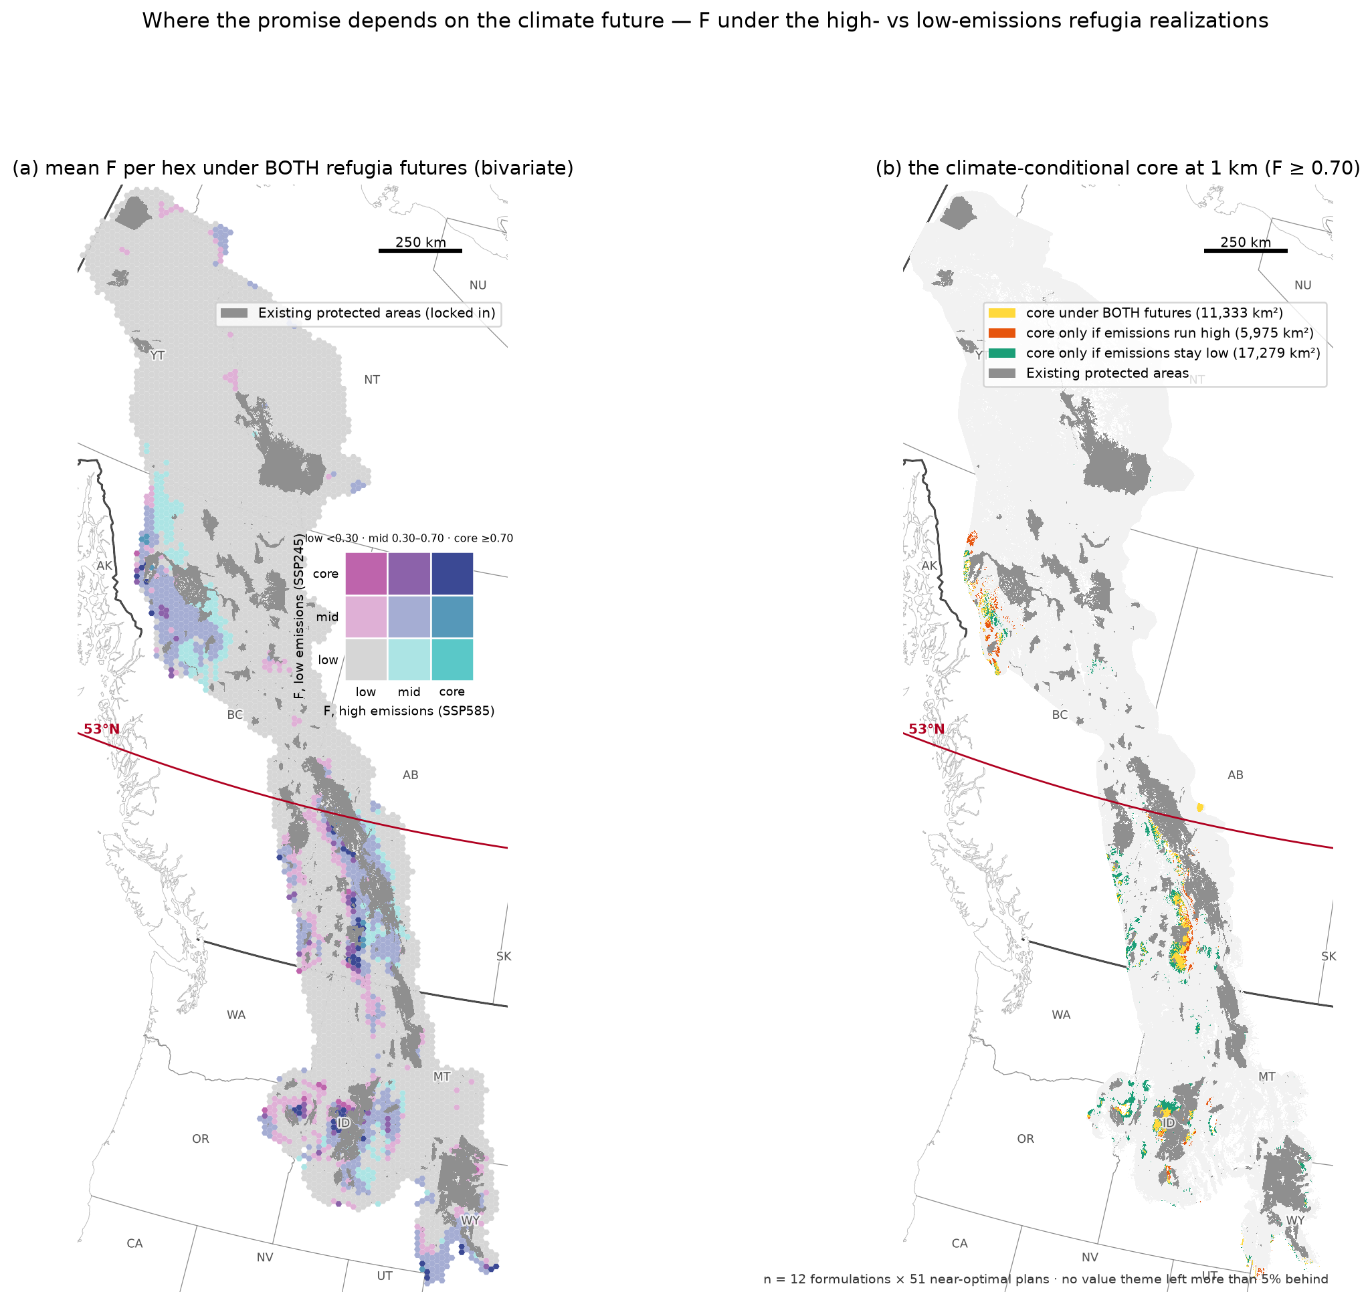
Where the core depends on the climate future
One hex, two refugia futures: bivariate F
Yellow = core under both futures; orange = only if emissions run high; green = only if they stay low
The 12-position core is what survives both

Slide 9
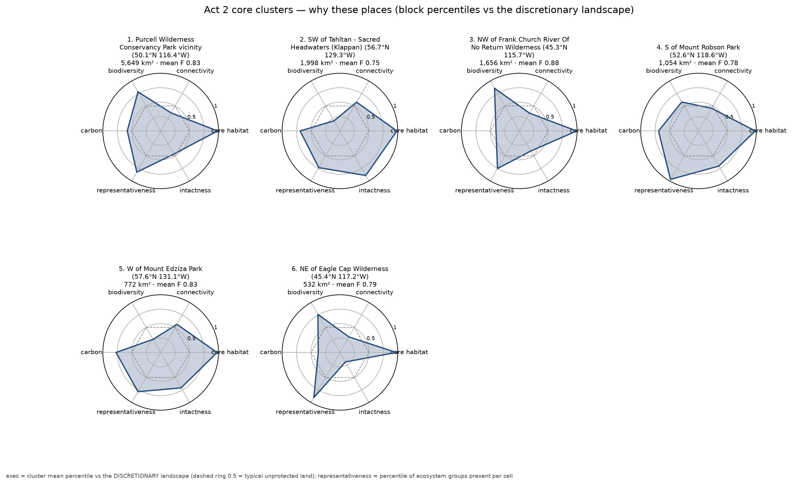
Why these places — core clusters
Core clusters spike on BINDING claims (dense climate refugia, scarce ecosystems) rather than excelling everywhere
Histogram of F: act2_F_histogram.png

Slide 10
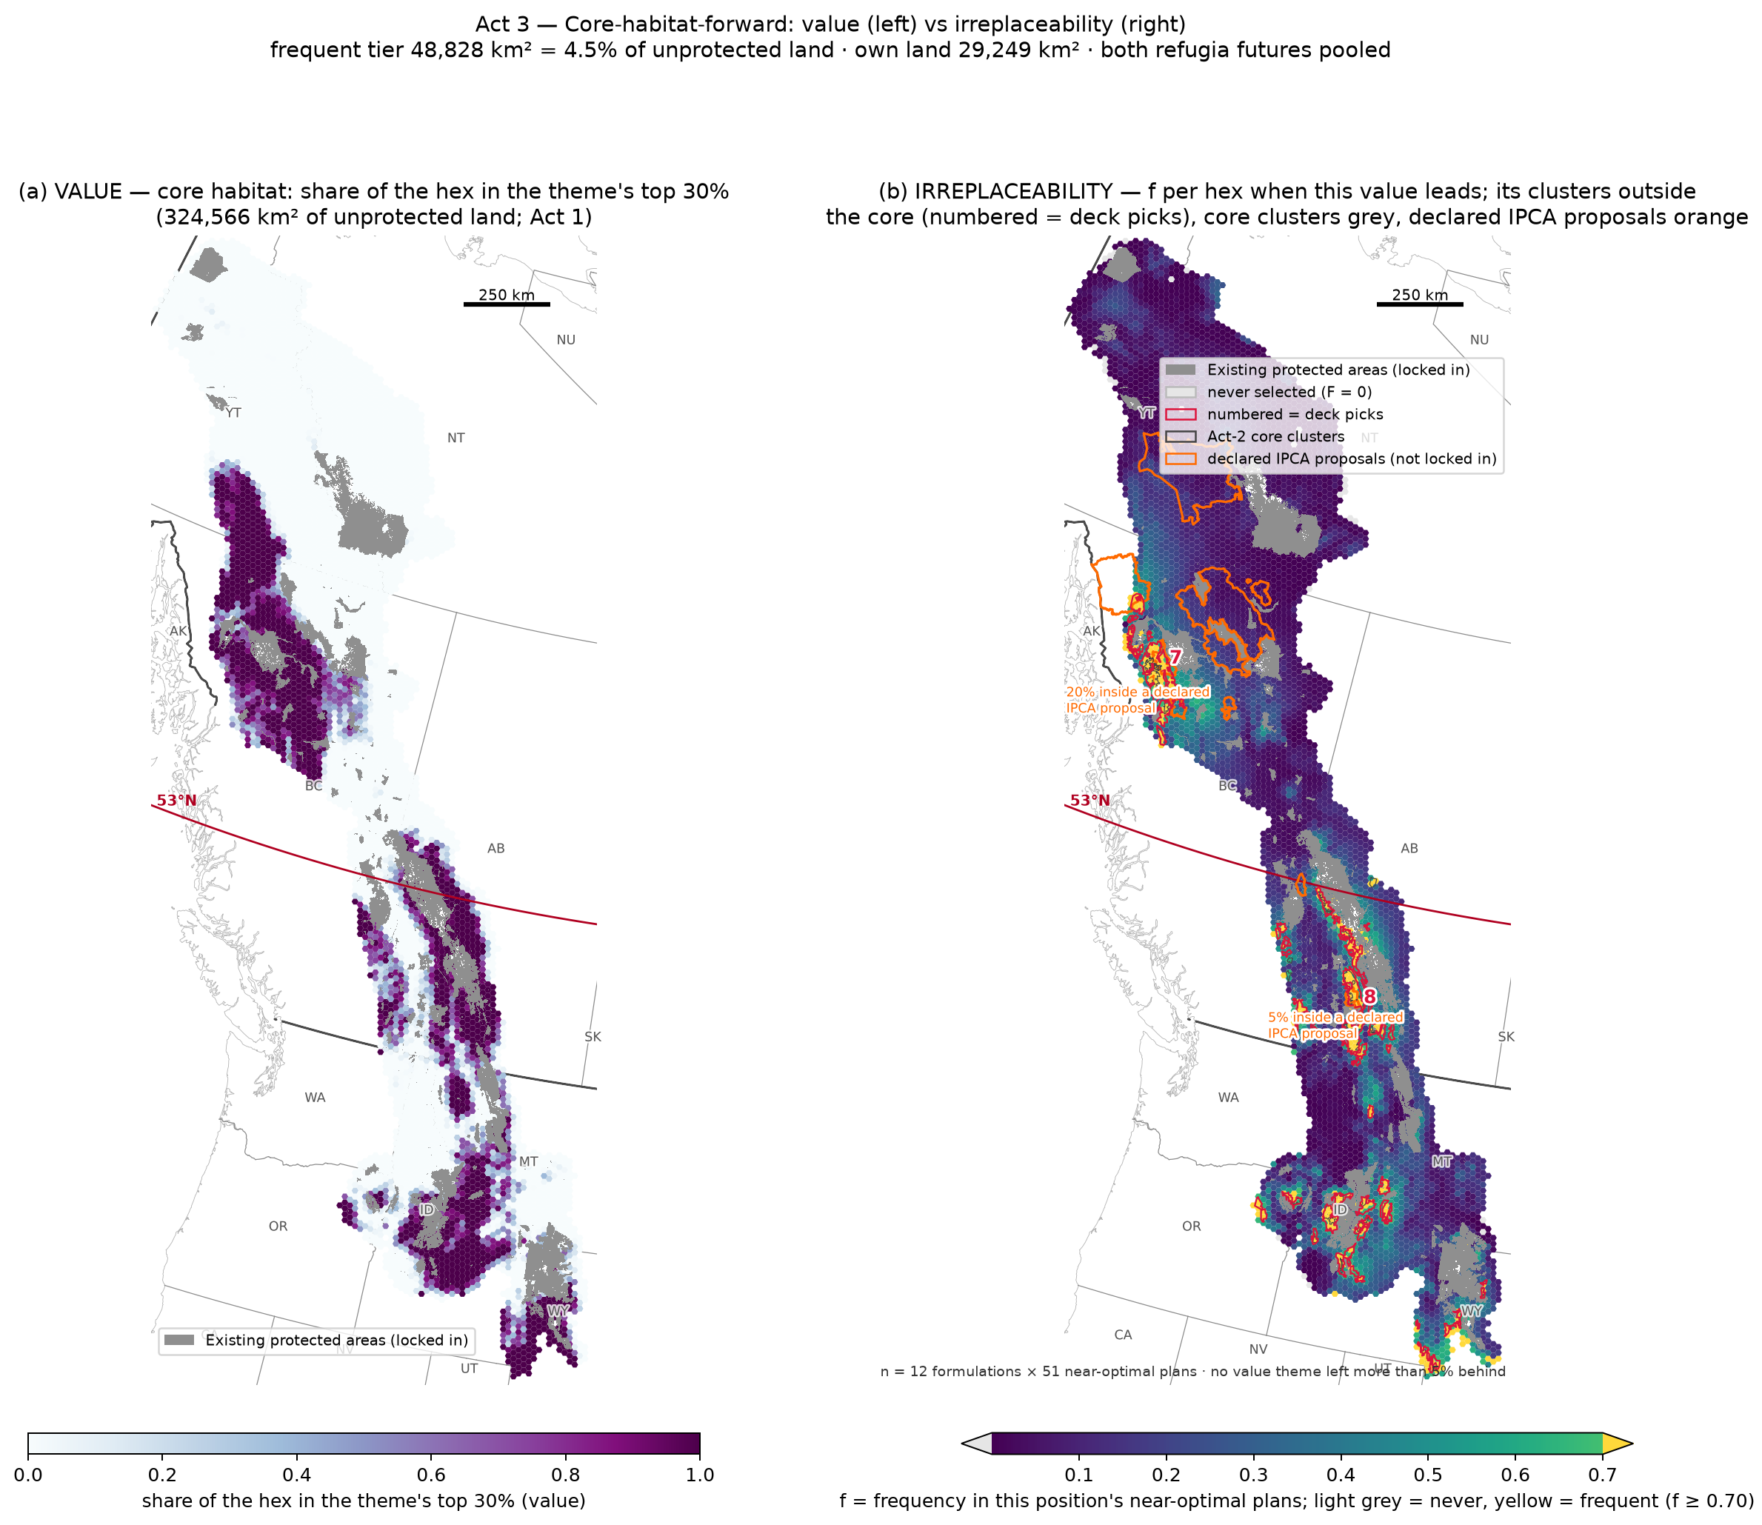
Act 3 — Core-habitat-forward: value vs irreplaceability
Left: where the theme's value is (Act 1). Right: what becomes irreplaceable when this value leads — its frequent tier, clusters outside the core numbered
Frequent tier 48,828 km²; own land (outside the core and the other scenarios' tiers) 29,249 km²
Orange outlines = Nations' declared IPCA proposals — overlap is independent convergence, not assignment
Precedent: the national 30×30 analysis (Currie et al. 2025) reports that proposed IPCAs coincide with priority areas and that Indigenous priorities supersede top-down prioritization — rights and title are not contingent on GBF compatibility

Slide 11
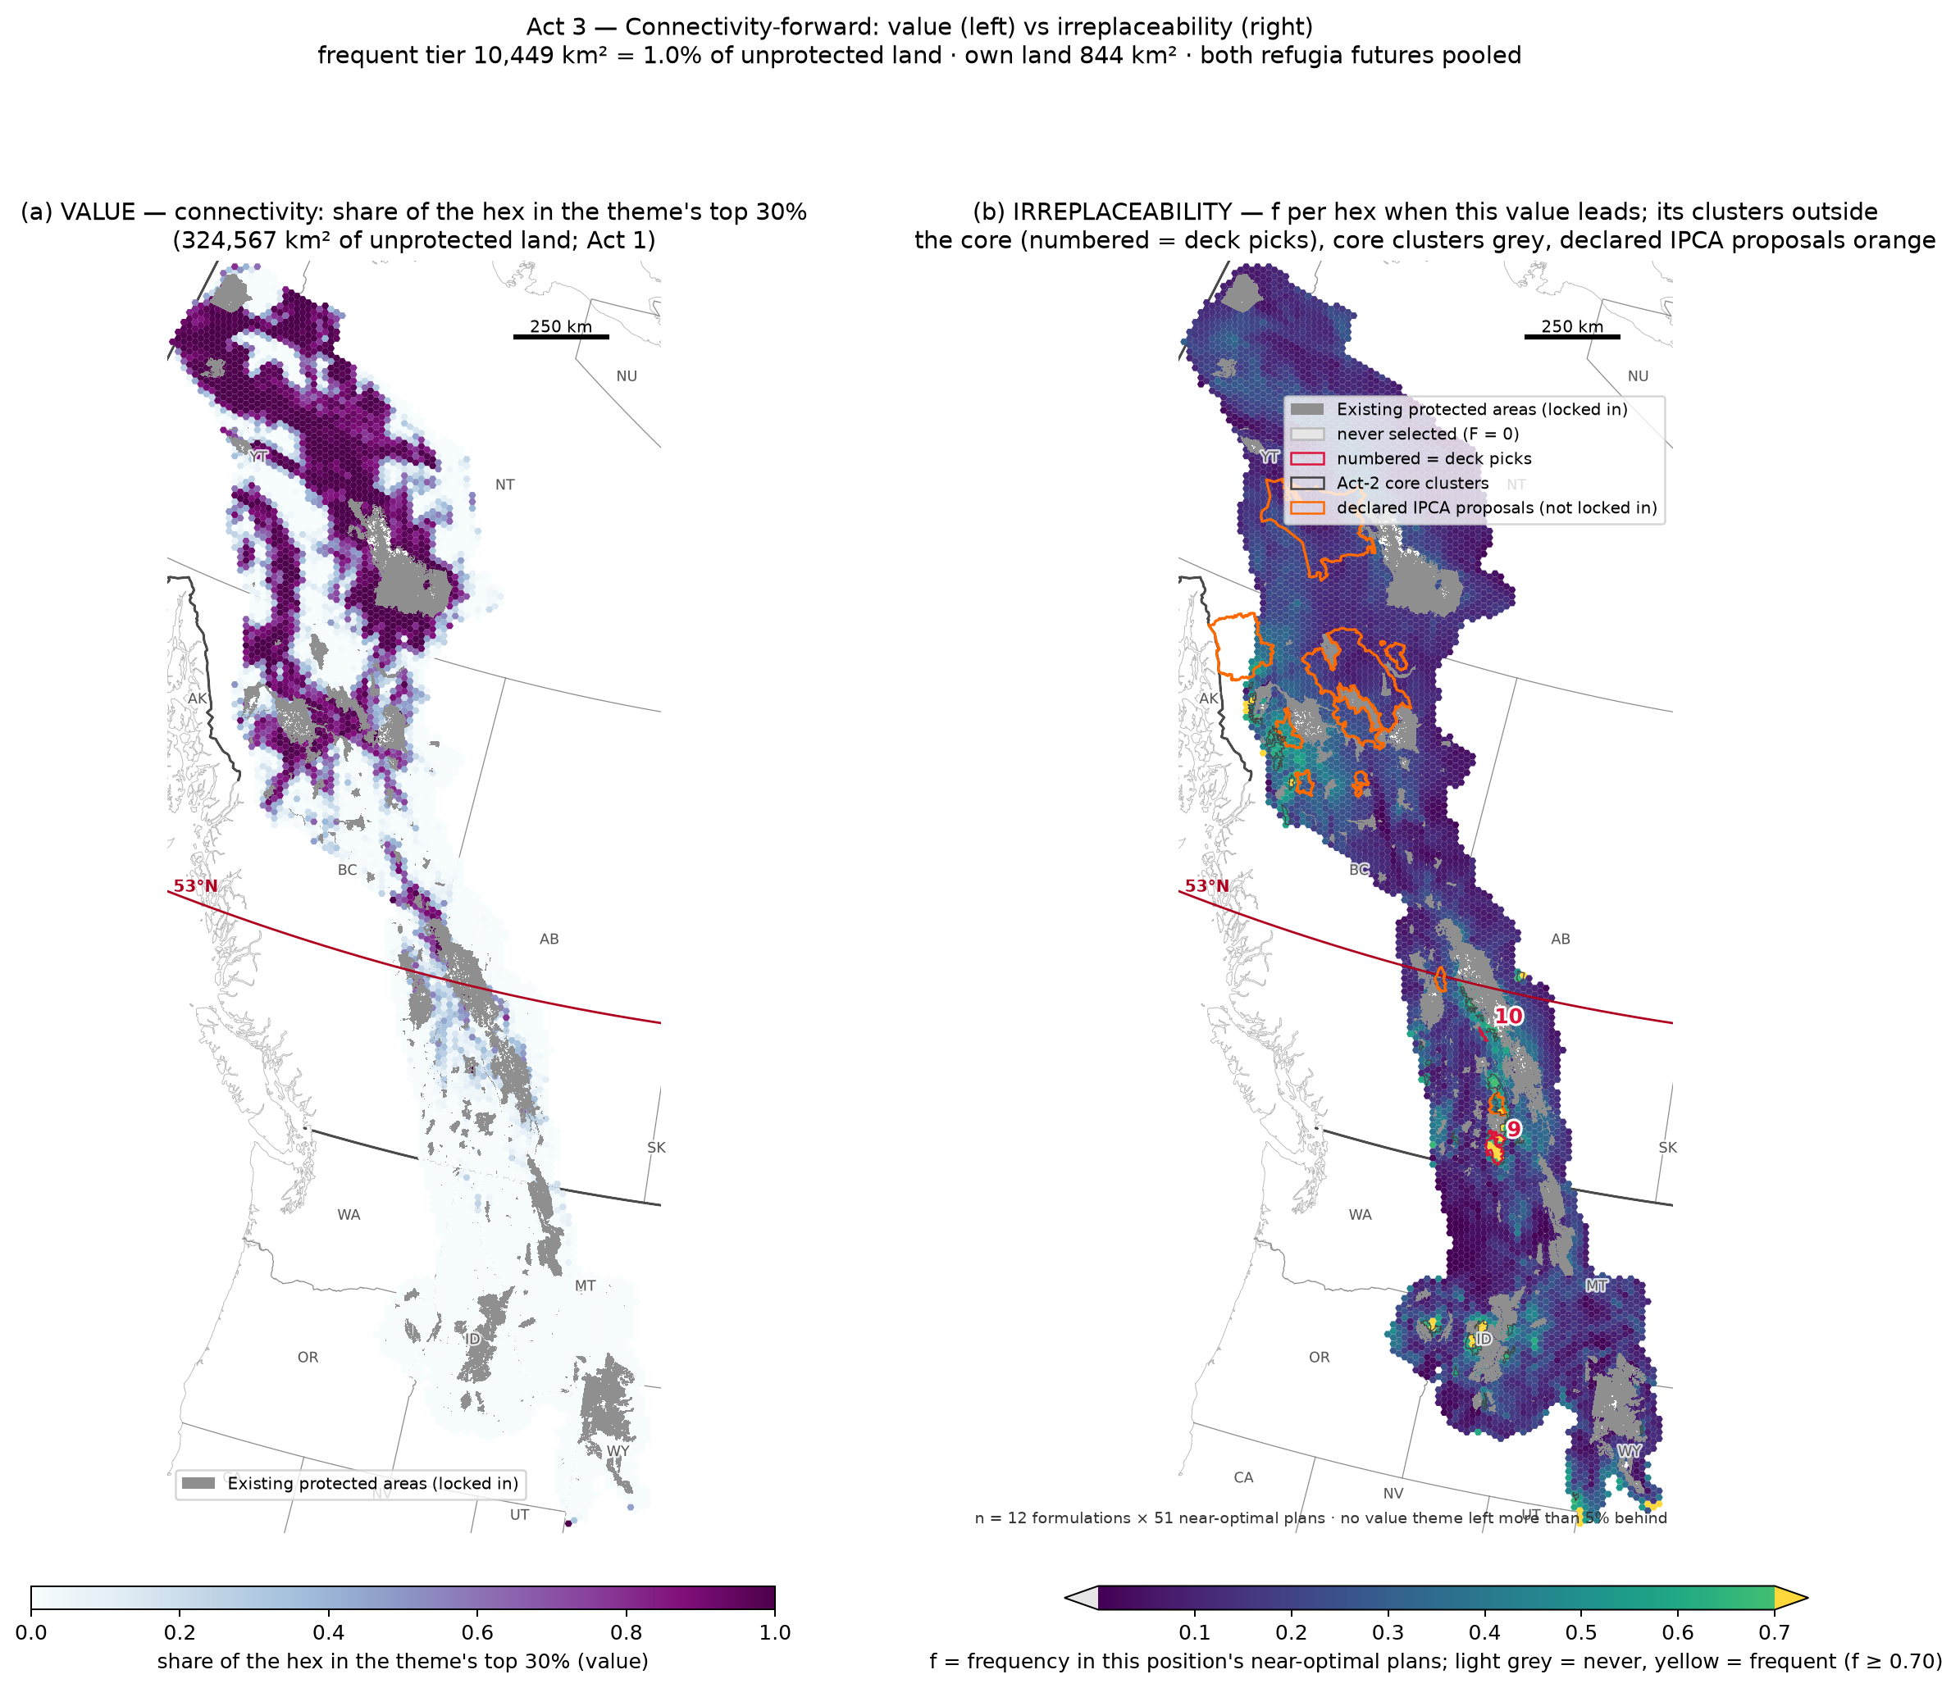
Act 3 — Connectivity-forward: value vs irreplaceability
Left: where the theme's value is (Act 1). Right: what becomes irreplaceable when this value leads — its frequent tier, clusters outside the core numbered
Frequent tier 10,449 km²; own land (outside the core and the other scenarios' tiers) 844 km²
Orange outlines = Nations' declared IPCA proposals — overlap is independent convergence, not assignment
Precedent: the national 30×30 analysis (Currie et al. 2025) reports that proposed IPCAs coincide with priority areas and that Indigenous priorities supersede top-down prioritization — rights and title are not contingent on GBF compatibility

Slide 12
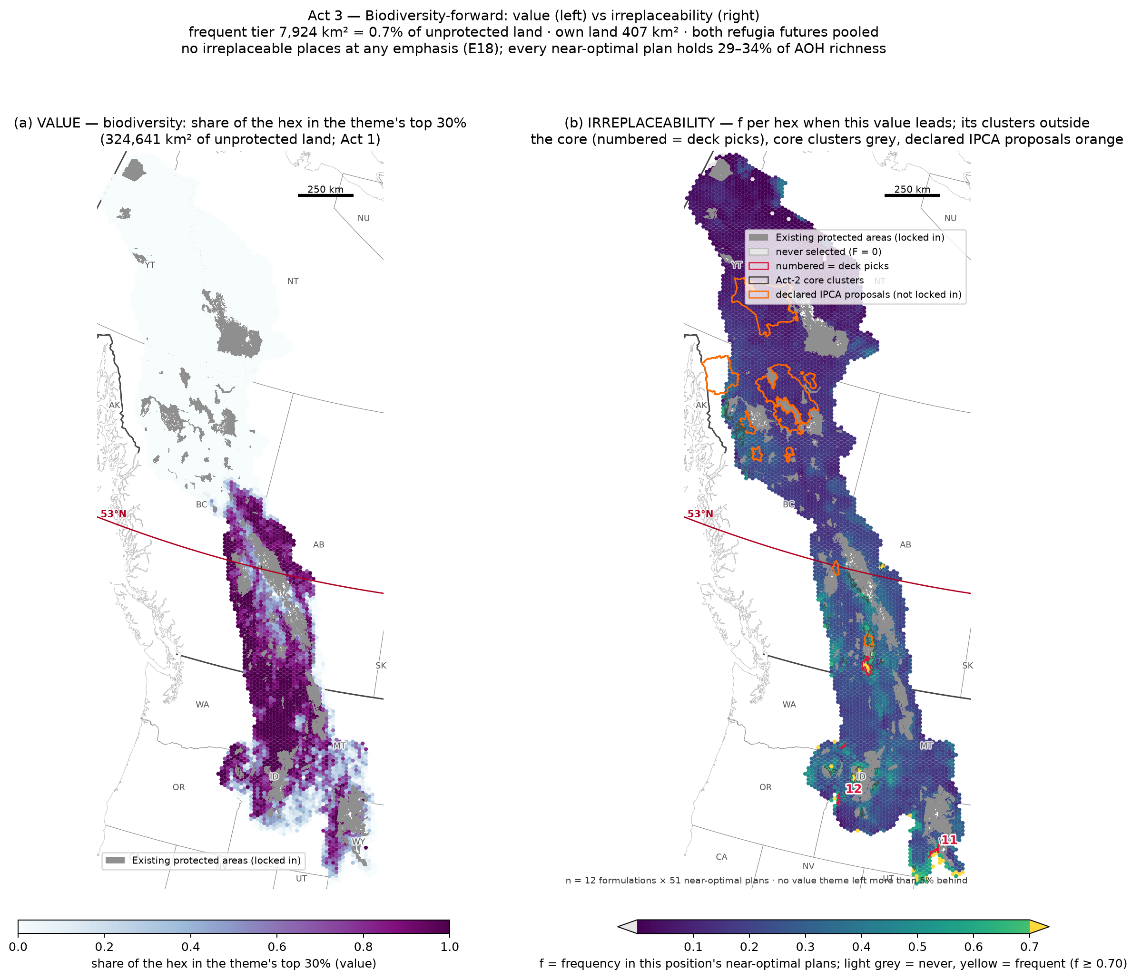
Act 3 — Biodiversity-forward: value vs irreplaceability
Left: where the theme's value is (Act 1). Right: what becomes irreplaceable when this value leads — its frequent tier, clusters outside the core numbered
Frequent tier 7,924 km²; own land (outside the core and the other scenarios' tiers) 407 km²
Orange outlines = Nations' declared IPCA proposals — overlap is independent convergence, not assignment
Precedent: the national 30×30 analysis (Currie et al. 2025) reports that proposed IPCAs coincide with priority areas and that Indigenous priorities supersede top-down prioritization — rights and title are not contingent on GBF compatibility
no irreplaceable places at any emphasis (E18); every near-optimal plan holds 29–34% of AOH richness — the finding IS the product: the value map (left) is where to work

Slide 13
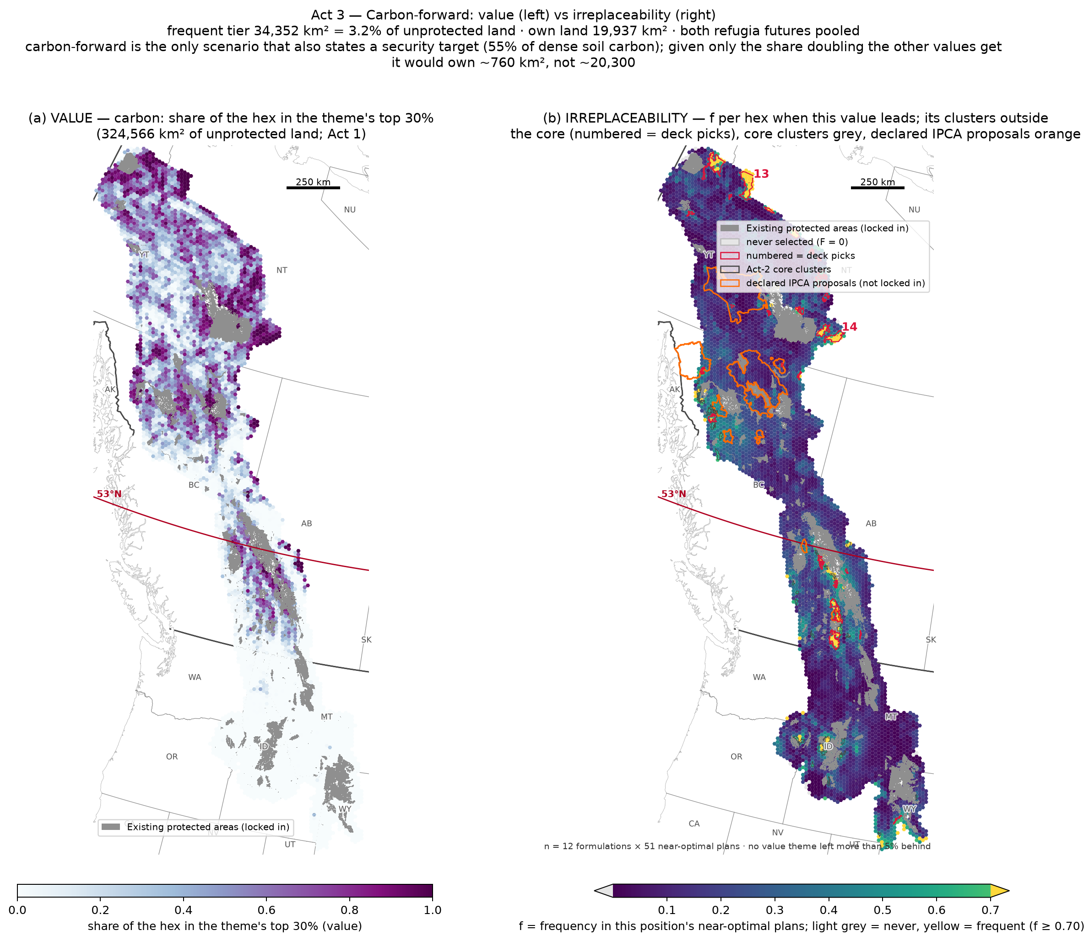
Act 3 — Carbon-forward: value vs irreplaceability
Left: where the theme's value is (Act 1). Right: what becomes irreplaceable when this value leads — its frequent tier, clusters outside the core numbered
Frequent tier 34,352 km²; own land (outside the core and the other scenarios' tiers) 19,937 km²
Orange outlines = Nations' declared IPCA proposals — overlap is independent convergence, not assignment
Precedent: the national 30×30 analysis (Currie et al. 2025) reports that proposed IPCAs coincide with priority areas and that Indigenous priorities supersede top-down prioritization — rights and title are not contingent on GBF compatibility
carbon-forward is the only scenario that also states a security target (55% of dense soil carbon); given only the share doubling the other values get it would own ~760 km², not ~20,300
carbon has a target lever because its geometry admitted a stopping rule; the diffuse values cannot; the asymmetry is the landscape's

Slide 14
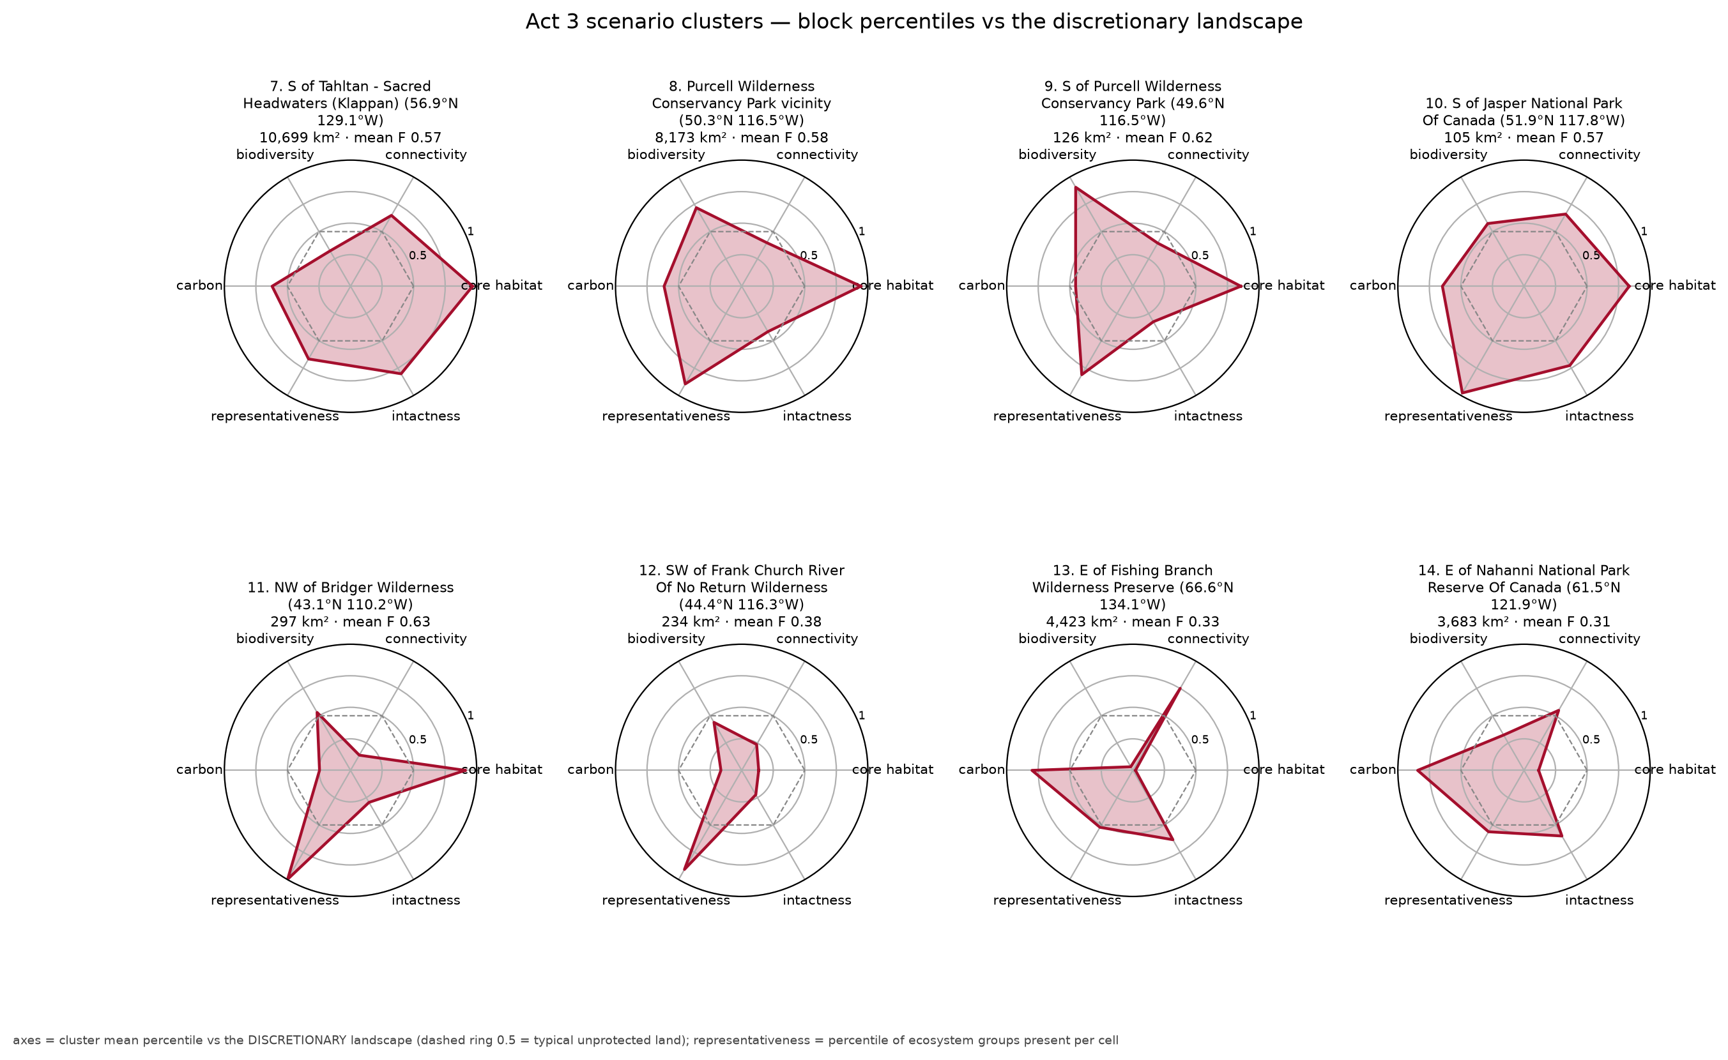
Scenario clusters — value profiles
Each scenario's two largest clusters outside the core
Same radial scale as the core stars

Slide 15
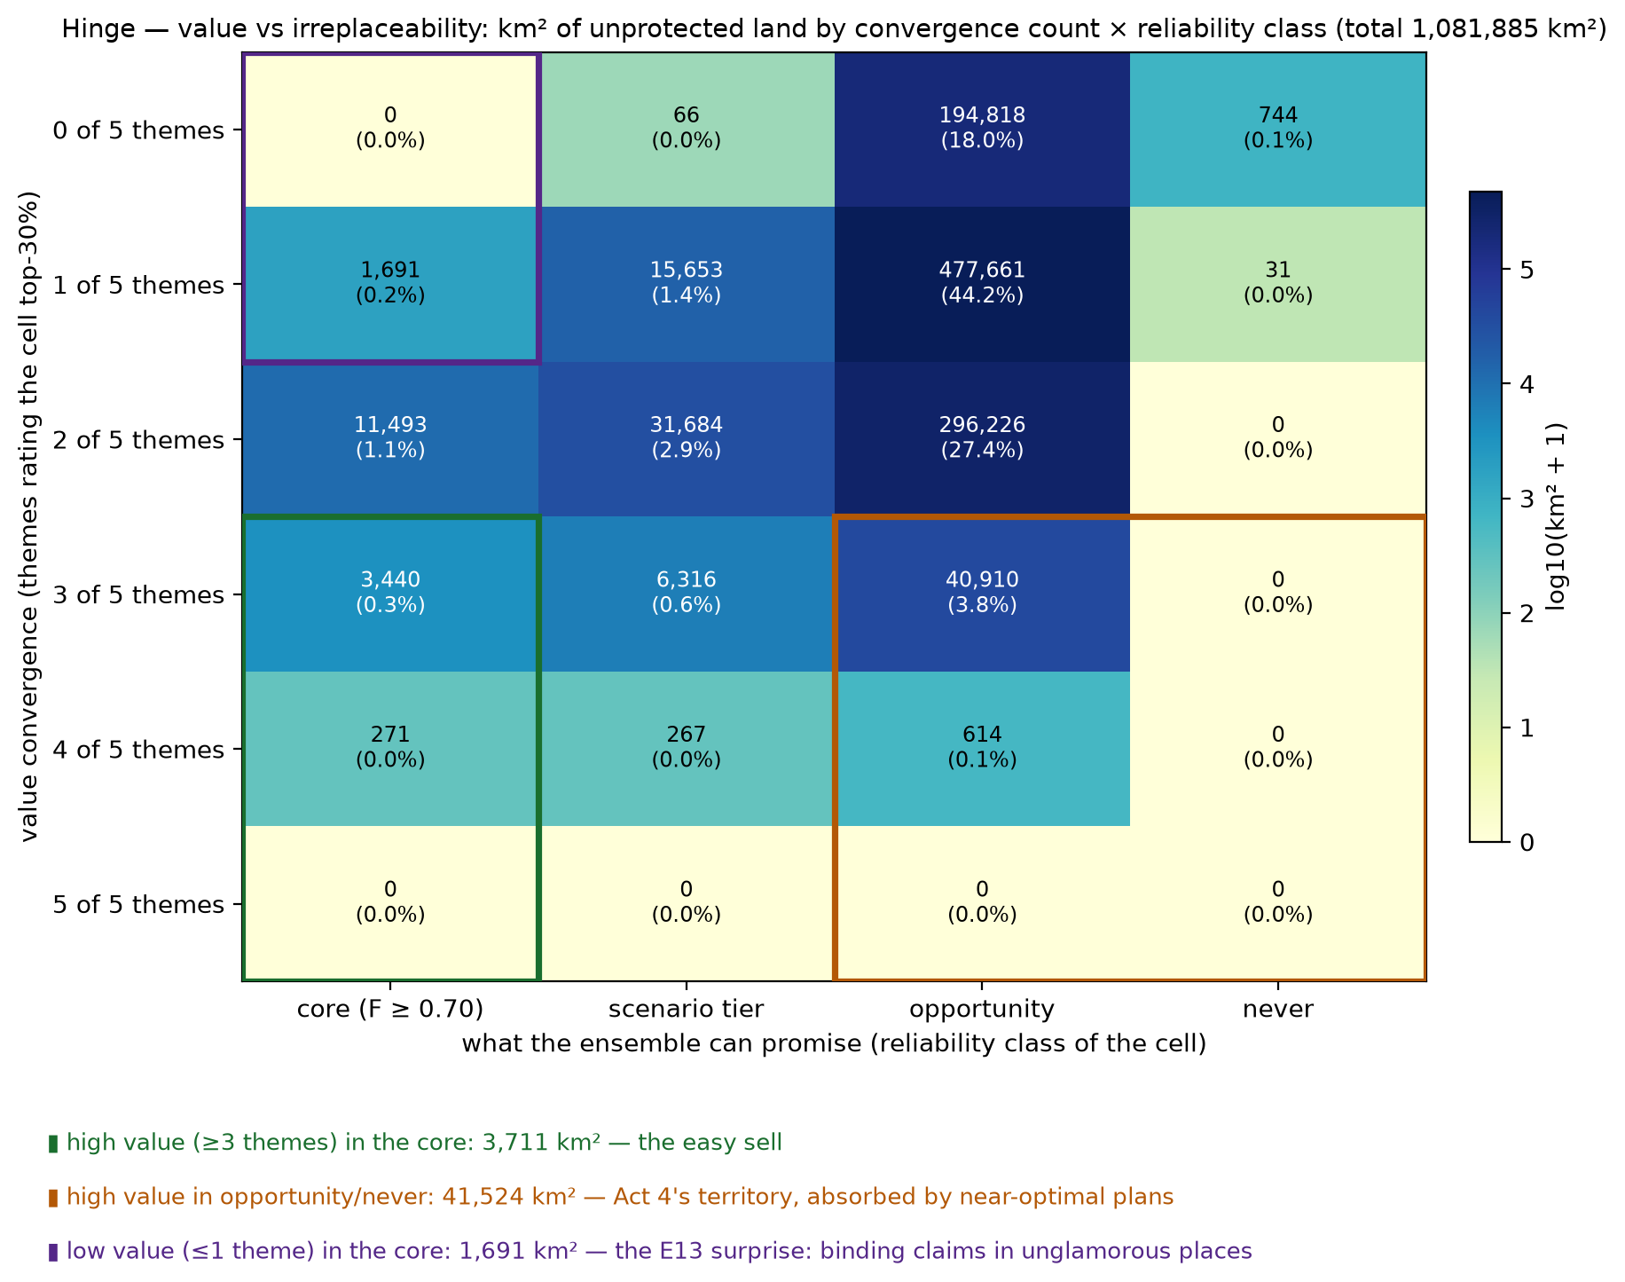
Hinge — value convergence × what can be promised
Rows: how many themes rate the cell top-30%; columns: the ensemble's reliability class
High value / core = the easy sell
High value / opportunity = Act 4's territory — near-optimal plans absorb it
Low value / core = the E13 surprise: binding claims in unglamorous places — point at it in the room

Slide 16
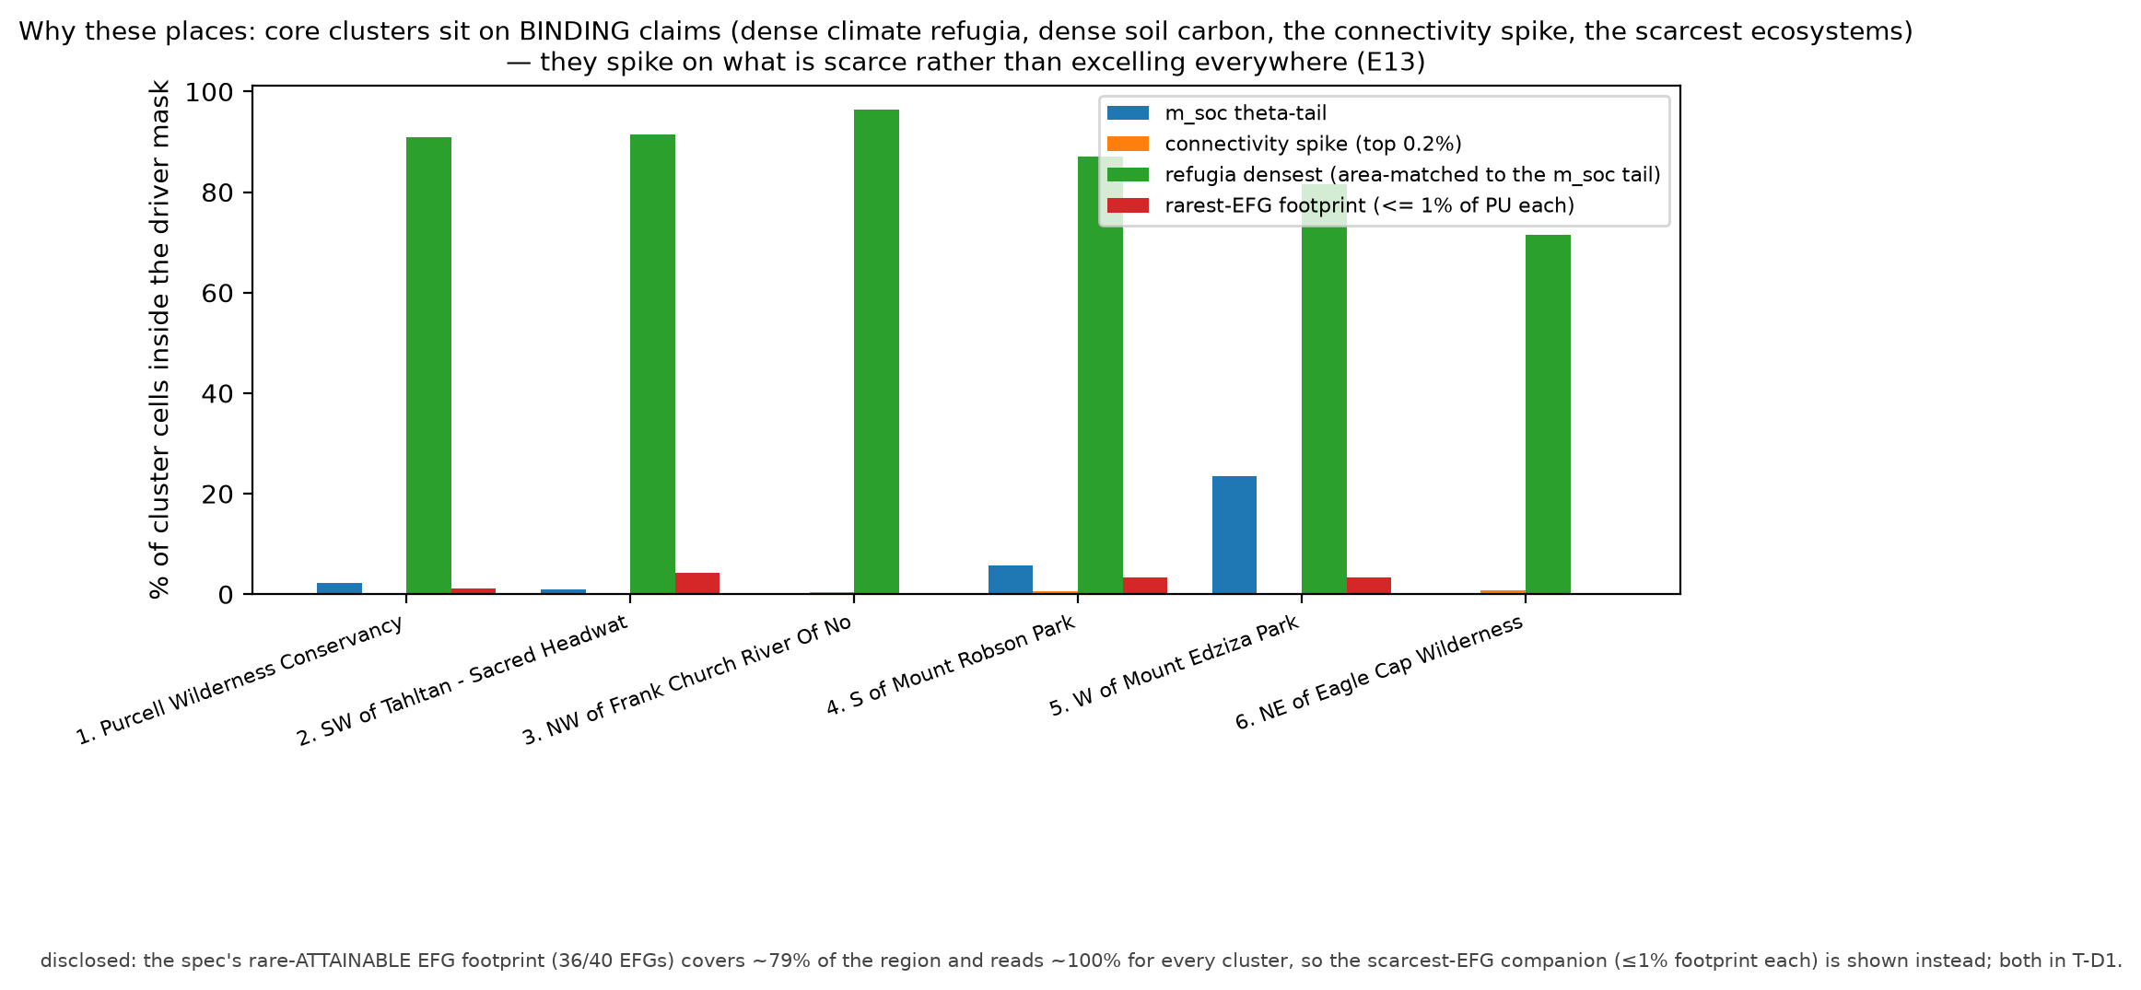
Why these places (driver attribution)
High frequency follows binding scarcity, not the most-valued layer
Dense climate refugia pin the core under every value position; dense soil carbon under carbon-forward values

Slide 17
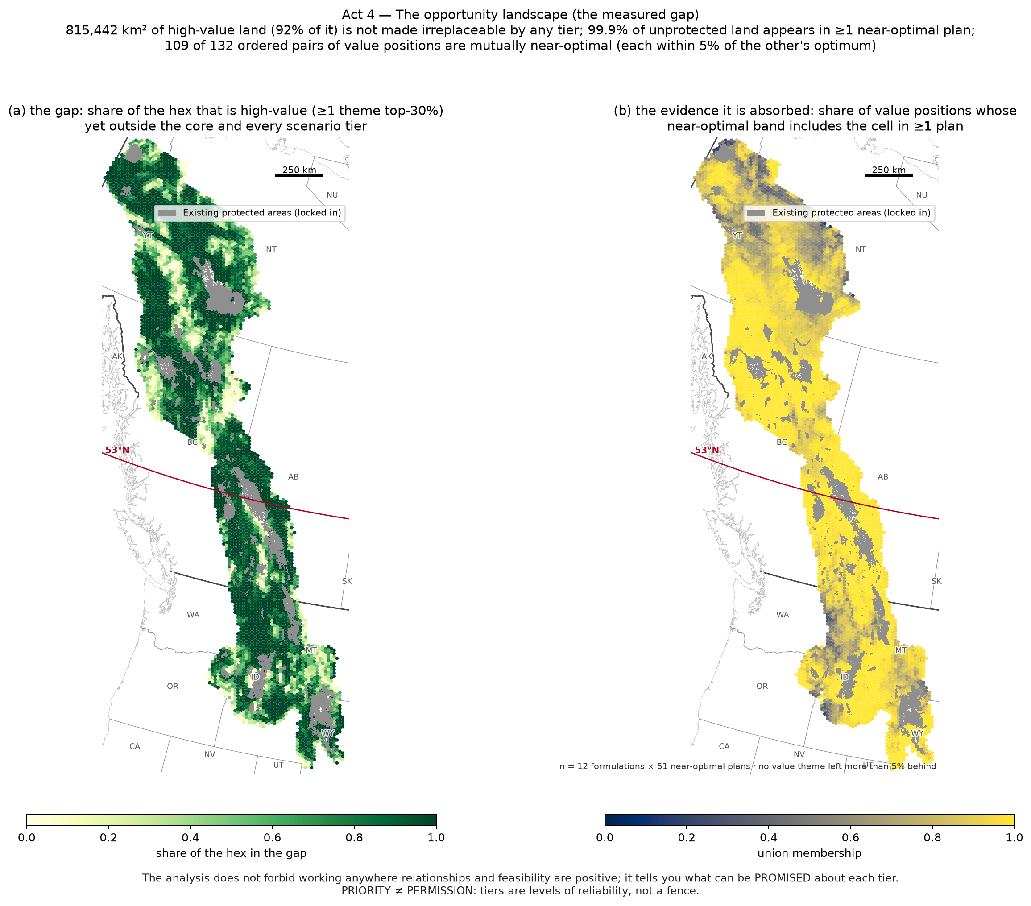
Act 4 — The opportunity landscape: the measured gap
815,442 km² of high-value land (92% of it) sits outside the core and every scenario tier
Near-optimal plans absorb it: 100% of unprotected land appears in ≥1 near-optimal plan; 109/132 pairs of value positions are mutually near-optimal
The analysis does not forbid working anywhere relationships and feasibility are positive — it tells you what can be promised about each tier
PRIORITY ≠ PERMISSION

Slide 18
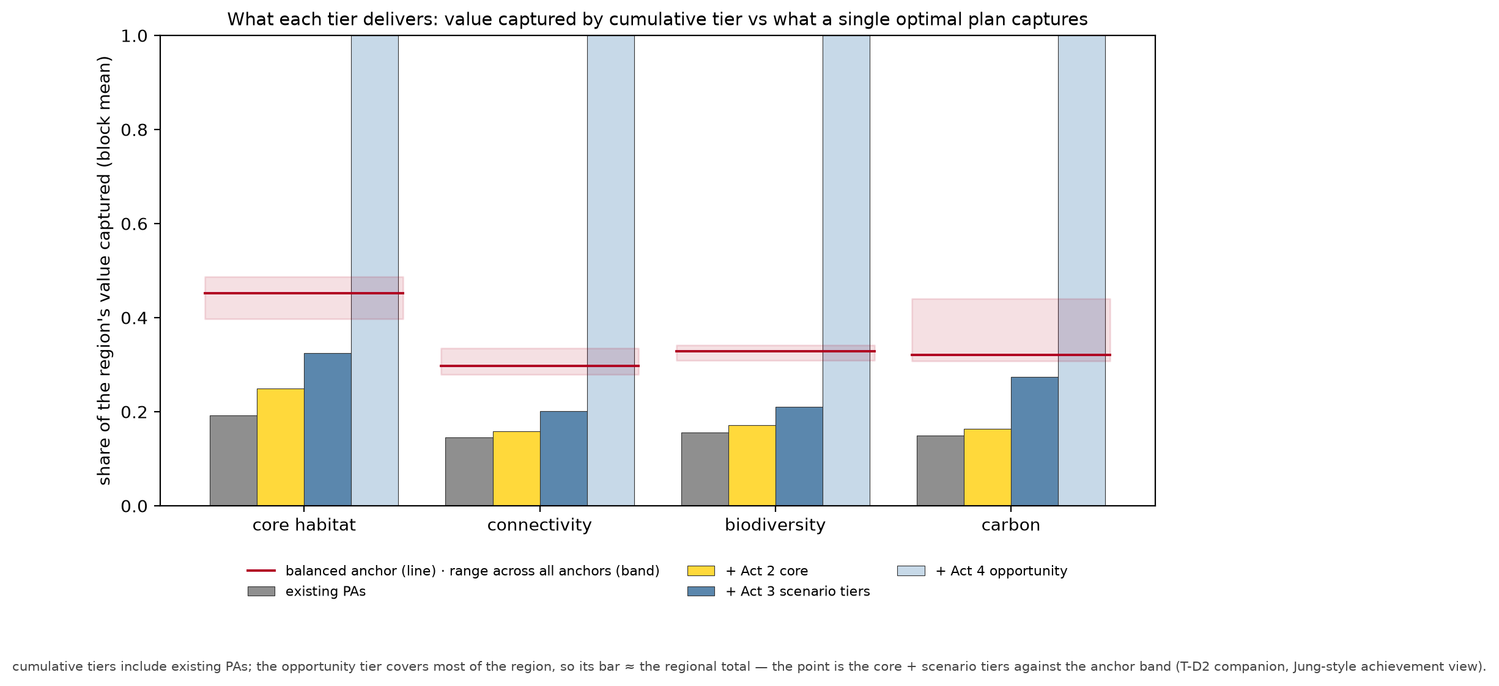
What each tier delivers
Value captured per theme by cumulative tier (PAs → + core → + scenario tiers → + opportunity)
Red line/band = what a single optimal plan captures (balanced; range across all positions)
Pairs with T-D6: the promise per tier, in the currency of each value

Slide 19
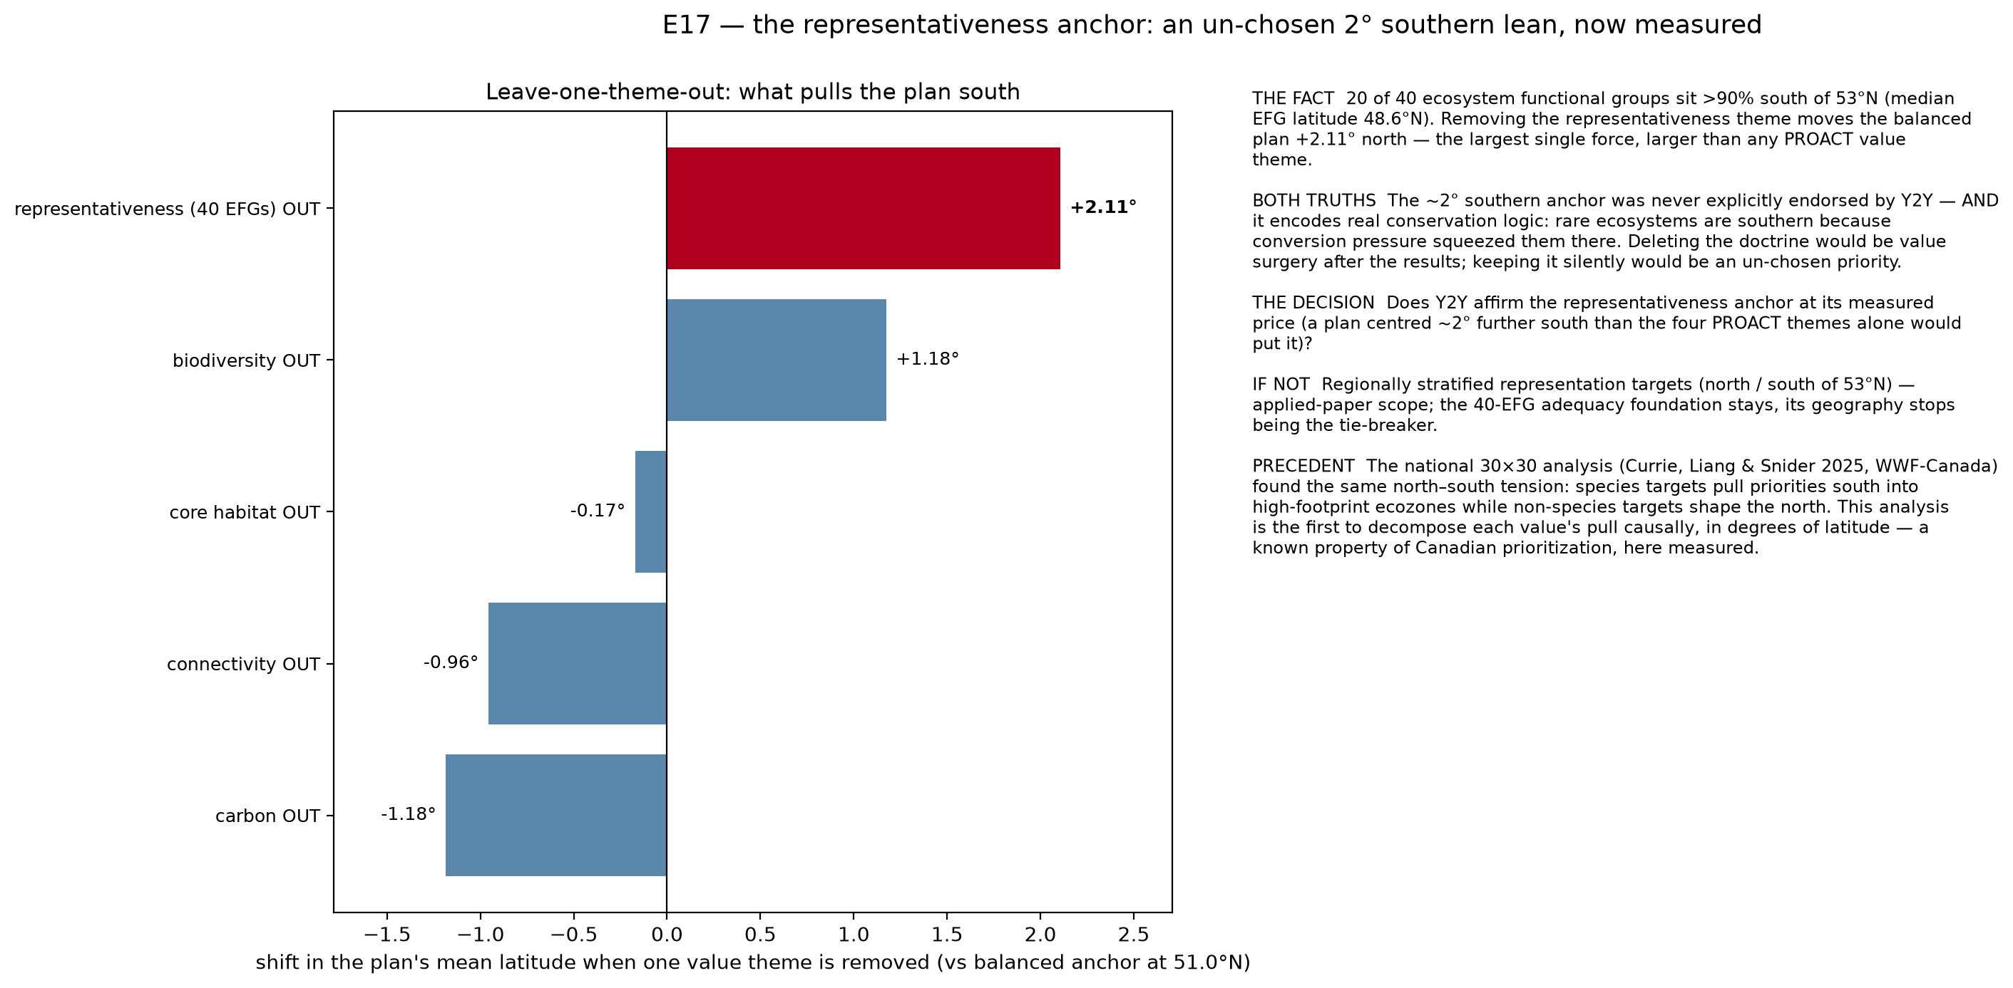
E17 — an un-chosen 2° southern lean
20/40 EFGs >90% south of 53°N
Removing representativeness moves the plan +2.1° north
Decision for Y2Y: affirm the representativeness anchor at its measured price?

Slide 20
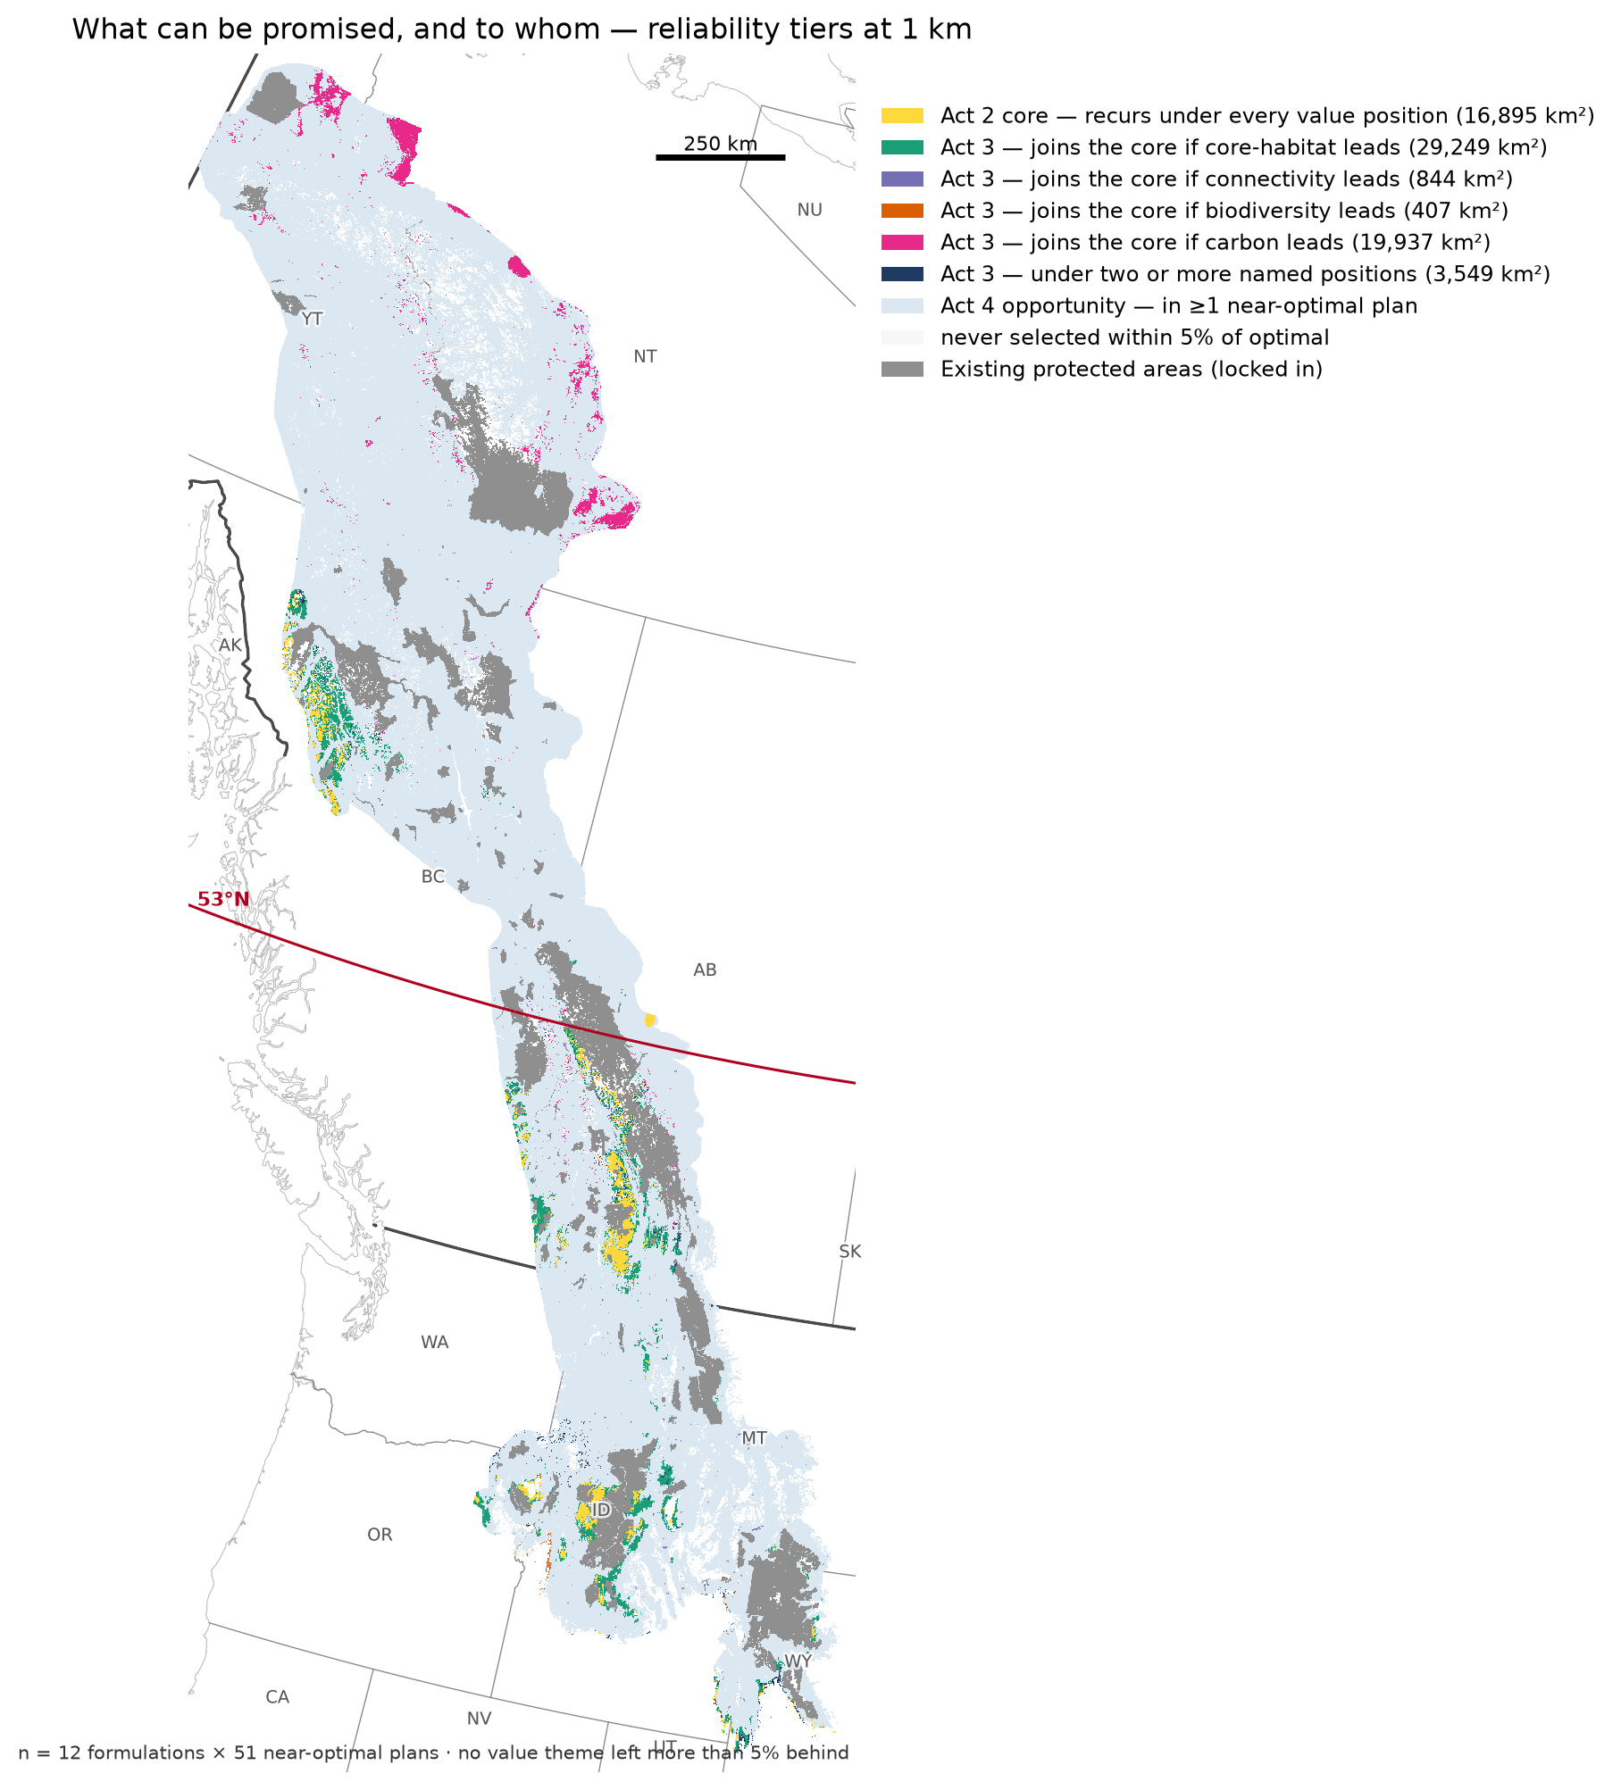
What we can promise — the map in one picture
Yellow = commit regardless of values (Act 2)
Coloured = joins the core if that value leads (Act 3; dark blue = more than one)
Light blue = defensible wherever feasibility is positive (Act 4)
Tiers are levels of reliability, not a fence

Slide 21
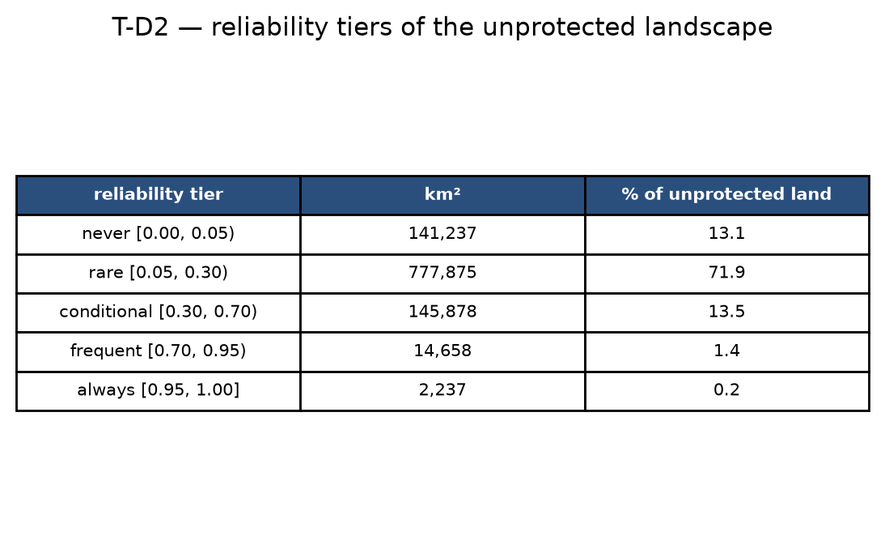
What we can promise
Core: recurs under every value position (commit)
Scenario tiers: join the core if that value leads (choose)
Opportunity: defensible wherever feasibility is positive (enable)
Next: cluster naming, E17 placement, ecoregion layer for T-D4

Slide 22
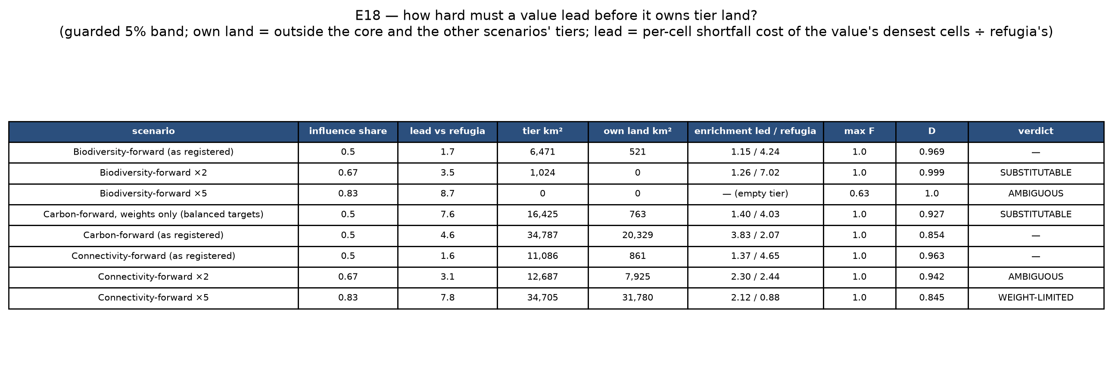
Appendix — How hard must a value lead before it owns land? (E18)
Pre-registered test: raise one value's emphasis and ask whether its tier is its own land or the refugia core under another name
Connectivity: at 2× the elicited emphasis it begins to own land (7,925 km²); at 5× it owns 31,780 km² — weight-limited, so its Act-2 statement holds at the elicited emphasis
Species richness: owns nothing at any emphasis — at 5× the tier is empty (max F 0.63); leaning harder only dissolves the refugia core
Carbon-forward is the one scenario that also states a security target (55% of dense soil carbon); given only the share doubling the others get, it would own 763 km², not 20,329 km² (E18) — the target, not the weight, is what buys carbon its own places
Reading rule for Act 2: each scenario's tier is stated at the elicited emphasis (influence share 0.50)
Notes:
Dose table from 22 (spec/E18_dose_table.csv; results_log R10.13/R10.14, methods_log M4.21/M4.22). 'Lead vs refugia' = per-cell shortfall cost of the led block's 10,000 densest unprotected cells relative to refugia's under the same weights/targets; it is charged only while the value sits below its target, which is why the weights-only carbon arm scores high yet owns almost nothing.

