Slide 1
ArrayList
© A+ Computer Science - www.apluscompsci.com
Lab 16

Slide 2
For each line either write the output or write “Syntax Error” or
“Run-time error”.
String s1 = null;
String s2 = "null";
String s3 = "";
System.out.print(s1.equals(s2));
System.out.print(s2.equals(s1));
System.out.print(s3.equals(s1));

Slide 3
ArrayList
Arraylist is a class that houses an
array.
An ArrayList can store any reference type.
All ArrayLists store the first reference
at spot / index position 0.
© A+ Computer Science - www.apluscompsci.com
Notes:
ArrayList can store a reference to any type of Object. ArrayList was built using an array[] of object references.

Slide 4
What is an array?
int[] nums = new int[10]; //Java int array
0 1 2 3 4 5 6 7 8 9
nums
0 | 0 | 0 | 0 | 0 | 0 | 0 | 0 | 0 | 0
An array is a group of items all of the same type which are accessed through a single identifier.
© A+ Computer Science - www.apluscompsci.com

Slide 5
ArrayList References
ArrayList list;
list
null
null
nothing
list is a reference to an ArrayList.
© A+ Computer Science - www.apluscompsci.com
Notes:
A reference variable is used to store the location of an Object. In most situations, a reference stores the actual memory address of an Object.
list stores the location / memory address of an ArrayList.

Slide 6
ArrayList Instantiation
list = new ArrayList();
0x213
[]
ArrayLists are Objects.
© A+ Computer Science - www.apluscompsci.com

Slide 7
Open
arraylistobjects.java
© A+ Computer Science - www.apluscompsci.com

Slide 8
Generic
ArrayLists
© A+ Computer Science - www.apluscompsci.com

Slide 9
ArrayList
With Java 5, you can now specify which
type of reference you want to store in the ArrayList.
ArrayList<String> words = new ArrayList<String>();
ArrayList<Long> bigStuff = new ArrayList<Long>();
List<Double> decnums = new ArrayList<Double>();
List<It> itList = new ArrayList<It>();
© A+ Computer Science - www.apluscompsci.com
Notes:
In the example above, words can only store String references. decNums can only store Double references.
Java knows the exact type of reference in both ArrayLists; thus, there is no need for casting when accessing class specific methods.
words.add("Hello");
out.println(words.get(0).charAt(0));

Slide 10
Java Collections
Map
Sub
Interfaces
-extends
Collection
Implementing
Classes
SortedMap
Sub
Interfaces
-extends
HashMap
HashTable
Implementing
Classes
List Set
Sub
Interfaces
-extends
Implementing
Classes
TreeMap
SortedSet
Implementing
Classes
ArrayList
LinkedList
Vector
Stack
TreeSet
AbstractSet
HashSet
LinkedHashSet
© A+ Computer Science - www.apluscompsci.com
Notes:
This Collections hierarchy chart is very important. It is a must to know which classes implement which interfaces and which interfaces extend which interfaces.

Slide 11
Arrays can store primitives or objects
String[] names = new String[3];
0 1 2
names
null | null | null
names[0] = “Jo”;
names[1] = “Su”;
names
Jo | Su | null

Slide 12
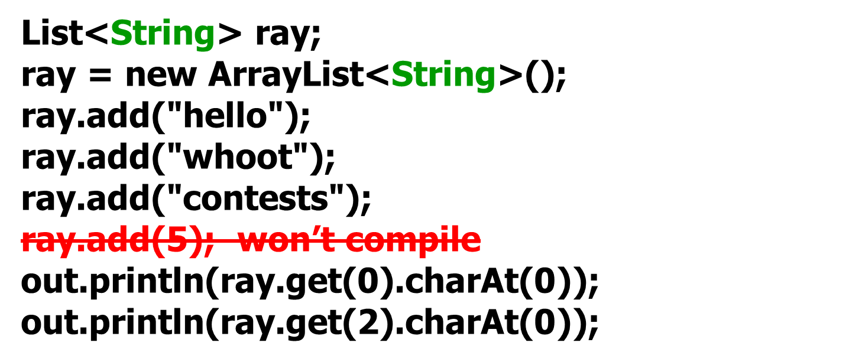
ArrayList
OUTPUT
h
c
ray stores String references.
© A+ Computer Science - www.apluscompsci.com
Notes:
In the example above, ray is an ArrayList that stores String references. Casting would not be required to call non-Object methods on ray.
ray.add(0,"hello");
ray.add(1,"chicken");
out.println(ray.get(0).charAt(0));
out.println(ray.get(1).charAt(5));

Slide 13
ArrayList
ArrayList list = new ArrayList();
list
0x213
0x213
[]
list is a reference to an ArrayList.
© A+ Computer Science - www.apluscompsci.com
Notes:
A reference variable is used to store the location of an Object. In most situations, a reference stores the actual memory address of an Object.
list stores the location / memory address of an ArrayList.

Slide 14
ArrayList
OUTPUT
h
c
List ray = new ArrayList();
ray.add("hello");
ray.add("whoot");
ray.add("contests");
ray.add(5); ← compiles, but . . .
out.println(((String)ray.get(0)).charAt(0));
out.println(((String)ray.get(2)).charAt(0));
out.println(((String)ray.get(3)).charAt(0));
["hello","whoot","contests“,5]
ray stores Object references.
© A+ Computer Science - www.apluscompsci.com
Notes:
In the example above, ray is an ArrayList that stores Object references. In order to call non-Object methods on a spot in ray, casting would be required.
ray.add(0,"hello");
out.println(((String)ray.get(0)).charAt(0));

Slide 15
ArrayList
Will only allow Strings to be added:
ArrayList<String> words = new ArrayList<String>();
ArrayList<String> words = new ArrayList<>();
Compile, but allow addition of non-Strings to list:
ArrayList words = new ArrayList<String>();
ArrayList<String> words = new ArrayList();
Don’t compile:
ArrayList<> words = new ArrayList<String>();
ArrayList<Comparable> words = new ArrayList<String>();
ArrayList<String> words = new ArrayList< Comparable>();
Notes:
In the example above, words can only store String references. decNums can only store Double references.
Java knows the exact type of reference in both ArrayLists; thus, there is no need for casting when accessing class specific methods.
words.add("Hello");
out.println(words.get(0).charAt(0));

Slide 16
Open
arraylistObjectGenerics.java
© A+ Computer Science - www.apluscompsci.com

Slide 17
ArrayList
Methods
© A+ Computer Science - www.apluscompsci.com

Slide 18
ArrayList frequently used methods
Name | Use
boolean add(item) | adds item to the end of the list. Returns true in all cases, because an ArrayList can’t fail to add an object.
void add(spot,item) | adds item at spot (this inserts the object and shifts other items right)
E set(spot,item) | Replace what’s at spot with item (this overwrites that spot. Nothing shifts.) Equivalent to z[spot]=item with an array z. Returns the object, E, that was at spot. Throws indexOutOfBoundException if spot is not valid spot.
© A+ Computer Science - www.apluscompsci.com

Slide 19
add() one
ArrayList<String> words;
words = new ArrayList<String>();
words.add("is");
words.add("a");
words.add("lie");
words.add(0,"it");
out.println(words);
[is]
[is, a]
[is, a, lie]
[it, is, a, lie]
OUTPUT
[it, is, a, lie]
© A+ Computer Science - www.apluscompsci.com
Notes:
The add(item) method adds item to the end of the ArrayList.
The add(spot, item) method adds the item at the spot specified. All other items are shifted toward the end of the ArrayList.

Slide 20
add() two
ArrayList<Integer> nums;
nums = new ArrayList<Integer>();
nums.add(34);
nums.add(0,99);
nums.add(21);
nums.add(11);
out.println(nums);
[34]
[99,34]
[99,34,21]
[99,34,21,11]
OUTPUT
[99,34,21,11]
© A+ Computer Science - www.apluscompsci.com
Notes:
The add(item) method adds item to the end of the ArrayList.
The add(spot, item) method adds the item at the spot specified. All other items are shifted toward the end of the ArrayList.

Slide 21
Open
arraylistaddone.java
arraylistaddtwo.java
© A+ Computer Science - www.apluscompsci.com

Slide 22
set()
ArrayList<Integer> ray;
ray = new ArrayList<Integer>();
ray.add(23);
ray.add(11);
ray.set(0,66);
ray.add(53);
ray.set(1,93);
ray.add(22);
out.println(ray);
[23]
[23,11]
[66,11]
[66,11,53]
[66,93,53]
[66,93,53,22]
Notes:
The add(item) method adds item to the end of the ArrayList.
The set(spot, item) method replaces the reference at spot with item. The location / address of item is placed in spot.

Slide 23
set()
ArrayList<Integer> ray = new ArrayList<Integer>();
ray.add(23);
ray.add(11);
ray.set(0,66);
ray.set(1,93);
int[] ray = new int[3];
ray[0] = 66;
ray[1] = 93;
Notes:
The add(item) method adds item to the end of the ArrayList.
The set(spot, item) method replaces the reference at spot with item. The location / address of item is placed in spot.

Slide 24
ArrayList frequently used methods
Name | Use
E get(spot) | returns the item at spot Equivalent to return z[spot] with an array z.
int size() | returns the # of items in the list Equivalent to z.length with an array z.
import java.util.ArrayList;
© A+ Computer Science - www.apluscompsci.com

Slide 25
size()
for (int i=0; i<ray.size(); i++)
{
out.println(ray.get(i));
}
.size( ) returns the number of elements/items/spots/boxes or whatever you want to call them.
© A+ Computer Science - www.apluscompsci.com
Notes:
The size() method returns the number of items in the ArrayList. If the ArrayList is storing seven references, size() would return a 7.

Slide 26
size()
for (Integer num : ray)
{
out.println(num);
}
Note that an ArrayList can’t hold primitives! So it can hold Integer objects, but not ints.
© A+ Computer Science - www.apluscompsci.com
Notes:
The size() method returns the number of items in the ArrayList. If the ArrayList is storing seven references, size() would return a 7.

Slide 27
get()
ArrayList<Integer> ray;
ray = new ArrayList<Integer>();
ray.add(23);
ray.add(11);
ray.add(12);
ray.add(65);
out.println(ray.get(0));
out.println(ray.get(3));
OUTPUT23
65
.get(spot) returns the reference stored at spot!
© A+ Computer Science - www.apluscompsci.com
Notes:
The get(spot) method returns the reference stored at spot.

Slide 28
get()
ArrayList<Integer> ray;
ray = new ArrayList<Integer>();
ray.add(23);
ray.add(11);
ray.add(12);
ray.add(65);
for(int i=0; i<ray.size(); i++)
out.println(ray.get(i));
OUTPUT23
11
12
65
.get(spot) returns the reference stored at spot!
© A+ Computer Science - www.apluscompsci.com
Notes:
The get(spot) method returns the reference stored at spot.

Slide 29
get()
ArrayList<Integer> ray;
ray = new ArrayList<Integer>();
ray.add(23);
ray.add(11);
ray.add(12);
ray.add(65);
for(Integer num : ray)
out.println(num);
OUTPUT23
11
12
65
.get(spot) returns the reference stored at spot!
© A+ Computer Science - www.apluscompsci.com
Notes:
The get(spot) method returns the reference stored at spot.

Slide 30
Open
arraylistset.java
arraylistget.java
© A+ Computer Science - www.apluscompsci.com

Slide 31
ArrayList frequently used methods
Name | Use
E remove(spot) | Removes the item at spot from the list. Returns the object, E, that was at spot. Throws indexOutOfBoundException if spot is not valid spot.
boolean remove(item) | Removes the object from the list. Returns true if it found the item and removed it, or false if the object was not found in the list.
void clear() | removes all items from the list
import java.util.ArrayList;
© A+ Computer Science - www.apluscompsci.com

Slide 32
remove
methods
© A+ Computer Science - www.apluscompsci.com

Slide 33
remove() one
ArrayList<String> ray;
ray = new ArrayList<String>();
ray.add("a");
ray.add("b");
out.println(ray.remove(0));
ray.add("c");
ray.add("d");
out.println(ray.remove(0));
out.println(ray);
OUTPUT
a
b
[c,d]
© A+ Computer Science - www.apluscompsci.com
Notes:
The remove method will remove the item at the specified spot / location or the specified value. When an item is removed, all items above the removed item are shifted down toward the front of the ArrayList. All items are shifted to the left.
[a, b] becomes [b]
[b, c, d] becomes [c, d]

Slide 34
remove() two
ArrayList<String> ray = new ArrayList<String>();
ray.add("a");
ray.add("b");
out.println(ray.remove("a"));
ray.add("c");
ray.add("d");
out.println(ray.remove("D"));
out.println(ray);
OUTPUT
true
false
[b,c,d]
© A+ Computer Science - www.apluscompsci.com
Notes:
The remove method will remove the item at the specified spot / location or the specified value. When an item is removed, all items above the removed item are shifted down toward the front of the ArrayList. All items are shifted to the left.
[a, b] becomes [b]
[b, c, d] becomes [b, c]

Slide 35
remove() two
ArrayList<String> ray;
ray = new ArrayList<String>();
ray.add("c");
ray.add("a");
ray.add("a");
ray.add("d");
ray.add("a");
while(ray.remove("a"));
out.println(ray);
[c, d]
OUTPUT
Notes:
The remove method will remove the item at the specified spot / location or the specified value. When an item is removed, all items above the removed item are shifted down toward the front of the ArrayList. All items are shifted to the left.
[a, b] becomes [b]
[b, c, d] becomes [b, c]

Slide 36
Open
arraylistremoveone.java
arraylistremovetwo.java
© A+ Computer Science - www.apluscompsci.com

Slide 37
clear()
ArrayList<String> ray;
ray = new ArrayList<String>();
ray.add("a");
ray.add("x");
ray.clear();
ray.add("t");
ray.add("w");
out.println(ray);
OUTPUT
[t, w]
© A+ Computer Science - www.apluscompsci.com
Notes:
The clear() method removes all items from the ArrayList. The ArrayList becomes an [] empty ArrayList.

Slide 38
Open
arraylistclear.java
© A+ Computer Science - www.apluscompsci.com

Slide 39
new for loop
ArrayList<Integer> ray;
ray = new ArrayList<Integer>();
ray.add(23);
ray.add(11);
ray.add(53);
for(Integer num : ray){
out.println(num);
}
OUTPUT
23
11
53
© A+ Computer Science - www.apluscompsci.com
Notes:
The new for loop is great to print out Arrays and Collections. The new for loop extracts an item from ray each time it iterates. The new for loop is an iterator based loop. Once the loop reaches the end of ray, it stops iterating.

Slide 40
Open
newforloopone.java
© A+ Computer Science - www.apluscompsci.com

Slide 41
Start work
on Lab 16
© A+ Computer Science - www.apluscompsci.com

Slide 42
AutoBoxing
AutoUnboxing
© A+ Computer Science - www.apluscompsci.com

Slide 43
Wrapper Classes
primitive | object
byte | Byte
short | Short
int | Integer
long | Long
float | Float
double | Double
char | Character
boolean | Boolean
== | .equals()
© A+ Computer Science - www.apluscompsci.com
Notes:
For each of the primitive types, there is a corresponding wrapper class.
int has a corresponding wrapper class named Integer.
int stores a non-decimal value.
Integer stores the location / memory address of an Integer Object which stores an int value.
double has a corresponding wrapper class named Double.
double stores decimal and non-decimal values.
Double stores the location / memory address of a Double Object which stores a double value.

Slide 44
Wrapper Classes
x is an int:
x == 5
str is a String:
str.equals("Y“)
y is an Integer:
y == 5
or
y.equals(5)
© A+ Computer Science - www.apluscompsci.com
Notes:
For each of the primitive types, there is a corresponding wrapper class.
int has a corresponding wrapper class named Integer.
int stores a non-decimal value.
Integer stores the location / memory address of an Integer Object which stores an int value.
double has a corresponding wrapper class named Double.
double stores decimal and non-decimal values.
Double stores the location / memory address of a Double Object which stores a double value.

Slide 45
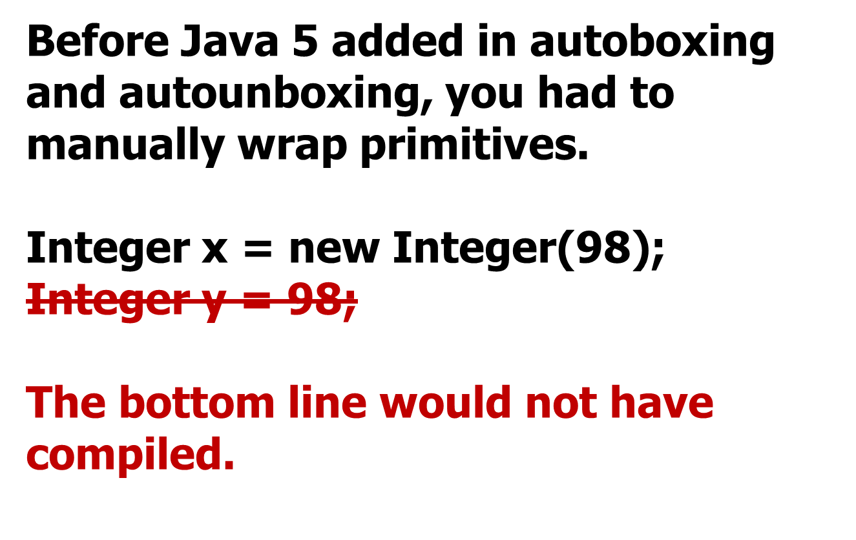
Box/Unbox
© A+ Computer Science - www.apluscompsci.com
Notes:
Before autoboxing and autounboxing, a reference could only refer to a primitive if a Wrapper class was instantiated and the primitive passed to the constructor.

Slide 46

Box/Unbox
Java now wraps automatically.
Integer x = new Integer(98);
Integer x = 98;
These two lines are now equivalent.
The bottom line illustrates auto-boxing.
© A+ Computer Science - www.apluscompsci.com
Notes:
Integer numOne = 99; is equivalent to
Integer numOne = new Integer(99);
With the introduction of Java 5, the new Integer() Object instantiation code happens in the background. Java takes care of these details, but does not show the work.

Slide 47
Box/Unbox
Java now wraps automatically.
Double numOne = 99.1;
Double numTwo = new Double(99.1);
=99.1;
=new Double(99.1);
These two lines are equivalent.
© A+ Computer Science - www.apluscompsci.com
Notes:
Double numOne = 99; is equivalent to
Double numOne = new Double(99);
With the introduction of Java 5, the new Double() Object instantiation code happens in the background. Java takes care of these details, but does not show the work.

Slide 48
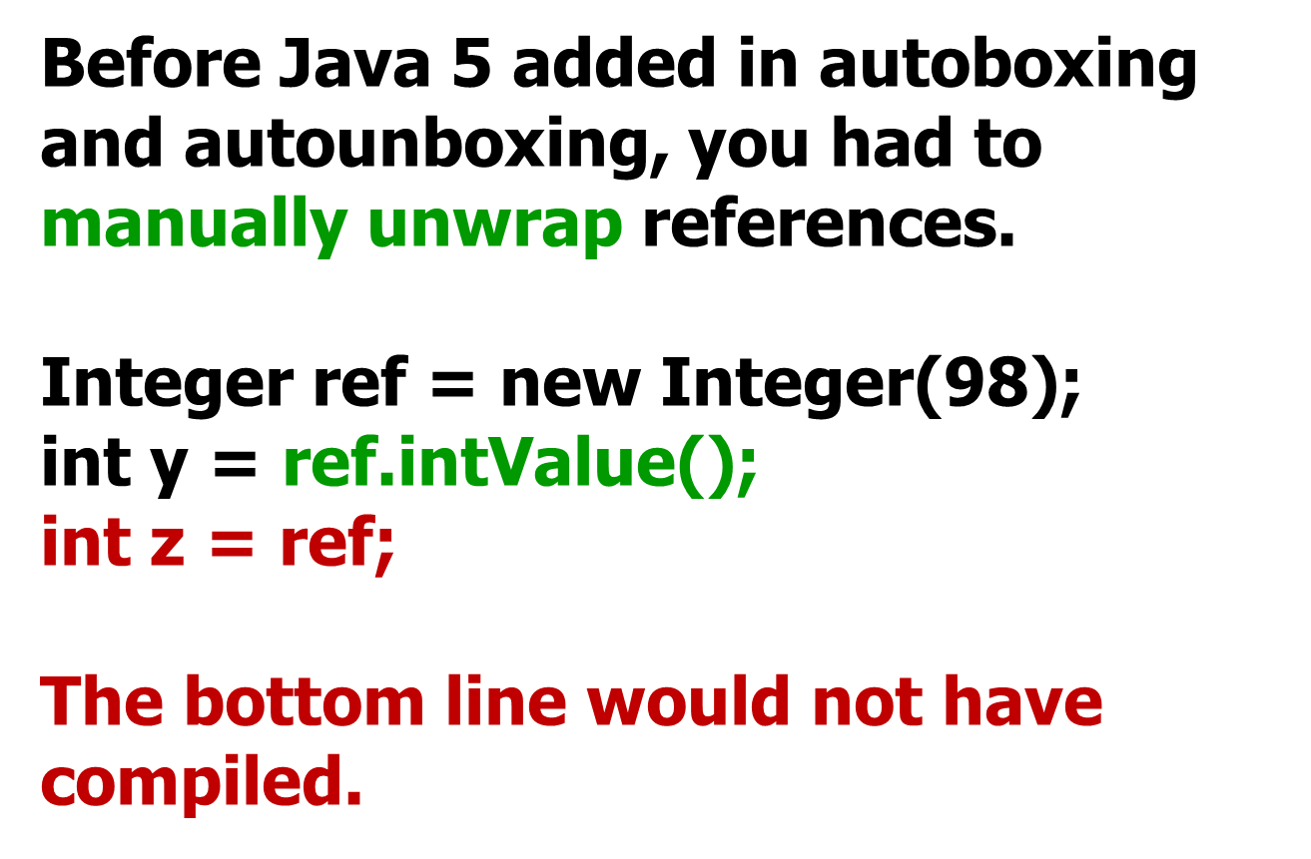
Box/Unbox
© A+ Computer Science - www.apluscompsci.com
Notes:
Before autoboxing and autounboxing, a reference value could only be stored in a primitive if the corresponding reference get method was called to retrieve the primitive value from the reference.

Slide 49
Box/Unbox
Now we have auto-unboxing:
Integer ref = new Integer(98);
int y = ref;
© A+ Computer Science - www.apluscompsci.com
Notes:
Before autoboxing and autounboxing, a reference value could only be stored in a primitive if the corresponding reference get method was called to retrieve the primitive value from the reference.

Slide 50
Box/Unbox
Double dub = 9.3;
double prim = dub;
out.println(prim);
int num = 12;
Integer big = num;
out.println(big.compareTo(12));
out.println(big.compareTo(17));
out.println(big.compareTo(10));
OUTPUT
9.3
0
-1
1
© A+ Computer Science - www.apluscompsci.com
Notes:
Before autoboxing and autounboxing, a reference could only refer to a primitive if a Wrapper class was instantiated and the primitive passed to the constructor.
Before autoboxing and autounboxing, a reference value could only be stored in a primitive if the corresponding reference get method was called to retrieve the primitive value from the reference.
With the introduction of Java 5, the wrapping and unwrapping / boxing and unboxing happens in the background. Java takes care of these details, but does not show the work.

Slide 51
Open
autoboxunbox.java
© A+ Computer Science - www.apluscompsci.com

Slide 52
new for loop
ArrayList<Integer> ray;
ray = new ArrayList<Integer>();
//add some values to ray
int total = 0;
for(Integer num : ray)
{
    total = total + num;
}
out.println(total);
© A+ Computer Science - www.apluscompsci.com
Notes:
The new for loop is great to print out Arrays and Collections. The new for loop extracts an item from ray each time it iterates. The new for loop is an iterator based loop. Once the loop reaches the end of ray, it stops iterating.

Slide 53
new for loop
ArrayList<Integer> ray;
ray = new ArrayList<Integer>();
//add some values to ray
int total = 0;
for(Integer num : ray)
{
//this line shows the AP preferred way
//it shows the manual retrieval of the primitive
total = total + num.intValue();
//the line below accomplishes the same as the line above
//but, it uses autounboxing to get the primtive value
//total = total + num;
}
out.println(total);
OUTPUT153
© A+ Computer Science - www.apluscompsci.com
Notes:
The new for loop is great to print out Arrays and Collections. The new for loop extracts an item from ray each time it iterates. The new for loop is an iterator based loop. Once the loop reaches the end of ray, it stops iterating.

Slide 54
Open
newforloopone.java
newforlooptwo.java
© A+ Computer Science - www.apluscompsci.com

Slide 55
ArrayList with
User-defined
classes
© A+ Computer Science - www.apluscompsci.com

Slide 56
ArrayList w/User Classes
public class Creature implements Comparable
{
//data and constructors now shown
public void setSize(int girth){
size=girth;
}
//compareTo not shown
//toString not shown
}
© A+ Computer Science - www.apluscompsci.com
Notes:
Creature is a class used to store information about Creatures.

Slide 57
ArrayList w/User Classes
ArrayList<Creature> creatures;
creatures = new ArrayList<Creature>();
creatures.add(new Creature(4));
creatures.add(new Creature(9));
creatures.add(new Creature(1));
0 1 2
creatures
0x12 | 0x32 | 0xD2
Creature
4
Creature
9
Creature
1
© A+ Computer Science - www.apluscompsci.com

Slide 58
ArrayList w/User Classes
ArrayList<Creature> creatures;
creatures = new ArrayList<Creature>();
creatures.add(new Creature(4));
creatures.add(new Creature(9));
creatures.add(new Creature(1));
out.println(creatures.get(0));
creatures.get(0).setSize(7);
out.println(creatures.get(0));
out.println(creatures.get(2));
OUTPUT
4
7
1
© A+ Computer Science - www.apluscompsci.com
Notes:
Creatures is an ArrayList that stores reference to Creature objects. In this example, creatures stores the addresses / locations of 3 Creature objects.

Slide 59
ArrayList w/User Classes
creatures.get(0)
.
setSize(7);
0x242
0x242
Creature
What does the . dot do?
What does this return?
The . dot grants access to the Object at the stored address.
© A+ Computer Science - www.apluscompsci.com
Notes:
Creatures.get(0) returns the address / location of a Creature object. Applying a . dot to a reference grants you access to the object referred to by the reference. .setSize() is a Creature method that changes the size property of the Creature.

Slide 60
Open
arraylistuserclassesone.java
© A+ Computer Science - www.apluscompsci.com

Slide 61
Open
creatures.java
creaturesrunner.java
© A+ Computer Science - www.apluscompsci.com

Slide 62
Collections
class
© A+ Computer Science - www.apluscompsci.com

Slide 63
Collections frequently used methods
Name | Use
sort(x) | puts all items in x in ascending order
binarySearch(x,y) | checks x for the location of y
fill(x,y) | fills all spots in x with value y
rotate(x,y) | shifts items in x left or right y locations
reverse(x) | reverses the order of the items in x
import java.util.Collections;
© A+ Computer Science - www.apluscompsci.com

Slide 64
Collections
ArrayList<Integer> ray;
ray = new ArrayList<Integer>();
ray.add(23);
ray.add(11);
ray.add(66);
ray.add(53);
Collections.sort(ray);
out.println(ray); out.println(Collections.binarySearch(ray,66));
out.println(Collections.binarySearch(ray,677));
OUTPUT
[11, 23, 53, 66]
3
-5
© A+ Computer Science - www.apluscompsci.com
Notes:
Collections.sort() will put all items in natural ascending order.
Collectoins.binarySearch() will locate an item. If the item does not exist, binarySearch() will return -1+ -(where the value would be if it was there).
-3 is -1 + -2(2 is the spot where the item would be)

Slide 65
Collections
ArrayList<Integer> ray;
ray = ArrayList<Integer>();
ray.add(23);
ray.add(11);
ray.add(53);
out.println(ray);
rotate(ray,2);
out.println(ray);
rotate(ray,2);
reverse(ray);
out.println(ray);
OUTPUT
[23, 11, 53]
[11, 53, 23]
[11, 23, 53]
© A+ Computer Science - www.apluscompsci.com
Notes:
Collections.rotate() rotates items to the right or to the left a specified number of spots / positions. A negative number rotates to the left and a positive number rotates to the right.
Collections. reverse() reverses the order of all items.

Slide 66
Collections
ArrayList<Integer> ray;
ray = new ArrayList<Integer>();
ray.add(0);
ray.add(0);
ray.add(0);
out.println(ray);
Collections.fill(ray,33);
out.println(ray);
OUTPUT
[0, 0, 0]
[33, 33, 33]
© A+ Computer Science - www.apluscompsci.com
Notes:
Collections.fill() will fill in all spots with a specified value.

Slide 67
Open
binarysearch.java
rotate.java
fill.java
© A+ Computer Science - www.apluscompsci.com

Slide 68
search
methods
© A+ Computer Science - www.apluscompsci.com

Slide 69
ArrayList frequently used methods
Name | Use
boolean contains(x) | checks if the list contains x
int indexOf(x) | checks the list for the location of x
© A+ Computer Science - www.apluscompsci.com

Slide 70
ArrayList<Integer> ray;
ray = new ArrayList<Integer>();
ray.add(23);
ray.add(11);
ray.add(66);
ray.add(53);
out.println(ray);
out.println(ray.indexOf(21));
out.println(ray.indexOf(66));
out.println(ray);
out.println(ray.contains(21));
out.println(ray.contains(66));
OUTPUT
[23, 11, 66, 53]
-1
2
[23, 11, 66, 53]
false
true
© A+ Computer Science - www.apluscompsci.com

Slide 71
Open
search.java
© A+ Computer Science - www.apluscompsci.com

Slide 72
Open
arraylistuserclassestwo.java
© A+ Computer Science - www.apluscompsci.com

Slide 73
Java
Collections
© A+ Computer Science - www.apluscompsci.com

Slide 74
Java Interfaces
The following are important
interfaces included in the
Java language ::
Collection
List
© A+ Computer Science - www.apluscompsci.com

Slide 75
Java Collections
Map
Sub
Interfaces
-extends
Collection
Implementing
Classes
SortedMap
Sub
Interfaces
-extends
HashMap
HashTable
Implementing
Classes
List Set
Sub
Interfaces
-extends
Implementing
Classes
TreeMap
SortedSet
Implementing
Classes
ArrayList
LinkedList
Vector
Stack
TreeSet
AbstractSet
HashSet
LinkedHashSet
© A+ Computer Science - www.apluscompsci.com
Notes:
This Collections hierarchy chart is very important. It is a must to know which classes implement which interfaces and which interfaces extend which interfaces.

Slide 76
The Collection Interface
The Collection interface is the parent of List
and Set. The Collection interface has many
methods listed including add(), clear(),
remove(), and size().
Collection
List
Set
others not shown
© A+ Computer Science - www.apluscompsci.com

Slide 77
The List Interface
The List interface extends the Collection
interface. The List interface adds in the
get() method as well as several others.
List
ArrayList
LinkedList
others not shown
© A+ Computer Science - www.apluscompsci.com

Slide 78
ArrayList
ArrayList is a descendant of List and Collection, but because List and Collection are interfaces, you cannot instantiate them.
Collection bad = new Collection(); //illegal
List ray = new ArrayList(); //legal
ArrayList list = new ArrayList(); //legal
ray and list store Object references.
© A+ Computer Science - www.apluscompsci.com
Notes:
In the example above, ray is an ArrayList that stores Object references. In order to call non-Object methods on a spot in ray, casting would be required.
ray.add(0,"hello");
out.println(((String)ray.get(0)).charAt(0));

Slide 79
Continue work
on Lab 16
© A+ Computer Science - www.apluscompsci.com

