Slide 1
Sets
Lab 07

Slide 2
Java Interfaces
The following are important
interfaces included in the
Java language ::
Collection
Set
Map

Slide 3
Java Collections
Map
Sub
Interfaces
-extends
Collection
Implementing
Classes
SortedMap
Sub
Interfaces
-extends
HashMap
HashTable
Implementing
Classes
List Set
Sub
Interfaces
-extends
Implementing
Classes
TreeMap
SortedSet
Implementing
Classes
ArrayList
LinkedList
Vector
TreeSet
AbstractSet
HashSet
LinkedHashSet

Slide 4
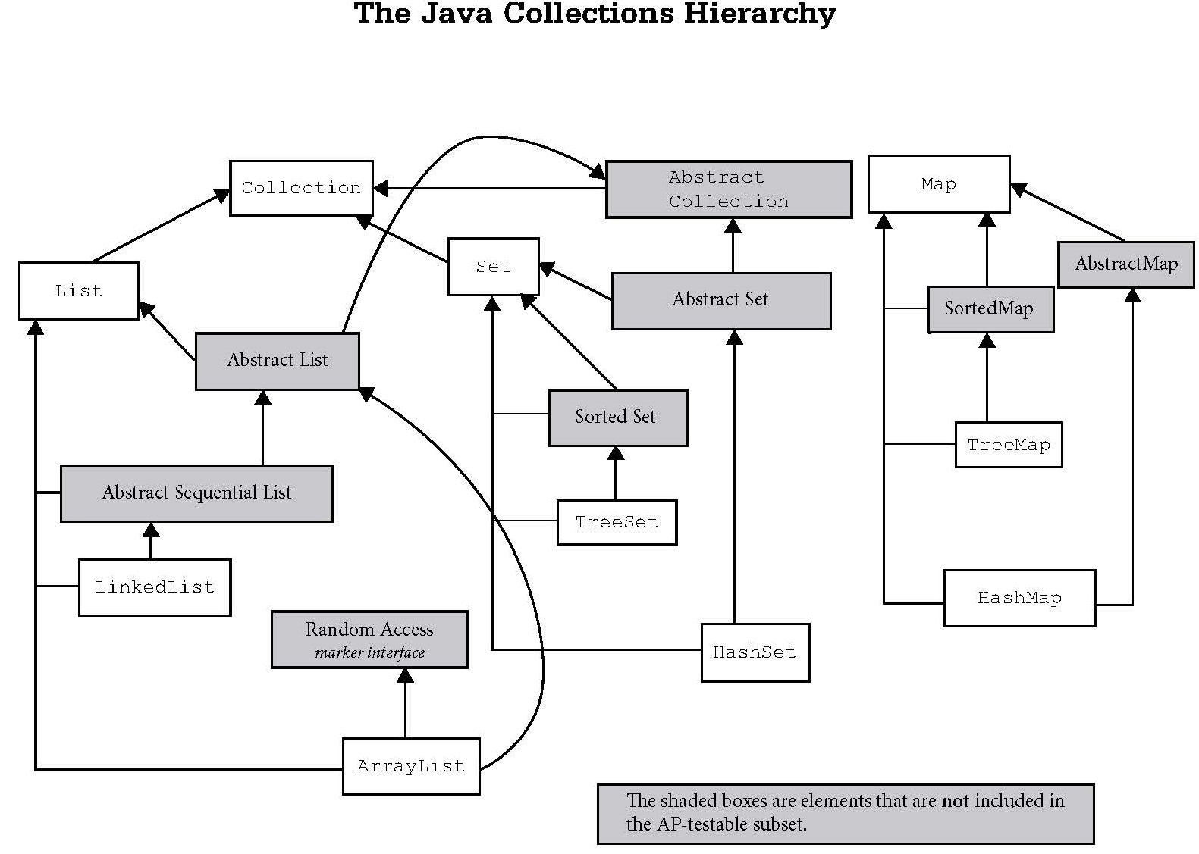
Iterable

Slide 5
The Collection Interface
The Collection interface is the parent of List
and Set. The Collection interface has many
methods listed including add(), clear(),
remove(), and size().
Collection
List
Set
others not shown

Slide 6
The Set Interface
The Set interface extends the Collection
interface.
Set
HashSet
SortedSet
TreeSet

Slide 7
Set
A set is a group of items all of the same type of which none are duplicates.

Slide 8
Set
Because Set is an interface, you cannot instantiate it.
Set bad = new Set(); //illegal
Set hash = new HashSet(); //legal
Set tree = new TreeSet(); //legal
hash and tree store Object references.
Notes:
Interfaces cannot be instantiated.
Set bad = new Set(); //illegal
Set can be used as a reference to one of its children.
Set hash = new HashSet();
Set tree = new TreeSet();

Slide 9
Set
You should always specify which
type of reference you want to store in the TreeSet or HashSet.
Set<Double> bytes = new TreeSet<Double>();
Set<String> its = new HashSet<String>();
Notes:
Interfaces cannot be instantiated.
Set<String> bad = new Set<String>(); //illegal
Set can be used as a reference to one of its children.
Set<Byte> hash = new HashSet<Byte>();
Set<String> tree = new TreeSet<String>();

Slide 10
Set
HashSet – a set ordered by each
item’s hashCode that is extremely time efficient.
TreeSet – a naturally ordered set that is very efficient, but not as efficient as HashSet.

Slide 11
HashTable
HashSet and HashMap were both
created around hash tables.
A hash table is essentially a giant array. Each item is inserted into the array
according to a hash formula.
0 1 2 3 4
Notes:
Hash tables will be explained in great detail later, but the following overview will be enough for now.
Hash tables typically exist in one of two forms.
The first form is a giant array. The drawback with a giant array is that you may have wasted positions in the array where no values are being stored. The other drawback involves determining how big to make the array and when and how to increase the size of the array if needed.
The second and probably more common form involves an array of a predetermined size where items with the same hash value are chained together. The drawback with this form is that many values could have the same hash value causing one position in the array to store most of the values.

Slide 12
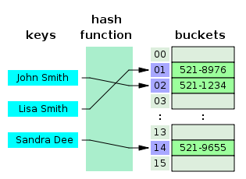
HashTable
The hash function calculates an index from the data item's key and use this index to place the data into the array.
Notes:
In another strategy, called open addressing, all entry records are stored in the bucket array itself. When a new entry has to be inserted, the buckets are examined, starting with the hashed-to slot and proceeding in some probe sequence, until an unoccupied slot is found. When searching for an entry, the buckets are scanned in the same sequence, until either the target record is found, or an unused array slot is found, which indicates that there is no such key in the table.[

Slide 13
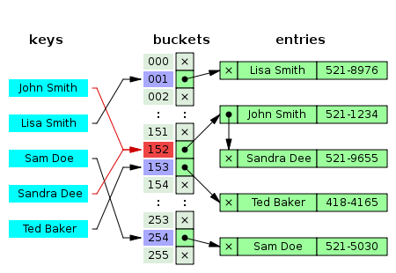
HashTable
The hash function might produce the same hashcode for different keys, which is called a collision.

Slide 14
In the strategy known as separate chaining, each slot of the bucket array is a pointer to a linked list that contains the key-value pairs that hashed to the same location.

Slide 15
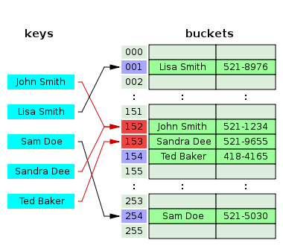
With open addressing, all entry records are stored in the bucket array itself. When a new entry has to be inserted, the buckets are examined, starting with the hashed-to slot and proceeding until an unoccupied slot is found.
Notes:
In another strategy, called open addressing, all entry records are stored in the bucket array itself. When a new entry has to be inserted, the buckets are examined, starting with the hashed-to slot and proceeding in some probe sequence, until an unoccupied slot is found. When searching for an entry, the buckets are scanned in the same sequence, until either the target record is found, or an unused array slot is found, which indicates that there is no such key in the table.[

Slide 16
Binary Tree
TreeSet and TreeMap were built
around binary trees.
A Binary Tree is a group of nodes that
contain left and right references.
Each item is inserted into the tree
according to its relationship to the
other nodes.
2
1
3
Notes:
Binary trees will be explained in great detail later, but the following overview will be enough for now.
Binary Trees are organized data structures that compare new values to existing values to determine placement of the new value.
By rule, smaller items go on the left of the tree and larger items go on the right.

Slide 17
Set
Methods

Slide 18
Set frequently used methods
 | Name | Use
boolean | add(x) | adds item x to the set
boolean | remove(Object) | removes an item from the set
void | clear() | removes all items from the set
Int | size() | returns the # of items in the set

Slide 19
Why does the Set interface not include corollaries to these List methods?
get(int index)
remove(int index)
add(int index, E element)
set(int index, E element)

Slide 20
HashSet add
Set<Integer> intSet;
intSet = new HashSet<Integer>();
System.out.println(intSet.add(45));
intSet.add(12);
System.out.println(intSet.add(12));
intSet.add(23);
System.out.println(intSet);
OUTPUT true
false [45, 23, 12]
Notes:
The add() method for HashSet and TreeSet is a return method. The reason add() is a boolean return method is due to the fact that an add() call may not add anything.
Sets do not store duplicate values so an attempt to add an item that is already present returns false. Attempting to add an item that is not present will return true.

Slide 21
HashSet add
Set<String> stringSet; stringSet = new HashSet<String>();
stringSet.add("AB");
stringSet.add("23");
stringSet.add("ab");
System.out.println(stringSet);
OUTPUT [ab, 23, AB]
Notes:
The ordering of items in a HashSet is not as predicable as the ordering of items in a TreeSet. HashSet orders items using a formula based on each item’s hashCode() whereas a TreeSet orders items using the natural ordering of the type using the item’s compareTo().

Slide 22
Open
hashsetint.java
hashsetstring.java

Slide 23
Quick Creation of a Set
String[] words = “I am Crazy I am".split(" ");
List<String> wordList = Arrays.asList(words); Set<String> set = new TreeSet<String>(wordList); System.out.println(set);
OUTPUT [Crazy, I, am]

Slide 24
Open
SetSplit.java

Slide 25
HashSet remove()
Set<Double> doubleSet;
doubleSet = new HashSet<Double>();
doubleSet.add(2.5);
doubleSet.add(5.8);
doubleSet.add(7.3);
System.out.println(doubleSet);
doubleSet.remove(5.8);
System.out.println(doubleSet.remove(0));
System.out.println(doubleSet);
OUTPUT [7.3, 2.5, 5.8]
false
[7.3, 2.5]
Notes:
The remove() method will remove a specified item if that item is present. If the specified item is not present, remove() simply does nothing.

Slide 26
Open
hashsetremove.java

Slide 27
TreeSet add
Set<Integer> intSet;
intSet = new TreeSet<Integer>();
System.out.println(intSet.add(45));
intSet.add(12);
System.out.println(intSet.add(12));
intSet.add(23);
System.out.println(intSet);
OUTPUT
true false [12, 23, 45]
Notes:
The add() method for HashSet and TreeSet is a return method. The reason add() is a boolean return method is due to the fact that an add() call may not add anything.
Sets do not store duplicate values so an attempt to add an item that is already present returns false. Attempting to add an item that is not present will return true.

Slide 28
TreeSet add
Set<String> stringSet;
stringSet = new TreeSet<String>();
stringSet.add("AB");
stringSet.add("23");
stringSet.add("ab");
System.out.println(stringSet);
OUTPUT [23, AB, ab]
Notes:
The ordering of items in a HashSet is not as predicable as the ordering of items in a TreeSet. HashSet orders items using a formula based on each item’s hashCode() whereas a TreeSet orders items using the natural ordering of the type using the item’s compareTo().

Slide 29
Open
treesetint.java
treesetstring.java

Slide 30
TreeSet remove()
Set<Double> doubleSet;
doubleSet = new TreeSet<Double>();
doubleSet.add(2.5);
doubleSet.add(5.8);
doubleSet.add(7.3);
System.out.println(doubleSet);
doubleSet.remove(5.8);
doubleSet.remove(0.0);
System.out.println(doubleSet);
OUTPUT [2.5, 5.8, 7.3]
[2.5, 7.3]
Notes:
The remove() method will remove a specified item if that item is present. If the specified item is not present, remove() simply does nothing.

Slide 31
Open
treesetremove.java

Slide 32
set output
Set<Double> doubleSet;
doubleSet = new TreeSet<Double>();
doubleSet.add(7.3);
doubleSet.add(2.5);
doubleSet.add(5.8);
Iterator<Double> it;
it = doubleSet.iterator();
while(it.hasNext()){
System.out.println(it.next());
}
OUTPUT 2.5
5.8
7.3
Notes:
The references stored in a set are not necessarily in sequential order. The references may be all over the place in memory.
Iterators are used to access the references in a data structure in a standard way. Iterators access the references in the order specified by the data structure.

Slide 33
Open
setoutput.java

Slide 34
set output new
Set<Double> doubleSet;
doubleSet = new TreeSet<Double>();
doubleSet.add(5.8);
doubleSet.add(7.3);
doubleSet.add(2.5);
for(double dec : doubleSet)
{
System.out.println(dec);
}
OUTPUT 2.5
5.8
7.3
Notes:
The new for loop iterates over all of the references in the set.
The new for loop is a little easier to code and a little easier to read than the standard iterator code needed to do the same job.
for( double dec : doubleSet ) //will iterate as long as the set contains values
//will copy the next value from doubleSet to dec each time the loop iterates
{
//do something
}

Slide 35
Open
setoutputnew.java
setsplit.java

Slide 36
BigO

Slide 37
Big-O Notation
Big-O notation is an assessment of an algorithm’s efficiency. Big-O notation helps gauge the amount of work that is taking place.
Actual runtime function Big-Oh notation
31, 500, etc. O(1)
3n + 1, 5n – 2, etc. O(N)
n² + 5n – 9, 4n² + 12, etc. O(N²)
5n³ – 4n² + 5n – 9, etc. O(N³)
Notes:
Constants, low-order terms, and the coefficient of the highest order term are ignored in assessing big-O run times. This is because for large values of n the highest-order term is much more significant than the others because it grows so much faster.

Slide 38
Big-O frequently used notations
Name | Notation
constant | O(1)
logarithmic | O(log₂N)
linear | O(N)
linearithmic | O(N log₂N)
quadratic | O(N²)
exponential | O(2^{n})

Slide 39
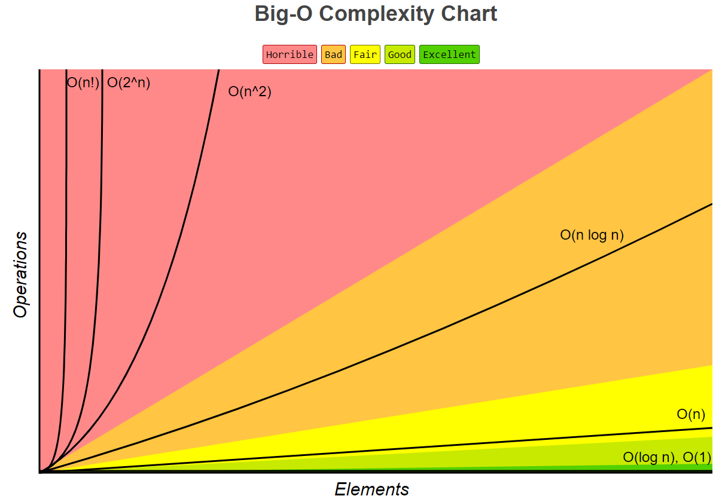

Slide 40
Big-O frequently used notations
n | O(1) | O(log₂N) | O(N) | O(N²) | O(2^{n})
16 | 1 | 4 | 16 | 256 | 65536
128 | 1 | 7 | 128 | 16384 | 3.4E38
1024 | 1 | 10 | 1024 | 1048576 | > 1E99
1048576 | 1 | 20 | 1048576 | 1.1E12 | > 1E99
2^30 | 1 | 30 | 2^30 | 1.2E18 | > 1E99

Slide 41
Examples
1. Search an unordered list of n elements.
Runtime: O(n)
2. Print the last five elements of an large array.
Runtime: O(1)
Notes:
Example 1: Search an unordered list of n elements.
Runtime: It could need n comparisons, so this search algorithm is O(n).
Example 2: Print out the last five elements of an large array.
Runtime: Same irrespective of length of list. The runtime is always 5, so the algorithm is O(1).

Slide 42
Java Collections
Set
Tree Set Hash Set
add O(Log₂N) O(1)
remove O(Log₂N) O(1)
contains O(Log₂N) O(1)
size O(1) O(1)
TreeSets are implemented with balanced binary trees ( red/black trees ).
HashSets are implemented with hash tables.

Slide 43
In the strategy known as separate chaining, each slot of the bucket array is a pointer to a linked list that contains the key-value pairs that hashed to the same location.

Slide 44
Set Theory
addAll
removeAll
retainAll

Slide 45
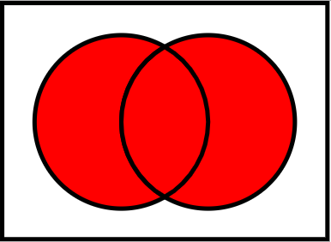
Union
A
B
union.addAll(A)
union.addAll(B)

Slide 46
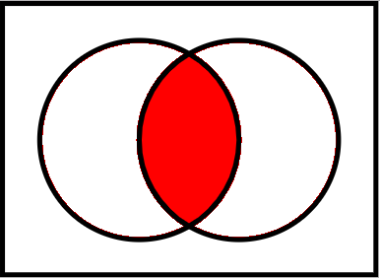
Intersection
A
B
intersection.addAll(A)
intersection.retainAll(B)

Slide 47
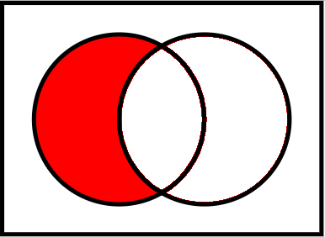
A minus B
A
B
diff.addAll(A)
diff.removeAll(B)

Slide 48
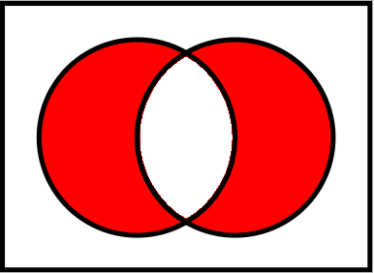
Symmetric Difference
A
B
Two ways!

Slide 49
Symmetric Difference
A
B
diff = new set
diff.addAll(aMinusB(A, B))
diff.addAll(bMinusA(A, B))

Slide 50
Symmetric Difference
A
B
diff = union(A, B)
diff.remove(intersection(A, B))

Slide 51
Symmetric Difference
A
B
diff = union(aMinusB(A, B), bMinusA(A, B))

Slide 52
Start work
on Lab 7

