Slide 1

Queues and
PQueues
Lab 14

Slide 2
What is a Queue?
A queue is a group of items all of the same type where items are added to the back of the queue and removed from the front.
The first item added would be the first item removed. Queues work in a FIFO manner.

Slide 3

What is a Queue?
In England, when you are to stand in a line, they tell you to go get in the queue.

Slide 4
What is a Queue?
An empty integer queue.
Queue<Integer> queue;
queue = new LinkedList<Integer>();
queue will only store integer values.

Slide 5
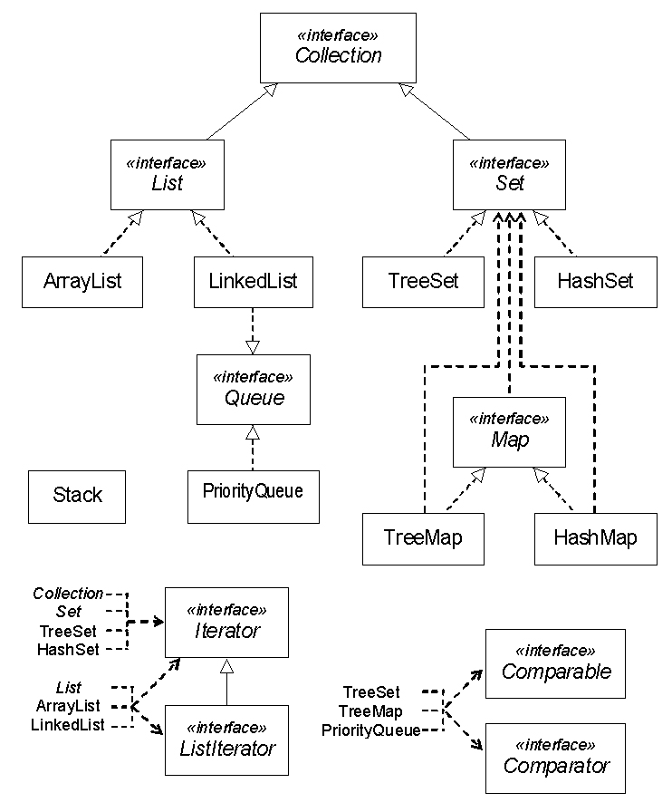

Vector

Slide 6
What is a Queue?
add adds an item to the queue.
enqueue is a very common name given to the operation of adding items to a queue.
queue.add(25);
25

Slide 7
What is a Queue?
add adds an item to the queue.
queue.add(14);
25 | 14

Slide 8
What is a Queue?
add adds an item to the queue.
queue.add(67);
25 | 14 | 67

Slide 9
What is a Queue?
remove removes an item from the queue.
dequeue is a very common name given to the operation of removing items from a queue.
queue.remove();
14 | 67

Slide 10
What is a Queue?
remove removes an item from the queue.
queue.remove();
67

Slide 11
What is a Queue?
add adds an item to the queue.
queue.add(99);
67 | 99

Slide 12
Java Queue Interface
The Queue interface was designed to allow
the use of a queue in java.
The LinkedList class implements the Queue
interface.
If you need a queue, just make a Queue
reference to a LinkedList.

Slide 13
Vector

Slide 14
Queue
Methods

Slide 15
Linked List as a Queue frequently used methods
Name | Use
add(x) | adds item x to the queue
remove() | removes and returns front item
element() | returns the front item with no remove
size() | returns the # of items in the queue
isEmpty() | checks to see if the queue is empty
import java.util.Queue;

Slide 16
add
Queue<Integer> queue;
queue = new LinkedList<Integer>();
queue.add(11);
queue.add(10);
queue.add(7);
out.println(queue);
OUTPUT
[11, 10, 7]

Slide 17
remove
Queue<Integer> queue;
queue = new LinkedList<Integer>();
queue.add(11);
queue.add(10);
queue.add(7);
out.println(queue.remove());
out.println(queue);
OUTPUT
11 [10, 7]

Slide 18
Open
queueadd.java
queueremove.java

Slide 19
peek
Queue<Integer> queue;
queue = new LinkedList<Integer>();
queue.add(11);
queue.add(7);
out.println(queue);
out.println(queue.element());
queue.remove();
out.println(queue.element());
queue.remove();
out.println(queue);
OUTPUT
[11, 7]
11
7
[]

Slide 20
Open
queuepeek.java

Slide 21
Queue Code
Queue<Integer> queue;
queue = new LinkedList<Integer>();
queue.add(11);
queue.add(10);
queue.add(7);
while(!queue.isEmpty())
{
out.println(queue.remove());
}
OUTPUT
11 10 7

Slide 22
Open
queueisempty.java

Slide 23
Summary of Queue methods
 | Throws exception | Returns special value
Insert | add(e) | offer(e)
Remove | remove() | poll()
Examine | element() | peek()

Slide 24
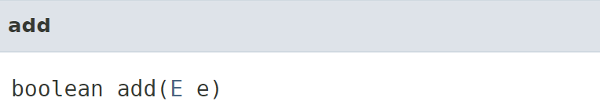
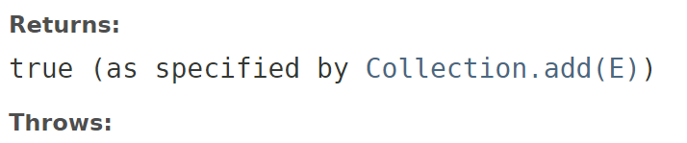

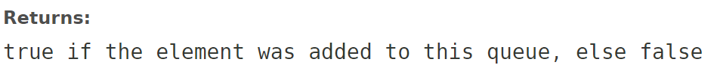
Add vs. Offer
IllegalStateException - if the element cannot be added at this time due to capacity restrictions

Slide 25
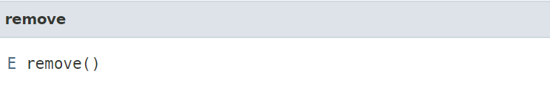
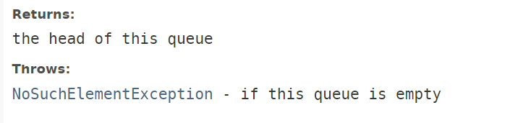
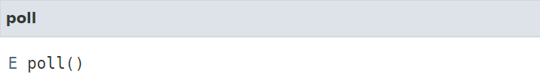

Remove vs. Poll

Slide 26
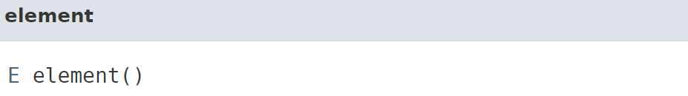
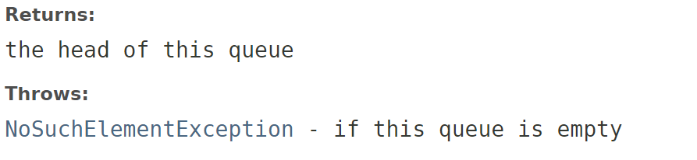
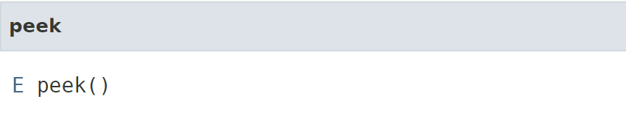
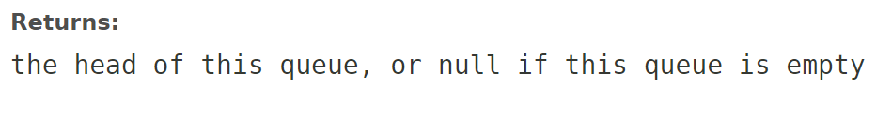
Element vs. Peek

Slide 27
Why are there two versions of the Queue methods?
In some situations it's expected that a queue will be empty, and in those cases having a method that doesn't throw an exception is appropriate.
In other situations it's an exceptional circumstance that the queue is empty, and an exception is appropriate.
Notes:
Throwing exceptions incurs a performance penalty, and if it's the case that you expect the queue to be empty from time to time you don't want to have to handle the queue-empty-logic as catching an exception -- it's both costly and difficult to read.
In the opposite case where you don't expect the queue to ever be empty it is a sign of a programming error, or some other exceptional circumstance that it is, and you don't want to write ugly error condition checking code (e.g. checking for null), because in this case that would be less readable than catching an exception (which you can do in another scope).

Slide 28
When is checking for null better?
Throwing exceptions incurs a performance penalty, and if you expect the queue to be empty from time to time then you don't want to have to handle the empty-queue logic by catching an exception.
It's both costly and difficult to read. It’s easier to check for null.

Slide 29
When is using try-catch better?
A queue being empty when it never should be is a sign of a programming error.
You don't want to write ugly error condition checking code (e.g. checking for null), because in this case that would be less readable than catching an exception (which you can do in another scope).

Slide 30
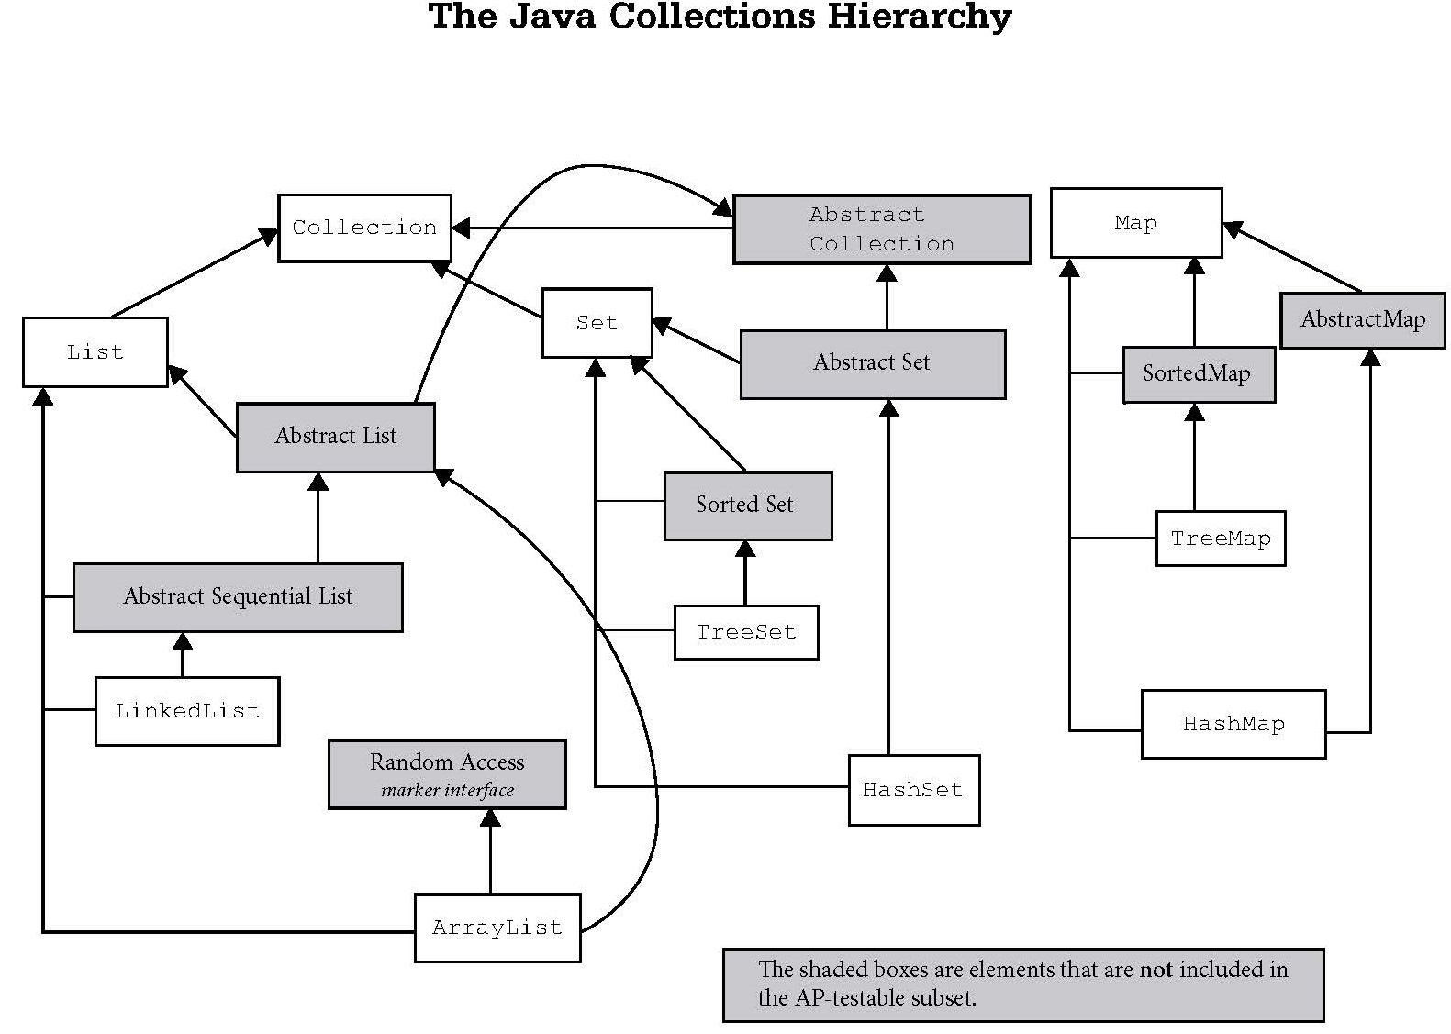
Iterable
Vector
Stack

Slide 32
Start work
on Lab 14

