Slide 1

Queues and
PQueues
Lab 14

Slide 2
Priority Queue
A PriorityQueue is a queue structure that organizes the data inside by the natural ordering or by some specified
criteria.
The Java PriorityQueue is a min heap
as it removes the smallest items first.
The Java PriorityQueue stores Comparables.

Slide 3
Priority Queue
A priority queue is an abstract datatype.
It is a shorthand way of describing a particular interface and behavior, and says nothing about the underlying implementation.
A heap is a data structure.
It is a name for a particular way of storing data that makes certain operations very efficient.

Slide 4
Priority Queue
A priority queue is an abstract datatype.
A heap is a data structure.
It just so happens that a heap is a very good data structure to implement a priority queue, because the operations which are made efficient by the heap data strucure are the operations that the priority queue interface needs.

Slide 5
PQ
Methods

Slide 6
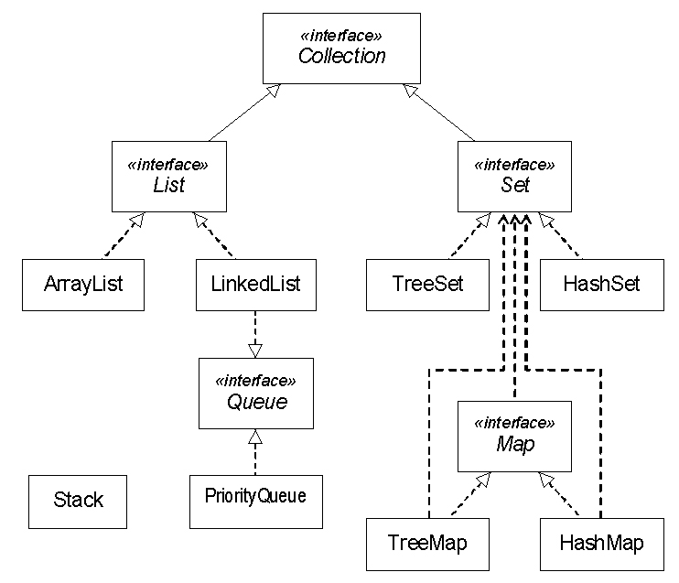

Vector

Slide 7
PriorityQueue frequently used methods
Name | Use
add(x) | adds item x to the pQueue
remove() | removes and returns min priority item
peek() | returns the min item with no remove
size() | returns the # of items in the pQueue
isEmpty() | checks to see if the pQueue is empty

Slide 8
add
PriorityQueue<Integer> pQueue;
pQueue = new PriorityQueue<Integer>();
pQueue.add(11);
pQueue.add(10);
pQueue.add(7);
out.println(pQueue);
OUTPUT
[7, 11, 10]
Notes:
The built-in iterator does not traverse the data structure in any particular order because the underlying data structure doesn't support it. A binary heap is only partially ordered, with the smallest element at the root. When you remove that, the heap is reordered so that the next smallest element is at the root. There is no efficient ordered traversal algorithm so none is provided in Java.

Slide 9
THE HEAP
© A+ Computer Science - www.apluscompsci.com
Lab 18

Slide 10
heap
The heap is essentially an array-based
binary tree with either the biggest
or smallest element at the root.
15
11
10
7
8
9

Slide 11
heap
Every parent in a Heap will always be
smaller or larger than both of its children.
This rule will hold true for every level of
the heap.

Slide 12
complete tree
In a complete tree, every level that can
be filled is filled. Any levels that are not
full have all nodes shifted as far left
as possible.

Slide 13
heap
A Heap is a complete tree.
15
11
10
Not complete:
7
8
9
15
11
10
[ 15, 11, 10, 7, 8, 9 ]
7
8
9
[ 15, 11, 10, 7,null, 8, 9 ]

Slide 14
min heap
9
18
23
20
21
25
A min heap is a binary tree that has
a root smaller than all of its children.

Slide 15
max heap
90
45
43
30
39
38
A max heap is a binary tree that has
a root larger than all of its children.

Slide 16
heap
root
15
11
10
7
8
9
root
15 | 11 | 10 | 7 | 8 | 9

Slide 17
array-based tree
Because a heap will always be a
complete tree, it makes sense to
use an array to store the values.
root
15 | 11 | 10 | 7 | 8 | 9

Slide 18
remove
PriorityQueue<Integer> pQueue;
pQueue = new PriorityQueue<Integer>();
pQueue.add(11);
pQueue.add(10);
pQueue.add(7);
out.println(pQueue); out.println(pQueue.remove());
out.println(pQueue);
OUTPUT
[7, 11, 10] 7 [10, 11]

Slide 19
Open
pqadd.java
pqremove.java

Slide 20
isEmpty
PriorityQueue<Integer> pQueue;
pQueue = new PriorityQueue<Integer>();
pQueue.add(11);
pQueue.add(10);
pQueue.add(7);
while(!pQueue.isEmpty())
{
out.println(pQueue.remove());
}
OUTPUT
7 10 11

Slide 21
Open
pqueueisempty.java

Slide 22
Continue work
on Lab 14

