Slide 1
Linked Lists
Lab 15

Slide 2
Java
LinkedList

Slide 3
Java Collections
Map
Sub
Interfaces
-extends
Collection
Implementing
Classes
SortedMap
Sub
Interfaces
-extends
HashMap
HashTable
Implementing
Classes
List Set
Sub
Interfaces
-extends
RandomAccess
TreeMap
SortedSet
ArrayList
LinkedList
Vector
TreeSet
Implementing
Classes
AbstractSet
HashSet
LinkedHashSet
Implementing
Classes

Slide 4
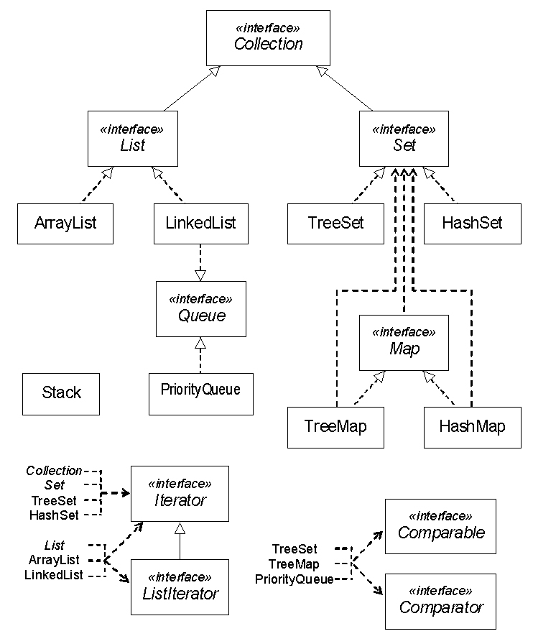

Vector

Slide 6
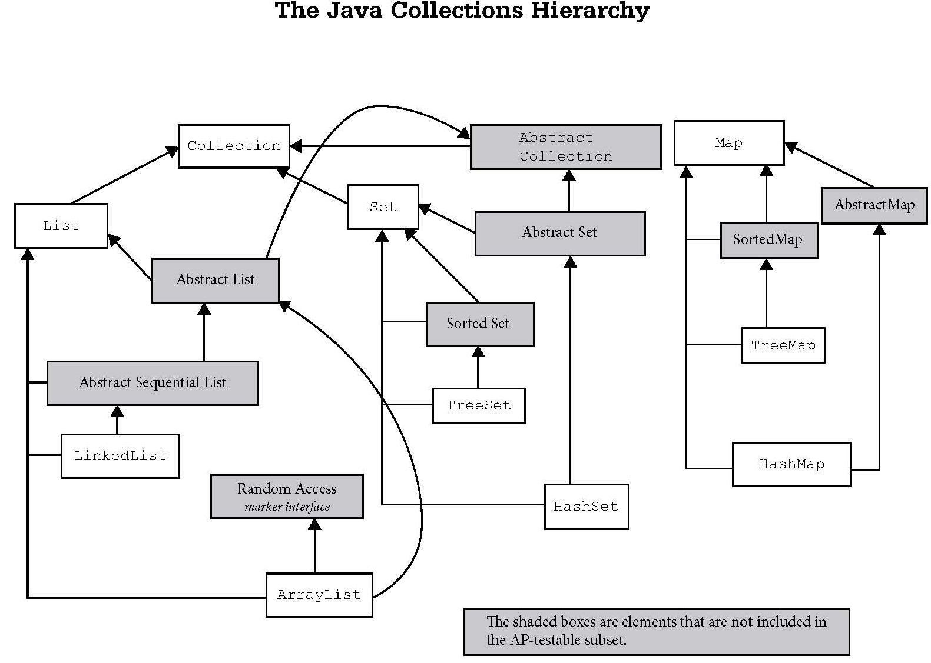
Iterable
Vector
Stack

Slide 7
ArrayList | LinkedList
Uses a dynamic array to store the elements. | Uses a doubly linked list to store the elements.
Manipulation is slow since when any element is removed, all following bits are shifted in memory. | Manipulation is faster because no bit shifting is required in memory.
Can only act as a list since it only implements List. | Can act as a list or queue (including a stack) because it implements List and Deque interfaces.
ArrayList is better for storing and accessing data. | LinkedList is better for manipulating data.

Slide 8
LinkedList
Methods

Slide 9
LinkedList frequently used methods
Name | Use
add(x) | adds item x to the list
set(x,y) | set location x to the value y
get(x) | get the item at location x
size() | returns the # of items in the list
remove() | removes an item from the list
clear() | removes all items from the list
import java.util.LinkedList;

Slide 10
add()
LinkedList<String> list;
list = new LinkedList<String>();
list.add("c");
list.add("b");
list.add("a");
list.add(1, "d");
out.println(list);
OUTPUT
[c, d, b, a]

Slide 11
get()
LinkedList<String> list;
list = new LinkedList<String>();
list.add("c");
list.add("b");
list.add("a");
list.add(1, "d");
out.println(list.get(0) );
out.println(list.get(1) );
out.println("first " + list.getFirst());
out.println("last " + list.getLast());
OUTPUT
c
d
first c
last a

Slide 12
Open
linkedlistadd.java
linkedlistget.java

Slide 13
Open
linkedlistdemo.java

Slide 14
Start work
on Lab 15a

Slide 15
Linked Lists
A linked list is a group of nodes. Each node contains a value and a
reference to the next node in
the list.

Slide 16
Simple Node Class
public class Node
{
private Comparable data;
private Node next;
public Node(Comparable dat, Node nxt)
{
data=dat;
next=nxt;
}
}

Slide 17
A Single Node
0xF2
node
B
null
0xF2
A node typically has a data
component and a reference
to the next node.

Slide 18
Linkable Interface
public interface Linkable
{
Comparable getValue();
Linkable getNext();
void setNext(Linkable next);
void setValue(Comparable value);
}

Slide 19
public class ListNode implements Linkable
{
private Comparable listNodeValue;
private ListNode nextListNode;
public ListNode(){
listNodeValue = null;
nextListNode = null;
}
public ListNode(Comparable value, ListNode next)
{
nextListNode = next;
listNodeValue = value;
}
//other methods not shown
//refer to the Linkable interface
}
The
ListNode
Class
This ListNode class is similar to the AP ListNode.
You can obtain the official AP ListNode class from the college board website. You will be provided with a copy of the AP ListNode class when you take the AP Computer Science AB exam.

Slide 20
Creating A
Single Node
Linkable node = new ListNode("10", null);
out.println(node.getValue());
out.println(node.getNext());
OUTPUT 10 null
0xFA
node
10
null
0xFA

Slide 21
Open
onenode.java

Slide 22
Linking Nodes

Slide 23
Linking Nodes
OUTPUT10 12 11
ListNode x = new ListNode("10",
new ListNode("11",
new ListNode("12",null)));
out.println(x.getValue());
out.println(x.getNext().getNext().getValue());
out.println(x.getNext().getValue());

Slide 24
Open
linkone.java

Slide 25
Linking Nodes
ListNode x = new ListNode("10", null);
ListNode y = new ListNode("11",x);
ListNode z = new ListNode("12",y);
0x12
0x15
0x17
z
12
0x15
11
0x17
10
null
null
0x12
y
x
0x15
0x17

Slide 26
Linking Nodes
ListNode x = new ListNode(10.3, null);
ListNode y = new ListNode(11.0, x);
ListNode z = new ListNode(12.5, y);
z
12.5
11.0
10.3
null
y
x

Slide 27
Linking Nodes
ListNode x = new ListNode(10.3, null);
ListNode y = new ListNode(11.0, x);
ListNode z = new ListNode(12.5, y);
out.println(z.getValue());
out.println(z.getNext().getNext().getValue());
out.println(z.getNext().getValue());
OUTPUT12.5
10.3
11.0

Slide 28
Open
linktwo.java

Slide 29
Using Loops
With Lists

Slide 30
Printing All Nodes
ListNode x = new ListNode("10",
new ListNode("11",
new ListNode("12",null)));
while( x != null )
{
out.println( x.getValue() );
}
OUTPUT10 10 10 . . .

Slide 31
Open
printone.java

Slide 32
Printing All Nodes
ListNode x = new ListNode("10",
new ListNode("11",
new ListNode("12",null)));
while( x != null )
{
out.println( x.getValue() );
x = x.getNext();
}
OUTPUT10 11 12

Slide 33
Open
printtwo.java

Slide 34
Summing All Nodes
ListNode x = new ListNode(11,
new ListNode(8,
new ListNode(5,null)));
int sum=0;
while( x != null )
{
sum = sum + (Integer)x.getValue();
x = x.getNext();
}
out.println(sum);
OUTPUT24

Slide 35
Open
sumone.java

Slide 36
Adding
Nodes

Slide 37
add
0xF2
front
cat
null
0xF2
front = new ListNode(word, null);

Slide 38
add
0xF33
0xF2
front
dog
cat
null
0xF2
0xF33
front = new ListNode(word, front);

Slide 39
add
0xF17
0xF33
0xF2
front
pig
0xF33
dog
0xF2
cat
null
0xF17
front = new ListNode(word, front);

Slide 40
add
OUTPUT
12 10 11
ListNode front=null;
front = new ListNode("10", front);
front = new ListNode("11",front);
front = new ListNode("12",front);
out.println(front.getValue());
out.println(front.getNext().getNext().getValue());
out.println(front.getNext().getValue());

Slide 41
Open
add.java

Slide 42
Finding A
Node

Slide 43
Finding a Node
ListNode list = front;
while ( there are more nodes to check )
{
if( a node containing the value was found )
return true;
move to the next node to check
}
return false;

Slide 44
Open
contains.java

Slide 45
Removing
Nodes

Slide 46
Removing the
First Node

Slide 47
Removing the first node
pig is to be removed.
0xF17
0xF21
0xFEA
front
0xF17
pig
dog
cat
null
0xF21
0xFEA
front refers to the 1st node in the list.

Slide 48
Removing the first node
front = front.getNext();
0xF17
0xF21
0xFEA
front
0xF21
pig
dog
cat
null
0xF21
0xFEA
front moves up one node.

Slide 49
Removing any Node

Slide 50
Removing any node
dog is to be removed. current = front;
0xF17
0xF21
0xFEA
front
0xF17
pig
dog
cat
null
0xF21
0xFEA
current
0xF17
front and current store the same memory address.

Slide 51
Removing any node
previous = current;
0xF17
0xF21
0xFEA
front
0xF17
pig
dog
cat
null
0xF21
0xFEA
current
0xF17
previous
0xF17
front, current, and previous all store the same memory address.

Slide 52
Removing any node
current=current.getNext();
0xF17
0xF21
0xFEA
front
0xF17
pig
dog
cat
null
0xF21
0xFEA
current
0xF17
current
previous
0xF21
0xF17
current moves forward one node.

Slide 53
Removing any node
previous.setNext(current.getNext());
0xF17
0xF21
0xFEA
front
0xF17
pig
dog
cat
null
0xF21
0xFEA
0xFEA
current
previous
0xF21
0xF17
Found dog. Removed dog from the list.

Slide 54
Removing any node
Some things you have to account for!
What if the linked list is null?
2. What if I need to remove the 1st node?
3. How do I process the remaining nodes?
4. Do I remove more than 1 occurrence
of the same value or just the 1st one?

Slide 55
Open
remove.java

Slide 56
Doubly
Linked Lists

Slide 57
DoublyNode Class
class DoublyNode
{
private Comparable data;
private DoublyNode next;
private DoublyNode prev;
public DoublyNode(Comparable dat,
DoublyNode prv, DoublyNode nxt)
{
data=dat;
prev=prv;
next=nxt;
}
//other methods not shown
}

Slide 58
A DoublyNode
0xF2
 | B
null
null
A doubly node typically has a data
component and a reference to the
next node and the previous node.

Slide 59
A DoublyNode
0xF2
0xF4
 | B
 | C
0xF4
0xF4
0xF2
0xF2
Doubly nodes can be used to make
a circular linked list where the front
points at the back and vice versa.

Slide 60
BigO

Slide 61
Big-O Notation
Big-O notation is an assessment of an
algorithm’s efficiency. Big-O notation
helps gauge the amount of work that
is taking place.
Common Big O Notations :
O(1) O(Log₂N)
O(2^{N}) O(N²)
O(N Log₂N) O(N)
O(Log₂N) O(N³)

Slide 62
Single LL BigO
traverse all nodes O(N)
search for an item O(N)
remove any item O(N) location unknown
get any item O(N) location unknown
add item at the end O(N)
add item at the front O(1)
A single linked list node has a reference to the next node only. A single linked list node has no reference to the previous node.
10

Slide 63
Java LL BigO
traverse all spots O(N)
search for an item O(N)
remove any item O(N) location unknown
get any item O(N) location unknown
add item at the end O(1)
add item at the front O(1)
LinkedList is implemented with a double linked list.

Slide 64
Continue work
on Lab 15

