Slide 1
HashTables
Lab 16

Slide 2
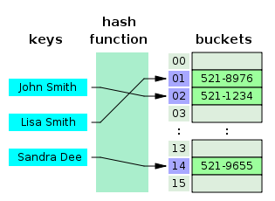
HashTable
The hash function calculates an index from the data item's key and use this index to place the data into the array.
Notes:
In another strategy, called open addressing, all entry records are stored in the bucket array itself. When a new entry has to be inserted, the buckets are examined, starting with the hashed-to slot and proceeding in some probe sequence, until an unoccupied slot is found. When searching for an entry, the buckets are scanned in the same sequence, until either the target record is found, or an unused array slot is found, which indicates that there is no such key in the table.[

Slide 3
Binary Tree
TreeSet and TreeMap were built
around binary trees.
A Binary Tree is a group of nodes that
contain left and right references.
Each item is inserted into the tree
according to its relationship to the
other nodes.
2
1
3
Notes:
Binary trees will be explained in great detail later, but the following overview will be enough for now.
Binary Trees are organized data structures that compare new values to existing values to determine placement of the new value.
By rule, smaller items go on the left of the tree and larger items go on the right.

Slide 4
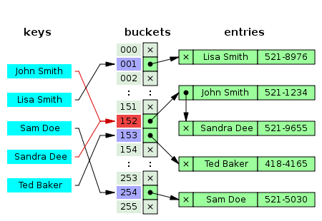
HashTable
The hash function might produce the same hashcode for different keys, which is called a collision.

Slide 5
In the strategy known as separate chaining, each slot of the bucket array is a pointer to a linked list that contains the key-value pairs that hashed to the same location.

Slide 6
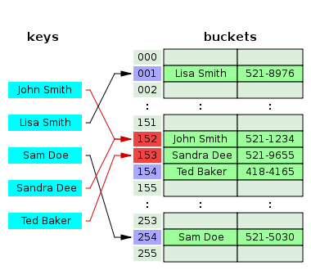
With open addressing, all entry records are stored in the bucket array itself. When a new entry has to be inserted, the buckets are examined, starting with the hashed-to slot and proceeding until an unoccupied slot is found.
Notes:
In another strategy, called open addressing, all entry records are stored in the bucket array itself. When a new entry has to be inserted, the buckets are examined, starting with the hashed-to slot and proceeding in some probe sequence, until an unoccupied slot is found. When searching for an entry, the buckets are scanned in the same sequence, until either the target record is found, or an unused array slot is found, which indicates that there is no such key in the table.[

Slide 7
What is a hashcode?
A hashcode is used to create a key
for an item.
The hashcode may be the same as the
value of the item or may involve the use
of some elaborate formula in hopes of
creating a unique key.

Slide 8
What is a hashcode?
Character c = new Character('a');
out.println(c.hashCode());
c = new Character('0');
out.println(c.hashCode());
c = new Character('A');
out.println(c.hashCode());
OUTPUT
97
48
65

Slide 9
What is a hashcode?
Integer num = 45;
out.println(num.hashCode());
num = new Integer(101);
out.println(num.hashCode());
int n = new Integer(50);
out.println(n.hashCode());
OUTPUT
45
101
error

Slide 10
Example HashCode Methods
public int hashCode( )
{
return x % someSize;
}
public int hashCode( )
{
return (numVowels(s) + s.length) % aSize;
}

Slide 11
Example HashCode Methods
public int hashCode( )
{
return x;
}
public int hashCode( )
{
return (numVowels(s) + s.length);
}

Slide 12
Hashcodes for Strings
String s1 = "A";
out.println(s1.hashCode());
String s2 = "a";
out.println(s2.hashCode());
String s3 = "act";
out.println(s3.hashCode());
OUTPUT
65
97
96402

Slide 13
Hashcodes for Strings
The String class’s hashcode method returns:
s[0]*31^(n-1) + s[1]*31^(n-2) + ... + s[n-1]

Slide 14
String[] words;
words = {"Computer", "Science", "computer", "science", . . . for(String word : words) { int h = word.hashCode(); out.print(word + " " + h);

Slide 15
word hashcode(h) h%19 (h&0x7fffffff)%19 Computer -534518981 -18 4 Science -712232380 -14 8 computer -599163109 -9 13 science 1918081636 1 1 BFND 2035962 17 17 bfnd 3021050 12 12 Cy-Fair -1453895141 -17 5 Bobcats 1717087858 3 3 at 3123 7 7 art 96867 5 5 an 3117 1 1 in 3365 2 2 am 3116 0 0

Slide 16
7FFFFFFF
& 7
7
2147483647
& 7
7
01111111111111111111111111111111
& 00000000000000000000000000000111
00000000000000000000000000000111
7FFFFFFF
& -7
7FFFFFF9
2147483647 & -7
2147483641
01111111111111111111111111111111
& 11111111111111111111111111111001
01111111111111111111111111111001

Slide 17
Open
hashcode.java

Slide 18
What is a hash table?
A hash table stores values based
on the hash code of each value.
Object[] hashTable = new Object[10];
Character c = new Character('1');
hashTable[c.hashCode()%10] = c;

Slide 19
What is a hash table?
Object[] hashTable = new Object[10];
Character c = new Character('1');
hashTable[c.hashCode()%10] = c;
Integer num = new Integer(113);
hashTable[num.hashCode()%10] = num;
String s = "e";
hashTable[s.hashCode()%10] = s;
for( Object thing : hashTable )
{
System.out.println(thing); }
OUTPUT
null
e
null
113
null
null
null
null
null
1

Slide 20
Open
hashtableone.java

Slide 21
What is a hash table?
Most hash tables are built using
an array of linked lists.
LinkedList[] table;
table = new LinkedList[10];

Slide 22
What is a hash table?
0
10
null
11
null
2
22
null
null

Slide 23
What is a hash table?
LinkedList[] hashTable = new LinkedList[5];
for( LinkedList list : hashTable )
{
System.out.println(list);
}
for(int i = 0; i< hashTable.length; i++)
{
hashTable[i] = new LinkedList();
}
for( LinkedList list : hashTable )
{
System.out.println(list);
}
OUTPUT
null
null
null
null
null
[]
[]
[]
[]
[]

Slide 24
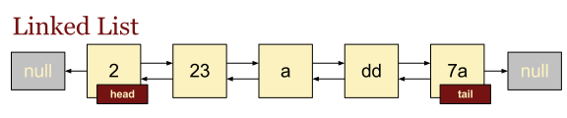
Java’s LinkedList Class

Slide 25
What is a hash table?
0
10
null
11
null
2
22
null
null

Slide 26
Java’s LinkedList Class
add(E element)
add(int index, E element)
addFirst(E element)
addLast(E element)
getFirst()
getLast()
removeFirst()
removeLast()
set(int index, E element)

Slide 27
Open
hashtabletwo.java

Slide 28
Open
hashtablethree.java

Slide 29
Open
hashtablefour.java

Slide 30
HashTable
HashSet and HashMap were both
created around hash tables.
A hash table is a giant array. Each
item is inserted into the array
according to a hash formula.
0 1 2 3 4

Slide 31
MAPS
Key | Value
restroom | bano
cat | gato
boy | muchacho
house | casa
toad | sapo
water | agua
Hash tables are similar to maps.
Both structures store each key and the value associated with that key.

Slide 32
HashTable
Key | Value
0 | 100
1 | 31
2 | 22
3 | 93
4 | 64
5 | 5
In most hash tables, the key involves some manipulation of the hash code and the value is just the thing being stored.

Slide 33
Collisions
Anytime you use a hash formula to generate
index positions, you could end up with the same
index position for several values.
Collisions are handled by putting all the values
with the same hash code in a list and storing
the list at the index position that matches the
hash code.

Slide 34
Bucket Hashing/Chaining
Using a bucket or a chain is a common way to
describe putting all of the values with the same
hash code in one list.
0
10
null
null

Slide 35
Bucket Hashing/Chaining
With only two buckets, this table would
have lots of collisions and very long
chains and be quite pointless.
LinkedList[] table = new LinkedList[2];
null
null

Slide 36
Bucket Hashing/Chaining
The larger the array, the less likely you are
to have collisions. The table will be much more
efficient as well.
LinkedList[] table = new LinkedList[100];
LinkedList[] bigTable = new LinkedList[1000];

Slide 37
Using ListNode
The LinkedList class works well to chain items
together, but ListNode could also be used.
ListNode[] table = new ListNode[100];
ListNode[] bigTable = new ListNode[1000];

Slide 38
Open
hashtablefive.java

Slide 39
HashTable
Big O Notation
Best Case / Average Case BigO of O(1)
Worst Case - BigO of O(N)
The Java HashSet and HashMap classes
have a BigO of O(1). This is considered
a generous BigO.

Slide 40
Start work
on Lab 16

