Slide 1
Sorting Definitions
In place sorting
  Sorting of a data structure does not require any external data structure for storing the intermediate steps
External sorting
  Sorting of records not present in memory
Stable sorting
  If the same element is present multiple times, then they retain the original relative order of positions

Slide 2
Procedures to follow for Heapsort
Since the tree satisfies Max-Heap property, then the largest item is stored at the root node.
Remove the root element and put at the end of the array (nth position) Put the last item of the tree (heap) at the vacant place.
Reduce the size of the heap by 1 and heapify the root element again so that we have highest element at root.
The process is repeated until all the items of the list is sorted.

Slide 3
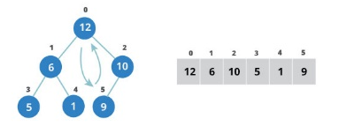


Slide 4



Slide 12
Heapsort
Min heap
  Build a binary minHeap of N elements
    O(N) time
  Then perform N findMin and deleteMin operations
    log(N) time per deleteMin
  Total complexity O(N log N)
  It requires an extra array to store the results
Max heap
  Storing deleted elements at the end avoid the need for an extra element

Slide 13
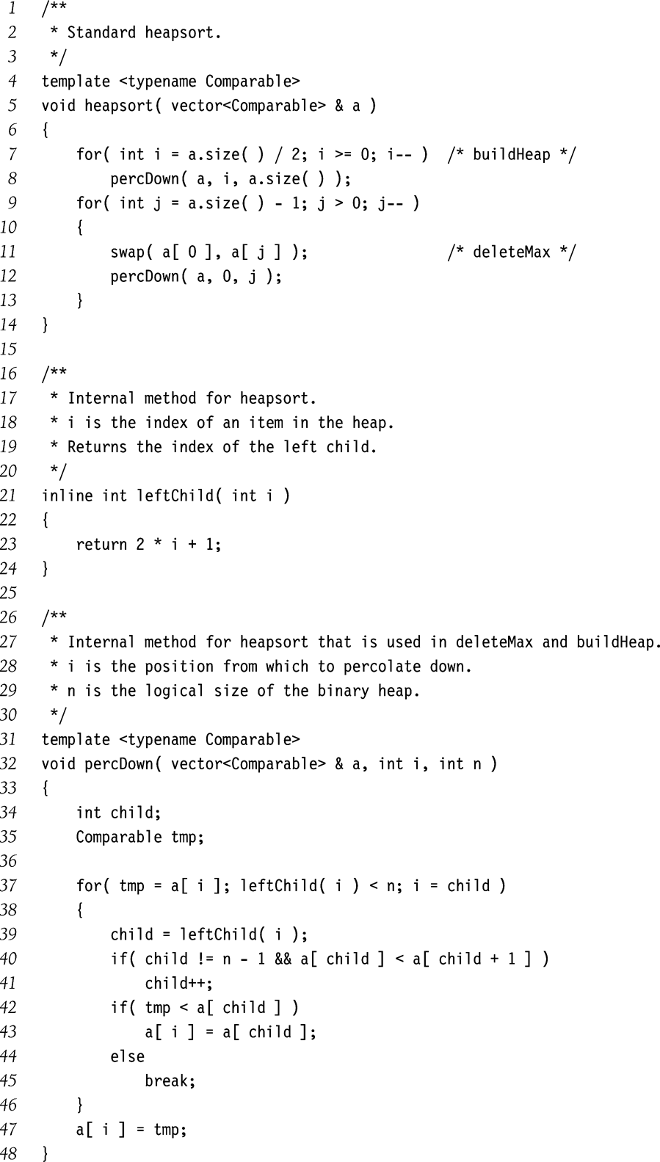
Heapsort Implementation

Slide 14
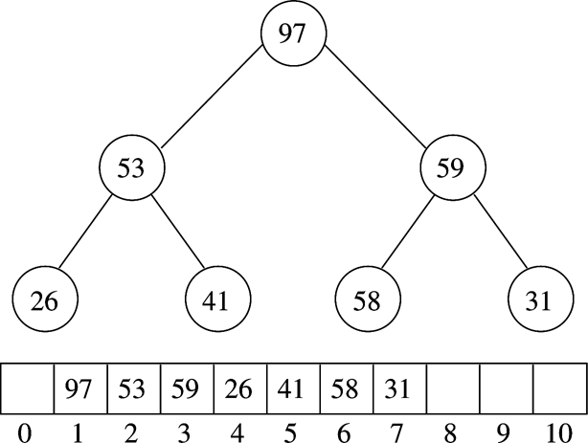
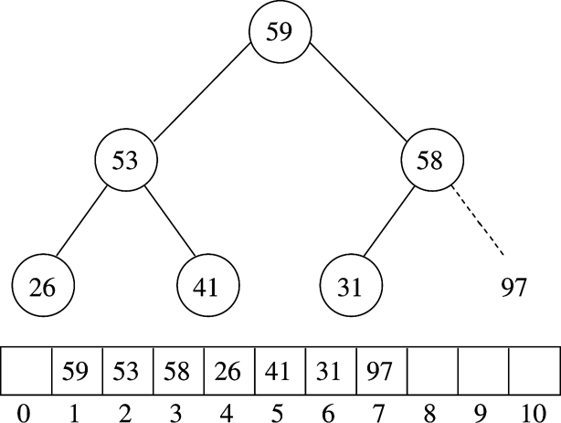
Example (MaxHeap)
After BuildHeap
After first deleteMax

Slide 15
Lower Bound on ‘Simple’ Sorting
Simple sorting
  Performing only adjacent exchanges
  Such as bubble sort and insertion sort
Inversions
  an ordered pair (i, j) such that i<j but a[i] > a[j]
  34,8,64,51,32,21
  (34,8), (34,32), (34,21), (64,51) …
Once an array has no inversions it is sorted
So sorting bounds depend on ‘average’ number of inversions performed

Slide 16
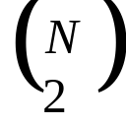
Theorem 1
Average number of inversions in an array of N distinct elements is N(N-1)/4
  For any list L, consider reverse list L_{r}
    L: 34, 8, 64, 51, 32, 21
    Lr: 21, 32, 51, 64, 8, 34
  All possible number of pairs is in L and Lr
  = N(N-1)/2
  Average number of inversion in L = N(N-1)/4

Slide 17
Theorem 2
Any algorithm that sorts by exchanging adjacent elements requires Ω(n²) average time
  Average number of inversions = Ω(n²)
  Number of swaps required = Ω(n²)

Slide 18
Bound for Comparison Based Sorting
O( n logn )
  Optimal bound for comparison-based sorting algorithms
  Achieved by Quick Sort, Merge Sort, and Heap Sort

