Slide 1
Heapsort
Merge sort time is O(n log n)
  But requires (temporarily) n extra storage items
Heapsort
  Works in place: no additional storage
  Offers same O(n log n) performance
Idea (not quite in-place):
  Insert each element into a priority queue
  Repeatedly remove from priority queue to array
    Array slots go from 0 to n-1
Chapter 10: Sorting

Slide 2
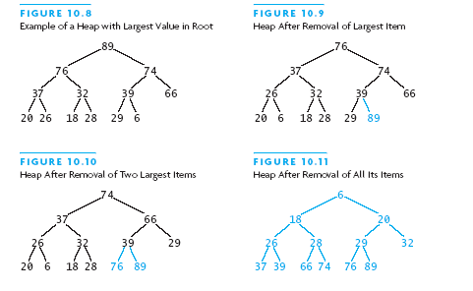
Heapsort Picture
Chapter 10: Sorting

Slide 3
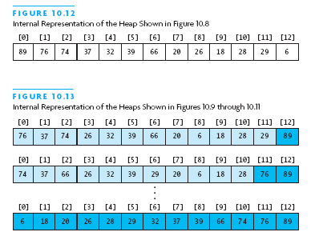
Heapsort Picture (2)
Chapter 10: Sorting

Slide 4
Algorithm for In-Place Heapsort
Build heap starting from unsorted array
While the heap is not empty
  Remove the first item from the heap:
    Swap it with the last item
  Restore the heap property
Chapter 10: Sorting

Slide 5
Heapsort Code
public static <T extends Comparable<T>>
void sort (T[] a) {
buildHp(a);
shrinkHp(a);
}
private static ... void buildHp (T[] a) {
for (int n = 2; n <= a.length; n++) {
int chld = n-1; // add item and reheap
int prnt = (chld-1) / 2;
while (prnt >= 0 &&
a[prnt].compareTo(a[chld])<0) {
swap(a, prnt, chld);
chld = prnt; prnt = (chld-1)/2
} } }
Chapter 10: Sorting

Slide 6
Heapsort Code (2)
private static ... void shrinkHp (T[] a) {
int n = a.length;
for (int n = a.length-1; n > 0; --n) {
swap(a, 0, n); // max -> next posn
int prnt = 0;
while (true) {
int lc = 2 * prnt + 1;
if (lc >= n) break;
int rc = lc + 1;
int maxc = lc;
if (rc < n &&
a[lc].compareTo(a[rc]) < 0)
maxc = rc;
....
Chapter 10: Sorting

Slide 7
Heapsort Code (3)
if (a[prnt].compareTo(a[maxc])<0) {
swap(a, prnt, maxc);
prnt = maxc;
} else {
break;
}
}
}
}
private static ... void swap
(T[] a, int i, int j) {
T tmp = a[i]; a[i] = a[j]; a[j] = tmp;
}
Chapter 10: Sorting

Slide 8
Heapsort Analysis
Insertion cost is log i for heap of size i
  Total insertion cost = log(n)+log(n-1)+...+log(1)
  This is O(n log n)
Removal cost is also log i for heap of size i
  Total removal cost = O(n log n)
Total cost is O(n log n)
Chapter 10: Sorting

Slide 9
Testing Sortiing Algorithms
Need to use a variety of test cases
  Small and large arrays
  Arrays in random order
  Arrays that are already sorted (and reverse order)
  Arrays with duplicate values
Compare performance on each type of array
Chapter 10: Sorting

Slide 10
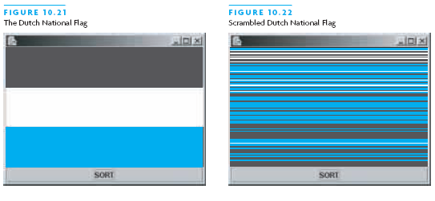
The Dutch National Flag Problem
Variety of partitioning algorithms have been published
One that partitions an array into three segments was introduced by Edsger W. Dijkstra
Problem: partition a disordered three-color flag into three contiguous segments
Segments represent < = > the pivot value
Chapter 10: Sorting

Slide 11
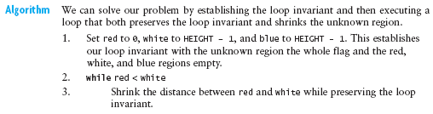
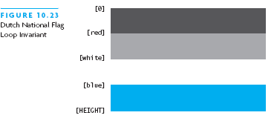
The Dutch National Flag Problem
Chapter 10: Sorting

Slide 12
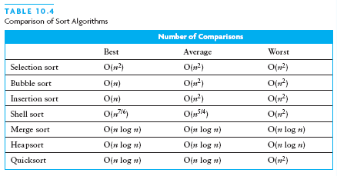
Chapter Summary (2)
Chapter 10: Sorting

