Slide 1

Sorting and
Searching
© A+ Computer Science - www.apluscompsci.com
Lab 22

Slide 2

Do the right things even though they're hard rather than the wrong things just because they're easy and you'll be smarter than most people.
© A+ Computer Science - www.apluscompsci.com

Slide 3
Java
Sorts and Searches
© A+ Computer Science - www.apluscompsci.com

Slide 4
Arrays frequently used methods
Name | Use
sort(x) | puts all items in x in ascending order
binarySearch(x,y) | checks x for the location of y
equals(x,y) | checks if x and y have the same values
fill(x, y) | fills all spots in x with value y
import java.util.Arrays;
© A+ Computer Science - www.apluscompsci.com
Notes:
The Arrays class methods above are very useful methods for manipulating Java arrays.
sort() will naturally order the items in an array.
binarySearch() will find an item in the array and return the spot at which the item was found.
equals() will see if two arrays contain the exact same items in the exact same order.
fill() will fill in all spots in the array with a provided value.

Slide 5
Collections frequently used methods
Name | Use
sort(x) | puts all items in x in ascending order
binarySearch(x,y) | checks x for the location of y
fill(x,y) | fills all spots in x with value y
rotate(x) | shifts items in x left or right
reverse(x) | reverses the order of the items in x
import java.util.Collections;
© A+ Computer Science - www.apluscompsci.com
Notes:
The Collections class methods above are very useful methods for manipulating Java Collections.
sort() will naturally order the items in the collection.
binarySearch() will find an item in the array and return the spot at which the item was found.
fill() will fill in all spots in the array with a provided value.
rotate() will shift items to the left(- negative x) a specified amount or shift items to the right(+ positive x) a specified amount.
reverse() will reverse the order of all items.

Slide 6
Java Searches
OUTPUT
-1
2
-6
String s = “The cat goes moo.";
out.println(s.indexOf("3"));
int[] ray = {1,3,5,7,11,18,91};
out.println(Arrays.binarySearch(ray,5));
int[] ray = {1,3,5,7,11,18,91};
out.println(Arrays.binarySearch(ray,15));
© A+ Computer Science - www.apluscompsci.com
Notes:
indexOf() and binarySearch() seach and array for specified value.
indexOf() will return the spot at which the item was found. It will return -1 if the item was not present.
binarySearch() will return the spot at which the item was found. It will return -1 + -location(where the item should be) if the item was not present.

Slide 7
Java Sorts
int[] ray = {13,6,17,18,2,-5};
Arrays.sort(ray);
for(int i = 0; i < ray.length; i++)
{
out.println(ray[i]);
}
OUTPUT-5
2
6
13
17
18
© A+ Computer Science - www.apluscompsci.com
Notes:
sort() will naturally order the items in an array.

Slide 8
Java Sorts
ArrayList<Integer> ray;
ray=new ArrayList<Integer>();
ray.add(21);
ray.add(2);
ray.add(13);
ray.add(-1);
ray.add(3);
Collections.sort(ray);
for(int num : ray )
out.println(num);
OUTPUT-1
2
3
13
21
© A+ Computer Science - www.apluscompsci.com
Notes:
sort() will naturally order the items in the Collection.

Slide 9
Searching
© A+ Computer Science - www.apluscompsci.com

Slide 10
Linear / Sequential
Search
The Linear Search searches through a
list one element at time looking for a match.
The index position of a match is returned if
found or -1 is returned if no match is found.
© A+ Computer Science - www.apluscompsci.com

Slide 11
Linear with Primitives
int linearSearch(int[] stuff, int val)
{
for(int i=0; i< stuff.length; i++)
{
if (stuff[i] == val )
return i;
}
return -1; //returns -1 if not found
}
© A+ Computer Science - www.apluscompsci.com

Slide 12
Linear with Objects
int linearSearch(Comparable[] stuff,
Comparable item)
{
for(int i=0; i<stuff.length; i++)
{
if (stuff[i].equals(item))
return i;
}
return -1; //returns -1 if not found
}
© A+ Computer Science - www.apluscompsci.com

Slide 13
Linear with Objects
int linearSearch(Comparable[] stuff,
Comparable item)
{
for(int i=0; i<stuff.length; i++)
{
if (stuff[i].compareTo(item)==0)
return i;
}
return -1; //returns -1 if not found
}
© A+ Computer Science - www.apluscompsci.com

Slide 14
open
linearsearch.java
linearsearchtester.java
© A+ Computer Science - www.apluscompsci.com

Slide 15
1/2
Binary Search
0100100101
© A+ Computer Science - www.apluscompsci.com

Slide 16
BinarySearch
The Binary Search only works with
sorted lists. The Binary search cuts
the list in half each time it checks for
for the specified value. If the value is
not found, the search continue in the
half most likely to contain the value.
© A+ Computer Science - www.apluscompsci.com

Slide 17
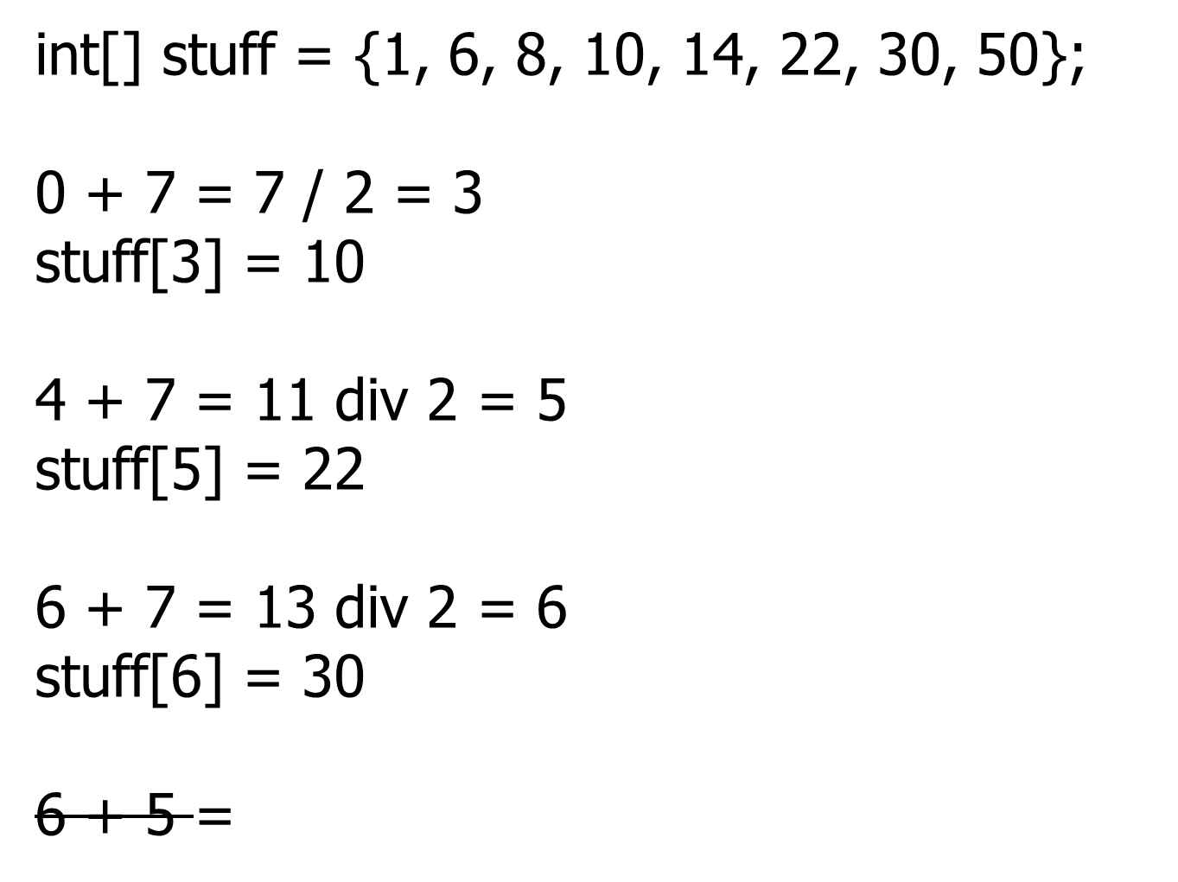
BinarySearch
If you are searching for 25, how many times will you check the stuff?
© A+ Computer Science - www.apluscompsci.com

Slide 18

int binarySearch(int[] list, int toFind)
{
int bot = 0, top = list.length-1;
while(bot<=top)
{
int middle = (bot + top) / 2;
if (list[middle] == toFind)
return middle;
else
if (toFind < list[middle])
top = middle-1;
else
bot = middle+1;
}
return -1;
}
© A+ Computer Science - www.apluscompsci.com
Notes:
Binary search will search a sorted array or Collection for a specified value. The spot at which the item was found will be returned. If the item was not found, -1 is returned.
Binary search is much more efficient that a Linear / Sequential search, but the data must be sorted. Binary Search will spit the list in half each time it looks for a match. If the search value is not found at the current spot, the current spot is compared to the search value. If the search value is bigger than the item at the current spot, the top half of the list is split and checked. If the search value is less than the item at the current spot, the bottom half of the list is split and checked. This process continues until the search value is found or the bottom and top indexes cross.

Slide 19

int binarySearch(Comparable[] list, int toFind)
{
int bot = 0, top = list.length-1;
while(bot<=top)
{
int middle = (bot + top) / 2;
if (list[middle].equals(toFind))
return middle;
else
if (toFind.compareTo(list[middle]) < 0)
top = middle-1;
else
bot = middle+1;
}
return -1;
}
© A+ Computer Science - www.apluscompsci.com
Notes:
Binary search will search a sorted array or Collection for a specified value. The spot at which the item was found will be returned. If the item was not found, -1 is returned.
Binary search is much more efficient that a Linear / Sequential search, but the data must be sorted. Binary Search will spit the list in half each time it looks for a match. If the search value is not found at the current spot, the current spot is compared to the search value. If the search value is bigger than the item at the current spot, the top half of the list is split and checked. If the search value is less than the item at the current spot, the bottom half of the list is split and checked. This process continues until the search value is found or the bottom and top indexes cross.

Slide 20

public int binarySearch(int[] list, int toFind)
{
int bot = 0, top = list.length-1;
while(bot<=top)
{
int middle = (bot + top) / 2;
if (list[middle] == toFind)
return middle;
else
if (toFind < list[middle])
top = middle-1;
else
bot = middle+1;
}
return -1;
}
© A+ Computer Science - www.apluscompsci.com
Notes:
Binary search will search a sorted array or Collection for a specified value. The spot at which the item was found will be returned. If the item was not found, -1 is returned.
Binary search is much more efficient that a Linear / Sequential search, but the data must be sorted. Binary Search will spit the list in half each time it looks for a match. If the search value is not found at the current spot, the current spot is compared to the search value. If the search value is bigger than the item at the current spot, the top half of the list is split and checked. If the search value is less than the item at the current spot, the bottom half of the list is split and checked. This process continues until the search value is found or the bottom and top indexes cross.

Slide 21

public int binarySearch(int[] stuff, int toFind)
{
return binarySearch(stuff, toFind, 0, stuff.length-1);
}
private int binarySearch(int[] stuff, int toFind, int bot, int top)
{
if(bot<=top) {
int middle = (bot+top)/2;
if(stuff[middle]== toFind)
return middle;
if(toFind < stuff[middle])
return binarySearch(stuff, toFind, bot, middle-1);
else
return binarySearch(stuff, toFind, middle+1, top);
}
return -1; //returns -1 if not found
}

Slide 22
Binary Search ShortCut
Given a list of N items.
What is the next largest power of 2?
If N is 100, the next largest
power of 2 is 7.
Log₂(100) = 6.64386
2⁷ = 128.
It would take 7 checks max to find if an item existed in a list of 100 items.
© A+ Computer Science - www.apluscompsci.com

Slide 23
BinarySearch
What would happen if you searched for the 14 in this array?
int[] stuff = {22, 1, 14, 10, 8, 50, 30, 1};
© A+ Computer Science - www.apluscompsci.com

Slide 24
General Big O Chart
for Searches
Name Best Case Avg. Case Worst Case
Linear/Sequential Search O(1) O(N) O(N)
Binary Search O(1) O( log₂ N ) O( log₂ N )
All searches have a best case run time of O(1) if written properly.
You have to look at the code to determine if the search has the
ability to find the item and return immediately. If this case is present,
the algorithm can have a best case of O(1).
© A+ Computer Science - www.apluscompsci.com

Slide 25
open
binarysearch.java
binarysearchtester.java
© A+ Computer Science - www.apluscompsci.com

Slide 26
People
Search
Demo
Line up some students and search for someone.
© A+ Computer Science - www.apluscompsci.com

Slide 27
Lab 22
Help
© A+ Computer Science - www.apluscompsci.com

Slide 28
Insertion Sort Logic
word = puppy
Original list
[ant, top, xylaphone]
Original list after adding puppy
[ant, puppy, top, xylaphone]
© A+ Computer Science - www.apluscompsci.com

Slide 29
Removing an Item
void remove(String word )
{
int loc = Collections.binarySearch(list, word);
if(loc >=0)
{
list.remove(loc);
}
}
© A+ Computer Science - www.apluscompsci.com
Notes:
binarySeach() works quite to locate items and to find the spot at which an item should be placed in the list..
binarySeach() will return the spot at which an item is located or -1 + -where the item should be if it were present.

Slide 30
Inserting an item into an ArrayList
void add(String word)
{
int loc = Collections.binarySearch(list, word);
if(loc < 0)
{
loc = Math.abs(loc+1); //??
list.add(loc, word);
}
}
© A+ Computer Science - www.apluscompsci.com
Notes:
binarySeach() works quite to locate items and to find the spot at which an item should be placed in the list..
binarySeach() will return the spot at which an item is located or -1 + -where the item should be if it were present.

Slide 31
Start work
on Lab 22a
© A+ Computer Science - www.apluscompsci.com

