Slide 1
SORTING AND
SEARCHING
Lab 22

Slide 2
In the very early days of Facebook, when it had fewer than 15 employees, a guy named Steve Chen decided after working there for only a few weeks that it just wasn't for him. He wanted to leave to found his own company, and his plan was to do a video startup.
Matt Cohler, the guy who had hired him in the first place, tried to convince him otherwise. "You're making a terrible mistake. Facebook is going to be huge! And there's already a ton of video sites. If you do this you're going to regret it for the rest of your life!“
Chen wasn't convinced, so he decided to do it anyway and left to start a company called YouTube.

Slide 3
Sorts
Quadratic ( N²)

Slide 4
The Bubble Sort

Slide 5
Bubble Sort
Bubble sort compares items that are adjacent and has the potential to swap a whole lot.
Bubble Sort is left in for historical purposes only!

Slide 6
Bubble Sort W/Objects
void bubbleSort( Comparable[] stuff ){
for(int i=0; i<stuff.length-1; i++){
for(int j=0; j<stuff.length-1; j++){
if(stuff[ j].compareTo(stuff[ j+1]) > 0 ){
Comparable temp = stuff[ j];
stuff[ j] = stuff [ j+1];
stuff [ j+1] = temp;
}
}
}
}
Lots O Swaps!

Slide 7
Bubble Sort W/Objects
void bubbleSort(Comparable[] stuff) {
boolean changed = false;
do {
changed = false;
for (int a = 0; a < stuff.length - 1; a++) {
if (stuff[a].compareTo(stuff[a + 1]) > 0) {
Comparable tmp = stuff[a];
stuff[a] = stuff[a + 1];
stuff[a + 1] = tmp;
changed = true;
}
}
} while(changed);
}

Slide 8

The Selection Sort

Slide 9
Selection Sort
The selection sort does not swap each time
it finds elements out of position. Selection sort
makes a complete pass while searching for the
next item to swap. At the end of a pass once
the item is located, one swap is made.

Slide 10
Selection Sort
void selectionSort( int[] ray ) {
for(int i=0; i< ray.length-1; i++){
int min = i;
for(int j = i+1; j< ray.length; j++)
{
if(ray[j] < ray[min])
min = j; //find location of smallest
}
if( min != i) {
int temp = ray[min];
ray[min] = ray[i];
ray[i] = temp; //put smallest in pos i
}
}
}
Notes:
Selection sort is pretty effective for small lists, but pretty horrible is used on large lists.
Selection sort consists of two loops.
The outer loops run based on the number of items in the list.
The inner loop runs to find the items that need to be moved. The inner loop either locates the spot with the smallest value or the spot with the largest value. After the inner loop completes, a swap may occur if needed. At most, selection sort will make one swap per pass. A pass is one complete execution of the inner loop.

Slide 11
Selection Sort
0 1 2 3 4
pass 0
9 | 2 | 8 | 5 | 1
pass 1
1 | 2 | 8 | 5 | 9
pass 2
1 | 2 | 8 | 5 | 9
pass 3
1 | 2 | 5 | 8 | 9
pass 4
1 | 2 | 5 | 8 | 9
Notes:
Selection sort is pretty effective for small lists, but pretty horrible is used on large lists.
Selection sort consists of two loops.
The outer loops run based on the number of items in the list.
The inner loop runs to find the items that need to be moved. The inner loop either locates the spot with the smallest value or the spot with the largest value. After the inner loop completes, a swap may occur if needed. At most, selection sort will make one swap per pass. A pass is one complete execution of the inner loop.

Slide 12
public void selSort(Comparable[] ray){
for(int i=0; i<ray.length-1; i++)
{
int min=i;
for(int j=i; j<ray.length; j++){
if(ray[j].compareTo(ray[spot])<0)
min=j;
}
if(min==i) continue;
Comparable save = ray[i];
ray[i]= ray[min];
ray[min]=save;
}
}
How many swaps
per pass?
Selection Sort
W/Objects

Slide 13
Selection Sort in Action
Original List
Integer[] ray = {90,40,20,30,10,67};
pass 1 - 90 40 20 30 10 67
pass 2 - 90 67 20 30 10 40
pass 3 - 90 67 40 30 10 20
pass 4 - 90 67 40 30 10 20
pass 5 - 90 67 40 30 20 10
pass 6 - 90 67 40 30 20 10

Slide 14
open
selectionsort.java
selectionsorttester.java

Slide 15
People
Sort
Demo
Line up some students and selection sort them.

Slide 16
The Insertion Sort

Slide 17
Insertion Sort
The insertion sort first selects an item and
moves items up or down based on the
comparison to the selected item.
The idea is to get the selected item in proper
position by shifting items around in the list.

Slide 18
void insertionSort( int[] ray)
{
for (int i=1; i< ray.length; ++i)
{
int val = ray[i];
int j=i;
while(j>0 && val<ray[j-1]) {
ray[j]=ray[j-1];
j--;
}
ray[j]=val;
}
}
Insertion
w/primitives

Slide 19
void insertionSort( Comparable[] ray)
{
for (int i=1; i< ray.length; ++i)
{
int val = ray[i];
int j=i;
while(ray[mid].compareTo(ray[ i ])<0) {
ray[j]=ray[j-1];
j--;
}
ray[j]=val;
}
}
Insertion
w/Objects

Slide 20
Insertion Sort in Action
Original List
Integer[] ray = {90,40,20,30,10,67};
pass 1 - 40 90 20 30 10 67
pass 2 - 20 40 90 30 10 67
pass 3 - 20 30 40 90 10 67
pass 4 - 10 20 30 40 90 67
pass 5 - 10 20 30 40 67 90

Slide 21
void insertionSort( int[] ray){
for (int i=1; i< ray.length; ++i){
int bot=0, top=i-1;
while (bot<=top){
int mid=(bot+top)/2;
if (ray[mid] < ray[ i ])
bot=mid+1;
else top=mid-1;
}
Comparable temp = ray[i];
for (int j=i; j>bot; --j)
ray[ j]=ray[ j-1];
ray[bot]=temp;
}
}
Insertion sort
with a
Binary search

Slide 22
People
Sort
Demo
Line up some students and insertion sort them.

Slide 23
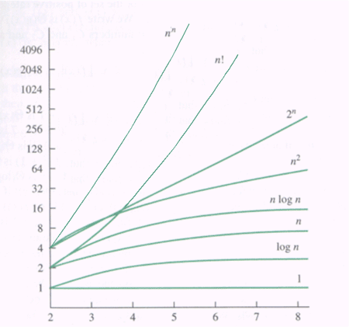

Slide 24
open
insertionsort.java
insertionsorttester.java

Slide 25
Divide and Conquer
Algorithms
0 ( N Log2N )

Slide 26
Divide and Conquer
32
16
16
8
8
8
8
4
4
4
4
4
4
4
4

Slide 27
The Merge Sort

Slide 28
Merge Sort
Merge sort splits the list into smaller sections
working its way down to groups of two or one.
Once the smallest groups are reached, the merge
method is called to organize the smaller lists.
Merge copies from the sub list to a temp array.
The items are put in the temp array in sorted order.

Slide 29
Merge Sort
1 . . 32
1 . . 16
17 . . 32
1 . . 8
9. . 16
17 . .25
26 . . 32
Merge sort chops in half repeatedly to avoid processing the whole list at once.

Slide 30
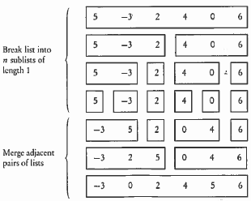
a[0] a[1] a[2] a[3] a[4] a[5]

Slide 31
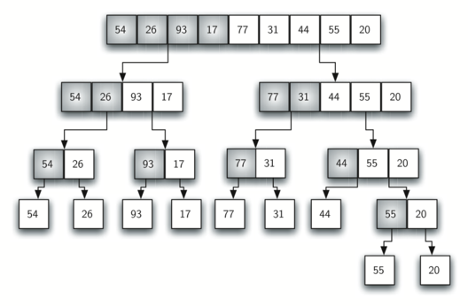
mergeSort, but with a right-hand split
splitting

Slide 32
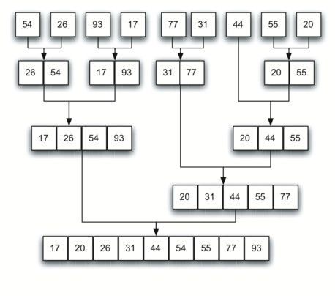
merging

Slide 33
mergeSort Algorithm
void mergeSort(Comparable[] stuff, int front, int back)
{
int mid = (front+back)/2;
if(mid==front) return;
mergeSort(stuff, front, mid);
mergeSort(stuff, mid, back);
merge(stuff, front, back);
}
Collections.sort( ) uses the mergeSort.
Arrays.sort( ) uses mergeSort for objects.

Slide 34
void merge(Comparable[] stuff, int front, int back)
{
Comparable[] temp = new Comparable[back-front];
int i = front, j = (front+back)/2, k =0, mid =j;
while( i<mid && j<back) {
if(stuff[i].compareTo(stuff[j])<0)
temp[k++]= stuff[i++];
else
temp[k++]= stuff[j++];
}
while(i<mid)
temp[k++]= stuff[i++];
while(j<back)
temp[k++]= stuff[j++];
for(i = 0; i<back-front; ++i)
stuff[front+i]=temp[i];
}
Merge
W/Objects

Slide 35
Merge Sort in Action
Original List Integer[] stuff = {90,40,20,30,67,10};
pass 0 - 40 90 20 30 67 10
pass 1 - 20 40 90 30 67 10
pass 2 - 20 40 90 30 67 10
pass 3 - 20 40 90 10 30 67
pass 4 - 10 20 30 40 67 90

Slide 36
The mergeSort has a N*Log₂N BigO.
The mergeSort method alone has a Log₂N run time, but cannot be run without the merge method.
The merge method alone has an N run time and can be run without the mergeSort method.
mergeSort
Merge

Slide 37
The Quick Sort

Slide 38
Quick Sort
Quick sort finds a pivot value. All numbers
greater than the pivot move to the right and
all numbers less move to the left.
This list is then chopped in two and the
process above is repeated on the smaller sections.

Slide 39
Quick Sort
1 . . 32
1 . . 22
23 . . 32
1 . . 19
20. . 22
23 . .25
26 . . 32
Quick sort chops up the list into smaller pieces as to avoid processing the whole list at once.

Slide 40
quickSort Algorithm
void quickSort(Comparable[] stuff, int low, int high)
{
if (low < high)
{
int spot = partition(stuff, low, high);
quickSort(stuff, low, spot);
quickSort(stuff, spot+1, high);
}
}
Arrays.sort( ) uses the quickSort
if sorting primitives.

Slide 41
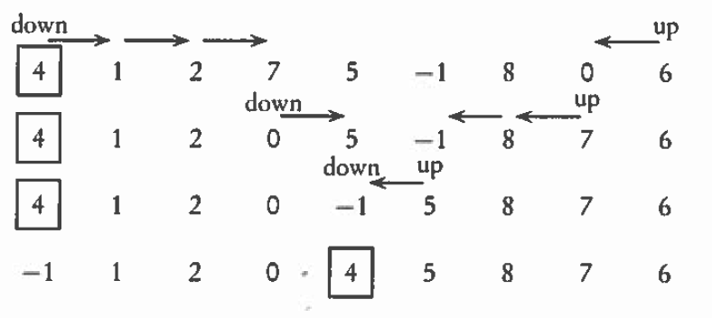
partition Algorithm
4, 1, 2, 7, 5, -1, 8, 0, 6

Slide 42
partition Algorithm
int partition(Comparable[] stuff, int low, int high)
{
Comparable pivot = stuff[low];
int bot = low-1;
int top = high+1;
while(bot<top) {
while (stuff[--top].compareTo(pivot) > 0);
while (stuff[++bot].compareTo(pivot) < 0);
if(bot >= top)
return top;
Comparable temp = stuff[bot];
stuff[bot] = stuff[top];
stuff[top] = temp;
}
}

Slide 43
Quick Sort in Action
Original List
Integer[] ray = {90,40,20,30,10,67};
pass 1 - 67 40 20 30 10 90
pass 2 - 10 40 20 30 67 90
pass 3 - 10 40 20 30 67 90
pass 4 - 10 30 20 40 67 90
pass 5 - 10 20 30 40 67 90

Slide 44
The quickSort has a N*Log₂N BigO.
The quickSort method alone has a Log₂N run time, but cannot be run without the partition method.
The partition method alone has an N run time and can be run without the quickSort method.
quickSort
Partition

Slide 45
Speed

Slide 46
Runtime Analysis
for( int i=0; i<20; i++)
System.out.println(i);
for( int j=0; j<20; j++)
for( int k=0; k<20; k++)
System.out.println(j*k);
Which section of code would execute the fastest?

Slide 47
Runtime Analysis
ArrayList<Integer> iRay;
iRay = new ArrayList<Integer>();
for( int i=0; i<20; i++)
iRay.add(i);
ArrayList<Double> dRay;
dRay = new ArrayList<Double>();
for( int j=0; j<20; j++)
dRay.add(0,j);
Which section of code would execute the fastest?

Slide 48
General Big O Chart
for N^2 Sorts
Name Best Case Avg. Case Worst
Selection Sort O(N²) O(N²) O(N²)
Bubble Sort O(N²) O(N²) O(N²)
Insertion Sort O(N) * O(N²) O(N²)
* If the data is sorted, Insertion sort should only make one pass
through the list. If this case is present, Insertion sort would have
a best case of O(n).

Slide 49
General Big O Chart
for NLogN Sorts
Name Best Case Avg. Case Worst
Merge Sort O(N log₂ N ) O(N log₂ N ) O(N log₂ N )
QuickSort O(N log₂ N ) O(N log₂ N ) O(N²) *
* QuickSort can degenerate to N². It typically will degenerate on
sorted data if using a left or right pivot. Using a median pivot will
help tremendously, but QuickSort can still degenerate on certain
sets of data. The split position determines how QuickSort behaves.

Slide 50
Continue work
on Lab22

