Slide 1
Divide and Conquer
Algorithms
0 ( N Log2N )

Slide 2
Divide and Conquer
32
16
16
8
8
8
8
4
4
4
4
4
4
4
4

Slide 3
The Merge Sort

Slide 4
Merge Sort
Merge sort splits the list into smaller sections
working its way down to groups of two or one.
Once the smallest groups are reached, the merge
method is called to organize the smaller lists.
Merge copies from the sub list to a temp array.
The items are put in the temp array in sorted order.

Slide 5
Merge Sort
1 . . 32
1 . . 16
17 . . 32
1 . . 8
9. . 16
17 . .25
26 . . 32
Merge sort chops in half repeatedly to avoid processing the whole list at once.

Slide 6
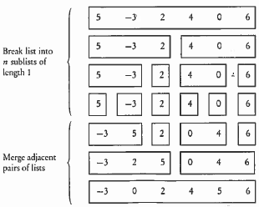
a[0] a[1] a[2] a[3] a[4] a[5]

Slide 7
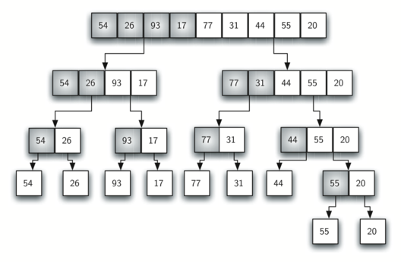
mergeSort, but with a right-hand split
splitting

Slide 8
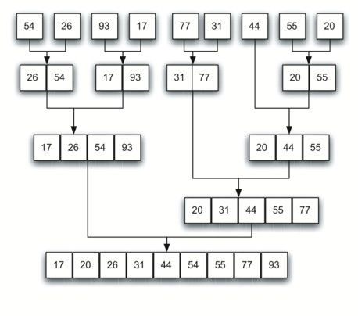
merging

Slide 9
mergeSort Algorithm
void mergeSort(Comparable[] stuff, int front, int back)
{
int mid = (front+back)/2;
if(mid==front) return;
mergeSort(stuff, front, mid);
mergeSort(stuff, mid, back);
merge(stuff, front, back);
}
Collections.sort( ) uses the mergeSort.
Arrays.sort( ) uses mergeSort for objects.

Slide 10
void merge(Comparable[] stuff, int front, int back)
{
Comparable[] temp = new Comparable[back-front];
int i = front, j = (front+back)/2, k =0, mid =j;
while( i<mid && j<back) {
if(stuff[i].compareTo(stuff[j])<0)
temp[k++]= stuff[i++];
else
temp[k++]= stuff[j++];
}
while(i<mid)
temp[k++]= stuff[i++];
while(j<back)
temp[k++]= stuff[j++];
for(i = 0; i<back-front; ++i)
stuff[front+i]=temp[i];
}
Merge
W/Objects

Slide 11
Merge Sort in Action
Original List Integer[] stuff = {90,40,20,30,67,10};
pass 0 - 40 90 20 30 67 10
pass 1 - 20 40 90 30 67 10
pass 2 - 20 40 90 30 67 10
pass 3 - 20 40 90 10 30 67
pass 4 - 10 20 30 40 67 90

Slide 12
The mergeSort has a N*Log₂N BigO.
The mergeSort method alone has a Log₂N run time, but cannot be run without the merge method.
The merge method alone has an N run time and can be run without the mergeSort method.
mergeSort
Merge

Slide 13
The Quick Sort

Slide 14
Quick Sort
Quick sort finds a pivot value. All numbers
greater than the pivot move to the right and
all numbers less move to the left.
This list is then chopped in two and the
process above is repeated on the smaller sections.

Slide 15
Quick Sort
1 . . 32
1 . . 22
23 . . 32
1 . . 19
20. . 22
23 . .25
26 . . 32
Quick sort chops up the list into smaller pieces as to avoid processing the whole list at once.

Slide 16
quickSort Algorithm
void quickSort(Comparable[] stuff, int low, int high)
{
if (low < high)
{
int spot = partition(stuff, low, high);
quickSort(stuff, low, spot);
quickSort(stuff, spot+1, high);
}
}
Arrays.sort( ) uses the quickSort
if sorting primitives.

Slide 17
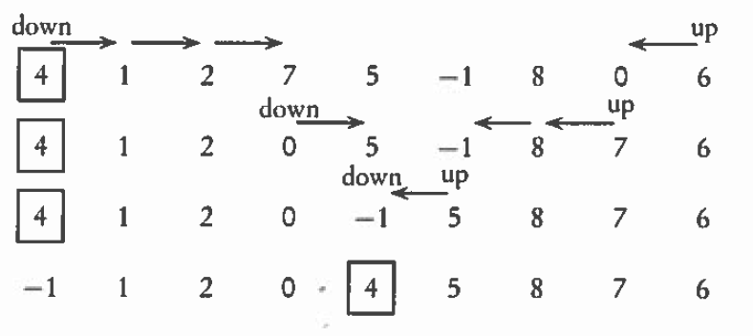
partition Algorithm
4, 1, 2, 7, 5, -1, 8, 0, 6

Slide 18
partition Algorithm
int partition(Comparable[] stuff, int low, int high)
{
Comparable pivot = stuff[low];
int bot = low-1;
int top = high+1;
while(bot<top) {
while (stuff[--top].compareTo(pivot) > 0);
while (stuff[++bot].compareTo(pivot) < 0);
if(bot >= top)
return top;
Comparable temp = stuff[bot];
stuff[bot] = stuff[top];
stuff[top] = temp;
}
}

Slide 19
Quick Sort in Action
Original List
Integer[] ray = {90,40,20,30,10,67};
pass 1 - 67 40 20 30 10 90
pass 2 - 10 40 20 30 67 90
pass 3 - 10 40 20 30 67 90
pass 4 - 10 30 20 40 67 90
pass 5 - 10 20 30 40 67 90

Slide 20
The quickSort has a N*Log₂N BigO.
The quickSort method alone has a Log₂N run time, but cannot be run without the partition method.
The partition method alone has an N run time and can be run without the quickSort method.
quickSort
Partition

Slide 21
Speed

Slide 22
Runtime Analysis
for( int i=0; i<20; i++)
System.out.println(i);
for( int j=0; j<20; j++)
for( int k=0; k<20; k++)
System.out.println(j*k);
Which section of code would execute the fastest?

Slide 23
Runtime Analysis
ArrayList<Integer> iRay;
iRay = new ArrayList<Integer>();
for( int i=0; i<20; i++)
iRay.add(i);
ArrayList<Double> dRay;
dRay = new ArrayList<Double>();
for( int j=0; j<20; j++)
dRay.add(0,j);
Which section of code would execute the fastest?

Slide 24
Sorting (cont’d)
Time
n²
n log n
n
n 10 100 1000
n² 100 10,000 1,000,000
n log n 10 200 3000
Notes:
When n is large enough, An² eventually overtakes Bn⋅log n no matter how small A is and how large B.

Slide 25
General Big O Chart
for N^2 Sorts
Name Best Case Avg. Case Worst
Selection Sort O(N²) O(N²) O(N²)
Bubble Sort O(N²) O(N²) O(N²)
Insertion Sort O(N) * O(N²) O(N²)
* If the data is sorted, Insertion sort should only make one pass
through the list. If this case is present, Insertion sort would have
a best case of O(n).

Slide 26
General Big O Chart
for NLogN Sorts
Name Best Case Avg. Case Worst
Merge Sort O(N log₂ N ) O(N log₂ N ) O(N log₂ N )
QuickSort O(N log₂ N ) O(N log₂ N ) O(N²) *
* QuickSort can degenerate to N². It typically will degenerate on
sorted data if using a left or right pivot. Using a median pivot will
help tremendously, but QuickSort can still degenerate on certain
sets of data. The split position determines how QuickSort behaves.

Slide 27
Continue work
on Lab22

