Slide 1
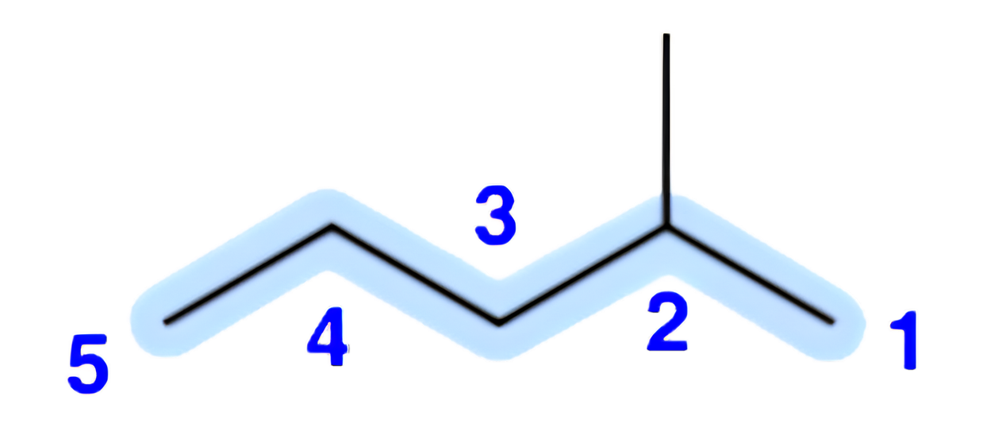
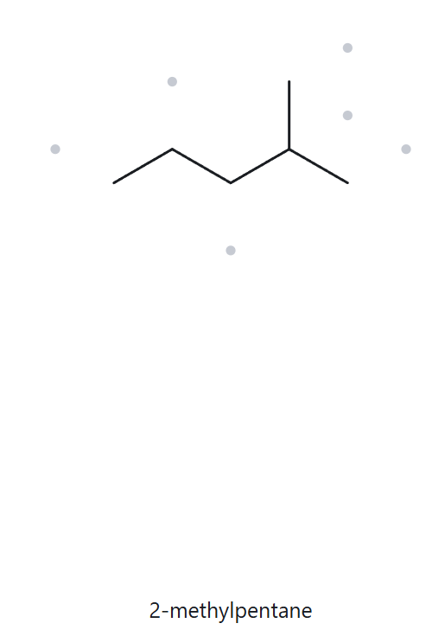
CARD A01 | Structure → Name
Level:
Foundation
Molecular Formula:
C₆H₁₄
01 NUMBERED PARENT
02 NAMING TRAIL
Parent: longest chain = 5 C → pentane.
Numbering: right → left gives 2; left → right gives 4. 2 < 4, so number from the right.
Substituents: methyl on C2.
03 MY NAME
04 THE ALKANE CHECK
{
Returned Name: 2-methylpentane
2-methylpentane
Verdict: Match
Verification Strip
longest chain/ring
lowest locants
alphabetical order
punctuation
formula counted

Slide 2
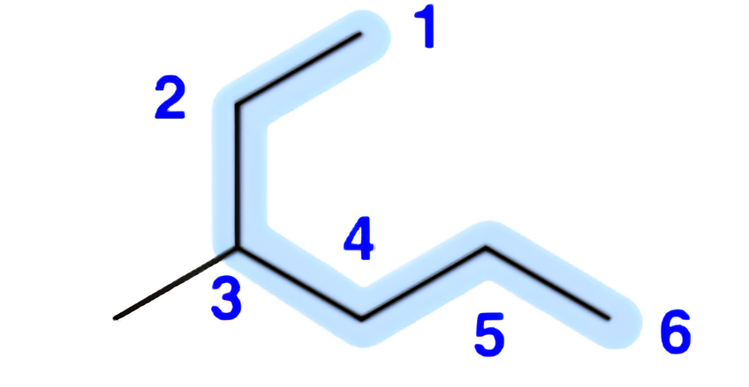
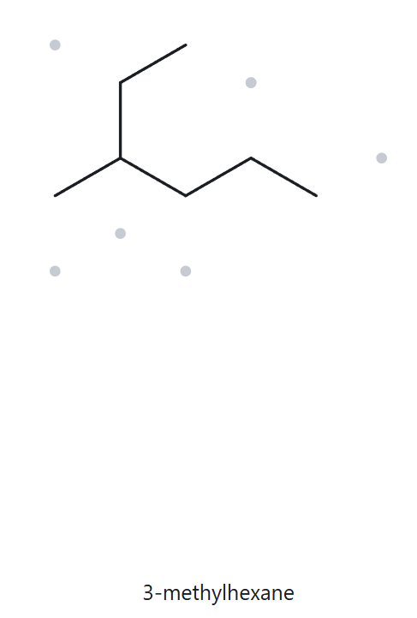
CARD A02 | Structure → Name
Level:
Foundation
Molecular Formula:
C₇H₁₆
01 NUMBERED PARENT
02 NAMING TRAIL
Parent: longest chain = 6 C → hexane. The horizontal path is only 5 C. The longest chain runs through the drawn “ethyl” branch.
Numbering: upper-branch end → right gives 3; right → upper-branch end gives 4. 3 < 4, so number from the upper-branch end.
Substituents: methyl on C3.
03 MY NAME
04 THE ALKANE CHECK
{
Returned Name: 3-methylhexane
3-methylhexane
Verdict: Match
Verification Strip
longest chain/ring
lowest locants
alphabetical order
punctuation
formula counted

Slide 3
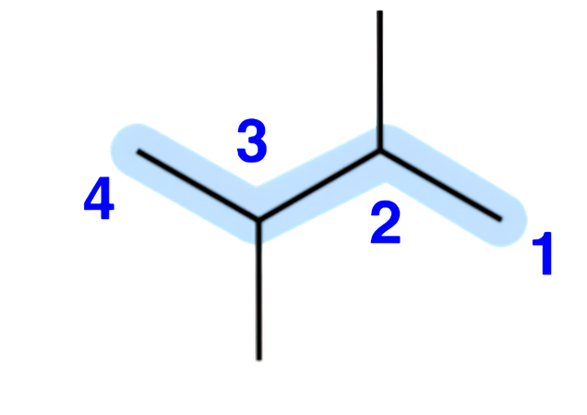
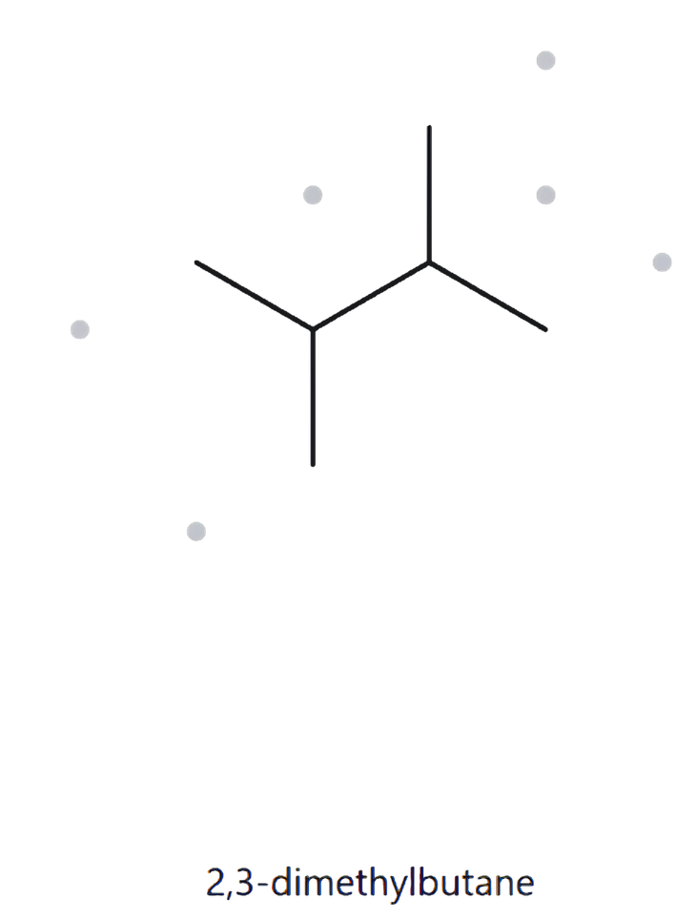
CARD A03 | Structure → Name
Level:
Foundation
Molecular Formula:
C₆H₁₄
01 NUMBERED PARENT
02 NAMING TRAIL
Parent: longest chain = 4 C → butane. No path is longer, because each central carbon carries two methyls.
Numbering: either direction gives 2,3, so the sets tie and either end may start.
Substituents: methyl on C2 and C3 → 2,3-dimethyl.
03 MY NAME
04 THE ALKANE CHECK
{
2,3-dimethylbutane
Returned Name: 2,3-dimethylbutane
Verdict: Match
Verification Strip
longest chain/ring
lowest locants
alphabetical order
punctuation
formula counted

Slide 4
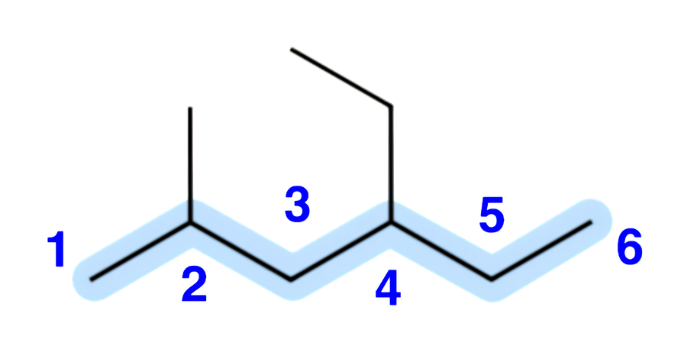
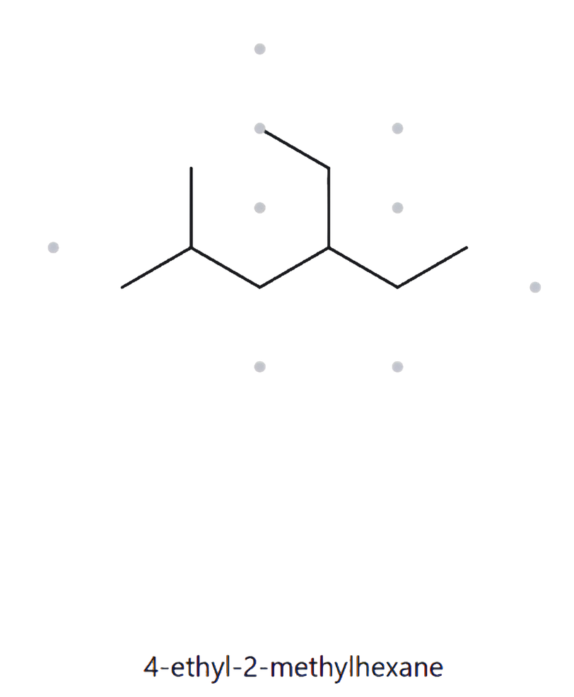
CARD A04 | Structure → Name
Level:
Developing
Molecular Formula:
C₉H₂₀
01 NUMBERED PARENT
02 NAMING TRAIL
Parent: longest chain = 6 C → hexane. Several 6-C paths exist through the branches, but all carry one methyl and one ethyl, so they give the same name.
Numbering: left → right gives 2,4; right → left gives 3,5. 2 < 3, so number from the left.
Substituents (alphabetical): ethyl on C4, methyl on C2.
03 MY NAME
04 THE ALKANE CHECK
{
Returned Name:
4-ethyl-2-methylhexane
4-ethyl-2-methylhexane
Verdict: Match
Verification Strip
longest chain/ring
lowest locants
alphabetical order
punctuation
formula counted

Slide 5
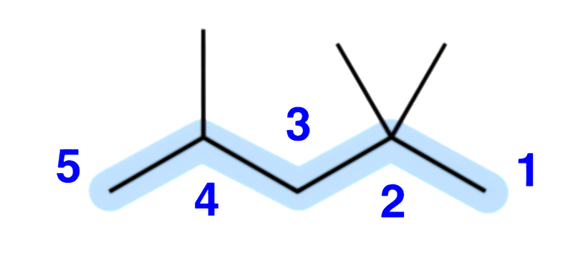
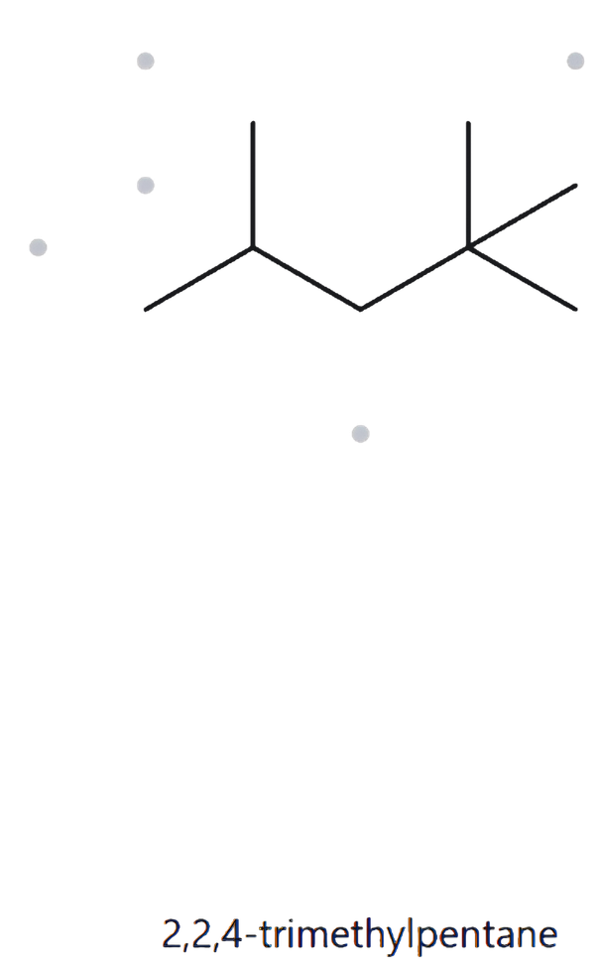
CARD A05 | Structure → Name
Level:
Developing
Molecular Formula:
C₈H₁₈
01 NUMBERED PARENT
02 NAMING TRAIL
Parent: longest chain = 5 C → pentane.
Numbering: right → left gives 2,2,4; left → right gives 2,4,4. The first term ties (2), and at the second term 2 < 4, so number from the right.
Substituents: methyl on C2, C2 and C4 → 2,2,4-trimethyl.
03 MY NAME
04 THE ALKANE CHECK
{
Returned Name: 2,2,4-trimethylpentane
2,2,4-trimethylpentane
Verdict: Match
Verification Strip
longest chain/ring
lowest locants
alphabetical order
punctuation
formula counted

Slide 6
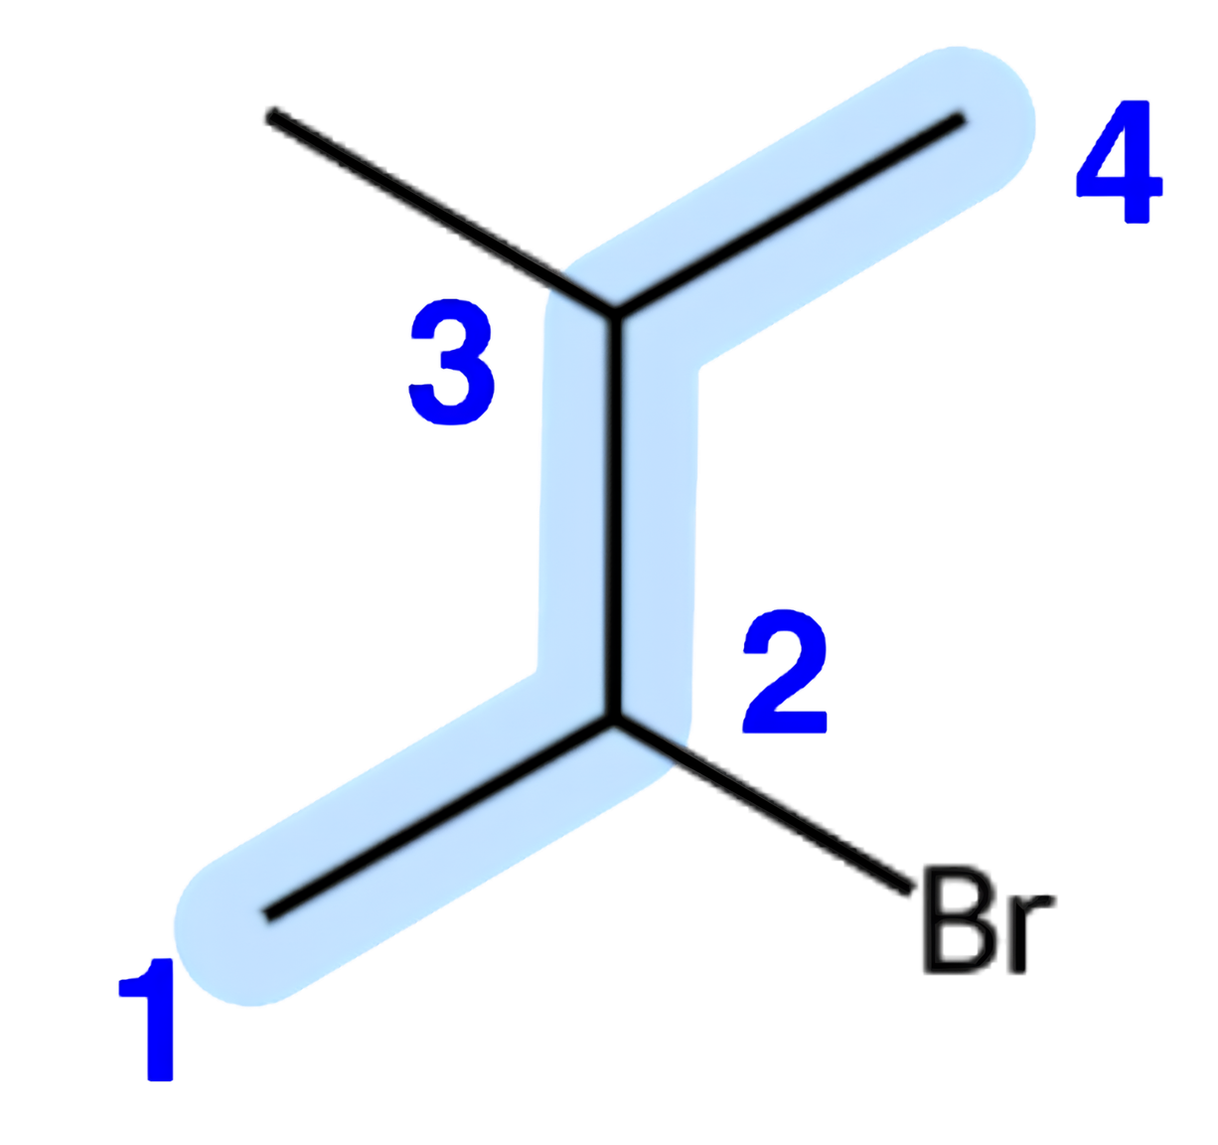
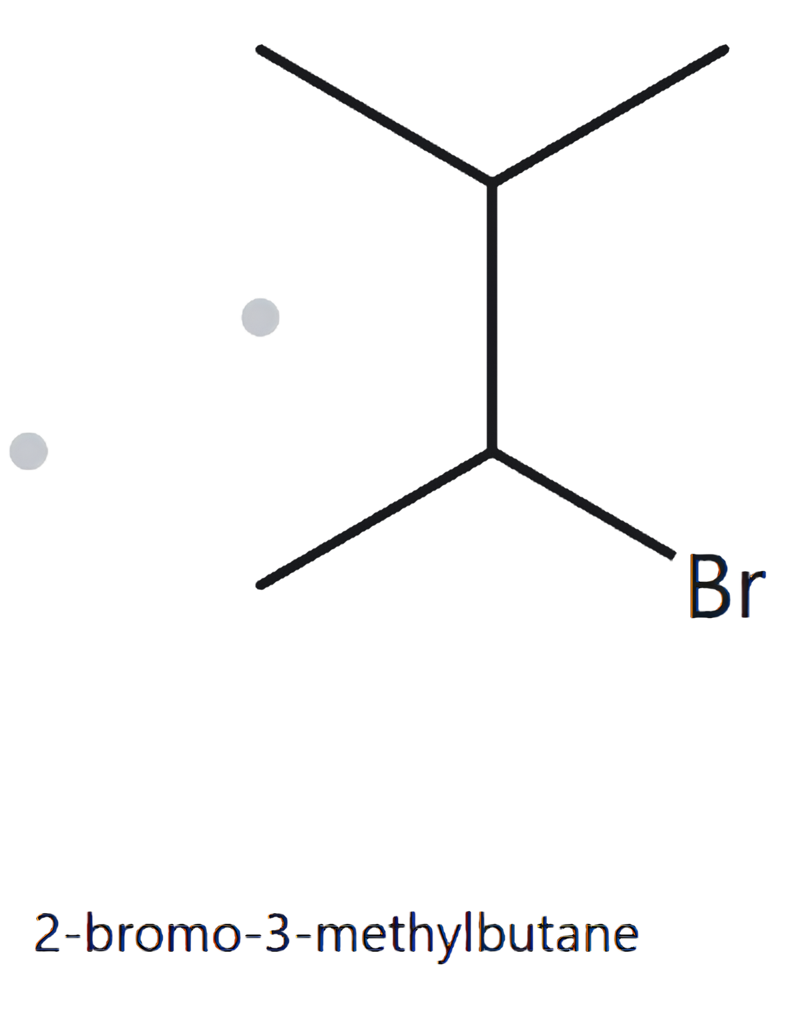
CARD A06 | Structure → Name
Level:
Developing
Molecular Formula:
C₅H₁₁Br
01 NUMBERED PARENT
02 NAMING TRAIL
Parent: longest chain = 4 C → butane.
Numbering: both directions give the locant set {2,3}, so the sets tie.
Tie-break: bromo precedes methyl alphabetically, so bromo gets the lower locant (C2).
Substituents (alphabetical): bromo on C2, methyl on C3.
03 MY NAME
04 THE ALKANE CHECK
{
Returned Name:
2-bromo-3-methylbutane
2-bromo-3-methylbutane
Verdict: Match
Verification Strip
longest chain/ring
lowest locants
alphabetical order
punctuation
formula counted

Slide 7
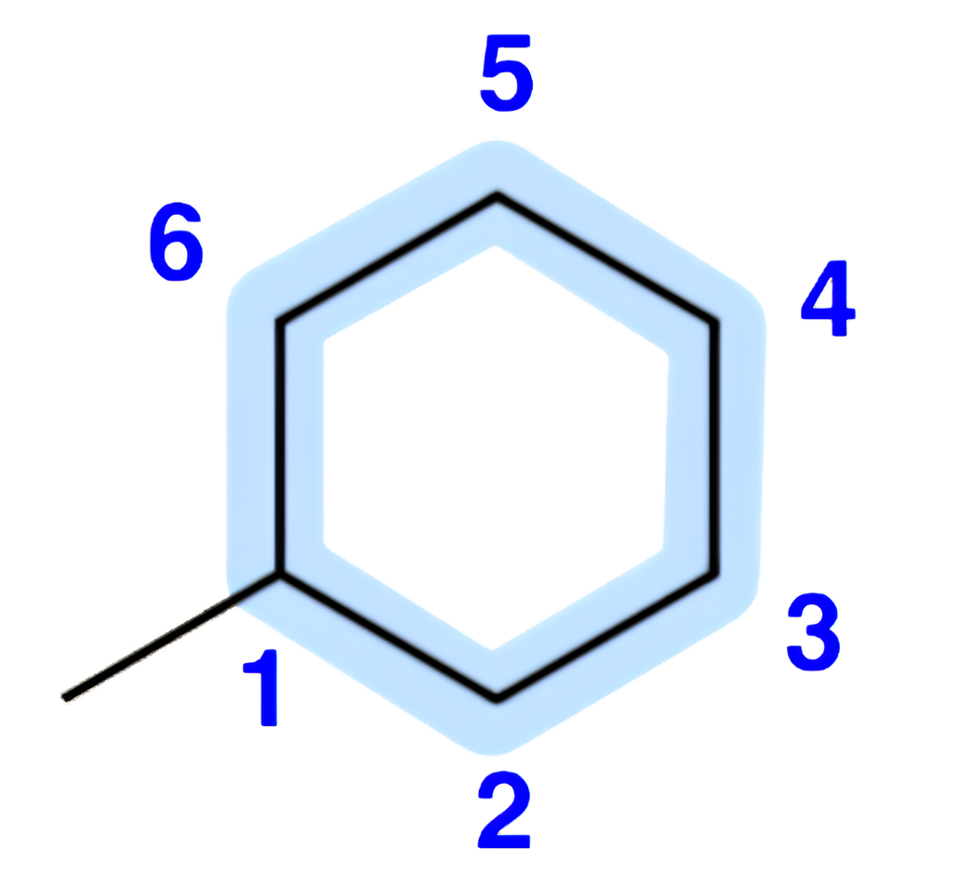
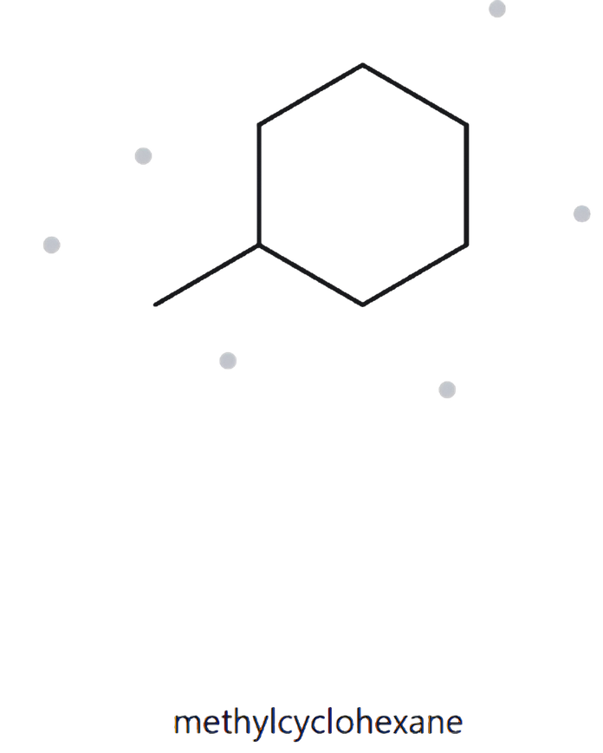
CARD A07 | Structure → Name
Level:
Developing
Molecular Formula:
C₇H₁₄
01 NUMBERED PARENT
02 NAMING TRAIL
Parent: ring present → ring is the parent; 6 C → cyclohexane.
Numbering: only one substituent, so it takes C1 and no locant is needed (direction is irrelevant).
Substituents (alphabetical): methyl.
03 MY NAME
04 THE ALKANE CHECK
{
methylcyclohexane
Returned Name:
methylcyclohexane
Verdict: Match
Verification Strip
longest chain/ring
lowest locants
alphabetical order
punctuation
formula counted

Slide 8
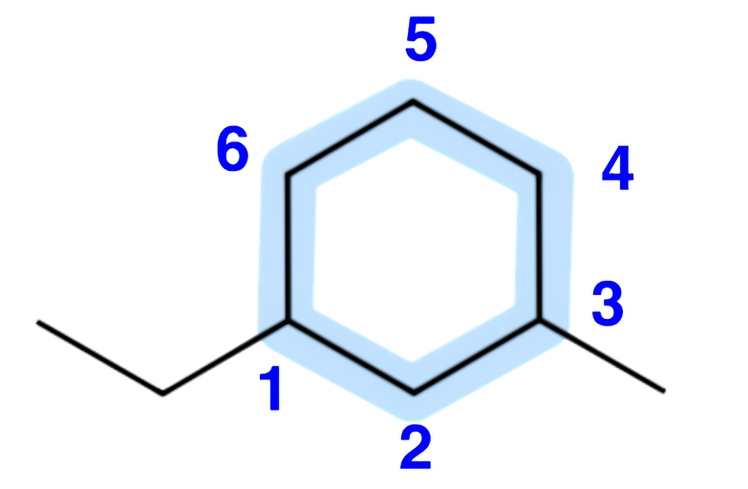
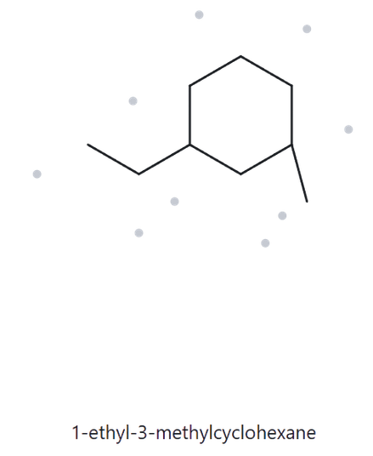
CARD A08 | Structure → Name
Level:
Challenge
Molecular Formula:
C₉H₁₈
01 NUMBERED PARENT
02 NAMING TRAIL
Parent: ring → cyclohexane (6 C).
Numbering: starting at ethyl (short way) gives {1,3}; starting at methyl (short way) also gives {1,3}, so the sets tie.
Tie-break: ethyl precedes methyl alphabetically, so ethyl gets C1.
Substituents (alphabetical): ethyl on C1, methyl on C3.
03 MY NAME
04 THE ALKANE CHECK
{
Returned Name:
1-ethyl-3-methylcyclohexane
1-ethyl-3-methylcyclohexane
Verdict: Match
Verification Strip
longest chain/ring
lowest locants
alphabetical order
punctuation
formula counted

Slide 9
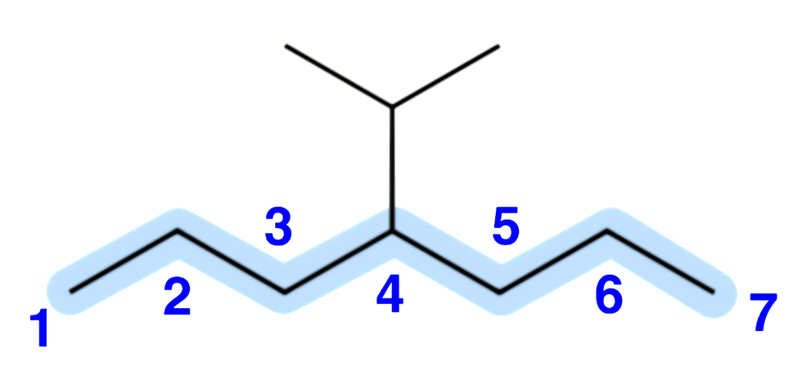
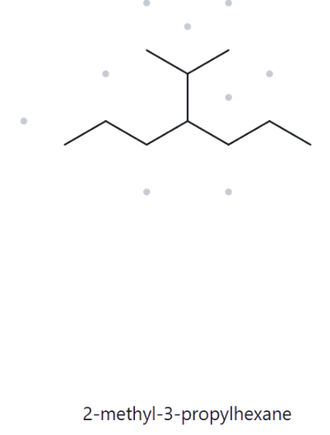
CARD A09 | Structure → Name
Level:
Challenge
Molecular Formula:
C₁₀H₂₂
01 NUMBERED PARENT
02 NAMING TRAIL
Parent: longest chain = 7 C → heptane. A path through the branch gives only 6 C, so the branch is a substituent.
Numbering: either direction gives 4, so the sets tie.
Substituents: isopropyl [(1-methylethyl)] on C4.
03 MY NAME
04 THE ALKANE CHECK
{
Returned Name:
2-methyl-3-propylhexane
4-isopropylheptane
Verdict: Mismatch
Correct name: 4-isopropylheptane [4-(1-methylethyl)heptane]. The parent must be the longest chain: 7 carbons (heptane), not 6 (hexane).
Verification Strip
longest chain/ring
lowest locants
alphabetical order
punctuation
formula counted

Slide 10
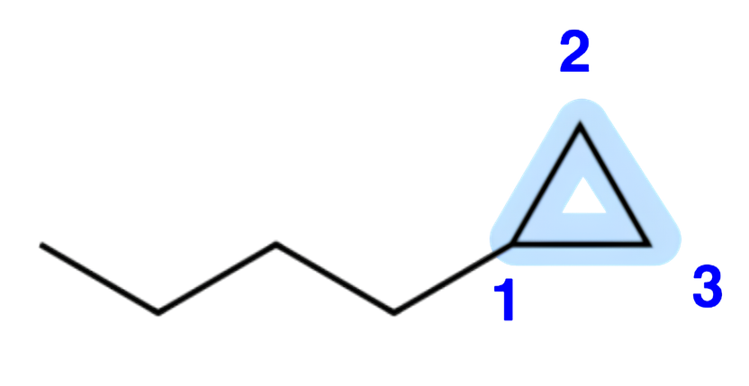
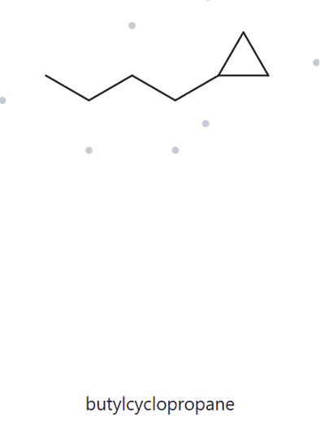
CARD A10 | Structure → Name
Level:
Challenge
Molecular Formula:
C₇H₁₄
01 NUMBERED PARENT
02 NAMING TRAIL
Parent: ring present → ring is the parent; 3 C → cyclopropane. The chain has more carbons (4 C), but the ring takes priority.
Numbering: only one substituent, so it takes C1 and no locant is needed.
Substituents: butyl (4 C).
03 MY NAME
04 THE ALKANE CHECK
{
butylcyclopropane
Returned Name:
butylcyclopropane
Verdict: Match
Verification Strip
longest chain/ring
lowest locants
alphabetical order
punctuation
formula counted

Slide 11
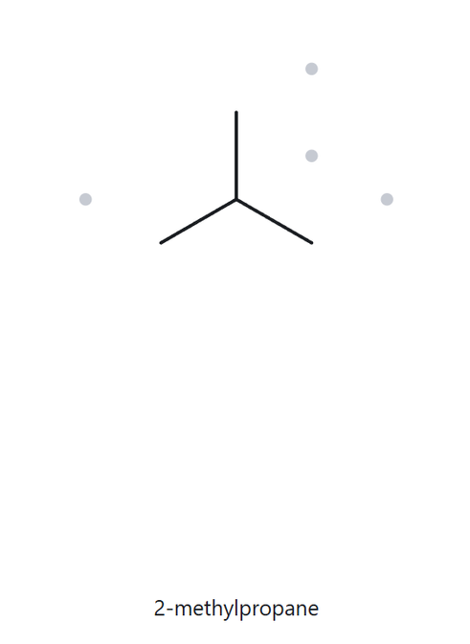
CARD B01 | Name → Structure
Level:
Foundation
Given Name:
2-methylpropane
01 NAME DECODED
02 BOND-LINE STRUCTURE (The Alkane)
Parent: propane → 3-C chain.
Substituent: methyl on C2.
Expected formula: 3 + 1 = 4 C;
open chain → C₄H₁₀.
03 FORMULA CHECK
04 BACK-CHECK
Returned Name:
2-methylpropane
Verdict: same as the given name
Counted from drawing: C₄H₁₀ (C: 3 + 1 = 4).
Open chain: CₙH₂ₙ₊₂ = C₄H₁₀
Verification Strip
parent length matches
substituent positions match
formula agrees
back-check recorded

Slide 12
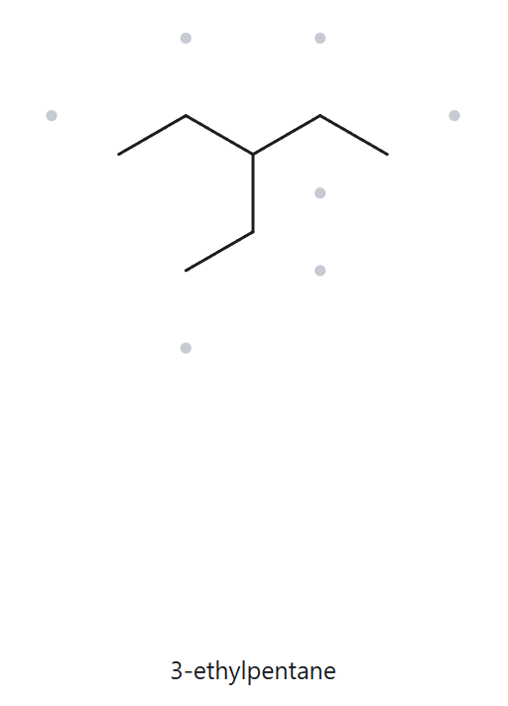
CARD B02 | Name → Structure
Level:
Foundation
Given Name:
3-ethylpentane
01 NAME DECODED
02 BOND-LINE STRUCTURE (The Alkane)
Parent: pentane → 5-C chain.
Substituent: ethyl on C3.
Expected formula: 5 + 2 = 7 C;
open chain → C₇H₁₆.
03 FORMULA CHECK
04 BACK-CHECK
Returned Name:
3-ethylpentane
Verdict: same as the given name
Counted from drawing: C₇H₁₆ (C: 5 + 2 = 7).
Open chain: CₙH₂ₙ₊₂,
n = 7 → 2(7) + 2 = 16 → C₇H₁₆
Verification Strip
parent length matches
substituent positions match
formula agrees
back-check recorded

Slide 13
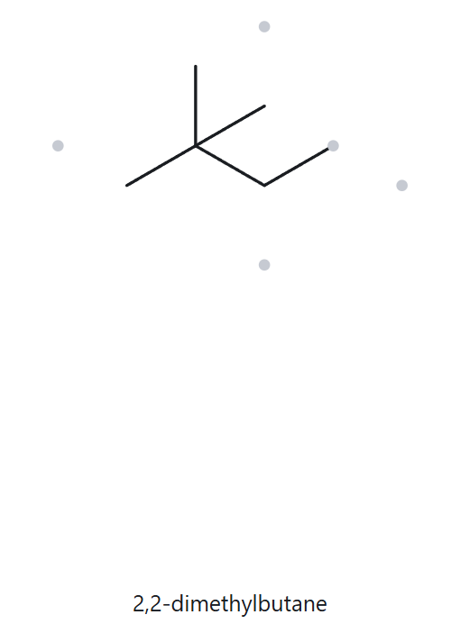
CARD B03 | Name → Structure
Level:
Foundation
Given Name:
2,2-dimethylbutane
01 NAME DECODED
02 BOND-LINE STRUCTURE (The Alkane)
Parent: butane → 4-C chain.
Substituents: two methyls, both on C2.
Expected formula: 4 + 2 = 6 C;
open chain → C₆H₁₄.
03 FORMULA CHECK
04 BACK-CHECK
Returned Name:
2,2-dimethylbutane
Verdict: same as the given name
Counted from drawing: C₆H₁₄ (C: 4 + 2 = 6).
Open chain: CₙH₂ₙ₊₂ = C₆H₁₄
Verification Strip
parent length matches
substituent positions match
formula agrees
back-check recorded

Slide 14
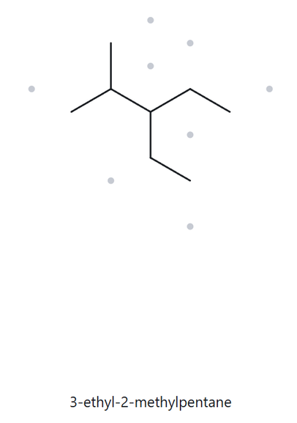
CARD B04 | Name → Structure
Level:
Developing
Given Name:
3-ethyl-2-methylpentane
01 NAME DECODED
02 BOND-LINE STRUCTURE (The Alkane)
Parent: pentane → 5-C chain.
Substituents: methyl on C2; ethyl on C3 (cited alphabetically: ethyl, then methyl).
Expected formula: 5 + 1 + 2 = 8 C;
open chain → C₈H₁₈.
03 FORMULA CHECK
04 BACK-CHECK
Counted from drawing: C₈H₁₈
(C: 5 + 1 + 2 = 8).
Open chain: CₙH₂ₙ₊₂ = C₈H₁₈
Returned Name:
3-ethyl-2-methylpentane
Verdict: same as the given name
Verification Strip
parent length matches
substituent positions match
formula agrees
back-check recorded

Slide 15
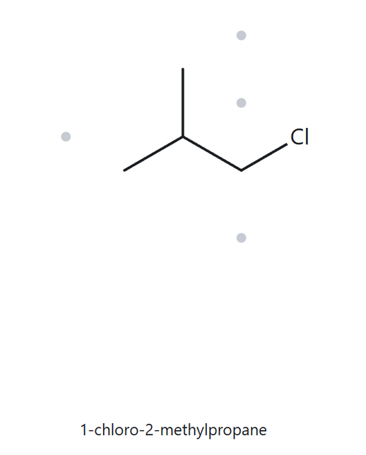
CARD B05 | Name → Structure
Level:
Developing
Given Name:
1-chloro-2-methylpropane
01 NAME DECODED
02 BOND-LINE STRUCTURE (The Alkane)
Parent: propane → 3-C chain.
Substituents: chloro on C1; methyl on C2.
Expected formula: 3 + 1 = 4 C;
open chain C₄H₁₀; Cl replaces one H → C₄H₉Cl.
03 FORMULA CHECK
04 BACK-CHECK
Returned Name:
1-chloro-2-methylpropane
Verdict: same as the given name
Counted from drawing: C₄H₉Cl.
Open chain: CₙH₂ₙ₊₂ = C₄H₁₀;
minus one H for Cl = C₄H₉Cl
Verification Strip
parent length matches
substituent positions match
formula agrees
back-check recorded

Slide 16
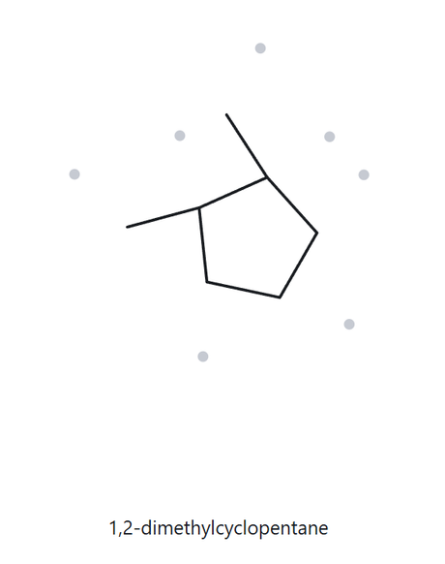
CARD B06 | Name → Structure
Level:
Developing
Given Name:
1,2-dimethylcyclopentane
01 NAME DECODED
02 BOND-LINE STRUCTURE (The Alkane)
Parent: cyclopentane → 5-C ring.
Substituents: methyl on C1 and C2 (adjacent ring carbons).
Expected formula: 5 + 2 = 7 C;
one ring → C₇H₁₄.
03 FORMULA CHECK
04 BACK-CHECK
Returned Name:
1,2-dimethylcyclopentane
Verdict: same as the given name
Counted from drawing: C₇H₁₄ (C: 5 + 2 = 7).
One ring: CₙH₂ₙ = C₇H₁₄
Verification Strip
parent length matches
substituent positions match
formula agrees
back-check recorded

Slide 17
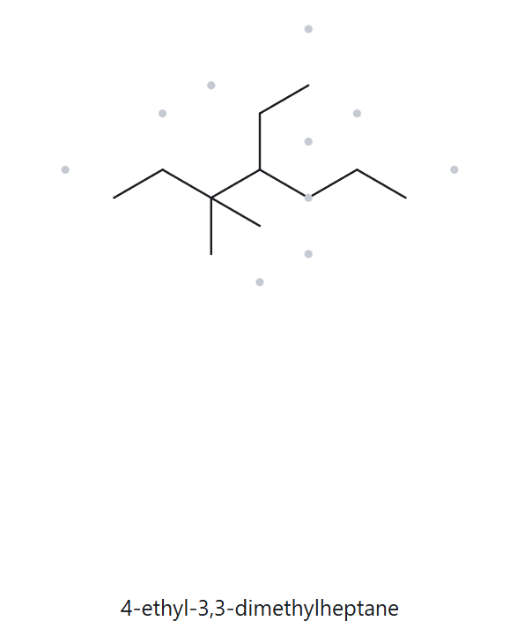
CARD B07 | Name → Structure
Level:
Developing
Given Name:
4-ethyl-3,3-dimethylheptane
01 NAME DECODED
02 BOND-LINE STRUCTURE (The Alkane)
Parent: heptane → 7-C chain.
Substituents: two methyls on C3 (3,3-dimethyl); ethyl on C4 (cited first alphabetically).
Expected formula: 7 + 2 + 2 = 11 C;
open chain → C₁₁H₂₄.
03 FORMULA CHECK
04 BACK-CHECK
Returned Name:
4-ethyl-3,3-dimethylheptane
Verdict: same as the given name
Counted from drawing: C₁₁H₂₄
(C: 7 + 2 + 2 = 11).
Open chain: CₙH₂ₙ₊₂,
n = 11 → 2(11) + 2 = 24 → C₁₁H₂₄
Verification Strip
parent length matches
substituent positions match
formula agrees
back-check recorded

Slide 18
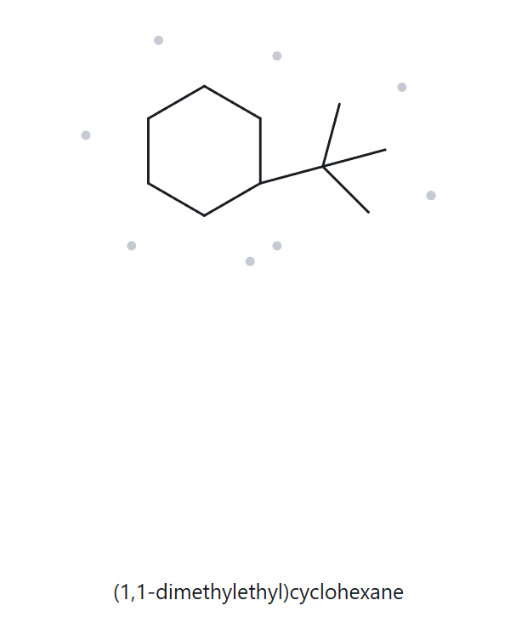
CARD B08 | Name → Structure
Level:
Challenge
Given Name:
tert-butylcyclohexane
01 NAME DECODED
02 BOND-LINE STRUCTURE (The Alkane)
Parent: cyclohexane → 6-C ring.
Substituent: tert-butyl, –C(CH₃)₃, a 4-C group attached through its central carbon. It is the only substituent, so no locant is needed.
Expected formula: 6 + 4 = 10 C;
one ring → C₁₀H₂₀.
03 FORMULA CHECK
04 BACK-CHECK
Returned Name:
(1,1-dimethylethyl)cyclohexane
Verdict: same compound
written with a different accepted substituent name. tert-Butyl = (1,1-dimethylethyl)
= 2-methylpropan-2-yl (Appendix B.3).
Counted from drawing: C₁₀H₂₀ (C: 6 + 4 = 10).
One ring: CₙH₂ₙ = C₁₀H₂₀
Verification Strip
parent length matches
substituent positions match
formula agrees
back-check recorded

Slide 19
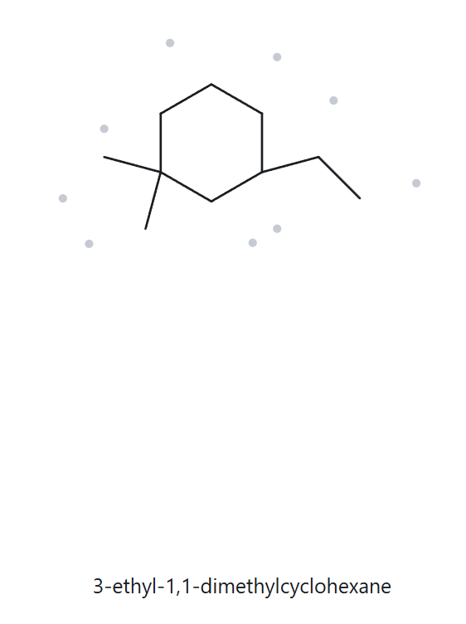
CARD B09 | Name → Structure
Level:
Challenge
Given Name:
3-ethyl-1,1-dimethylcyclohexane
01 NAME DECODED
02 BOND-LINE STRUCTURE (The Alkane)
Parent: cyclohexane → 6-C ring.
Substituents: two methyls on C1 (1,1-dimethyl); ethyl on C3.
Numbering check: Dimethyl carbon gives {1,1,3}; ethyl carbon gives {1,3,3}. Since {1,1,3} is lower at the first point of difference, the numbering is correct.
Expected formula: 6 + 2 + 2 = 10 C;
one ring → C₁₀H₂₀.
03 FORMULA CHECK
04 BACK-CHECK
Counted from drawing: C₁₀H₂₀
(C: 6 + 2 + 2 = 10).
One ring: CₙH₂ₙ = C₁₀H₂₀
Returned Name:
3-ethyl-1,1-dimethylcyclohexane
Verdict: same as the given name
Verification Strip
parent length matches
substituent positions match
formula agrees
back-check recorded

Slide 20
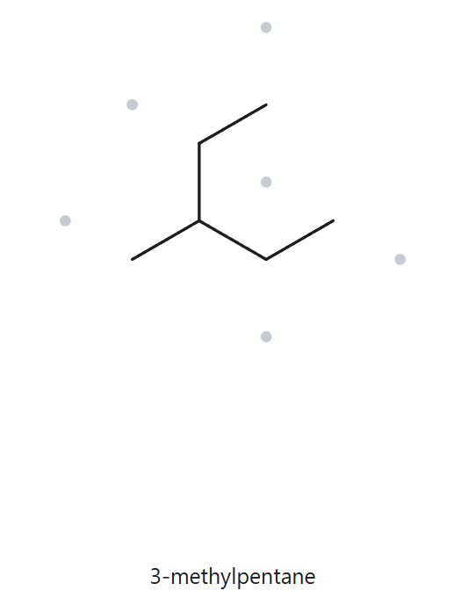
CARD B10 | Name → Structure
Level:
Challenge
2-ethylbutane
Given Name:
(deliberately incorrect)
01 NAME DECODED
02 BOND-LINE STRUCTURE (The Alkane)
Parent: butane → 4-C chain.
Substituent: ethyl on C2.
Expected formula: 4 + 2 = 6 C;
open chain → C₆H₁₄.
03 FORMULA CHECK
04 BACK-CHECK
Returned Name:
3-methylpentane
Verdict: differs from the given name
Given name: 2-ethylbutane.
Correct name: 3-methylpentane.
Rule broken: the parent must be the longest continuous chain. The ethyl branch extends the chain through C2, giving 5 C (pentane), so the original C1 becomes a methyl on C3 of pentane.
Counted from drawing: C₆H₁₄ (C: 4 + 2 = 6).
Open chain: CₙH₂ₙ₊₂ = C₆H₁₄
Verification Strip
parent length matches
substituent positions match
formula agrees
back-check recorded

