Slide 1
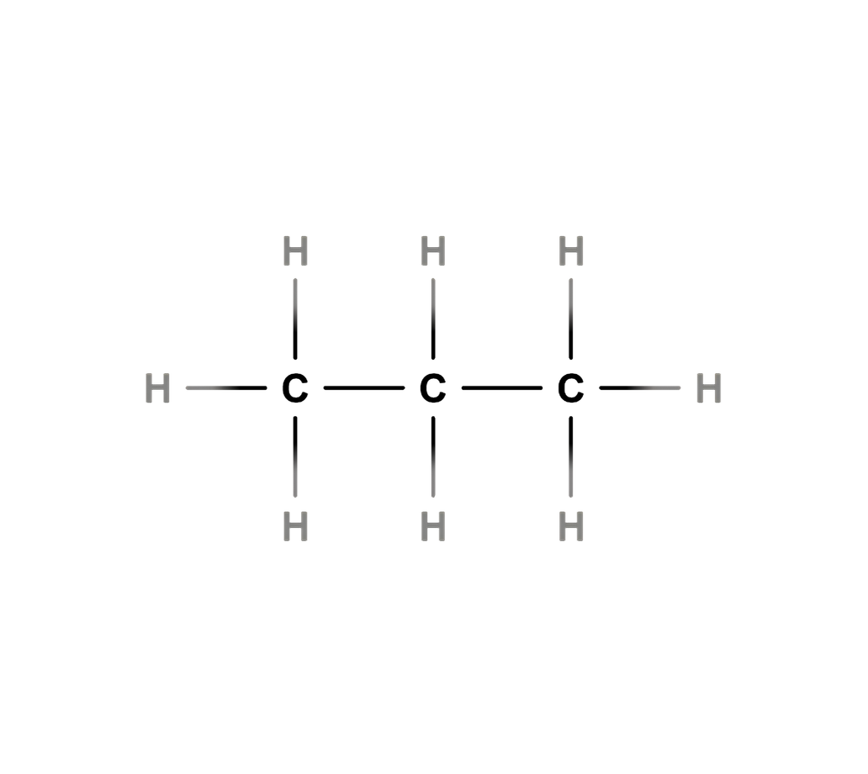
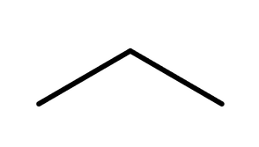
01 | PROPANE
IUPAC Name: Propane
Molecular Formula: C₃H₈
01 MOLECULAR FORMULA
02 LEWIS STRUCTURE
C₃H₈
03 CONDENSED STRUCTURAL FORMULA
04 BOND LINE STRUCTURE
CH₃CH₂CH₃
Verification Strip
atom count verified
valence checked
bond order checked
same connectivity confirmed

Slide 2
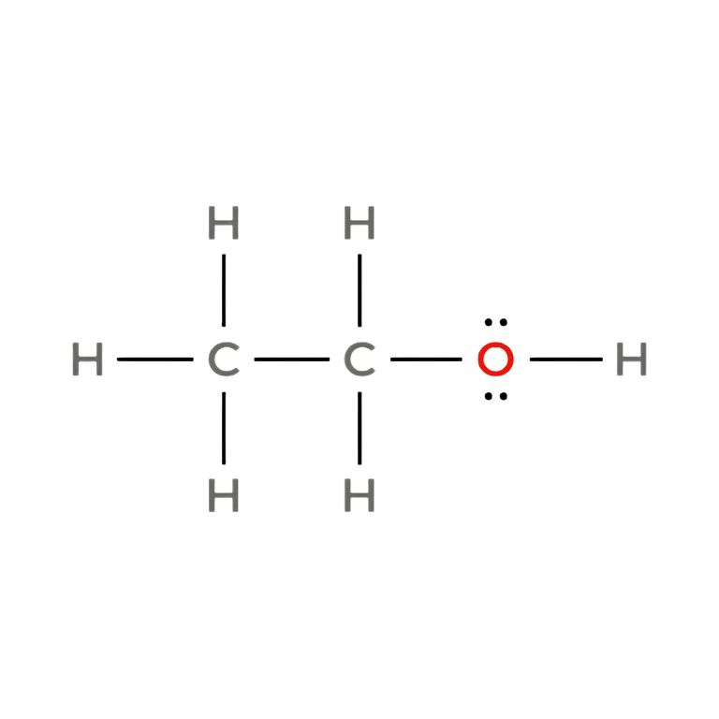
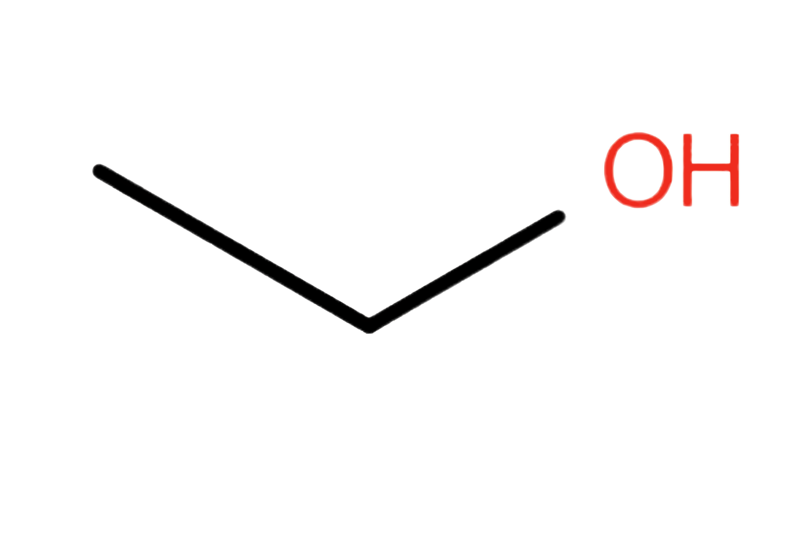
02 | ETHANOL
IUPAC Name: Ethanol
Molecular Formula: C₂H₆O
01 MOLECULAR FORMULA
02 LEWIS STRUCTURE
C₂H₆O
03 CONDENSED STRUCTURAL FORMULA
04 BOND LINE STRUCTURE
CH₃CH₂OH
Verification Strip
atom count verified
valence checked
bond order checked
same connectivity confirmed

Slide 3
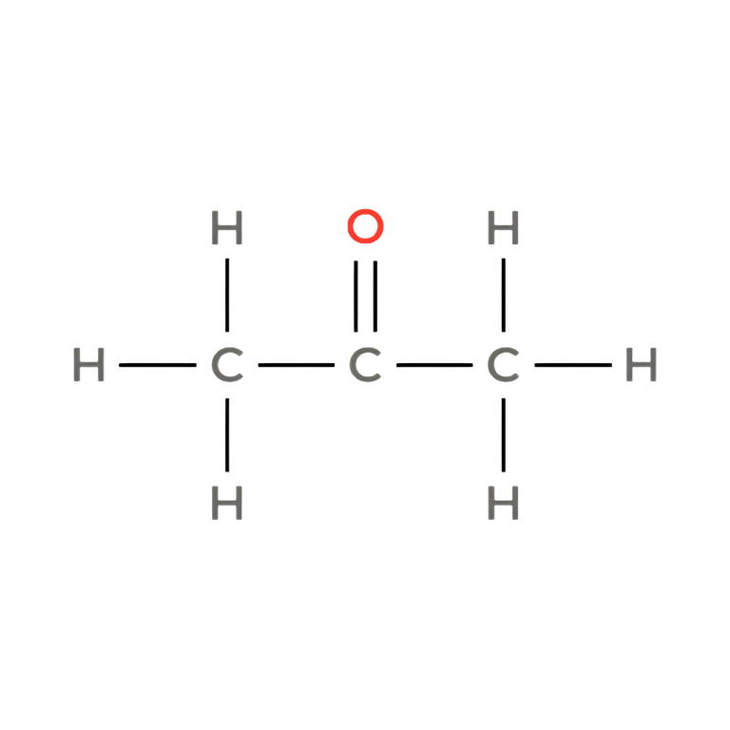
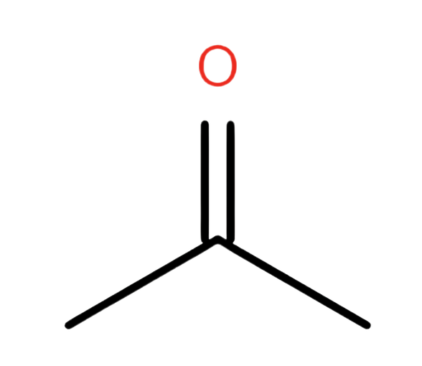
03 | Acetone
IUPAC Name: Propan-2-one
Molecular Formula: C₃H₆O
01 MOLECULAR FORMULA
02 LEWIS STRUCTURE
C₃H₆O
03 CONDENSED STRUCTURAL FORMULA
04 BOND LINE STRUCTURE
CH₃COCH₃
Verification Strip
atom count verified
valence checked
bond order checked
same connectivity confirmed

Slide 4
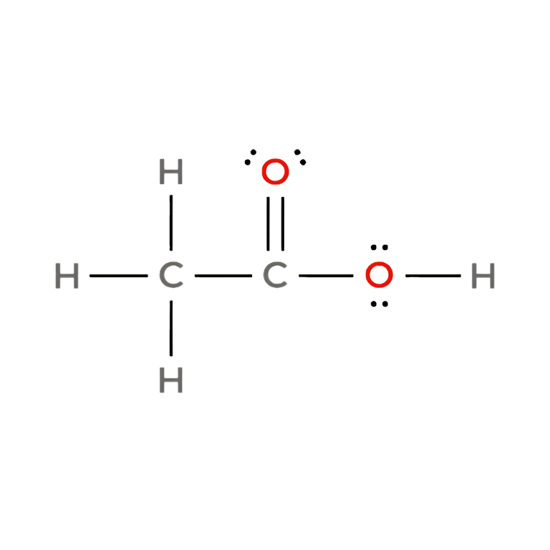
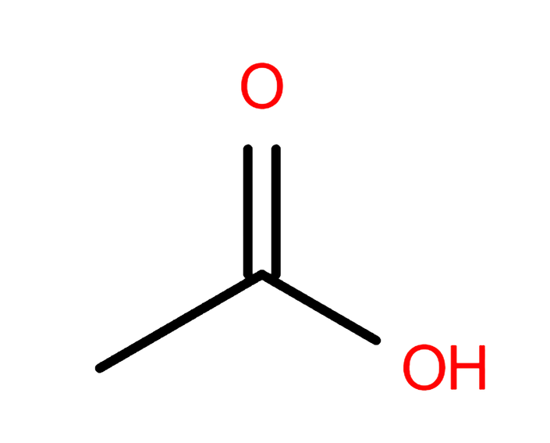
04 | ACETIC ACID
IUPAC Name: Ethanoic acid
Molecular Formula: C₂H₄O₂
01 MOLECULAR FORMULA
02 LEWIS STRUCTURE
C₂H₄O₂
03 CONDENSED STRUCTURAL FORMULA
04 BOND LINE STRUCTURE
CH₃COOH
Verification Strip
atom count verified
valence checked
bond order checked
same connectivity confirmed

Slide 5
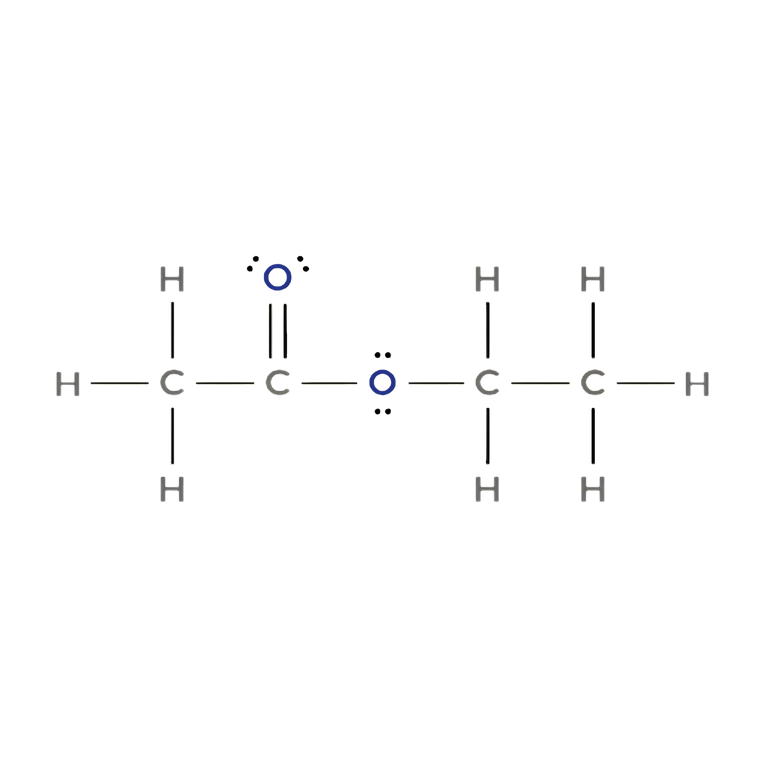
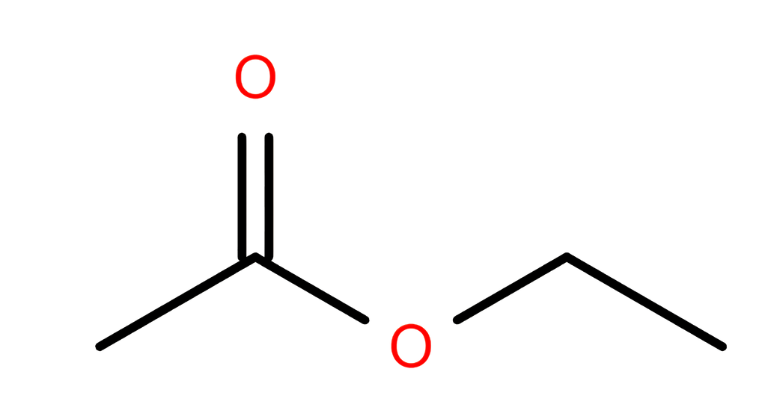
05 | ETHYL ACETATE
IUPAC Name: Ethyl ethanoate
Molecular Formula: C₄H₈O₂
01 MOLECULAR FORMULA
02 LEWIS STRUCTURE
C₄H₈O₂
03 CONDENSED STRUCTURAL FORMULA
04 BOND LINE STRUCTURE
CH₃COOCH₂CH₃
Verification Strip
atom count verified
valence checked
bond order checked
same connectivity confirmed

Slide 6
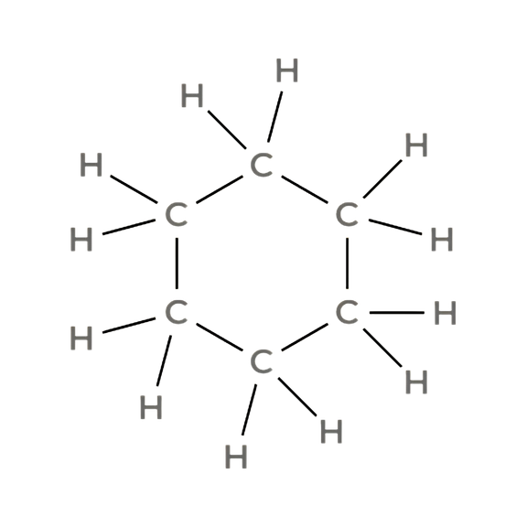
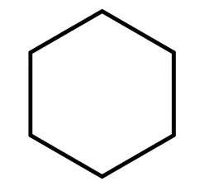
06 | CYCLOHEXANE
IUPAC Name: Cyclohexane
Molecular Formula: C₆H₁₂
01 MOLECULAR FORMULA
02 LEWIS STRUCTURE
C₆H₁₂
03 CONDENSED STRUCTURAL FORMULA
04 BOND LINE STRUCTURE
(CH₂)₆
(cyclic; six CH₂ groups form a ring)
Verification Strip
atom count verified
valence checked
bond order checked
same connectivity confirmed

Slide 7
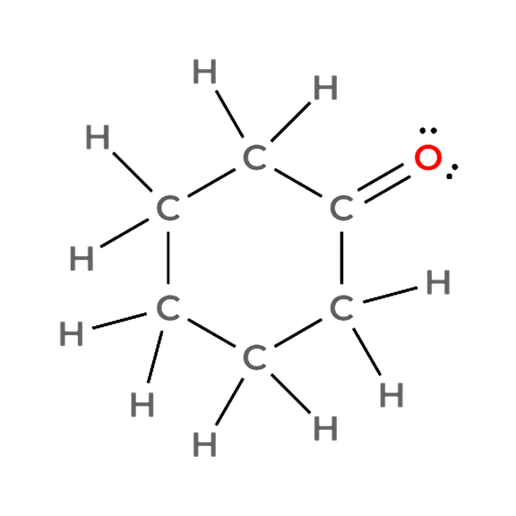
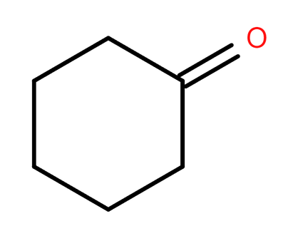
07 | CYCLOHEXANONE
IUPAC Name: Cyclohexanone
Molecular Formula: C₆H₁₀O
01 MOLECULAR FORMULA
02 LEWIS STRUCTURE
C₆H₁₀O
03 CONDENSED STRUCTURAL FORMULA
04 BOND LINE STRUCTURE
Cyclic –CO–(CH₂)₅–
(ring containing one carbonyl carbon and five CH₂ groups)
Verification Strip
atom count verified
valence checked
bond order checked
same connectivity confirmed

Slide 8
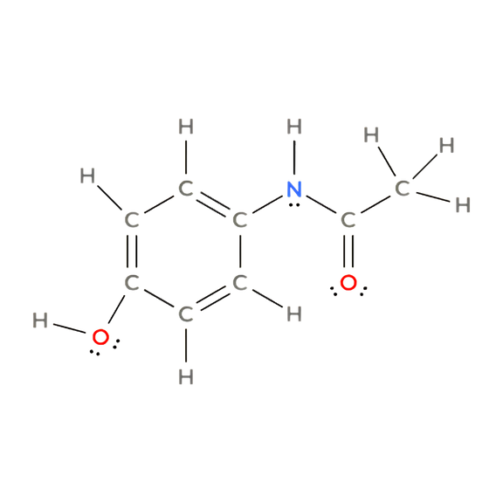
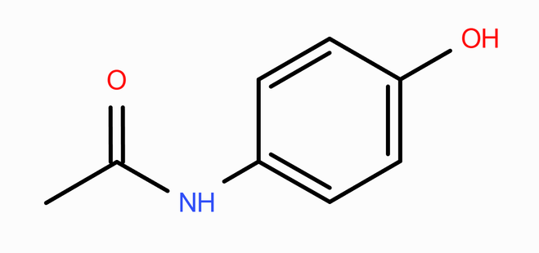
08 | ACETAMINOPHEN
Accepted Name: Paracetamol | IUPAC Name: N-(4-hydroxyphenyl)acetamide
Molecular Formula: C₈H₉NO₂
01 MOLECULAR FORMULA
02 LEWIS STRUCTURE
C₈H₉NO₂
03 CONDENSED STRUCTURAL FORMULA
04 BOND LINE STRUCTURE
p-HOC₆H₄NHCOCH₃
The “p-” indicates that the OH and NHCOCH₃ substituents are opposite each other on the benzene ring (para positions).
Verification Strip
atom count verified
valence checked
bond order checked
same connectivity confirmed

Slide 9
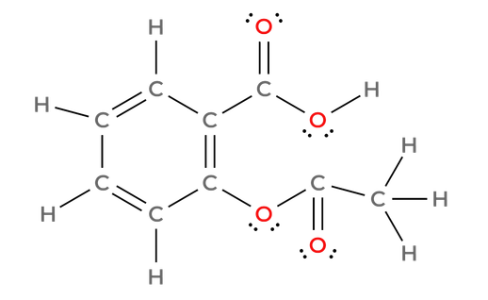
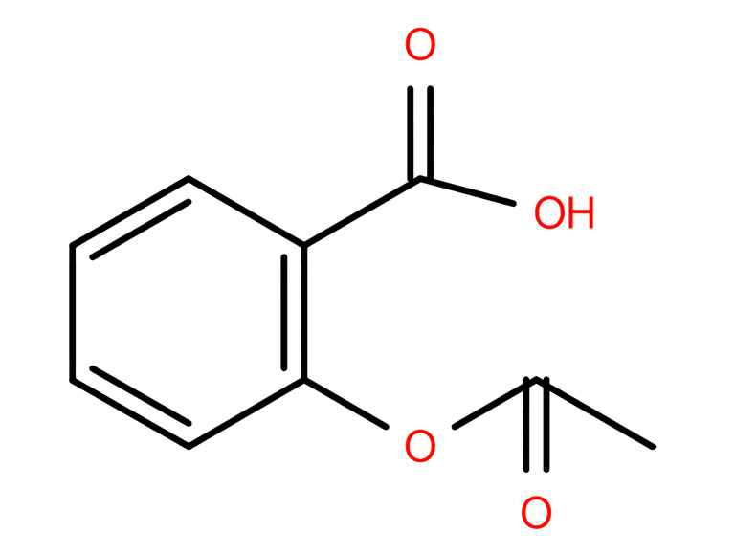
09 | ASPIRIN
Accepted Name: Acetylsalicylic acid | IUPAC Name: 2-(acetyloxy)benzoic acid
Molecular Formula: C₉H₈O₄
01 MOLECULAR FORMULA
02 LEWIS STRUCTURE
C₉H₈O₄
03 CONDENSED STRUCTURAL FORMULA
04 BOND LINE STRUCTURE
CH₃COOC₆H₄COOH
(ortho-substituted benzene ring)
Verification Strip
atom count verified
valence checked
bond order checked
same connectivity confirmed

Slide 10
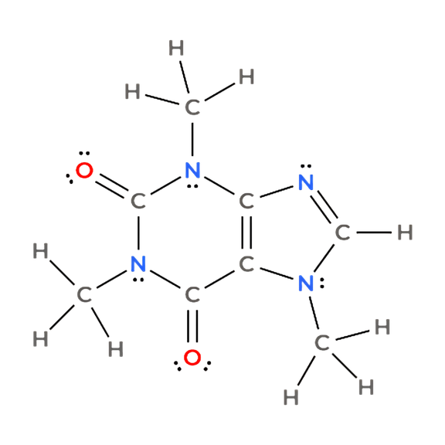
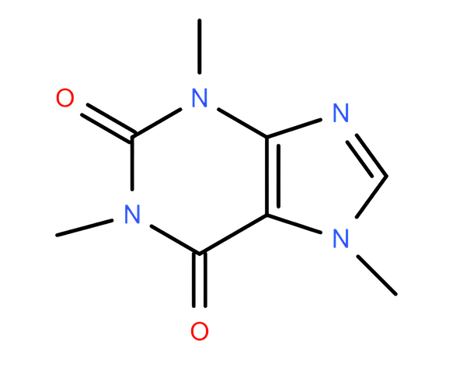
10 | CAFFEINE
IUPAC Name: 1,3,7-trimethylpurine-2,6-dione
Molecular Formula: C₈H₁₀N₄O₂
01 MOLECULAR FORMULA
02 LEWIS STRUCTURE
C₈H₁₀N₄O₂
03 CONDENSED STRUCTURAL FORMULA
04 BOND LINE STRUCTURE
(CH₃)₃C₅HN₄O₂
(Fused-ring structure; see bond-line representation.)
Verification Strip
atom count verified
valence checked
bond order checked
same connectivity confirmed

