Slide 1
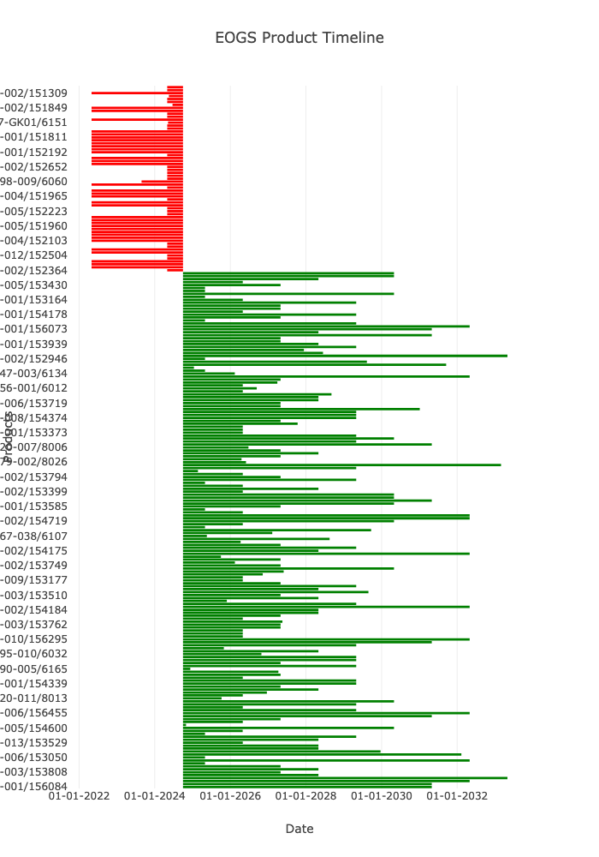
Region Overview
Head Count: 60
Average IP Age: 7.99
Device Type Frequency: ip
VERSA HD 103
ELEKTA INFINITY 102
ELEKTA SYNERGY 37
LGK Icon 32
LGK Perfexion 10
UNITY SYSTEM 8
ELEKTA SYNERGY PLATFORM 3
ELEKTA AXESSE 1
HARMONY 1
Name: count, dtype: int64

Slide 2
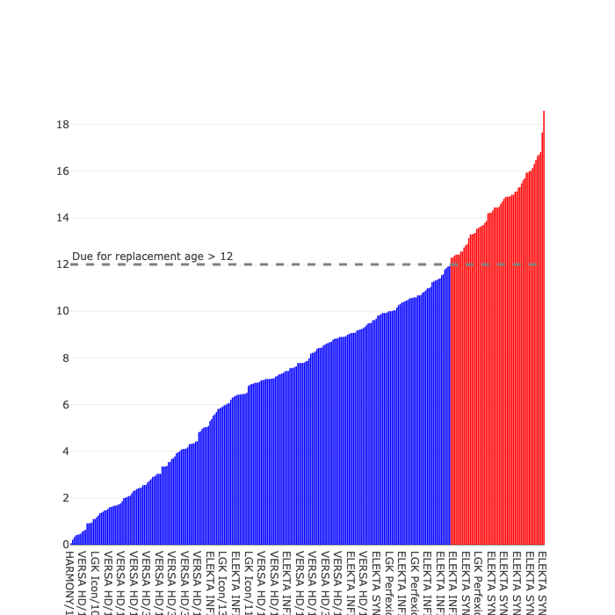
Device Age

