Slide 1
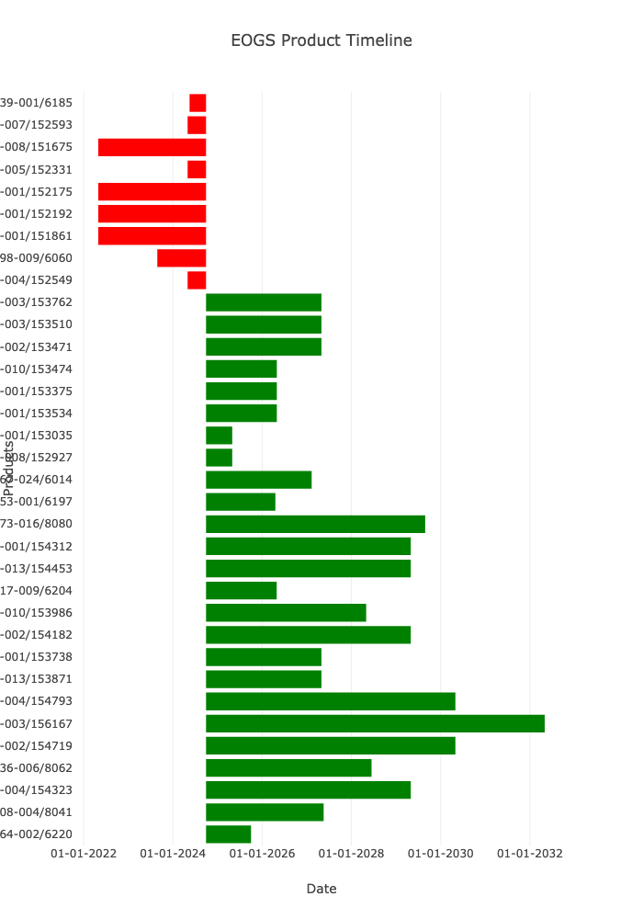
Region Overview
Head Count: 9
Average IP Age: 7.99
Device Type Frequency: ip
VERSA HD 16
ELEKTA INFINITY 14
LGK Icon 6
ELEKTA SYNERGY 4
LGK Perfexion 3
UNITY SYSTEM 2
Name: count, dtype: int64

Slide 2
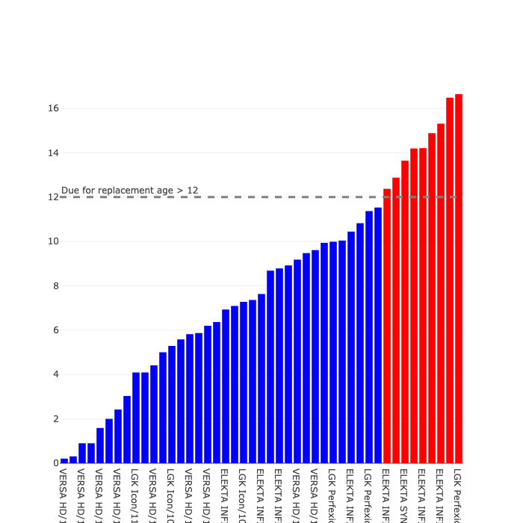
Device Age

