Slide 1
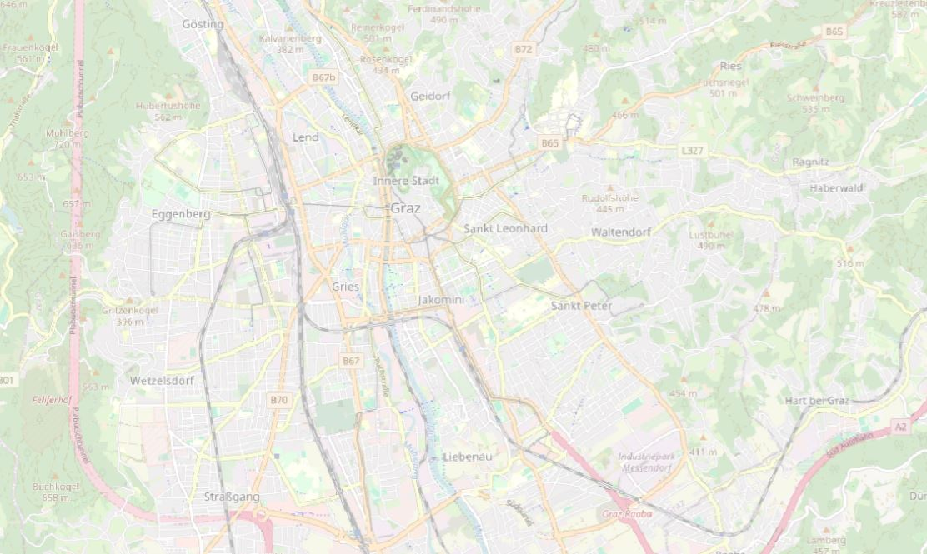


Routing – Lab 01
Course: Navigation Systems (GST330UF)
WS 2025/26
Bernadette Kakuska & Hannah Öttl
16.11.2025

Slide 2
Task and objective
Routing task for the city of Graz
Start node chosen as nearest to our home coordinates
Compute routes to three landmarks
Evaluate distance and time as cost functions
Compare Dijkstra and A* (distance as cost function)

Slide 3
Methodology: Dijkstra‘s Algorithm
Single-source shortest path algorithm
Works for weighted, non-negative graphs
Uses temporary and permanent labels
Initialize all distances as infinity, source as zero
Repeatedly select node with smallest distance
Update neighbors if shorter path found
Stop when all nodes have permanent labels or target reached

Slide 4
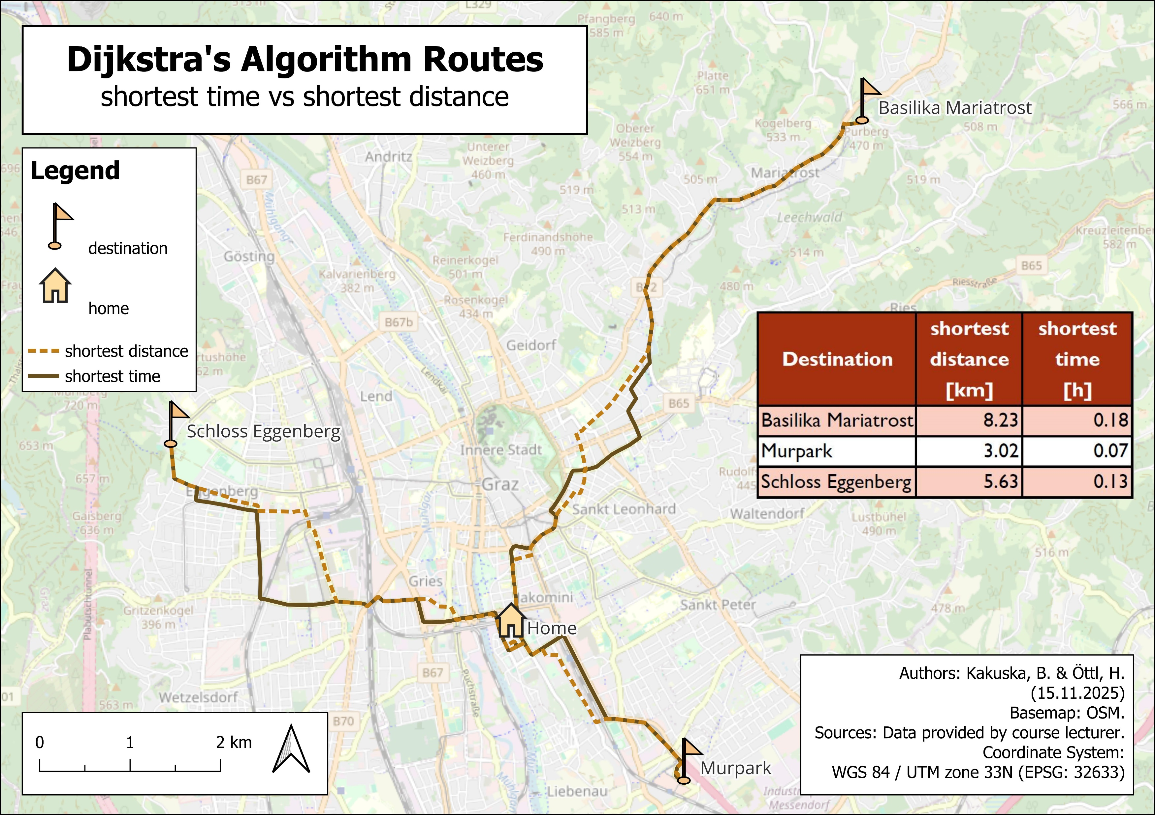
Figure 1: Shortest time and distance to the targets ‘Basilika Mariatrost’, ‘Murpark’ and ‘Schloss Eggenberg’, calculated by Dijkstra’s Routing Algorithm (created by Kakuska, B. and Öttl, H. 2025)

Slide 5
Methodology: A* Algorithm
Combines path cost with straight-line heuristic (Haversine)
f = actual cost (l_j) + heuristic (h_j)
Maintains sets: T (temporary), P (permanent)
Always expand node with smallest f_j
Updates neighbor costs and predecessors
Stops when goal (destination) reached
Returns shortest path, cost, visited nodes set
More directed, fewer expanded nodes

Slide 6
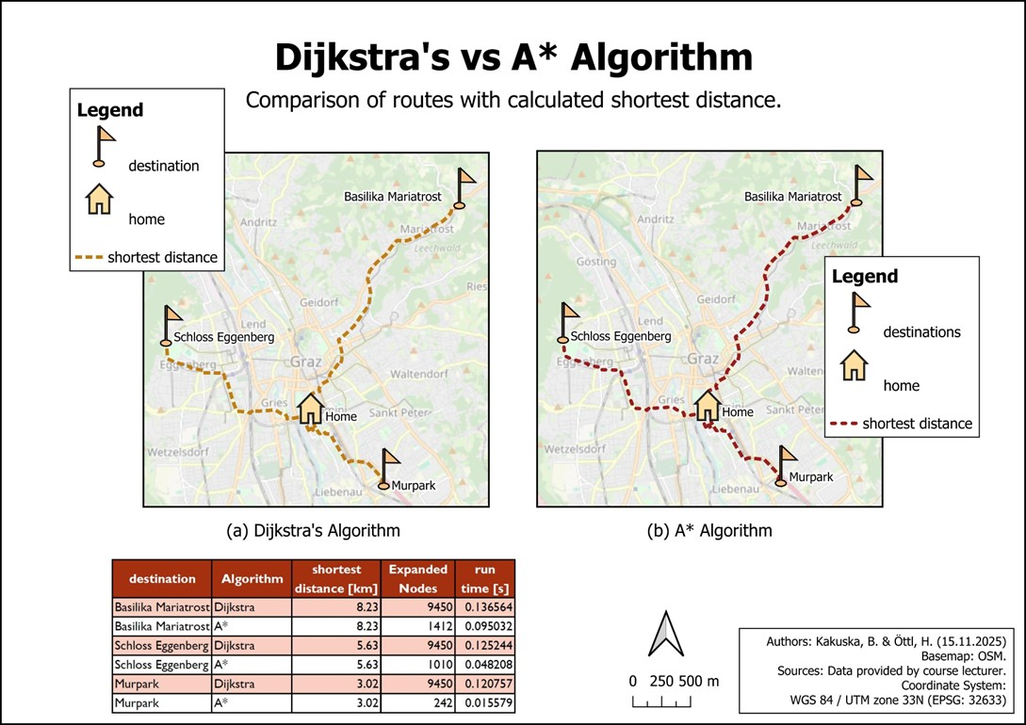
Figure 2: Comparison of the shortest routes using distance cost function to the targets ‘Basilika Mariatrost’, ‘Murpark’ and ‘Schloss Eggenberg’, calculated by Dijkstra’s Routing Algorithm vs. A* Algorithm (created by Kakuska, B. and Öttl, H. 2025).

Slide 7
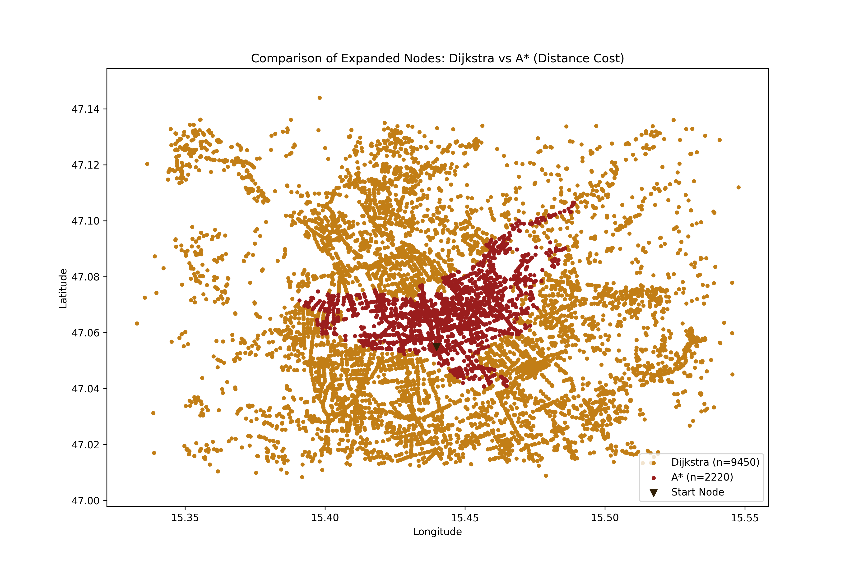
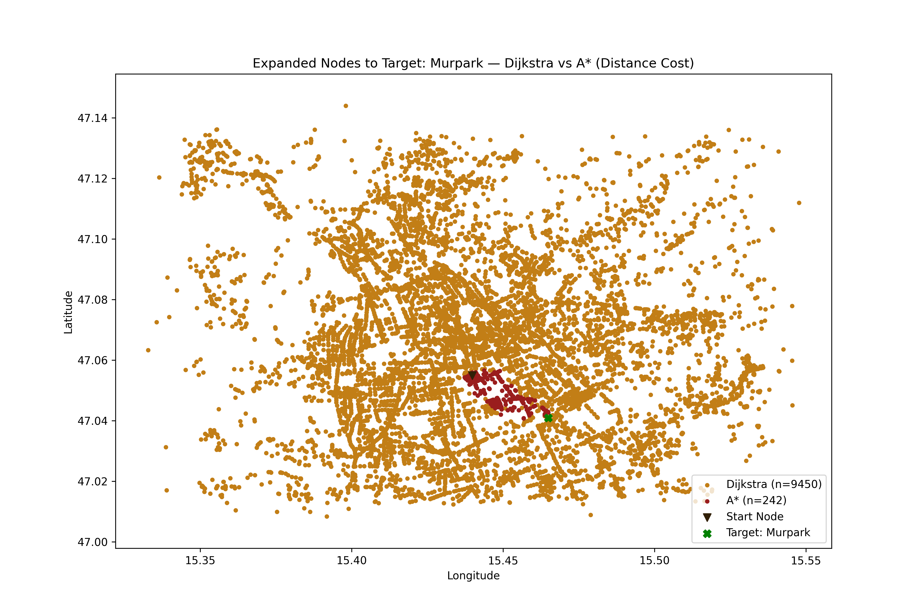
Comparison Dijkstra’s vs. A* algorithm
(a)
(b)
Figure 3: Comparison of the expanded nodes used to calculate the shortest routes (distance) routes using distance cost function to (a) the targets ‘Basilika Mariatrost’, ‘Murpark’ and ‘Schloss Eggenberg’, (b) only the target ‘Murpark’ calculated by Dijkstra’s Routing Algorithm vs. A* Algorithm (created by Kakuska, B. and Öttl, H. 2025).

Slide 8
Conclusion
Both algorithms produce identical path distance and length
Dijkstra expands almost all nodes (9450 visited per target) for full shortest-path coverage
A* consistently faster computation times for all routes
Visualizations clearly show denser node exploration by Dijkstra, focused search by A*
A* lowers search effort (242–1412 nodes per target) by using straight-line heuristic.

Slide 9
Limitations
Heuristic uses straight-line (Euclidean/Haversine) distance—may not reflect real travel routes or obstacles.
No real-time traffic, dynamic speed limits, or changing road conditions included in the model.
Network graph, nodes, and routes built from static input files; unable to react to live or updated data.
Pathfinding does not account for elevation, construction zones, or temporary closures.
One-way street rules and turn restrictions handled only via static arc attributes; may miss complex routing logic.
Time cost only reflects ideal car travel—unrealistic for other modes or conditions.

