Slide 1
Numerical Analysis of Series1
Convergence Studies: e, Derivatives & Taylor Series

Slide 2
Overview
Three key mathematical concepts explored:
  1. Limit definition of e: (1 + 1/n)^n → e
  2. Derivative approximation: (a^h − 1)/h → ln(a)
  3. Taylor series expansion: e^x = Σ (x^n / n!)
Goals:
  • Implement each in Python
  • Analyze convergence behavior
  • Visualize results with Matplotlib histograms

Slide 3
Exercise 1: The Limit of e
Formula: (1 + 1/n)^n as n → ∞
Progression of values:
  n=1 → 2.000000
  n=2 → 2.250000
  n=4 → 2.441406
  n=1000 → 2.716924
  n=10^6 → 2.718280
Converges to Euler's number: e ≈ 2.718281828...

Slide 4
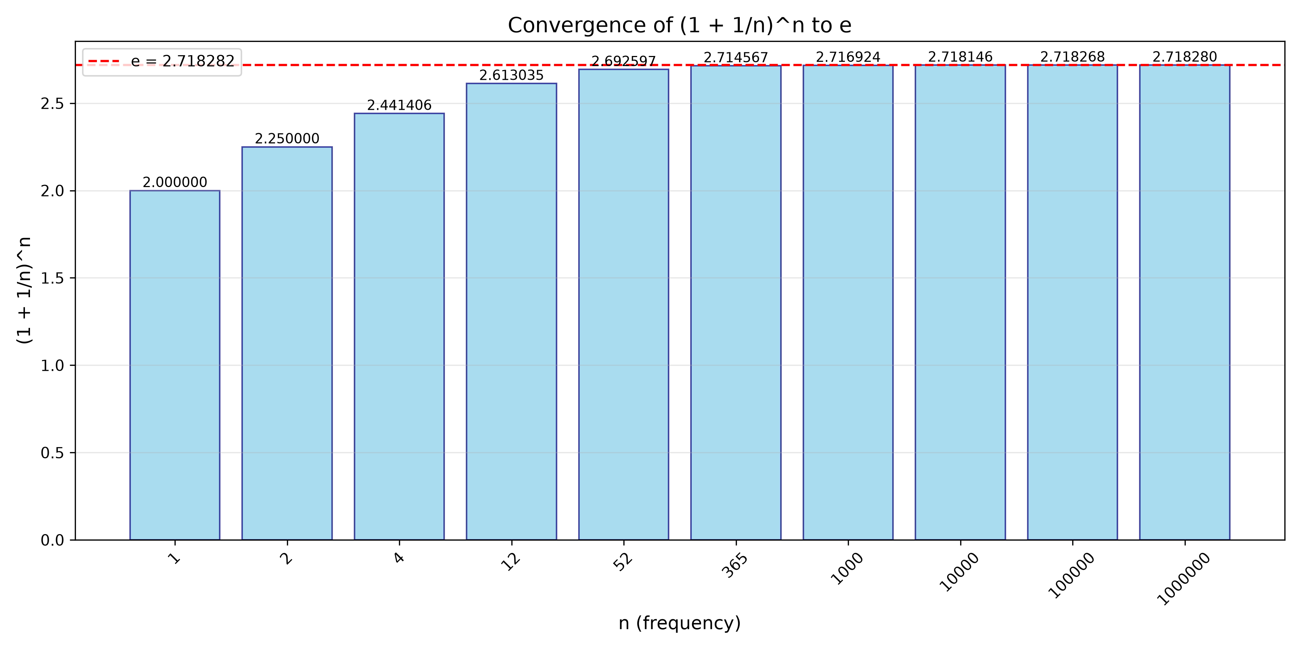
Exercise 1: Convergence Visualization
Bar chart showing monotonic convergence of (1+1/n)^n toward e

Slide 5
Exercise 1: Key Findings
Convergence is monotonic (increasing)
Approaches e from below
Error decreases as O(1/n)
Reaches 6 decimal places by n ≈ 10^6
Why it matters:
  • Foundation for compound interest calculations
  • Defines the natural exponential base e
  • Demonstrates limit-based numerical convergence

Slide 6
Exercise 2: Derivative Approximation
Formula: (a^h − 1) / h as h → 0
Approximates derivative of a^x at x = 0:
  d/dx(a^x) at x=0 = ln(a)
Convergence values:
  a = 2 → ln(2) ≈ 0.6931
  a = e → ln(e) = 1.0000
  a = 3 → ln(3) ≈ 1.0986
Tolerance target: ×10⁻⁶

Slide 7
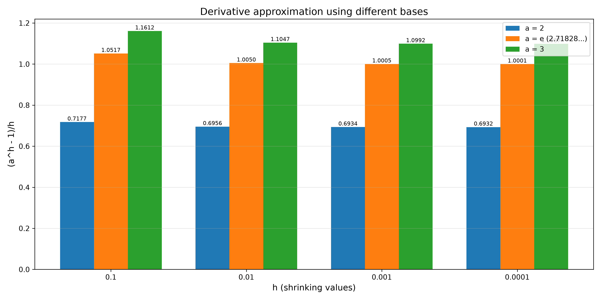
Exercise 2: Convergence Visualization
Grouped bar chart showing (a^h − 1)/h converging to ln(a) as h shrinks

Slide 8
Exercise 2: Key Findings
As h → 0, values converge to ln(a)
First-order finite difference method
Error scales as O(h)
For base e, result is exactly 1
Why base e is special:
  • Only base where derivative of a^x at 0 equals 1
  • This property makes e the 'natural' base
  • Foundation of calculus and exponential growth

Slide 9
Exercise 3: Taylor Series for e^x
Formula: e^x = Σ (x^n / n!) for n = 0 to ∞
Expanded form:
  e^x = 1 + x + x²/2! + x³/3! + x⁴/4! + ...
Implementation details:
  • Up to 10,000 terms supported
  • Tolerance: 10⁻⁶ relative error
  • Tested for x from −5 to +5

Slide 10
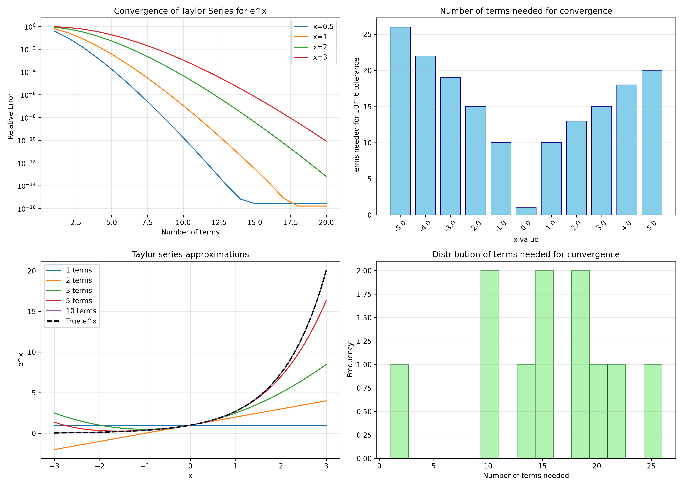
Exercise 3: Convergence Visualization
Four-panel plot: convergence, terms needed, approximations, distribution

Slide 11
Exercise 3: Key Findings
Convergence depends strongly on |x|
For |x| ≤ 5: 15–50 terms typically needed
For x near 0: as few as 5 terms suffice
For large |x|: more terms required
Observations:
  • Factorial growth in denominator ensures fast convergence
  • Accuracy improves dramatically with each added term
  • Series diverges in term count but converges in value

Slide 12
Summary: Comparison of Methods
Method 1: (1 + 1/n)^n
  → Computes e | Convergence: O(1/n)
Method 2: (a^h − 1)/h
  → Computes ln(a) | Convergence: O(h)
Method 3: Σ (x^n / n!)
  → Computes e^x | Convergence: factorial (fastest)
All three demonstrate numerical techniques for fundamental constants.

Slide 13
Real-World Applications
Scientific Computing
  • Numerical integration and differentiation
Financial Mathematics
  • Compound interest (continuous vs periodic)
Machine Learning
  • Softmax and sigmoid activation functions
Physics & Engineering
  • Radioactive decay, RC circuits, population growth

Slide 14
Key Takeaways
✔ Different numerical approaches reveal the same fundamental constants
✔ Convergence rate depends on the method used
✔ Taylor series offers fastest convergence for e^x
✔ Python + Matplotlib provides an effective platform for numerical visualization
✔ Understanding convergence is essential for reliable numerical computing

Slide 15
Thank You
Questions?

